Slide 1

Sustainable intensification of irrigated rice ecosystem in Asia
Bui Ba Bong
FAORAP
 | The Second External Rice Advisory Group (ERAG) Consultation on the Formulation of a Rice Strategy for Asia
Bangkok, Thailand, 28-29th November 2013

Slide 2
Rice area, production and yield of Asia and the world in 2011 compared to 1991
Region | Area (M ha) |  | Yield (t/ha) |  | Production (M tons)
 | 2011 | Increase compared to 1991 | 2011 | Increase compared to 1991 | 2011 | Increase compared to 1991
Asia | 144.5 | 12.3 | 4.52 | 0.9 | 653.8 | 178.6
World | 163.1 | 16.4 | 4.42 | 0.9 | 722.6 | 203.9
In 1991-2011:
Rice area in Asia increased 12.3 million ha or 0.6 million ha per year,
Yield increased 0.9 t/ha or 45 kg/ha per year
Rice production increased 179 million tons equivalent to 9 million tons per year

Slide 3
1999-2009: Annual growth rate
Area: 0.3%
Yield: 1.3%
Production: 1.5%
Annual growth rate (%) of rice area, yield and production in Asia in different periods

Slide 4
Area (million ha) of irrigated rice, rainfed lowland rice and upland rice and their percentage of total rice area

Slide 5
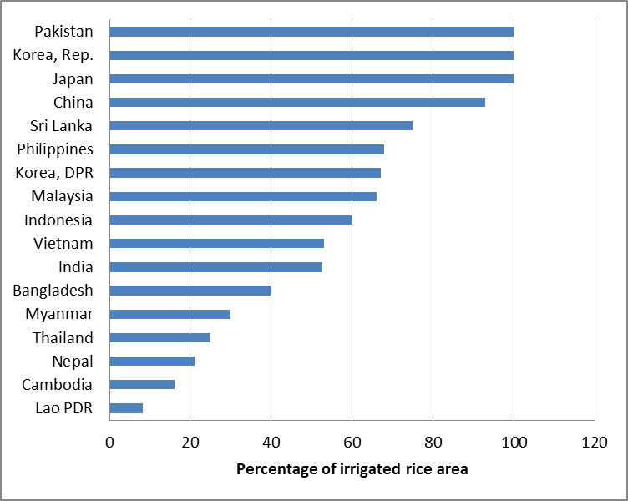
Percentage of irrigated rice area in Asian countries (FAO, 2004-2006)

Slide 6
Annual growth rate in rice area, yield and production of China, Japan, R. of Korea and all Asia in 1991-2011 and 1999-2009.
Data 1991-2011 calculated by the author, data 1999-2009 from FAO (2011)

Slide 7
Percentage of irrigated rice area per total rice area and milled rice yield in India (1960/61-2011/12)
(http://ricestat.irri.org:8080/wrs)

Slide 8
Rice (milled) yield (2010/11) and percentage of irrigated rice area (2009/10) in different states of India
(http://ricestat.irri.org:8080/wrs; Agricultural Statistics at a Glance 2012, Govt of India)

Slide 9
Irrigated rice area and percentage of irrigated area (a) and their yields (b) during 1961-2009 period in Indonesia
(Panuju et al., 2013)

Slide 10
Percentage of irrigated area in Bangladesh in 2008-2011
(Bangladesh Bureau of Statistics, 2011)

Slide 11
The trend of yield (milled rice) in irrigated area as compared to rainfed area in Bangladesh from 1972-2005 (Handbook of Agricultural Statistics, December 2007, Ministry of Agriculture of Bangladesh)

Slide 12
Annual growth (% per year) in total factor productivity (TFP) and components in five Asian countries in different periods
Country | 1980-2010 |  |  | 2001-2005 | 2006-2010
 | Efficiency change | Technology change | TFP change | TFP change | TFP change
Malaysia | 0.0 | -0.1 | -0.1 | 0.7 | 4.5
Myanmar | 0.0 | 2.5 | 2.5 | 61.8 | 4.8
Philippines | 0.5 | 0.6 | 1.1 | 2.1 | 2.6
Thailand | 0.7 | 0.4 | 1.1 | 1.4 | 4.2
Vietnam | 0.8 | 1.7 | 2.5 | 3.6 | 3.3
Mean | 0.4 | 1.0 | 1.4 | 11.8 | 3.9
Source: Sawaneh et al. (2013)

Slide 13
Annual growth rate (%) of TFP in rice production in 9 states of India during early and late green revolution (GR)
Janaiah et al. (2006)

Slide 14
Exploitable and theoretical yield gap in different locations of SE Asia
DRY SEASON
Laborte et al. (2012), yields achieved by 20-25 farmers in the period of 1995-1999 were documented for each locations in Thailand, Indonesia and Vietnam; for the Philippines yields achieved by 100 farmers were documented in the period of 1966-2008.

Slide 15
Comparison of average farm yields and potential yield (%) in various studies
(Lobell et al., 2009)

Slide 16
Summary of trends in rice production in irrigated rice ecosystems
Trends:
In countries with high level of irrigation coverage : Reduction of irrigated rice area and production. Growth rate of yield is lower than average in Asia or even negative. Yield is approaching the yield potential.
In countries with medium level of irrigation coverage (40-60%): Marginal increase of irrigated area and little scope to convert rainfed areas or new land to irrigated areas.
In countries with low level of irrigation average (<40%): In short term, scope to increase irrigated area is limited; in long term, depends on investment and other natural conditions (particularly water resources).
Declined TFP in some intensive irrigated systems.
Wide yield gaps: Exploitable: 20-40% - Theoretical 30-50%.
Implications:
Suitable policies to limit the loss of irrigated rice land.
Sustainable production technologies are required to prevent downward growth rate of yield.
Increasing the adoption of available technologies by farmer to close yield gaps through efficient agriculture extension and policy support.

Slide 17
Technology options for irrigated rice ecosystem
Improved varieties and Hybrid rice
INM – leaf color chart, SSNM, urea granule deep placement
IPM – “3 reductions 3 gains”, ecological engineering
SRI
Water save: AWD, Zero tillage, Direct seeding
Diversification of rice-based farming system

Slide 18
High yielding Rice varieties
Gaps
Little progress in enhancing yield potential.
Lack of varieties for multiple pest resistance , multiple abiotic tolerance, yield stability (wide adaptability), high nutrition (Fe and Zn), Low pace in replacement of varieties.
Seed purity and availability.
Recommendations
Develop and adoption of new varieties focusing on multiple tolerance to biotic and abiotic stresses, and meeting consumers’ preference.
(Prospect of IRRI – China mega search program on development of Green Supper Rice; Success of India in developing high yielding Basmati rice)
Prospect of genomics research to identify novel genes for rice improvement.

Slide 19
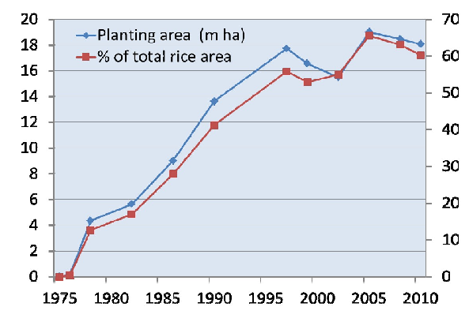
Hybrid Rice in China
Achievements
HR yields an average of 7.2 tons/ha compared with 5.9 tons/ha for conventional rice (2008).
Average yield of hybrid rice is 30.8 percent higher than inbred rice (1976-2008).
Accumulated planting acreage is 401 million ha under hybrid rice (1976-2008).
Accumulated yield increase is 608 million tons due to hybrid rice technology (1976-2008.
(Jiming Li, Yeyun Xin and Longping Yuan. 2009)
Area planted to hybrid rice in China from 1975-2010
(Cheng Shihua, 2012)

Slide 20
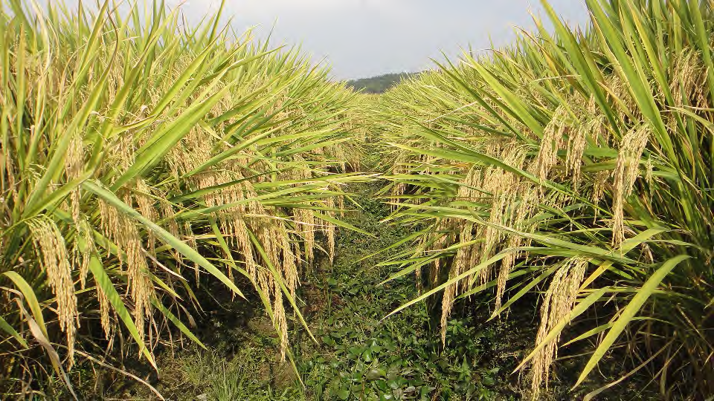
Super Hybrid Varieties in China
Yield target in 2006-2015: 13.5 t/ha
In 2011:
Super HR variety Y Liangyou 2 reached 13.9 t/ha
HR Yongyou 12 was over 13.65 t/ha
Y Liangyou No. 2, the super hybrid rice variety yielding 13.9 t/ha at Longhui, Hunan in 2011 Photo of L. P. Yuan

Slide 21
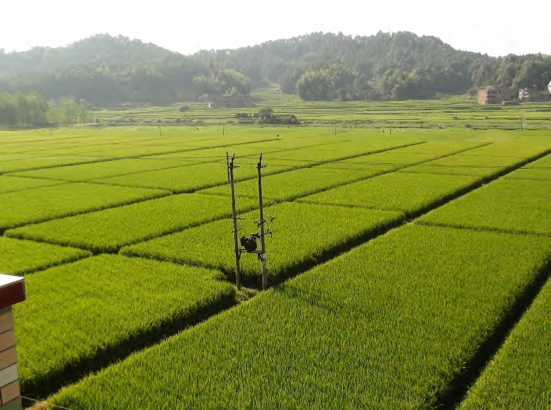
The 7.2 ha-demonstrative location yielding 13.9 t/ha at Longhui, Hunan in 2011
Photo of L. P. Yuan

Slide 22
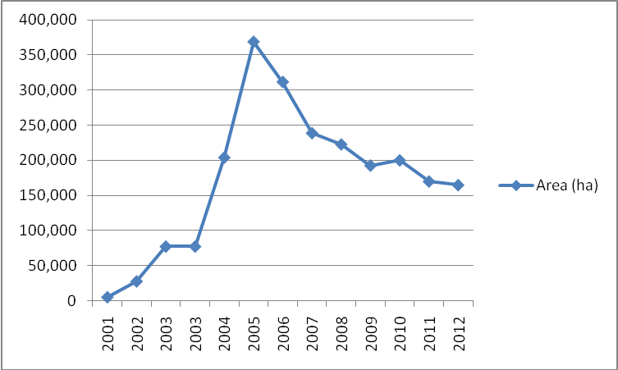
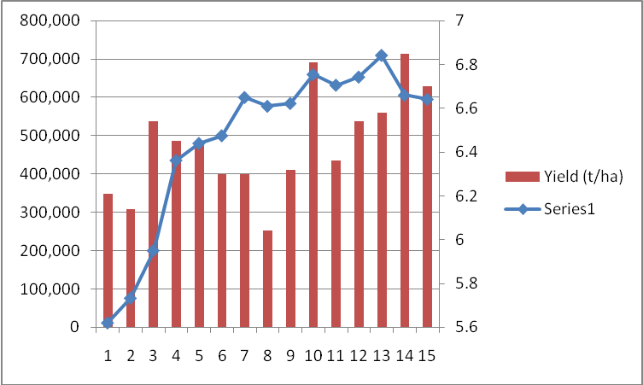
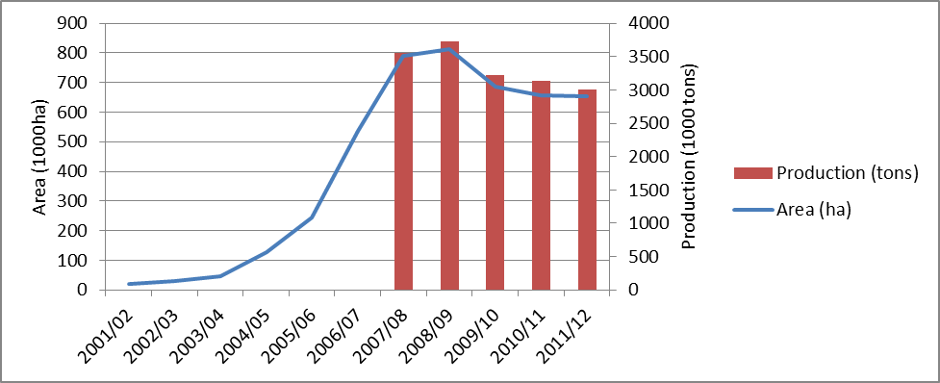
Four million ha of Hybrid Rice is being planted outside China
INDIA
PHILIPPINES
Hybrid rice area (ha)
VIETNAM
VIETNAM
BANGLADESH
Area (ha)
India: 2 M ha (4.5%), Bangladesh 0.65 M ha (5.7%), Indonesia 0.6 M ha (4.5%)
Vietnam 0.6 M ha (8%), Philippines 0.16 M ha (3.5%), Myanmar 0.08 M ha (1.0%)

Slide 23
Hybrid Rice
Gaps
There is narrow diversity in genetic materials.
HR variety: poor grain quality, low percentage head rice recovery, susceptible to pests and do not meet specific production conditions.
HR seed production is difficult, high seed cost, insufficient domestic HR seed supply
Cultivation of HR rice requires additional input expense - There has been a reduction in subsidy for HR adoption.
Inadequate national capabilities for HR adoption.
Trade offs
Increased of external inputs.
Expense of rice quality.
Recommendations
Designed clear target of application.
Develop HR varieties superior than the best conventional HYVs.
Advocate public-private partnership in production of HR seeds.
Increase capacity of domestic HR production.
Invest infrastructure and support farmers (credit, technology transfer, training, etc.

Slide 24
Total N + P2O5 + K2O
Fertilizer use on rice for selected Asian countries
(Gregory D.I. et al.,2010)

Slide 25
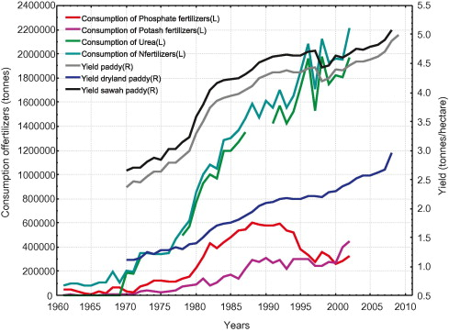
Yield
N
P
K
Fertilizer consumption in Indonesia (1960-2009)
(Panuju DR, 2013)

Slide 26
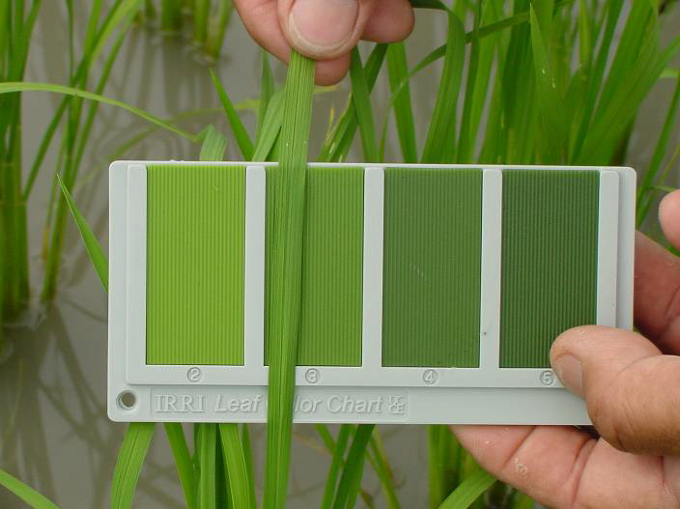
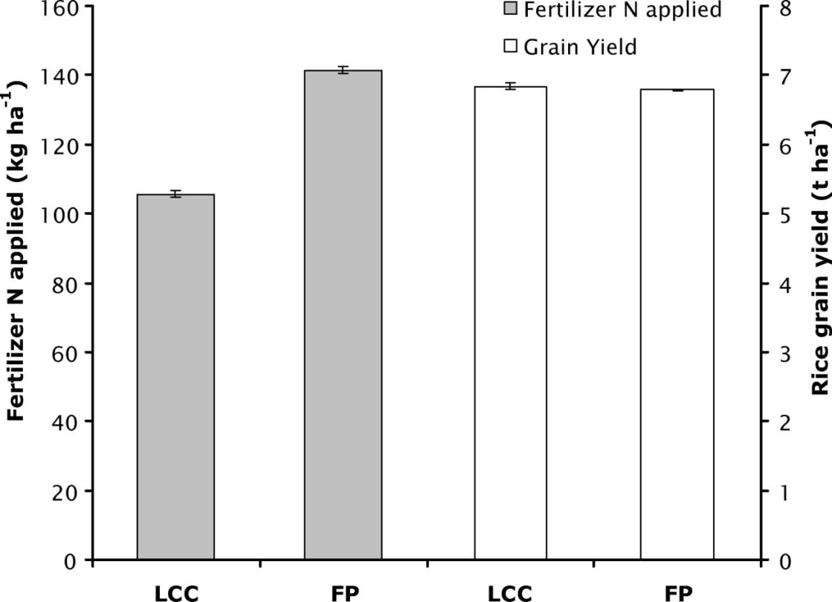
Leaf color chart : reducing 20% of N fertilizer rate – without yield reduction
IRRI photo
Average fertilizer N applied and grain yield of rice in 350 on-farm trials comparing LCC-based N management (LCC) with farmers’ practice (FP) in Indian Punjab. (2002-2005)
(Varinderpal-Singh, 2007)

Slide 27

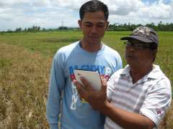
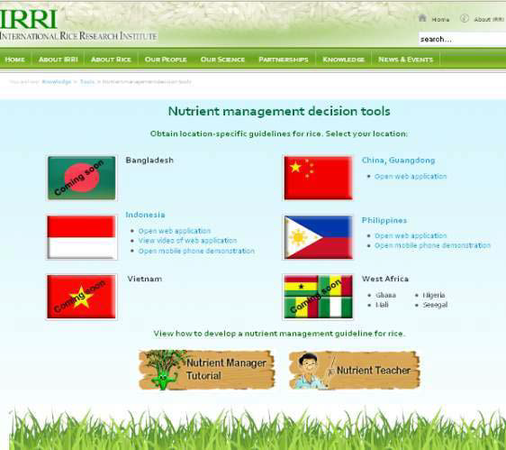
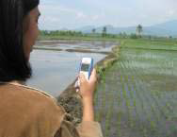
Web
SSNM
Yield increase: 8%
N rate decrease: 10% (Vietnam) -14% (Philippines)
Profit differentials to nonuser farmers in India, Philippines, and Vietnam : 47%, 10%, and 4%, respectively
Pampolino et al. (2007)
Smart phone
SSNM Tool: Nutrient Manager of Rice
GMS Mobile phone
Source: IRRI

Slide 28
Farmers adoption of SSNM
The total number of adopters of SSNM were from 400,000 to 600,000 in Bangladesh and Vietnam. These adopters mainly used leaf color charts to manage N fertilizer management thanks to the distribution of leaf color charts to farmers under the sponsorship of various national extension programs.
The adoption of Nutrient Manager for Rice is only at the initial stage, data on the number of adopter and impact are not available.
[External review report of the Irrigated Rice Research Consortium (IRRC) Phase 4 (2009-2012), October 2011]

Slide 29
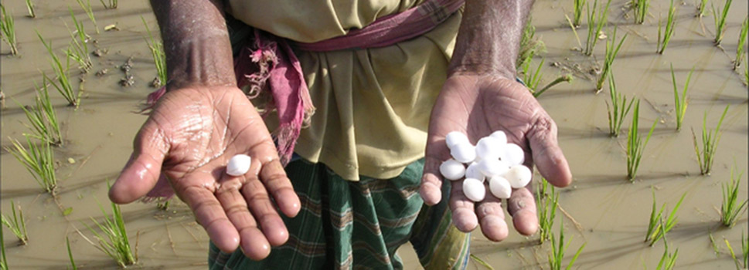
Deep urea granule placement
The benefits of deep urea placement:
Reduced N loss (up to 50%)
Improved rice grain yield (15-35%).
Less N fertilizer use (25-40%)
Higher P recovery
Less N2O and NO emission
Improvement:
Urea briquettes containing diammonium phosphate (UB-DAP
Urea briquette shops in Bangladesh
Source: Fertilizer Deep Placement Technology A Useful Tool in Food Security Improvement presented by Samba Kawa, USAID/BFS Upendra Singh, IFDCJohn H. Allgood, IFDC

Slide 30
Achievements of using Super Granule Urea (Guti Urea) for deep placement in Bangladesh through December 2012
(Source: IFDC – www.ifdc.org)
Guti Urea Manufactured/Sold | Metric Ton | 252,817
Guti Urea Dealers/Machines Installed | Number | 897
Farmers Applied Guti Urea in last three rice seasons | Number | 4,125,860
Rice Area under Guti Urea in last three rice seasons | Hectare | 1,317,652
Incremental Rice Production | Metric Ton | 863,432
Increased Value of Rice | Million US $ | 299.88
Urea Saved | Metric Ton | 120,237
Value of Urea Saved | Million US $ | 67.43
GOB Savings on Urea Subsidy | Million US $ | 42.47

Slide 31
Summary of Integrated nutrient management in rice
Gaps
Overuse of chemical N fertilizers, unbalanced use of N-P-K fertilizers.
Unbalanced use of inorganic fertilizers and organic matters.
Low efficiency in fertilizer use.
Trade-offs
SSMM: Knowledge intensive.
Deep placement of urea: Labor intensive (if not mechanized).
Plant Residue management: expense of other use (animal feed) .
Technology and policy options
Use of leaf color chart, SSNM tools.
Deep placement of urea granules
Crop rotation and plant residues management.
Strong policy to reduce chemical N fertilizer (no subsidy) and to advocate use of indigenous organic matters.

Slide 32
Increase of pesticides production and export

Slide 33
Frequency of insecticide application to rice in selected Asian countries in 1992 and 2011
* Source: Heong and Escalada, 1997;**DACE = days after crop establishment; ***0.8 times in the wet season and 1.4 times in the dry season, from survey in 2001; $ Study in India carried out in late 1990s; $$Study in one season in 2009; $$$Survey conducted in Nueva Ecija Provinc

Slide 34
The primary causes of these outbreaks: misuse and overuse of pesticides and resistance of planthopper to imidacloprid application
(Heong 2010)

Slide 35
Three reductions - Three gains technology
Three Reductions:
Reduction of seed rate by half
Reduction of pesticide use: no early spray, field monitoring
Reduction of N fertilizer by using leaf color chart
Three Gains:
Productivity
Profitability
Environment protection
Results:
Study on 951 farmers showed that seeds, fertilizers, and insecticides can be reduced by 40%, 13%, and 50%, marginal yield increase, increased profits of US$44–58/ha
(Zenaida, 2010)

Slide 36
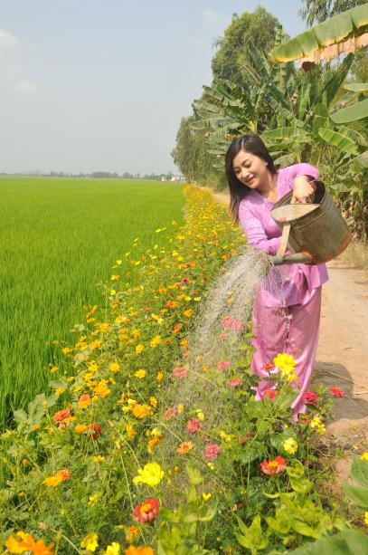
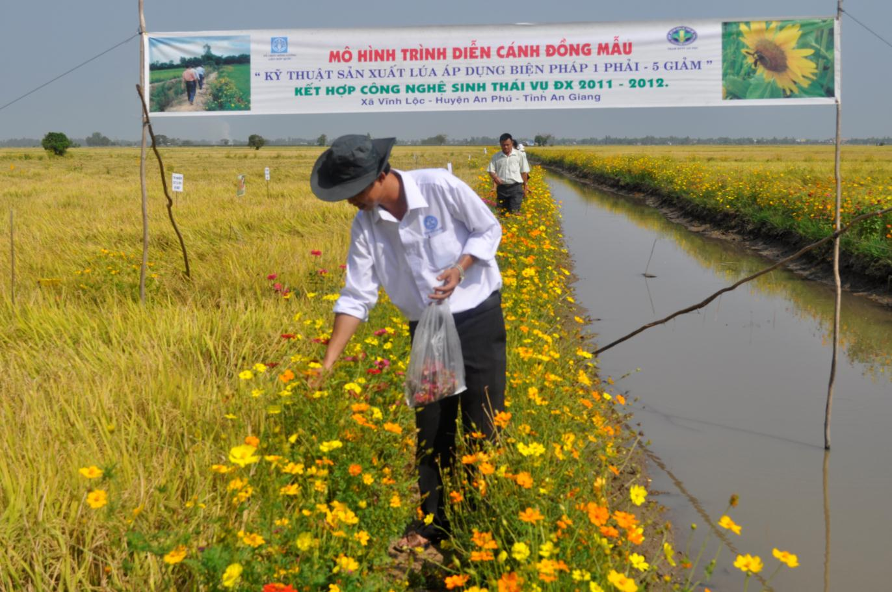
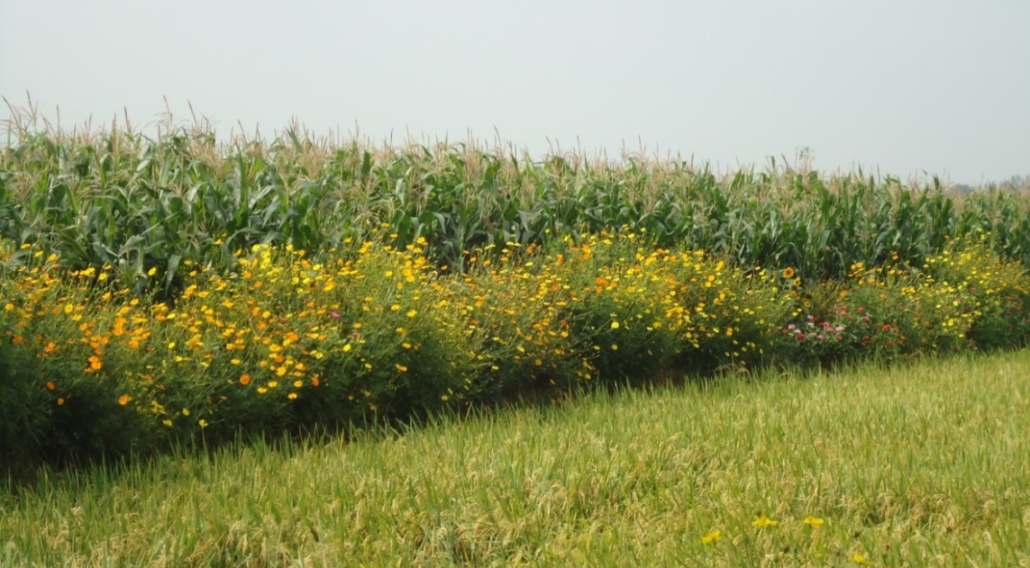
Ecological engineering of rice in the Mekong delta of Vietnam, 2012

Slide 37
Summary: Integrated pest management in rice
Gaps
Misuse and overuse of pesticides by farmers.
Malpractices in pesticide sales by retailers.
Strong advertisement and market promotion of pesticides by companies.
Technology and policy options
Strengthening IPM with innovative approaches.
Model: “3 reductions, 3 gains” Vietnam, rice-fish, ecological engineering (LEGATO project).
Country commitment on reduce pesticide use (legal regulations, support of IPM, training and education, mass media coverage).

Slide 38
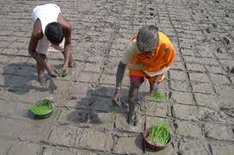
System of Rice Intensification
SRI)
Application scale
Kassam et al. (2011) estimated that about 2 million rice farmers have already adopted SRI methods, in whole or in part.
Data given by Uphoff (2012):
China (Sichuan province): 300,000 ha (2010)
India (Bihar): 350,000 ha (2011
In Vietnam, in 2011 that over 1 million farmers used SRI method

Slide 39
Controversy over SRI
Weak scientific base to support the advantage of SRI performance (Dobermann, 2004), Sinclair, 2004 and Sinclair and Cassman, 2004).
Analysis of data over 40 site-years of SRI versus best management practices (BMP) from different countries, it was concluded that SRI performance in most of the cases showed lower yields than BMP performance (McDonald et al. , 2006, 2008).
Challenge to the achievement of SRI to yield 13 t/ha in Bihar, India (Yuan, 2013).
The controversy has centred on the imprecision with which SRI’s component practices have been deﬁned. This poses a conceptual and practical challenge for scientiﬁc evaluation of SRI methods (Glover , 2011

Slide 40
SRI: Gaps and Options
Gaps
Narrow match of SRI methodology with recommended practices to conditions of rice fields and farmers.
SRI practices are modified by farmers and do not apply all components in SRI.
Gaps in information on the contribution of each separate component and their synergies and adoption patterns of farmers, and the long-term effects SRI (stability).
Trade-offs
Labor intensive (particularly transplanting and weeding)
Stable yield performance over years and risks (weeds/nutrient deficiency)
Recommendations
The principles of SRI is in line with the direction of “save and grow” that FAO as well as many countries have advocated. Modifications of SRI practices to suit to local conditional is process of adaptation. There is no contest to SRI principles by other available best practices in rice cultivation like resistance varieties, INM, IPM, alternately wetting and drying (AWD) and others.
In countries where SRI have been applied, data on the application of SRI practices or SRI modified practices should be documented systematically and the long-term effects should be monitored. The expansion of SRI to rainfed areas should be carefully assessed and demonstrated.

Slide 41
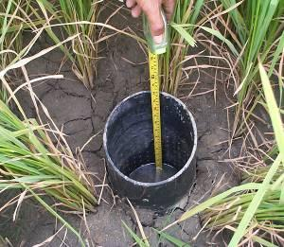
Alternate wetting and drying irrigation (AWD )
Advantages
Reducing water required for rice by 25-45 per cent (IFAD 2011).
Decreasing irrigation cost by nearly 20% (Kürschner et al. ,2010).
Without yield decrease of yield increased by 10% (Zhang et al.,2009).
Reduction of amount of arsenic taken up in the rice in Bangladesh (IFAD 2011).
Adoption scale
AWD adoption in the Philippines and Vietnam is about 81,687 farmers (~93,000 ha) and 40,688 farmers (~50,000 ha), respectively (Lampayan ,2012)
Trade-offs
Increase of weeds
Uncertainties in long-term effect on soil and rice productivity
Recommendations
Applying integrated weed management.
Integration in other technologies (SRI methodology or “1 Must Do and 5 Reductions’ model applied in Vietnam).
Studies the long term yield stability in AWD irrigation regime and change in soil properties, and the response of varieties to AWD.

Slide 42
Direct seeding of rice (DSR)
A. | Advantages
1. | Labor savings average of 25%
2. | Reduces drudgery by eliminating transplanting operation
3. | Water savings ranged from 12% to 35%
4. | Reduces irrigation water loss through percolation due to fewer soil cracks
5. | Reduces methane emissions (6–92% depending on types of DSR and water management)
6. | Reduces cost of cultivation, ranging from 2% - 32%
7. | Increases the total income of farmers (US$30–51 ha⁻ ¹)
8. | Allows timely planting of subsequent crop due to early harvest of direct-seeded rice crop by 7–14 days
B. | Trade-offs
1. | Sudden rain immediately after seeding can adversely affect crop establishment
2. | Reduces availability of soil nutrients such as N, Fe, and Zn especially in Dry-DSR
3. | Appearance of new weeds such as weedy or red rice
4. | Increases dependence on herbicides
5. | Increases incidence of new soil-borne pests and diseases such as nematodes
6. | Enhances nitrous oxide emissions from soil
7. | Relatively more soil C loss due to frequent wetting and drying
(Kumar and Ladha, 2011)

Slide 43
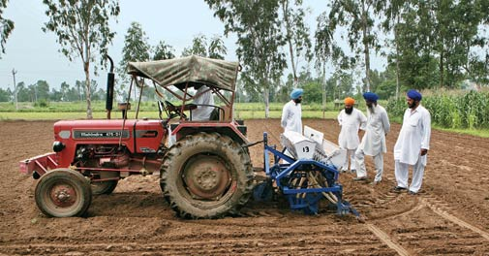
India:
100,000 hectares estimated area in India where rice is grown using the direct seeding method
Direct seeding being carried out at a farm in Jalandhar district, Punjab
Aditya Kapoor/www.indiatodayimages.com

Slide 44
Rice area (million ha) by cropping system for Asian regions, 2000-2009
Dawe et al., 2010

Slide 45
Percentage of rice-based cropping systems per total rice area in China
(Frolking et al. (2002

Slide 46
Rice-based farming diversification
Rice – (Rice) – Legumes/Pulses
Rice + Fish (+Shrimp)
Sustainable management for Rice – Wheat and Rice – Maize systems
Trade-offs:
Reduction of rice production
Labor intensive
Market risk

Slide 47
Policy implications for sustainable intensification of irrigated rice production
Strong commitments in solving negative factors causing degradation of irrigated ecosystems and environment and human health, of which utmost adverse factors are overuse and misuse of pesticides and overuse of chemical N fertilizers.
Preventing negative growth trend of productivity in highly intensive systems.
Closing yield gaps at two levels: to approach yield potential or best practice yield with suitable technology options.
Policies to limit irrigated land loss.
Policies to advocate “save and growth” technologies and reduction of rice mono-culture systems.

Slide 48
Sustainable intensification of upland rice ecosystem in Asia
Bui Ba Bong
FAORAP
 | The Second External Rice Advisory Group (ERAG) Consultation on the Formulation of a Rice Strategy for Asia
Bangkok, Thailand, 28-29th November 2013

Slide 49
To major changes in upland rice landscape
Shrinkage of upland rice area due to conversion to cash crops
In Asia upland rice area is reduced to 8 million ha (compared to 9 million ha in 2005 and 11 million ha in 1980s)
In 1980’s:
The world upland rice area: 19.1 million ha comprising 13.2% of the world rice area (143.5 million ha), of which 10.7 million ha were in Asia (8.5% of the total rice area) (Gupta and O’Toole, 1986)
Change in traditional shifting cultivation to permanent cultivation or short cycle of shifting cultivation

Slide 50
Upland rice area in Laos dropped from 230.000 ha in 1991 to 90.000 ha in 2011
Steady decline in upland areas, which was particularly strong between 1991-2003 (compound annual average of -6.1%). In 1980s upland rice area occupied 54% of the total rice area , in 1990s 36%, and in 2011 only 10%.

Slide 51
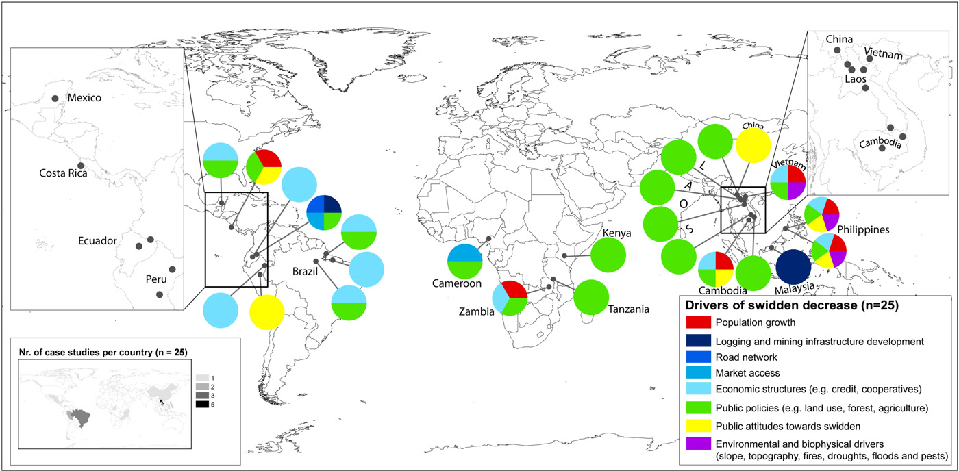
Drivers of decrease in shifting (swidden) cultivation area
(Nathalie van Vliet, 2012)

Slide 52
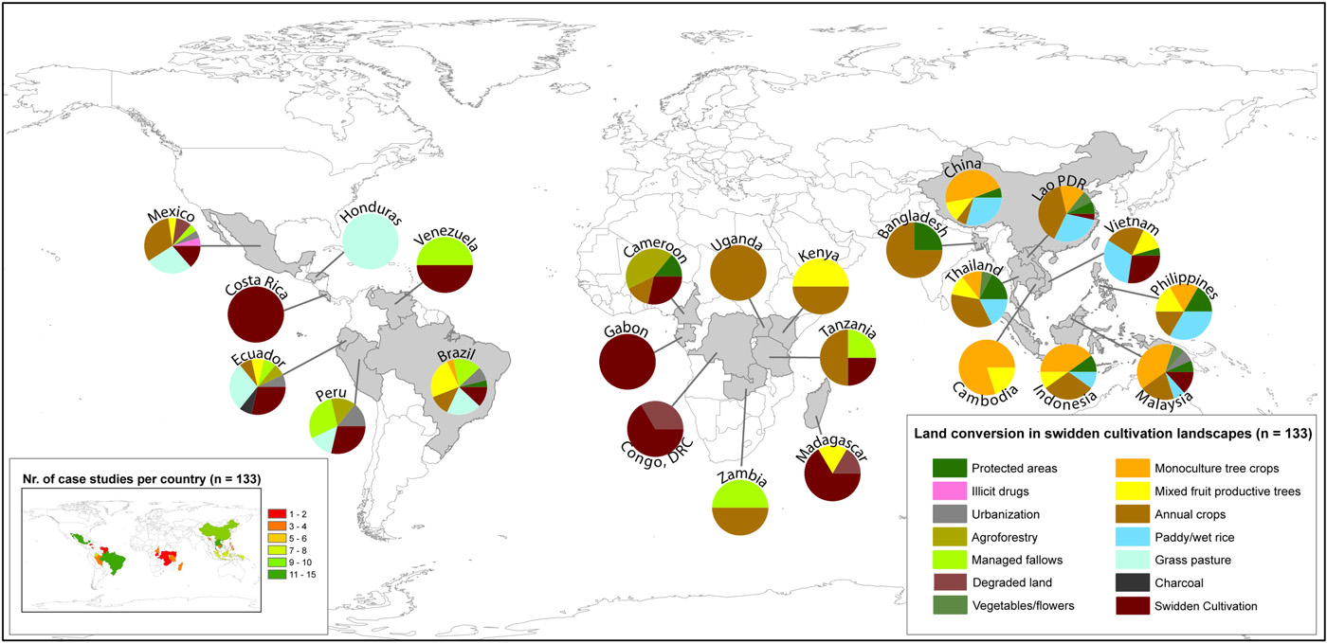
Land conversion in shifting cultivation landscapes
(Nathalie van Vliet, 2012)

Slide 53
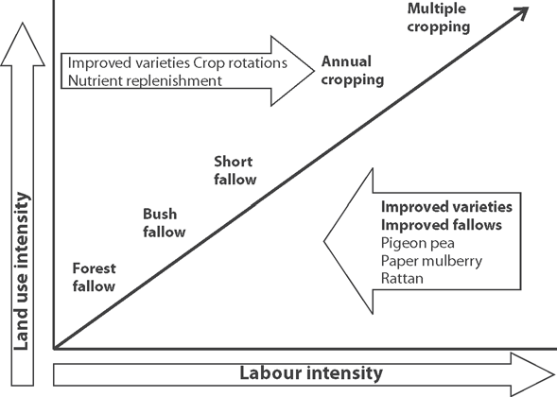
Pathway of conversion of shift cultivation in Laos

Slide 54
Conversion of shifting cultivation to other intensive land use
Benefits
Restricting forest clearing and encouraging commercial agriculture
increased household incomes
Trade-offs and risks
Farmers have unequal or insecure access to investment and market opportunities
intensification is not suitable if population densities and/or food market demands are low
Leading to permanent deforestation, loss of biodiversity, increased weed pressure, declines in soil fertility, and accelerated soil erosion.
Options
Despite the global trend towards land use intensification, in many upland areas shifting cultivation will remain part of rural landscapes as the safety component of diversified systems, particularly in response to risks and uncertainties associated with more intensive land use systems.
(Nathalie van Vliet, 2012)

Slide 55
Technology options for upland rice ecosystem
Improved varieties and aerobic rice varieties
Traditional varieties with quality speciality (Farmers participation in selection and seed production)
Technologies for replacing shifting cultivation
Conservation technology
Organic rice

Slide 56
Upland rice classification based on rainfall duration and soil fertility
Long growing season (rainfall exceeded potential evaporation by 20%) with fertile soils (LF): 15% of upland area
Long growing season with infertile soils (LI): 33% of upland area
Short growing season with fertile soils (SF): 19% of upland area
Short growing season with infertile soils (SI): 23% of upland area
(Gupta and O’Toole, 1986)

Slide 57
Aerobic rice for upland
Aerobic rice varieties possess the traits of upland varieties like drought tolerance, deep roots plus the traits of lowland high-yielding varieties.
In northern China, new aerobic varieties (e.g., Han Dao 277, Han Dao 297, and Han Dao 502) with yield a potential of up to 6.5 t/ha
India officially released for cultivation its first drought tolerant aerobic rice variety MAS 946-1 followed by MAS 26 (2008). Yields were 5.5-6/ha using 60 percent less water. Aerobic rice emits 80-85 percent lesser methane gas

Slide 58
Selection of traditional upland rice varieties
High genetic diversity in traditional upland rice varieties.
Varieties with quality specialities should be selected and produce seeds with farmers’ participation (commune-based seed production system).
Examples:
Two upland rice varieties (Nok and Makhinsoung) which yield 0.3 - 0.5 t/ha more than local varieties (an 18-27% increase in yield).
Nok is an early duration variety that has good yields and receives high farmer preference ratings due to its large seed and panicle, ability to perform in poor soils and high quality (aroma and softness).
Makhinsoung is a medium duration variety that also receives high farmer preference ratings.

Slide 59
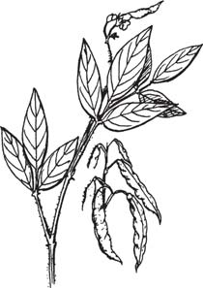
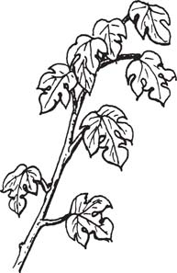
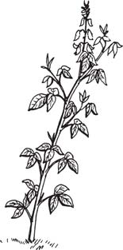
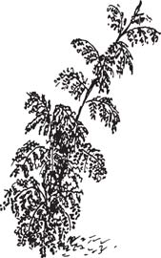
Technology options for replacing shifting cultivation: Promising fallow species for upland rice
Leucaena Pigeon pea Paper mulberry Crotalaria
(Leucaena leucocephala) (Cajanus cajan) (Brousonnetia papyrifera) (Crotalaria anagyroides)

Slide 60
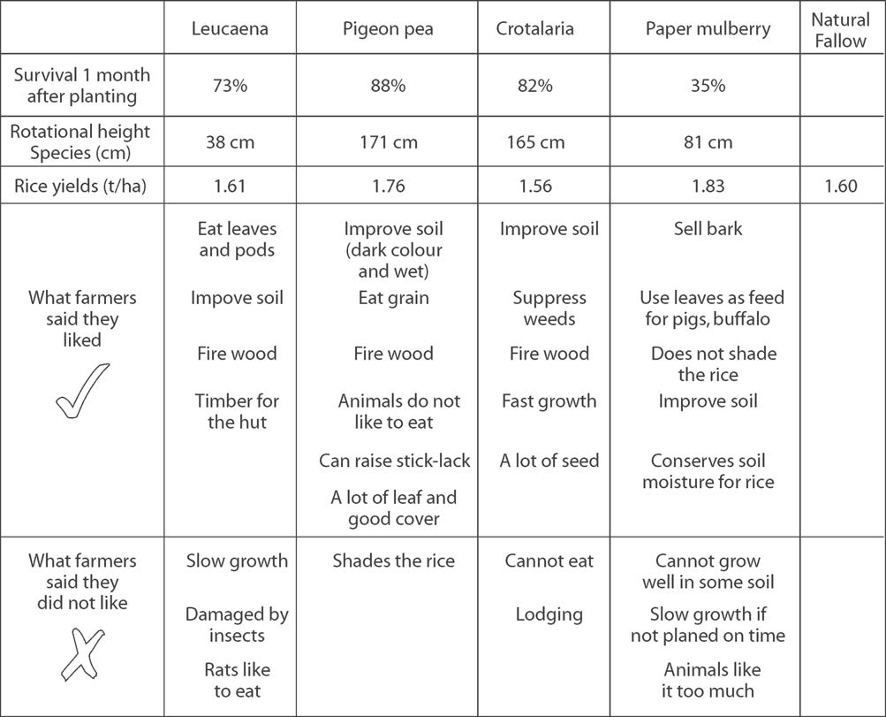

Slide 61
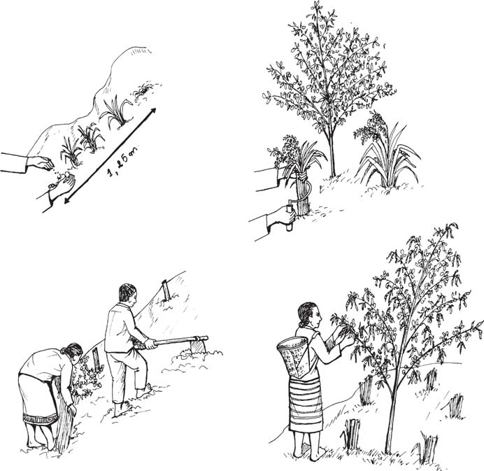
1. Pigeon pea
planted into rice
crop
2. Rice is harvested
and pigeon pea left
to grow
3. Pigeon pea is
harvested in
March / April
4. Pigeon pea is cut down
and land prepared for rice
NAFREC/NAFRI, 2005

Slide 62
Improved sloping agriculture: alternative to shift agriculture in Karbi Anglong (Northeast India)
Planting in sequential strips across the slope improved upland rice variety with improved varieties of pineapple, sesame , toria, greengram , Assam lemon, banana, turmeric.
Yield of upland rice under improved sloping agriculture was higher (2.21 t/ha) than that under traditional jhum agriculture (1.24 t/ha). Good yields of other crops were also obtained.
(IFAD, 2011)

Slide 63
Intercropping upland rice
Intercropping upland rice is most common system of upland rice. In Meghalaya, Northeast India, peanut , soybean and blackgram were potential legume crops for intercropping which doubled gross margin as compared to upland rice mono-cropping (IFAD, 2011) .
Many crops are intercropped with upland rice, depending on length of growing period and farmer preference. Common systems include rice + maize, rice + maize + cassava, rice + cowpea, rice + peanut, rice + sesamum, rice + beniseed, rice + soybean, rice + mungbean, rice + pigeonpea, sugarcane + rice, rice + Capsicum sp. + Solanum sp. + beans + maize + banana + cassava, and rice + cassava + maize + okra + pepper .

Slide 64
Conservation technology for upland rice
Hedgerows of trees, shrubs and grasses along hill contours can help reduce soil erosion up to 90 percent. Rice or other crops are planted between these strips of permanent ground cover.
Leguminous plants in hedgerows make substantial amounts of atmospheric nitrogen available to both rice plants and annual crops and recycle other nutrients and organic matter.
Zero and minimum tillage

Slide 65
Upland rice management
Weeds management
Blast management
Management Soil acidity and P deficiency

Slide 66
Policy implications for sustainable intensification of upland rice production
Integrating farmer’s knowledge and local preferences with advanced technologies.
Resilient rice production through diversified cropping systems.
Promotion of conservation technologies and ecological engineering.
Promotion of rice quality specialities and organic rice.

