Slide 1
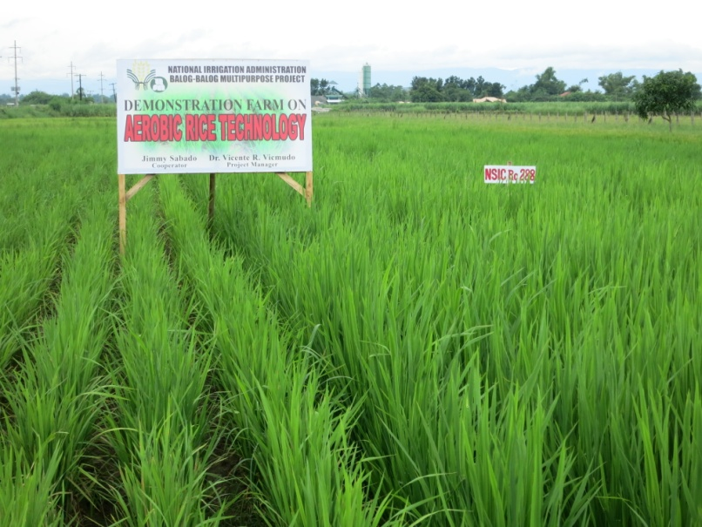
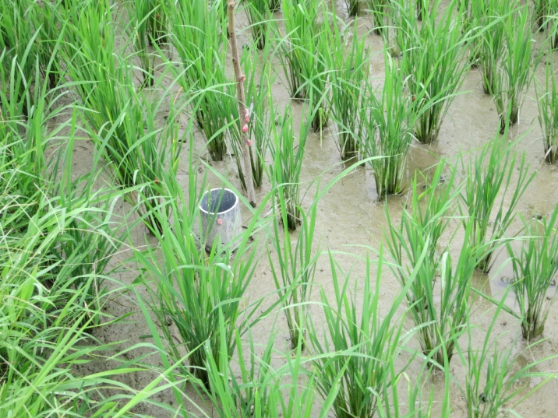
Formulation of A Rice Strategy for Asia
WATER AND IRRIGATION
Dick Tzou
Water Resources Development and Conservation Officer
FAO RAP 28 November 2013

Slide 2
Formulation of A Rice Strategy for Asia
Water and Irrigation
Objectives
To evaluate the sustainability of increased rice production
in the four rice-based ecosystems (i.e., upland, rainfed and
irrigated lowlands, and coastal/delta) separately in the context of
water, irrigation, water accounting framework, and other drivers
To further examine major trends and drivers of change that affect
the availability and management of water resources and the overall
rice production.
To identify and evaluate management options and strategies
that will further improve the crop water productivity and
  sustainability of the rice-based ecosystems in Asia.

Slide 3
Formulation of A Rice Strategy for Asia
Water and Irrigation
State of the Land Resources (2009)
Cultivable areas are shrinking in East and South Asia
Source: FAO, 2012

Slide 4
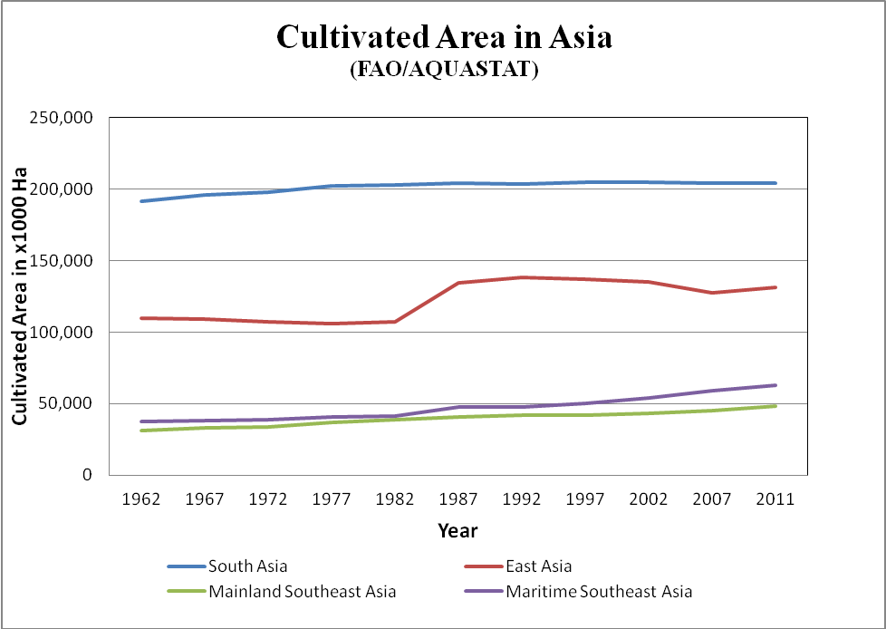
Formulation of A Rice Strategy for Asia
Water and Irrigation
State of the Land Resources Trends
Cultivated areas are stabilizing in East and South Asia and slightly rising
in southeast Asia
Source: FAO, 2012

Slide 5
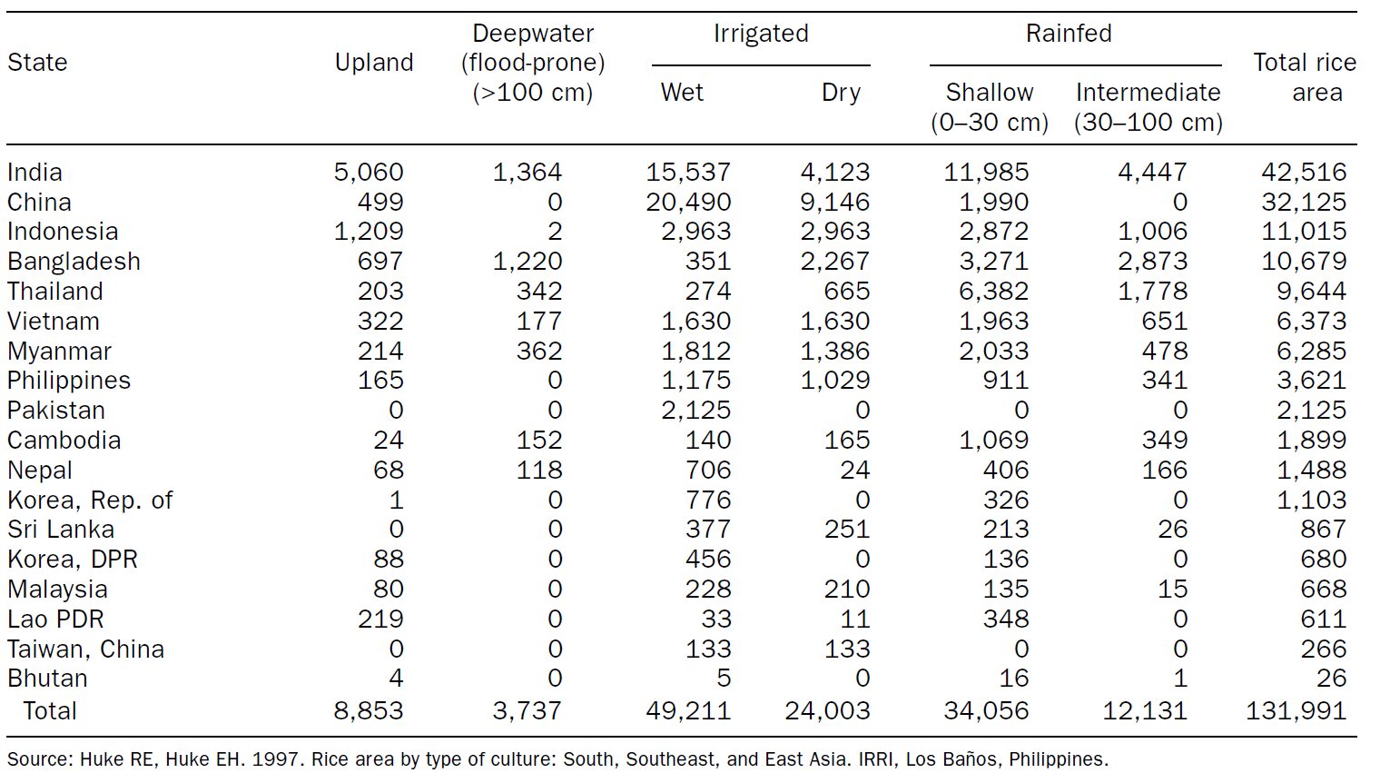
Formulation of A Rice Strategy for Asia
Water and Irrigation
Status of Areas of Rice Ecosystems in Asia
Irrigated = 55%, Rainfed lowland = 35%, Deepwater and Upland = 10%

Slide 6
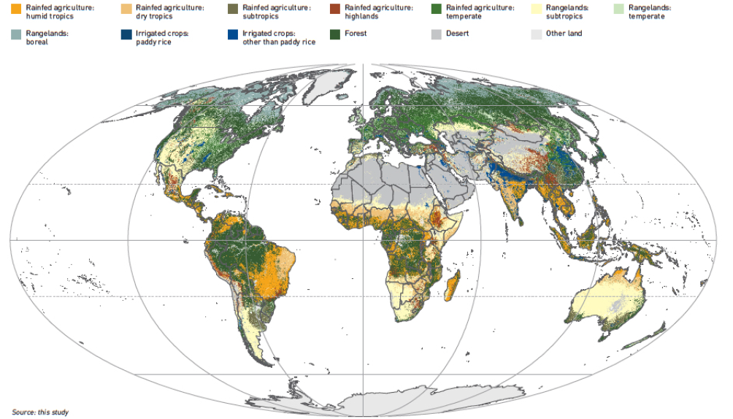
Formulation of A Rice Strategy for Asia
Water and Irrigation
State of the Resources – Locations of Irrigated and Rainfed
Share of rainfed and irrigate rice varies from country to country
Source: FAO, 2011

Slide 7
Formulation of A Rice Strategy for Asia
Water and Irrigation
State of the Water Resources – Water Scarcity

Slide 8
Formulation of A Rice Strategy for Asia
Water and Irrigation
State of the Water Resources – Groundwater Abstraction
Asian accelerated its groundwater abstraction during the 1960’s

Slide 9
Formulation of A Rice Strategy for Asia
Water and Irrigation
State of Affairs – Potential and Actual Crop Water
Productivity
Source: Sandras et al., 2010)

Slide 10
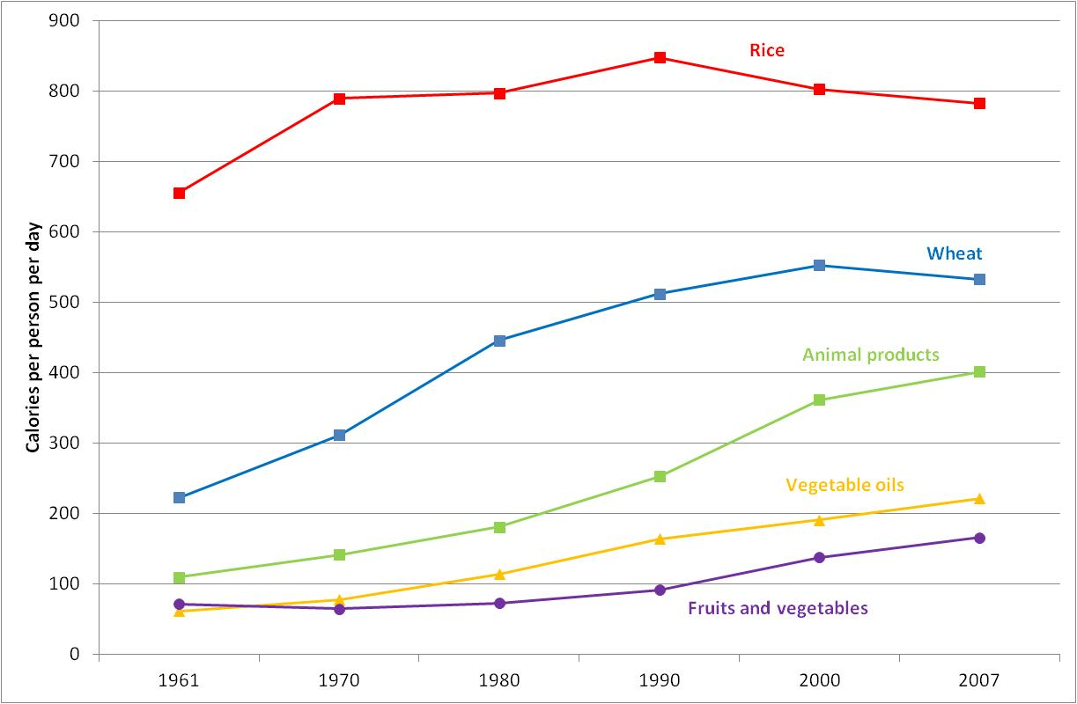
Formulation of A Rice Strategy for Asia
Water and Irrigation
State of Affairs - Dietary Diversification
Source: FAO, 2011

Slide 11
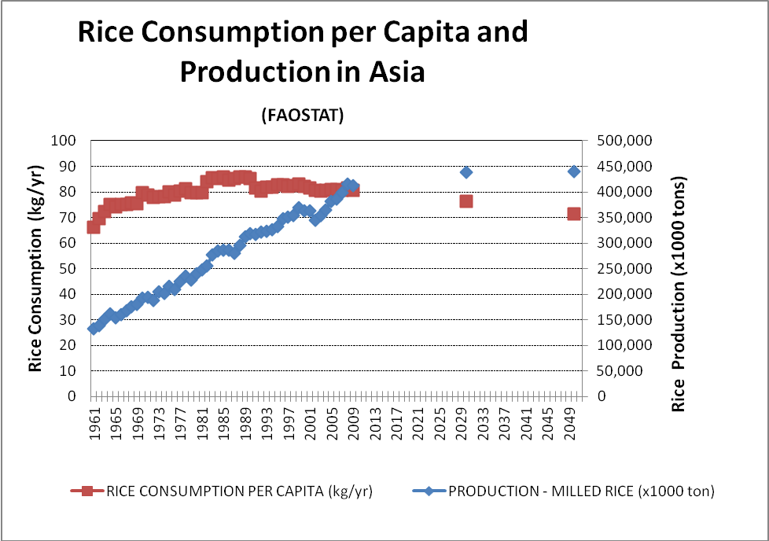
Formulation of A Rice Strategy for Asia
Water and Irrigation
State of Affairs - Rice Production and
Consumption/Person Projections
Source: FAO, 2013

Slide 12
Formulation of A Rice Strategy for Asia
Water and Irrigation
State of Affairs - Water Productivity of Large-Scale
Irrigation Systems (MASSCOTE assessments)
Poor system performance using economic productivity as indicator
Source: FAO, 2013

Slide 13
Formulation of A Rice Strategy for Asia
Water and Irrigation
State of Affairs - Poor in Asia
Southern Asia continues to be poor yet self-sufficient in rice production

Slide 14
Formulation of A Rice Strategy for Asia
Water and Irrigation
State of Affairs – Share of Agricultural Employment
Effects of urbanization and labor migration to urban centers
Source: ILO, 2011

Slide 15
Formulation of A Rice Strategy for Asia
Water and Irrigation
State of Affairs
Limited land resources
Water scarcity: economic and physical; availability and variability
Groundwater overdraft
Poor results from poverty reduction and livelihoods improvements
through rice production
Environmental issues related to rice cultivation
Rice production projection in 2050
Poor performance in large-scale irrigation systems
Low crop productivity of rain-fed rice-based ecosystems
Dietary diversification
Agricultural labor shortage
Asia must continue to increase and sustain rice productivity
for food security, while contributing to farmers’ livelihoods

Slide 16
Formulation of A Rice Strategy for Asia
Water and Irrigation
Water Accounting
Water accounting framework is necessary for all strategic evaluations related to water
  Water balance studies
    Inflows, outflows, storage
    Beneficial vs non-beneficial uses
    Consumptive vs. non-consumptive and recoverable vs. non-recoverable
  Scalar effects
    Farm => system => landscape =>basin
  Temporal distribution
  Crop water productivity, efficiency evaluations, water resource allocation and management

Slide 17
Formulation of A Rice Strategy for Asia
Water and Irrigation
Strategies
1. Improved Water Management and Technologies
  Yield increase for irrigated and rainfed ecosystems
    Varietal improvements (e.g., aerobic rice – rainfed lowland)
    Soil nutrient management
    Higher inputs for rainfed ecosystems
    Integrated Pest Management (IPM) practices
    Supplemental irrigation for rainfed ecosystems
    Externalities
      More intense crop management required
      Decrease in soil fertility and land degradation for rainfed
      Potential increase in crop consumptive use

Slide 18
Formulation of A Rice Strategy for Asia
Water and Irrigation
Strategies
1. Improved Water Management and Technologies
  Water-saving technologies to improve crop water productivity
    Various forms of alternate wetting and drying methods (e.g., AWD – 15-30% = water savings) for irrigated rice including System of Rice Intensification (SRI)
    Direct wet or dry-seeding to save water and labor during planting for irrigated and improve rainfall efficiency for rainfed
    Aerobic rice – favorable upland and lowland
    Saturated soil culture (SSC) along with raised bed, land leveling, mechanical soil compaction, good puddling and bund maintenance, and others.
    Positive externalities ? : water savings, labor savings, energy savings, reduced ammonia volatization and methane emissions.

Slide 19
Formulation of A Rice Strategy for Asia
Water and Irrigation
Strategies
1. Improved Water Management and Technologies
  Water-saving technologies to improve crop water productivity
    Trade-offs/negative externalities
      Decline of groundwater table
      Loss of ecosystem services benefits – biodiversity, carbon sequestration, and others
      Potential reduction in yield depending on management and field conditions
      Increase of nitrous oxide emission
      Increase in herbicide use
      Diseases

Slide 20
Formulation of A Rice Strategy for Asia
Water and Irrigation
Strategies
2. Rice-Ecosystem Diversification and Multiple Use Services
  Diversification and intensification of rice farm systems
    Income from rice insufficient – average 1 hectare with majority less than 1 hectare although rice price is rising
    Multiple cropping of high-value crops to supplement income
    Other types of farming diversification as part of the multiple use rice ecosystems such as livestock and aquaculture (i.e., fish and shrimp)
    Requiring flexible and reliable delivery services
    Direct pumping from groundwater aquifers
    Negative externalities
    Negative environmental impacts from rice-fish and rice-shrimp, especially in coastal regions
    Conversions from rice-fish or rice-shrimp to shrimp farming only
    Over-exploitation of groundwater abstraction
    More labor and management intensive

Slide 21
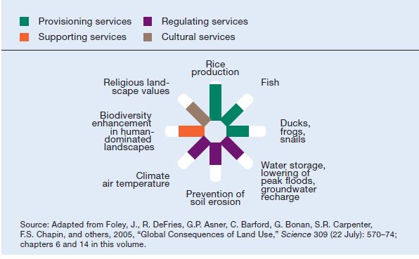
Formulation of A Rice Strategy for Asia
Water and Irrigation
Multiple Use and Ecosystem Services
Recognition and institutional reform to support ecosystem services

Slide 22
Formulation of A Rice Strategy for Asia
Water and Irrigation
Multiple Uses Services Assessments (MASSMUS)
Source: FAO, 2010

Slide 23
Formulation of A Rice Strategy for Asia
Water and Irrigation
Strategies
3. Irrigation System Modernization
  Upgrade to provide improvements in system efficiency, flexibility,
  reliability, and equity in service
  Infrastructure improvements
    Diversion
    Controls and regulators
    Conveyance
    Turnouts
  Service oriented approach (MASSCOTE, MASSMUS, and MASSIF)
    Assess on changes in service to farmers and future demands
    Mapping and benchmarking existing system and water accounting
    Develop plans for improvements in operations and management that are cost-effectve.
  Irrigation Management Transfer/Participatory Irrigation Management (IMT/PIM)
    Results are mixed
    Conversions from rice-fish or rice-shrimp to just shrimp farming

Slide 24
Formulation of A Rice Strategy for Asia
Water and Irrigation
Strategies
3 Irrigation System Modernization
  Institutional Reforms
    Irrigation Management Transfer/Participatory Irrigation
    Management (IMT/PIM)
      Results are mixed, not as successful as expected
      New alternative approach – Public-Private Partnership
        Public and private organization
        Financial and management framework that is self-
        governing and funding
        Only a few similar PPP entities have been implemented in
        Asia

Slide 25
Formulation of A Rice Strategy for Asia
Water and Irrigation
Strategies
4. Groundwater Abstraction and Management
  Benefits – on-demand, flexibility for farm system diversification,
  supply adequacy, provides efficient on-farm irrigation management
  Development of shallow groundwater wells for rainfed and irrigated
  ecosystems under the water, food, and energy nexus framework
  Utilization of metered pumps for power charges through IT
  innovations
  Conjunctive use and management of surface water and groundwater
  under a large-scale gravity irrigation system
    Advantages - groundwater recharge, improved delivery service
    and reliability of water supply
  Negative externalities
    Subsidy for energy cost, economic sustainability, groundwater
    overdraft if not well managed, water quality issues

Slide 26
Formulation of A Rice Strategy for Asia
Water and Irrigation
Summary of Strategies
A mix of strategies supported by sound water accounting with associated trade-offs must be considered for the sustainable intensification of rice production depending on the constraints and conditions in the areas as well as policies:
Increasing yield and crop water productivity through improved water
management in both rainfed and irrigated environments
2 Improving rural livelihoods and the environment through rice-
ecosystem diversification and ecosystem services
3 Delivery service improvements through system modernization
4 Mitigating groundwater overdraft and shallow well development
through conjunctive management

Slide 27
Formulation of A Rice Strategy for Asia
Water and Irrigation
Summary of Scope for Rice Ecosystem Intensification
Upland
  Aerobic rice under favorable field conditions (>600 mm rainfall
  and supplemental irrigation)
  Increase shifting cycles greater than the 2-3 yr cycle currently
  practiced in many area for shifting cultivation systems
  Typical yield = 1.3 t/ha =>Improved yield = 3 – 4 t/ha
Rainfed Lowland
  Direct seeding and improved nutrient management to benefit
  early season precipitation (maximizing green-water consumption)
  and even potential for second crop
  Varietal improvements for drought, flood submergence, and soil
  stresses

Slide 28
Formulation of A Rice Strategy for Asia
Water and Irrigation
Summary of Scope for Rice Ecosystem Intensification
Irrigated
  High-yielding semi-dwarf variety with potential of 10 -11 t/ha
  compared to average yields of 3 – 9 t/ha
  Multiple rice cropping using water saving technologies as
  indicated earlier to increase production and total crop water
  productivity such as alternative wet and dry techniques, direct dry
  and wet-seeding, and etc.
Coastal Flood-Prone
  New submergence-tolerant varieties in combination with nutrient
  management.
  New salt-tolerant varieties in combination with soil amendments to
  mitigate salt stress and improve soil quality.
  Multiple cropping with boro rice as second crop in the dry season
  with irrigation. Typical floating and deepwater rice yields, 1 - 2.5
  t/ha.

Slide 29
Formulation of A Rice Strategy for Asia
Water and Irrigation
Further Points for Discussion
Is rice production the answer to lift poor from poverty ?
Different levels of income ?
Is government subsidy is necessarily a bad thing in regard to cost-
recovery issues on irrigation systems (gravity and pumps) ?
How can ecosystem services be part of the answer to saving water in
rice production in view of water saving technologies on-farm?
Compatibility between biodiversity, paddy rice, environment, water
scarcity
Is the priority poverty reduction/livelihood improvements or food
security ?

