Slide 1

Rice Strategy : Quality, safety & Nutrition
Ms. Shashi Sareen
Senior Food Safety & Nutrition Officer
FAO Regional Office for the Asia & the Pacific
E-mail: shashi.sareen@fao.org

Slide 2
Supported by
Quality:
Mr Anut Visetrojana, ACFS Thailand
Nutrition:
Mr Longvah T, National Institute of Nutrition, India

Slide 3
Quality
Not easy to define – depends on consumer preference and intended use of product – consumers prefer the best at the price they can afford
In rice quality broadly covers 3 aspects
Organoleptic, physical, chemical, refractions, variety
Safety requirements
Nutritional aspects

Slide 4
Rice grain quality indicators
Genetic (variety based) | Acquired (farming/processing based)
• chemical characteristics such as gelatinization temperature, gel consistency, and aroma | • moisture content
• grain shape and size – elongation ratio | • color and chalkiness
• bulk density | • purity – varietal, level of impurities
• thermal conductivity | • damage
• equilibrium moisture content | • cracked grains
protein content | • immature grains
 | • milling related characteristics -head rice recoveries, whiteness & milling degree, translucency, damaged, broken, chalkiness, red & red streaked,

Slide 5
Factors affecting quality
Production, harvesting, processing, handling
Moisture, temperature, insect and micro-organisms, impurities, immature grain, thermal & mechanical stress, mixed varieties, etc

Slide 6
Safety & other related issues
Pesticide residues – high pesticide use, prohibited ones
Heavy metals – As, Pb, Cd, Cr, Hg
Aflatoxin – Codex limit 15ppb
Packaging – clean, labelling, toxic inks, glue
Traceability – safety & recalls, authenticity (organic/ Gis), include in legislation with clear role of industry - origin
Standards
Market recognition & premium price – Organic/ GI
Certifications
Fumigation
GMOs
Environmental impacts - fumigants, rice fields major generators of methane and nitrous oxide

Slide 7
Standards
Codex standard – Codex STAN 198-1995
Husked rice, milled rice, and parboiled rice, all for direct human consumption; not apply to other products derived from rice or to glutinous rice.
Composition & Q factors – moisture, extraneous matter, filth, organic/ inorganic extraneous matter, pesticide residues, heavy metals, hygiene, packaging labelling, Classification (l, l/w, both), milling degree
Codex generic standards – organic, labelling, residues, contaminants, etc
ISO 7301 husked, husked parboiled, milled & milled parboiled
Organic – IFOAM, Asian Regional Organic Standard

Slide 8
Market recognition and premium price
Organic rice and GI rice
legal and institutional framework
Certification system
Traceability
International standards
Benefit – creation of a system, certification and meeting safety requirements

Slide 9
Rice Certifications
Different types – safety (GAP, ISO 220,000…) quality (ISO 9000), GIs, Organic…
Purpose is to have a 3rd party assurance for compliance to standards
Issues - Cost, time period, documentation development/ maintenance
Strategic decisions – understand & conscious decisions, mandatory/voluntary, producer/ producer groups

Slide 10
Fumigation
Stored grain insects causing damage to grain – quality and safety issues
Managed by various means – sanitation, storage in sound dry conditions, managing temperature/ aeration, fumigation
Gases that can be used CH₃Br, N₂, PH₃, CO₂; CH₃Br has ozone depleting potential so use restricted
CH₃Br – Montreal Protocol/IPPC refrain from use except for quarantine treatments
Explore other options – alternate techniques – use of CO₂ ethyl formate (EtF) treatment – but need more studies
Good practices for fumigation (eg Thailand)

Slide 11
Genetic Modifications
Application of recombinant DNA technology or genetic engineering
Benefits – nutritional eg high B-carotene, stem borer resistant, other studies
Concerns – food safety, environmental effects, socio economic, public perceptions, testing to check
Establishment of regulatory frameworks

Slide 12
Strategic Policy Options in Quality/ safety
Basic safety parameters essential (non negotiable)– important are pesticide residues, As, Pb, aflatoxin - either adopt international standards or base on risk assessments
For quality parameters – consumer choice so countries to decide on strategy – eg variety, cooking quality
Value addition – GIs/ organic - focus on niche markets, develop label & marketing, strengthen producers/ producer groups
Certifications – seed quality (purity/ varietal admixtures), GAP, GMP, ISO 22000, GIs, Organic – country level/ regional level schemes specifically for rice for recognition across the region, individual/group schemes, strengthen certification capacity (regional)

Slide 13
Strategic Policy Options in Quality/ safety
Genetic modifications – countries to decide (consumer acceptance, scientific data); regulations, labelling/ consumer information
Infrastructure – storage, testing, certification, accreditation
Awareness & Capacity Building – manual on pesticide use in rice, trainings
Environmental impact – fumigants to be used, rice fields major generators of methane and nitrous oxide? – scientific work

Slide 14
Nutrition

Slide 15
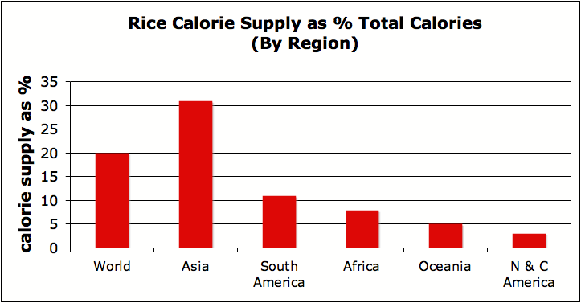
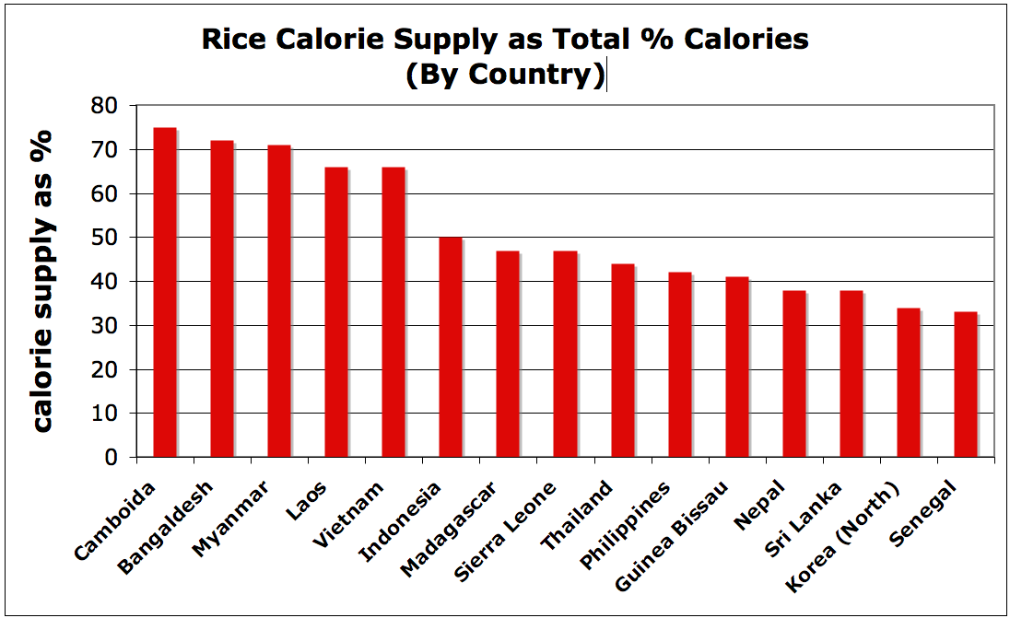
Importance of nutrition in rice
About 3 b people consume rice and in Asia 30% calories from rice
7 countries account for 80% total rice production
Other nutrients also – protein, B-complex, essential fatty acids, dietary fibre….

Slide 16
Rice Composition
Starch - amylose & amylopectin; CHO content of brown rice 83%, milled 89%, parboiled 90 & glutinous 88%
Protein – brown rice 6.44 – 12.33% (avg 9.35%); milled (8.95%), parboiled (8.18%) & glutinous is lower; also varietal difference
Amino acid profile – lysine is main limiting followed by threonine
Amino acid score 50-84 (68+/- 11) – milling not much effect
Fat – palmitic, oleic & linoleic acid (essential) content 94% of total fatty acids – breeding can impact
Ash – mean 1.49 mineral abundance(10 elements represents 50%) – P, K, Mg, Ca, Na, Zn, Mn, Fe, Al, Cu - Phylate
Dietary fibre – brown rice avg 3.98 % and milled 0.32%
Vitamin – reduced during milling
B complex (thiamine, riboflavin, niacin);
Vit E – alpha/Y-tocotrienol (higher cholesterol lowering & antioxidant activities), (α tocopherol
A (β carotene), C, D & K– little or absence (α, β, γ and δ)
Minerals
Fe (mg/100g) –high variation; brown 0.58 – 5.5 (mean 1.59); milled 0.96; parboiled rice 1.17
Zn (mg/100g) : 0.7 – 4.1 (mean 2.88); +ve correllation with Fe

Slide 17
Rice Composition
Rich source of CHO, good source of protein, reasonable source of thiamine, riboflavin, niacin, tocopherols & tocotrienols. Fe & Zn low but as quantities of rice consumed are high it is a principle source of macro & micro nutrients

Slide 18
Factors affecting nutrient composition of rice
Varietal differences – environmental conditions, soil fertility, fertilizer use,
Post harvest processing
Milling - minerals & B-complex, phytic acid, fibre
Washing & rinsing - protein (2.7%), thiamine (22-59%), riboflavin (20-60%), niacin (20-40%), K (20-41%), Fe (75%), Ca & P (50%); cooking in excess water, soaking & cooking cause losses in Phytic acid, Na & P; microwave – water, FFA & prt reduced
Phytic acid (decreasing levels improves micro nutrient incl mineral bio availability) – milling (70%), soaking (60%), cooking, fermentation, germination

Slide 19
Nutritional problems in major rice consuming country
Stunting, wasting underweight
Overweight – obesity, cardio-vascular diseases, diabetes
Iron-deficiency anaemia
Vitamin A deficency

Slide 20
Problem: Micronutrient Malnutrition
Cause: poor source of Vit A and minerals
Strategic options for mitigation
Fortification to improve micronutrient content of rice
spraying natural rice with vitamin & mineral mix – enrichment gets washed so advanced technologies
extrusion technology - stable
Fortifying rice products like noodles
Effective for small targeted groups but not large scale, expensive
2. Dietary diversification – good option, may require change of food habits, availability of different foods
3. Plant breeding – conventional methods - selection of cultivars rich in Fe, Zn – successful in Zn & Fe but not in B-carotene
4. Biotechnological approach – applied to Fe enriched & golden rice (B-carotene)
Concerns on health, environment, consumer acceptance…

Slide 21
Problem - Diabetes
Glycemic index – quantifies rate of release of glucose into blood when CHO consumed
Cause: Rice is high GI food with increased risk of Type II diabetes; large variability with GI from 52-92 in a study 235 varieties; rice products (parboiled rice/ vermicelli) have low GI
Strategic choices:
use varieties with low GI
Convert to rice products
More research and studies needed

Slide 22
Other methods for improving nutritional content of rice
Rice processing/ rice products/ by products
Brown rice, germinated brown rice, parboiled rice – phytochemicals in brown/ coloured rice has health benefits
Rice products – rice flakes high fibre/ Fe,
Rice bran – rich in protein, fibre, Ca, Fe, B-complex…
Strategic choices: consumer awareness

Slide 23
Conclusion (Nutrition)
Genetic diversity to be further studied – comprehensive database for nutrient data at cultivar level
Beneficial effects of brown rice is in germ/bran of grain – increase consumption, with education
Processing and cooking practices need to be emphasized with education & awareness
Biofortification may be explored
Glycemic index – studies needed
Studies on rice bran and its addition to other rice products
Food-based approaches for dietary diversification

Slide 24
THANK YOU
Any Questions?

