Slide 1
External Rice Advisory Group (ERAG)
Bangkok, 28 November 2013
Science and Sustainable Food and Nutritional Security
Prof M S Swaminathan, FNA, FRS
UNESCO Chair in Ecotechnology, MSSRF, Chennai

Slide 2
2013 – A Significant Year in India’s Struggle Against Hunger
Some Milestones
1943 : Bengal Famine; 3 million children, women and men died of
hunger
1963 : Beginning of intensive research on raising the ceiling to
yield
1966 : Increasing PL 480 wheat imports, going upto 10 million
tonnes
1968 : Issue of the stamp “Wheat Revolution”, depicting the role of
science in agricultural transformation
2013 : Parliament approves the National Food Security Act, conferring the legal right to food on over 70% of India’s population
Thus, 2013 marks the transition from ‘ship to mouth’ to ‘right to food’ with home grown food

Slide 3
Ehrlich (1968)
Some time between 1970 and 1985 the world will undergo vast famines — hundreds of millions of people are going to starve to death. That is, they will starve to death unless plague, thermonuclear war, or some other agent kills them first.
The United States should announce that it will no longer ship food to countries such as India where dispassionate analysis indicates that the unbalance between food and population is hopeless.
Source : The Population Bomb

Slide 4
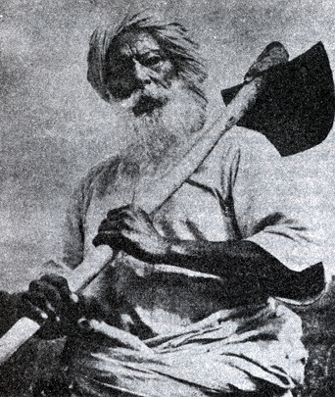
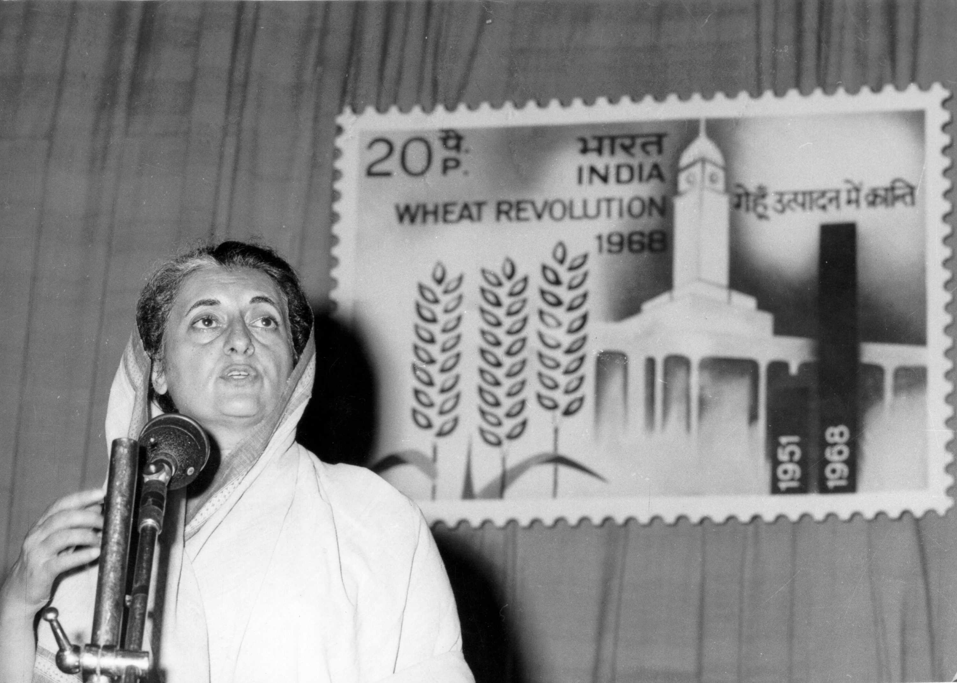
Green Revolution Symphony (1968)
Major Components
Technology
Services
Public Policies
Farmers’ enthusiasm
Indian farmers achieved as much progress in wheat production
in four years (1964–68), as during the preceding 4000 years.
Scientific skill, Political will and Farmers’ toil – major ingredients of the revolution
Notes:
4
4

Slide 5
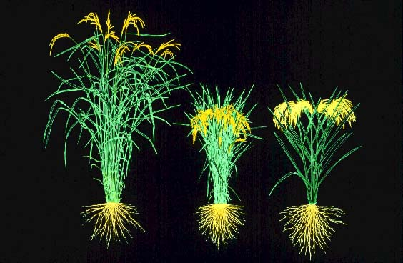
Rice: The advent of new plant type in the 1960s
Non-lodging habit together with a vigorous root system

Slide 6
Trend in Rice, Paddy Production over Decades (in Million Tonnes)
Source: Data from http://faostat.fao.org/

Slide 7

Evergreen Revolution is the Pathway
World requires 50% more rice in 2030 than in 2004 with approximately 30% less arable land of today
Mainstreaming ecology in technology development and dissemination is the road to sustainable agriculture

Slide 8
From Green to an Ever-green Revolution
Pathways
Green Revolution : Commodity-centred increase in productivity Change In plant architecture, and harvest index Change in the physiological rhythm-insensitive to photoperiodism Lodging resistance | Evergreen Revolution : increasing productivity in perpetuity without associated ecological harm Organic agriculture : cultivation without any use of chemical inputs like mineral fertilizers and chemical pesticides Green Agriculture : conservation farming with the help of integrated pest management, integrated nutrient supply and integrated natural resource management
If farm ecology and economics go wrong, nothing else will go right

Slide 9
Global Food Security Situation Today
12.5% of the world’s population (868 million) are undernourished in terms of energy intake
26% of the world’s children are stunted
2 billion suffer from 1 or more micronutrient deficiencies
1.4 billion are over-weight, of whom 5 million are obese
Cost of under-nutrition and micronutrient deficiencies – 2 to 3 % of global GDP, equivalent to USD 1.4 to 2.1 trillion per year
Source : The State of Food and Agriculture, FAO 2013

Slide 10
Hunger and Human Development
India’s Position in the World
National Family Health Survey (2005-06) Malnourished Children under 5 – above 40 %
Low Birth Weight Children – 21 %
Union Planning Commission (2012) – About 217 Million are undernourished
Global Hunger Index (IFPRI, 2012) – 65th position among 79 countries
UNDP Human Development Report (2012) – 134th position among 187 countries
Nutrition Barometer (Save the Children, 2012) - Very Low Position

Slide 11
Food Insecurity: Challenge and Response
Challenge | Response
1. Calorie Deprivation | National Food Security Act 2013
2. Protein Hunger | Pulses Villages and Panchayats
3. Hidden Hunger (i.e. Micronutrient deficiencies) | National Dairy Mission; Nutri-Farm Fortified Salt

Slide 12
National Food Security Bill of India, 2013
Goal : To provide food and nutritional security in human life cycle approach, by ensuring access to adequate quantity of quality food at affordable prices
Enlargement of the Food Basket : Foodgrains mean rice, wheat or coarse grains (i.e. nutri-cereals)
Life Cycle approach with emphasis on the first 1000 days of a child’s life.
Women as custodians of household food security. The eldest woman, over 18 years of age, as head of household for the purpose of issue of ration cards
The world’s largest social protection measure against hunger

Slide 13
Increase in Productivity – Only pathway open
  Rice requirement in 2035 : additional of 100 million tonnes
  required
  Production in 2013 : million tonnes
  Population in 2035 : over 8.5 billion
  Pathway to achieving the
  additional requirement : Evergreen Revolution

Slide 14
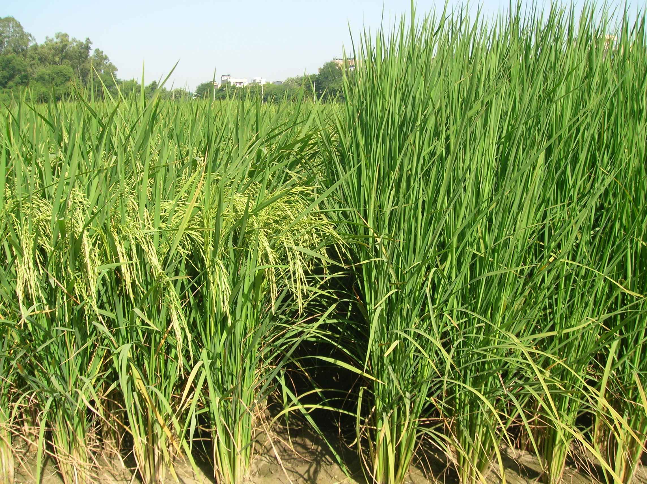
Pusa Basmati 1509: Released in 2013
Reduced height
Earliness
Non-lodging
Non-shattering
Pusa Basmati 1509
Pusa Basmati 1121

Slide 15
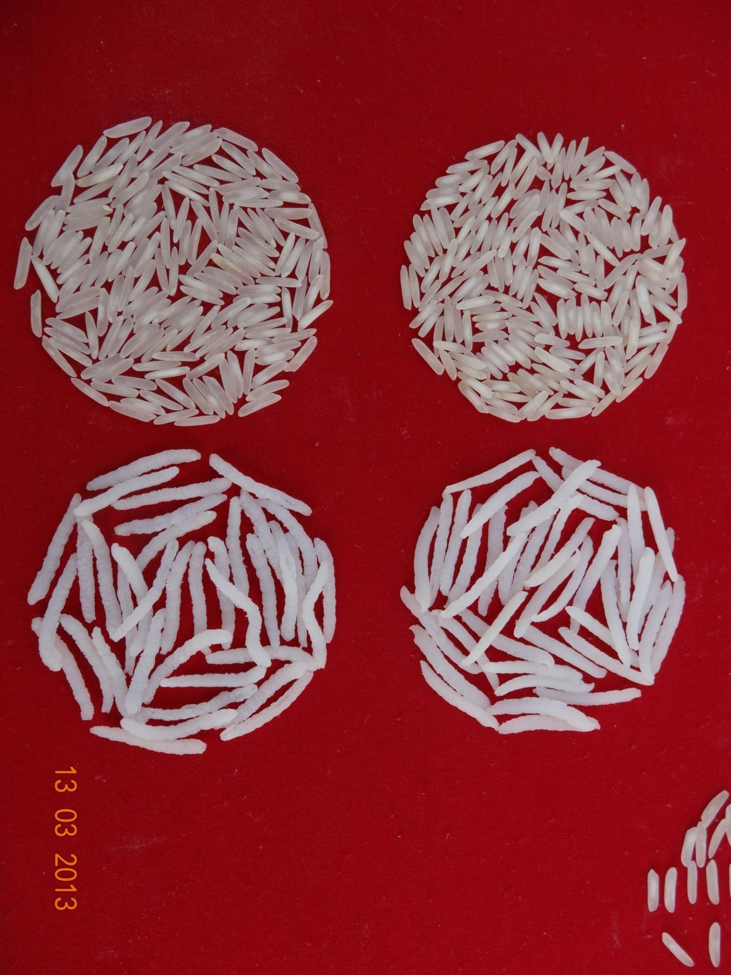
Milled rice
There is need for information on functional genomics of cooked kernel elongation and volume expansion in Basmati rice
Pusa Basmati 1509
Pusa Basmati 1121
Cooked rice

Slide 16
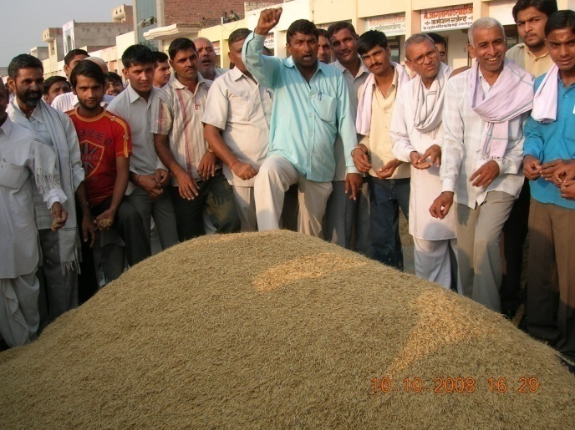
Power of Science : Forex earning from export of Basmati Rice
US $ 4.6
billion
Total Export ~ 4.0 million tons
(Rs. in crores)
US $ 55 million
(Year)

Slide 17
No Time to Relax : Major Challenges Ahead
Food losses and Food Waste
Climate change : scientific checkmating of adverse impact
Shrinking per capita land and water resources
Expanding biotic and abiotic stresses
Adverse cost-risk-return structure of farming
Market volatility
Reluctance of youth to take to farming
The Monsoon and the Market are two of the major determinants of farmers’ well being

Slide 18
Climate Change : Temperature
Global mean surface temperatures continue to rise. Eleven of the last 12 years rank among the 12 warmest years on record since 1850
It is extremely likely that human influence has been the dominant cause of the observed warming since the mid 20th century. The evidence for this has grown
Global surface temperature change for the end of the 21st century is projected to be likely to exceed 1.5°C relative to 1850 to 1900 in all but the lowest scenario considered, and likely to exceed 2°C for the two high scenarios
Warming will continue to exhibit inter-annual-to-decadal variability and will not be regionally uniform
Heat waves are very likely to occur more frequently and last longer. As the earth warms, it is expected that current wet regions receiving more rainfall, and dry regions receiving less, although there will be exceptions
Source : SPM, IPCC AR-5

Slide 19
Sea Level Rise
Global mean sea level has risen by 0.19 [0.17 to 0.21]m, estimated from a linear trend over the period 1901–2010
Between 1993 and 2010, the rate was very likely higher at 3.2 [2.8 to 3.6] mm yr–1
Ocean thermal expansion and glacier mass loss are very likely the dominant contributors to global mean sea level rise during the 20th century
Global mean sea level will continue to rise during the 21st century. Under all RCP scenarios the rate of sea level rise will very likely exceed that observed during 1971–2010 due to increased ocean warming and increased loss of mass from glaciers and ice sheets
As the ocean warms, and glaciers and ice sheets reduce, global mean sea level will continue to rise, but at a faster rate than that have been experienced over the past 40 years
Source: SPM, IPCC AR-5

Slide 20
Impact of Sea Level Rise
Inundation of low lying coastal lands with sea water
  millions of ha of land would be affected
  small islands would be affected very severely
Increased incidence of storm surges
Seawater intrusion into freshwater and groundwater
Enhancement of tidal waters into rivers
Accelerated coastal erosion
Climate Refugees will look for new areas to settle

Slide 21
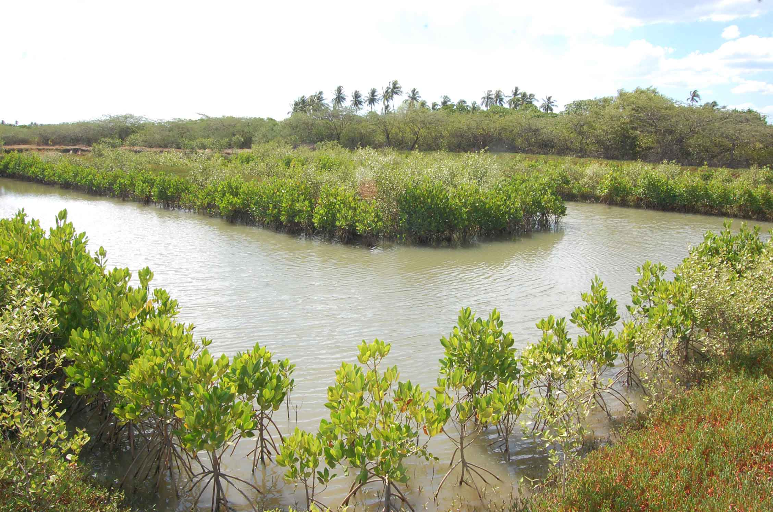
Sea Water Farming
(Sea water constitutes 97% of the world’s water resource)

Slide 22

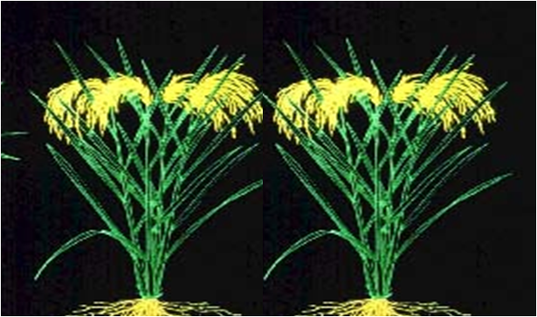

Innovations in below sea level farming in Kuttanad
ONE RICE - ONE FISH
April- October
Monoculture – Giant Prawn (Macrobrachium rosenbergii)
Polyculture*- Indian major carps or common carps or Silver carps and grass carps and Giant Prawn
Yield- Rice: 4.2 t/ha
Fish- Prawn: 480 kg;
Carp : 300 kg.
Punja season
November- February
Low chemical input or Organic
Yield- 4.2 t/ha
* Recommended practice

Slide 23
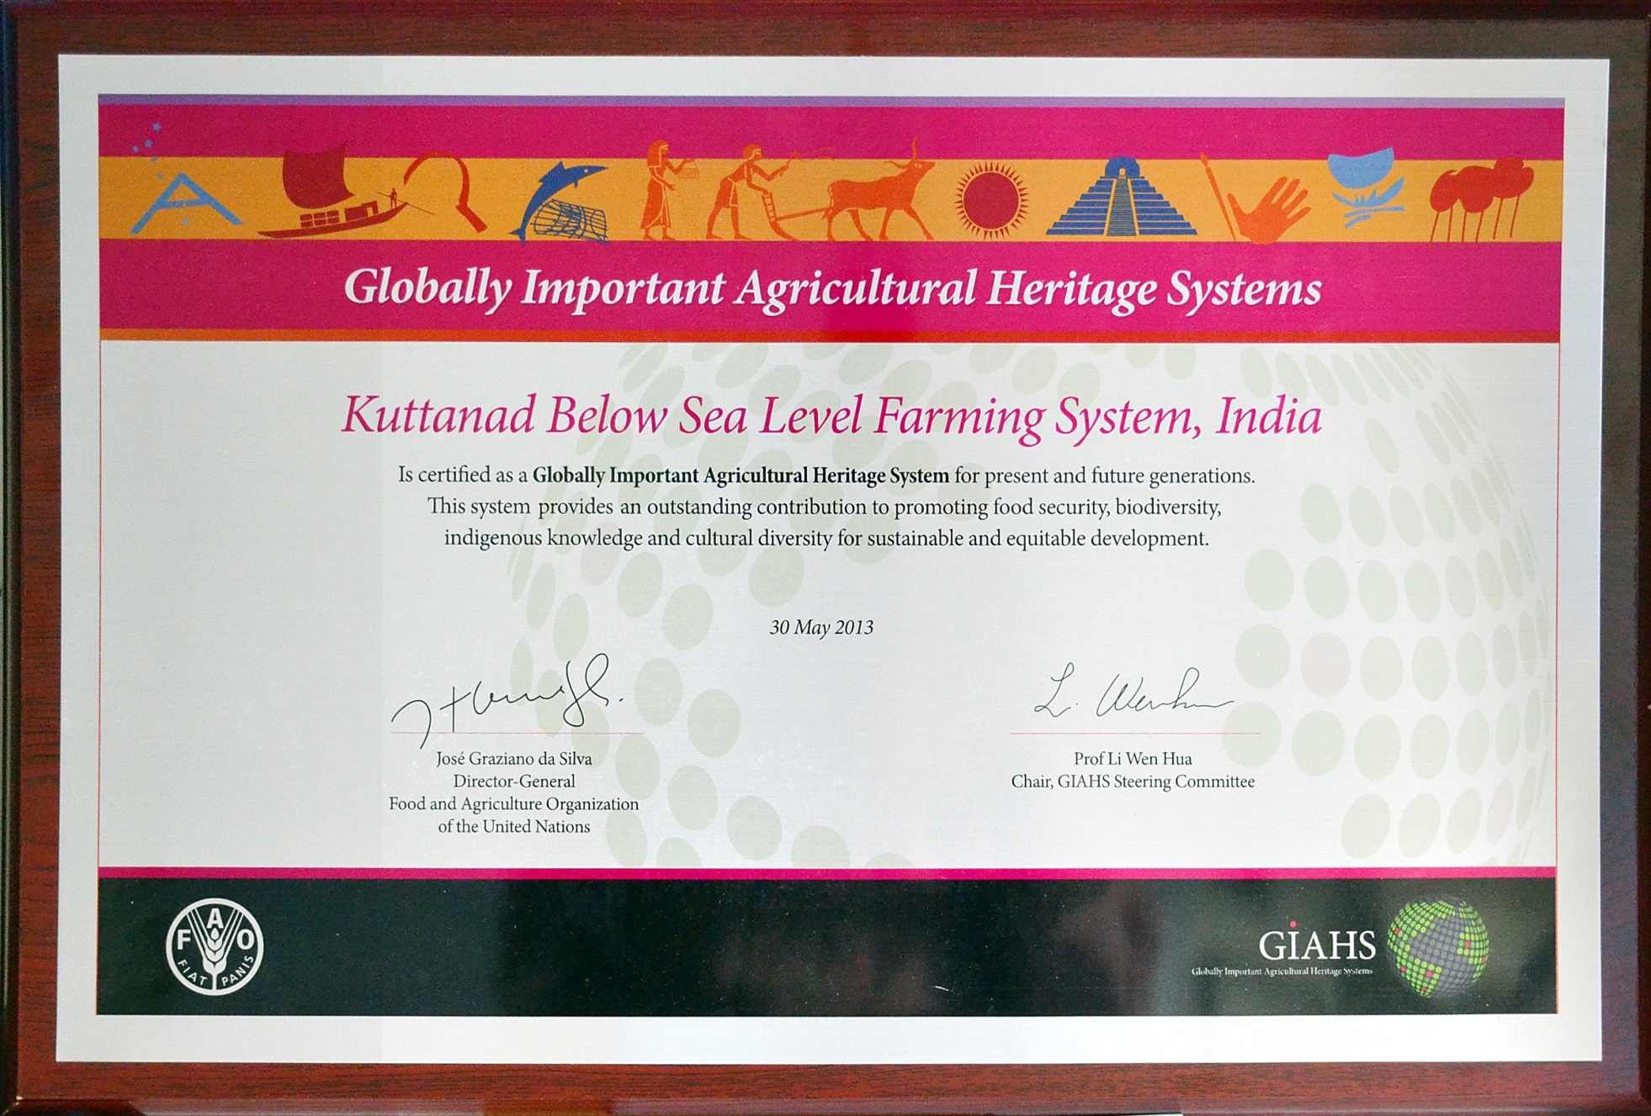

Slide 24
Genetic Garden of HALOPHYTES at Vedaranyam
Converting Sea Water into Fresh Water through Halophytes
Obligatory halophytes
Facultative halophytes
Tolerate high concentration
of sodium salts
> 3 times of seawater salinity
Even demand high NaCl for
survival and reproduction
1560 species
Most of the species tolerate only moderate level of salinity
Reproduction requires low saline condition
Mangroves
60 species

Slide 25
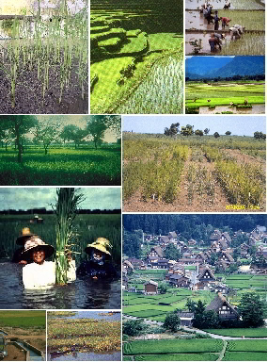
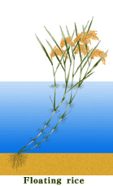
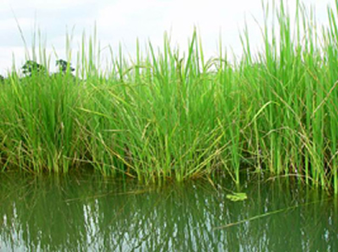
Genes for Climate Resilience
Deepwater (floating) rice has
three special adaptations:
  ability to elongate with the rise of water levels;
  develop nodal tillers and roots from the upper nodes in the water
  the upward bending of the terminal part of the plant called 'kneeing' that keeps the reproductive parts above the water as flood water subsides

Slide 26

Genetic Shield against Sea Level Rise
Mangrove Forests
Notes:
26

Slide 27
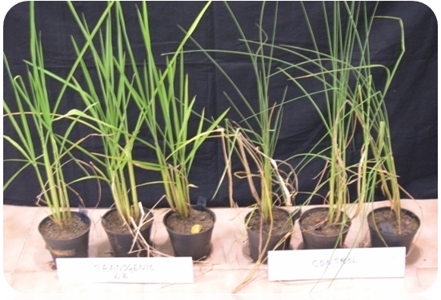
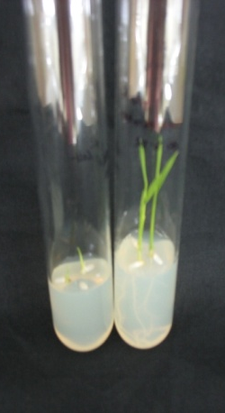
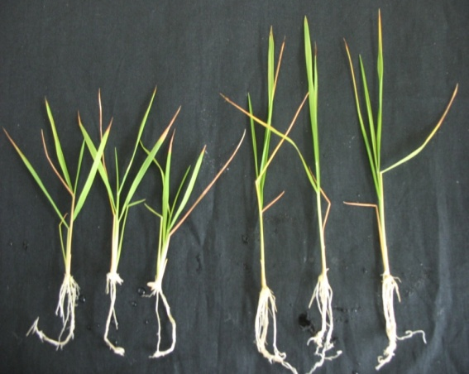
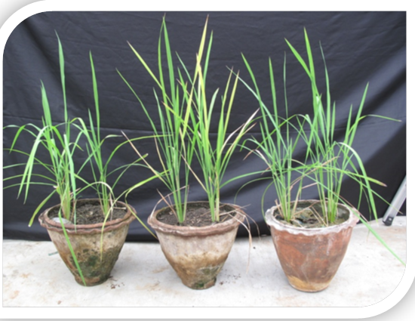
Salt tolerant Rice Plants with Mangrove Genes
10 days 1 month
Transgenic DC2
Control (UT)
C T
CTRL Transgenic
Performance Evaluation
Characters | White ponni with 150mM NaCl | Transgenic with 150mM NaCl
Plant height (cm) | 95.10 | 104.95
No. of productive tillers | 9.90 | 14.20
Panicle length (cm) | 17.08 | 22.45
No. of grains per panicle | 134.60 | 174.80
100 grain weight (g) | 1.45 | 1.63
Yield per plant (g) | 20.30 | 34.75
Rice plants with Mangrove Genes and Promoter

Slide 28
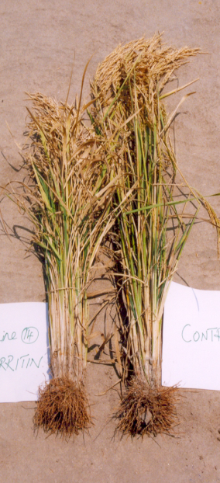
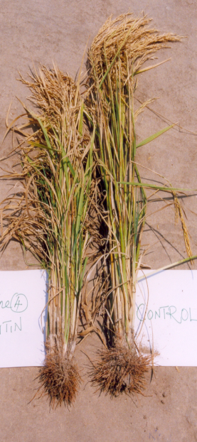
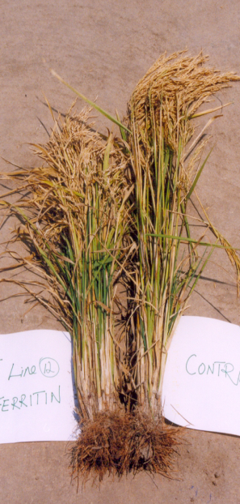
Breeding saline tolerant, drought tolerant, iron fortified local varieties of rice
Salt Tolerant
IR 20
Salt Tolerant
White Ponni
Iron Rich Rice
Donor : Avicennia marina

Slide 29
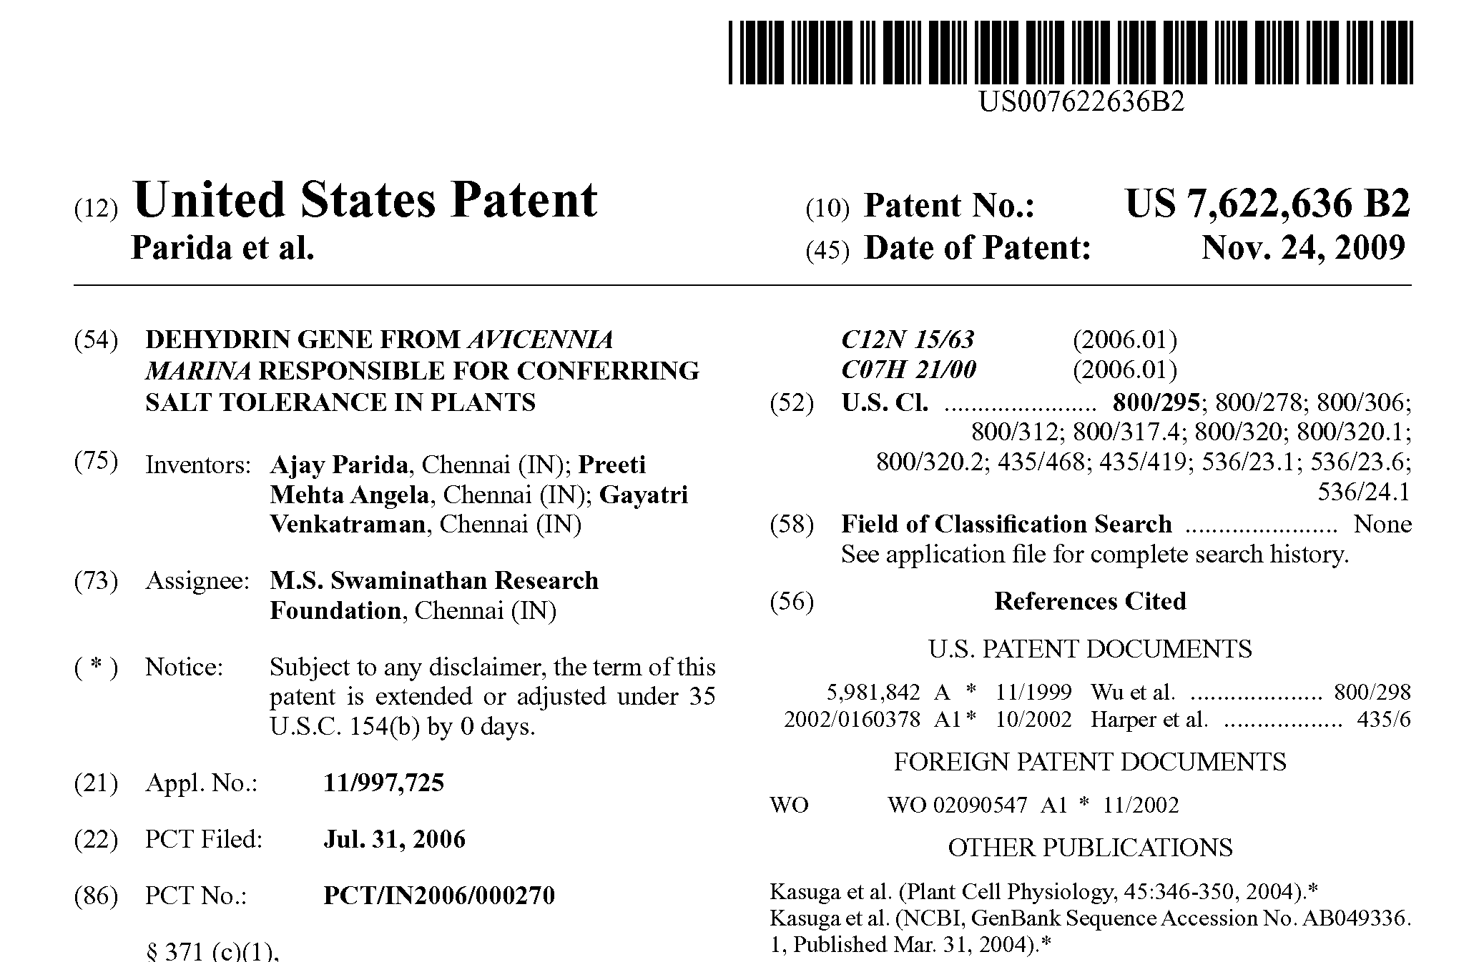
US Patent No. 7,622,636 Issued on Nov. 24, 2009, Assigned to
M.S. Swaminathan Research Foundation for Dehydrin Gene

Slide 30
C4-re-engineering photosynthesis to develop physiologically efficient rice
C4 rice could:
increase rice yield by 25-50%
double water-use efficiency
improve nitrogen-use efficiency
C4 photosynthesis is one of the few evolutionary mechanisms that could deliver these superior combination of benefits.
Evolutionary Change
Evolutionary Change
Evolutionary Change
Genetic alterations
Genetic alterations
Genetic alterations
C3
C3
C3
C4
+
C4
+
+
+
+
+
+
+
+
=
=
Anatomy
=
Anatomy
Anatomy
Biochem
Biochem
Biochem
Fine
Fine
Fine
Change
Change
Change
Change
Change
Change
Tuning
Tuning
Tuning
P. Quick & J. Sheehy, IRRI

Slide 31
Some advantages of C4 photosynthetic systems over C3 include
Faster and more complete translocation of assimilates from leaves
Photorespiration is rarely greater than 5% of the rate of photosynthesis while in C3 it can exceed 30% of the rate of photosynthesis above 30⁰C
Almost twice the efficiency in dry matter production per unit of water transpired
In drought prone ecosystems, yield could be maintained or increased with less water and less fertilizers
Greater photosynthetic efficiency at high temperature

Slide 32
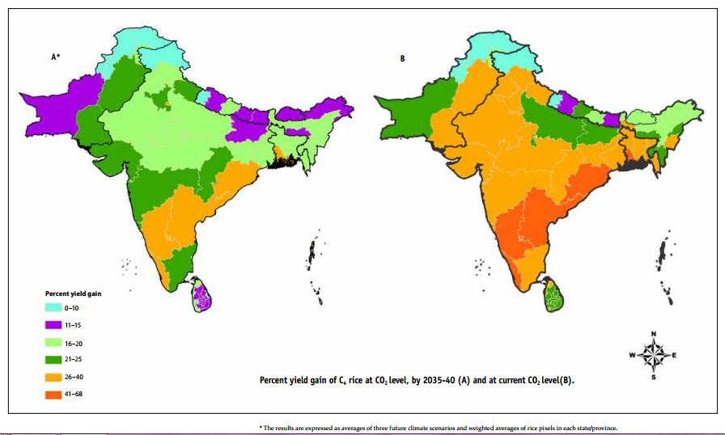
Percentage yield gain in C4 rice at different CO2 levels
Percent Yield Gain
0-10
11-15
16-20
21-25
Percent yield gain of C4 rice at CO2 level, by 2035-40 (A) and
at current CO2 level (B)
26-40
41-68
International C4 Rice Consortium
Source: M V R Murty et. Al., Rice Today, IRRI, Oct-Dec 2013, Vol.12, No.4

Slide 33
HarvestPlus :
Biofortification Challenge Programme
Inter-disciplinary, global alliance of research and implementing institutions
Six staple food crops
Iron, zinc, pro-vitamin A
Conventional breeding and exploratory research in developing transgenic varieties
$95 million over 10 years; $50 in the first four years

Slide 34

Horticultural Remedy for Nutritional Malady
Moringa Oleifera
25 x iron in spinach
17 x calcium in milk
15 x potassium in bananas
10 x vitamin A in carrots
9 x protein in yogurt
National Geographic, November 2012

Slide 35
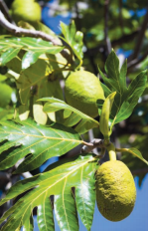
Botanists Spread the Gospel That Breadfruit Can Be Manna
The Breadfruit Institute has found that the perennial trees produce more food in dry weight per hectare than corn, rice, or wheat
A fruit rich in iron, potassium, and Vitamin A precursors
Source: Science Vol 342 18 October 2013

Slide 36
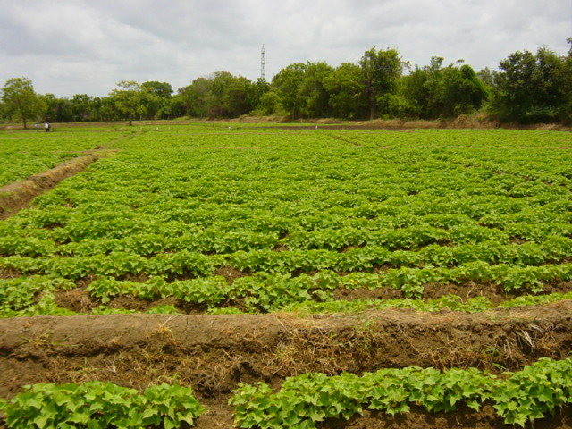
Orange-fleshed Sweet Potato Rich in Beta carotene

Slide 37
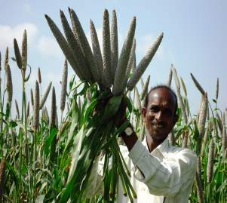
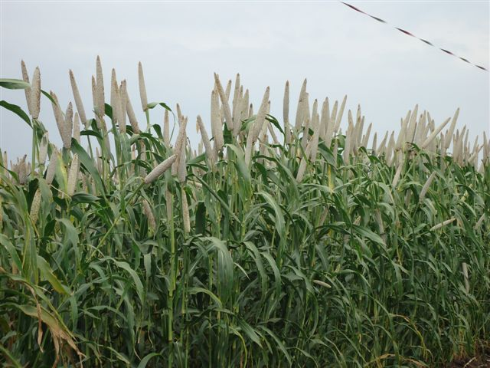
Biofortification: High-iron Pearl Millet
ICTP 8203
ICRISAT-bred OPV
(70-74 ppm Fe)
With 10% Higher Yield
Marketed by NIRMAL SEEDS
86M86
Pioneer hybrid (54-64 ppm Fe)

Slide 38
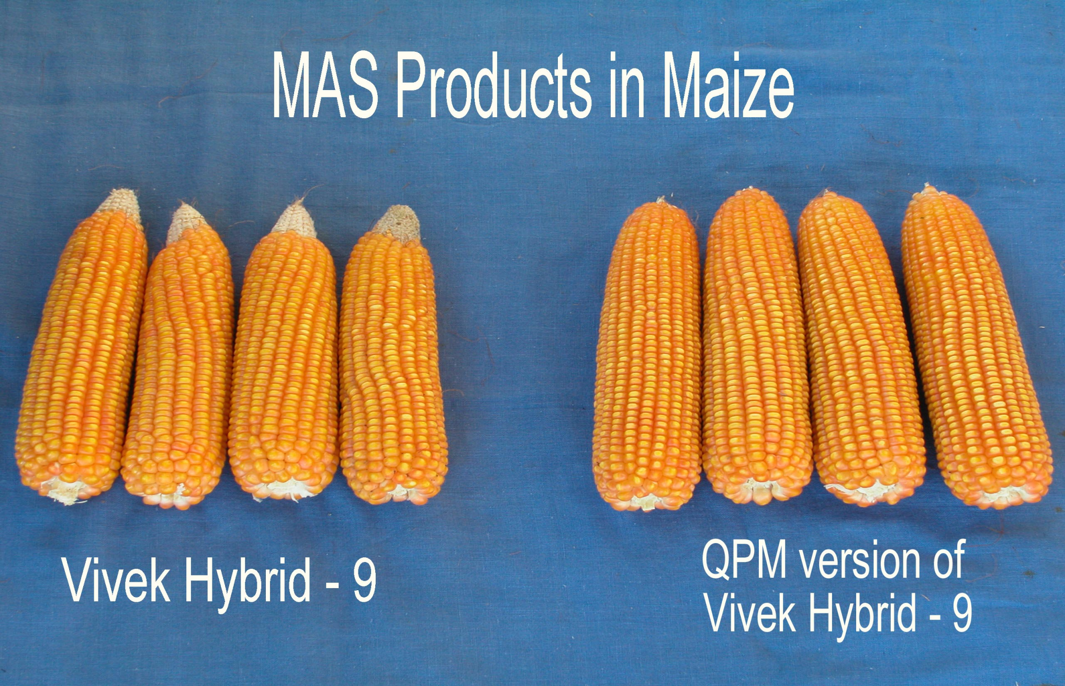
VPKPS, Almora

Slide 39
Launching a Nutri-Farm Movement
In the Union Budget 2013-14, the Finance Minister Mr P Chidambaram announced a pilot programme on Nutri-Farms for introducing new crop varieties that are rich in micro-nutrients such as iron-rich bajra, protein-rich maize and zinc-rich wheat. For this purpose he has provided a sum of `. 200 crore in the Budget.

Slide 40
Genome Saviours

Slide 41









Cultural & Curative Diversity
TRIBE | DISTRICT | Medicinal Plants used
Bhatra | Nawarangpur | 81
Bhumia | Koraput | 69
Bonda | Malkangiri | 55
Gadaba | Koraput | 83
Gond | Nawarangpur | 67
Kandha | Koraput + Rayagada | 124
Koya | Malkangiri | 48
Paroja | Koraput | 74
Saora | Rayagada | 59
9 tribes | 4 districts | 660 MPs

Slide 42
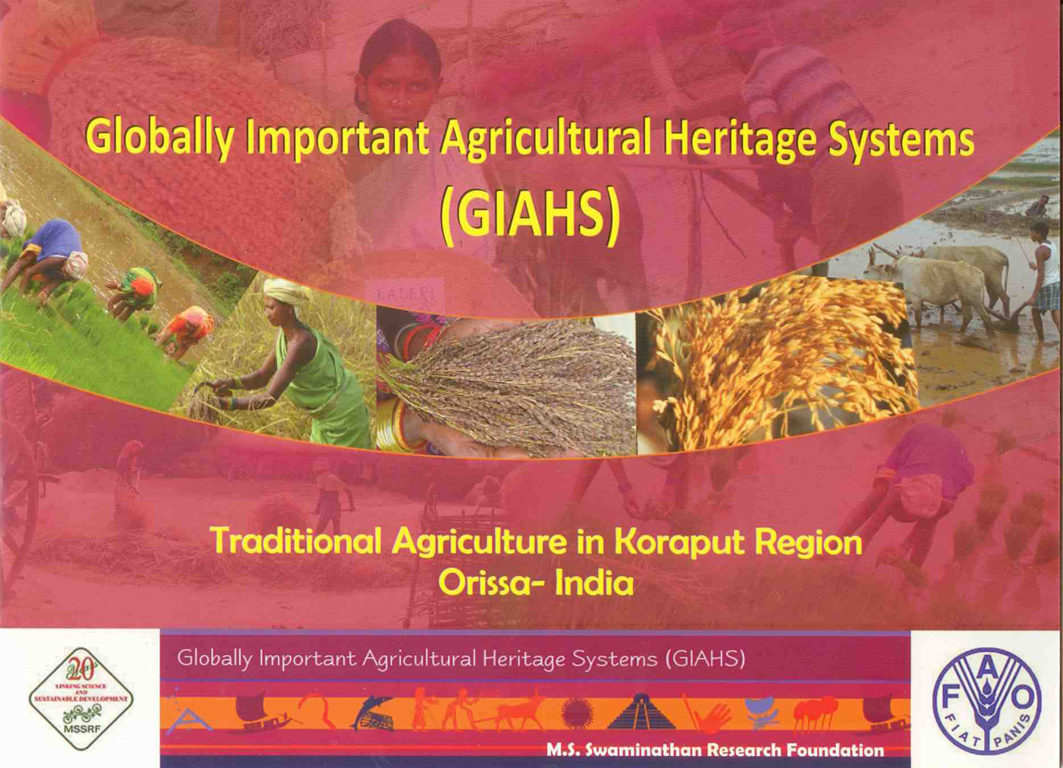
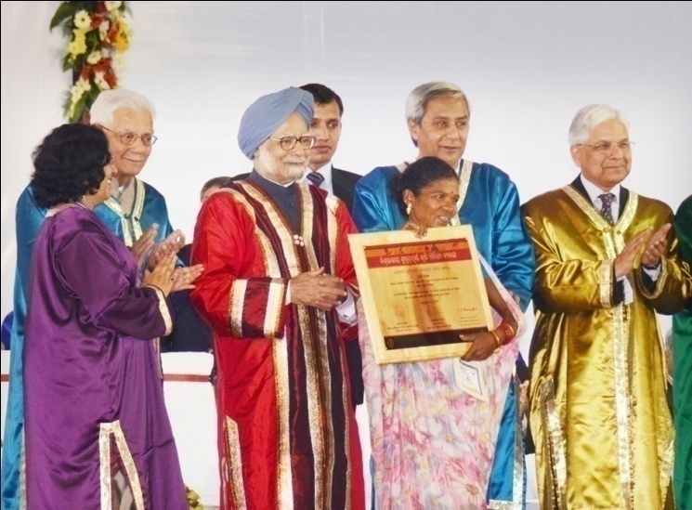
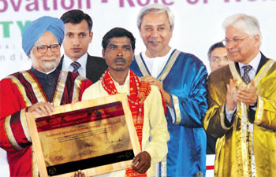

Slide 43
Expediting Research on Functional Genomics
Develop large scale high throughput genetic transformation facilities
Strengthen the existing infrastructure and policy support for research on transgenic crops
Develop suitable regulatory procedures
Improve functional validation of gene by genetic transformation and gene silencing

Slide 44
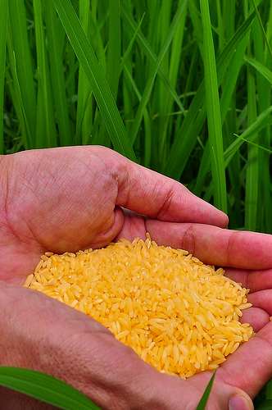
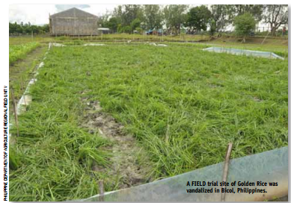
Golden Rice :
Trial Site Vandalized in Bicol, Philippines
Source: Rice Today, IRRI, Oct-Dec 2013, Vol.12, No.4

Slide 45
National Biosafety Authority
“To assess risks and benefits from GMOs with reference to biodiversity, human and animal health and environment, a National Biosafety Authority is needed”
Parliamentary Committee on Agriculture Chaired by Shri Basudeb Acharya (2012)

Slide 46
Role of Rice in safeguarding food security in an era of climate change
Grows under a wide range of altitudes and latitudes
Rich germplasm collections available
Appropriate combination of Mendelian and Molecular breeding will help to promote climate resilient rice farming system

Slide 47
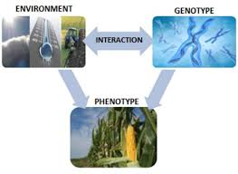
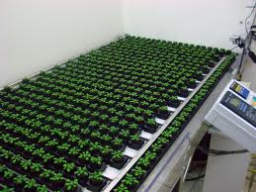
Linking Genome to the Phenome
In this area, we face challenges such as the establishment of robust protocols and screening methods, which integrate non‐invasive, automated high throughput measurement of relevant plant traits both under controlled greenhouse and field scenarios. Plant phenotyping is fast developing as a scientific field that aims to quantify accurately phenotypic traits, and give valuable prognoses for plant-environment interaction.
Towards this, MSSRF is organizing the 3rd International Plant Phenotyping Symposium together with the International Plant Phenotyping Network from Feb 17 – 19, 2014 at Chennai

Slide 48
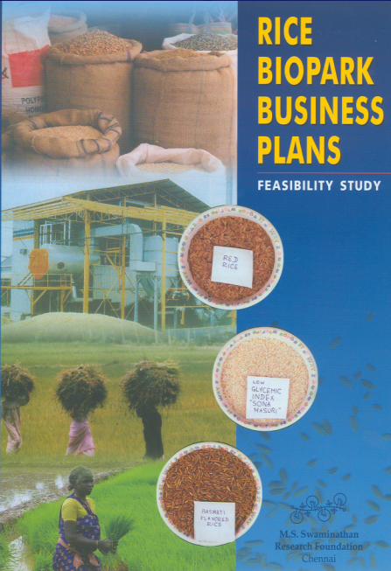
Non-farm Employment
Biomass – an under- utilized resource for enhancing income, energy
and work security
Notes:
48

Slide 49
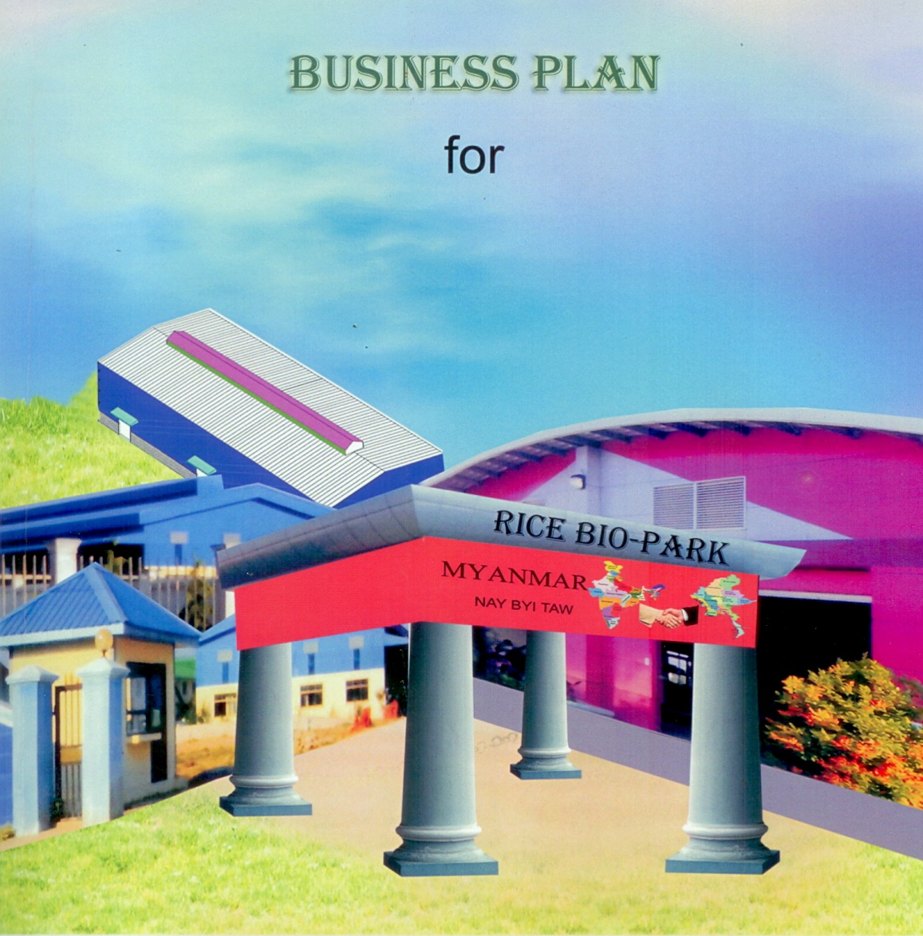
Designed to save and add value to each part of the rice biomass, such as rice straw, husk and bran
RICE BIOPARK
IN Nay Pyi Taw
Myanmar

Slide 50
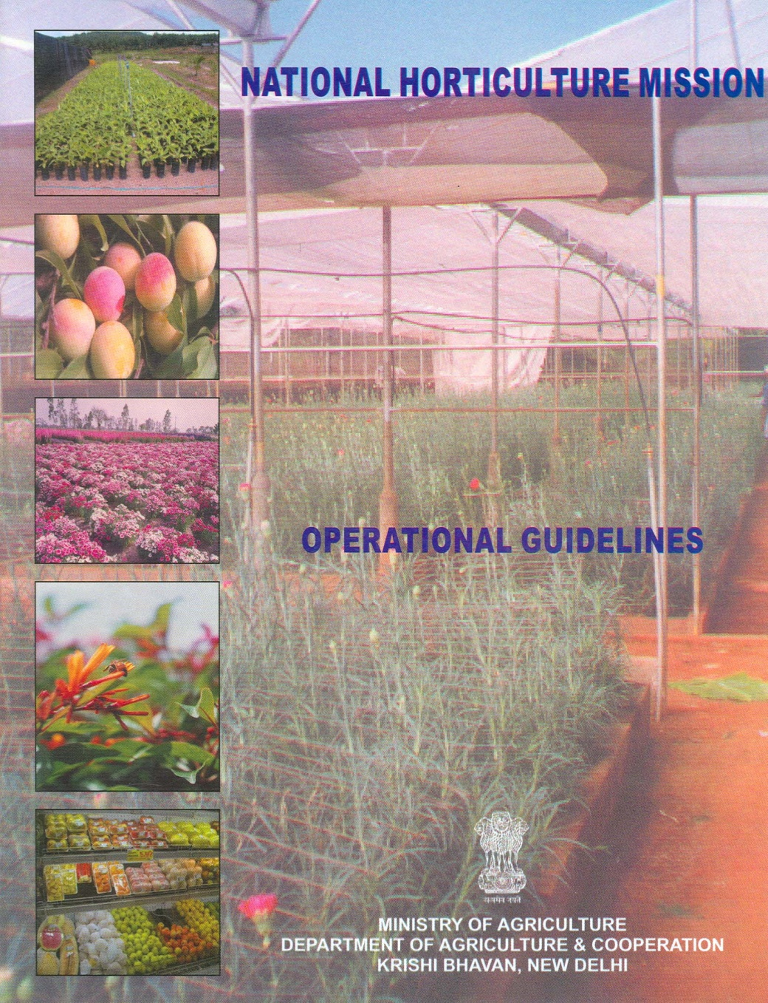
Mainstream the nutritional dimension in National Horticulture Mission by setting up a Nutrition Advisory Council in every agro-climatic zone

Slide 51
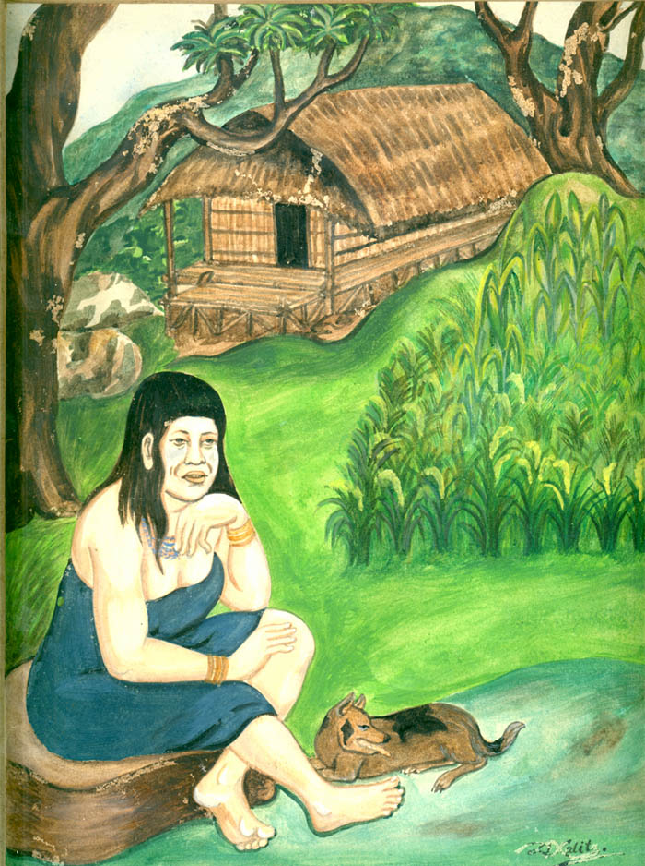
Domestication of Rice
Women and Domestication of Rice
10,000 years ago
Temple at Along, Arunachal Pradesh

