Slide 1
Economic implications of changing food consumption patterns
Franco Sassi PhD
OECD – Health Division
Rome, 14th November 2013

Slide 2
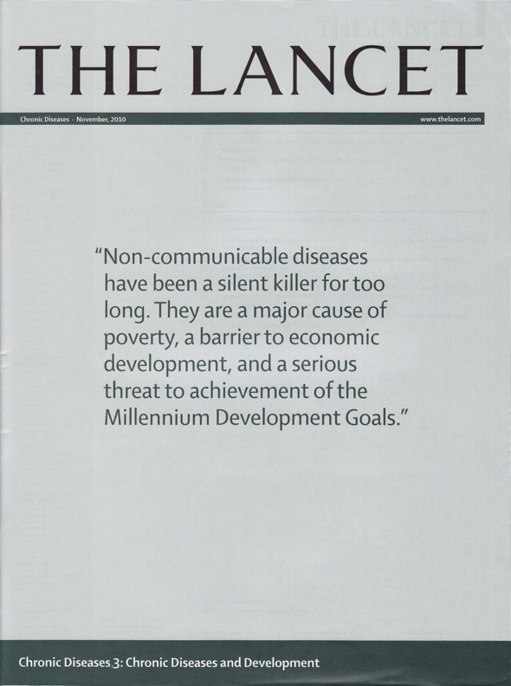

UN High-level Meeting on NCDs

Slide 3
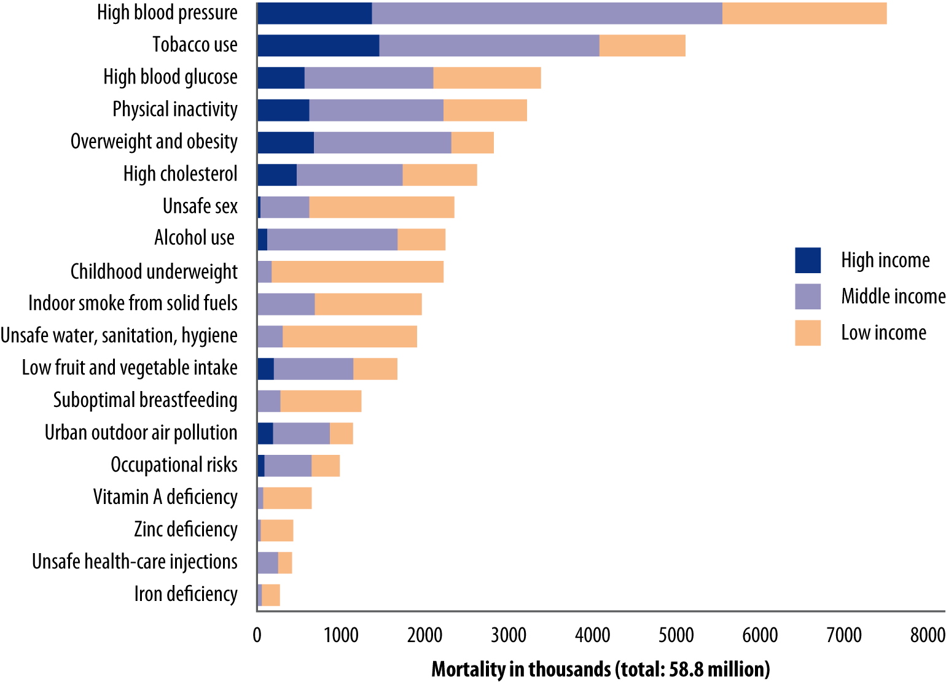
Leading Risk Factors for Health
Attributable Mortality, 2004
Source: WHO, 2009

Slide 4
Deaths from NCDs
Worldwide, by Income Group
Source: WHO estimates and projections, 2008

Slide 5
Obesity: a Global Epidemic
In Brazil, obesity tripled in men and doubled in women in 30 years; in India, up to 40% are overweight in urban areas
Diabetes in China is now as common as in the US
Obesity accounts for less than 1% of GDP in most OECD countries, over 1% in the US and up to 4% in China
India
China
Russia
OECD
Brazil
S Africa
UK
Mexico
% of adult population

Slide 6
The OECD/WHO CDP Model
Blood pressure
 | normal
 | hypertension
Cancers
Fibre
 | adequate fibre intake
 | low fibre intake
Fat
 | low fat intake
 | medium fat intake
 | high fat intake
Body mass index
 | normal weight
 | pre-obesity
 | obesity
Cholesterol
 | normal
 | hypercholesterolemia
Stroke
Physical activity
 | adequate physical act
 | insuff .physical act
Glycaemia
 | normal
 | diabetes
Ischemic heart
disease
Socio-economic status
 | upper
 | lower

Slide 7
A Comprehensive & Affordable Prevention Package
OECD Countries |  | Emerging Economies
Mass media campaigns |  | Mass media campaigns
Compulsory food labelling |  | Compulsory food labelling
Industry self-regulation of food advertising to children |  | Government regulation of food advertising to children
Physician-dietician counselling |  | Fiscal measures
School-based interventions
Canada | Europe | Brazil | China
24.03 $/cap | 22.45 $/cap | 0.40 $/cap | 0.20 $/cap

Slide 8
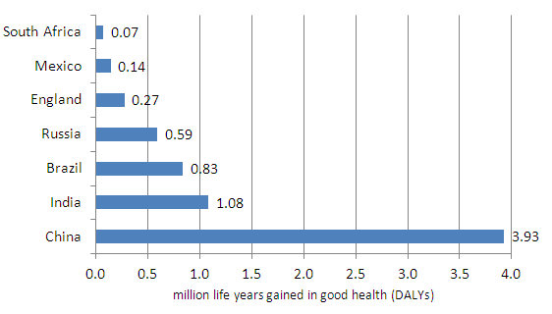
What Can Prevention Achieve?

Slide 9
Prevention Keeps Healthy
Years of Life Free of NCDs
Cancers (lung, colorectal, breast)
Cardiovascular diseases

Slide 10
An Affordable Prevention Package
1.2
0.4

Slide 11
Prevention is a Good Investment
Impact on Health Expenditure

Slide 12
% Decrease Rrequired in Fat Consumption
COUNTRIES | % decrease on average (2012-2021)
Argentina | -0.9
Australia | -1.4
Brazil | -0.9
Canada | -1.2
Chile | -0.9
China | -0.8
European Union | -1.1
India | -0.7
Japan | -0.8
Korea | -0.8
Mexico | -1.4
New Zealand | -1.4
Russian Federation | -0.8
United States | -1.4
Notes:
Apply a shock Δi for a period of ten years : values given health department model

Slide 13
Scenario 1 Results

Slide 14
SATURATED FAT REDUCTION needed to meet WHO guidelines

Slide 15
Scenario2 Results

Slide 16
Scenario2 Results
Notes:
Decrease by 30 % at the end of the period of the simulation

Slide 17
Scenario2 Results

Slide 18
Key Policy Implications
Obesity and NCDs are global economic issues
Food and nutrition policies must be part of a comprehensive intersectoral prevention strategy
Potential for major health, health expenditure and productivity gains
Limited effects on world markets imply such changes should be economically sustainable over the medium and long term

Slide 19
The Obesity Epidemic
Source: OECD Obesity Update, 2012

Slide 20
The Burden of Obesity on Health Systems
Roux & Donaldson, 2004
Konnopka, Bodemann, Konig, 2011
Notes:
Cross-sectional costs are higher for obese patients; obese patients cost 30% more than normal-weight patients
But lower costs in a life perspective as lower life-expectancy
Obesity accounts for 1 to 3% of total health expenditure in most countries and up to 10% in the US
Obesity accounts for up to 1% of GDP in most OECD countries, over 1% in the US and up to 4% in China

Slide 21
Prevention Saves Lives
Life Years and DALYs Saved Every Year
1 DALY / 17 persons

