Slide 2
Trends in Food Supply and Impacts
on Food Consumption
WB Traill, University of Reading
Paper co-authors: M Mazzocchi, B Shankar, D Hallam

Slide 3
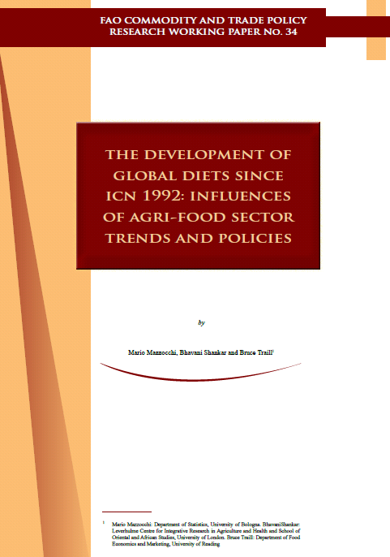

Slide 4
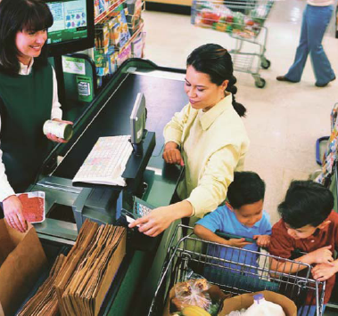
Outline
How diets have changed since 1992
Supply system drivers of
change
Some policy implications

Slide 5
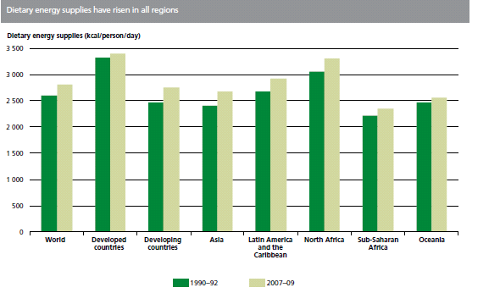

Slide 6
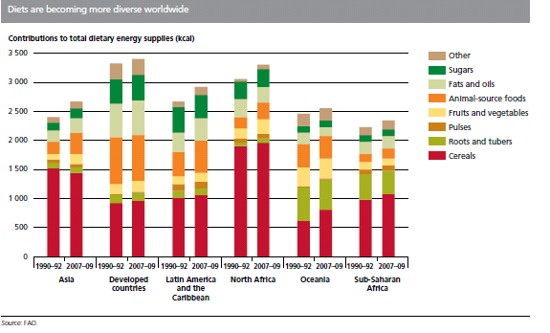

Slide 7
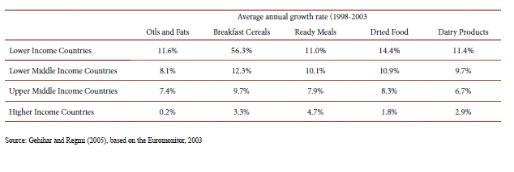
Sales growth rates selected food categories

Slide 8
Overweight and Underweight prevalence

Slide 9
AGRICULTURAL & TRADE POLICIES
AGRICULTURAL & TRADE POLICIES
Trade polices
Consumer policies
Producer support policies
Trade polices
Consumer policies
Producer support policies
Food prices
Food availability
Food preferences
Food prices
Food availability
Food preferences
TRENDING FACTORS
TRENDING FACTORS
Population growth
Globalisation
Urbanisation
Energy prices (biofuels, oil price volatility)
Market organization
Technical progress (agricultural productivity, progress in processing / preserving foods)
Incomes
Other socio-demographic trends
Population growth
Globalisation
Urbanisation
Energy prices (biofuels, oil price volatility)
Market organization
Technical progress (agricultural productivity, progress in processing / preserving foods)
Incomes
Other socio-demographic trends
Food consumption
Intakes
Dietary quality
Food consumption
Intakes
Dietary quality
Income effects
Income effects
Prevalence of undernutrition
Prevalence of
overnutrition
Prevalence of undernutrition
Prevalence of
overnutrition

Slide 10
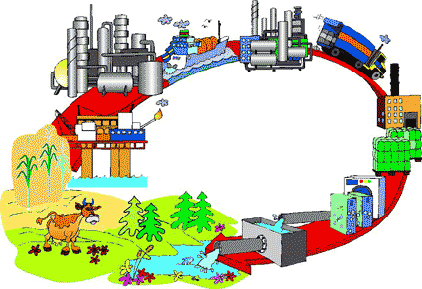
Today’s focus:
Consumption implications of supply chain modernisation

Slide 11
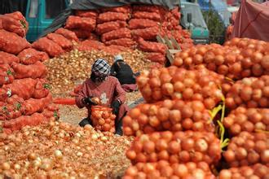
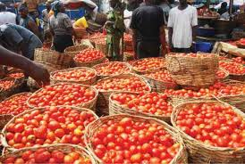
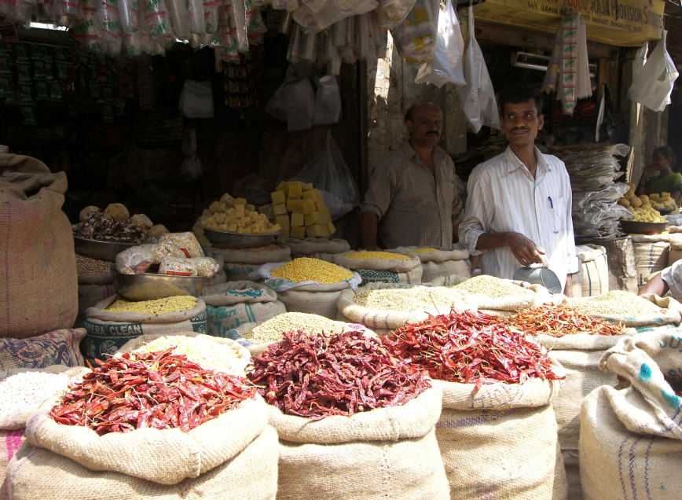

Slide 12
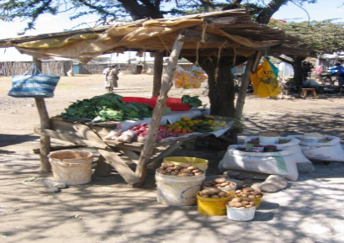
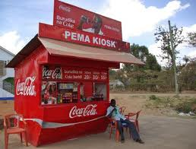
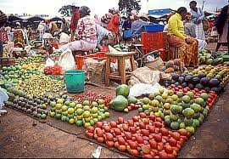

Slide 13
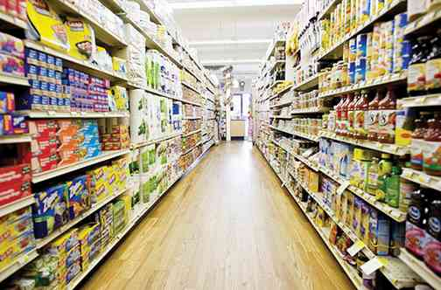
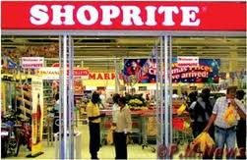

Slide 14
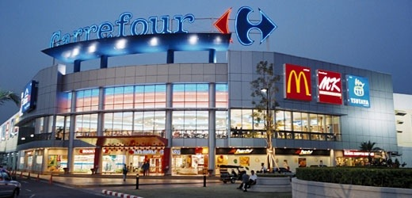

Slide 15
Income growth

Slide 16
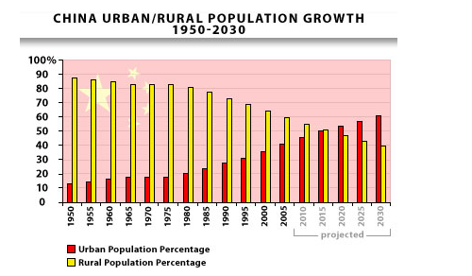
Urbanisation

Slide 17
Female labour force participation
  OECD Growth 1992-2010 =20% (48m)
  Low income countries + 58%
  Middle income countries +46%

Slide 18
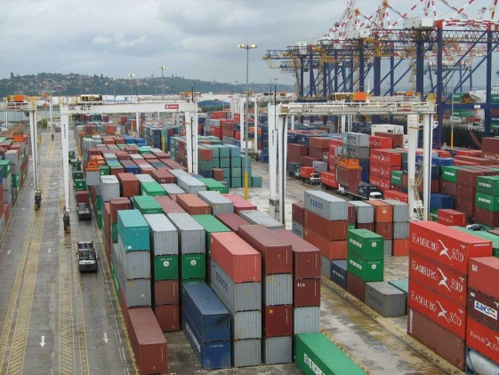
Globalisation

Slide 19
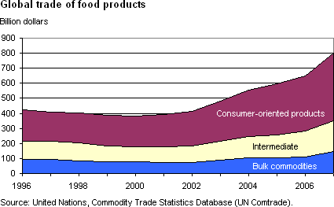

Slide 20
Foreign Direct Investment

Slide 21
Trade and Investment policies
Uruguay Round Agreement on Agriculture (URAA) (1994) and World Trade Organisation (1995)
200 plus regional agreements registered with WTO
SPS and TBT measures of WTO/Codex
Trade-Related Investment Measures (TRIMS)

Slide 22
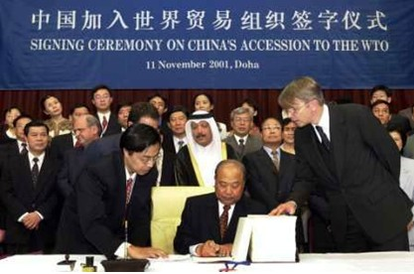
WTO

Slide 23

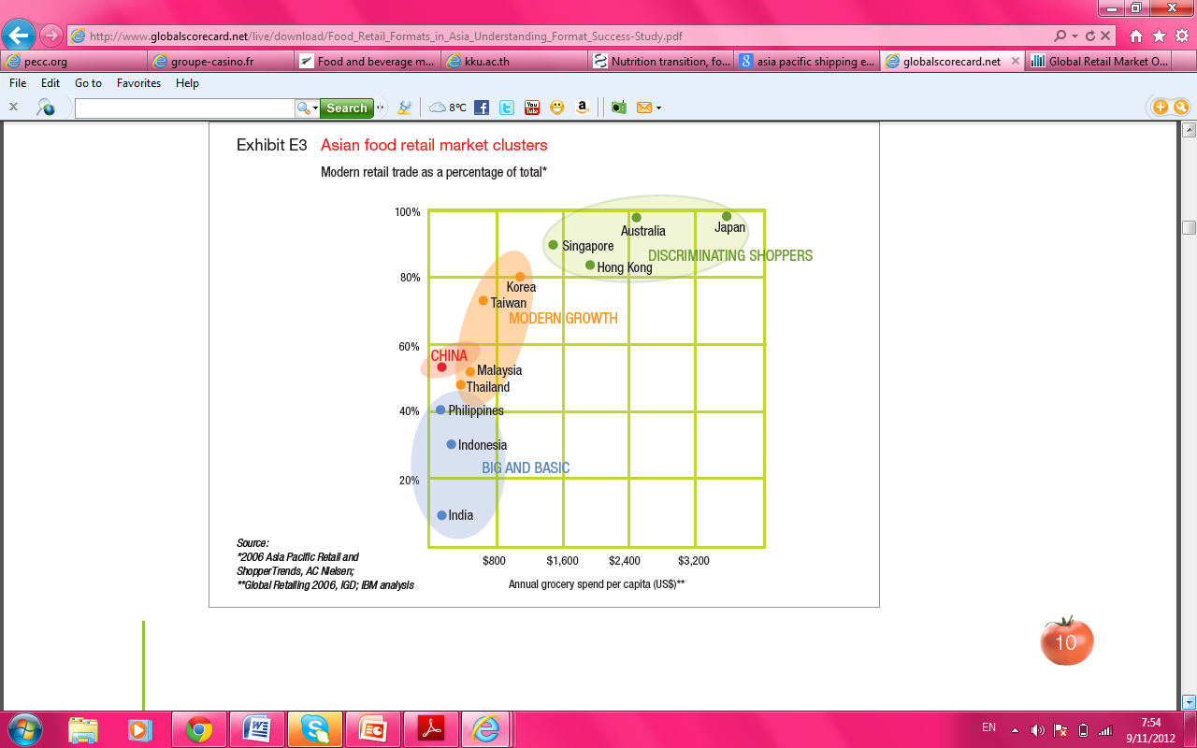
RETAILERS
Asian food retail market clusters
Discriminating Shopper Markets
Multi-Format
Modern Growth Markets
Big and Basic Markets
Source: Food Retail Formats in Asia

Slide 24
Implications of supply chain modernisation
On supply chain organisation
  Tight vertical control
  Private standards
  Centralised purchasing, warehousing and distribution
  Product differentiation and sophisticated marketing
On supply chain actors
  Opportunities and threats to domestic farmers, processors, distributors and retailers
On consumers?
  Have the observed changes caused consumption shifts or responded to them?
  Much less well understood!

Slide 25
Hypotheses of why food system changes have an ‘additional’ impact on consumption
They lower the price of processed foods relative to traditional staples and fresh F&V.
They make more foods available (e.g. chilled foods such as dairy products, processed meats, product variety, snack foods, fast foods, soft drinks)
They enhance food safety and quality (enforcement of standards) which promotes consumer confidence in the foods supermarkets sell
They employ sophisticated marketing, often targeted at children, to encourage a preference for western foods
Implications: diets are more diverse, deliver cheaper energy, enhanced micronutrient availability, but processed/fast foods are often energy dense with higher levels of salt, saturated and trans fats. NB. In general consumers derive pleasure from these developments!

Slide 26
Some policy implications:
Harness the good, avoid the bad
Continued liberalisation of markets (trade, investment, institutions) will contribute to supply chain modernisation and the benefits (and costs) this can bring
Modern supply chains offer opportunities for delivery of micronutrients through dietary diversity and fortification
Governments should work with industry to promote reformulation (reduced salt, saturated and trans fats, sugar)
Take early steps to minimise/reverse trends in over-nutrition—information and market intervention measures.

Slide 27

Thank you for your attention!

