Slide 1
Population nutrient and dietary goals for health
How can agriculture and the food systems respond?

Slide 2
Population Nutrient Intake Goals
(TRS 916)
Recommended Population Nutrient Intake Goals (as a share of total energy intake)
Dietary Factor | Recommendations (WHO/FAO)
Total Fat | 15 - 30%
Polyunsaturated FA | 6-10 %
Saturated FA | <10 %
Trans FA | <1 %
Total Carbohydrate | 55 – 75 %
Free sugars* | <10 %
Protein | 10 - 15%
* “Free sugars” refers to all monosaccharides and disaccharides added to foods, plus sugars naturally present in honey, syrups and fruit juices
Notes:
These are Population Nutrient Intake Goals

Slide 3
http://www.fao.org/docrep/005/ac911e/ac911e00.htm
Population Nutrient Intake Goals
(TRS 916)
Recommended Population Nutrient Intake Goals (in g or mg/person/day)
Dietary Factor | WHO/FAO Recommendations
Cholesterol | < 300 mg/day
Sodium chloride (sodium) | <5 g/day (<2 g/day)
Fruits and vegetables | > 400 g per day
Total dietary fiber/Non-starch polysaccharides (NSP) | (>25 g, or 20g/d of NSP) from whole grain cereals, fruits, and vegetables

Slide 4
Recommended Dietary Guidelines (WHO, 2004)
Dietary recommendations for populations and individuals should include the following:
achieve energy balance and a healthy weight
limit energy intake from total fats and shift fat consumption away from saturated fats to unsaturated fats and towards the elimination of trans-fatty acids
increase consumption of fruits and vegetables, and legumes, whole grains and nuts
limit the intake of free sugars
limit salt (sodium) consumption from all sources and ensure that salt is iodized

Slide 5
Recommended Dietary Guidelines
Consumption of fish and marine products at least twice a week
Restrict consumption of red meat (processed and unprocessed)
These recommendations need to be considered when preparing national policies and dietary guidelines, taking into account the local situation.
Improving dietary habits is a societal, not just an individual problem. Therefore it demands a population-based, multi-sectoral, multi-disciplinary, and culturally relevant approach.

Slide 6
Priority of objectives
Increase availability
Improve quality, diversity, micro-nutrients
Improve access, including within households
Increase food safety/utilization
Increase stability/resilience
Improve sustainability (production/consumption)
Address issues of under and over nutrition

Slide 7
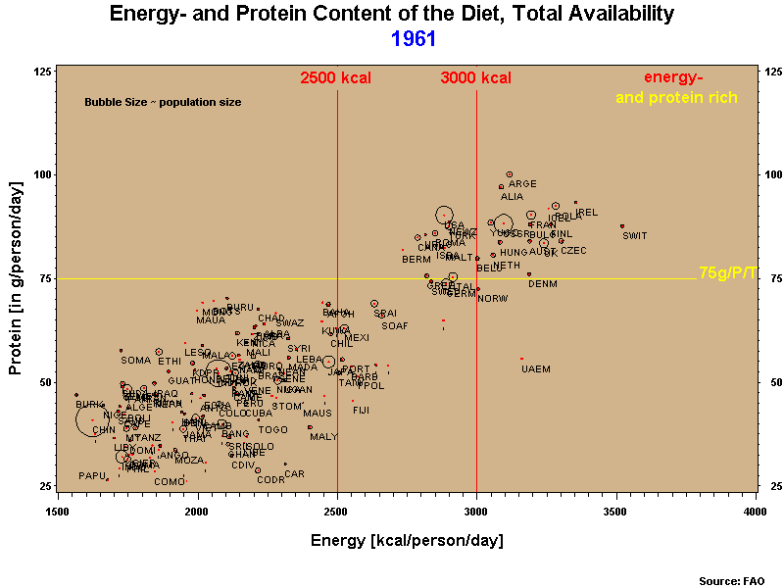
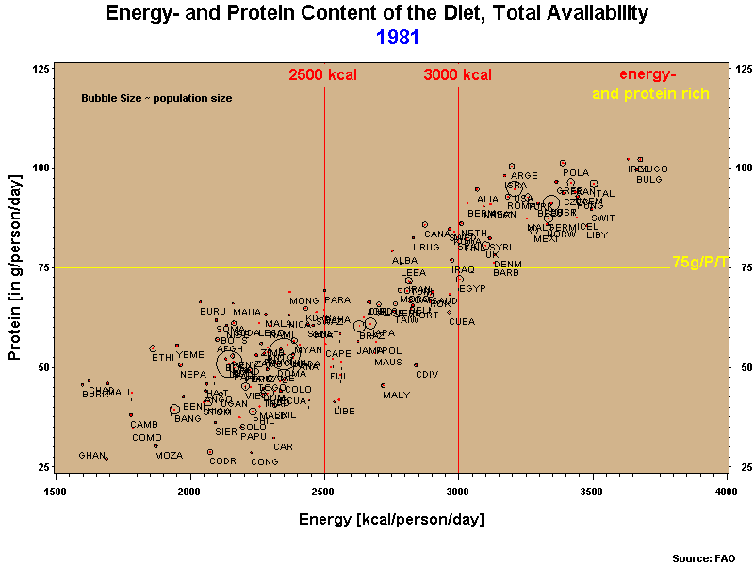
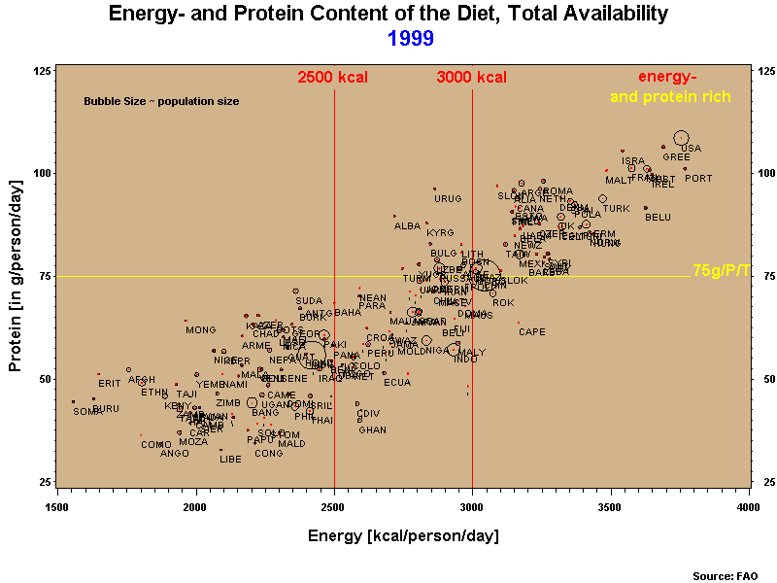
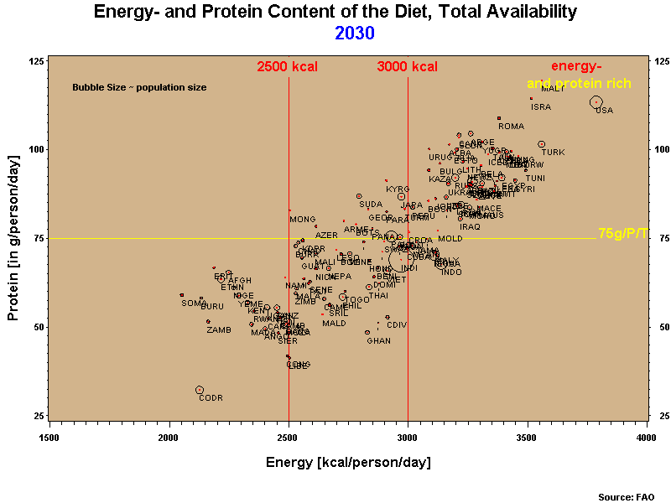
Figure 4a/b/c/d: Energy and protein availability, 1961, 1981, 1999, 2030
Schmidhuber & Shetty, 2005

Slide 8
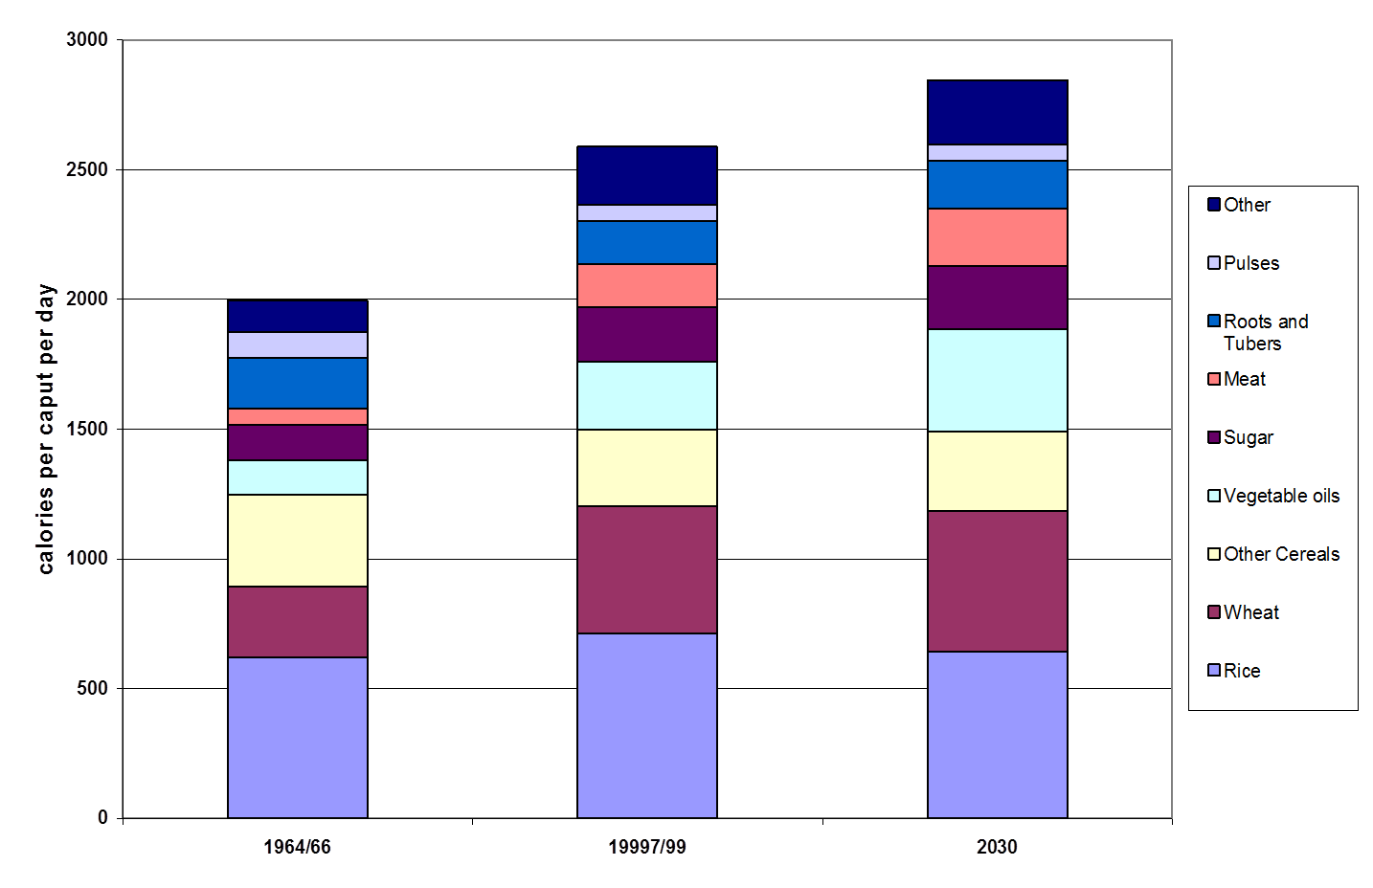
Changes in the structure of diets (1960 – 2030) (World agriculture: towards 2015/2030)

Slide 9
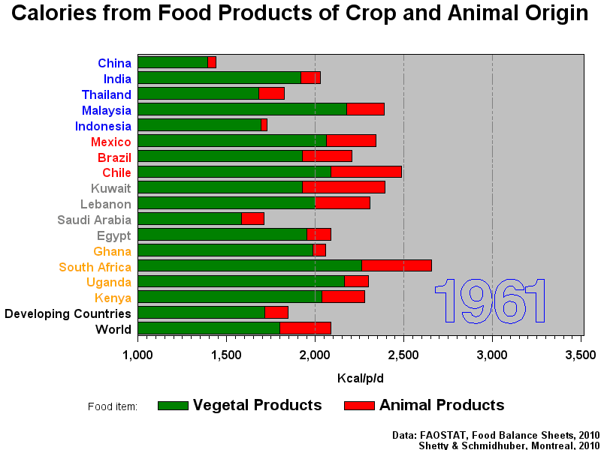

Slide 10
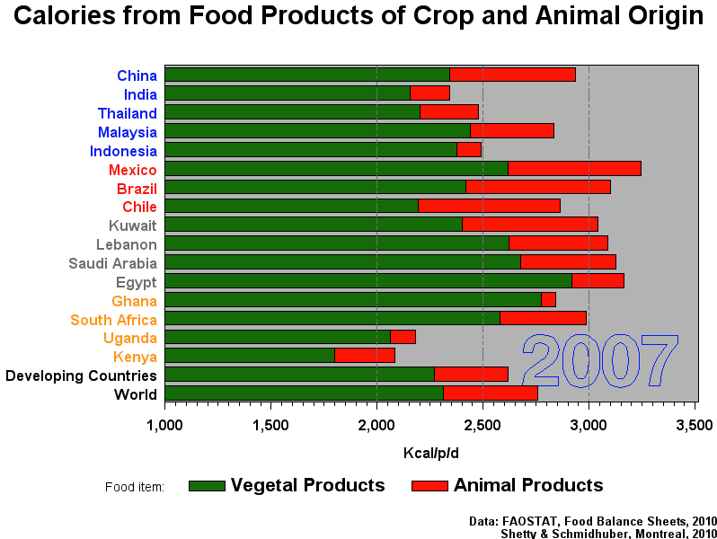

Slide 11
Per capita meat consumption increases with income
Uruguay
USA
Bolivia
Sweden
Saudi Arabia
Albania
China
Japan
Somalia
Turkey
Ethiopia
Indonesia
Rwanda
Burundi
India

Slide 12
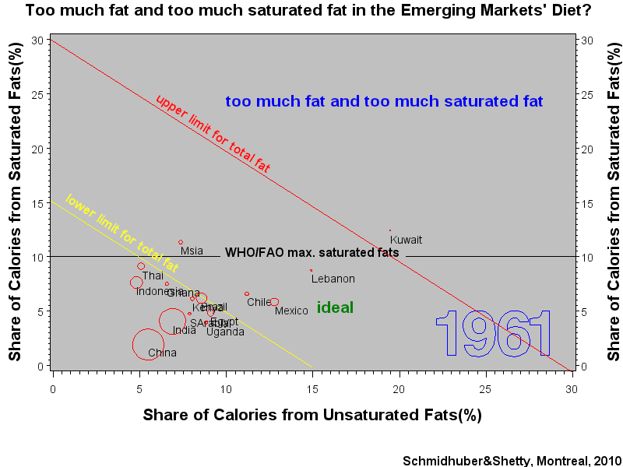

Slide 13
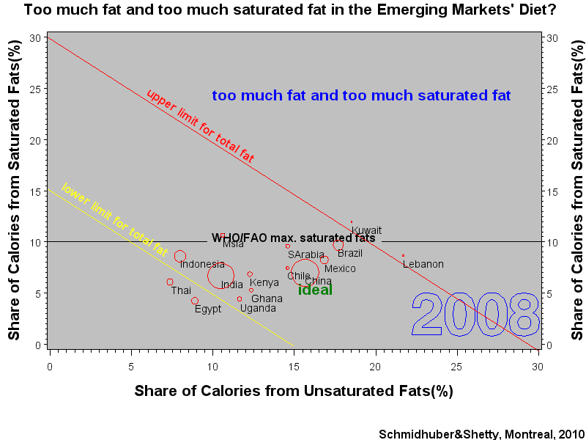

Slide 14
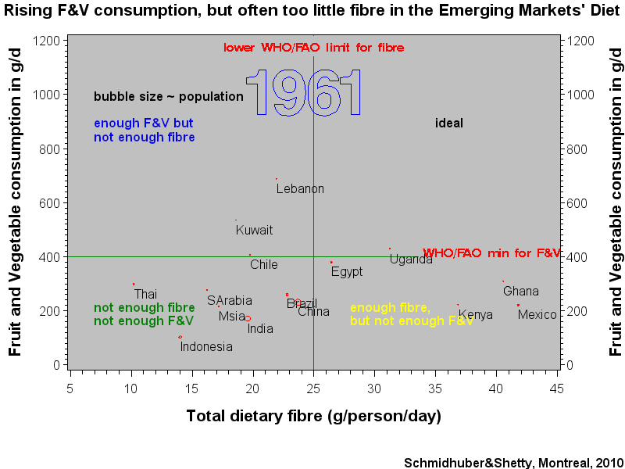
Notes:
This one shows how the AD diets became to rich in free sugars and too poor in overall carbohydrates. Both developments are typically associated with negative developments
Watch on POR/ESP

Slide 15
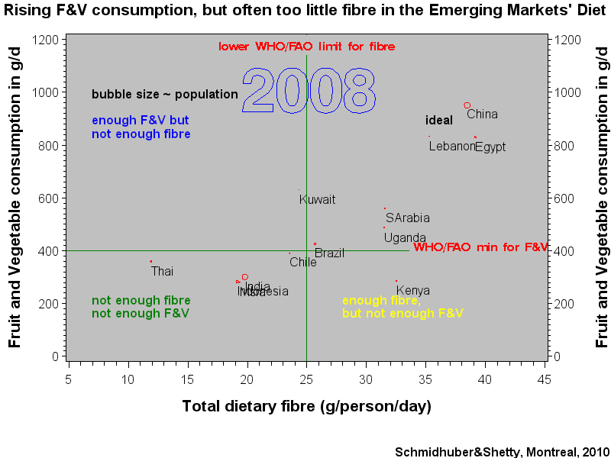

Slide 16
Global and regional trends in supply of vegetables (kg/capita/year)

Slide 17
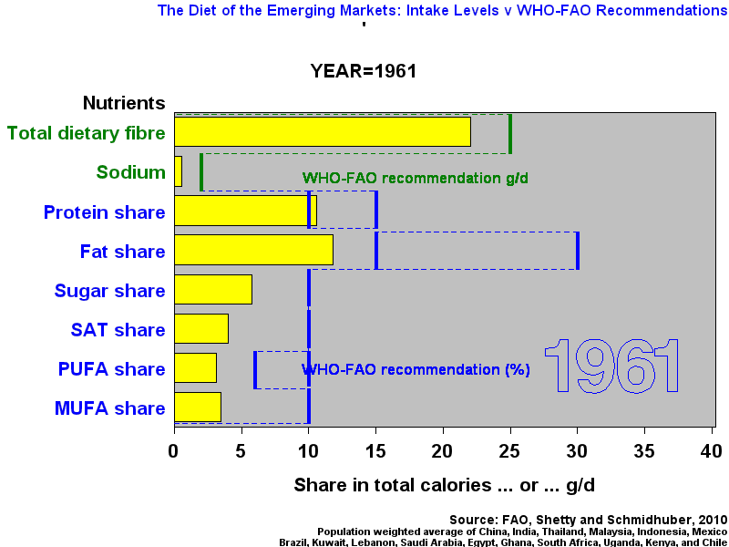
Nutrient Intake trends vs TRS 916 PNI guidelines
Notes:
This one shows how the AD diets became to rich in free sugars and too poor in overall carbohydrates. Both developments are typically associated with negative developments
Watch on POR/ESP

Slide 18
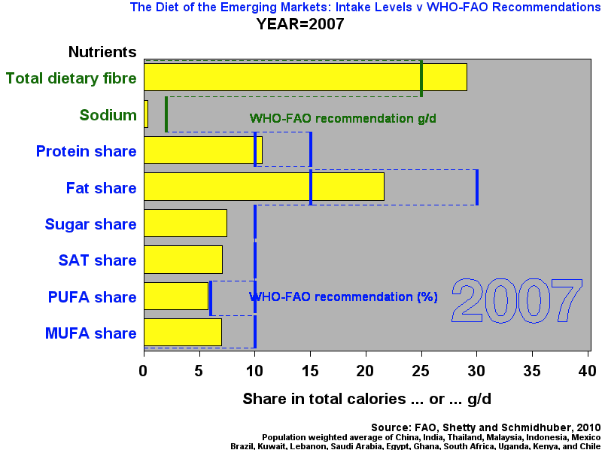

Slide 19
Monitoring requires information of the distribution: e.g. the 10% sat fat goal
PNI goal 10%
Mean:15%, cv=0.29
f_{x}(x | _{mean, cv,})
Notes:
Let’s summarize the issues identified so far with a schematic illustration of how the various parameters determine the PoU under a probability density function (pdf), (log-normal, skewed log-normal)

Slide 20
Agriculture vs Food Systems
From Farm-gate to Plate:
WHO Recommendations on Salt (and sodium) intake
WHO deliberations of upper limit for intakes of free sugar
Food systems beyond the farm gate have significant impact on intakes of salt and sugars

Slide 21
National average ‘apparent’ food consumption trends from FAOSTAT indicate:
Increasing energy intakes and free sugar intakes
Increasing contribution from animal foods
Increasing fat intakes, SFs and PUFAs, sub-optimal fatty acid ratios
Improving F&V availability and consumption
Progressive convergence of dietary consumption patterns globally

Slide 22
Agriculture and food policies and nutritional guidelines

Slide 23
Influencing the role of agriculture in nutrition in this century
There is a need to understand the CONTEXT
Recognise that IMPACTS of policies that affect agriculture and food systems may be different in different contexts
Be aware of the TRADE-OFFS and opportunity costs
Be aware of LINKAGES and appreciate the COMPLEXITIES

Slide 24
Context 1: A long food chain: Industrial agricultural and industrial food processing in the US
~8000 food products for a consumer in the US
8 major food groups
~80 crops and livestock activities
Notes:
SR 26 of USDA shows 8463 different food items

Slide 25
Context 2: Short food chain: subsistence production in LDC
~80 food products for a consumer in Mali
8 major food groups
~80 crops and livestock activities

Slide 26
Concluding comments
Food availability and diversity and hence consumption is increasing.
For monitoring purposes, national averages need to be supplemented with distributional information
‘Agriculture’ impacts on the continuum from subsistence to highly diversified affluent diets
The length of the food chain from farm-gate to plate has a much greater impact
Policies and recommendations: Analyse the situation, understand the context, measure impacts within the context, recognize trade-offs, appreciate complexity.

