Slide 1
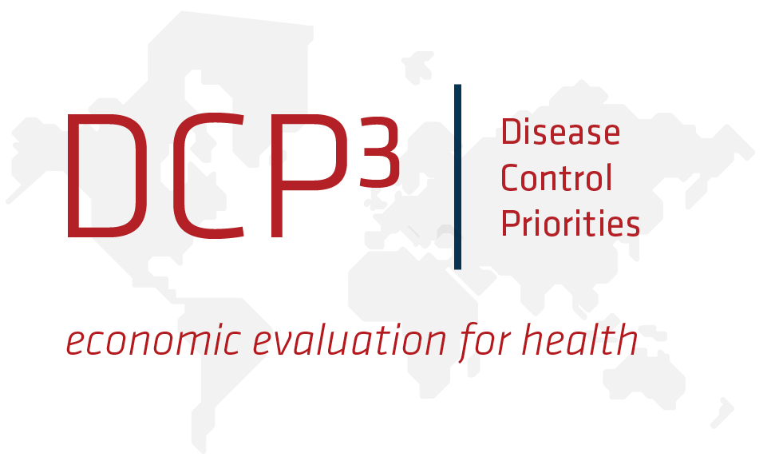
The Cost of Changing the Food Supply
ICN2 Prep Consultation, Rome
November 14, 2013
Rachel Nugent, Director, DCPN
University of Washington
Department of Global Health
Seattle, WA
Notes:
Thanks to WHO and FAO for the invitation to speak and to Franco for organizing this session. Even though it’s the end of a long two days and I’m feeling the 9-hour time difference, I think this is a very important session. I will tip my hand and say that I think we need to infuse economics into all aspects of ICN2 and not save it for the very end.
I was asked to speak about the costs of supply side changes for improving the food supply.
I want to make two points first about the topic before sharing some thoughts.
it’s better to talk about investments than costs. The words go down more easily, and we need to think about this effort in investment terms: over time, what are the returns and how do we measure them, and who benefits?
Point two: we ought to be talking about the costs of NOT changing the food supply. It’s really a societal issue, not just a farming issue. So I’m going to talk about supporting farming for the benefit of society, and a few ideas for doing that.

Slide 2
The Cost of Changing the Food Supply
ICN2 Prep Consultation, Rome
November 14, 2013
NOT
Rachel Nugent, Director, DCPN
University of Washington
Department of Global Health
Seattle, WA
Notes:
As Francesco and others said yesterday: the healthy-ness of the food supply is a development issue.
In 30 years obesity has doubled around the world:
15% adults in China
10% adults in India
28% women in SA
49% women in Russia
47% adults in Brazil
Not to mention US, Mexico, other countries that are supposed to be already developed
If this is what transpires as countries develop, what kind of development is this? And why are we working toward it? A paper coming out soon on obesity in BRICS with nationally representative and comparable data shows clearly the associations of o/w and obesity with HT, angina, arthritis, and diabetes.
What are the costs of these health conditions? $47 trillion from NCDs globally between now and 2030 (Bloom et al), CVD costs in US are $273 billion direct per year and $172 billion in productivity losses. Projected to grow to $818 by 2015.
And there are multiple ways to deal with these diseases. For instance, many low-cost drugs available to treat hypertension, diabetes, and heart disease. But even cheap drugs are not always available and affordable.
So what else can we do? We always know that more F&V are good—for problems of both under- and over-nutrition, to answer one of Jeff Waage’s points yesterday. So I’ll just focus on that in my suggestions about agricultural investment in supply-side change, but a main point I’m making is: there are opportunities for agriculture if we provide the enabling environment and incentives for the right investments to be made – we can’t just rely on health solutions to achieve the kind of development people want.
What should we do?

Slide 3
Economic and health benefits of changing the food supply
Fruits and vegetables in U.S.
Save 127,000 lives
Reduce health care costs by $17 billion
Produce $11 trillion in lives saved (VSL method)
Source: Union of Concerned Scientists, 2013
Notes:
This illustrates the need to understand the costs of NOT changing the food supply.
If we meet the RDAs for F&V, we will gain lives, health, money.
And in the US, demand is rising for agriculture to contribute to health:
Farmers markets rose from 340 in 1970 to 7864 in 2012 (AMS)
Farm-to-school programs rose from 6 in 2001 to 10,000 in 2013
So that’s a bit of encouraging news, and Sergio gave us a nice framework earlier for understanding the implications.

Slide 4
Main points
Compare the appropriate costs and benefits
What are the possible trade-offs?
What is the right baseline? Not status quo
Consider not just health benefits, and not just ag costs
Make the investment case (cross-sectorally)
Different roles and responsibilities for public vs private sector
Notes:
So to my main points.
As Marie pointed out this morning, the economic analysis to be done is not only within the ag and food system
What is the right investment case?

Slide 5
Expenditures on ag/food subsidies
HICs spent $252 billion in 2011 on agricultural and food subsidies (EU, US, Japan, So. Korea).
CAP still absorbs 40% of EU budget (Anderson et al, 2013)
2013 US Farm Bill: direct payments of $4-18 billion/year on commodity crops (corn, wheat, soybeans, cotton, rice), >$9 billion/year in crop insurance subsidies.
Ag taxation shifting into ag subsidization (India, China)
Notes:
It’s useful to remind ourselves that in some places, we are already spending (not investing) a lot in agriculture. My point is not to take issue with these particular farm subsidy programs (although I do), but to suggest that because a lot of ag inputs are reasonably substitutable in production, there may be some room for shifting within the envelope of ag subsidies.
An important new point is that this is increasingly happening in MICs.
Anderson/Rausser/Swinnen give good empirical evidence that the anti-agricultural policies of the past in LMICs are disappearing. They attribute the changes to income growth, (some) political reform, and growth in mass media (Anderson, Rausser, et al, 2013). It’s not that there is no interference in the ag sector, rather, it appears that ag taxation shifts to become ag subsidization, reflecting a new political equilibrium in some countries. We see this in India, Indonesia, and China, and elsewhere.

Slide 6
Role of Ag Investment
Private sector requires
Competitive returns
Term-limited (usually short)
Capturable gains
Public sector should produce
Social returns, broadly distributed
Over a long time horizon
“Enabling environment”
Aligned incentives
Avoid social harms
Notes:
As we look at all these examples, how should we understand the role of ag investment?
In the strictest sense, investment is spending that produces some return – a benefit in the future. For instance, longer lives.
In order to compare and prioritize investments, that return must be measurable, and we should measure it with the right factors included.
The main point here is that private and public investments have different goals, but both are necessary.
Don’t neglect private sector. But government funded research and demand-creation can also help inform where the private sector spends its money
In discussing a few specific investments needed for changing the food supply, as I said, I’m going to focus on F&V–there are BIG opportunities here, and some encouraging signs. It’s the proverbial “low-hanging fruit (and vegetables)”
Where do we start? We know we need more. A majority of Americans, on average, are eating half as many vegetables as they should. We eat less than half the recommended amount of fruits. (2010 assessment published jointly by the Departments of Agriculture and Health and Human Services)
And work being undertaken at Emory University on F&V supply relative to need is showing that is true in almost all countries. And this is consistent with the findings of the 2010 GBD, based on hundreds of surveys gathered from countries across the world. So, while the opportunities to produce F&V vary (Per’s point about needing to contextualize), with the right investments, we can get closer to meeting needs almost everywhere. And we need to try even in the difficult environments, not with autarky, but by increasing capacity.

Slide 7
What investments are needed for F&V Production?
Farm Level
Societal Level
Labor or labor-saving mechanization
Irrigation
Agribusiness services: financing inputs, technical assistance
Small-scale post-harvest storage and processing
Risk management advice
R&D for productivity enhancement
Upgrade traditional markets
Crop insurance
Market infrastructure: distribution facilities, loans, marketing programs
Notes:
Here are some examples of what’s relevant for farm-level and for societal-level ways to increase F&V production.
For instance, the traditional markets and distributional infrastructure that Miguel mentioned this morning. We don’t have much of this kind of investment available for F&V farmers in the US – therefore, it’s not a surprise that in the US there are 97 million acres planted in maize, 240,000 acres planted in green leafy veg. AFT estimates we need 13 million more acres of farmland planted in veg to produce sufficient supply to meet RDAs.
Investment in traditional markets is growing as I’ll mention momentarily

Slide 8
Comparing Investments
Private Sector
R&D
$2 billion/year maize (Monsanto, DuPont Pioneer)
$181 million/year for 22 vegetable crops (Monsanto)
Commodity Marketing
$300 million/year for dairy and livestock
Public Sector
R&D
$121 million/year for maize
$13 million/year for green leafy vegetables
Commodity Marketing
5-a-Day
$7 million (est.) required for a major marketing campaign
Notes:
What are we doing? (apologies for all the US examples ….) For F&V, these two areas are vital.
Productivity-enhancing R&D – most of the funds coming from private sector, where should the government strategically invest? Have they taken advantage of all opportunities? There are numerous efforts that can be examples at the ICN2 next year. For instance, BMGF is leveraging additional social R&D by partnering with private sector to support smallholders to participate in value chains – the traditional to modern ones we heard about earlier.
Marketing:
The private sector spends millions for certain commodity marketing programs.
The Government’s 5-a-Day program is also in the millions – tens of millions of $$, not hundreds of millions
Check-offs, there just hasn’t been enough money for marketing fresh F&V.
in 2009, the produce industry weighed a proposal to create a much bigger kitty, a $30 million annual fund that would require a minuscule 0.047 percent levy on their crops. The farmers rejected the plan for various reasons, including the worry that it still paled by comparison with the livestock and dairy industries’ $300 million.
However, there is progress here as well. One example is the marketing of baby carrots (Baby Carrots: Eat ‘Em Like Junk Food.”)
The creator of that program (used to be with Coca-Cola) told a crowd of more than 1,000 at the Produce Marketing Association convention: “We must change the game. We can help solve the obesity crisis by stealing junk food’s playbook, by creating passion for produce, by becoming demand creators, not just growers and processors.” The association’s president, has said they soon would announce their new initiative. “We have a unique opportunity now, when the stars have aligned and public opinion is starting to show signs of change in dietary habits,” he said. “This is a real tipping point.”
“

Slide 9
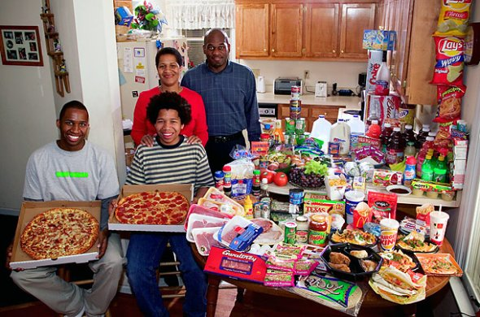
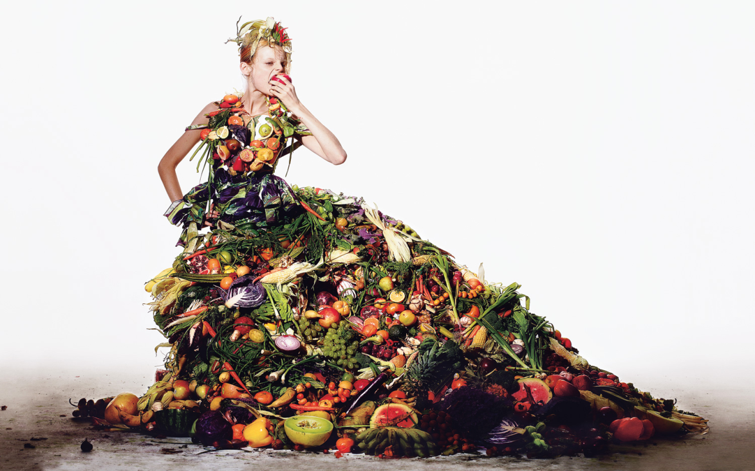
“Good” or “Bad” policies?
Consumer subsidies: staple food provision, CCTs, home gardens, food vouchers/credits, school feeding
Regulatory: nutritional guidelines, institutional nutrition programs (schools, etc.), nutrition education
Producer: price supports, direct income payments, insurance guarantees
Regulatory: land use, production quotas, marketing restrictions
Notes:
How do we answer the “HOW” question that Per raised?
In addition to professional marketing (sorry, 5-a-day people), we have a lot of tools at our disposal. We DO have the instruments. What we don’t have is the political will to use them to achieve our objectives. So, how should we use these policies?

Slide 10
Factors influencing policy impact on health
Size (adequacy and stability of payments)
Targeting (efficiency and equity)
Elasticities (substitution effects)
Barriers to altering choice set of producers and consumers
Administrative costs
Political acceptability
Notes:
Need to analyze these aspects in order to come up with good policy design.
And, we need to do costing – in situ. We have all kinds of programs in place in ag and nutrition (and health too) that we have virtually no cost-benefit analysis for, not even cost-effectiveness, in fact, not even costing! We simply can’t afford to not know the costs, which takes me to where I started: what are the costs of changing the food supply, and what are the returns?

Slide 11
Conclusions
Move towards a “do no harm” stance
Urge transparency in policies (politicians choose inefficient tools if they can be less transparent-EWG)
Can discriminate among heterogeneous producers, but more distortionary
In the short-run, for health purposes, prefer nutrition subsidies to ag commodity subsidies
In the long-run, need allocative shifts in ag (probably not with a health rationale, maybe a development one would fly)
Notes:
My conclusions – changing the food supply doesn’t happen overnight. It took a lot of bad decisions to get where we are today!

