Slide 1
Value chain : THAILAND
Back Ground Study
Amporn Laowapong
Economist, Senior Professional
Department of Fisheries
Ministry of Agriculture and cooperative
Thailand
FAO Value chain project workshop
The university of Tokyo
9-11 December 2011

Slide 2
Content for Today : Selected species
1. Fishery Industry of Thailand : Supply & Utilization
2. Main species of Thai Production and Import
3. Species of the study ????
Are impact to small scale of Thai fisherman or others ?
( I need your commentation)

Slide 3
1.Supply(Production +Import)
3.82 +1.59=5.41MT

Slide 4
2. UTILIZATION

Slide 5
Supply
(Prod 3.8 MT+
Im 1.59 MT)=5.39 MT
Intermediated
Demand
Do2.68 +Ex1.78 +
Fmeal 0.93=5.39MT)
1.Marine Capture 2.2 MT
(57.9%) (Food 1.6 MT+
Trash Fish 0.6MT)
2.Marine Culture 0.9 MT
(23.7%)
3.FreshWater Culture
0.5MT(13.2%)
4. Fresh water Capture
0.2 MT (5.2%)
(1.62+1.56 +0.02+0.6
= 3.8 MT)
3.8 MT
Domestic Market
(1.62+0.19=1.81MT)
Domestic
Consumed
(1.81
+0.88 +0.08
=2.77MT)
1.81 MT
1.62 MT
0.19 MT
Exported
(0.02+
0.65
+1.11 MT
=1.78)
0.02 MT
Processing Plants
(1.56+1.4=2.96 MT)
(0.88+0.08+0.65+1.11+0.24
= 2.96 MT)
1.56 MT
1.4 MT
1.76 MT
0.24 MT
0.96 MT
Imported 1.59 MT
(0.19 + 1.4 =1.59 MT)
Fish Meal
Industry
(0.6+0.24
= 0.84 MT)
0.6 MT
Fisheries Supply Chain of THAILAND

Slide 6
1.Production 3.82 MT

Slide 7
1.1 Production : Marine Capture
1. Fish 62%
2. Crustaceans 21%
3. Cephalopod 17%

Slide 8
1.2 Production :Marine Capture Species
1. Indo Pacific Mackerel : Fresh , Frozen
2. Anchovy : Fish sauce and dried
3. Big eyes : Surimi

Slide 9
1.3 Production : Marine Culture
1. Shrimp (Vannamie , Black Tiger) 60%
2. Shell Fish (Green Mussel, Bloody Cocker ) 36%
3. Fish (Seabass, Grouper)4%

Slide 10
1.4 Production :Fresh Water Culture
1. Tilapia 32%
2. Cat Fish 19%
3. Others ( Carp, snake head, prawn) 49%

Slide 11
2. Import : Products
1. Frozen Tuna 52% for Canning
2. Chill & Frozen Fish 38% for surimi
3. Chill & Frozen Cephalopod 4% for Frozen
4. Others Products 6% for domestic market

Slide 12
3. Criteria to selected Species : 3 level of price collected
Value Chain :
1. Wild Capture
  1.1 Production
    Indo Pacific Mackerel
  1.2 Import
    Tuna
2. Culture
  2.1 Marine Culture
    Sea bass
    Vannamie Shrimp
  2.2 Fresh Water Culture
    Tilapia
    Catfish
1. Species mainly for
Domestic Consume
  1.1 Tilapia
  1.2 Catfish
  1.3 Sea bass
  1.4 Indo Pacific Mackerel
2. Species mainly For Export
  2.1 Shrimp
  2.2 Tuna

Slide 13
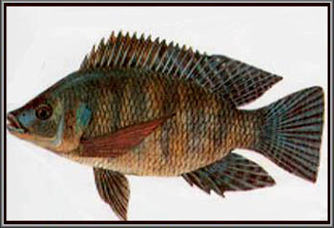
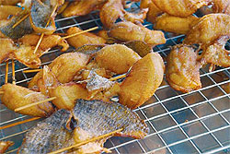
Value chain : Tilapia (Oreochromis nilotica)
Fish Agents
(1.3$)
Wholesale
(1.4$)
Retailers
(1.8$)
Tilapia
Culturelists
(1.2$)

Slide 14
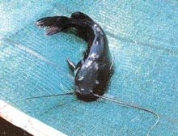
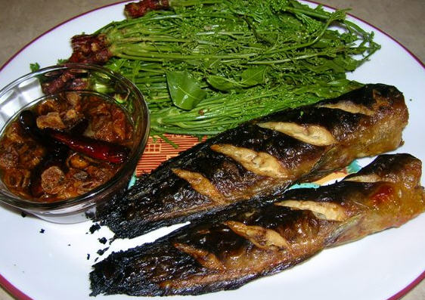
Value chain : Catfish (Claras batrachus)
Fish Agents
(1.5$)
Wholesale
(1.6$)
Retailers
(2$)
Catfish Culturelists
(1.3$)

Slide 15
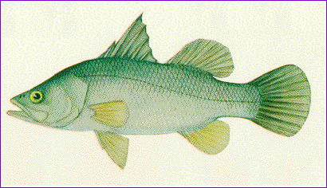
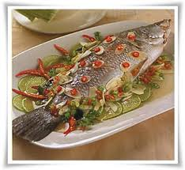
Value chain : Seabass (Lates calcarifer)
Fish Agents
(3$)
Wholesale
(3.2$)
Retailers
(4.5$)
Seabass Culturelists
(2.7$)

Slide 16

Value chain : Indo Pacific Mackerel
Fish Agents
(0.22$)
Processing Plants
(0.33$)
Retailers
(1.0$)
Fishermen
(Large and small scale)
(0.2$)

Slide 17
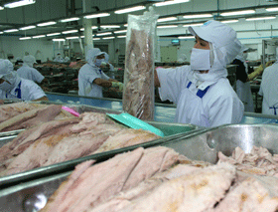
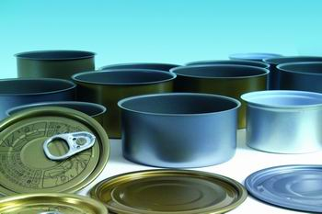
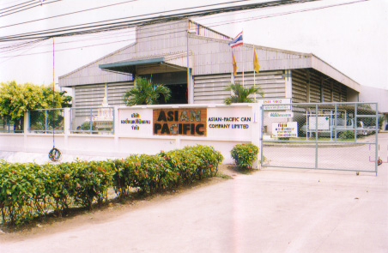
Value chain : TUNA
Processing Plants
(1.21$)
Exporters
(1.25$)
Retailers
(1.35$)
Tuna
Importers
(1.2$)

Slide 18
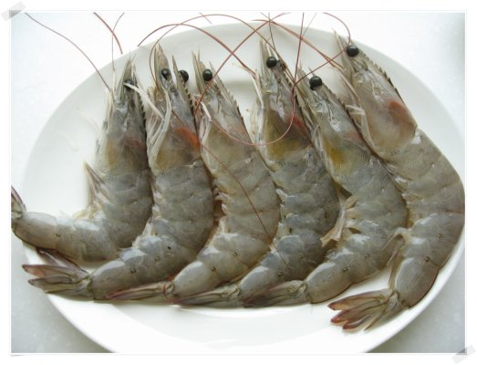
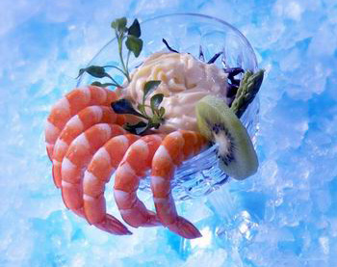
Value chain : Vannamie Shrimp
Shrimp Agents
(3.5$)
Processing Plants
(4.5$)
Exporters
(6$)
Shrimp Culturelists
(3$)

Slide 19
Conclusion : Species for The Study
For Domestic Consumed
  Tilapia
  Cat Fish
  Sea bass
  Indo Pacific Mackerel ????
For Exported
  Vannamie shrimp : impact to small scale fisheries in case of shrimp price, shrimp gill net gear and other fish price
  Tuna Canned ?????
  *****What are you interest ?
  Impact to Small scale Fishermen?********

Slide 20
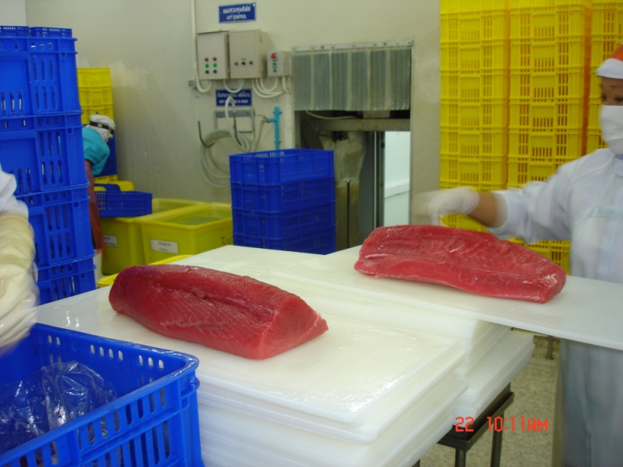
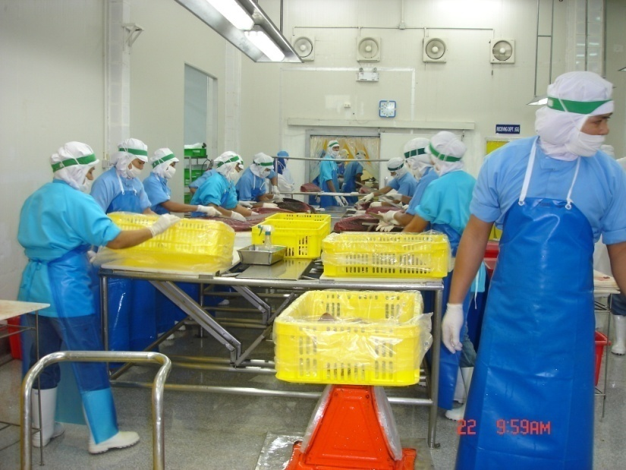
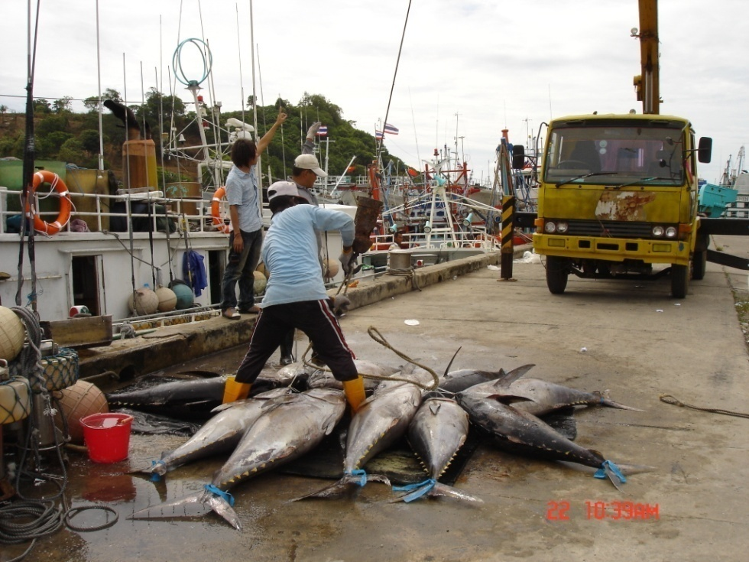
Thank you very much for your attention

