Slide 1



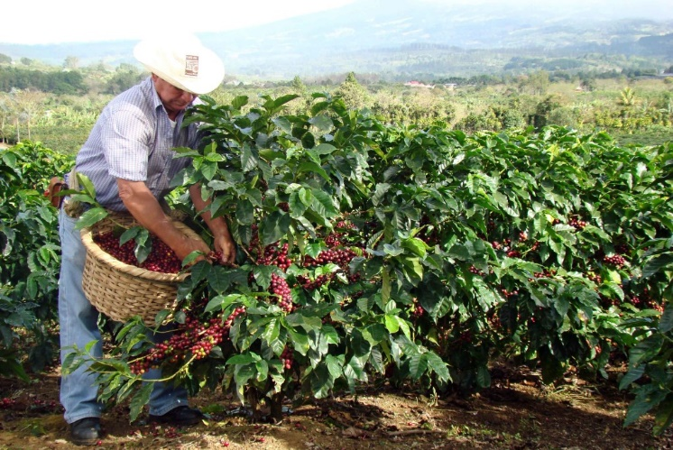
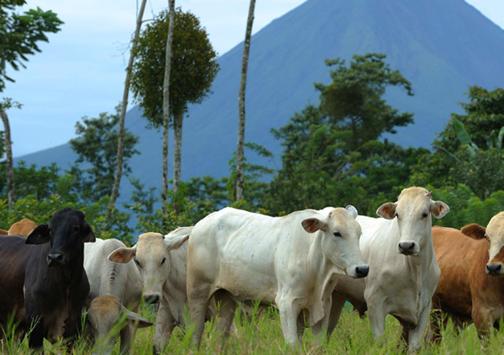
Climate Smart Agriculture in Costa Rica
June 15, 2016
Roberto Azofeifa (MAG), Kelly Witkowski (IICA), Raffaele Vignola(CATIE)

Slide 2

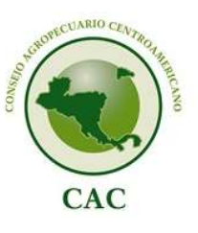

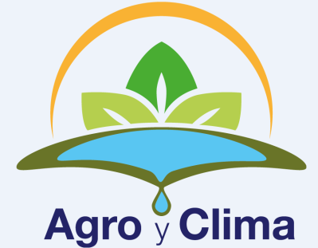
Regional Enabling Environment supporting CSA in Costa Rica
Central American Integration System
  Central American Commission on Environment and Development
  Central American Agricultural Council
    Technical Group on CC and Integrated Risk Management
    Policies/Strategies
      CA Ag Policy, ECADERT, ERAS, FNS Policy, etc.

Slide 3
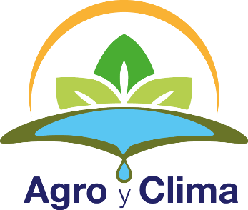




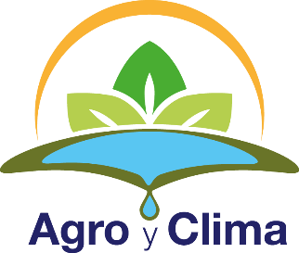



CAC: Technical Group on Climate Change and Integrated Risk Management
Est. in 2012
Conformed by a rep. of the Min of Ag. from each country
Coordinated by the CAC’s Executive Secretariat, supported by Interagency Support Group
Regional Declaration on CSA (8/ 2015):
  “prepare a regional declaration to promote CSA…as an option to raise agricultural and fishery productivity, strengthen resilience and support adaptation to CC with the goal of improving food and nutritional security.”

Slide 4
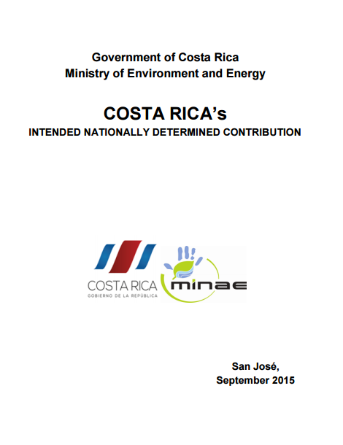
International
  Participation in international initiatives to support achievement of national CSA goals
Active participation of ag sector in negotiations
  Inclusion in negotiating team, sending submissions, side events
GACSA
Global Research Alliance
Bonn Challenge
Initiative 20x20
Costa Rica’s INDC
- Adaptation
- Mitigation
- Means of Implementation

Slide 5
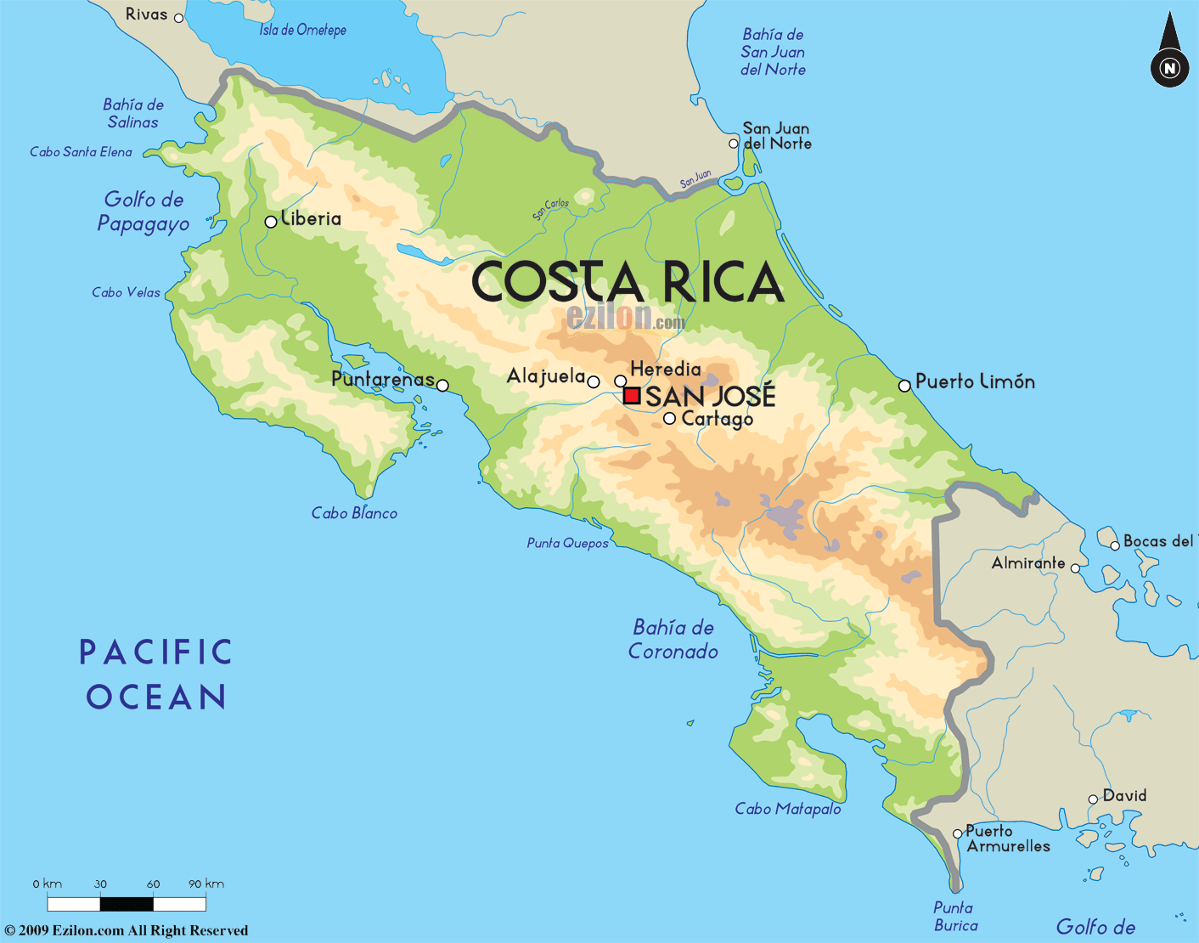
Key Messages
Regional framework enables:
  articulation between different levels
  efficient use of resources
  technical – political interactions
  S-S cooperation
  longer term sustainability and stability for CSA
Costa Rica has demonstrated leadership and proactively involved itself early on in international and regional initiatives to address CC, especially in the agricultural sector
CR leadership has recognized the strategic opportunity presented by CC to achieve efficiency and enhance resilience in their ag sector – and dedicated national resources to this

Slide 6
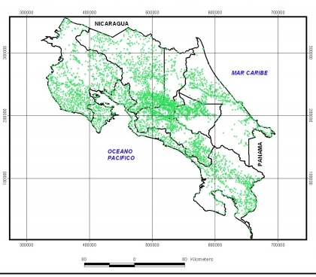
Costa Rica
51.1 thousand km²
4.8 million people
Caribbean
GDP/capita: 10.000 US$
GHGE/capita: 1.7 ton CO_{2e}
53% of land in protected areas
Pacific Ocean
Agricultural sector:
12.6% GDP; 12.3% EAP
45.7% of total exportations
Agriculture: 463.9 thousand ha
Livestock: 1.94 million ha
Main products in terms of land use: coffee, oil palm, sugar cane, pineapple, banana
Main exportation products:
Pineapple, banana, coffee
Total # of farms | 93,017
Total agricultural area | 2,406,418
Average ha/farm | 26
% in pastures | 43.4%
% in forests | 30.6%
% in perennial crops | 15.7%
% in annual crops | 6.9%
% other | 3.4%
Source: National Census 2014

Slide 7
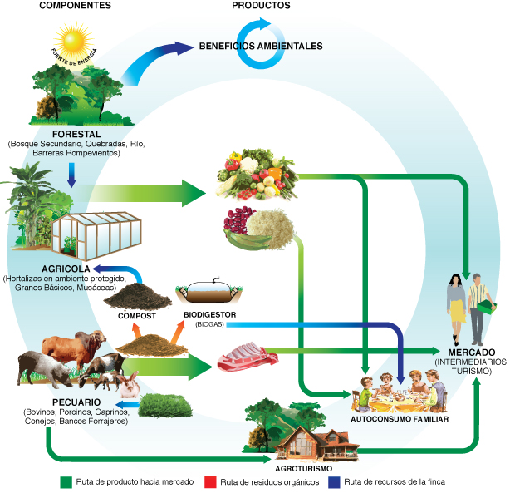
Trajectory of agricultural production in Costa Rica
1980-1990
1990- 2000
2000-2010
2010-2021
Sustainable production fostering
Low emission agricultural production
Climate change strategy
Coffee and livestock NAMAs
Sustainable consumption and production
Legislation for sustainable production
Legislation for organic production
International standards and certifications
Good Agricultural Practices
Costa Rican declaration on Carbon Neutrality
Environmental and agricultural common agenda
GHG emissions and CO2 capture?
Pilot projects on soil and water conservation
Pilot projects on agroforestry
Capacity building on farming research systems: from down to up
Foster intercropping and crop diversification
Environmental legislation; Soil management legislation
Agriculture sector crisis
New governmental programs for agriculture development
Irrigation programs
Fostering of export crops: banana, coffee, flowers, orange, among others

Slide 8
Enabling policy framework
Agricultural Sector: Relationship among the National and Agricultural Objectives and the Sector’s Policies
Reduce poverty and
social and territorial
inequality
Generate greater economic growth and better jobs
2015-2018
National
Objectives
Increase agricultural
added value by enhancing
productivity and sustainable rural development
2015-2018
Agricultural Sector Objectives
Support the national
goal of reducing poverty
Sectorial
Policies
Nutritional and
food security
and
sovereignty
Opportunities
for the
rural youth
Rural
territorial
development
Agriculture
adaptation and
mitigation to
climate
change
Strengthening
of agro-
exporting
sector
Adapted from Sepsa (2014)

Slide 9
Enabling conditions for CSA in Costa Rica
Subject | Regulation | Payment | Extension and research | Tax reduction | Eco-Labeling
Land/Soil use | X |  | X | X
Water use | X | -X | X
Agricultural Organic Residues | X |  | X
Air emissions | X |  | X
Water protection |  | +X | X
Agrochemical use | X |  | X
ESR (Environmental Services Recognition) Organic agriculture | X | +X | X | X
ESR (Environmental Services Recognition) Sustainable agriculture | X | +X | X
PES (Payment for Environmental Services) |  | +X (agroforestry) | X
Ecological Blue Flag Program |  |  | X |  | X
Good Agricultural Practices |  |  | X |  | X
Public legislation and standards | X |  |  |  | X
Private standards |  |  |  |  | X
C-Local Market | X | X
C-Neutral |  |  |  |  | X

Slide 10
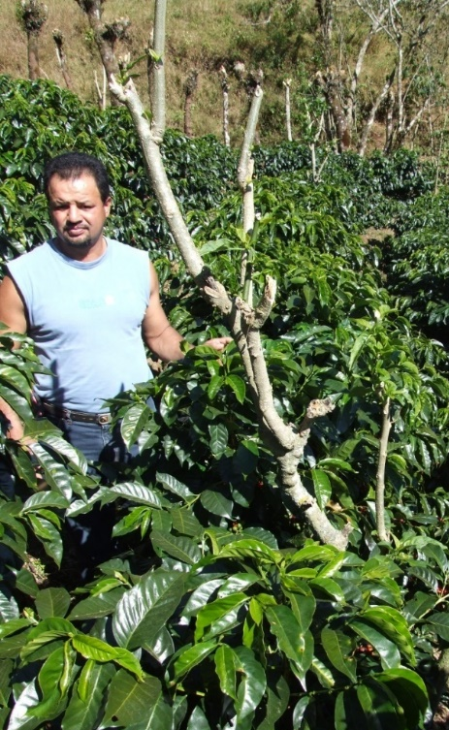
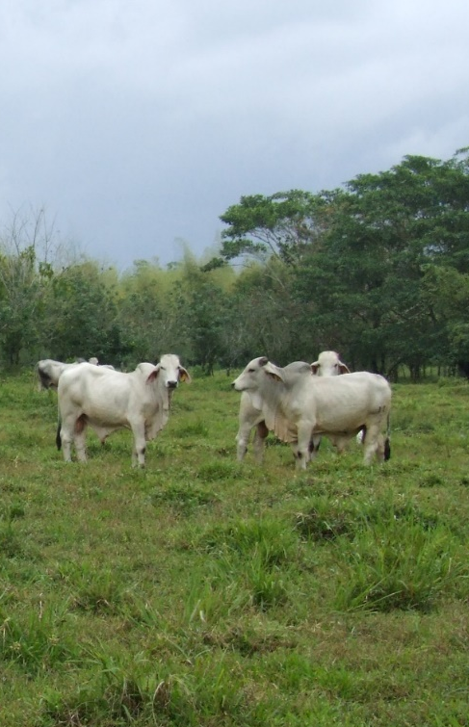
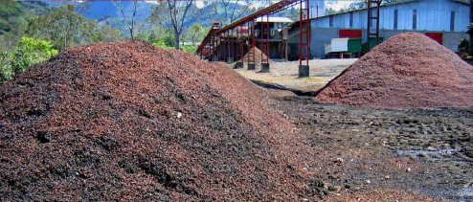
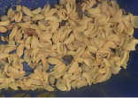
Mitigation Priorities
Coffee NAMA
... toward a low carbon coffee sector
Livestock NAMA
... low carbon strategy for the sustainability of livestock sector
NAMA WAB2E

Slide 11
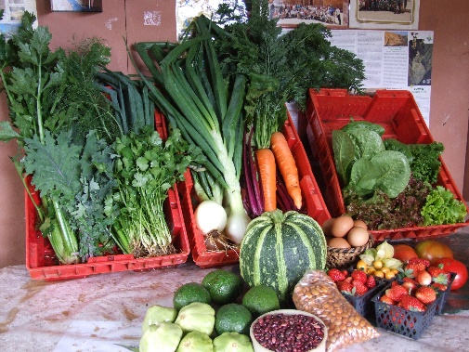
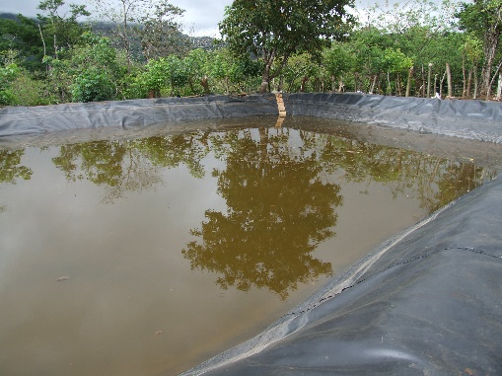
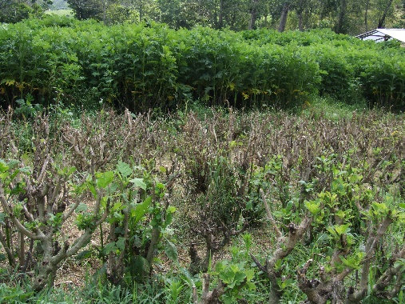
Adaptation priorities
Crop diversification
Water: efficiency in use, water reservoirs, infrastructure for water suply
Forrage banks
Low external input systems
Soil and water conservation
Plasticulture

Slide 12
Opportunities and challenges for scaling up CSA in Costa Rica
Based on WB, CIAT, CATIE (2014): CSA country profile

Slide 13
Smartness and adoption rates for some CSA practices

Slide 14
So, the big question is……….
How can we increase adoption rates?
Increase demand for climate responsible products (certification schemes?)
Revise extension services:
  Few agents need to reach many farmers
  Agents need to combine farmers’ objectives with societal goals
  Taylor made technical, climate and financial services (e.g. Centroclima, a service in construction by CATIE/IUCN/DAI/USAID for the Comite Regional de Recursos Hidricos, )
Education and awareness programs, particularly in relation to
  Use of agrochemicals
  Efficient use of water and energy
  Potential of appropriate use of climate information

Slide 15
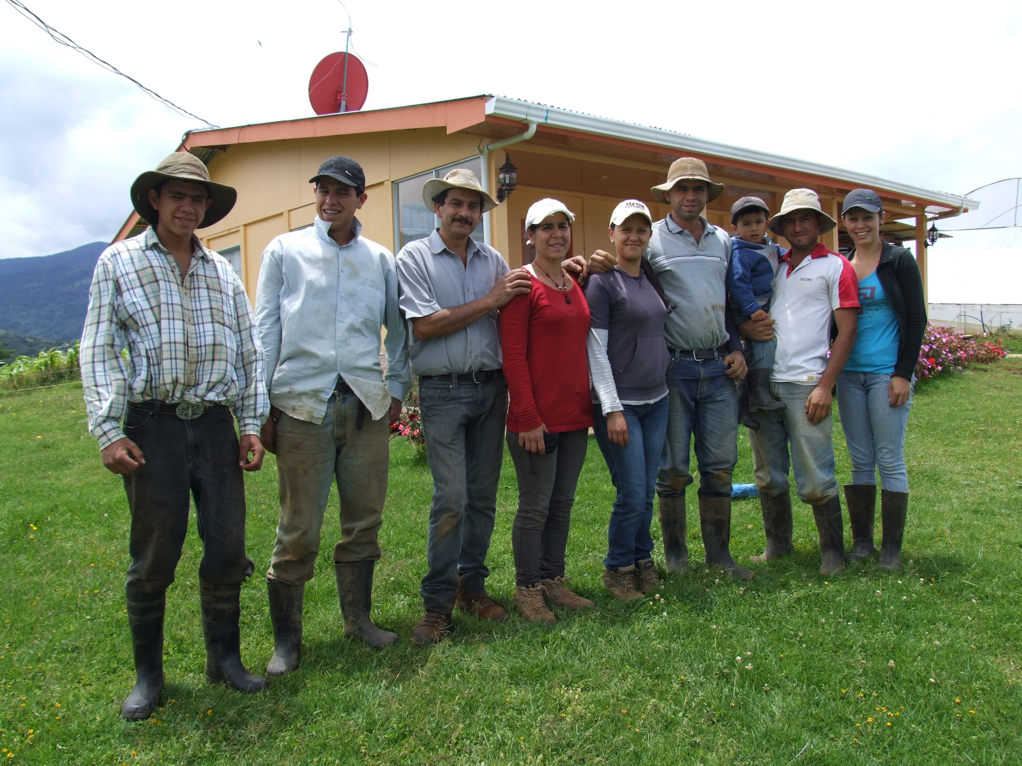
Thank you
With special thanks to:
Manuel Jimenez (SE-CAC),
Claudia Bouroncle, Pablo Imbach, Claudia Medellin (CATIE)
Members of Climate Change Technical Group from MAG who contributed to the Costa Rica Case Study on CSA
Farmer Organizations Members who contributed to the Costa Rica Case Study on CSA
GACSA Facilitation Unit
World Bank
Gomez Cordero Family Agriculture
La Cima de Dota, Costa Rica
Foto: R. Azofeifa

