Slide 1
Priority works areas/products for KAG 2016/2017 Federica Matteoli (FAO) GACSA Annual Forum 14-17 June, 2016

Slide 2
Technical interventions and practices in CSA (e.g. practice briefs). SG 1
Livestock (e.g. manure management): Feed quality and digestibility are major determinants of animal and herd productivity and also affect greenhouse gas emissions from livestock. Improved livestock feeding practices involve improving the quality of forages for ruminants through sourcing or processing, balancing feed component within rations and supplementing the feed provided to animals. CCAFS/FAO
Animal breeding: Selecting preferred animals can yield permanent and cumulative improvements in the population. More efficient animals can greatly reduce greenhouse gas emissions and feed costs. Breeding, including cross-breeding between indigenous and imported species, can also improve resilience to diseases and heat stress and increase reproductive performance. GRA
Report on approach to results-based management of CSA: Documentation of an approach to results-based management of CSA (being piloted by CCAFS).

Slide 3
Technical interventions and practices in CSA (e.g. practice briefs). SG1
Agro-forestry: Practice brief focused on the application of agro-forestry to achieve CSA outcomes. CCAFS/FAO
Field-scale water harvesting: provide an overview of field-scale water harvesting practices that are available to improve water management under CSA. FAO
Quesungual and Kuxur Rum – climate-smart agroforestry systems for semi-arid areas: present two similar agro-forestry systems which were developed in Guatemala and Honduras and are currently promoted as CSA practices by an FAO project. The practice brief should look at their contribution to CSA and their potential for transfer to other geographic regions. FAO

Slide 4
Technical interventions and practices in CSA (e.g. practice briefs). SG1
Climate Smart Forest Management: TENTATIVE - overview of practices and strategies available to support CSA. FAO
Forest Landscape Restoration: TENTATIVE - overview of Forest Landscape Restoration and how it can best contribute to the achievement of CSA outcomes. FAO
Compendium on CSA Irrigation: discuss the issue of irrigation in the context of climate change in general, provide a perspective on the implications for the landscape/river basin level, and analyse a number of specific irrigation practices for their potential contributions to climate-smart production systems. Contributions of analyses of specific irrigation practices by interested partners are welcome. FAO

Slide 5
Technical interventions and practices in CSA (e.g. practice briefs). SG1
Diversified maize system in Southern Africa: focused on the diversification of maize-based food systems in Southern Africa. IITA
Intensification for conservation in DRC: Within the Congo Basin, pressure on forests has resulted in deforestation or forest degradation. Intensification of agriculture in the forest margins associated with appropriate policy and regulatory frameworks can reduce such pressures. IITA

Slide 6
Technical interventions and practices in CSA (e.g. practice briefs). SG1
Index-based insurance: Traditional crop insurance gives payouts that are explicitly determined on measured loss for a specific client. Index insurance allows farmers to purchase coverage based on an index that is correlated with those losses, such as average yield losses over a larger area or a well-defined climate risk, e.g. erratic rainfall, that significantly influences crop yields. CYMMIT
Climate resilience maize germplasm: targets, approaches and scaling up: Use of improved germplasm tolerant to drought and heat stress to achieve CSA outcomes. CYMMIT

Slide 7
Technical interventions and practices in CSA (e.g. practice briefs). SG1
Water Smart Agriculture: UC Davis
System of Rice Intensification (SRI). The System of Rice Intensification (SRI) is a knowledge-based, climate-smart methodology for increasing the productivity and resilience of rice. Cornell University
Nutrient Management booklet. WFO/IFA

Slide 8
Support, services and extension for CSA (e.g. extension products). SG2
Providing climate services in agriculture to farmers in Science Field Shops—where farmers learn agrometeorology to enable them to respond better to climate change—needs well-educated extension intermediaries (extension staff and farmer-facilitators). FAO/Uni. Ind.
Training of extension trainers had to be urgently worked on to enable them guiding Science Field Shops by making them “climate literate” and improving their capability to provide “climate services to farmers in a dialogic knowledge exchange”. FAO/Uni. Ind.
Review of existing examples of successful index-based insurance for scaling up- Ethiopia, India, Malawi, Senegal, USA, West Africa. FAO/ CYMMIT (?)

Slide 9
Evidence base for CSA (case studies). SG3
Continuing support to Enabling Environment AG on analyzing 6 country case studies
Identifying new case studies including other stakeholder groups
Identifying policy specific focus
Cross cutting enabling environment policies subject to analysis.
Possible topics: examples successful policies/best practices
Establishing case study working group.

Slide 10
Inclusive knowledge system for CSA. SG4
A renewed research agenda for CSA
A 2017 CSA International Congress focused on innovation organized by NEPAD

Slide 11
Integrated planning and monitoring for CSA. SG5
Compendium of farm-level practices: focus on LED: General compendium planned for 2015, LED component is an addition which focuses on low emissions development aspects. CCAFS
The CSA X-rays: 2 page data-driven briefs on key CSA practices for given places: The CSA X-rays pulls out information from the CSA compendium to produce x-rays on either specified geographies (cutting across practices) or specified practices (cutting across geographies). The x-rays incorporate results from scientific papers testing the performance of different CSA practices against multiple criteria (from yield gains through to gender equality). ICRAF

Slide 12
Integrated planning and monitoring for CSA. SG5
Collaboration with Investment action group on metrics
Collaboration with Enabling Environment action group on case studies.

Slide 13
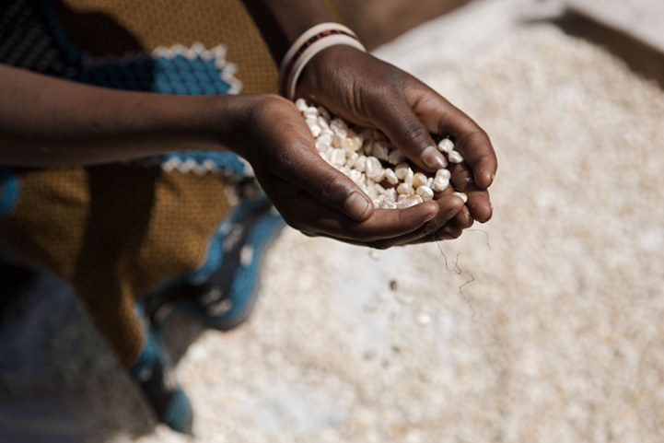
Thank you for your attention!

