Slide 1


Perspectives on Climate-Smart Agriculture: A Case Study of Malawi
7th June 2016
Wilfred Kadewa (PhD)
Webinar Series
Enabling Environment Action Group

Slide 2
What we’ll cover in today’s webinar
General overview: Agriculture and climate change in Malawi
Climate-Smart Agriculture interventions
Enabling policy environment for CSA
Challenges and opportunities for financing of CSA

Slide 3
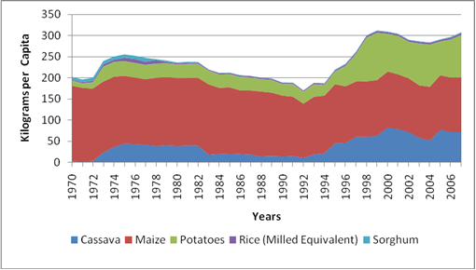
General overview
Land use | Million Ha | % of total
Total land (excluding water) | 9.4 | 100
Protected area (Game Reserves etc.) | 1.7 | 18
Land available for Agriculture | 7.7 | 82
Estimated land under estates | 1.2 | 13
Estimated land under small holder agriculture | 6.5 | 69
Population size estimated at 15 million.
Average land holding size
  1.2 ha per household
  0.2 ha per capita
Change in landholding per capita 0.4 ha in 1970 to 0.2 in 2010.
Economic contribution of agriculture
  Employs 84% of national workforce
  Contribute 39% GDP
  Smallholder ➔ 70% Agriculture GDP and 20% of agricultural exports
  Approx 6 million smallholder farmers.
  Smallholder farming is mainly food crops: maize, cassava and sweet potatoes

Slide 4
General overview

Slide 5
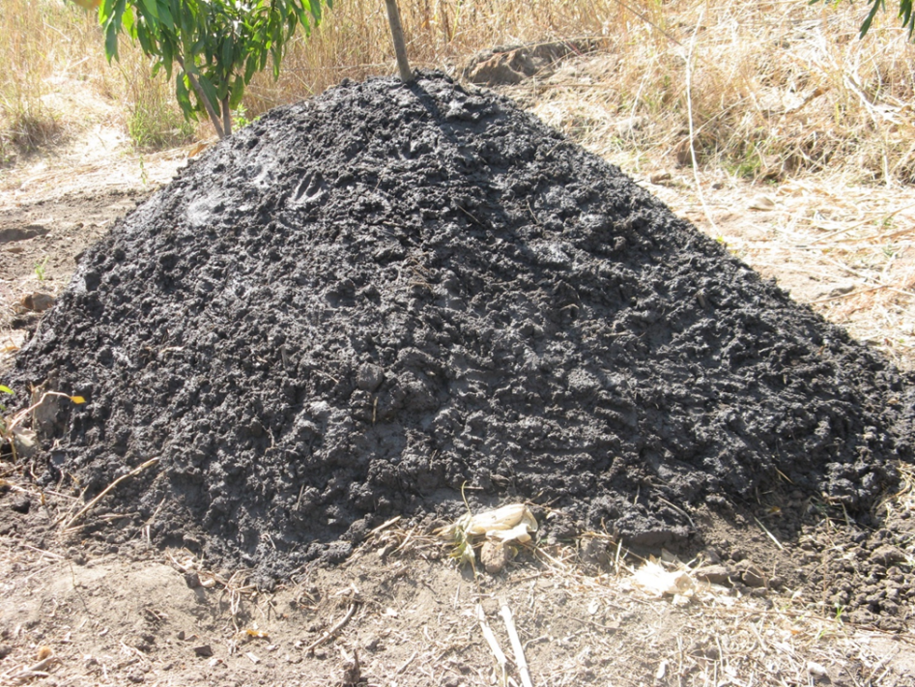
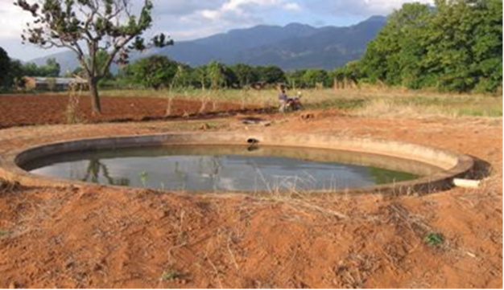
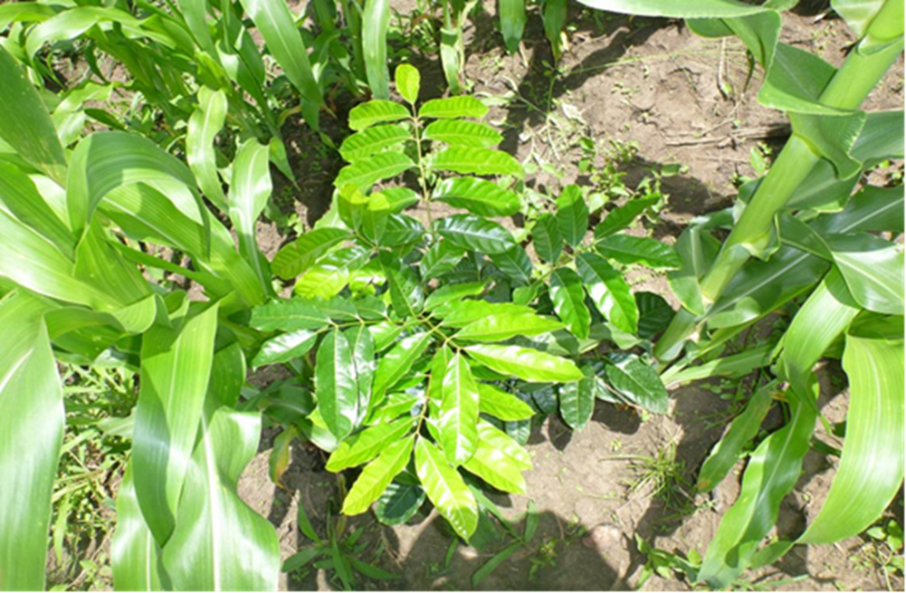
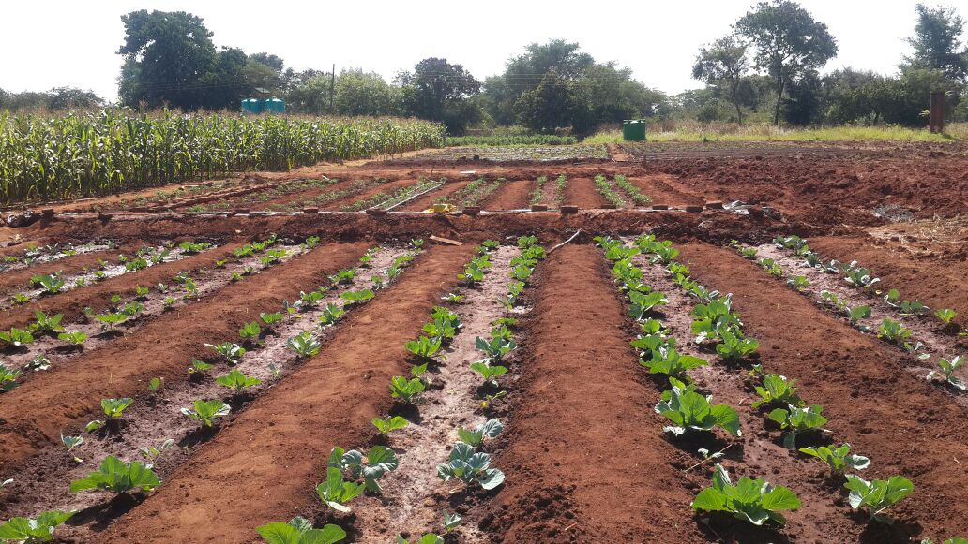
CSA Interventions

Slide 6
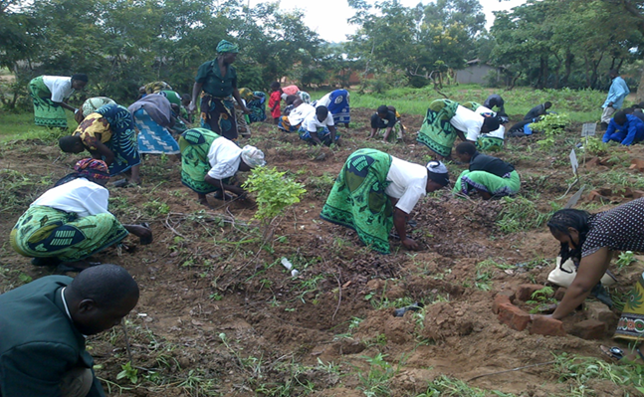
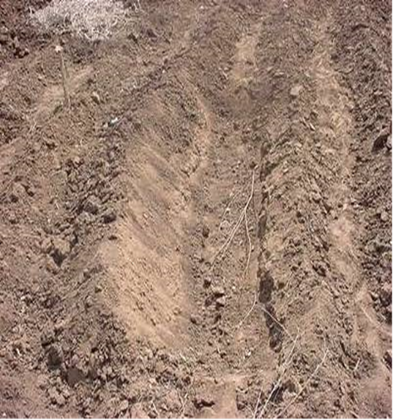
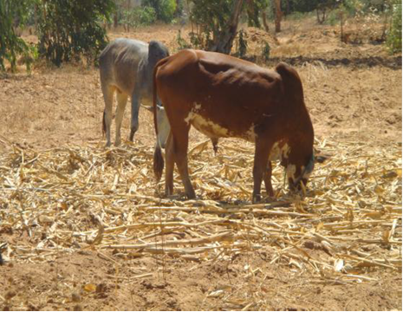
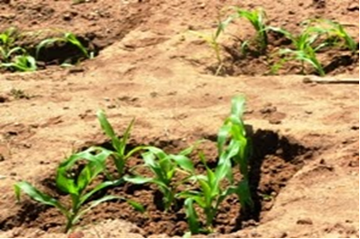

Slide 7
CSA Technology/Practice | Measured impact
Conservation agriculture – minimum soil disturbance, retain organic soil cover, diversify crop species: 6% of total maize are produced under conservation agriculture Reduced tillage Reduced tillage and mulching Reduced tillage and legume integration Reduced tillage and herbicide application | Yield increases 9 – 11% Labour costs reduced 25 % over conventional agriculture
Agroforestry systems – mixed crop and tree species intercropping for fertility maximisation Fertiliser tree species. Some for fodder/soil fertility | Yield increases up to 100%
Water retention structures Stabilisation of hedgerows with vertiver Pit planting Box ridges infiltration trenches, weirs and swales Small scale irrigation systems | Treadle pump increase up to 300% in net farm income from increased yields
Early maturing, drought-tolerant crop varieties
Livestock feeding systems Intensive zero feed systems maximises weight gain and milk production in dry conditions
Adapted from FAO, 2013

Slide 8
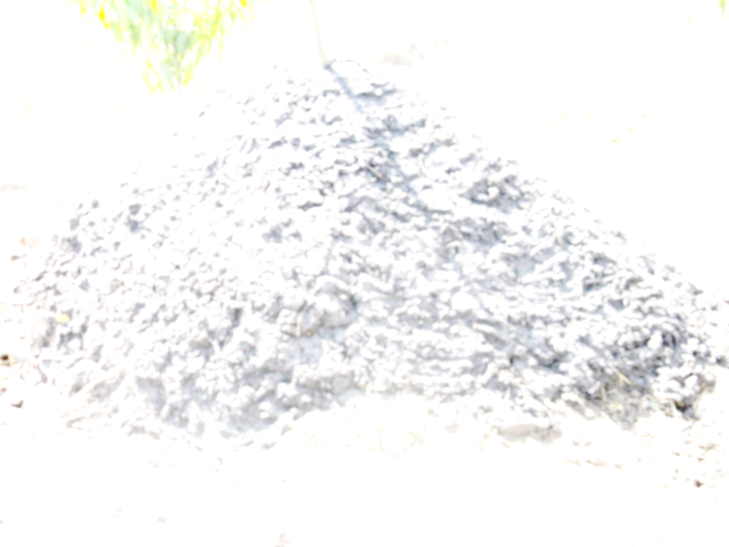

Slide 9
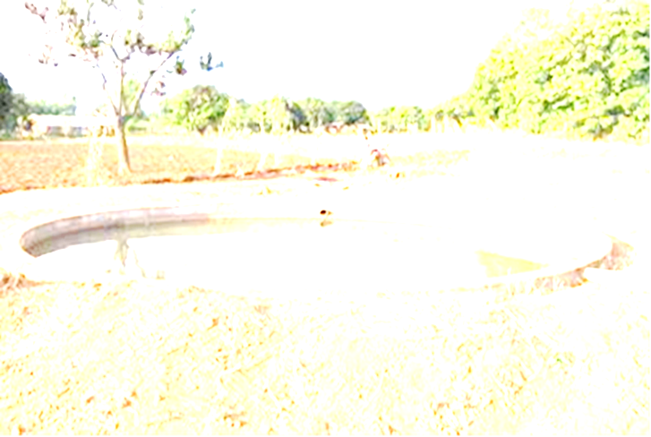

Slide 10
Enabling Policy Environment for CSA
Actively implemented
In formulation
NAPA
LP
NEP
AFSP
ASWAp II
NMP
NCCP
NAPA(II)
MNFP
LRCP
FP
MEP
NLP
1996
1999
2001
2003
2006
2007
2015
MNFP – Malawi National Forest Policy (Capacity Building)
LRCP – Land Resources Conservation Policy (Adaptation & Resilience)
FP – Fisheries Policy (Resilience)
MEP – Malawi Energy Policy (Mitigation)
NAPA – National Adaptation Plan of Action (Adaptation)
LP – Livestock Policy (Adaptation & Resilience)
NEP – National Environment Policy (Resilience & Mitigation)
AFSP – Agriculture and Food Security Policy (Resilience & Mitigation)
NLP – National Land Policy (Adaptation & Mitigation)
ASWAp – Agriculture Sector Wide Approach (Productivity)
NMP – National Meteorological Policy (Productivity)
NCCP – National Climate Change Policy (Adaptation, Mitigation & Resilience)

Slide 11
Challenges and opportunities for investments
National budget
Development partners
(JICA, EU, Irish Aid, WB, GIZ, USAID)
Levies
e.g. Fuel, carbon
Public Sector Investment Programme/
budget
Private (local & International banks and micro-finance)
Climate Change Funding
Trust Funds
e.g. MEET
MMCT

Slide 12
Conclusions and Outlook
  Co-deliver wider services in support of CSA (e.g. health and sanitation services, education and knowledge exchange);
Need up to date information on land use which calls for studies on land utilisation and approaches that improve the understanding farmer preferences (e.g. practices and provenness);
Investments : ASWAP builds on strong on-going programmes currently being implemented (FISP-Farm Input Subsidy Programme and GBI – Green Belt Initiative) which show high potential for quick deployment of CSA;
Capacity building across all levels in simulation models to predict future scenarios in a more reliable manner;
It is clear that all essential areas of climate change policy development, including programme management, coordination and networking, policy advocacy, GHG inventories, and national registries, require additional attention and investments of human, financial and technical resources

Slide 13


Acknowledgements
Photographic materials used from
  Rainwater Harvesting Association
  NASFAM
  Land Resources and Conservation Department
  Sustainable Agricultural Land and Water Management - Technical Working Group.
FANRPAN
World Bank, the Webinar hosts.
GACSA facilitation unit.

Slide 14
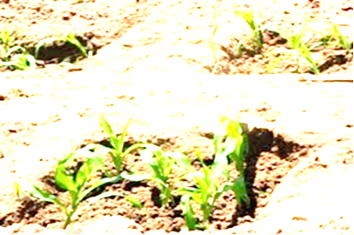
THANK YOU
FOR YOUR ATTENTION

