Slide 1



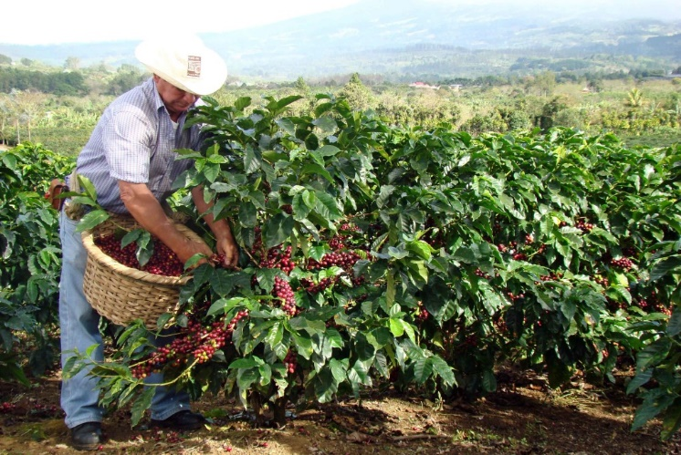
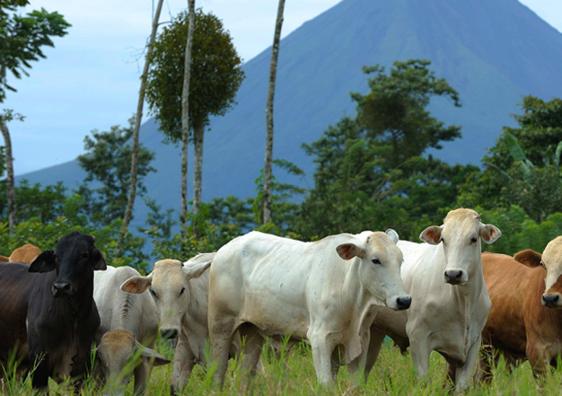
Climate Smart Agriculture in Costa Rica
May 26, 2016
Kelly Witkowski (IICA), Roberto Azofeifa (MAG), Bastiaan Louman (CATIE)

Slide 2

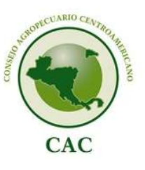


Regional Enabling Environment supporting CSA in Costa Rica
Central American Integration System
  Central American Commission on Environment and Development
  Central American Agricultural Council
    Technical Group on CC and Integrated Risk Management
Central American Dry Corridor

Slide 3
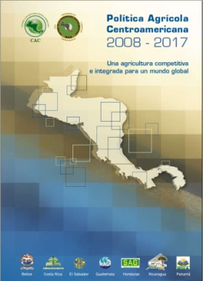


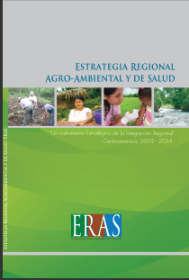

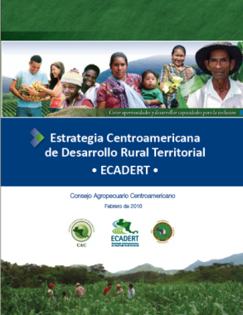
Regional Sectoral and Intersectoral Policies and Strategies
Central American Agricultural Policy (2007)
POR-FRUTAS (2011)
Regional Agro-Environmental and Health Strategy (2008)
Rural Territorial Development Strategy (2010)
Food and Nutrition Security Policy
(2012)

Slide 4









CAC: Technical Group on Climate Change and Integrated Risk Management
Est. in 2012
Conformed by a rep. of the Min of Ag. and an alternate from each country
President is the rep. from the country with the pro tempore presidency of the CAC
Coordinated by the CAC’s Executive Secretariat
Supported by Interagency Support Group

Slide 5
Regional Declaration on CSA
August of 2015
“Direct the ES-CAC, together with other organizations, to prepare a regional declaration to promote CSA…as an option to raise agricultural and fishery productivity, strengthen resilience and support adaptation to CC with the goal of improving food and nutritional security.”
In the regional declaration establishing an alert regarding El Nino, a directive was included to develop a regional action plan that considers CSA
Regional Sectoral Policies
Regional Intersectoral Policies
Regional Bodies
(TG has articulator/ coordinator role)
National Intersectoral Public Policy Instruments (or from other sectors)
National Sectoral
Agricultural Policies

Slide 6
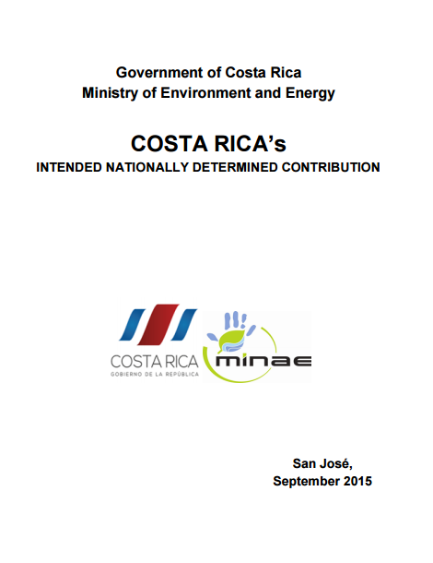
International
  Participation in international initiatives to support achievement of national CSA goals
Active participation of ag sector in negotiations
  Inclusion in negotiating team, sending submissions, side events
GACSA
Global Research Alliance
Bonn Challenge
Initiative 20x20
Costa Rica’s INDC
- Adaptation
- Mitigation
- Means of Implementation

Slide 7
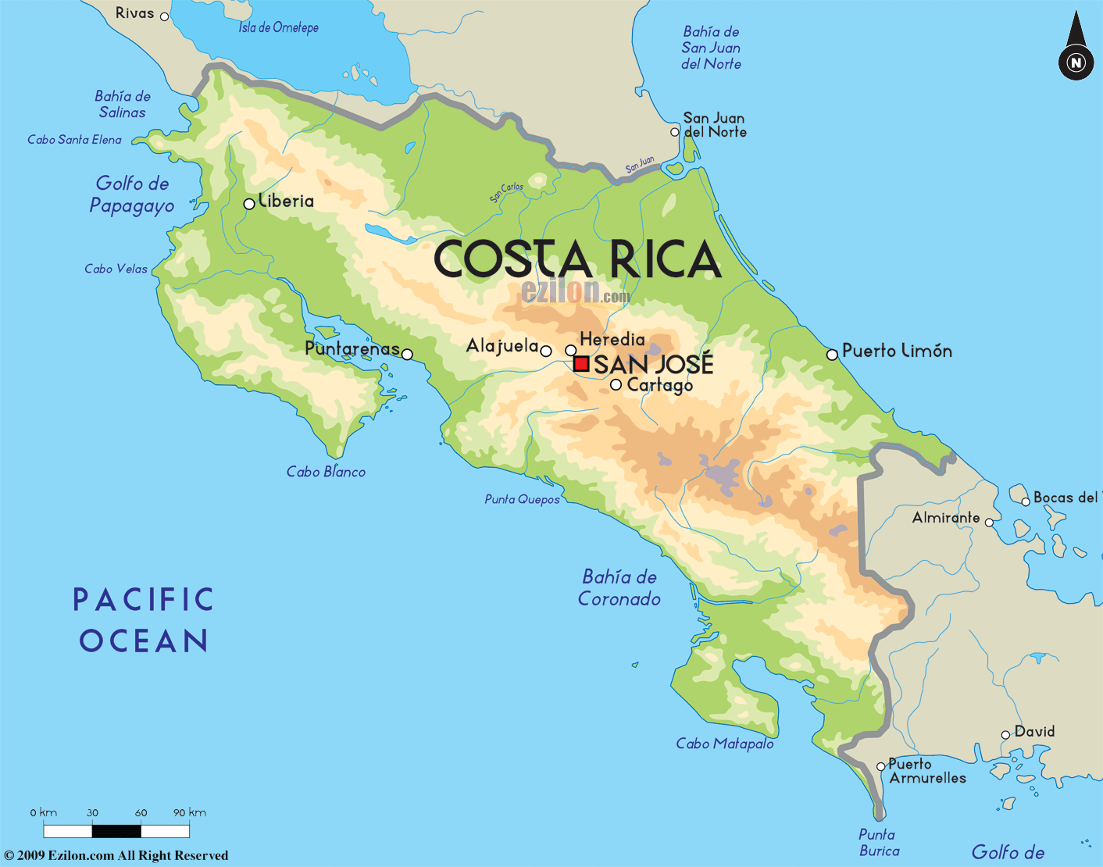
Key Messages
Regional framework enables:
  articulation between different levels
  efficient use of resources
  technical – political interactions
  S-S cooperation
  longer term sustainability and stability for CSA
Costa Rica has demonstrated leadership and proactively involved itself early on in international and regional initiatives to address CC, especially in the agricultural sector
CR leadership has recognized the strategic opportunity presented by CC to achieve efficiency and enhance resilience in their ag sector – and dedicated national resources to this

Slide 8
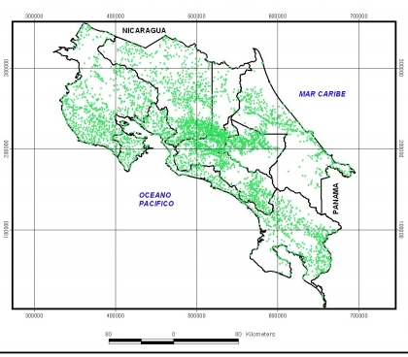
Costa Rica
51.1 thousand km²
4.8 million people
Caribbean
GDP/capita: 10.000 US$
GHGE/capita: 1.7 ton CO_{2e}
53% of land in protected areas
Pacific Ocean
Agricultural sector:
12.6% GDP; 12.3% EAP
45.7% of total exportations
Agriculture: 463.9 thousand ha
Livestock: 1.94 million ha
Main products in terms of land use: coffee, oil palm, sugar cane, pineapple, banana
Main exportation products:
Pineapple, banana, coffee
Total # of farms | 93,017
Total agricultural area | 2,406,418
Average ha/farm | 26
% in pastures | 43.4%
% in forests | 30.6%
% in perennial crops | 15.7%
% in annual crops | 6.9%
% other | 3.4%
Source: National Census 2014

Slide 9
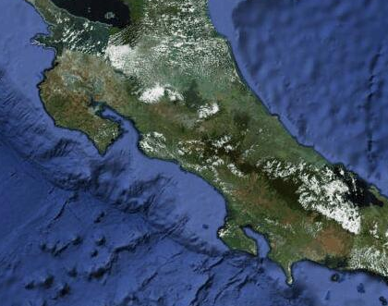
N
Climate Change Vulnerability
E
Slope lands / erosion
Droughts / West part
Floods / East part
Increase in temperature
Irregular rainy season

Slide 10
National Inventory of GHG 2005 (CO₂ e)
46%
Transportation and Energy
37%
Agricultural sector
11%
Solid Residues
5%
Industry
Source: IMN,2009
Author: J. Montenegro

Slide 11
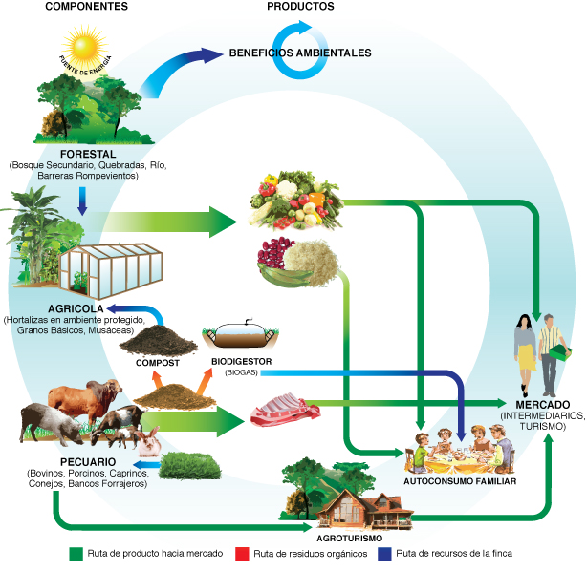
Trajectory of agricultural production in Costa Rica
1980-1990
1990- 2000
2000-2010
2010-2021
Sustainable production fostering
Low emission agricultural production
Climate change strategy
Coffee and livestock NAMAs
Sustainable consumption and production
Legislation for sustainable production
Legislation for organic production
International standards and certifications
Good Agricultural Practices
Costa Rican declaration on Carbon Neutrality
Environmental and agricultural common agenda
GHG emissions and CO2 capture?
Pilot projects on soil and water conservation
Pilot projects on agroforestry
Capacity building on farming research systems: from down to up
Foster intercropping and crop diversification
Environmental legislation; Soil management legislation
Agriculture sector crisis
New governmental programs for agriculture development
Irrigation programs
Fostering of export crops: banana, coffee, flowers, orange, among others

Slide 12
Enabling policy framework
Agricultural Sector: Relationship among the National and Agricultural Objectives and the Sector’s Policies
Reduce poverty and
social and territorial
inequality
Generate greater economic growth and better jobs
2015-2018
National
Objectives
Increase agricultural
added value by enhancing
productivity and sustainable rural development
2015-2018
Agricultural Sector Objectives
Support the national
goal of reducing poverty
Sectorial
Policies
Nutritional and
food security
and
sovereignty
Opportunities
for the
rural youth
Rural
territorial
development
Agriculture
adaptation and
mitigation to
climate
change
Strengthening
of agro-
exporting
sector
Adapted from Sepsa (2014)

Slide 13
Enabling conditions for CSA in Costa Rica
Subject | Regulation | Payment | Extension and research | Tax reduction | Eco-Labeling
Land/Soil use | X |  | X | X
Water use | X | -X | X
Agricultural Organic Residues | X |  | X
Air emissions | X |  | X
Water protection |  | +X | X
Agrochemical use | X |  | X
ESR (Environmental Services Recognition) Organic agriculture | X | +X | X | X
ESR (Environmental Services Recognition) Sustainable agriculture | X | +X | X
PES (Payment for Environmental Services) |  | +X (agroforestry) | X
Ecological Blue Flag Program |  |  | X |  | X
Good Agricultural Practices |  |  | X |  | X
Public legislation and standards | X |  |  |  | X
Private standards |  |  |  |  | X
C-Local Market | X | X
C-Neutral |  |  |  |  | X

Slide 14
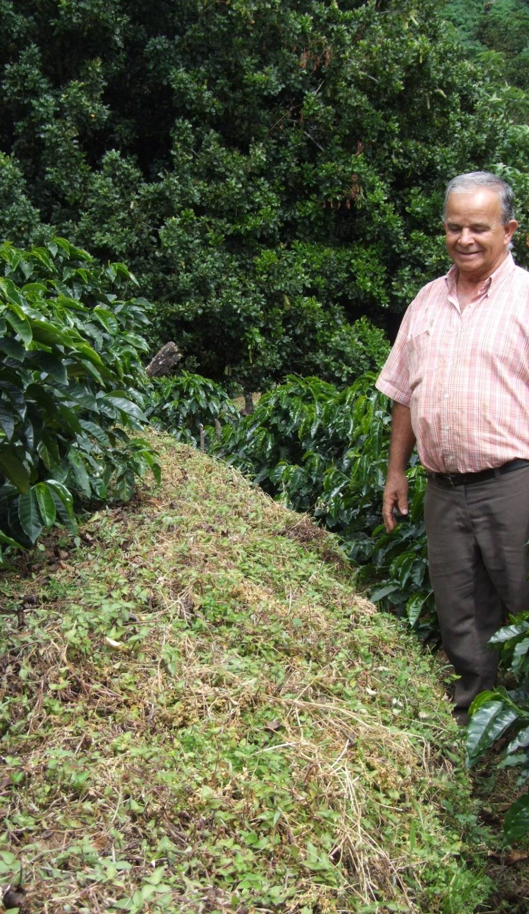
Main milestones in Costa Rica experience towards low carbon, resilient agricultural sector
Pilot experiences (beginning of 90^{s})
Training program on sustainable development (beginning of 90^{s})
Legal framework ( since end of 90^{s})
Common agenda for the environment and agricultural sectors
Program Promoting Sustainable Agricultural Production (2004)
Costa Rica C-Neutral (a big challenge to reach in 2021)
Carbon market mechanism development

Slide 15
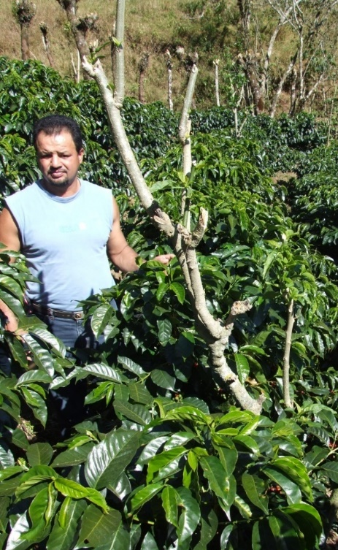
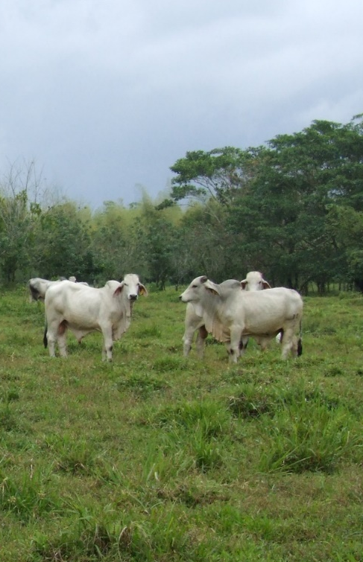
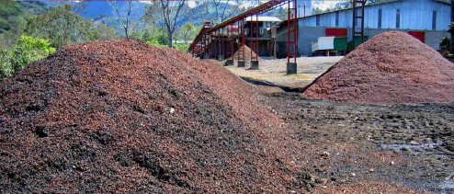
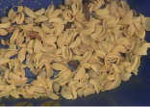
Mitigation Priorities
Coffee NAMA
... toward a low carbon coffee sector
Livestock NAMA
... low carbon strategy for the sustainability of livestock sector
NAMA WAB2E

Slide 16
Coffee sector
Coffee sector | 2002 | 2012
Number of farmers | 70.143 | 52.787
Number of mills | 93 | 184
Number of exporters | 56 | 93
Number of roasters | 34 | 57
Source: ICAFE
25% of GHG agricultural sector emissions
Covers 93,000 hectares between 600-1600 msnm
Coffee NAMA affects 50 thousand farming families

Slide 17
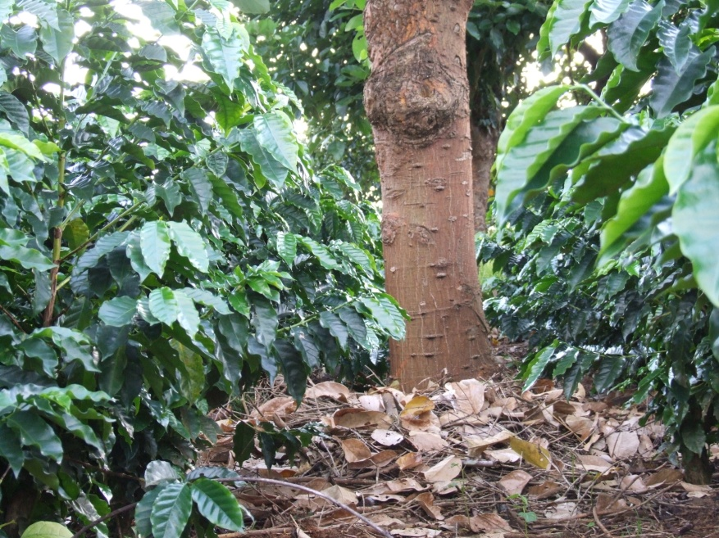
Key NAMA aspects
Smart combination of public and market incentives aimed at:
increasing carbon sinks, reducing emissions of nitrous oxide and methane, combined with climate adaptation practices.
At the farm level:
Improving adoption rates of innovative mitigation practices which reduce N2O emissions. and proven adaptation techniques
At coffee mill:
Introducing equipment and techniques that reduce methane emissions in wastewater and pulp treatment

Slide 18
Expected outcomes
Eco-competitiveness coffee growing (cost savings, diversification, keep market access and environmental impact reduced)
Resilience of 50.000 farming families
Reduction potential: approx. 30.000 Ton of CO2/year.
Carbon sink potential: approx. 90.000 Ton of CO2/year.
120,000 Ton CO2e/year until 2024 at full implementation
Expected reductions over 20 years are 1,850,000 Ton CO2e
Combines mitigation measures with climate adaptation practices

Slide 19
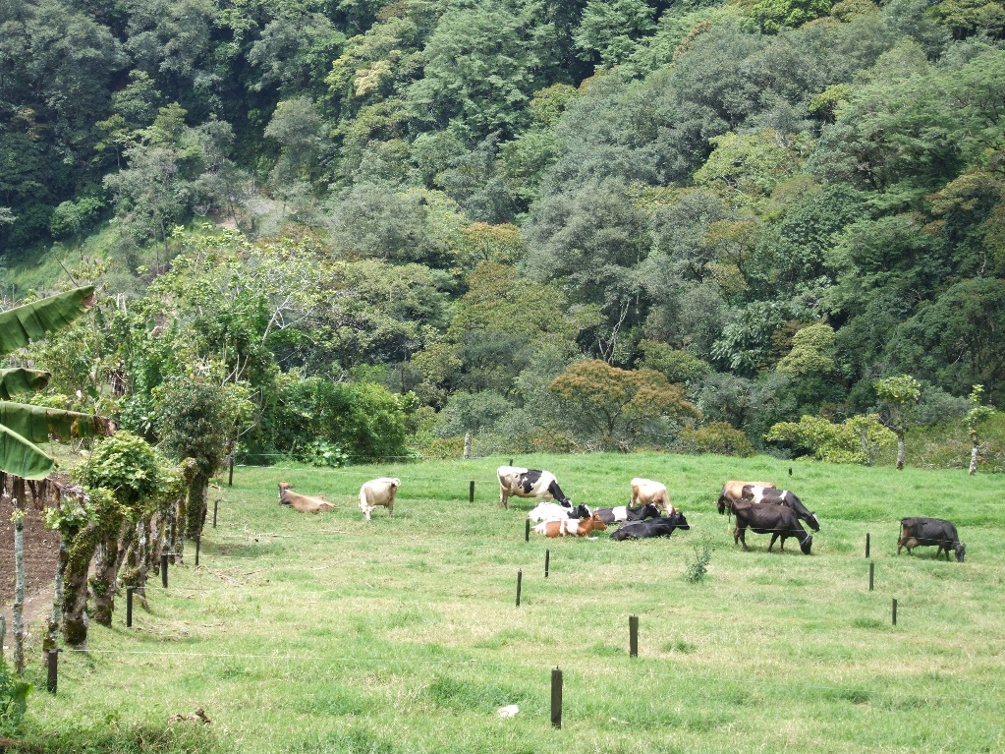
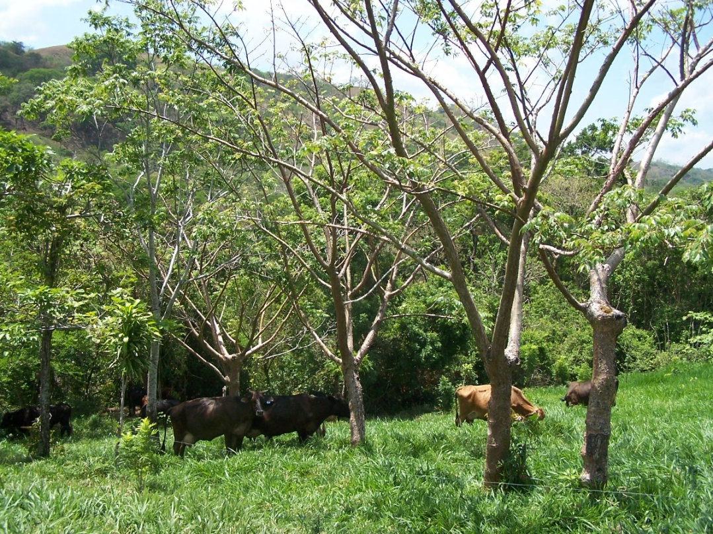
Livestock
1,278,817 head of livestock
40% of farms in the country have livestock
Livestock is the main activity on 28% of farms in the country
Main production system is grassland
Average farm size: 41 ha
43.4% of total area in livestock farms is pasture, 30.6% is forest
Produces 23.6% of GHG – (second highest emitting sector with 3.3 million tons of CO_{2e} in 2010)

Slide 20
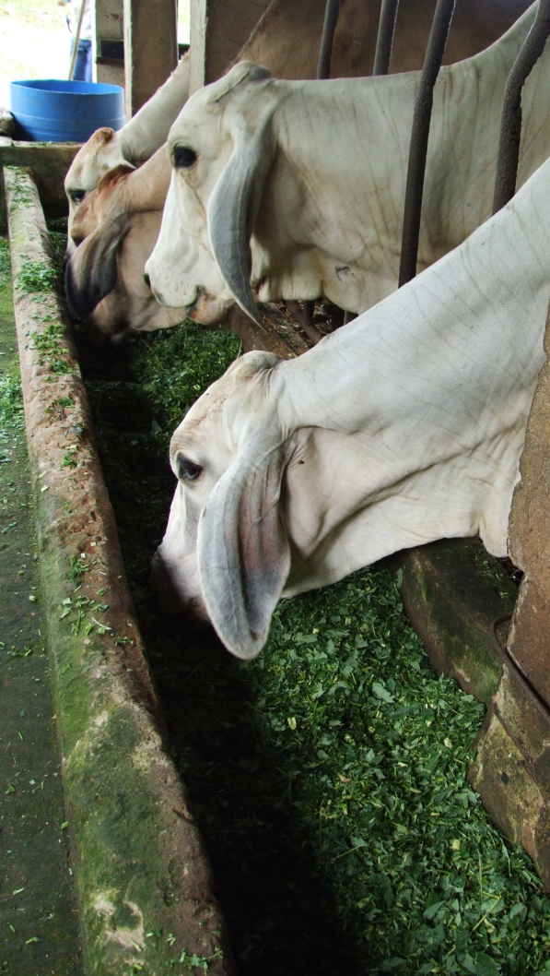
Livestock NAMA: expected outcomes
In 15 years, the following are expected:
70% of herd, 60% of area under livestock use
6 million tons of CO2e mitigation
Resulting in:
Increasing productivity, profitability and reducing emissions simultaneously
Improvement in ecosystem services: landscape connection, water source protection, carbon sequestration, soil protection
Strengthening linkages among public and private relevant stakeholders
Strengthening linkages among research and extension sectors
Eco-competitiveness in livestock production

Slide 21
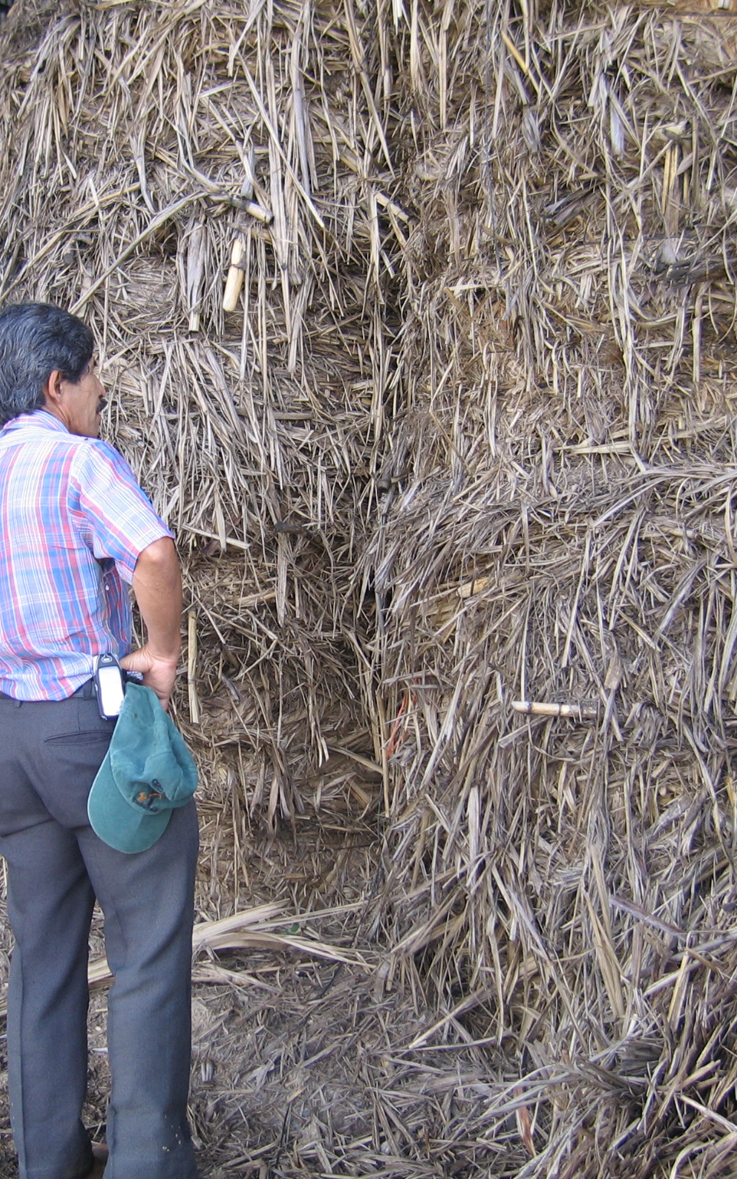
NAMA WAB2E
Incorporate Organic Residues in Energy Matrix
Energy for self consumption in the production process / to improve efficiency of production process
Contribute to GHG emission reduction
Improve soil fertility and production capacity
Using wet and dry biomass from agriculture (coffee, rice, sugar cane, oil palm, pineapple, banana, citrus), forestry (firewood, wood chips, sawdust) and livestock (cattle, poultry, pigs)

Slide 22
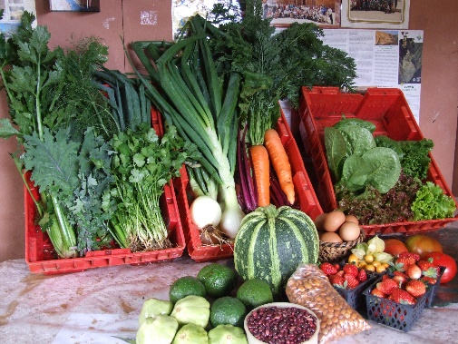
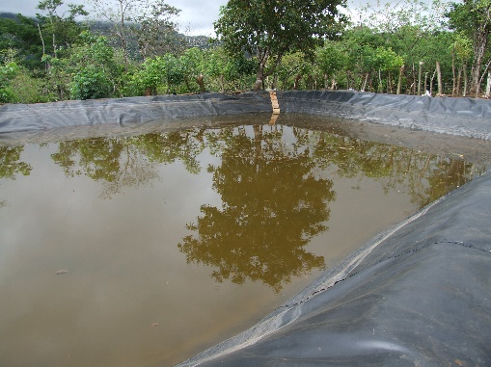
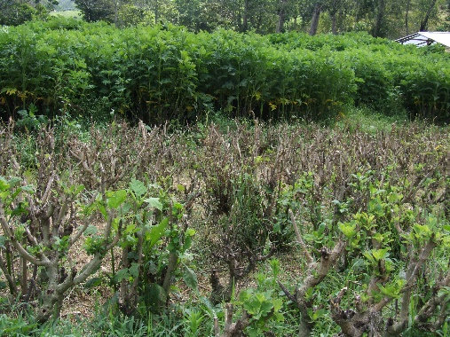
Adaptation priorities
Crop diversification
Water: efficiency in use, water reservoirs, infrastructure for water suply
Forrage banks
Low external input systems
Soil and water conservation
Plasticulture

Slide 23
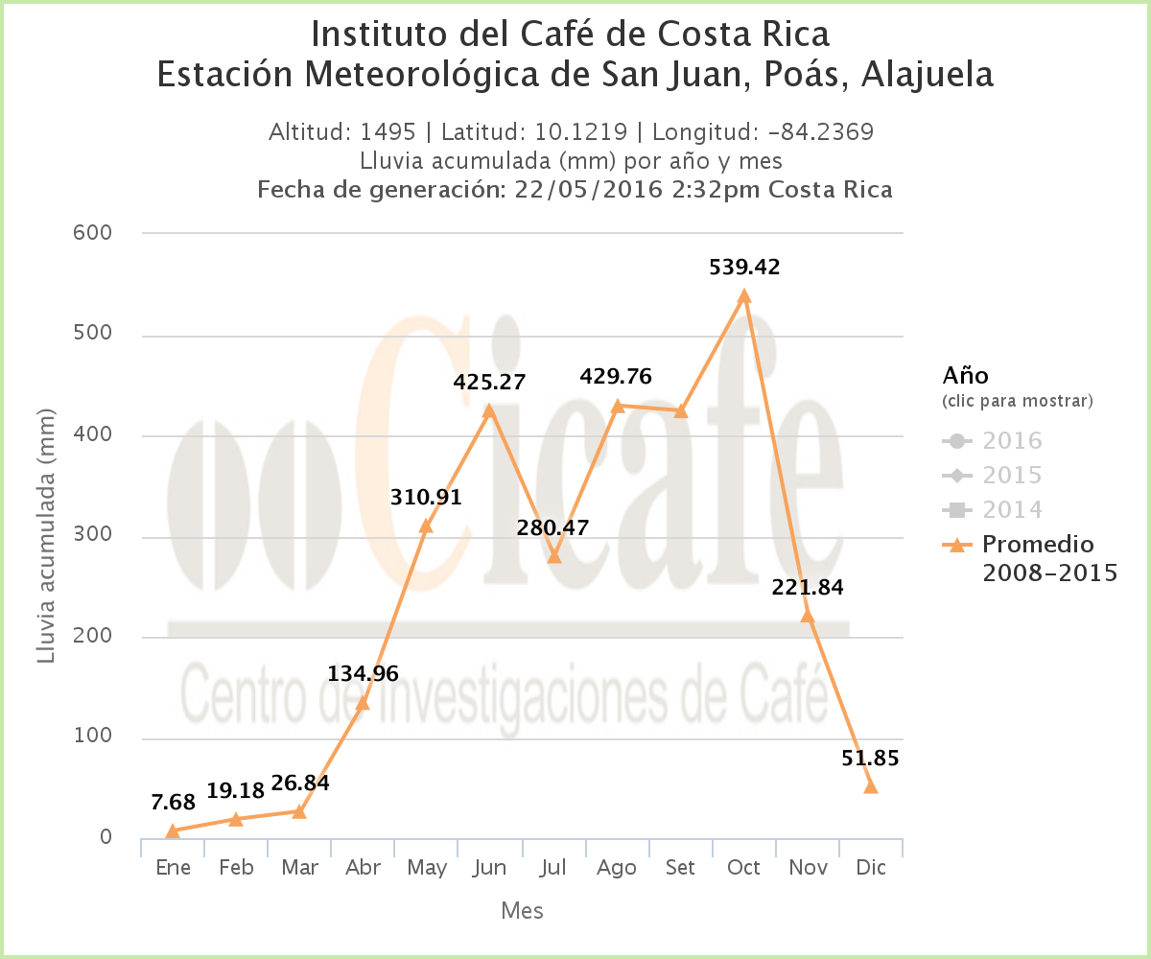
Innovations for Climate Smart Agriculture
Clima del café http://www.icafe.cr/sector-cafetalero/clima/
A system to help coffee farmers and other relevant stakeholders to know climate conditions per region

Slide 24
Other ongoing initiatives
Ecological Blue Flag: based on Good Agricultural Practices with regard to water resources, soil, residues, agrochemicals, adaptation, animal care, mitigation
Promotion of organic agriculture
Environmental Recognition Program
Public Certification on Good Agricultural Practices
National Plan on Sustainable and Healthy Gastronomy
Adaptation projects

Slide 25
Opportunities and challenges for scaling up CSA in Costa Rica
Based on WB, CIAT, CATIE (2014): CSA country profile

Slide 26
Smartness and adoption rates for some CSA practices

Slide 27
Needs greater energy efficiency but above all greater adoption
Complementary measures
Currently only applied in banana but has great scope for other production systems as well
Complementary measures but low adoption rates

Slide 28
So, the big question is……….
How can we increase adoption rates?
Increase demand for climate responsible products (certification schemes?)
Revise extension services:
  Few agents need to reach many farmers
  Agents need to combine farmers’ objectives with societal goals
  Taylor made technical, climate and financial services (e.g. Centroclima, a service in construction by CATIE/IUCN/DAI/USAID for the Comite Regional de Recursos Hidricos, )
Education and awareness programs, particularly in relation to
  Use of agrochemicals
  Efficient use of water and energy
  Potential of appropriate use of climate information

Slide 29
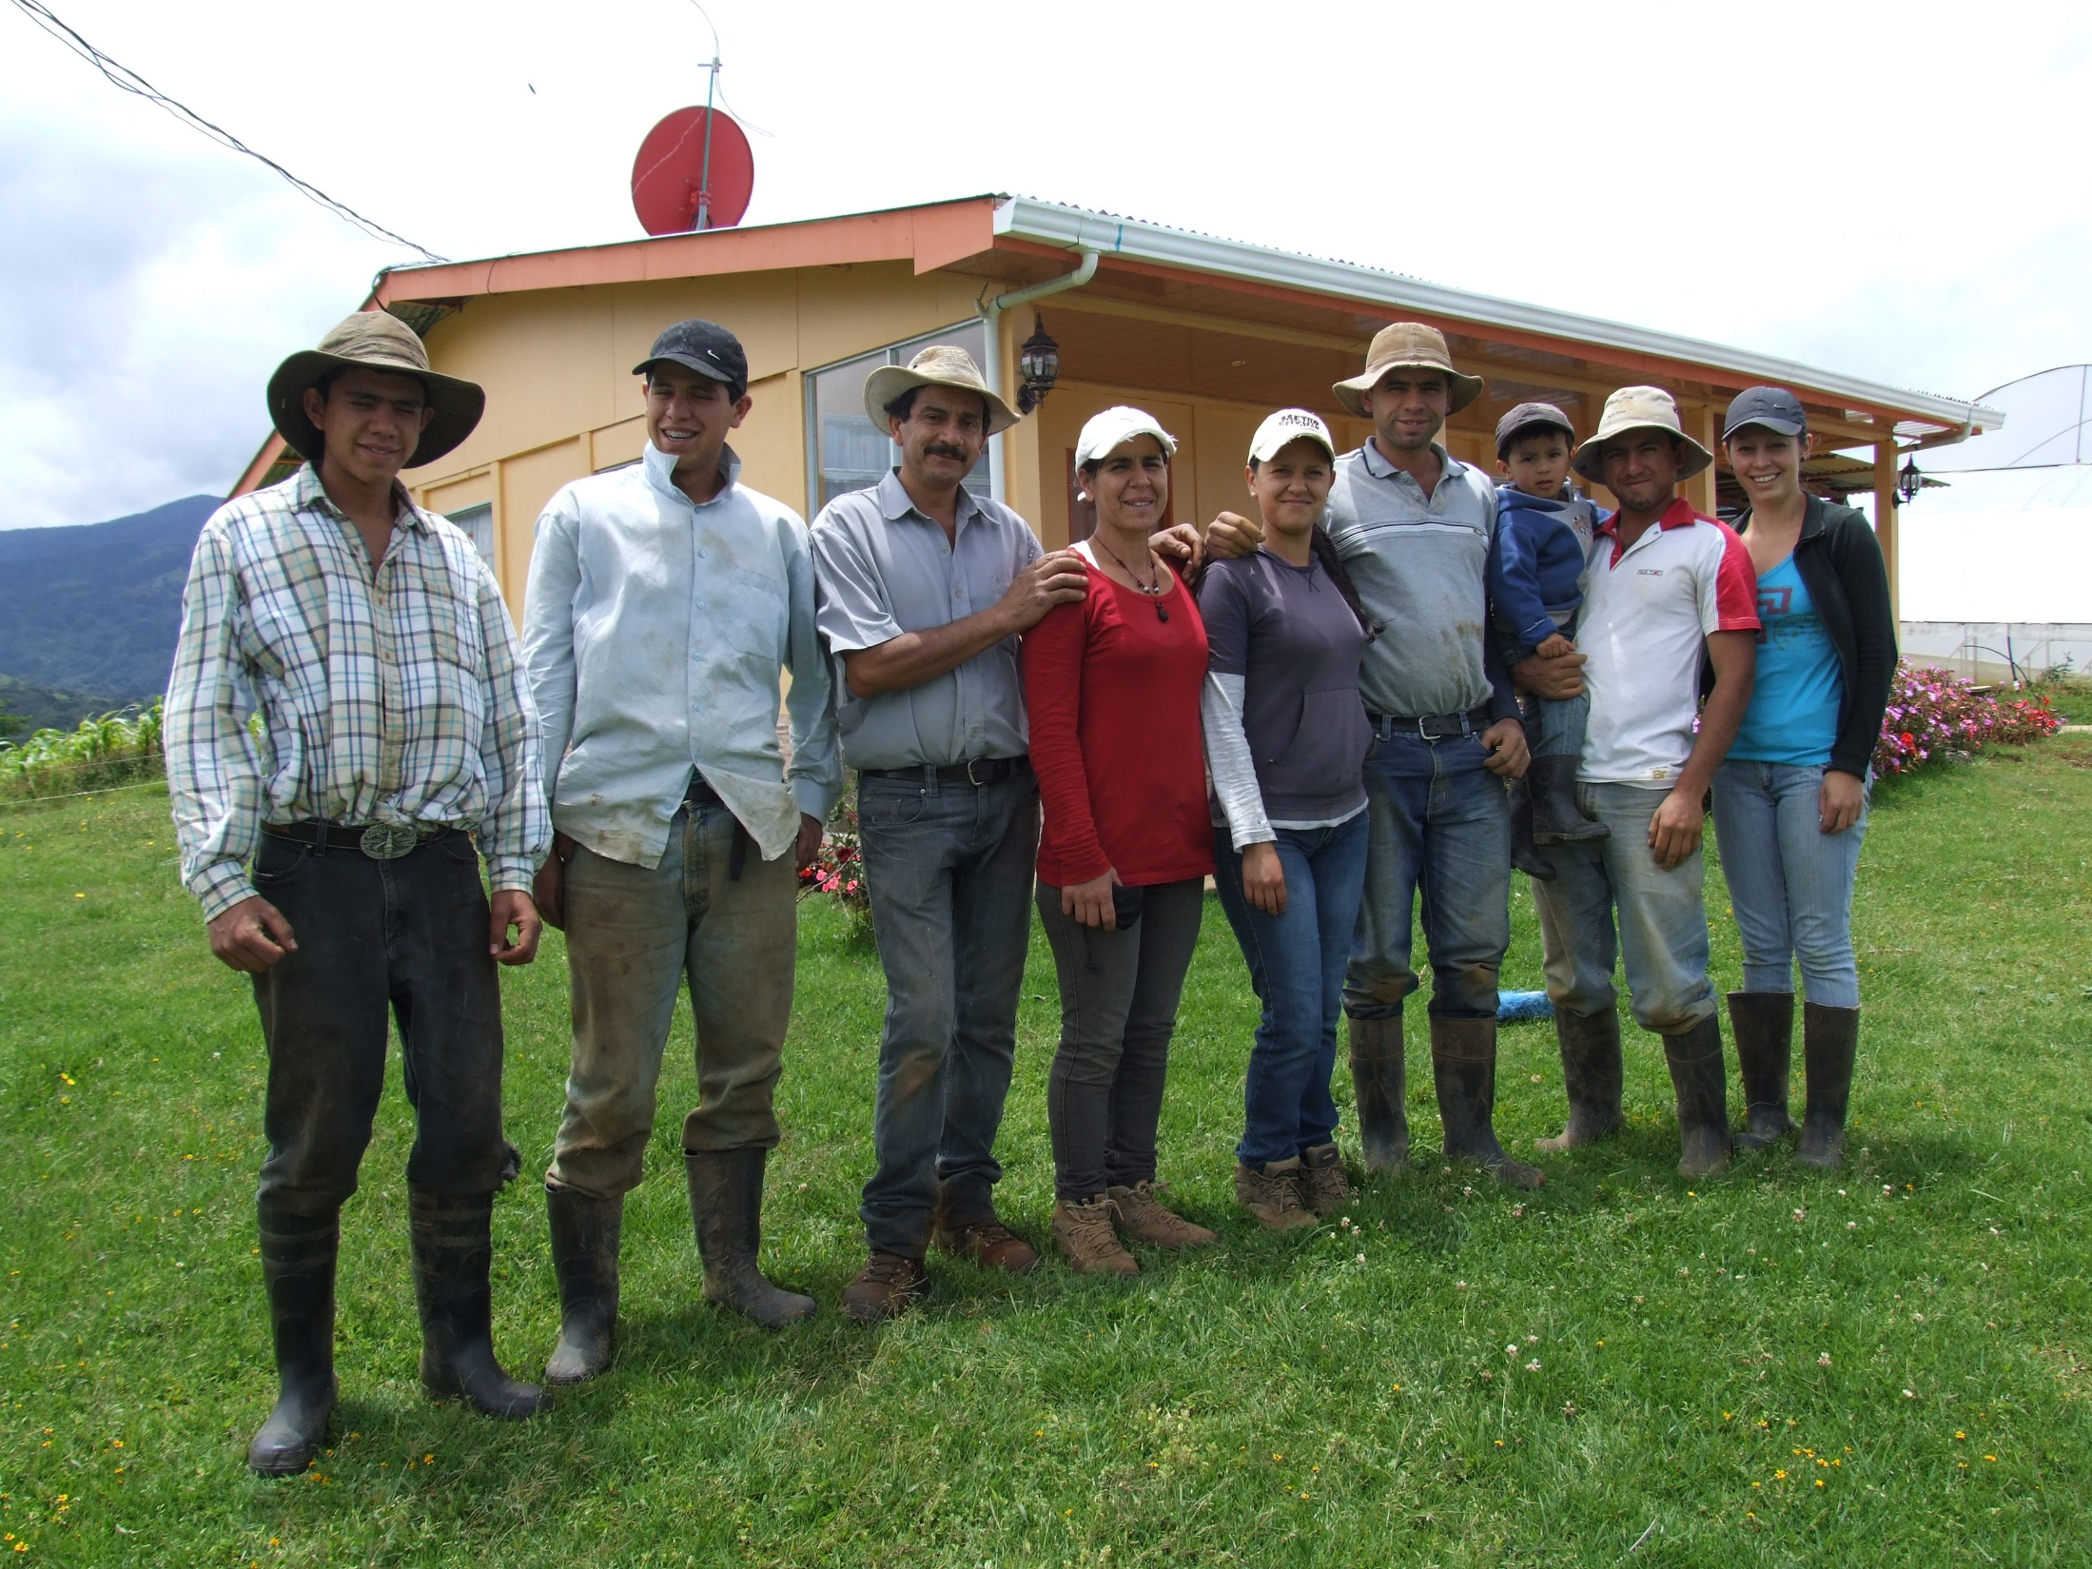
Thank you
With special thanks to:
Manuel Jimenez (SE-CAC),
Claudia Bouroncle, Pablo Imbach, Claudia Medellin (CATIE)
Members of Climate Change Technical Group from MAG who contributed to the Costa Rica Case Study on CSA
Farmer Organizations Members who contributed to the Costa Rica Case Study on CSA
GACSA Facilitation Unit
World Bank
Gomez Cordero Family Agriculture
La Cima de Dota, Costa Rica
Foto: R. Azofeifa

