Slide 1


Slide 2
Fall Armyworm
Side event

Slide 3

Management and control of the
Fall Armyworm, Spodoptera frugiperda:
Experience from Brazil
Dr. Fernando Hercos Valicente

Slide 4
Embrapa Maize and Sorghum Research Center

Slide 5
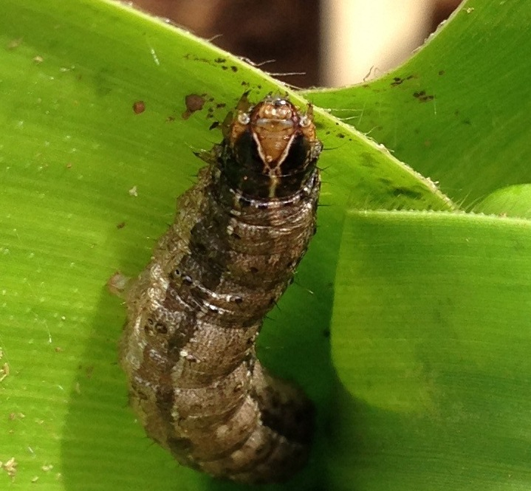
Fall Armyworm, Spodoptera frugiperda (J.E. Smith, 1797)
(Lepidoptera: Noctuidae)
Larvae
Damage may reduce yield production from 34 to 52% -
Millions of dollars in chemical insecticides

Slide 6
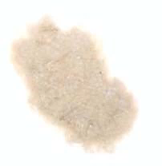
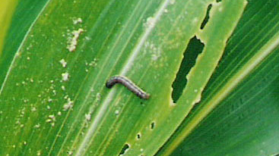
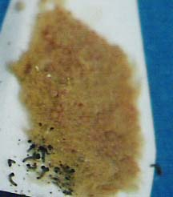
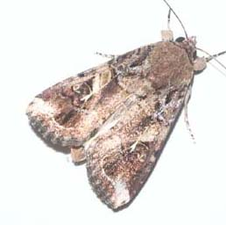
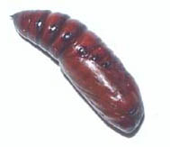
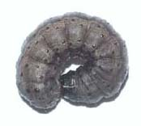
Life cycle around 30 days (temperature dependent)

Slide 7
Fall armyworm management
Chemical control
  Chemical insecticides – useful and should not be discarded
Cultural Control
  Expose pupae to high temperature
  Damage pupae during plowing
Biological Control
  Parasitoids: Trichogramma
  Pathogens: Bacillus thuringiensis (Bt), Baculovirus and Fungi
Transgenic Maize (Bt Maize)
  Different genes (proteins expressed)
  Insect Resistance Management (IRM) – Refuge area + high dose of the protein

Slide 8
Management of FAW in the Americas
Efficacy of Integrated Pest Management (IPM) interventions for FAW may be adopted and transferred to Africa
Monitoring and scouting the presence of FAW in the field – for each regin and country
Larvae should be observed in the laboratory for the presence of parasitoids (important biological control agents) reaching up to 50% of parasistism
Low-cost, effective and environmentally safer pesticides (or biopesticides) against FAW
  Synthetic pesticides and their treatment protocols (e.g. Seed and foliar treatments)
  Biopesticide (e.g. Baculovirus – SfMNPV, Bacillus thuringiensis (Bt) sprays)
Classical biological control (e.g. Introduction of effective egg parasitoids from Brazil to African countries)
Possibility of use of GM crops, respecting policy and laws of each country

Slide 9
IPM interventions
Pheromone – Monitor the presence of FAW adults – early start
Bt – Bt strains may be grown using rice as a substrate (sterile) – cheap to produce and large scale fermentation systems
Baculovirus – efficient to control FAW
  Use healthy larvae to multiply the virus in laboratory – formulations
Trichogramma – egg parasitoid
  Rear the host and field release
Chemical (synthetic) pesticides – When necessary according to the use of other IPM agents
GM crops – All IPM interventions are suitable to be used with Bt Maize

Slide 10
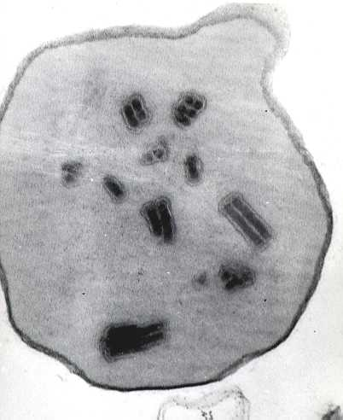
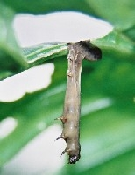
Biological control with Baculovirus

Slide 11
Baculovirus collection
NPV Baculovirus
Fall armyworm: Spodoptera frugiperda
Southern armyworm: Spodoptera eridania
Black armyworm: Spodoptera cosmioides
Soybean looper: Chrysodeixis includens
Cotton bollworm: Helicovera armigera
Corn earworm: Helicoverpa zea
EMBRAPA has been collecting since 1984

Slide 12
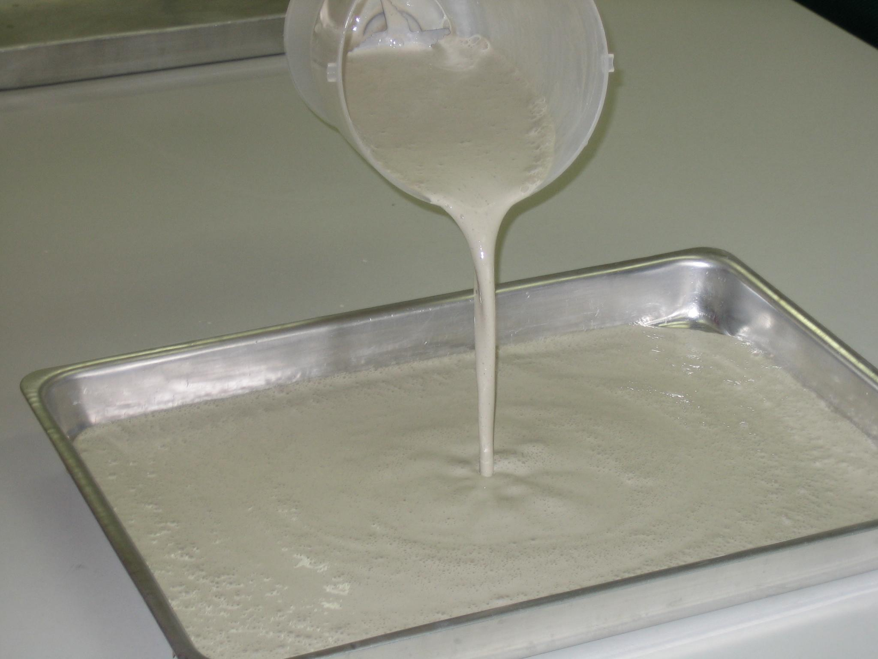
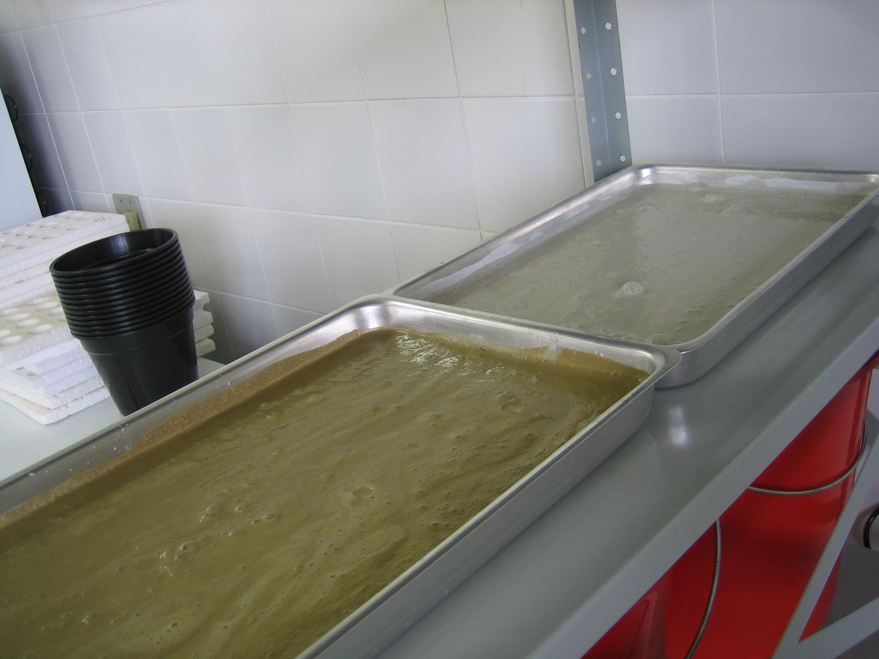
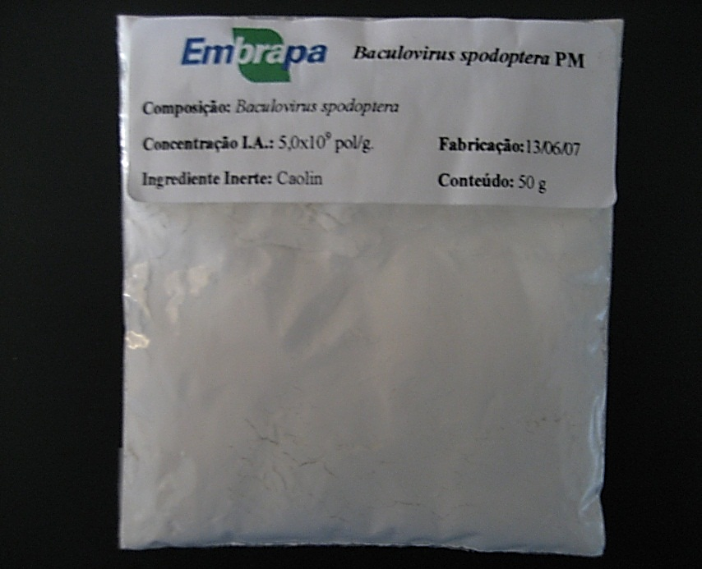
Different types of formulations – final product

Slide 13
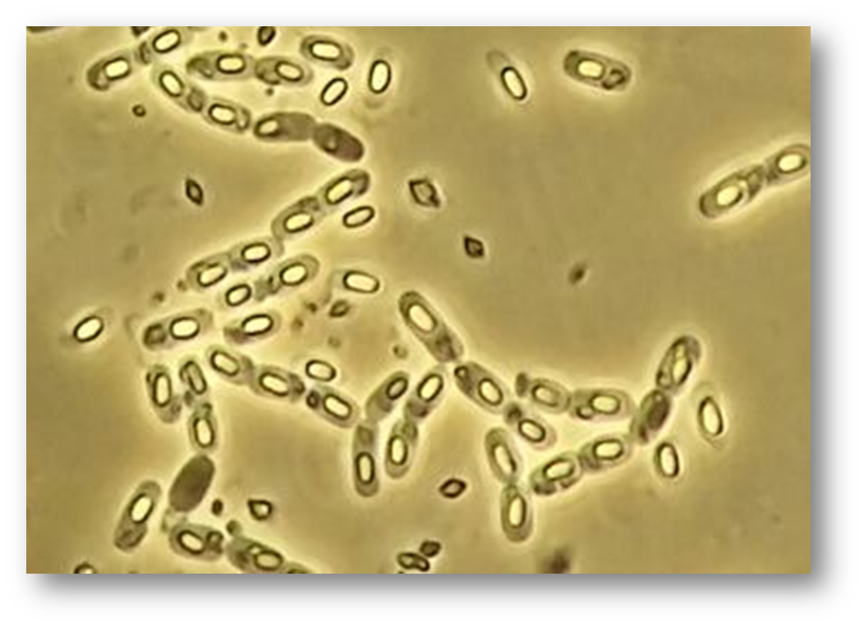
Biological Control with Bacillus thuringiensis

Slide 14
2000 soil samples
  surface
10 Brazilian States
From North to South
since 1992
More than 4600 isolates
  Maintained
  in freezers

Slide 15
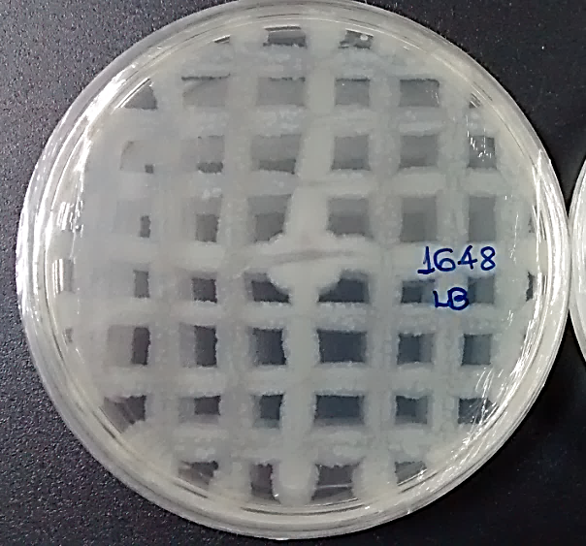
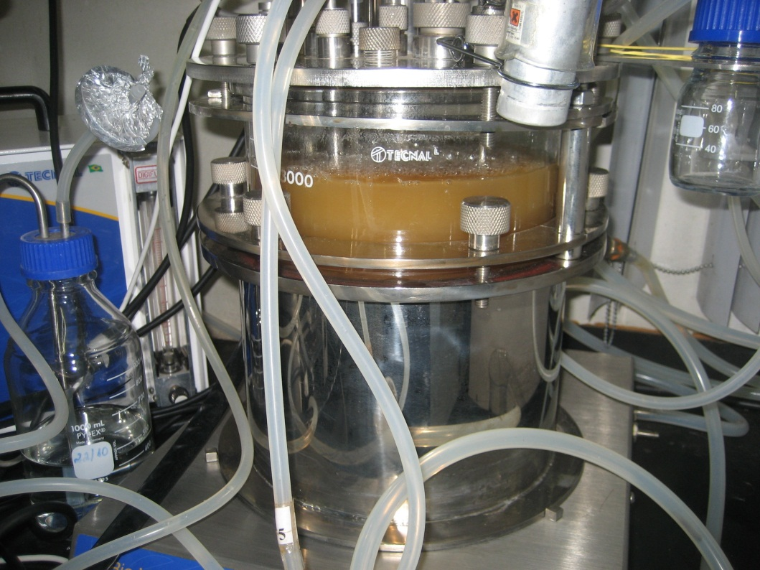
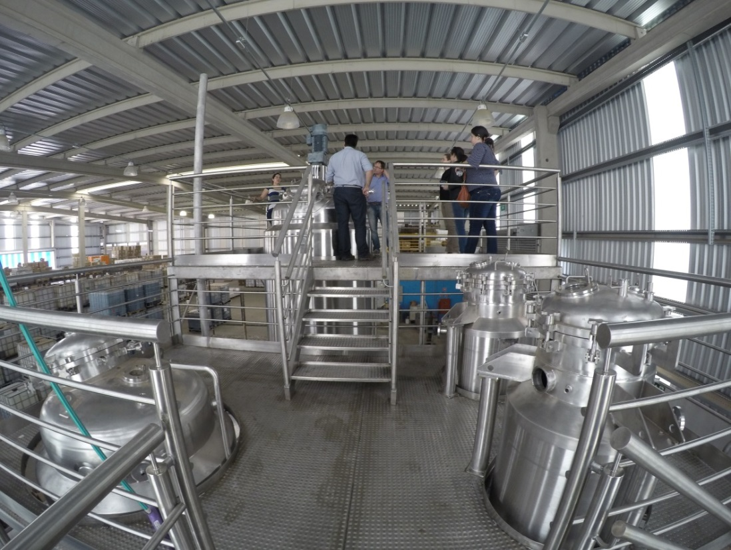
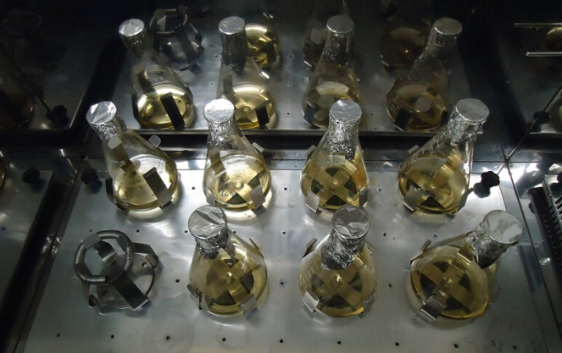
Isolation, identification, testing against insect pests,
pilot scale fermentation
Large scale fermentation systems with
private companies

Slide 16
Fermentation using rice as a substrate (the same as with fungi) – very cheap and efficient
Ceará
Secretary of Agriculture – public strains are used
Small holder farmers
Africa
Project – MarketPlace – Africa
Mali, Burkina Faso, Niger and Ivory Coast
Bacillus thuringiensis isolated in Mali

Slide 17
Thanks for your attention!
fernando.valicente@embrapa.br

