Slide 1
Digital skills:
Capacity Development from farms to policy level
Harnessing the power of innovation in agriculture
Sophie Treinen - Information and Knowledge Management Officer
FAO Regional Office for Europe and Central Asia
Agrotech-2019. Steps Beyond the Horizon
Moscow, 30-31 may 2019

Slide 2
Overview
FAO Capacity development framework
Primary and secondary schools
Life long learning at farm level and in rural areas
FAO e-learning centre

Slide 3
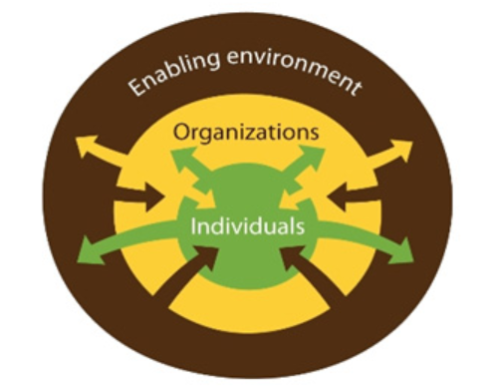
FAO Capacity Development Framework
www.fao.org/capacity-development/our-vision/en/
Notes:
Capacities at the three dimensions are interlinked: individuals, organizations and the enabling environment are parts of a whole. Capacity development often involves enhancing the knowledge and skills of individuals, whose work results greatly rely on the performance of the organizations in which they work. The effectiveness of organizations is influenced by the enabling environment. Conversely, the environment is affected by organizations and the relationships between them.

Slide 4
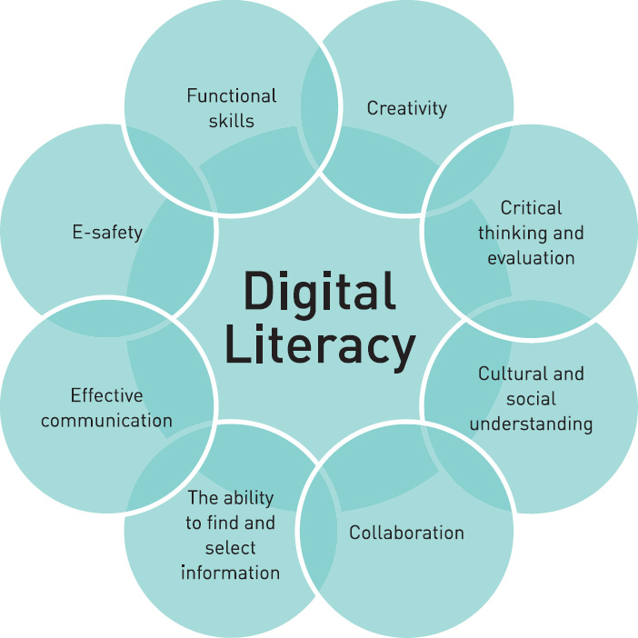
Digital literacy and skills
https://edtechnow.net/2013/03/23/good_lord/

Slide 5
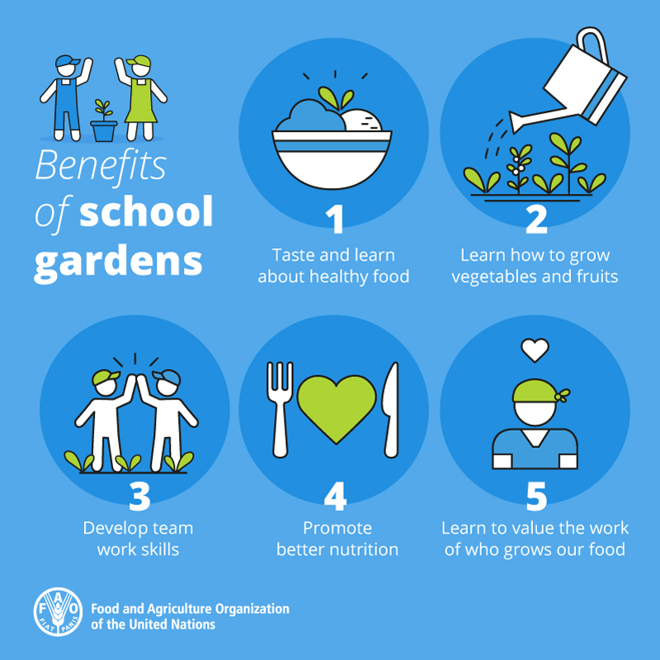
At primary and secondary school level
Are agricultural skills part of the curriculum?

Slide 6
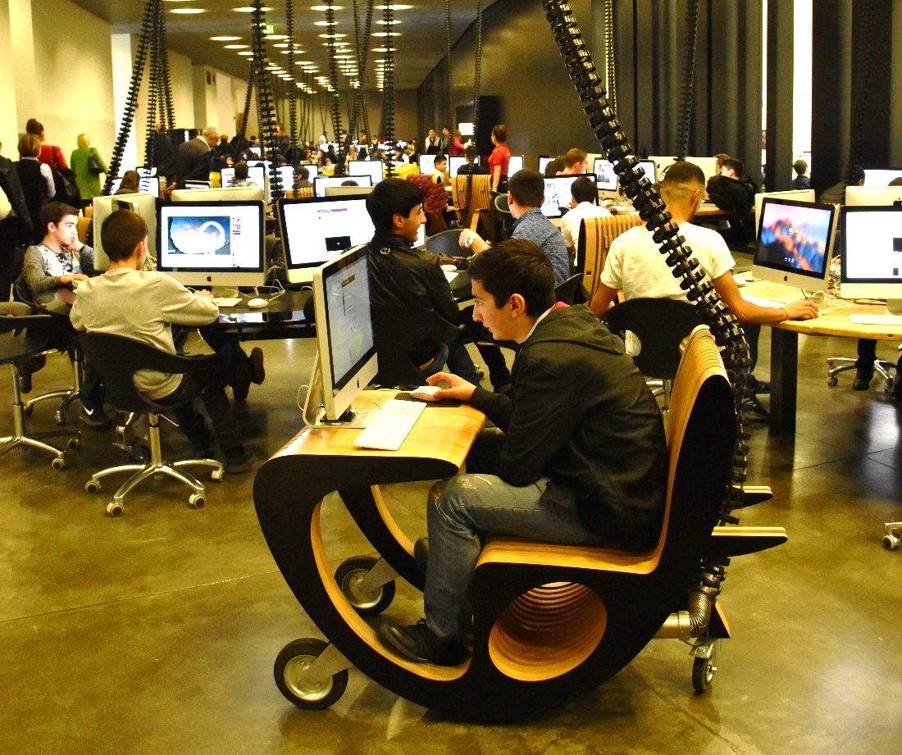
At primary and secondary school level
Basics
Netiquette
Safe use of Internet and social media
Are digital skills part of the curriculum?
e-reputation
Tools
Office package
Collaborative spaces
Apps
Gamification

Slide 7
Life long learning at farm level and in rural areas for all
Digital skills in rural areas? A few examples
Purpose
Audience
Methodology
Farm mgt
Age
Farmer field school
Precision Ag
Sex
Field days - visits
Marketing
Role
Face-to-face
Tax & Subs
Literacy level
e-learning

Slide 8
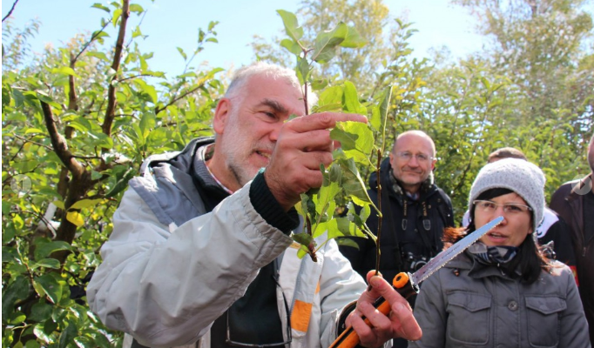
Learning by doing
“I hear and I forget.
I see and I remember.
I do and I understand.”
Confucius
Farmers prefer:
Concrete, localized info at the right time
Videos
Mobile phone resistant to shock, water, cold and heat, with large keys (big fingers)
Support from trusted people
Source: FAO Armenia - Farmers field schools in video

Slide 9
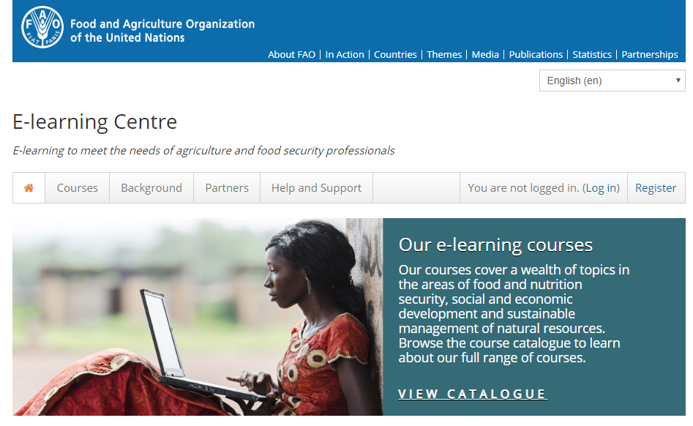
FAO e-learning Centre https://elearning.fao.org/

Slide 10
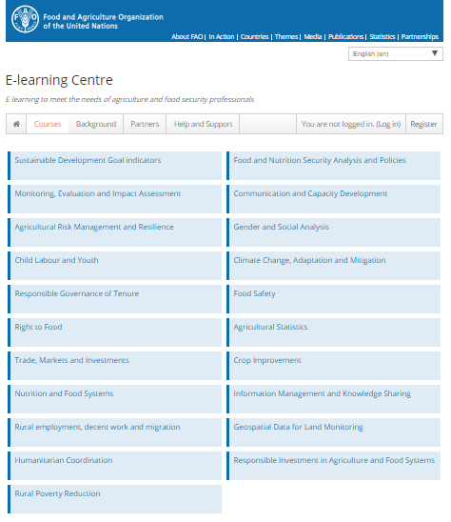

Slide 11
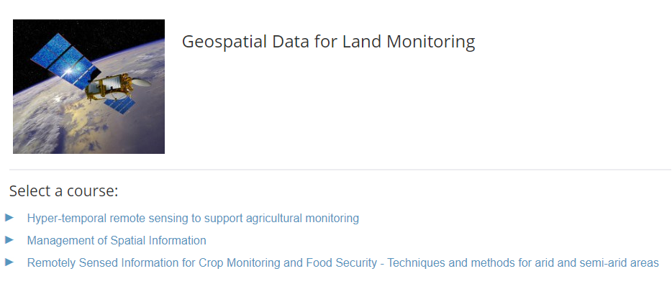

Slide 12
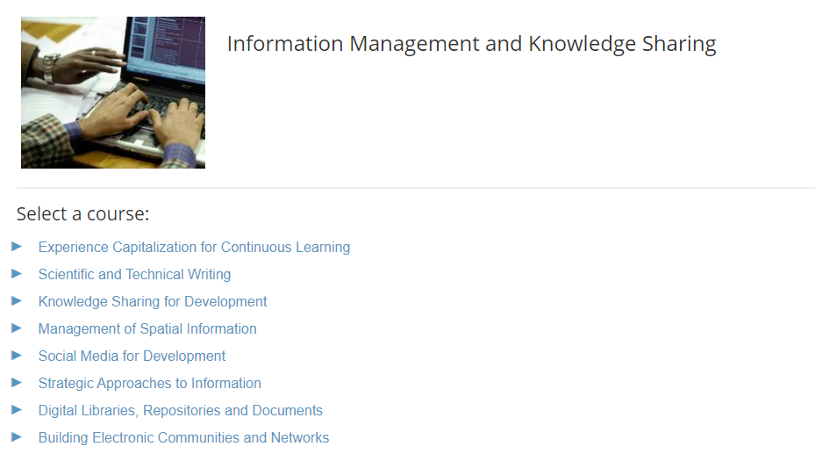

Slide 13
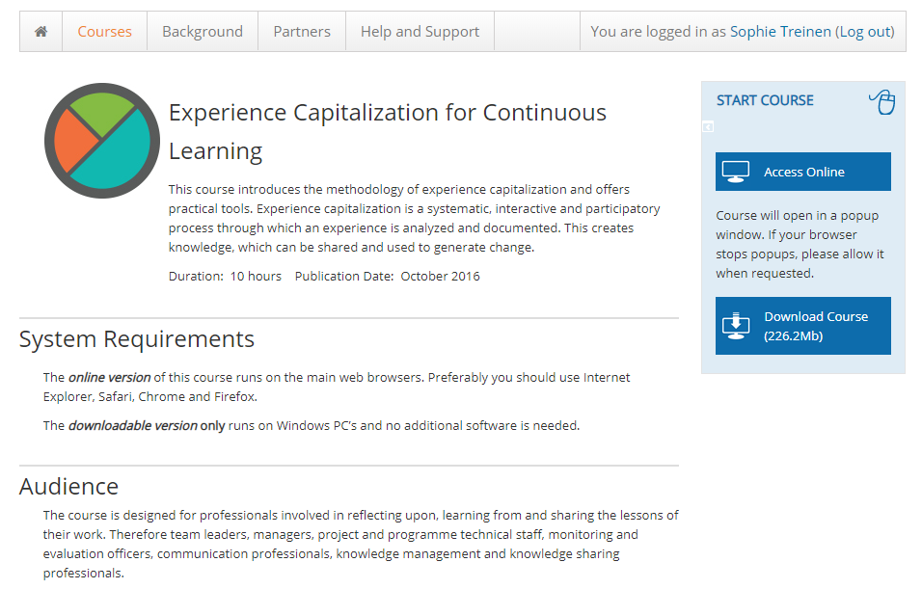

Slide 14
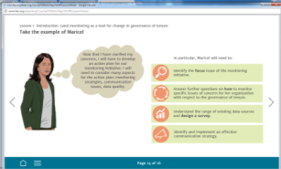
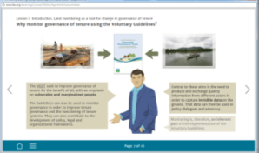
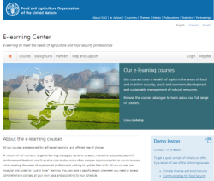
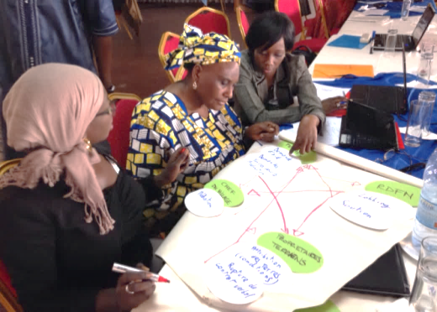
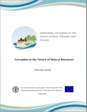
E-learning content and delivery methods
E-learning Content
Internet
Other Learning Systems Universities, Donors, Other UN, NGOs
Online tutored courses
Face to face
Notes:
Policy makers
Administrators
Service deliverers in public and private sectors
Dispute resolution actors
Advocacy, control and monitoring professionals
Civil society
Private sector
Academics
Researchers

Slide 15
Let’s discover together
FAO e-learning Centre
https://elearning.fao.org/

Slide 16
Thank you
For more information
https://elearning.fao.org/
sophie.treinen@fao.org

Slide 17
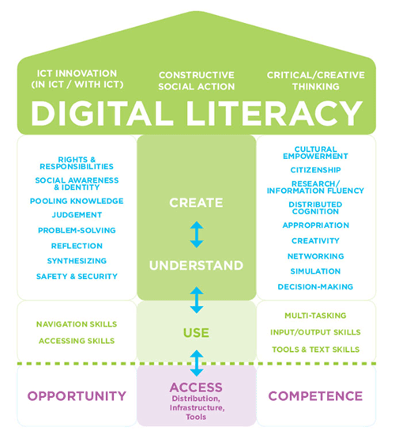
http://mediasmarts.ca/digital-media-literacy/general-information/digital-media-literacy-fundamentals/digital-literacy-fundamentals

Slide 18
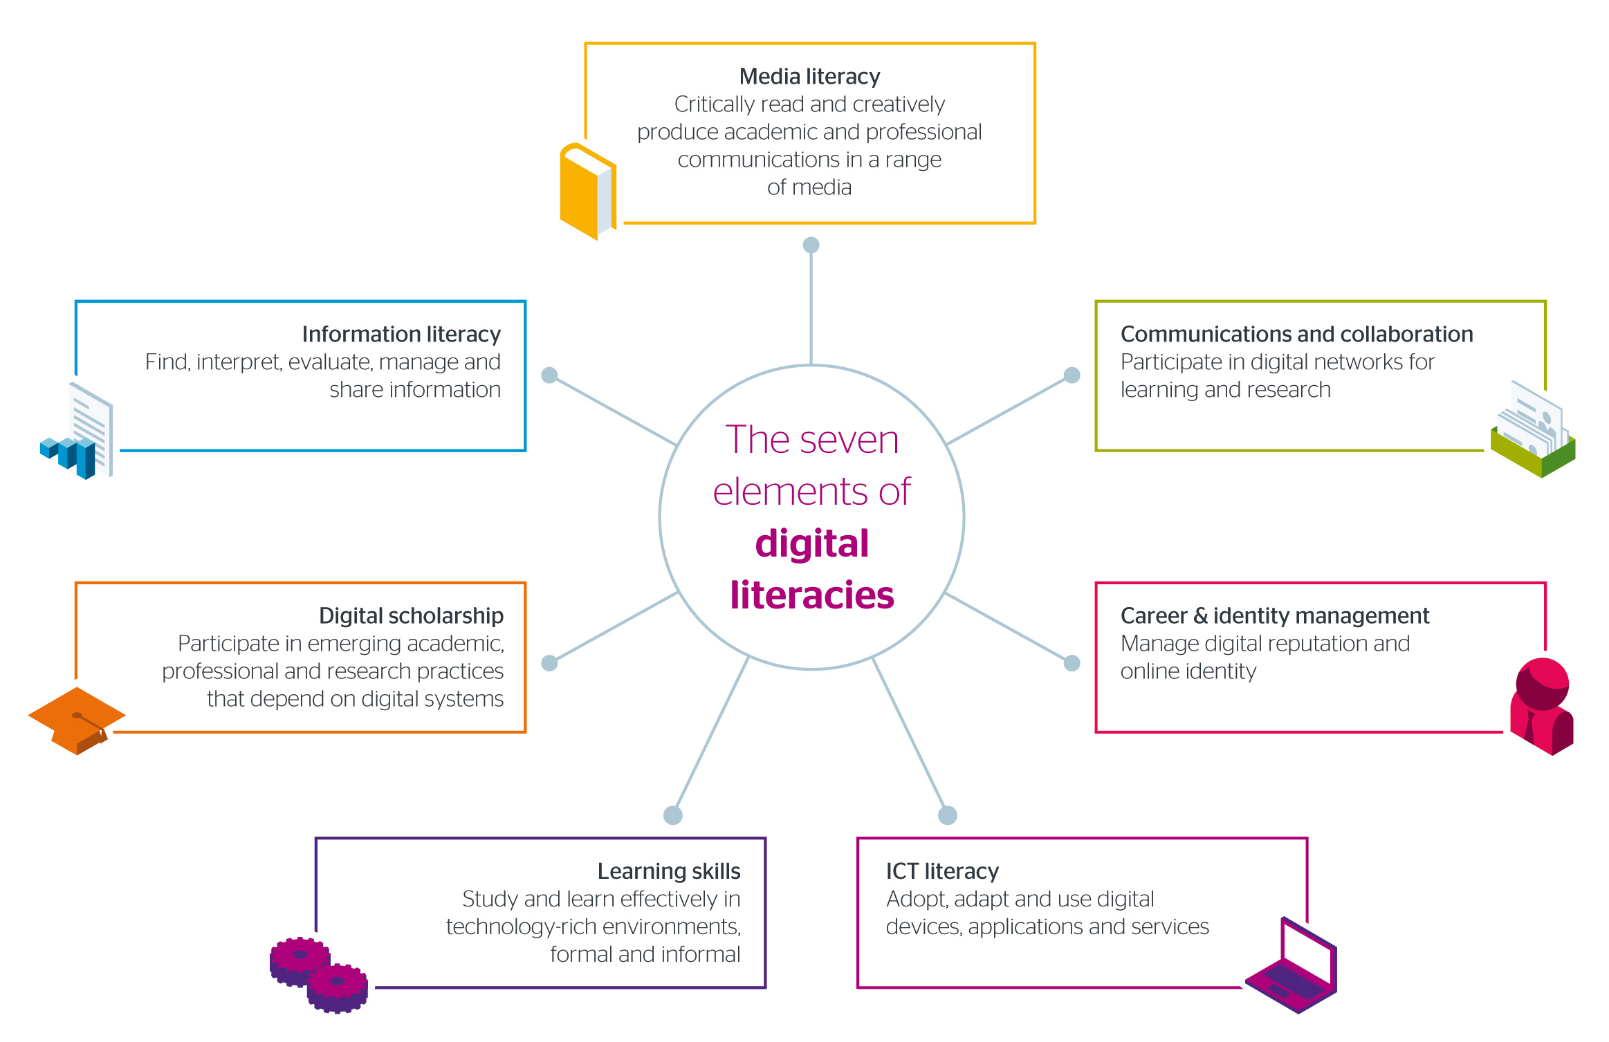
Seven element of digital literacies - ©Jisc CC BY-NC-ND

