Slide 1


FAO VME Database and
Input user guide
The purpose of this voice over presentation is to enable regional bodies to undertake data entry for the purpose of reviewing previously entered data and for entering new data.
VME database (beta 1.0) can be viewed at http://figisapps.fao.org/figis/geoserver/figis-vme/
An input user guide have been developed to assist this.
FAO support will be provided to data inputters as part of the development process.

Slide 2
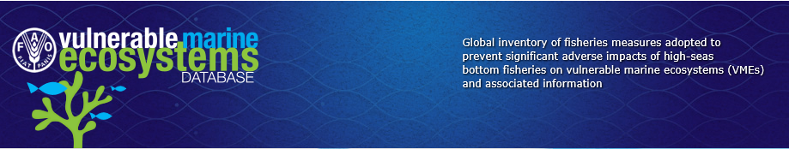
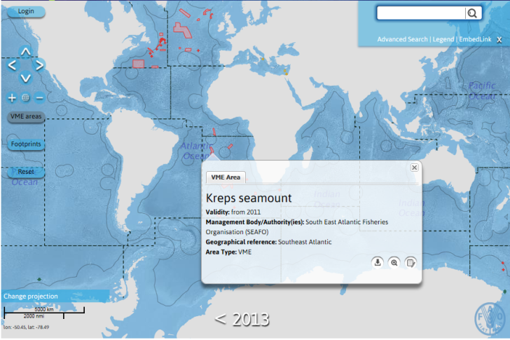

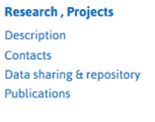


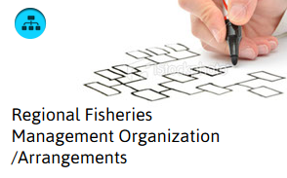
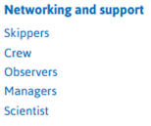
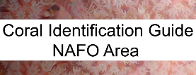
Portal
VME Database
VME DB (this presentation)
UNITED NATIONS
Species Identification
Notes:
VME DB Portal

Slide 3
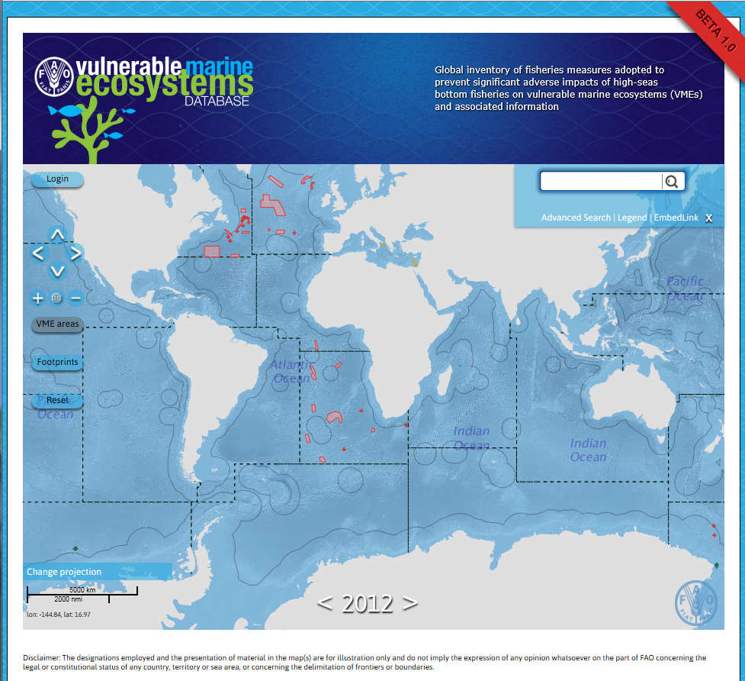
VME Database
Page showing searchable map, legend and search interface
Notes:
I think I would have the search function separately and add VME name. Ideally this could also be selected with a filter if the RFB is selected first.

Slide 4
VME-DB Input User Guide
The VME-DB Input User Guide is in two parts:
Part 1. Introduction to the VME-DB version Beta 1.0 Oracle database
Part 2. Data input via MS EXCEL forms (worksheets).

Slide 5
Part 1. Introduction to the VME-DB version Beta 1.0 Oracle database

Slide 6
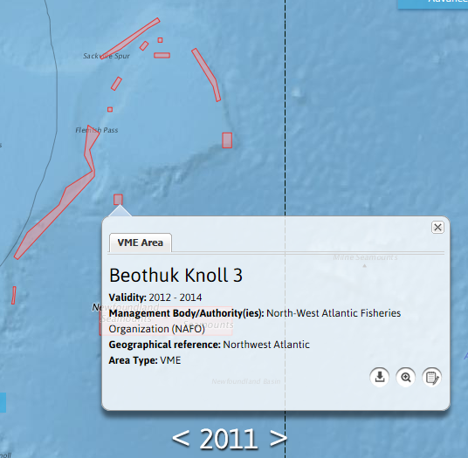

Mouse-over VME
Basic information in pop-up
Download shapefile
Zoom to area
View factsheet

Slide 7
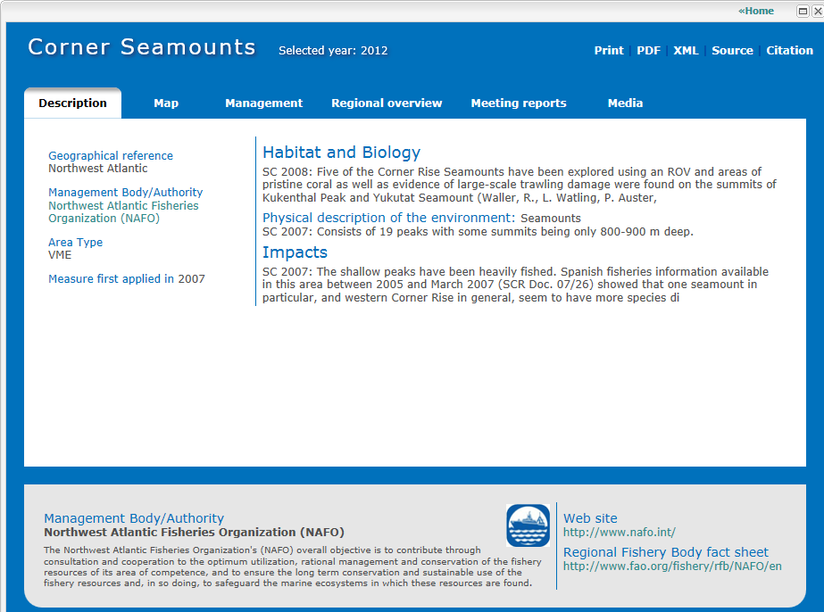
VME Factsheets
Characteristics of VME and human impact
Media
Detailed map of VME
VME measures within RFB
General history of DSF and VMEs within RFB region
Meeting reports and measures

Slide 8
Comments on the Beta 1.0 VME Database
The VME database is written in Oracle and available as a Beta 1.0 version
The Beta 1.0 version is fully functional (but with opportunities to extend)
Data is currently entered through MS EXCEL worksheets and mapped to the Oracle database
Input will eventually be through customised input forms
Beta 1.0 can be viewed at http://figisapps.fao.org/figis/geoserver/figis-vme/

Slide 9
Part 2. Data input via
MS EXCEL forms (worksheets)

Slide 10
Data input
To date, data input has been undertaken by FAO for some VMEs from NAFO, NEAFC, SEAFO, CCAMLR and GFCM. This was necessary for the development of the database.
The data entered was undertaken at different stages in the development process and is not necessarily consistent. ALL entered information needs checking, editing and validating.
It is expected that data will be entered for a full year, say 2012, by all partners (n.b. It may be easier to start from the beginning as the database is really designed to build on previous year entries).

Slide 11
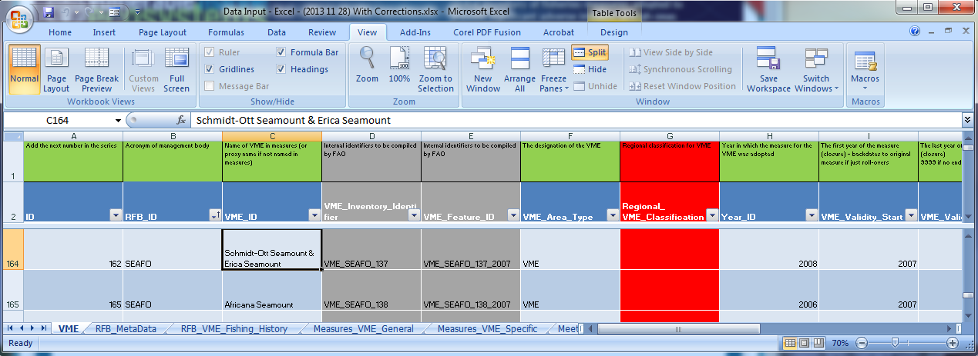
MS EXCEL input forms
The MS Excel input tables (worksheets) are designed by “subject” area:
VME
RFB
Regional history (VMEs, fishing footprints)
General measures
Specific Measures
Meetings
Key
Green = Description of fields (columns)
Dark blue = Field names
Light blue = Records (rows)
Grey = FAO entered fields
Red = Field in Excel input but not yet in database

Slide 12
Data entry - preparation
The purpose of the database is to provide access to information.
Some of the information is stored directly within the database.
Some is summarised in the database with links or references to the source document.
Source documents are typically meeting reports or measures pdfs
Some preparation is necessary for easy data entry in to the separate worksheets “tables”. This is explained in the guide.

Slide 13
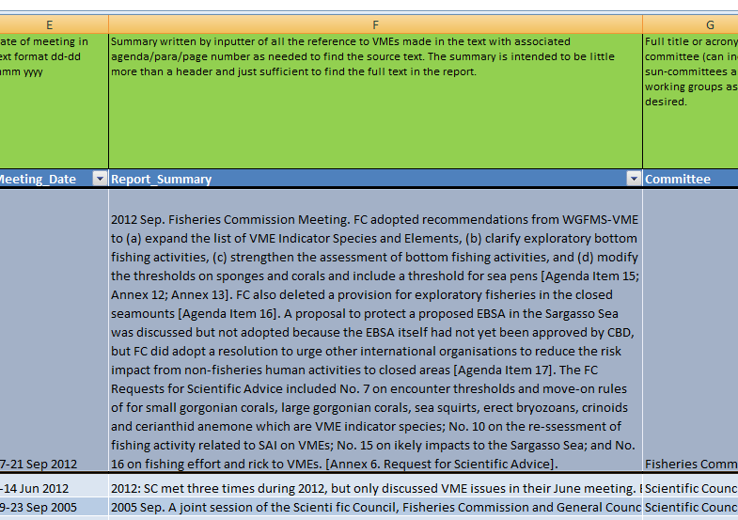
Example of Preparation e.g. Meeting Reports
An example of an input into the Meetings Reports table showing both the worksheet view and form view. Notice the field “Report_Summary”

Slide 14
Example of Preparation
“Report_Summary” field for Record 1
2012 Sep. Fisheries Commission Meeting. FC adopted recommendations from WGFMS-VME to (a) expand the list of VME Indicator Species and Elements, (b) clarify exploratory bottom fishing activities, (c) strengthen the assessment of bottom fishing activities, and (d) modify the thresholds on sponges and corals and include a threshold for sea pens [Agenda Item 15; Annex 12; Annex 13]. FC also deleted a provision for exploratory fisheries in the closed seamounts [Agenda Item 16]. A proposal to protect a proposed EBSA in the Sargasso Sea was discussed but not adopted because the EBSA itself had not yet been approved by CBD, but FC did adopt a resolution to urge other international organisations to reduce the risk impact from non-fisheries human activities to closed areas [Agenda Item 17]. The FC Requests for Scientific Advice included No. 7 on encounter thresholds and move-on rules of for small gorgonian corals, large gorgonian corals, sea squirts, erect bryozoans, crinoids and cerianthid anemone which are VME indicator species; No. 10 on the re-assessment of fishing activity related to SAI on VMEs; No. 15 on likely impacts to the Sargasso Sea; and No. 16 on fishing effort and risk to VMEs. [Annex 6. Request for Scientific Advice].
Here we are trying to indicate topics discussed at the meeting with a reference to the main text in the report. This needs to be prepared in advance of data entry.

Slide 15
Data entry – Input frequency
Table | Input Frequency | First year of input (hours per year) | Subsequent input (hours per year)
RFB_MetaData | Once every 5 years | 1 | 0.1
Regional_History | Once every 2 years | 3 | 1
VME | Once every year | 14 | 3
Measures_VME_General | Once per year | 2 | 2
Measures_VME_Specific | Once per year | 1 | 1
Meeting Report | Say 3 times per year | 3 | 3
TOTAL INPUT PER YEAR |  | 24 (= 3 days) | 10.1 (= 1+ days)

