Slide 1
7 Reasons
FOR
OceanExpert
REDESIGN
ISSUES
&
SOLUTIONS

Slide 2







1
Restrictions
ISSUES:
Cannot use different CMS
All programme websites use custom PPC : Incompatible code
Problems implementing PPC on newer versions of Joomla
SOLUTIONS:
OceanExpert will be used for creating/editing records
Data will be displayed on individual programme websites
WebService
Add / Edit
WebService
WebService

Slide 3

2
Interoperability
ISSUES :
Need to “Talk” to partner organization / project websites
Institutions and Projects want easy access to data
WMO
LME Learn
IOC Country Profiles
OBIS
SOLUTIONS :
Standard Technology and no more black boxes
Web services and APIs
Structured data
Semantic Technologies
Authentication API

Slide 4

3
Quality
ISSUES:
Incorrect records
Multiple profiles for the same experts and organizations
Institutions without members
Wrong or made-up email addresses
Manual Cleanup tedious
SOLUTIONS :
Controlled Lists of affiliation, sea regions etc.
New institution management system
Country based expert registration
Email verification of new registration
Less need for manual intervention
Common notification email for permanent deligations

Slide 5

4
Efficiency
ISSUES:
Manual quality control
Difficult to find person (multiple profiles)
Non-working / Bouncing emails
Incorrect Details such as affiliation or address
SOLUTIONS:
New institution management system
Working email addresses
Reduced instances of incorrect addresses
Better self registration for events
Self application for trainings

Slide 6

5
World has changed - Users
ISSUES:
Expect More
Smooth experience
Will not update details
Use modern browsers
Online Privacy and Security
Language support
SOLUTIONS :
Latest Responsive design
Less page reloads
Support for all modern browsers
Support for different designs
Enhanced security with encrypted passwords
Internationalization ready

Slide 7

6
World has changed - Security
ISSUES:
Attacks to steal information are growing
Present version is vulnerable
Users complain about plain text passwords
Users worried about hacking
Users want password reset.
SOLUTIONS :
More security against hacking
Encrypted passwords
Password Reset Email
Email Verification
High security technology

Slide 8

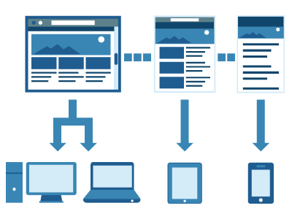
7
World has changed - Devices
ISSUES:
Various Devices
Operating Systems
Screen Sizes
Browsers
SOLUTIONS :
Responsive Design
Latest Browser compatibility

Slide 9
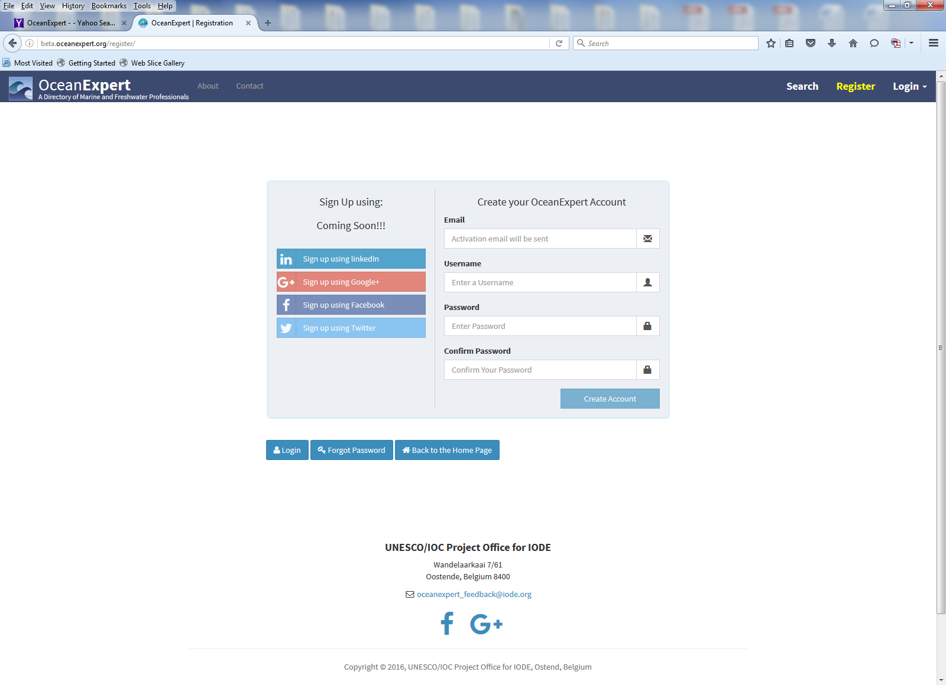
Example of New page:

Slide 10
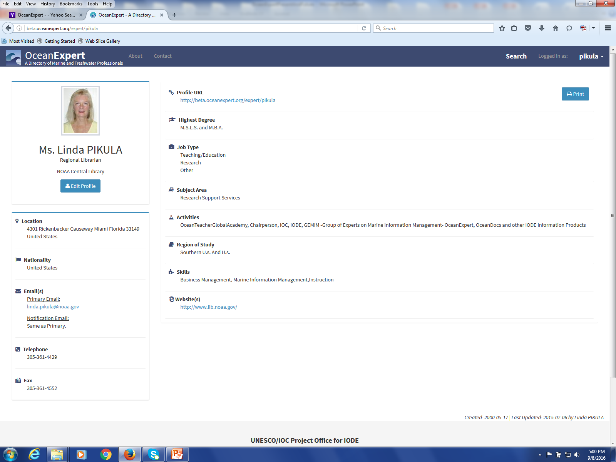
My Page:

