Slide 1


CCSBT
Overview and expectations from workshop
Commission for the Conservation
of Southern Bluefin Tuna
Rome 19-22 March 2018

Slide 2
General Overview of the CCSBT
Manages a single species, Southern Bluefin Tuna
8 Members – Australia, European Union, Indonesia, Japan, Korea, New Zealand, South Africa, Taiwan
No convention area, CCSBT manages the global fishery of SBT
Strict annual catch quota, 17,647t for 2018, distributed to the 8 Members.

Slide 3
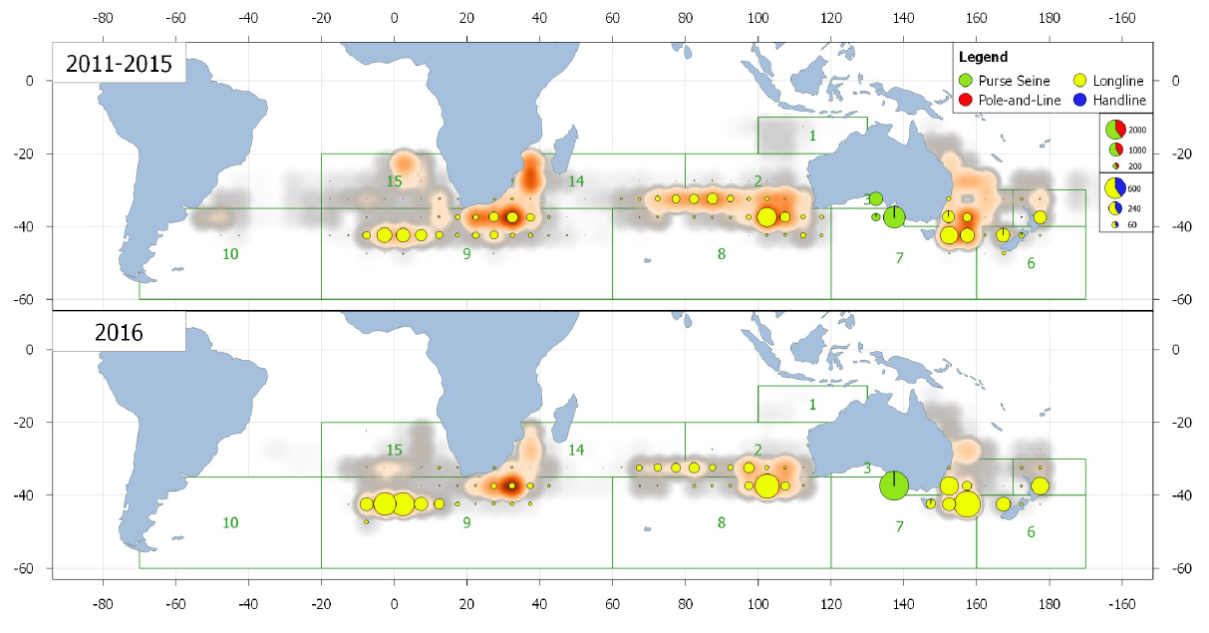
SBT catch distribution

Slide 4


Flow of data to CCSBT
Compliance data
Transhipment
CDS
Landings
Logbook
Observer
VMS
Government Fisheries Authority
Science data
Authorised vessels
Total catch by month
Aggregated C&E
Aggregated observer for ERS
Other Scientific Data
CCSBT
Compliance Data
Science Data

Slide 5
Provision of data to CCSBT
Compliance Data
Catch Documentation Scheme
  CDS tag on every fish caught, weight and length
  Imports and exports
  Farm stocking and transfers
Transhipments – including observer reports of TS
Authorisation of fishing and carrier vessels to catch and transship SBT
Authorised farms
Data provision and entry:
CDS data required every quarter, sometimes more frequently
  Scans of paper forms – entered manually
  Excel templates of data - most loaded electronically (CDS tags in the hundreds of thousands in some quarters)
Transhipments, Authorisations provided within days of event.

Slide 6
Provision of data to CCSBT
Science Data – includes:
Total annual catches by fleet
Aggregated catch and effort (5 x 5 x month)
Ageing, length, an CPUE datasets
Non-retained catches / recreational catches
*** Essentially no operational level logbook or observer data, no VMS data. Member countries collect, validate, and process these and send the CCSBT aggregated data.
Science data provision and entry:
Provided in Excel files annually
2 Data exchange periods
  ~April for general scientific data
  July for ERS data
Science data are used by the CCSBT Management Procedure and Stock assessments – a single dataset and agreed methods / models.

Slide 7
Expectations from workshop
Global tuna RFMO harmonisation standards
  Reference data
  Reporting standards
The CCSBT is reviewing its systems and will move to standards for reference tables and reporting where possible
Impact of Session 2?
Possibly not a lot since CCSBT doesn’t deal with operational level data
Datasets are fairly regular and aggregated

Slide 8
Experiences of data collection of artisanal and recreational fisheries
Indonesian SBT catch is largely artisanal, but is managed by Indonesia
Australia has a large recreational catch of SBT and is attempting to get estimates. They haven’t achieved this yet but are making efforts to do it in a robust way (expensive and complicated since Australia's recreational fisheries are managed by the States

Slide 9
End

