Slide 1
Inter-American Tropical Tuna Commission
  Technical workshop on global harmonization of Tuna fisheries statistics
  19-22 March, 2018
  FAO HQ, Rome
  Nick Vogel – IATTC Data manager
  nvogel@iattc.org

Slide 2
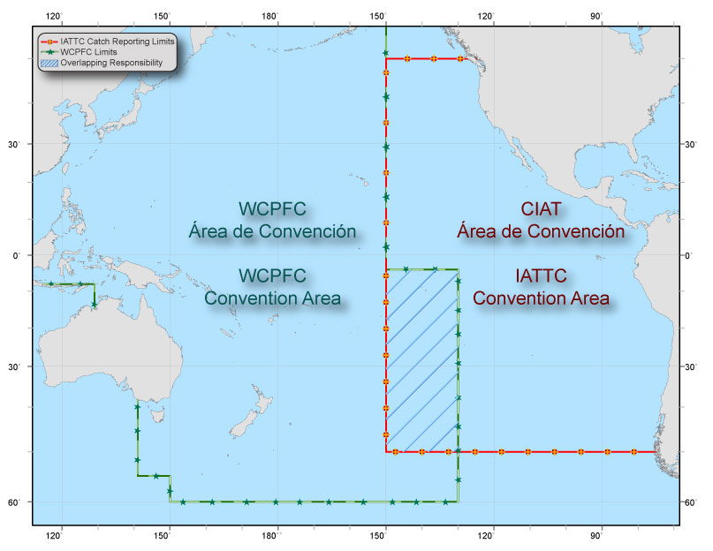
Inter-American Tropical Tuna Commission

Slide 3
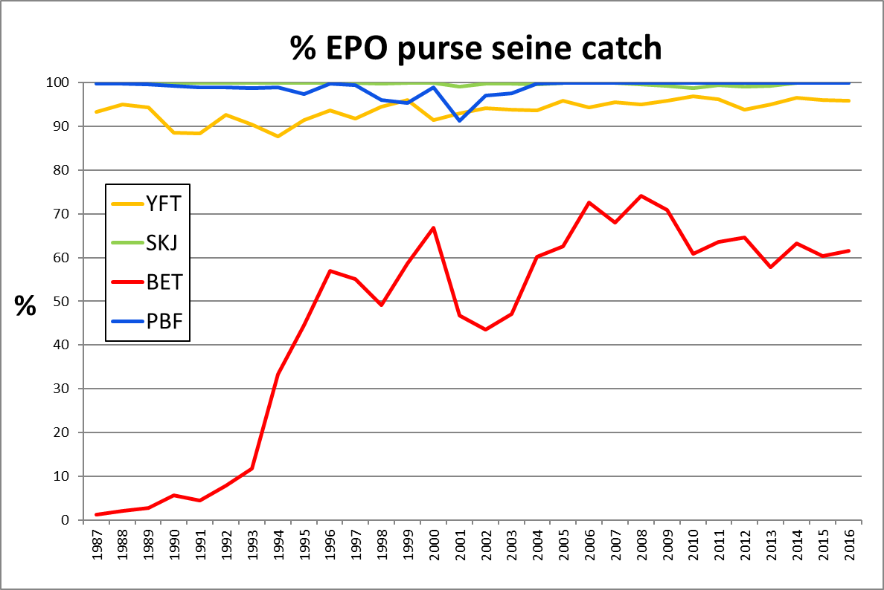
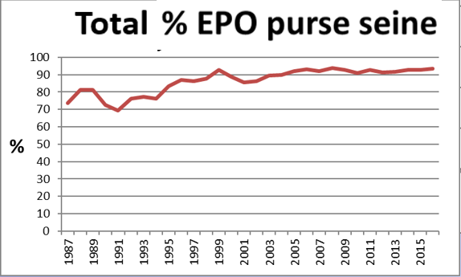
Inter-American Tropical Tuna Commission
Notes:
93% of total EPO tuna is purse seine. 7% longline. <0.1% other gears.

Slide 4
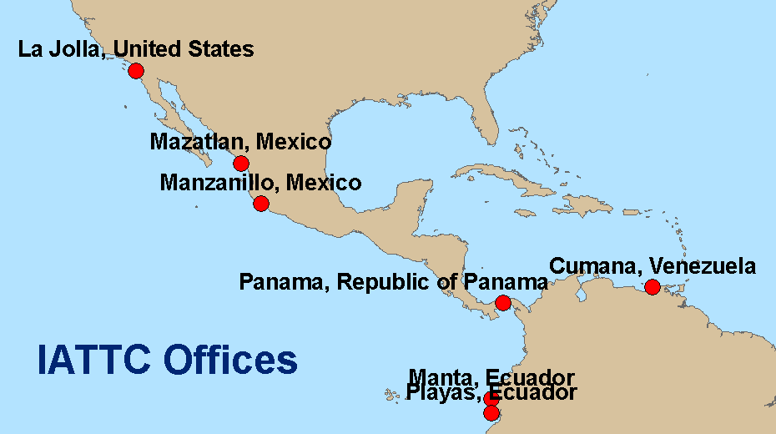
IATTC offices

Slide 5
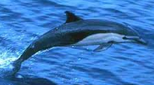
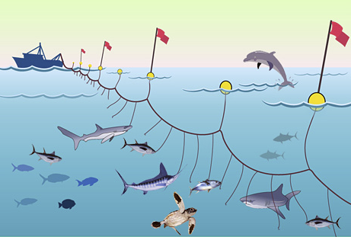
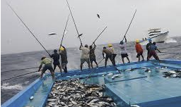
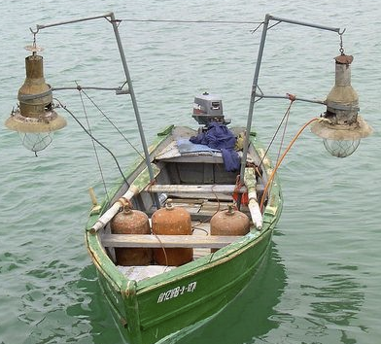
IATTC data sources
  Purse seine
  Data sources
    Fishing vessel logbooks (1958 >)
    Cannery unloading data (1958 >)
    Field office tuna sampling (1970 >)
    Onboard observer program (1979 >)
      IATTC
      National Observer programs
Industrial longline
  Data sources
    Country submissions
      EPO aggregated catch and effort
      C&E year/month/5x5° cell
    LL observer program
      Established 2014
      5% coverage goal
    Transshipment observer program
      EPO high seas transshipments
  Bait boat
  Data sources
    Fishing vessel logbooks (1931 >)
    Cannery unloading data (1958 >)
    Field office tuna sampling (1970 >)
  Artisanal gear
  Data sources
    Collected at national level

Slide 6
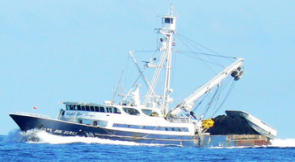






Data flow
  Purse seine
  Observer data
  IATTC
  Observer data
  Catch/effort data
  Field offices
  Fishing logs
  Cannery data
  Observer data
  Length frequency
  Preliminary
  summary
  sampling
  Physical data sheets
  Industrial longline
  National observer program data
  Excel
  text files
  Word
  IATTC Headquarters
  San Diego, CA USA
  High-seas transshipment observer program
  Yearly summarized data submissions
  Data entry / edit
Permanent database
  Data entry / edit
Temporary database
Notes:
Windows forms rather than web forms

Slide 7
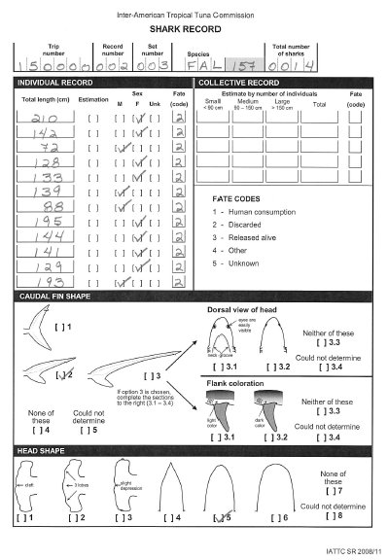
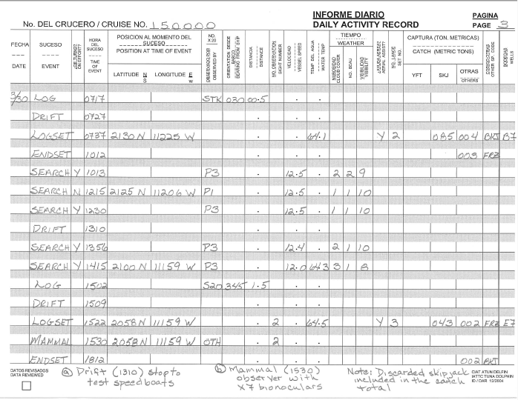
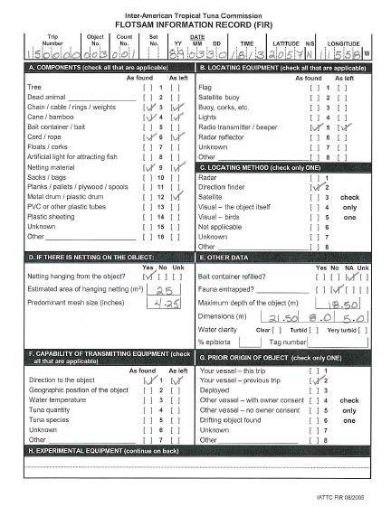
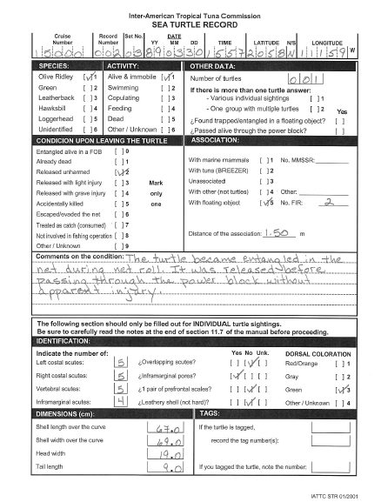
Harmonization of reference data
  Purse seine observer data
    High resolution
      Continuous monitoring of vessel activity: search, run, drift, sets
      Position every 2 hours
      Detailed catch and bycatch data
      Flexibility in reporting – data may be grouped as needed

Slide 8
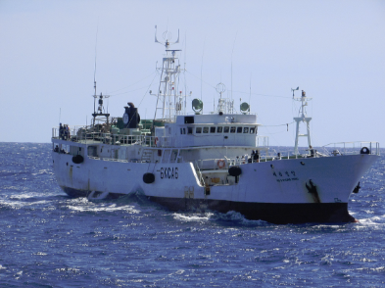
Harmonization of reference data
  Industrial longline data
    Country submissions
      Aggregated catch and effort
      C&E year/month/5x5° cell
      No. individuals, weight, both
      Effort as number of hooks
    Size measurements
      Length, weight, both
      Varying cell size aggregation
        1x1°, 5x5° and 5x10°
      Varying time aggregation
        Month and quarter
      Varying bin size
        1, 2 and 5 cm/kg
  Industrial longline observer data
    LL observer program
      Established 2013 – IATTC Resolution C-11-08
      5% coverage goal
    To date IATTC receives summarized reports from most countries
  Transshipment observer program
    Established 2009
    Covers high-seas transshipments in the EPO
    Transshipment declaration data

Slide 9
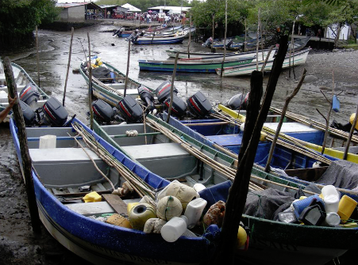
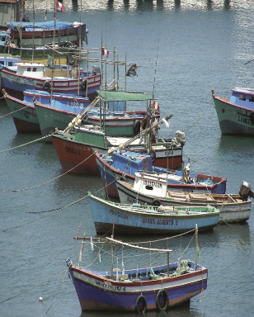
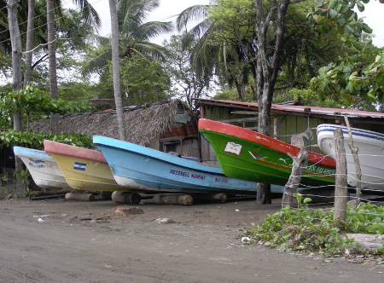
Harmonization of reference data
  Artisanal gear
    Small longline skiffs
    Limited data collected
      Known to catch small % of EPO tuna
      Substantial catch of sharks, billfish, large fish (dorado, etc.)
    IATTC collaboration with countries
      Shark landings

Slide 10
