Slide 1


Overview OF IOTC fisheries data REPORTING AND MANAGEMENT PROCESSES
Technical workshop on global harmonization of Tuna fisheries statistics
CWP ad-hoc Task Group on reference harmonization
IOTC Secretariat – Fabio Fiorellato, Data Coordinator

Slide 2
IOTC history and mandate
Background + context
The agreement for the establishment of the Indian Ocean Tuna Commission (IOTC) was signed in 1993 and entered in force in 1996;
The IOTC agreement covers 16 tuna and tuna-like species…
… within an area of competence corresponding to the Western and Eastern Indian Ocean (FAO areas F51 and F57);
As of January 2018, the IOTC has 34 CPCs of which 31 are contracting parties while 3 are cooperating, non-contracting parties;
IOTC mandate is not to directly collect data: rather, the IOTC Secretariat receives information from CPCs and contributes to strengthen data collection at national level through capacity building activities.

Slide 3
IOTC REQUIREMENTS
REQUIREMENTS | general
50 active IOTC Resolutions (binding)
31 have reporting obligations
83 total reporting requirements
Reporting information (e.g. Resolution 16/07 – Banning of artificial lights to attract fish)
Reporting data (e.g. Resolution 15/02 – Mandatory statistical information)
Notes:
Data is more “structured” that information – easier to model and process
Resolution 16/07 -> e.g. whether or not a law has been enacted / is in the process of being drafted / does not exist
Resolution 15/02 -> well known data sets, formally specified

Slide 4
IOTC resolutions (SCIENCE)
REQUIREMENTS | science
15/02 – Mandatory statistical data (all fisheries)
15/05 – Conservation of marlins
17/05 – Conservation of sharks
17/08 – Procedures on a Fish Aggregating Devices (FADs) mgmt. plan
11/04 – Observers coverage
13/04 – Interaction with cetaceans
13/05 – Interaction with whale sharks
Notes:
Data + science related
Conservation of marlins and sharks request explicit reporting by CPCs, beside setting other specific requirements (release, cap on catches)

Slide 5
IOTC resolutions (COMPLIANCE)
REQUIREMENTS | COMPLIANCE
01/06 – Import of frozen bigeye tuna caught by large-scale LL vessels
05/03 – Catch composition landings (foreign vessels)
10/08 – Attributes of active domestic vessels
10/10 – Import, landing, transhipment of tuna and tuna-like products in port
14/05 – Attributes of foreign vessels licensed to fish IOTC species in the waters of coastal States
15/04 – Attributes of authorized vessels
17/08 – Procedures on a Fish Aggregating Devices (FADs) mgmt. plan
Notes:
Mostly related to compliance

Slide 6
IOTC Secretariat structure
Processes | overview
Three distinct, interacting sections, sharing information with CPCs, scientists, policy makers and stakeholders
CWP focus
Regional Observer Database
Science
Consolidated
To be strengthened
Data
Compliance
Statistical Working System
RAV + e-PSM, IUU list
Notes:
Data flows have different “strengths”, depending on the source / target sections

Slide 7
IOTC TIMELINE
Processes | workflow
JAN - APR
May
June 30th
Jun-dec
Dec 30Th
CPCs
Comp. DATA SUBMISSION
Compliance committee
CPCs
Stat. data submission
Working
parties
CPCs
Stat. data Updates (LL)
compliance assessments
STAT. data
validation
Scientific committee
STAT. data assessments
Current year
Next year
CPC
IOTC
Meeting
Notes:
CPCs compliance data submission: e.g. Reports of implementation / Compliance questionnaires / National reports etc.

Slide 8
DATA Reporting requirements
REPORTING | SCIENTIFIC information
RETAINED
DISCARDED
OBSERVER DATA
Resolution 15/02
Resolution 17/08
Resolution 11/04
IOTC Species
Nominal Catch
Form
1RC
Catch & Effort
Forms
3CE / 3AR
3FA / 3SU
Size & Freq.cy
Form
4SF
Discards
Form
1DI
IOTC Observer templates
ROS e-reporting
Sharks
Voluntary
Other species
Resolution 13/05
Whale sharks
GN / PS
Resolution 12/06
Seabirds
LL / GN
Resolution 13/04
Marine mammals
GN / PS LL
Resolution 12/04
Marine turtles
PL / GN PS / LL

Slide 9
IOTC main DATA SETS
reporting | Data sets
* currently subject to revisions
 | DATA SET | FORM | TIME RES. | AREA RES. | NOTES
OBLIGATORY | Nominal catches in live weight | 1_RC* | Year / Quarter | IO areas (W/E) | ---
 | Discard levels in live weight or numbers | 1_DI* | Year | IO areas (W/E) | ---
 | Catch-and-effort in live weight or numbers | 3_CE | Month | 1°x1° CWP grids | Surface fisheries
 | Catch-and-effort in live weight or numbers | 3_CE | Month | 5°x5° CWP grids | Longline fisheries
 | Catch-and-effort in live weight or numbers | 3_AR | Month | CWP grids + custom areas | Coastal fisheries
 | FAD numbers, interactions and catches | 3_FA* | Month | 1°x1° CWP grids | Surface fisheries
 | No. of support vessels and effort (days at sea) | 3_SU | Month | 1°x1° CWP grids | PS fisheries
 | Size-frequency data | 4_SF | Month | 5°x5° CWP grids | At least 1 fish should be sampled per each MT of catches reported for the strata
VOLUNTARY | No. of fishing crafts by type of fisheries and craft size | 2_FC | Year | Not applicable | ---
 | Average fish prices by type of fish product and market | 7_PR | Month | Not applicable | ---
 | Country indicators (e.g. GDP, OECD status etc.) | N.A. | Year | Not applicable | ---

Slide 10
IOTC main DATA SETS | details
reporting | Data sets
Nominal Catches: annual report of total catches (in weight) by fleet, gear, species (IOTC and non-IOTC) and IO area
  Includes retained catches and catches used as bait / for crew consumption;
Discards: annual report of discards (in weight or number) by fleet, gear, species and IO area
  Shall include also relevant non-commercial species (mammals, seabirds, cetaceans, whale sharks and sea turtles);
Catch-and-effort: annual report of efforts and catches (in weight or number) by month, fleet, gear, species (IOTC and non-IOTC) and grid / irregular area
  Depending on the gear type, catches can be either in numbers (longline) or weight;
  Also, the minimum grid resolution changes accordingly, and goes from 1x1 degrees grids (surface fisheries) to 5x5 degrees grids (longline fisheries) to any grid / irregular area (coastal / artisanal fisheries);
Size-frequency: annual report of size measurements (mostly, lengths) by month, fleet, gear, species and type of measure.

Slide 11
IOTC main DATA SETS | additional notes
reporting | Data sets
Datasets reported using the IOTC forms are expected to come with the following metadata, either at global or at each strata level:
  Sender / National Organization contact details
  Type of data (final / preliminary)
  Target species for the specific fleet + gear combination
  Data source (i.e. how the original data was collected)
  Data processing (i.e. what type of estimation procedure has been applied to produce the final data)
  Coverage level (i.e. how extensively the strata have been sampled)

Slide 12
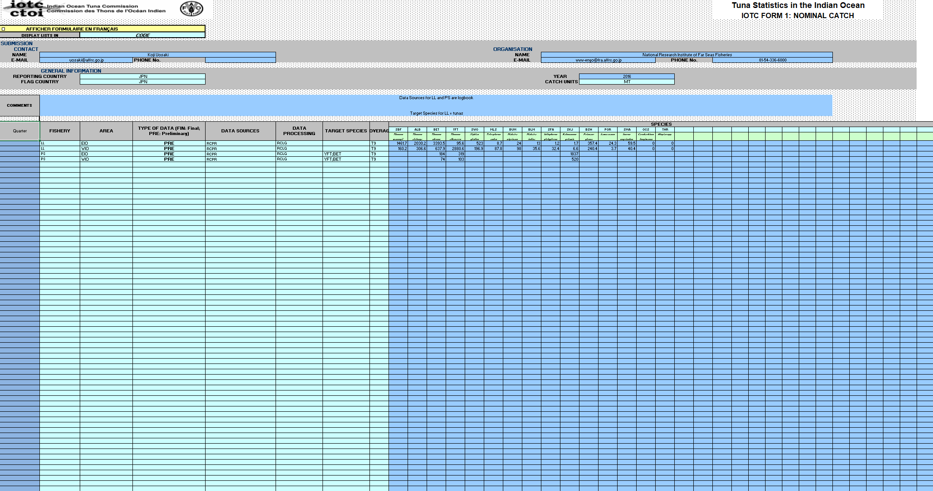
examples | FORM 1_RC – Nominal Catch
reporting | IOTC FORMS and templates
Notes:
This example is lacking the ‘Catch type’ field, that is going to be added in the revised version

Slide 13
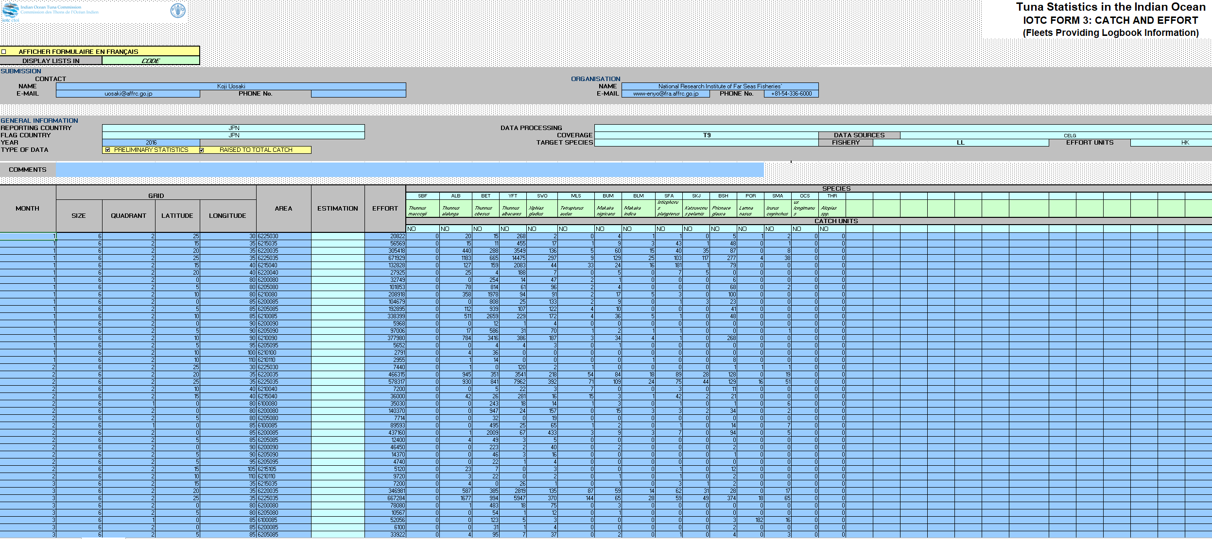
examples | FORM 3_CE – Catch-Effort
reporting | IOTC FORMS and templates

Slide 14
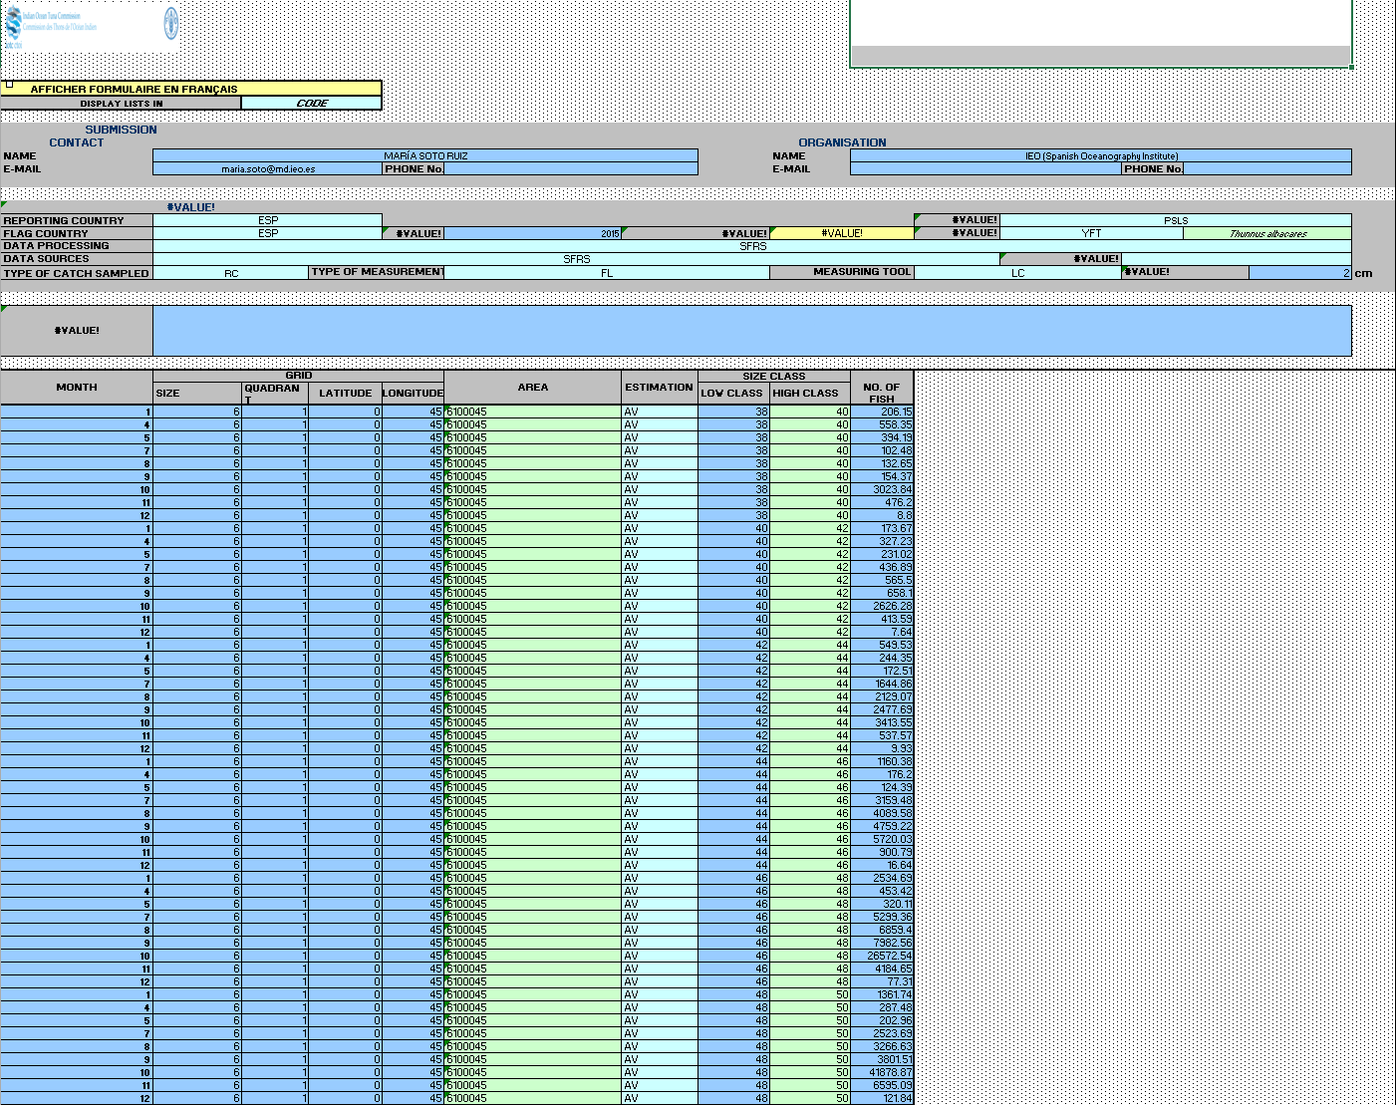
examples | FORM 4_SF – Size-frequency
reporting | IOTC FORMS and templates

Slide 15
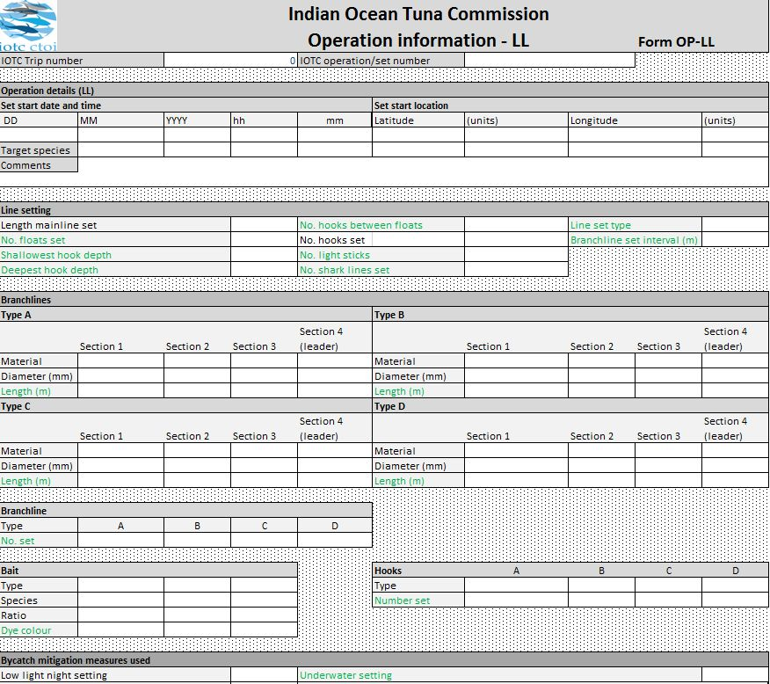
examples | Obs. data reporting template
reporting | IOTC FORMS and templates
Notes:
Example of IOTC observer data reporting form (XLS template)

Slide 16
practical issues
reporting | IOTC FORMS and templates
IOTC forms and templates are RECOMMENDED, not mandatory
  CPCs tend to submit data in whatever format they consider more appropriate or comfortable, sometimes in an incomplete way;
IOTC forms include reference lists and basic quality checks, and are password protected to avoid tampering
  CPCs often use their own copy of the forms, lacking data input checks and proper, standardized reference data;
IOTC forms have a rigid structure, suited to be filled manually by a trained clerk
  This can be impractical for some data sets; many CPCs lack adequate capacity to design automated processes to correctly fill the forms with required data;
Scientific observer data often come in formats (PDF, Word document) not suitable for acquisition and processing
  The ROS pilot project considers – among its outputs – standardized data collection and reporting tools

Slide 17
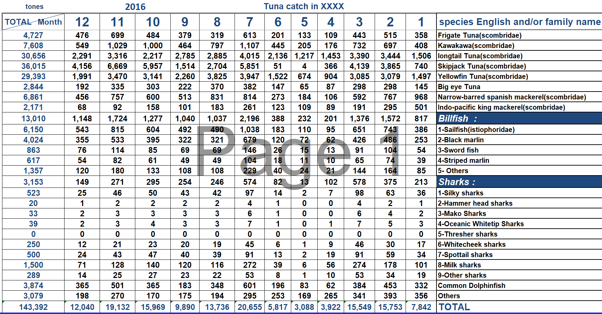
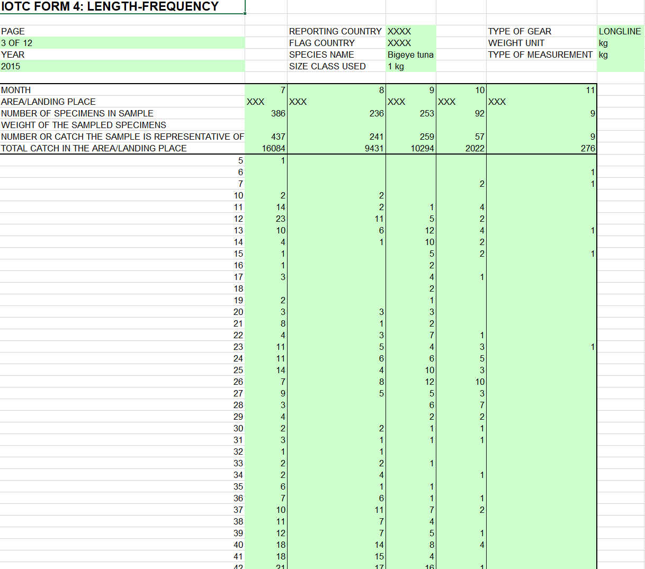
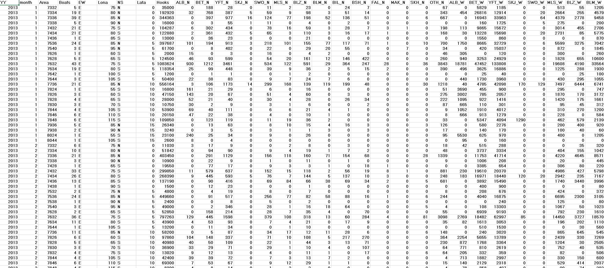
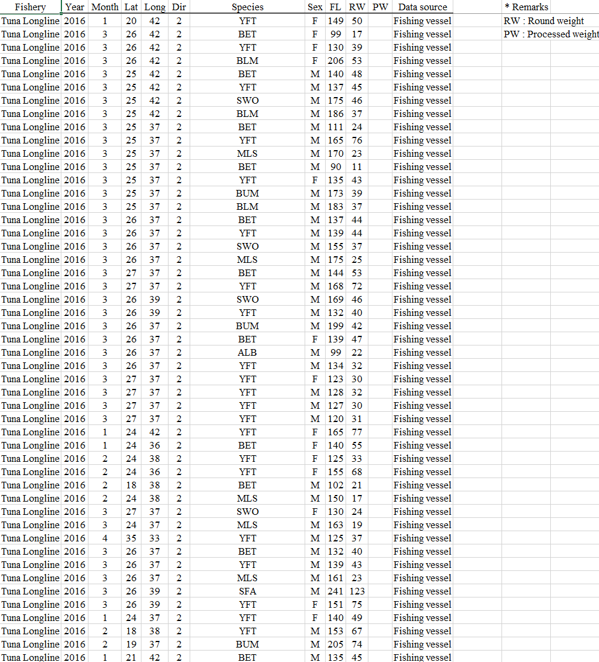
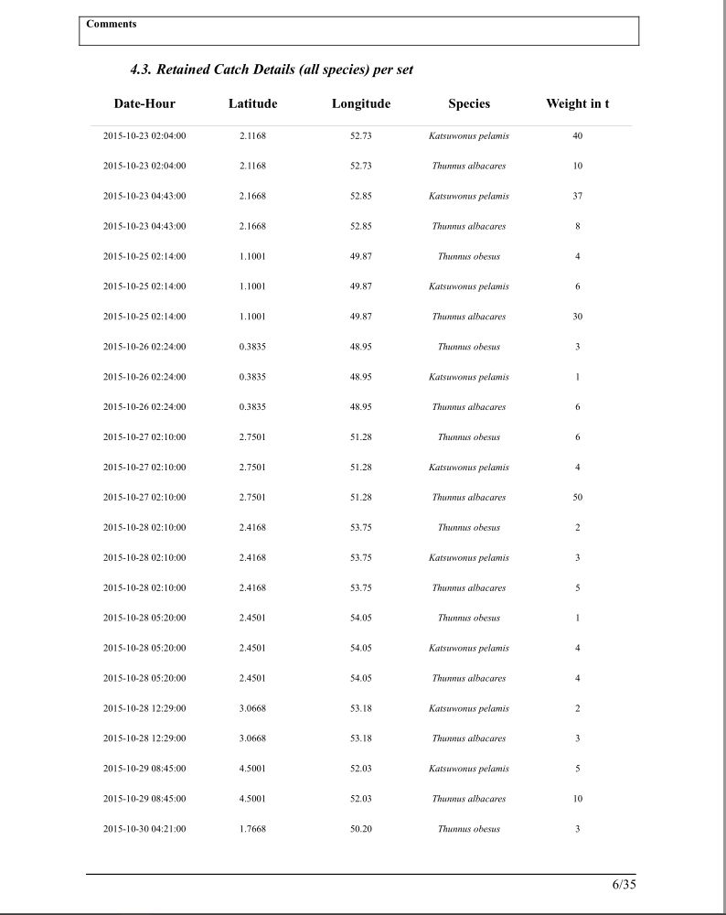
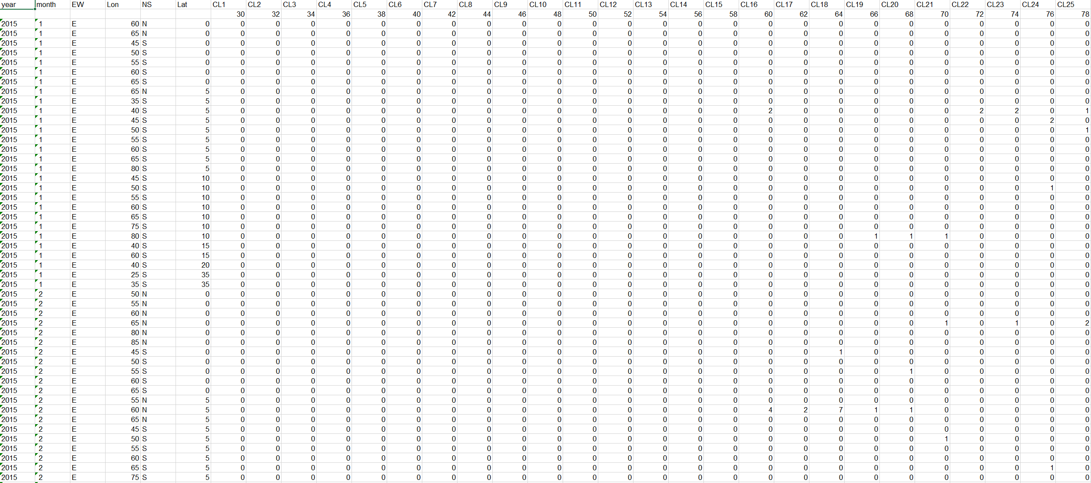
examples | custom, CPC-SPECIFIC forms
reporting | IOTC FORMS and templates

Slide 18
Known issues and challenges
reporting | Artisanal vs. industrial fishery data
Over two-thirds of all catches reported to the IOTC Secretariat in recent years comes from ARTISANAL fisheries;
The fraction of artisanal catches is even higher if we limit the analysis to non-IOTC species only;
Collection and reporting of data from artisanal, small scale fisheries poses a number of relevant challenges that are currently affecting the proper reporting of nominal catches and geo-referenced catch-and-effort data for these fisheries;
Some countries (LKA, IRN, KEN, COM) are improving their own data collection processes and systems, also with support from the IOTC Secretariat (data compliance and support missions);
A project to support data collection from recreational fisheries (mostly, billfish species) completed its first phase in Q4-2017;
The overall issues with artisanal fisheries in the region are still far from being resolved, though.
Notes:
NON-IOTC species, NOMINAL catches in MT.
In 2016, IOTC species: 1,742KT, NON-IOTC species 232KT

Slide 19
ARTISANAL vs. industrial catches (ALL)
reporting | Artisanal vs. industrial fishery data
Notes:
All species, NOMINAL catches in MT. In 2016: IND = 666KT, ART = 1,308KT

Slide 20
ARTISANAL vs. industrial catches (non-IOTC)
reporting | Artisanal vs. industrial fishery data
Notes:
NON-IOTC species, NOMINAL catches in MT.
In 2016, IOTC species: 1,742KT, NON-IOTC species 232KT

Slide 21
% georeferenced Catches (all)
reporting | Artisanal vs. industrial fishery data
Notes:
NON-IOTC species, NOMINAL catches in MT.
In 2016, IOTC species: 1,742KT, NON-IOTC species 232KT

Slide 22
% GEOREFERENCED CATCHES (ARTISANAL)
reporting | Artisanal vs. industrial fishery data
Notes:
NON-IOTC species, NOMINAL catches in MT.
In 2016, IOTC species: 1,742KT, NON-IOTC species 232KT

Slide 23
conclusions
reporting
Peculiarities of fisheries operations within the region require non-standard codes for gears and species (mainly);
Adoption of IOTC forms for data reporting is still a problem for many countries;
Difficulties in obtaining adequate and comprehensive data from artisanal, small-scale fisheries;
The Regional Observer Scheme pilot project is still under way;
Harmonization of reference codes and data sets / concepts is possible and welcome, particularly in the context of worldwide initiatives (Global Tuna Atlas). With caveats!

Slide 24
End of the first part
REPORTING | IOTC and CWP
Following slides describe the current state of the art in terms of IOTC processes vs. proposed CWP harmonization tasks.
These should fit within the topics of session #2

Slide 25
CWP proposed standards
reporting | HARMONIZATION
The outcomes of the first consultation among CWP members (June 2017) have been well received by participants;
IOTC involvement is only expected / required within the Capture Production domain;
Two types of standardization efforts to consider:
  adoption of CWP-proposed data structures and definitions;
  adoption of CWP-proposed reference classifications;
The IOTC Secretariat provided feedback (January 2018) in terms of how proposed structures match with current IOTC data requirements

Slide 26
DSD | Global capture PRODUCTION
reporting | HARMONIZATION | structures and definitions
The CWP proposed structure (CWP-Ref-Harm-DSDs V2.0) represents an aggregated version of the corresponding IOTC closest data set (Nominal Catches, Form 1_RC);
In particular, compared to the DSD, the existing IOTC data set:
  Requires fleet information (can differ from country / flag);
  Can accommodate quarterly information;
  Requires gear information;
  Lacks whatsoever reference to monetary value

Slide 27
DSD | CATCH
reporting | HARMONIZATION | structures and definitions
The CWP proposed structure (CWP-Ref-Harm-DSDs V2.0) seems to roughly correspond to the IOTC Catch-and-Effort data set (Form 3_CE / 3_AR);
In particular, compared to the DSD, the existing IOTC data set:
  Requires fleet information (can differ from country / flag);
  Does not require vessel type information;
  Requires time information (1 month resolution);
  Requires area information (either CWP grids or irregular areas, depending on the gear)

Slide 28
DSD | CATCH and effort
reporting | HARMONIZATION | structures and definitions
The CWP proposed structure (CWP-Ref-Harm-DSDs V2.0) describes logbook-level data, that are not directly available to the IOTC Secretariat;
In particular, existing IOTC scientific data sets:
  do not expect vessel identifier / GT / LOA information;
  do not expect vessel operation start / end timestamps;
  do not expect vessel position start / end coordinates;
Potentially, part of this information can be submitted to the IOTC Secretariat through Scientific Observers reports, although with references to distinct fishing operations in a given trip

Slide 29
cwp and IOTC reference classifications
reporting | HARMONIZATION | reference classifications
Concept | CWP | IOTC | Notes
Country / Flag state | ISO 3166 / UN | ISO 3166 | IOTC also considers ‘NEI’ – Not Elsewhere Identified
Fleet | --- | Custom | IOTC adopts a combination of flag country and reporting country / entity to uniquely qualify a fleet from three different points of view (as reported / scientific / official)
Fishing area | FAO / CWP | Custom / CWP | IOTC adopts the CWP standard for regular grids (1x1 to 30x30) and a proprietary standard for irregular areas (not necessarily matching with FAO areas / subareas)
Aquatic species | ASFIS / ISSCAAP | ASFIS | IOTC adopts a customized version of the ASFIS list that includes a number of aggregated entries (e.g. YFT + SKJ, all billfish combined etc.) that are statistically relevant yet originally not available within the ASFIS list
Catch type | CWP | Custom (CWP based) | IOTC requires catch type references only within the Nominal Catch data set, and these are based on the CWP catch concepts, although using proprietary codes
Catch unit type | Not formally defined | Custom | KG / MT / NO
Effort unit type | CWP | Custom | IOTC classification expects multiple possible effort unit types by gear, with different priorities. CWP classification is unique, and divided in 3 levels (A, B, C)
Vessel type | ISSCFV | Not required / not used | IOTC scientific data sets do not require any reference to vessel types. Where needed (e.g. IOTC RAV) IOTC adopts a subset of the ISSCFV classification
Gear type | ISSCFG | Custom | IOTC adopts a gear classification that is loosely based on the ISSCFG and that includes a number of gears that are of statistical relevance within the region

Slide 30
reference classifications ISSUES | GEARS
reporting | HARMONIZATION | reference classifications
IOTC |  |  | ISSCFG
Name | Group | Code | Code
Longline targeting swordfish | Longline | ELL | 09.32
Longline Fresh | Longline | FLL | 09.32
Longline operated attached to Gillnet | Longline | LG | 07.9
Longline | Longline | LL | 09.32
Exploratory longline | Longline | LLEX | 09.32
Longline and Handline combination | Longline | LLHA | 09
Coastal Longline and Troll line combination | Longline | LLTR | 09.39
Trolling mechanized | Line | TROLM | 09.5
Trolling non-mechanized | Line | TROLN | 09.5
Hook and line | Line | HOOK | 09.9
Trawl and Hooks and Line | Other | TWLHT | 09.9
ISSCFG / CWP
Name | Std. abbr. | Code
Hooks and lines | --- | 09
Handlines and hand-operated pole-and-lines | LHP | 09.1
Mechanized lines and pole-and-lines | LHM | 09.2
Set longlines | LLS | 09.31
Drifting longlines | LLD | 09.32
Longlines (nei) | LL | 09.39
Vertical lines | LVT | 09.4
Trolling lines | LTL | 09.5
Hooks and lines (nei) | LX | 09.9
Gillnets and entangling nets (nei) | GEN | 07.9
Notes:
IOTC vs. ISSCFG comes from one of the initial mappings defined for the Global Tuna Atlas

Slide 31
HARMONIZATION ISSUES
reporting | HARMONIZATION | reference classifications
IOTC classifications (especially for what concerns Gears) are often region-specific and with different granularity than CWP / standard ones;
This means that they cannot be mapped onto CWP standards without introducing information aliasing;
IOTC vs. CWP reference code mappings can be produced and maintained, yet they’re not always reversible (e.g. ELL / FLL / LL / LLEX gear codes are all mapped to 9.32 – Drifting longlines in the ISSCFG classification, according to the Global Tuna Atlas);
When disseminating harmonized tRFMO-specific data sets (e.g. Global Tuna Atlas) the reference code mappings used for the harmonization should be disseminated as well

Slide 32
conclusions
reporting | HARMONIZATION
IOTC is well positioned in the process of adopting standard coding systems for the exchange of information;
Due to specificities within the region, standard codes cannot be implemented / adopted internally;
A first attempt at producing IOTC vs. standard reference codes mappings has been done both with CWP and with IRD (Global Tuna Atlas) with some caveats;
CWP proposed DSDs and concepts do not completely match with data reporting requirements for IOTC CPCs;
Whatever choice is taken to support information exchange, CWP should strive for simplicity and effectiveness

Slide 33
References
REFERENCES
Fishing gear classification (ISSCFG):
  http://www.fao.org/cwp-on-fishery-statistics/handbook/capture-fisheries-statistics/fishing-gear-classification/en/
IOTC Resolution 15/02:
  http://www.iotc.org/cmm/resolution-1502-mandatory-statistical-reporting-requirements-iotc-contracting-parties-and
Reporting data to IOTC:
  http://www.iotc.org/data/reporting-data-iotc
IOTC data submission forms:
  http://www.iotc.org/data/requested-statistics-and-submission-forms

Slide 34

Any Questions?
Thank you for your attention!

