Slide 1

WCPFC Scientific Data
Technical workshop
on global harmonisation of tuna fisheries statistics
19-22 March 2018
FAO HQ, ROME, italy

Slide 2
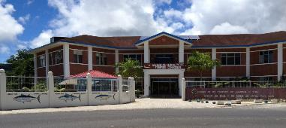
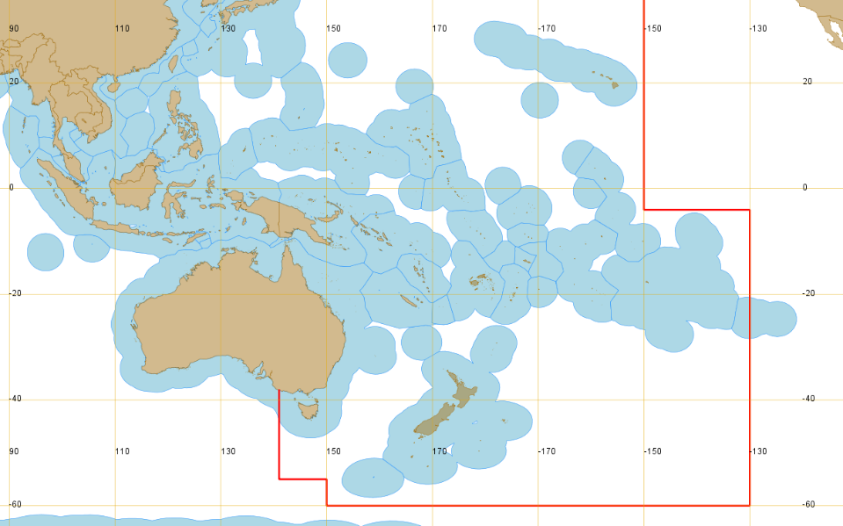


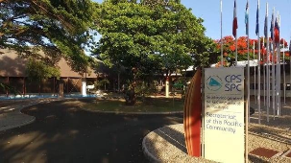
WCPFC
SPC
SPC : WCFPC Science service provider and data manager
Convention Area
Notes:
I work for SPC and we are the contracted Science service providers and the data managers for the WCPFC…. hence the reason why I am giving this presentation.
The WCPFC, located in Pohnpei FSM, has been in existence since 2004, and is now in its fourteenth year.
The SPC, located in Noumea, New Caledonia, has been in existence since 1947, and celebrated it’s 70th year anniversary last year.

Slide 3

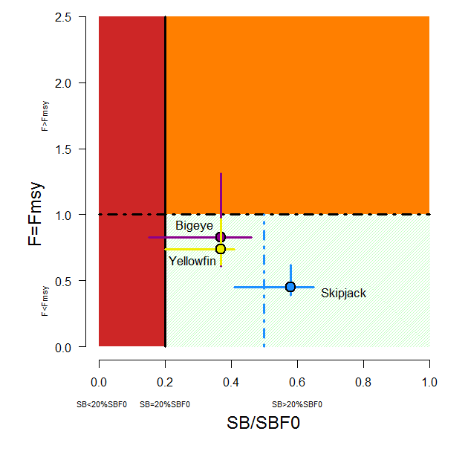
WCPFC: some key statistics
40 seats at the table:
  26 Members, 7 Participating Territories and 7 cooperating non member Countries
  SPC – 26 seats – 15 Pacific Islands + 7 Territories, with 4 founding Countries
55% of the worlds tuna catch: 2.7 million mt
  PNA (8 Pacific Is. Countries) : ~50% of worlds canned skipjack
  80-85% of catches taken from EEZ’s
Tuna fisheries provide significant income to Pacific Islands
Main tuna stocks are in reasonable condition
Notes:
The following are some key statistics related to the WCPFC, acknowledging there are much more information available…
PNA – a group of 8 PIC in the tropical region of the WCPFC Area…
Main tuna stocks … last year BET and YFT assessments returned more optimistic assessment of these stocks than previously – particularly BET. This graph shows that the point estimates for the four tuna species are in the areas outside overfishing occurring and an over-fished population, (although levels of uncertainty in the assessment – error bars – extend into the red/orange zones …

Slide 4
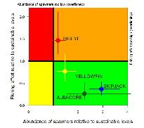



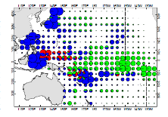

SPC WCPFC science service provider and data manager
Conducts the key WCPFC stock assessments and related analyses
Collection, management and dissemination of WCPFC scientific data
Direct assistance to Pacific Island countries (SPC members) with data collection and management through provision of database tools and capacity development
Supports compliance work of WCPFC
Tuna Data Workshops
Notes:
SPC as the WCPFC Science service provider and data manager has a number of roles ….

Slide 5
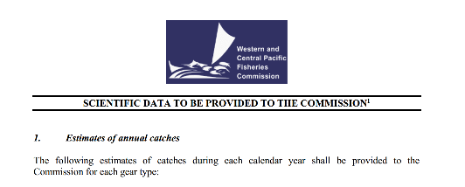
WCPFC – scientific DATA
Various other types of data, including …
  WCPFC Secretariat VMS, RFV (Record of fishing vessels), HS transshipments, etc.
  SPC Tagging, Biological (otoliths, stomach contents, tissue samples, etc.), etc.
Notes:
As far as scientific data are concerned, this table shows the characteristics of the WCPFC scientific data, as outlines in the document “SCIENTIFIC DATA TO BE PROVIDED ….”
Some of these charateristics are no doubt similar to those in other tRFMOs

Slide 6
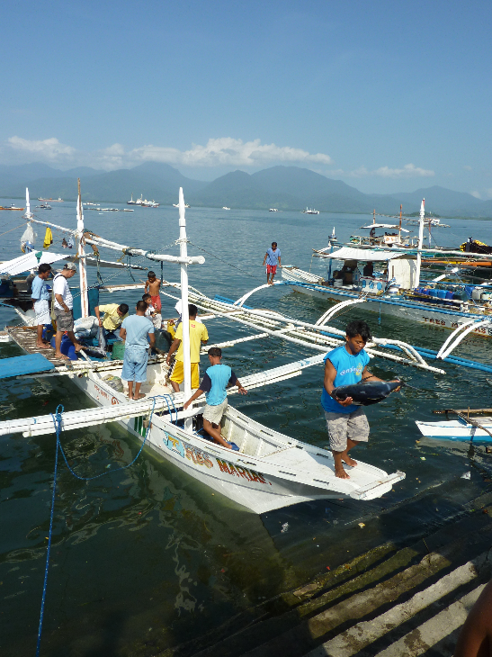

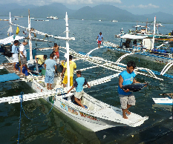
WCPFC – GEARS
Notes:
Gears … with % of the total catch … and an attempt to map to the FAO standards…

Slide 7















WCPFC – Key species
Bigeye tuna | Blue shark
Skipjack tuna | Silky shark
Yellowfin tuna | Oceanic Whitetip shark
Albacore tuna | Mako sharks (2 spp.)
Swordfish | Thresher sharks (3 spp.)
Blue Marlin | Porbeagle shark
Black Marlin | Hammerhead sharks (4 spp.)
Striped Marlin | Whale shark
Notes:
Key species in three groups tuna, billfish and shark.
There is more information for the tuna species for which main assessments done, some for billfish, but historical trends in shark species catches are very poor.

Slide 8
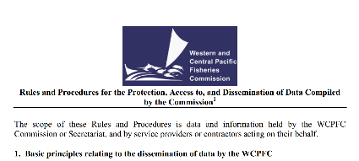
WCPFC – Scientific data dissemination
Guided by the RaP for dissemination of WCPFC data
  Lists types of public and non-public domain data
  Rules for members access to data (flag state and coastal state)
  Includes provision for the data exchange agreements between WCPFC and other RFMO (based on equivalence and reciprocity)
Public domain data products on web site
  Aggregated catch/effort data
  Yearbook (bulletin and data files)
  Data Inventory
  Bycatch Data Exchange Protocol (BDEP)
WCPFC Data Request Form for non-public domain data
Memorandums of Cooperation (MOC) on data exchange with IATTC and CCSBT
Importance of data exchange under PMS and CDS in future…
Notes:
IN regards to dissemination, the WCPFC is guided by RaP which was established and agreed by its members.
The RaP lays out areas such as …
The WCPFC produces a number of public domain data products …
For non-public domain data, there is a data request form and this needs ED approval after consultation with key/relevant WCPFC and SPC staff.
As per above, we already have two MOCs (and soon others ?) …
Noting the importance for data exchange under PMS and CDS in the future … (Session 4)

Slide 9
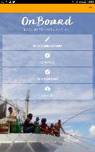
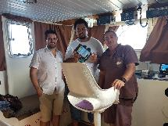
WCPFC –Standards for E-Data
E-Reporting and E-Monitoring are evolving very quickly
Third-party technical E-Service Providers now active in our fishery
WCPFC has adopted standards for E-data submissions…
WCPFC E-Reporting data field standards
  Defines WHAT needs to be submitted
  Standards adopted for logbook, observer and transhipment data
Draft E-Monitoring Process standards
  Defines HOW data are to be collected using EM
  Draft standards developed for LL and PS EM observer data and transhipment data
Nearly all the tropical WCPFC purse seine fleet use E-Reporting (PNA iFIMS eLog)
French Polynesia has agreed to full implementation of SPC OnBoard app for their longline fleet (~70 vessels)
Notes:
I wanted to briefly touch on the area of E-Reporting and E-Monitoring and understand that there will be an opportunity for discussions later in this workshop.
This is an area evolving rapidly in the WCPFC area …
We have a number of 3rd party tech .. Engaged by countries … or developed internally (e.g. Chinese Taipei and Korea)
Anticipating the rapid change the WCPFC has formed a ERandEM working group and one of the work items was the establishment of standards to guide the submission of E-Data…
At this stage, WCPFC ER data field standards have been adopted for LOGSHEET, OBSERVER and TRANSHIPMENT data … these define WHAT
With regards to E-Monitoring data, with several trial projects already under way, two workshops (led by SPC) were dedicated to look at HOW E-Monitoring data can generate the data required. At this stage, draft EM “PROCESS” standards have been established for OBSERVER and TRANSHIPMENT data ..
Significant progress in this area includes … PNA iFIMS and PF LL …. KR LL logbook …

Slide 10
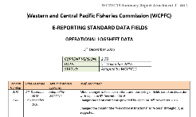
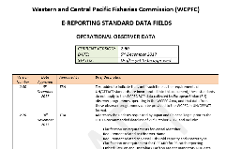
WCPFC –Standards for E-Data
Hard-copy forms process
E-Reporting and standards

Slide 11

Technical workshop
on global harmonisation of tuna fisheries statistics
Expectations ?
  What happens in other tRFMOs ?
  To hear from FAO and others on new initiatives, successes, challenges, etc.
  E-Reporting and E-Monitoring is the future !
  Opportunities for standardisation for mutual benefit ?
  Potential for future collaboration ?
    (…within the bounds of WCPFC data rules, resourcing, capacity, etc.)

