Slide 1

Technical workshop on global harmonization
of Tuna fisheries statistics
Coordinating Working Parties
ad-hoc Task Group on Reference harmonization for capture fisheries and aquaculture
Progress and review of CWP standards
Aymen CHAREF (FAO)

Slide 2
Outlines
Scene setting and task group objectives
Terminology and conceptual global DSD
Concepts and definition
Classifications
Conclusions for approval
Feedback and progress
Scope and structure
Points of discussion

Slide 3
Setting the Scene
The CWP is a forum and mechanism, functional since 1960, to streamline statistical activities among the relevant RFBs and create standard concepts, definitions, classifications and methodologies for the collection and collation of fishery statistics.
The incessant increase of diversification of information systems among fisheries institutions produced multiplicity of dissemination structures, definitions and formats.
It has been always shown the need to structure and exchange the reference data together with statistical datasets to enable their identification and interoperability across different databases of statistical institutions.
In the CWP 25th plenary meeting held in 2016 in Rome, the ad-hoc Task Group on “Reference harmonization for capture fisheries and aquaculture statistics” was established.
Notes:
The overall aim is to present a set of concepts and a structure that accommodate the codes used across the CWP parties to improve the data reporting and exchange.
It becomes crucial that the CWP plays its role of coordination to develop common procedures for streamlining statistics collation, reducing the burden of statistical offices at national and regional level. And in the CWP 25th plenary meeting…

Slide 4
Task Group Objectives
Main objectives of the ad-hoc Task Group are:
improve the multilateral exchange between CWP parties and reduce the burden of multiple reporting from the data producers
build a CWP standard for global Data Structure Definition (DSD) that compiles minimum data requirements of the aquaculture production and capture datasets,
disseminate Standard for global DSD and related metadata, based on common set of statistical concepts and a standard terminology.

Slide 5
Task Group Activities
CWP members that expressed their interest are: CCSBT, EUROSTAT, FAO, GFCM, IATTC, ICCAT ICES, IOTC, NACA, OECD, SEAFO and SPC-WCPFC.
Activities
23rd March 2017: Teleconference for kick-off .
20th June 2017: First proposal of global DSD presented in CWP-IS meeting.
2nd November 2017: Second draft of working document and global DSDs
19th March 2018: Sub-group of tuna RFMOs to thoroughly review the global DSDs and their components.

Slide 6
Tuna RFMOs Sub-Group
This sub-group is cluster of Tuna bodies aiming to reflect and boost the CWP Task Group activities
Objectives
Review the proposals of CWP standard for global DSD and terminology used to define its structural elements and related codification.
Scrutinize and review the mapping between the codes of Tuna RFMOs and CWP standards.
Outputs
Outputs will be presented to other CWP parties in the coming session towards endorsement.
Validation of CWP standard for the global DSD for Tuna data (catch, catch and effort, logbook) and related metadata.
Validation of the mapping between codes of Tuna RFMOs and CWP standards.
Notes:
Since we have set the objectives. The objectives have been amended to also focus on the data exchange agreement between CWP parties
The CWP parties Tuna RFMOs have been identified as cluster to thoroughly discuss and reflect on the proposal of DSD

Slide 7
Terminology
Data Structure Definition describes how information in a specific dataset is structured in terms of their dimensionality and coding schemes.
The structure is composed of a selection of measures, associated dimensions that gather lists of codes.
Reference data are sets of values or classification schemas that are widely re-used and referenced by systems, applications, data stores, processes, and reports.
In our context, reference data of the global DSD represents the authoritative information to be adopted whenever possible. When the DSD’s reference data cannot meet the requirements of CWP Parties, they use concepts for their specific purpose to characterize or standardize their own information.
Notes:
I will start first with the terminology, used for the conceptual DSD and its elements

Slide 8
Summary of feedback
Conceptual Proposal for the Standard for Data Structure Definition
Modularity
Module: is building block composed of concepts that can be assembled to describe information. For instance Catch Module is composed of five core concepts; aquatic species, catch type, Obs measure, Unit and Obs status
The CWP international standard statistical classification system are primarily used (e.g. ASFIS, ISSCFG, Areal grid system,..). A classification system is named, owned and maintained by an institution, including the coding, set of aggregations, hierarchies.

Slide 9

Points of discussion
Concepts and definitions
Classification systems
Codelists and description
Mapping of codes
Notes:
Here are the points that have discussed during the meeting. The second round of feedback was should work on today to review and build the global DSD and related reference data

Slide 10
Summary of feedback
Main Comments
To broaden the scope/data domain of the global DSD by compiling essential dimensions/concepts for data collection in use broadly by the CWP parties (catch and effort).
To use the catch defined in the CWP annex B1, and also landings, catch and effort.
To elaborate the global DSD that could accommodate other domains of data collection (e.g. logbooks) to address the requirements of CWP Members.
To create Building Block (module within the DSD) to collate observed or measured variables such as Catch or Effort
The group recommended that FAO proceed with CWP registry/catalog development to be accessed through the CWP website.

Slide 11
Summary of feedback
Three DSDs corresponding to different data domains:
DSD of Global capture production: is designed to cover the capture production in volume and value for economic purpose. Volume and value of nominal catch are compiled according to dimensions represented by concepts Country, Fishing area, Aquatic Species, and Time unit;
DSD of Catch: covers continuum of concepts (gross catch, discards, nominal catch, etc…) for management purpose to which are added Fishing gear and/or Fishery vessel concepts. The concept “value of catch” could also be included;
DSD of Catch and effort (Logbook): covers data for management purpose and the collection scheme. It contains vessel information, catch and effort for each operation (i.e haul). Information on start and end of time and location of fishing information are also included.
Notes:
What we have in our plate, as result of discussion and feedback during the Inter sessional meeting
We will go through each of them

Slide 12
Points of discussion
DSD of Global Capture Production
covers the capture production in volume and value for economic purpose.
Module |  |  |  | CATCH
Concept | COUNTRY / FLAG STATE | FISHING AREA | TIME UNIT | AQUATIC SPECIES | CATCH_TYPE | OBS_MEASURE | UNIT | OBS_STATUS | OBS_VALUE | UNIT
Concept_Type | Dimension | Geographic Dimension | Time Dimension | Dimension | Dimension | Measure | Attribute | Attribute | Measure | Attribute
Classification system | UN Standard country or area codes for statistical use (M49) | FAO Major Fishing Areas for statistical purpose | Calendar year | ASFIS List of Species for Fishery Statistics Purposes | CWP definition of concepts (for Catch types) |  | UCUM Unified Code for Units of Measure | FAO statistical standard for Observation status flags |  | UCUM Unified Code for Units of Measure
 |  | Areal grid coding system
Code List | UN code | FAO Fishing Areas; GRID System | Calendar Year | Inter-agency 3-alpha code | Catch type |  | Units of measure | Observation Status Flag |  | Units of measure
Codelist_id | UN_CODE | FAO_AREAS | YEAR | 3ALPHA_CODE | CATCH_TYPE |  | UNIT | STATUS_FLAG |  | UNIT
 |  | GRID_SYSTEM
Description | List of countries or areas (three digits code) | FAO_AREAS | Reference year (e.g 2017) | Species reference | In this DSD, Catch type correponds to the Nominal Catch defined as the live weigh equivalent of the landings (NOMINAL CATCHES = LANDINGS * CONVERSION FACTORS) ftp://ftp.fao.org/FI/DOCUMENT/cwp/handbook/annex/AnnexB1CatchConcepts.pdf | Amount or quantity of the observation measure (a positive integer number) | Unit of measure (e.g tonnes or number of animals, 1000 US$) | FAO Observation status codes (e.g "E"Estimate value, "R"Revised) | Monetary Value | Unit of measure (e.g tonnes or number of animals, 1000 US$)
 |  | GRID_SYSTEM
Notes:
To breakdown the DSD
In our context, the global DSD is a universal framework/structure enabling to describe DSDs of CWP parties in a standardized way: the concepts and codelists are given standard names and also comprises the CWP standard classification and related hierarchies.

Slide 13
DSD of Catch
covers concepts for management purpose. The concept “value of catch” could also be included
Module | FLAG STATE | VESSEL INFORMATION | GEAR INFORMATION | EFFORT |  |  |  | CATCH
Concept | VESSEL FLAG | FISHERY VESSEL | FISHING GEAR | OBS_ MEASURE | EFFORT DESCRIPTOR (Cat A) | EFFORT DESCRIPTOR (Cat B) | EFFORT DESCRIPTOR (Cat C) | AQUATIC SPECIES | CATCH TYPE |  | OBS_ MEASURE |  | UNIT |  | OBS_STATUS
Concept_Type | Dimension | Dimension | Dimension | Measure | Attribute | Attribute | Attribute | Dimension | Dimension |  | Measure |  | Attribute |  | Attribute
Classification system | UN Standard country or area codes for statistical use (M49) | The International Standard Statistical Classification of Fishery Vessels by Categories (ISSCFV ) | The International Standard Statistical Classification of Fishing Gear (ISSCFG) |  | CWP definition of concepts (for Fishing effort measure) | CWP definition of concepts (for Fishing effort measure) | CWP definition of concepts (for Fishing effort measure) | ASFIS List of Species for Fishery Statistics Purposes | CWP definition of concepts (for catch type) |  |  |  | UCUM Unified Code for Units of Measure |  | FAO statistical standard for Observation status flags
Code List | UN code | Fishery Vessel Type | Gear Category |  | EFFORT descriptor | EFFORT descriptor | EFFORT descriptor | Inter-agency 3-alpha code | Catch type |  |  |  | Units of measure |  | Observation Status Flag
Codelist_id | UN_CODE | VESSEL_TYPE | ISSCFG_CODE |  | EFFORT_DESCIPTOR | EFFORT_DESCIPTOR | EFFORT_DESCIPTOR | 3ALPHA_CODE | CATCH_TYPE |  |  |  | UNIT |  | STATUS_FLAG
Description | Flag State of vessel | ISSCFV code corresponding to Vessel type and its standard abbreviation | ISSCFG code corresponding to gear category and its standard abbreviation ftp://ftp.fao.org/FI/DOCUMENT/cwp/handbook/annex/AnnexM2fishinggear.pdf | The amount of fishing gear of a specific type used on the fishing grounds over a given unit of time | Selected combinations of gear and effort ftp://ftp.fao.org/FI/DOCUMENT/cwp/handbook/annex/AnnexN1.pdf | Total number of days fishing. Level Category B of fishing effort precision http://www.fao.org/fishery/cwp/handbook/N/en | Total number of days on the ground. Level Category C of fishing effort precision http://www.fao.org/fishery/cwp/handbook/N/en | Species reference | Catch types* (gross catch, retained catch, landings, discards) |  |  |  | Unit of measure (weight kg tonnes, or number) |  | FAO Observation status codes (e.g "E"Estimate value, "R"Revised)

Slide 14
DSD Catch and Effort (Logbook)
covers data for management purpose and collection scheme.
MODULE | FLAG STATE | VESSEL INFORMATION |  |  |  | GEAR INFORMATION | EFFORT |  |  |  | TIME |  |  | POSITION DETAILS |  |  |  |  |  |  |  | CATCH
Concept | VESSEL FLAG | VESSEL IDENTIFIER | VESSEL NAME | VESSEL Gross TONNAGE (GT) | VESSEL LENGTH (LOA) | FISHING GEAR | OBS_MEASURE | Measure descriptors (Cat A) | Total number of days fishing (Cat B) | Total number of days on the ground (Cat C) | START TIME | END TIME | REPORTING PERIOD | START LATITUDE |  | START LONGITUDE |  | END LATITUDE |  | END LONGITUDE |  | AQUATIC SPECIES | CATCH_TYPE | OBS_MEASURE | UNIT | OBS_STATUS
 |  |  |  |  |  |  |  |  |  |  |  |  |  | degrees (-DD) | minutes (MM.mm) | degrees (DD) | minutes (MM.mm) | degrees (-DD) | minutes (MM.mm) | degrees (DD) | minutes (MM.mm)
Concept_Type | Dimension | Measure | Measure | Measure | Measure | Dimension | Measure | Attribute | Attribute | Attribute | Time Dimension | Time Dimension | Time Dimension | Observation | Observation | Observation | Observation | Observation | Observation | Observation | Observation | Dimension | Dimension | Measure | Attribute | Attribute
Classification system | UN Standard country or area codes for statistical use (M49) | The Unique Vessel Identifier (UVI) based on IMO number |  | Convention on Tonnage Measurement of Ships, 1969 |  | The International Standard Statistical Classification of Fishing Gear (ISSCFG) |  | CWP definition of concepts (Fishing effort measures) | CWP definition of concepts (Fishing effort measures) | CWP definition of concepts (Fishing effort measures) | Date Time (UTC date time according to ISO 8601 format) | Date Time (UTC date time according to ISO 8601 format) |  | ISO 6709 | ISO 6709 | ISO 6709 | ISO 6709 | ISO 6709 | ISO 6709 | ISO 6709 | ISO 6709 | ASFIS List of Species for Fishery Statistics Purposes | CWP definition of Concepts (for catch type) |  | UCUM Unified Code for Units of Measure | FAO statistical standard for Observation status flags
Code List | UN code |  |  |  |  | Gear Category |  | EFFORT descriptor | EFFORT descriptor | EFFORT descriptor |  |  |  |  |  |  |  |  |  |  |  | Inter-agency 3-alpha code | Catch type |  | Units of measure | Observation Status Flag
Codelist_id | UN_CODE |  |  |  |  | ISSCFG_CODE |  | EFFORT_DESCIPTOR | EFFORT_DESCIPTOR | EFFORT_DESCIPTOR |  |  |  |  |  |  |  |  |  |  |  | 3ALPHA_CODE | CATCH_TYPE |  | UNIT | STATUS_FLAG
Description | Flag State of vessel | The Unique Vessel Identifier (UVI) is established by the Global Recod of Fishing Vessels, Refrigerated Transport Vessels and Supply Vessels. | Registered Vessel Name; Mandatory concept for Global Record of Fishing Vessels, Refrigerated Transport Vessels and Supply Vessels. | Gross Tonnage of vessel (Gross Tons). It is a Mandatory concept for Global Record of Fishing Vessels, Refrigerated Transport Vessels and Supply Vessels. | Length overall (meters) . It is a Mandatory concept for Global Record of Fishing Vessels, Refrigerated Transport Vessels and Supply Vessels. | ISSCFG code corresponding to gear category and its standard abbreviation ftp://ftp.fao.org/FI/DOCUMENT/cwp/handbook/annex/AnnexM2fishinggear.pdf | The amount of fishing gear of a specific type used on the fishing grounds over a given unit of time | Selected combinations of gear and effort ftp://ftp.fao.org/FI/DOCUMENT/cwp/handbook/annex/AnnexN1.pdf | Level Category B of fishing effort precision http://www.fao.org/fishery/cwp/handbook/N/en | Level Category C of fishing effort precision http://www.fao.org/fishery/cwp/handbook/N/en | time_start / Starting time - first date of availability of the measure. The Date Time (UTC date time according to ISO 8601 format) when the position was obtained by the vessel navigation equipment. e.g. 2008-10-31T15:07:38Z (milliseconds can be provided optionally). | time_end / Ending time - last date of availability of the measure | Interval of time over which the measure is defined | Coordinate expressed in WGS84, decimal degree notation, using a precision of at least 3 and maximum 6 decimal positions. Positive coordinate refers to North of equator. Negative coordinate refers to South. | Coordinate expressed in WGS84, decimal degree notation, using a precision of at least 3 and maximum 6 decimal positions. | Coordinate expressed in WGS84, decimal degree notation, using a precision of at least 3 and maximum 6 decimal positions. | Coordinate expressed in WGS84, decimal degree notation, using a precision of at least 3 and maximum 6 decimal positions. |  |  |  |  | Species reference | Catch types* (gross catch, retained catch, landings, nominal catch, discards) |  | Unit of measure (weight kg tonnes, or number) | FAO Observation status codes (e.g "E"Estimate value, "R"Revised)

Slide 15
DSD Catch and Effort (Logbook)
covers data for management purpose and collection scheme.
TIME
START TIME | END TIME | REPORTING PERIOD
Time Dimension | Time Dimension | Time Dimension
Date Time (UTC date time according to ISO 8601 format) | Date Time (UTC date time according to ISO 8601 format)
time_start / Starting time - first date of availability of the measure. The Date Time (UTC date time according to ISO 8601 format) when the position was obtained by the vessel navigation equipment. e.g. 2008-10-31T15:07:38Z (milliseconds can be provided optionally). | time_end / Ending time - last date of availability of the measure | Interval of time over which the measure is defined
FLAG STATE | VESSEL INFORMATION
VESSEL FLAG | VESSEL IDENTIFIER | VESSEL NAME | VESSEL Gross TONNAGE (GT) | VESSEL LENGTH (LOA)
Dimension | Measure | Measure | Measure | Measure
UN Standard country or area codes for statistical use (M49) | The Unique Vessel Identifier (UVI) based on IMO number |  | Convention on Tonnage Measurement of Ships, 1969
UN code
UN_CODE
Flag State of vessel | The Unique Vessel Identifier (UVI) is established by the Global Recod of Fishing Vessels, Refrigerated Transport Vessels and Supply Vessels. | Registered Vessel Name; Mandatory concept for Global Record of Fishing Vessels, Refrigerated Transport Vessels and Supply Vessels. | Gross Tonnage of vessel (Gross Tons). It is a Mandatory concept for Global Record of Fishing Vessels, Refrigerated Transport Vessels and Supply Vessels. | Length overall (meters) . It is a Mandatory concept for Global Record of Fishing Vessels, Refrigerated Transport Vessels and Supply Vessels.
POSITION DETAILS
START LATITUDE |  | START LONGITUDE |  | END LATITUDE |  | END LONGITUDE
degrees (-DD) | minutes (MM.mm) | degrees (DD) | minutes (MM.mm) | degrees (-DD) | minutes (MM.mm) | degrees (DD) | minutes (MM.mm)
Observation | Observation | Observation | Observation | Observation | Observation | Observation | Observation
ISO 6709 | ISO 6709 | ISO 6709 | ISO 6709 | ISO 6709 | ISO 6709 | ISO 6709 | ISO 6709
Coordinate expressed in WGS84, decimal degree notation, using a precision of at least 3 and maximum 6 decimal positions. Positive coordinate refers to North of equator. Negative coordinate refers to South. | Coordinate expressed in WGS84, decimal degree notation, using a precision of at least 3 and maximum 6 decimal positions.
MODULE | FLAG STATE | VESSEL INFORMATION |  |  |  | GEAR INFORMATION | EFFORT | TIME |  |  | POSITION DETAILS |  |  |  |  |  |  |  | CATCH
Concept | VESSEL FLAG | VESSEL IDENTIFIER | VESSEL NAME | VESSEL Gross TONNAGE (GT) | VESSEL LENGTH (LOA) | FISHING GEAR | OBS_EFFORT | START TIME | END TIME | REPORTING PERIOD | START LATITUDE |  | START LONGITUDE |  | END LATITUDE |  | END LONGITUDE |  | CATCH_TYPE
 |  |  |  |  |  |  |  |  |  |  | degrees (-DD) | minutes (MM.mm) | degrees (DD) | minutes (MM.mm) | degrees (-DD) | minutes (MM.mm) | degrees (DD) | minutes (MM.mm)
Concept_Type | Dimension | Measure | Measure | Measure | Measure | Dimension | Measure | Time Dimension | Time Dimension | Time Dimension | Observation | Observation | Observation | Observation | Observation | Observation | Observation | Observation | Dimension
Classification system | UN Standard country or area codes for statistical use (M49) | The Unique Vessel Identifier (UVI) based on IMO number |  | Convention on Tonnage Measurement of Ships, 1969 |  | The International Standard Statistical Classification of Fishing Gear (ISSCFG) |  | Date Time (UTC date time according to ISO 8601 format) | Date Time (UTC date time according to ISO 8601 format) |  | ISO 6709 | ISO 6709 | ISO 6709 | ISO 6709 | ISO 6709 | ISO 6709 | ISO 6709 | ISO 6709 | CWP definition of Concepts (for catch type)
Code List | UN code |  |  |  |  | Gear Category |  |  |  |  |  |  |  |  |  |  |  |  | Catch type
Codelist_id | UN_CODE |  |  |  |  | ISSCFG_CODE |  |  |  |  |  |  |  |  |  |  |  |  | CATCH_TYPE
Description | Flag State of vessel | The Unique Vessel Identifier (UVI) is established by the Global Recod of Fishing Vessels, Refrigerated Transport Vessels and Supply Vessels. | Registered Vessel Name; Mandatory concept for Global Record of Fishing Vessels, Refrigerated Transport Vessels and Supply Vessels. | Gross Tonnage of vessel (Gross Tons). It is a Mandatory concept for Global Record of Fishing Vessels, Refrigerated Transport Vessels and Supply Vessels. | Length overall (meters) . It is a Mandatory concept for Global Record of Fishing Vessels, Refrigerated Transport Vessels and Supply Vessels. | ISSCFG code corresponding to gear category and its standard abbreviation ftp://ftp.fao.org/FI/DOCUMENT/cwp/handbook/annex/AnnexM2fishinggear.pdf | The amount of fishing gear of a specific type used on the fishing grounds over a given unit of time | time_start / Starting time - first date of availability of the measure. The Date Time (UTC date time according to ISO 8601 format) when the position was obtained by the vessel navigation equipment. e.g. 2008-10-31T15:07:38Z (milliseconds can be provided optionally). | time_end / Ending time - last date of availability of the measure | Interval of time over which the measure is defined | Coordinate expressed in WGS84, decimal degree notation, using a precision of at least 3 and maximum 6 decimal positions. Positive coordinate refers to North of equator. Negative coordinate refers to South. | Coordinate expressed in WGS84, decimal degree notation, using a precision of at least 3 and maximum 6 decimal positions. | Coordinate expressed in WGS84, decimal degree notation, using a precision of at least 3 and maximum 6 decimal positions. | Coordinate expressed in WGS84, decimal degree notation, using a precision of at least 3 and maximum 6 decimal positions. |  |  |  |  | Catch types* (gross catch, retained catch, landings, nominal catch, discards)

Slide 16
List of concepts used in each DSD
 | DSD Global capture production | DSD Catch data | DSD Catch and Effort data (Logbook)
 |  |  |  | Catch module | Effort module | Vessel Information module
Aquatic species | X | X |  | X
Catch type |  |  |  | X
Country/Flag state | X | X | X |  |  | X
Effort descriptor |  | X |  |  | X
Fishery vessel |  | X |  |  |  | X
Fishing area | X | X
Fishing gear |  | X |  |  | X
Obs_Measure | X | X | X | X | X
Obs_Status | X | X | X | X
Obs_Value | X | X
Position details (geographic) |  |  | X
Unit | X | X | X | X
Vessel Gross Tonnage |  |  |  |  |  | X
Vessel Length |  |  |  |  |  | X
Vessel Name |  |  |  |  |  | X
Vessel Identifier |  |  |  |  |  | X
Notes:
By this, we concluded this is the list of concepts and modules used in each DSD.

Slide 17
CWP Catalog
Specifications
A unified and collaborative catalog that compiles public reference data made available by all CWP parties
A centralized repository, as a hub, of public contents to be harvested by users to facilitate data usage and exchange.
FAO MDM services would facilitate management of CWP catalog contents and dissemination of these interoperable items
Contents
global DSD, after endorsement by CWP
reference data used in the global DSD including the CWP standards
reference data used by each CWP party
mappings of codes between the CWP standards and CWP parties
Notes:
Here is the last point of discussion we had in the last CWP meeting. I will show you here the progress we have made so far in building the CWP catalog. This product/catalog will be presented to other CWP parties towards endorsement. I will just show a some screenshots and will share to the members of the TaskGroup, to seek their feedback, as soon as we have more consolidated/advanced version

Slide 18
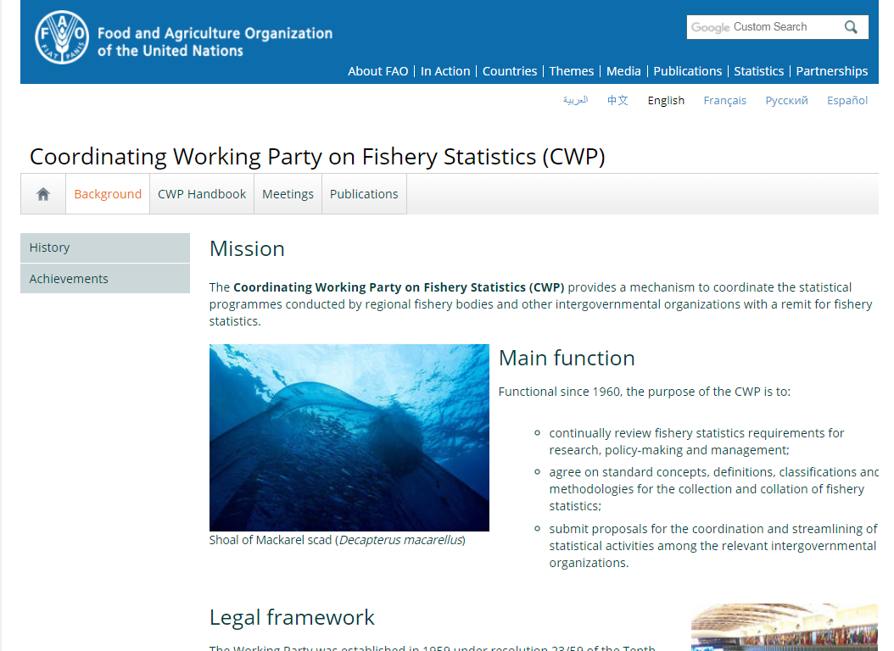
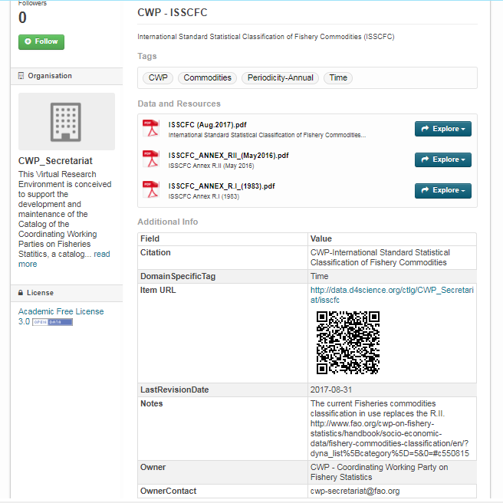
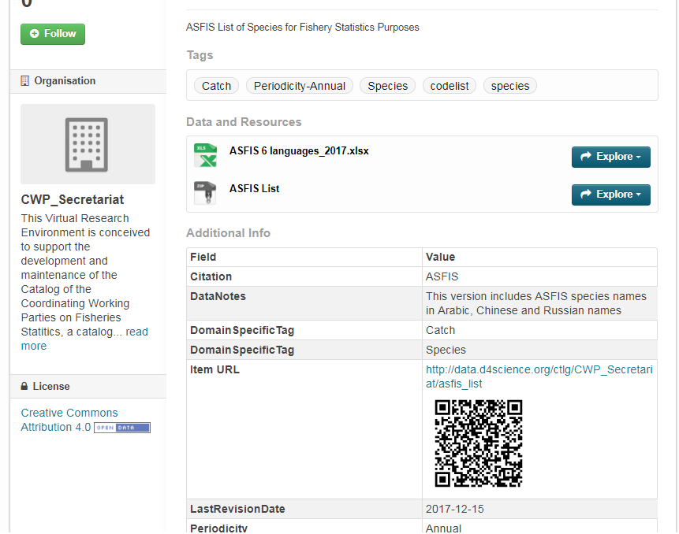
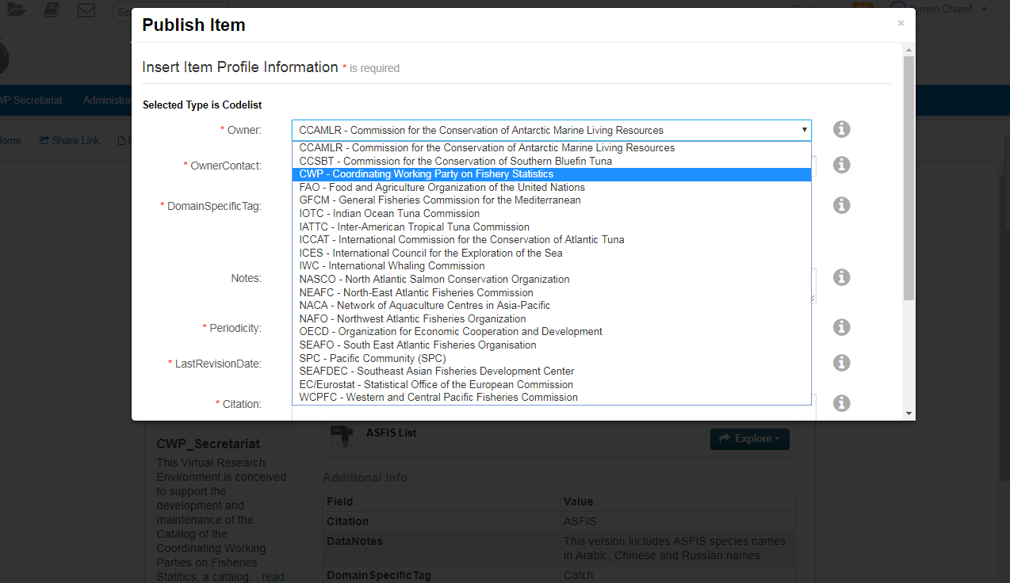
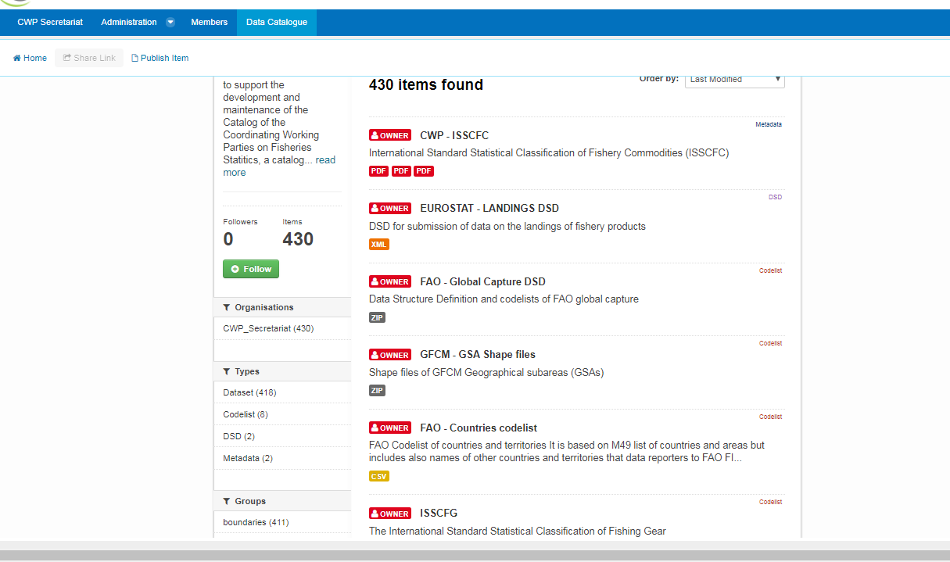
CWP Catalog

Slide 19
CWP Catalog
Governance – Maintenance
The governance covers practices to ensure CWP parties own the process, to maintain and disseminate the global DSD, the international classifications and the codes’ mappings.
FAO as CWP secretariat is setting best practices for maintenance of the CWP catalog contents and the dissemination workflow across the organizations (to be finalized if endorsed).
The maintenance encompasses:
changes in the reference data and metadata already registered (e.g updates of the CWP standards available in the catalog)
mappings of classifications between CWP standards and any CWP party.
The role of maintaining the mapping (is not frequent) should reside at the level of the CWP party.
In the case of any change in the mapping codelists, updates (copies and notifications) should be made available to the CWP catalog.
Notes:
The last points we agreed on are : governance and the maintenance

Slide 20

Thank you for your attention, so FAR

Slide 21
Points of discussion
For each DSD
Scope and structure
Concepts and definitions
Classification and codelists
Notes:
Here are the points that we should work on today to review and build the global DSD and related reference data
We will have to focus on these points, please use the printout to write down you notes during our discussion, if you find this helpful.

Slide 22
Points of discussion
DSD of Global Capture Production
covers the capture production in volume and value for economic purpose.
Module |  |  |  | CATCH
Concept | COUNTRY / FLAG STATE | FISHING AREA | TIME UNIT | AQUATIC SPECIES | CATCH_TYPE | OBS_MEASURE | UNIT | OBS_STATUS | OBS_VALUE | UNIT
Concept_Type | Dimension | Geographic Dimension | Time Dimension | Dimension | Dimension | Measure | Attribute | Attribute | Measure | Attribute
Classification system | UN Standard country or area codes for statistical use (M49) | FAO Major Fishing Areas for statistical purpose | Calendar year | ASFIS List of Species for Fishery Statistics Purposes | CWP definition of concepts (for Catch types) |  | UCUM Unified Code for Units of Measure | FAO statistical standard for Observation status flags |  | UCUM Unified Code for Units of Measure
 |  | Areal grid coding system
Code List | UN code | FAO Fishing Areas; GRID System | Calendar Year | Inter-agency 3-alpha code | Catch type |  | Units of measure | Observation Status Flag |  | Units of measure
Codelist_id | UN_CODE | FAO_AREAS | YEAR | 3ALPHA_CODE | CATCH_TYPE |  | UNIT | STATUS_FLAG |  | UNIT
 |  | GRID_SYSTEM
Description | List of countries or areas (three digits code) | FAO_AREAS | Reference year (e.g 2017) | Species reference | In this DSD, Catch type correponds to the Nominal Catch defined as the live weigh equivalent of the landings (NOMINAL CATCHES = LANDINGS * CONVERSION FACTORS) ftp://ftp.fao.org/FI/DOCUMENT/cwp/handbook/annex/AnnexB1CatchConcepts.pdf | Amount or quantity of the observation measure (a positive integer number) | Unit of measure (e.g tonnes or number of animals, 1000 US$) | FAO Observation status codes (e.g "E"Estimate value, "R"Revised) | Monetary Value | Unit of measure (e.g tonnes or number of animals, 1000 US$)
 |  | GRID_SYSTEM
Notes:
We will proceed one by one and I will give the suggestions we have received.

Slide 23
DSD of Catch
covers concepts for management purpose. The concept “value of catch” could also be included
Module | FLAG STATE | VESSEL INFORMATION | GEAR INFORMATION | EFFORT |  |  |  | CATCH
Concept | VESSEL FLAG | FISHERY VESSEL | FISHING GEAR | OBS_ MEASURE | EFFORT DESCRIPTOR (Cat A) | EFFORT DESCRIPTOR (Cat B) | EFFORT DESCRIPTOR (Cat C) | AQUATIC SPECIES | CATCH TYPE |  | OBS_ MEASURE |  | UNIT |  | OBS_STATUS
Concept_Type | Dimension | Dimension | Dimension | Measure | Attribute | Attribute | Attribute | Dimension | Dimension |  | Measure |  | Attribute |  | Attribute
Classification system | UN Standard country or area codes for statistical use (M49) | The International Standard Statistical Classification of Fishery Vessels by Categories (ISSCFV ) | The International Standard Statistical Classification of Fishing Gear (ISSCFG) |  | CWP definition of concepts (for Fishing effort measure) | CWP definition of concepts (for Fishing effort measure) | CWP definition of concepts (for Fishing effort measure) | ASFIS List of Species for Fishery Statistics Purposes | CWP definition of concepts (for catch type) |  |  |  | UCUM Unified Code for Units of Measure |  | FAO statistical standard for Observation status flags
Code List | UN code | Fishery Vessel Type | Gear Category |  | EFFORT descriptor | EFFORT descriptor | EFFORT descriptor | Inter-agency 3-alpha code | Catch type |  |  |  | Units of measure |  | Observation Status Flag
Codelist_id | UN_CODE | VESSEL_TYPE | ISSCFG_CODE |  | EFFORT_DESCIPTOR | EFFORT_DESCIPTOR | EFFORT_DESCIPTOR | 3ALPHA_CODE | CATCH_TYPE |  |  |  | UNIT |  | STATUS_FLAG
Description | Flag State of vessel | ISSCFV code corresponding to Vessel type and its standard abbreviation | ISSCFG code corresponding to gear category and its standard abbreviation ftp://ftp.fao.org/FI/DOCUMENT/cwp/handbook/annex/AnnexM2fishinggear.pdf | The amount of fishing gear of a specific type used on the fishing grounds over a given unit of time | Selected combinations of gear and effort ftp://ftp.fao.org/FI/DOCUMENT/cwp/handbook/annex/AnnexN1.pdf | Total number of days fishing. Level Category B of fishing effort precision http://www.fao.org/fishery/cwp/handbook/N/en | Total number of days on the ground. Level Category C of fishing effort precision http://www.fao.org/fishery/cwp/handbook/N/en | Species reference | Catch types* (gross catch, retained catch, landings, discards) |  |  |  | Unit of measure (weight kg tonnes, or number) |  | FAO Observation status codes (e.g "E"Estimate value, "R"Revised)

Slide 24
DSD Catch and Effort (Logbook)
covers data for management purpose and collection scheme.
MODULE | FLAG STATE | VESSEL INFORMATION |  |  |  | GEAR INFORMATION | EFFORT |  |  |  | TIME |  |  | POSITION DETAILS |  |  |  |  |  |  |  | CATCH
Concept | VESSEL FLAG | VESSEL IDENTIFIER | VESSEL NAME | VESSEL Gross TONNAGE (GT) | VESSEL LENGTH (LOA) | FISHING GEAR | OBS_MEASURE | Measure descriptors (Cat A) | Total number of days fishing (Cat B) | Total number of days on the ground (Cat C) | START TIME | END TIME | REPORTING PERIOD | START LATITUDE |  | START LONGITUDE |  | END LATITUDE |  | END LONGITUDE |  | AQUATIC SPECIES | CATCH_TYPE | OBS_MEASURE | UNIT | OBS_STATUS
 |  |  |  |  |  |  |  |  |  |  |  |  |  | degrees (-DD) | minutes (MM.mm) | degrees (DD) | minutes (MM.mm) | degrees (-DD) | minutes (MM.mm) | degrees (DD) | minutes (MM.mm)
Concept_Type | Dimension | Measure | Measure | Measure | Measure | Dimension | Measure | Attribute | Attribute | Attribute | Time Dimension | Time Dimension | Time Dimension | Observation | Observation | Observation | Observation | Observation | Observation | Observation | Observation | Dimension | Dimension | Measure | Attribute | Attribute
Classification system | UN Standard country or area codes for statistical use (M49) | The Unique Vessel Identifier (UVI) based on IMO number |  | Convention on Tonnage Measurement of Ships, 1969 |  | The International Standard Statistical Classification of Fishing Gear (ISSCFG) |  | CWP definition of concepts (Fishing effort measures) | CWP definition of concepts (Fishing effort measures) | CWP definition of concepts (Fishing effort measures) | Date Time (UTC date time according to ISO 8601 format) | Date Time (UTC date time according to ISO 8601 format) |  | ISO 6709 | ISO 6709 | ISO 6709 | ISO 6709 | ISO 6709 | ISO 6709 | ISO 6709 | ISO 6709 | ASFIS List of Species for Fishery Statistics Purposes | CWP definition of Concepts (for catch type) |  | UCUM Unified Code for Units of Measure | FAO statistical standard for Observation status flags
Code List | UN code |  |  |  |  | Gear Category |  | EFFORT descriptor | EFFORT descriptor | EFFORT descriptor |  |  |  |  |  |  |  |  |  |  |  | Inter-agency 3-alpha code | Catch type |  | Units of measure | Observation Status Flag
Codelist_id | UN_CODE |  |  |  |  | ISSCFG_CODE |  | EFFORT_DESCIPTOR | EFFORT_DESCIPTOR | EFFORT_DESCIPTOR |  |  |  |  |  |  |  |  |  |  |  | 3ALPHA_CODE | CATCH_TYPE |  | UNIT | STATUS_FLAG
Description | Flag State of vessel | The Unique Vessel Identifier (UVI) is established by the Global Recod of Fishing Vessels, Refrigerated Transport Vessels and Supply Vessels. | Registered Vessel Name; Mandatory concept for Global Record of Fishing Vessels, Refrigerated Transport Vessels and Supply Vessels. | Gross Tonnage of vessel (Gross Tons). It is a Mandatory concept for Global Record of Fishing Vessels, Refrigerated Transport Vessels and Supply Vessels. | Length overall (meters) . It is a Mandatory concept for Global Record of Fishing Vessels, Refrigerated Transport Vessels and Supply Vessels. | ISSCFG code corresponding to gear category and its standard abbreviation ftp://ftp.fao.org/FI/DOCUMENT/cwp/handbook/annex/AnnexM2fishinggear.pdf | The amount of fishing gear of a specific type used on the fishing grounds over a given unit of time | Selected combinations of gear and effort ftp://ftp.fao.org/FI/DOCUMENT/cwp/handbook/annex/AnnexN1.pdf | Level Category B of fishing effort precision http://www.fao.org/fishery/cwp/handbook/N/en | Level Category C of fishing effort precision http://www.fao.org/fishery/cwp/handbook/N/en | time_start / Starting time - first date of availability of the measure. The Date Time (UTC date time according to ISO 8601 format) when the position was obtained by the vessel navigation equipment. e.g. 2008-10-31T15:07:38Z (milliseconds can be provided optionally). | time_end / Ending time - last date of availability of the measure | Interval of time over which the measure is defined | Coordinate expressed in WGS84, decimal degree notation, using a precision of at least 3 and maximum 6 decimal positions. Positive coordinate refers to North of equator. Negative coordinate refers to South. | Coordinate expressed in WGS84, decimal degree notation, using a precision of at least 3 and maximum 6 decimal positions. | Coordinate expressed in WGS84, decimal degree notation, using a precision of at least 3 and maximum 6 decimal positions. | Coordinate expressed in WGS84, decimal degree notation, using a precision of at least 3 and maximum 6 decimal positions. |  |  |  |  | Species reference | Catch types* (gross catch, retained catch, landings, nominal catch, discards) |  | Unit of measure (weight kg tonnes, or number) | FAO Observation status codes (e.g "E"Estimate value, "R"Revised)

Slide 25
DSD Catch and Effort (Logbook)
covers data for management purpose and collection scheme.
TIME
START TIME | END TIME | REPORTING PERIOD
Time Dimension | Time Dimension | Time Dimension
Date Time (UTC date time according to ISO 8601 format) | Date Time (UTC date time according to ISO 8601 format)
time_start / Starting time - first date of availability of the measure. The Date Time (UTC date time according to ISO 8601 format) when the position was obtained by the vessel navigation equipment. e.g. 2008-10-31T15:07:38Z (milliseconds can be provided optionally). | time_end / Ending time - last date of availability of the measure | Interval of time over which the measure is defined
FLAG STATE | VESSEL INFORMATION
VESSEL FLAG | VESSEL IDENTIFIER | VESSEL NAME | VESSEL Gross TONNAGE (GT) | VESSEL LENGTH (LOA)
Dimension | Measure | Measure | Measure | Measure
UN Standard country or area codes for statistical use (M49) | The Unique Vessel Identifier (UVI) based on IMO number |  | Convention on Tonnage Measurement of Ships, 1969
UN code
UN_CODE
Flag State of vessel | The Unique Vessel Identifier (UVI) is established by the Global Recod of Fishing Vessels, Refrigerated Transport Vessels and Supply Vessels. | Registered Vessel Name; Mandatory concept for Global Record of Fishing Vessels, Refrigerated Transport Vessels and Supply Vessels. | Gross Tonnage of vessel (Gross Tons). It is a Mandatory concept for Global Record of Fishing Vessels, Refrigerated Transport Vessels and Supply Vessels. | Length overall (meters) . It is a Mandatory concept for Global Record of Fishing Vessels, Refrigerated Transport Vessels and Supply Vessels.
POSITION DETAILS
START LATITUDE |  | START LONGITUDE |  | END LATITUDE |  | END LONGITUDE
degrees (-DD) | minutes (MM.mm) | degrees (DD) | minutes (MM.mm) | degrees (-DD) | minutes (MM.mm) | degrees (DD) | minutes (MM.mm)
Observation | Observation | Observation | Observation | Observation | Observation | Observation | Observation
ISO 6709 | ISO 6709 | ISO 6709 | ISO 6709 | ISO 6709 | ISO 6709 | ISO 6709 | ISO 6709
Coordinate expressed in WGS84, decimal degree notation, using a precision of at least 3 and maximum 6 decimal positions. Positive coordinate refers to North of equator. Negative coordinate refers to South. | Coordinate expressed in WGS84, decimal degree notation, using a precision of at least 3 and maximum 6 decimal positions.
MODULE | FLAG STATE | VESSEL INFORMATION |  |  |  | GEAR INFORMATION | EFFORT | TIME |  |  | POSITION DETAILS |  |  |  |  |  |  |  | CATCH
Concept | VESSEL FLAG | VESSEL IDENTIFIER | VESSEL NAME | VESSEL Gross TONNAGE (GT) | VESSEL LENGTH (LOA) | FISHING GEAR | OBS_EFFORT | START TIME | END TIME | REPORTING PERIOD | START LATITUDE |  | START LONGITUDE |  | END LATITUDE |  | END LONGITUDE |  | CATCH_TYPE
 |  |  |  |  |  |  |  |  |  |  | degrees (-DD) | minutes (MM.mm) | degrees (DD) | minutes (MM.mm) | degrees (-DD) | minutes (MM.mm) | degrees (DD) | minutes (MM.mm)
Concept_Type | Dimension | Measure | Measure | Measure | Measure | Dimension | Measure | Time Dimension | Time Dimension | Time Dimension | Observation | Observation | Observation | Observation | Observation | Observation | Observation | Observation | Dimension
Classification system | UN Standard country or area codes for statistical use (M49) | The Unique Vessel Identifier (UVI) based on IMO number |  | Convention on Tonnage Measurement of Ships, 1969 |  | The International Standard Statistical Classification of Fishing Gear (ISSCFG) |  | Date Time (UTC date time according to ISO 8601 format) | Date Time (UTC date time according to ISO 8601 format) |  | ISO 6709 | ISO 6709 | ISO 6709 | ISO 6709 | ISO 6709 | ISO 6709 | ISO 6709 | ISO 6709 | CWP definition of Concepts (for catch type)
Code List | UN code |  |  |  |  | Gear Category |  |  |  |  |  |  |  |  |  |  |  |  | Catch type
Codelist_id | UN_CODE |  |  |  |  | ISSCFG_CODE |  |  |  |  |  |  |  |  |  |  |  |  | CATCH_TYPE
Description | Flag State of vessel | The Unique Vessel Identifier (UVI) is established by the Global Recod of Fishing Vessels, Refrigerated Transport Vessels and Supply Vessels. | Registered Vessel Name; Mandatory concept for Global Record of Fishing Vessels, Refrigerated Transport Vessels and Supply Vessels. | Gross Tonnage of vessel (Gross Tons). It is a Mandatory concept for Global Record of Fishing Vessels, Refrigerated Transport Vessels and Supply Vessels. | Length overall (meters) . It is a Mandatory concept for Global Record of Fishing Vessels, Refrigerated Transport Vessels and Supply Vessels. | ISSCFG code corresponding to gear category and its standard abbreviation ftp://ftp.fao.org/FI/DOCUMENT/cwp/handbook/annex/AnnexM2fishinggear.pdf | The amount of fishing gear of a specific type used on the fishing grounds over a given unit of time | time_start / Starting time - first date of availability of the measure. The Date Time (UTC date time according to ISO 8601 format) when the position was obtained by the vessel navigation equipment. e.g. 2008-10-31T15:07:38Z (milliseconds can be provided optionally). | time_end / Ending time - last date of availability of the measure | Interval of time over which the measure is defined | Coordinate expressed in WGS84, decimal degree notation, using a precision of at least 3 and maximum 6 decimal positions. Positive coordinate refers to North of equator. Negative coordinate refers to South. | Coordinate expressed in WGS84, decimal degree notation, using a precision of at least 3 and maximum 6 decimal positions. | Coordinate expressed in WGS84, decimal degree notation, using a precision of at least 3 and maximum 6 decimal positions. | Coordinate expressed in WGS84, decimal degree notation, using a precision of at least 3 and maximum 6 decimal positions. |  |  |  |  | Catch types* (gross catch, retained catch, landings, nominal catch, discards)

Slide 26
List of concepts used in each DSD
 | DSD Global capture production | DSD Catch data | DSD Catch and Effort data (Logbook)
 |  |  |  | Catch module | Effort module | Vessel Information module
Aquatic species | X | X |  | X
Catch type |  |  |  | X
Country/Flag state | X | X | X |  |  | X
Effort descriptor |  | X |  |  | X
Fishery vessel |  | X |  |  |  | X
Fishing area | X | X
Fishing gear |  | X |  |  | X
Obs_Measure | X | X | X | X | X
Obs_Status | X | X | X | X
Obs_Value | X | X
Position details (geographic) |  |  | X
Unit | X | X | X | X
Vessel Gross Tonnage |  |  |  |  |  | X
Vessel Length |  |  |  |  |  | X
Vessel Name |  |  |  |  |  | X
Vessel Identifier |  |  |  |  |  | X
Notes:
By this, we concluded this is the list of concepts and modules used in each DSD.

Slide 27
Structure
Catch Module
Effort Module

Slide 28
Concepts
Country/Flag/chartered
Statistical area/Fishing area
Observation measure
Flag (restricted data access, partially restricted, publicly available)

Slide 29
For the workshop with tRFMOs, the DSD proposal aligns with the CAT I, CAT II systems that tRFMOs are accustomed to and for which there is some level of standardisation already.
There are some specific areas where tRFMOs are aligned that don’t exist elsewhere.
To what extent might tRFMOs diverge from non-tuna fisheries?
Examples to be discussed
Flag state/ chartered flag (e.g WCPFC the catch is allocated to chartered state and not flag state). Could CWP consider these arrangement in the definition of the country where an RFMO can cater these breakdown
Country: ISO 2 Alpha code
Time unit : local time or UTC/GMT time definition of catch: we focus on nominal catch (e.g from logbooks), whereas adjusted catch are calibrated by observers data
Effort: In purse seine tuna fisheries, there is strong interest in having catch and effort broken down by SET TYPE, an example how this set type could be catered in the DSD.
Days fishing is the most commonly used.

Slide 30
Examples to be discussed
Area / grid information could be added to this DSD.
(e.g IOTC expects catch data (for the catch-and-effort dataset) to be reported on either a regular grid (using CWP standard) or on an irregular one, depending on the gear type.)
Chassot
For the same gear purse seine but different: called: fishing mode Associated schools and Free schools
Vessel module: generally RFMOs don’t receive information at this level of granularity. Then vessel information in the catch and effort DSD or the logbook could be recommended by RFMOs to be used at national level (e.g NAFO and CCAMLR)

Slide 31
Harmonization at semantic level

Slide 32
Harmonization - Mapping of Codes
Codelist mapping is defining semantic relationships between codes of different databases. The relationships can be one to one or more complex to be mapped when it is many to one.
The inventory revealed that CWP parties are using CWP standards coding system to a certain extent.
Some members adopted different classification system (e.g EU DCF for EUROSTAT) which make the mapping challenging to impossible.
Others (e.g, t-RFMOs) adopted extra codes within the same classification system for their purposes.

Slide 33
Harmonization - Mapping of Codes
In general, the extra codes can be grouped in two main situations:
built on the codes of CWP standards by aggregating a group of codes (e.g. group of species built upon the ASFIS codelist),
by extending the CWP standards with more details resulting in lower level of aggregation (e.g gear codes that fall within one class/code of the ISSCFG codelist).
The discussion should focus on solving the common issues as highest priority.
The output is to provide codelists’ mappings to be disseminated in the CWP catalog.

Slide 34
Thank you

