Slide 1


DATA COLLECTION AND MANAGEMENT TOOLS TO SUPPORT THE REGIONAL OBSERVER SCHEME PILOT PROJECT
Technical workshop on global harmonization of Tuna fisheries statistics
CWP ad-hoc Task Group on reference harmonization
IOTC Secretariat – Fabio Fiorellato, Data Coordinator - Enrico Anello, Software Engineer

Slide 2


The ROS tools are a set of data models, software components and interactive applications developed by the IOTC Secretariat (with funds from NOAA and WWF) as part of the Regional Observer Scheme (ROS) pilot project IOTC Resolution 16/04.
The purpose was to:
Create a set of tools to support the collection and management of scientific information as recorded by on-board observers.
Enable automated data exchange with national institutions and eventually the IOTC Secretariat.
To build a reliable Regional Observer Database.

Slide 3
Rationale for the e-Reporting tools
Observer data is currently submitted to IOTC in a number of different hardcopy and electronic formats, including:
  Excel data sheets
  Word documents
  Hardcopy/softcopy observer trip reports
  Scanned pdf documents
  Fleet specific formats (e.g., ObServer, ICCAT ST09)
Time-consuming for the IOTC Secretariat to extract, process and validate the data.
Differences in the data submission formats mean data are often inconsistent and incomplete, missing many of the mandatory data fields.
Also the IOTC Secretariat lacks a centralized database for the processing and analysis of observer data.

Slide 4
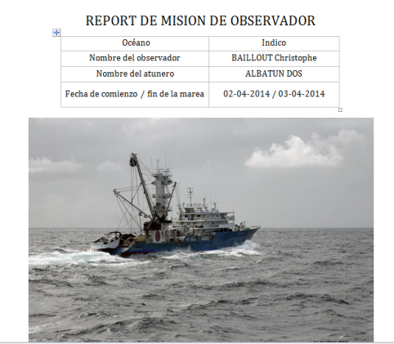
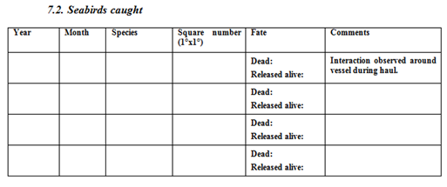
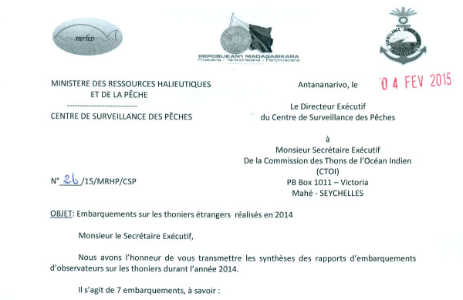
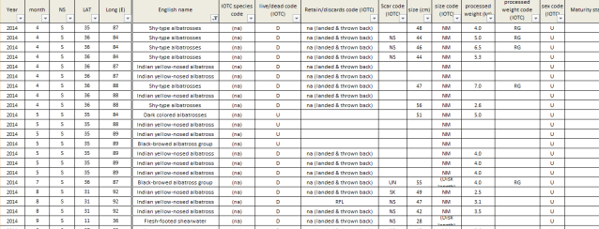
Highly variable observer data submissions to the IOTC Secretariat!
Examples of trip reports submitted to IOTC
Notes:
Old/new & everything in between

Slide 5
To recap - objectives of the IOTC ROS e-Reporting tools
Improve the efficiency of data capture and quality of data collected by observers, and timeliness of data reporting to the IOTC Secretariat.
Standardize the format and content of observer data submitted to the IOTC Secretariat
Reduce the burden on data processing of observer data by the IOTC Secretariat.
Target IOTC CPCs:
Generally developing coastal states lacking a dedicated national observer database or technical expertise to report observer data to the IOTC Secretariat.

Slide 6
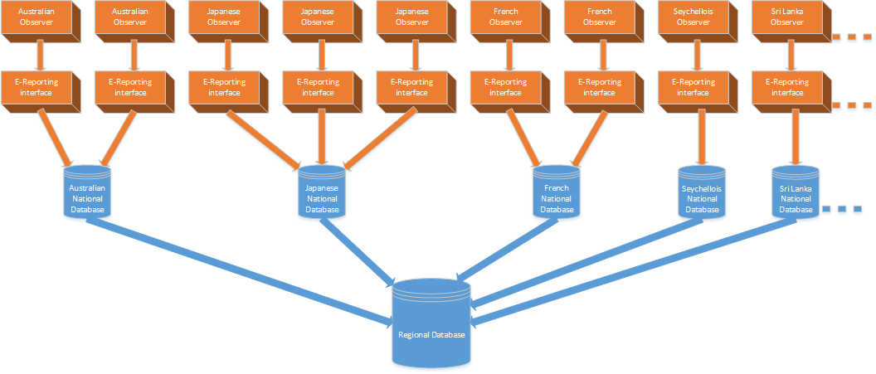
The ROS tools consist of the following components:
The e-Reporting interface: data entry portal for scientific observers, that incorporates validation checks, code-list synchronization, and export functionality.
The National Observer Database (to be deployed at country level)
The Regional Observer Database (hosted by the IOTC secretariat)
(1.)
(2.)
(3.)

Slide 7
The ROS tools - overview
The goal of the ROS tools is manifold, as these tools and their interconnecting workflow are currently capable of supporting:
The formal definition of a scientific observer data model (based on the ROS Observer Manual) that is independent from the data exchange format;
A more effective scientific observer data collection process (including the mandatory fields for data reporting to the IOTC Secretariat);
The creation of a number of National Observer Databases, whose content can be used to generate country-specific statistics and reports;
The collation of all mandatory data reporting information from National Observer databases into a single, centralized Regional Observer Database.

Slide 8
The ROS data model
The ROS model represents the logical structure of the gear-specific scientific observer data structure and acts as the conceptual interface interconnecting the various components of the workflow.
Beside simplifying all interactions between the system components, this structured and comprehensive data model (formally defined by its XSD schema) can also be easily extended and modified when required.
All data within the ROS model (one or more trips) can be serialized to XML and eventually, through ad-hoc XSL transformations, converted to other formats such as HTML, PDF, Excel spreadsheets and more.

Slide 9
The ROS data model – complementary tools
Complementary tools to allow scientific observations recorded with different tools to be converted to the ROS data model have been already developed or are currently planned for development.
Available converters already exist for:
ICCAT ST09 format;
Japanese LL custom format.
While converters are planned to be developed for:
ObServe2 format;
SWIOFP database.

Slide 10
The e-Reporting interface
The e-Reporting interface is a user-friendly graphical tool, running in a common browser window, that supports on-board observers in recording the various gear-dependent data fields as specified by the ROS Observer Manual¹, on a trip-to-trip basis.
The e-Reporting interface is an offline tool and as such it does not require an active internet connection to function properly.
Scientific data collected for a trip (or for a set of trips) can be exported and shared with the identified national focal point for the vessel flag country once finalized.

Slide 11
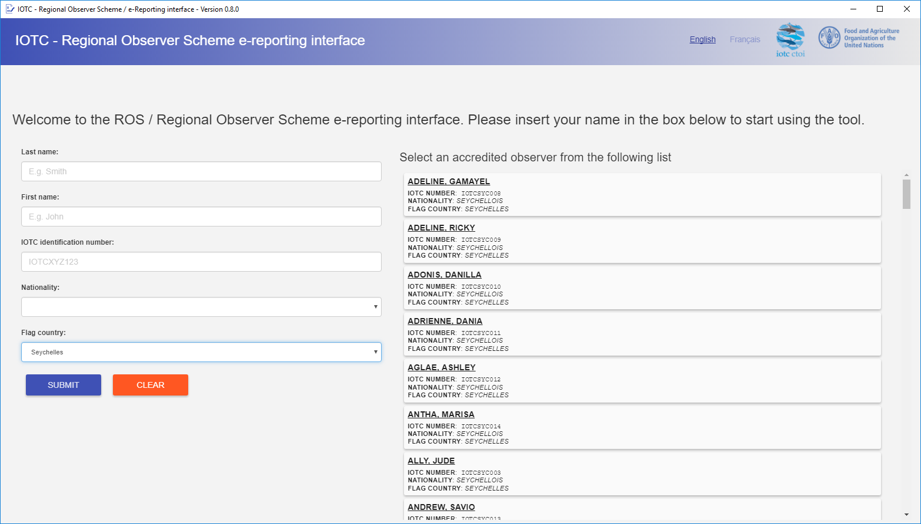
The e-Reporting interface – Login

Slide 12
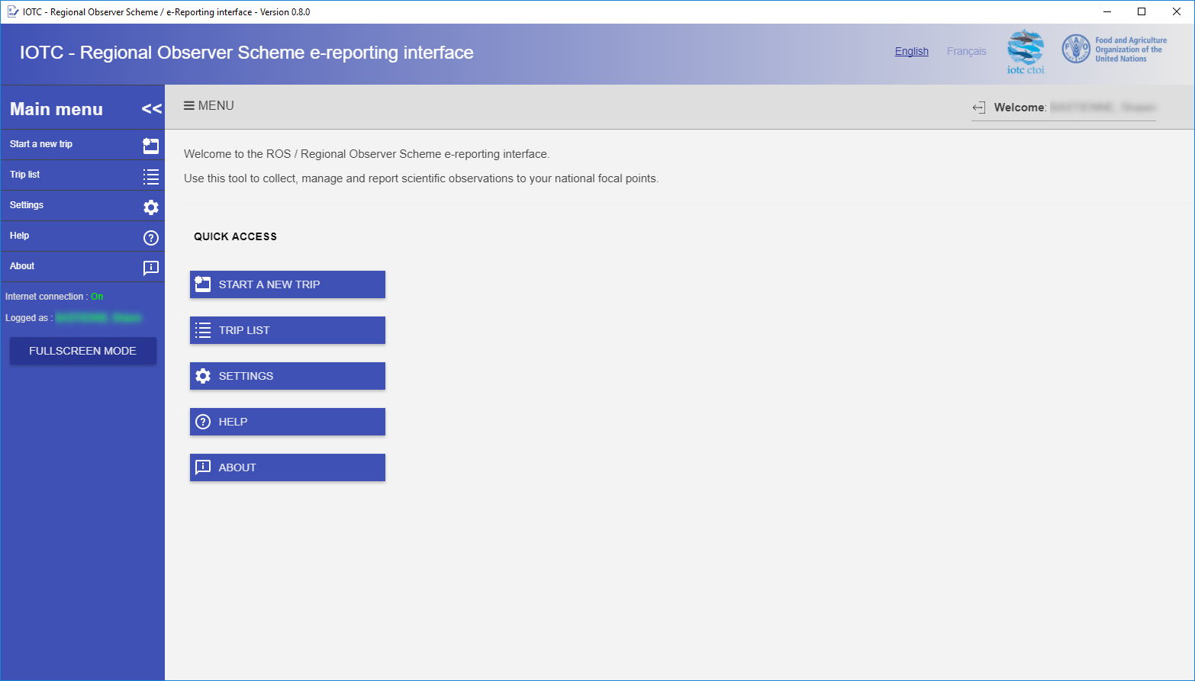
The e-Reporting interface – Main menu

Slide 13
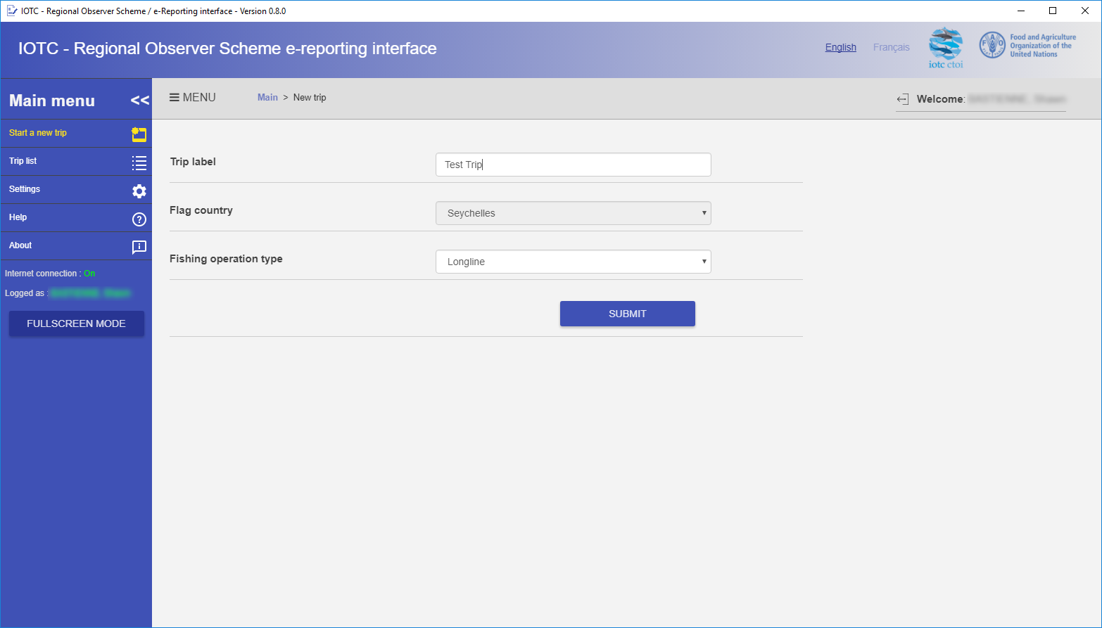
The e-Reporting interface – Start a new trip

Slide 14
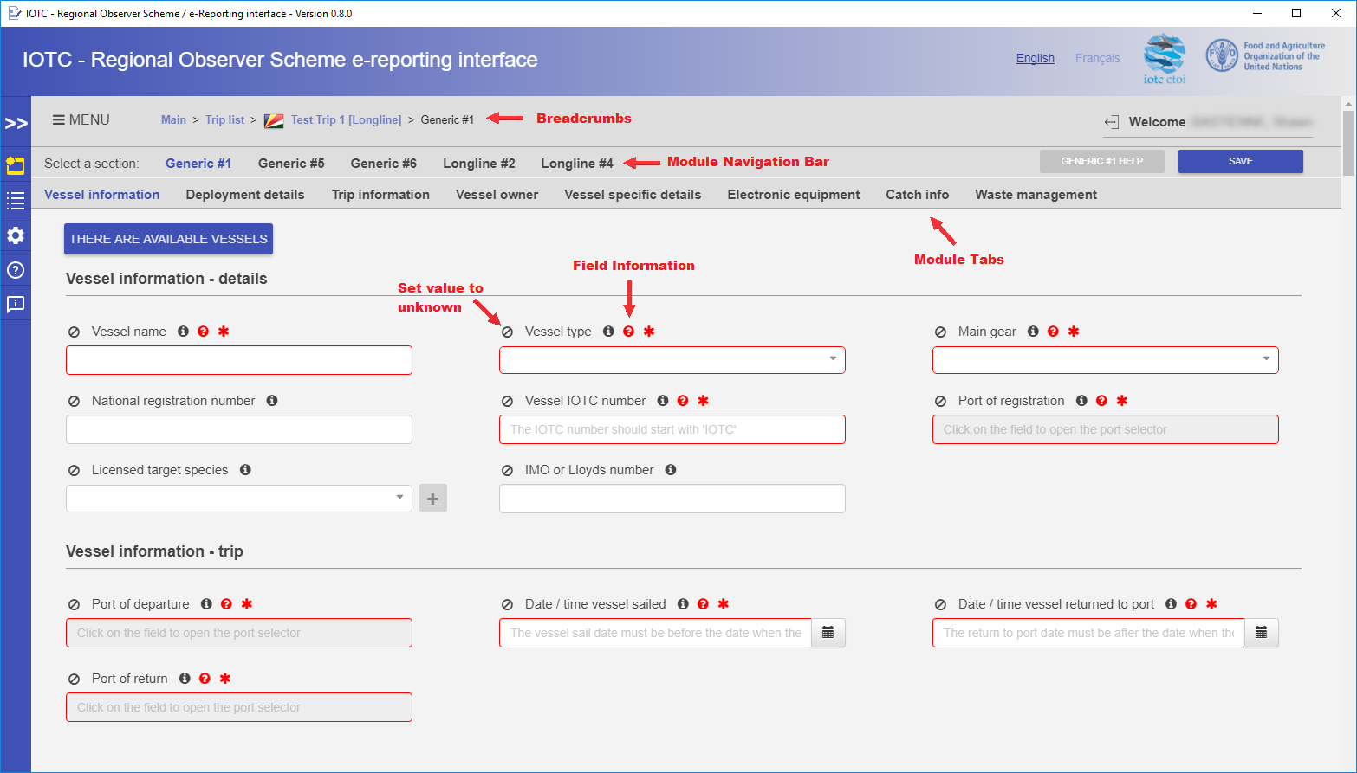
The e-Reporting interface – Generic module (example)

Slide 15
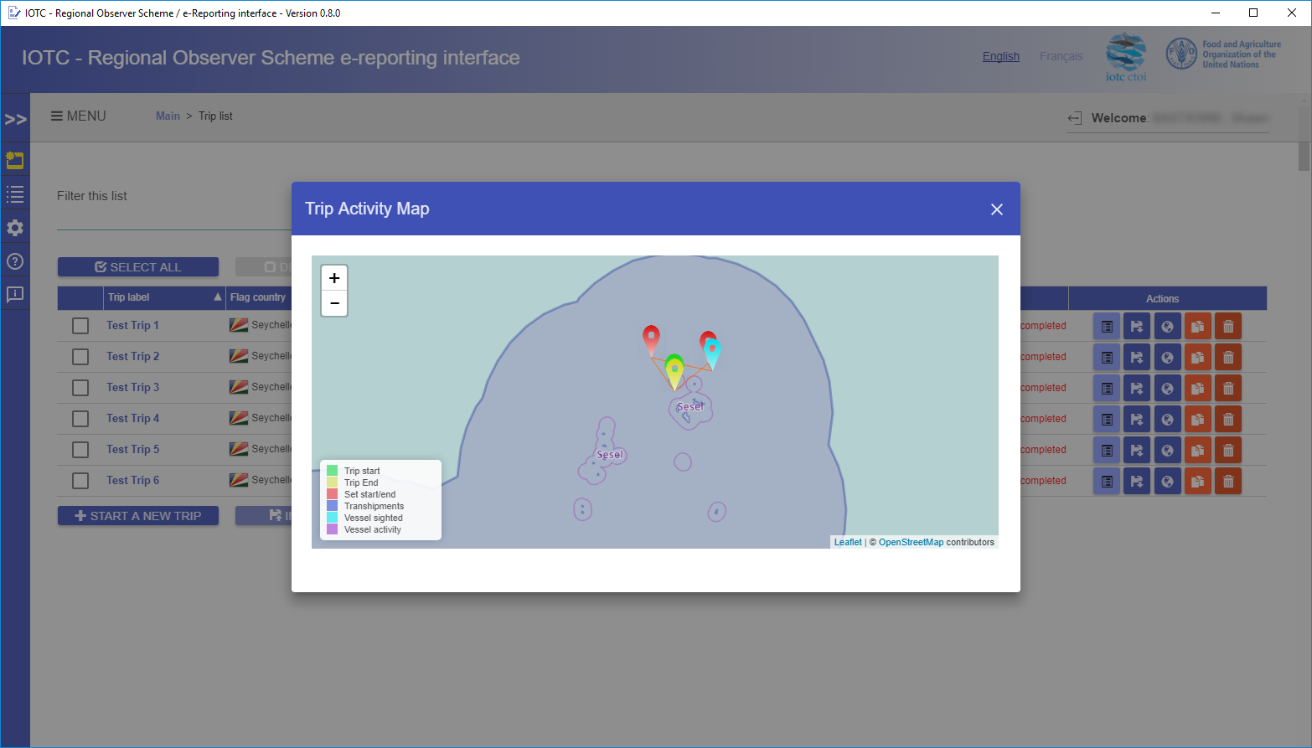
The e-Reporting interface – Trip Activity Map

Slide 16
The National Observer Database
As part of the suite of ROS tools, the IOTC Secretariat has also designed a specific application - meant to be deployed locally, once for each participating CPC - with the purpose of ingesting all scientific data collected by observers for a specific flag country and provide CPC with the skeleton of a National Observer Database where all information that is currently marked as “mandatory for collection” is stored.
The National Observer Database can be exported as a standalone Microsoft Access database for national focal point to analyze its content and extend its basic data extraction capabilities.
The interface designed for the management of the National Observer Database is capable of synchronizing its content with the centralized Regional Observer Database (hosted by the IOTC secretariat), that will accommodate and collate the set of information marked as mandatory for reporting within the ROS Observer Manual².

Slide 17
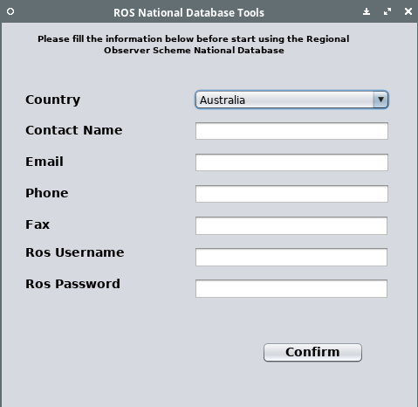
The National Observer Database – Login

Slide 18
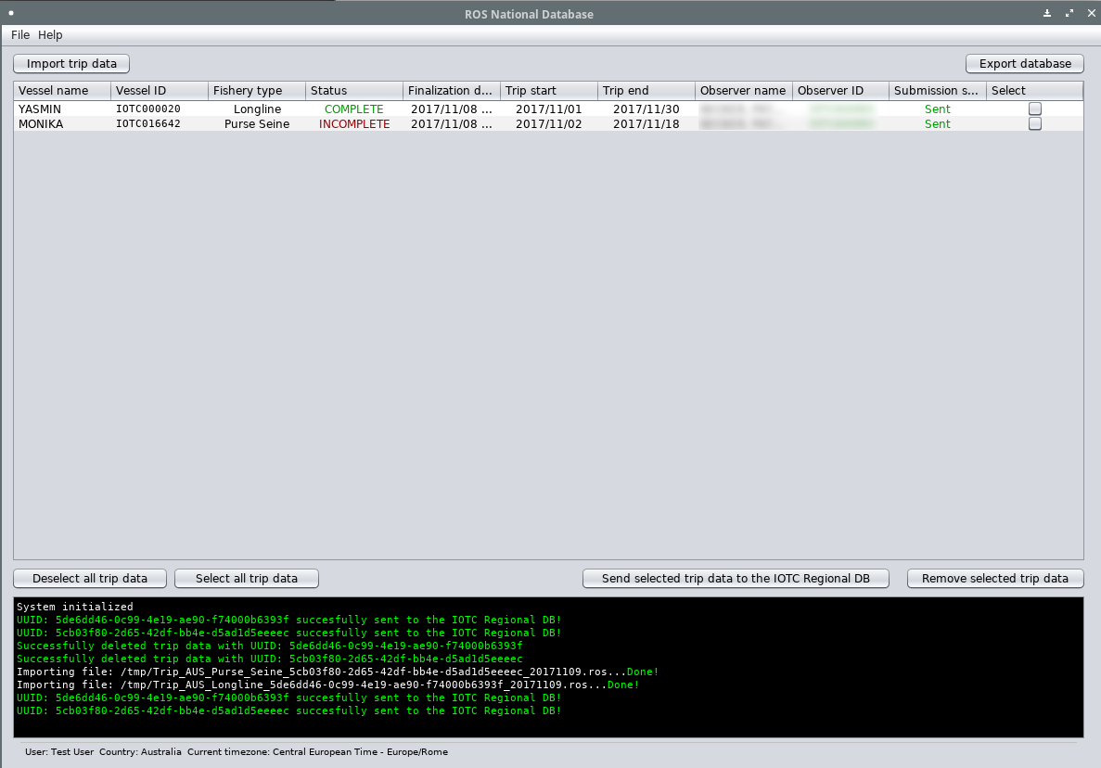
The National Observer Database – Main screen

Slide 19
Main advantages of the new IOTC e-Reporting tools
Reduces the burden of data entry for observers. No longer necessary for data to be entered in the IOTC data collection forms AND data reporting forms.
IOTC observer reports are generated as an automatic output within the National Database module. Streamlines reporting of observer between IOTC CPCs and the IOTC Secretariat.
The e-Reporting interface contains validation checks, and ensures that all mandatory data fields have been completed prior to submitting data to IOTC.
Enables automatic updates to IOTC gear/species code lists, including the IOTC Record of Active Vessels (RAV).
Future versions of the E-Reporting interface can be updated easily with changes to the ROS data collection and reporting forms and deployed remotely to CPCs.
Dedicated modules for third-party proprietary tools (e.g. ObServer, ICCAT ST09) are also being developed to automatically export observer to the IOTC ROS Regional database.

Slide 20
Future developments
The 1st development phase of the ROS tools completed in late-2017.
IOTC Secretariat currently rolling out workshops to CPCs interested in trialling the tools with actual observer data:
  Training workshop delivered in Sri Lanka (Dec-2017 & Feb-2018). Sri Lanka to begin reporting observer data using the ROS tools from early-2018.
  Additional workshops planned for 2018: Indonesia, Mauritius, Tanzania.
A number of developments will completed in the next future will include:
  Development of the ObServe2 importer;
  Import of historical data within the Regional Observer Database;
  Definition of country-dependant, specific extraction queries for the National Observer Database;
  Implementation of a data dissemination interface for the Regional Observer Database.

Slide 21
Thank You!
Yo can download a beta version of the Ereporting interface at this URL:
https://tinyurl.com/y9xrk3xs

