Slide 1


Fisheries Data Interoperability
–
Geographic Information (Meta)data standards
Emmanuel Blondel (FAO)
emmanuel.blondel@fao.org

Slide 2
Outline
Background – Research Data Alliance, FDI working group
(Meta)data information standards
Methodology for cross-domain geo-referenced statistics dissemination & visualization
Use Case 1: Global Tuna Atlas
Use Case 2: Regional database – WECAFC-FIRMS Fisheries
FAIR (meta)data principles

Slide 3
Background
RDA – Research Data Alliance
    “Research Data Without barriers” – https://www.rd-alliance.org/about-rda
    Vision: “Researchers and innovators openly sharing data across technologies, disciplines, and countries to address the grand challenges of society”
    Community: 6600 members from 135 countries
    General findings
      Data is fragmented worldwide, within and across disciplines and domains
      Need of building blocks and data bridges to foster data discovery, access, exploitation including cross-disciplinary approaches

Slide 4
Background
Fisheries Data Interoperability Working Group
    https://rd-alliance.org/group/fisheries-data-interoperability-wg/
    Participation of FAO and IRD under EC BlueBridge project
    Synergy with Coordinating Working Party on Fishery Statistics
      Adhoc task group of reference data harmonization
      GIS working group
    Activities
      Inventory of (meta)data standards in support to fisheries data
        Statistical (meta)data exchange standards
        Geo-referenced (meta)data exchange standards
      Discuss a draft standard vocabulary for defining data structures & variables, categorizing datasets. Notion of “building blocks”
      Draft a generic methodology for geo-referenced cross-domain statistical data dissemination & visualization using open standards
      Knowledge exchange with/from other RDA interest & working groups

Slide 5
(Meta)data standards for fisheries data interoperability
(Meta)data standards for fisheries data interoperability?
    Statistics-oriented standards
      SDMX Information Model; https://sdmx.org/
      UN-CEFACT FLUX
    Geospatial-enabled standards
      ISO/TC211 Geographic information Standards
      OGC (Open Geospatial Consortium) Format & Service Standards
    Generic Standards: Dublin Core
    But also standards in specific domains: e.g. EML – Ecological Metadata Language
    (Meta)data standards are part of policy frameworks
    Examples:
      Statistics: Commission Recommendation of 23 June 2009 on reference metadata for the European Statistical System 3 (2009/498/EC)
      Geospatial: EC INSPIRE Directive – 2007/2/CE

Slide 6
(Meta)data standards for fisheries data interoperability
Trends noticed through RDA
    Common pathway towards adoption of FAIR Data Principles (Findable, Accessible, Interoperable, Re-usable)
    Convergence of data domains in using:
      Common Data & Metadata standards
        Data standards:
          Geospatial OGC formats, Unidata NetCDF
        Metadata standards:
          Generic: DublinCore
          Geospatial: ISO/OGC 19115/19139, Catalogue Service for the Web (CSW),
          Domain specific:
            CF-Conventions, EML
        Few mention of SDMX. Mentioned with a need of mapping from/to ISO/OGC Geospatial “world” (e.g. European Statistical framework vs. INSPIRE)
      Common Data access & sharing Methodologies
      Common Technologies (but technology is NOT the focus here)

Slide 7
FAIR Principles
Data needs to have a structured description
(not only a data structure definition)
METADATA

Slide 8
FAIR Principles
Data Identification
Data Structure Definition
Data Distribution
(Meta)Data Quality
Metadata Information
Lineage (Data provenance, Process steps / Methodology)
Genealogy (Related datasets)
(Meta)Data Compliance & Quality assurance reports
Unique Identification
Associated actors & roles
Language, etc
Change History
Data service endpoints
Map service endpoints
Data archives
Related resources
Unique identification
Cited Responsible party
Associated actors & roles
Extents (geo, time, vertical)
Description (title, abstract, purpose, keywords, overview)
Data access & use constraints
Dimensions
Related reference datasets / codelists

Slide 9
FAIR Principles
FAIR Principles
FINDABLE
F1. (meta)data are assigned a globally unique and eternally persistent identifier.
F2. data are described with rich metadata.
F3. (meta)data are registered or indexed in a searchable resource.
F4. metadata specify the data identifier.
ACCESSIBLE
A1 (meta)data are retrievable by identifier using a standardized communications protocol.
A1.1 the protocol is open, free, and universally implementable.
A1.2 the protocol allows for an authentication and authorization procedure, where necessary.
A2 metadata are accessible, even when the data are no longer available.
INTER
OPERABLE
RE-USABLE
I1. (meta)data use a formal, accessible, shared, and broadly applicable language for knowledge representation.
I2. (meta)data use vocabularies that follow FAIR principles.
I3. (meta)data include qualified references to other (meta)data.
R1. meta(data) have a plurality of accurate and relevant attributes.
R1.1. (meta)data are released with a clear and accessible data usage license.
R1.2. (meta)data are associated with their provenance.
R1.3. (meta)data meet domain-relevant community standards.
https://www.force11.org/group/fairgroup/fairprinciples

Slide 10

Methodology for cross-domain, geo-referenced statistics dissemination & visualization
Methodology for cross-domain, geo-referenced statistics dissemination & visualization – Principles
    FAIR data principles
    Standards
      Use of internationally recognized and widely adopted open standards for data, metadata, processes and services.
      Primary choice oriented on geospatial-oriented standards: ISO/TC211 and OGC, rather than statistics-oriented standards (SDMX):
        Wider user community and support
        Tools availability and reliability
        Better fitting with cross-domain / integrated vision (enabling confrontation with other data products such as stock assessment model outputs, scientific fishery surveys, vessel trajectories – VMS and AIS, etc.)
    Tools used to promote the approach
      Free and Open Source Software (FOSS)
      Simple, Affordable and Flexible tools , ie that can be easily adopted and fine-tuned in autonomy by a wide data managers community (and not only a pure IT community)
      Main programming language used:

Slide 11




Methodology for cross-domain, geo-referenced statistics dissemination & visualization
DATA
GEOREF
DATA
(Geo-referencing)
Data structure
Definition (DSD)
Dataset
Description
Data Service Description
ISO 19110
ISO 19115
OGC Formats / Protocols
(+ ISO 19119)
(META) DATA
CATALOGUE
METADATA SERVICES
OGC Catalogue Service for the Web (CSW)
DATA SERVICES
OGC Data services (WMS / WFS)

Slide 12
Methodology for cross-domain, geo-referenced statistics dissemination & visualization
(META) DATA
CATALOGUE
METADATA SERVICES
OGC Catalogue Service for the Web (CSW)
DATA SERVICES
OGC Data services (WMS / WFS)
FINDABLE
ACCESSIBLE
INTER
OPERABLE
RE-USABLE
EASILY
QUERYABLE ?

Slide 13
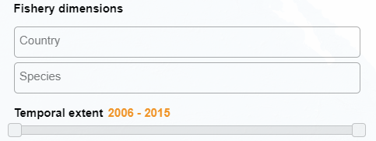
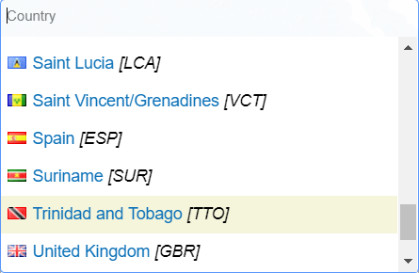
Methodology for cross-domain, geo-referenced statistics dissemination & visualization
    a Data Structure Definition file is not only useful for data exchanging…
    But also for data dissemination & exploitation
    (query, map, graphs, download)
DSD
Country dimension
Species dimension
Time dimension
ISO 19110

Slide 14
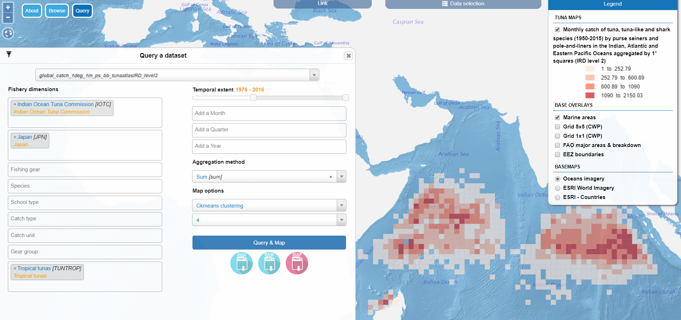
Methodology for cross-domain, geo-referenced statistics dissemination & visualization
  Global Tuna Atlas

Slide 15
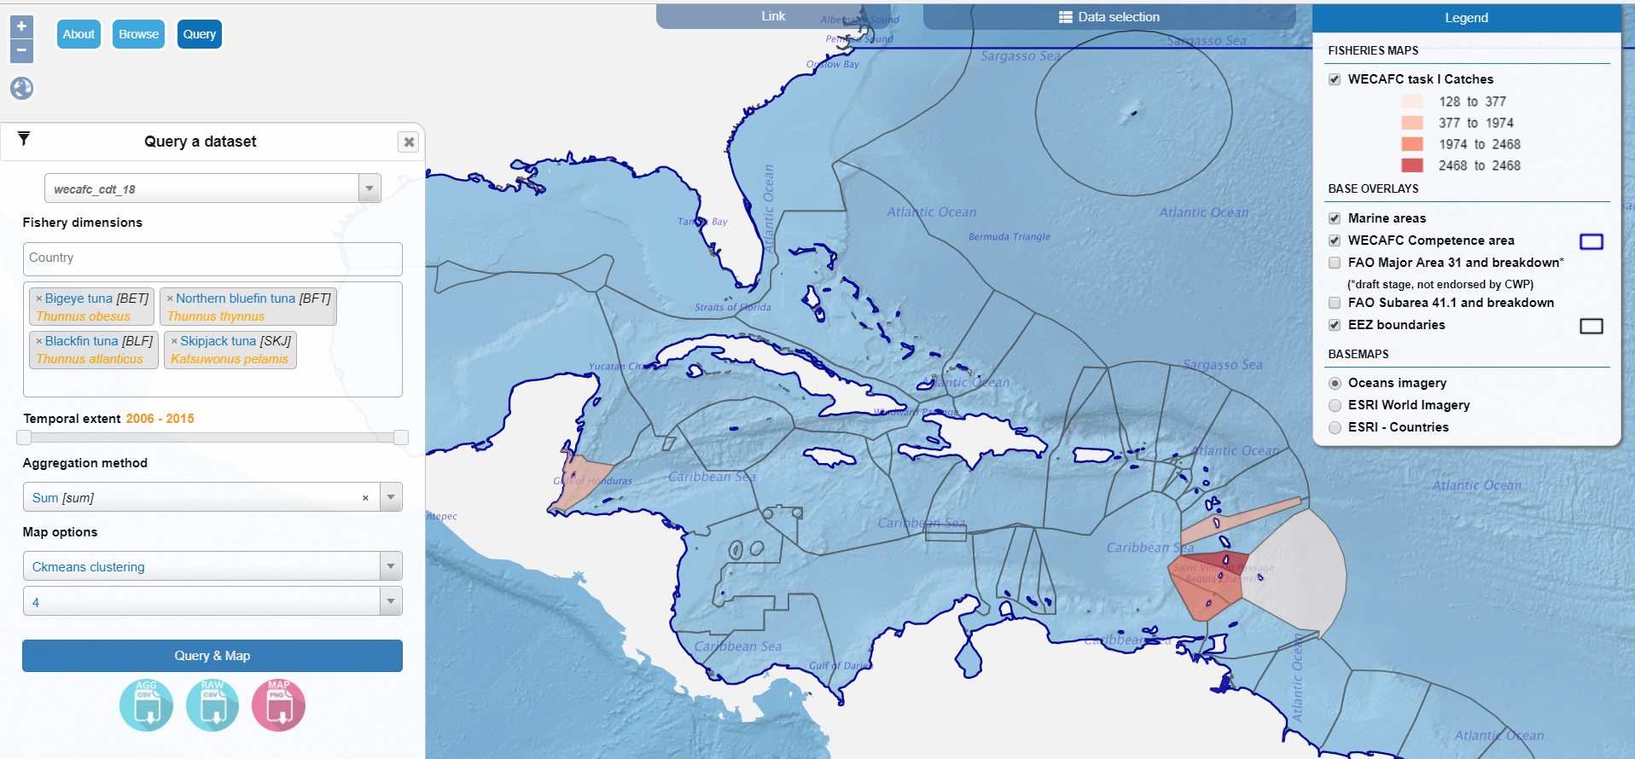
Methodology for cross-domain, geo-referenced statistics dissemination & visualization
  WECAFC-FIRMS Regional Database

Slide 16
Other Areas of work and Perspectives in RDA FDI
Establish mappings between (meta)data standards
    Some objectives
      Fulfill legal (meta)data exchange obligations
      Foster cross-disciplinary approach
    (Meta)data standards Mappings
      Between ISO/OGC and Statistics/SDMX
      e.g. Provide reference metadata for the European Statistical System (2009/498/EC)
      From NetCDF-CF
      NetCDF / CF-Conventions, initially for Climate / Weather sciences
      Now widely used in fields of marine sciences, oceanography & stocks assessment
      From/To Ecological Metadata Language
      Ecological Metadata Language (EML) used in ecology / biodiversity data communities

Slide 17
Other Areas of work and Perspectives in RDA FDI
Strengthen the data extraction & visualization tools
    Contextualization to Regional areas/RFMOs or other criteria: already available
    Need to fine-tune map visualization tools.
      Additional map types: proportional maps, charts-embedded maps
      Enable Cross-disciplines analyses
    Capacity to interact further with statistical maps & add graphs
    Enable visualization of confidential data, depending on use cases
    Fine-tune data export / sharing facilities
    ….

Slide 18
Other Areas of work and Perspectives
Work papers
    Paper in preparation to describe the (meta)data publication & exploitation methodology and how to apply it using R software for statistical computing.
    Related use case communications:
      Barde J., E. Blondel, E. Chassot, T. Imzilen, A-E Nieblas, P. Taconet, 2017. Collaboration between fisheries and computer scientists for improved data description: The case of IOTC data sets.
      Nieblas A-E, S. Bonhommeau , T. Imzilen , D. Fu, F. Fiorellato, J. Barde, 2017. Standardization of data formats, metadata, access protocols and statistical visualization of SS3 stock assessment outputs.
      Barde J., E. Blondel, P. Taconet, 2018. Using R to manage a Spatial Data Infrastructure (SDI) in the South West Indian Ocean (SWIO). Submitted to FOSS4G 2018 Conference http://2018.foss4g.org

Slide 19
Thank you for your attention

