Slide 1
FAO (AGP) Plant Production and Protection Division
Seed Group Presentation

Slide 2
Presentation Overview
Global Activities:
  World Seed Conference follow up
  Hortivar
  UG99
Activities in the Regions
  Africa
  Asia Pacific
  Central America
  Europe

Slide 3
FAO Global Activities
Seed Security assessment: Haiti and S Sudan
Seed Posters
Follow up from World Seed Conference with ISF, OECD, UPOV and ISTA
Hortivar: a web based on database of Varieties by the horticulture group that needs to be promoted through the seed sector
UG99: Wheat stem rust that is a threat to wheat production
  Borlaug Global Rust Initiative (BGRI)
  Collaboration of CIMMYT, ICARDA, Cornell University, FAO and scientists and national programmes around the world
  FAO role on surveillance, contingency planning and seed delivery systems, FFS

Slide 4
Regional Seed Activities in Africa
CEMAC(Economic Community of Central Africa ) Seed Harmonization Process: Cameroon, Chad, Congo, Gabon, Central African Republic and Equatorial Guinea
  Technical negotiations complete for 13 priority crops
Pilot Seed Information System: Burkina Faso, Côte d’Ivoire and Mali
  Seed Policy & regulations, and procedures for seed import and export, seed sector statistics, seed availability

Slide 5
National Seed Activities in Africa
Regional Project to Boost Rice Production in Côte d’Ivoire Mali Mauritania Niger and Sénégal
Burkina Faso
Mozambique
Sierra Leone
Madagascar
South Sudan

Slide 6
Seed Activities in the Asia Pacific
APSA: Seed Quality and Phytosanitary Standards
ECO Seed Association first AGM 2-4 Dec 2009:10 member countries of the Economic Cooperation Organization (ECO) region comprise Afghanistan, Azerbaijan, Iran, Kazakhstan, Kyrgyzstan, Pakistan, Tajikistan, Turkey, Turkmenistan and Uzbekistan.
National Projects
  Afghanistan
  Cambodia
  Myanmar

Slide 7
FAO Seed Activities in Central America
Regional Seed Project in CAC (Consejo Agropecuario Centroamericano)
Belice, Costa Rica, El Salvador, Guatemala, Honduras, Nicaragua

Slide 8
FAO Seed Activities in Europe
  Regional Seed Conference with Central and Eastern Europe, 24-26 November 2009: Albania, Bosnia and Herzegovina, Croatia, Macedonia, Montenegro and Serbia, Armenia, Belarus, Georgia, Moldova, Russian Federation and Ukraine.

Slide 9
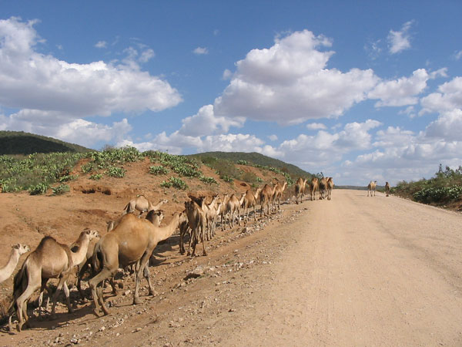
The Road Ahead to Seed Security

