Slide 1


Promoting local seed enterprises to address global food security : Success stories from Africa, Asia and Latin America
Paul Van Mele, Agro-Insight
Robert G. Guéi, FAO

Slide 2


Slide 3
Overview
1 The issues
2 Objective
3 Definition
4 Methodology
5 Country overview
6 What makes African seed entrepreneurs

Slide 4
1. The issues
“There are no successful seed enterprises in Africa”
Notes:
Stereotypes

Slide 5
The issues
governments invested heavily in producing seed of their food security crops
structural adjustment policy in the 1980s
governments abandoned plant breeding and seed provision
ignoring the difficulties for the private sector
seed is alive and delicate (unlike mobile phones)
> 90% is farm-saved seed (although much of modern cvs)
large companies often ignore seeds with thin profit margins

Slide 6
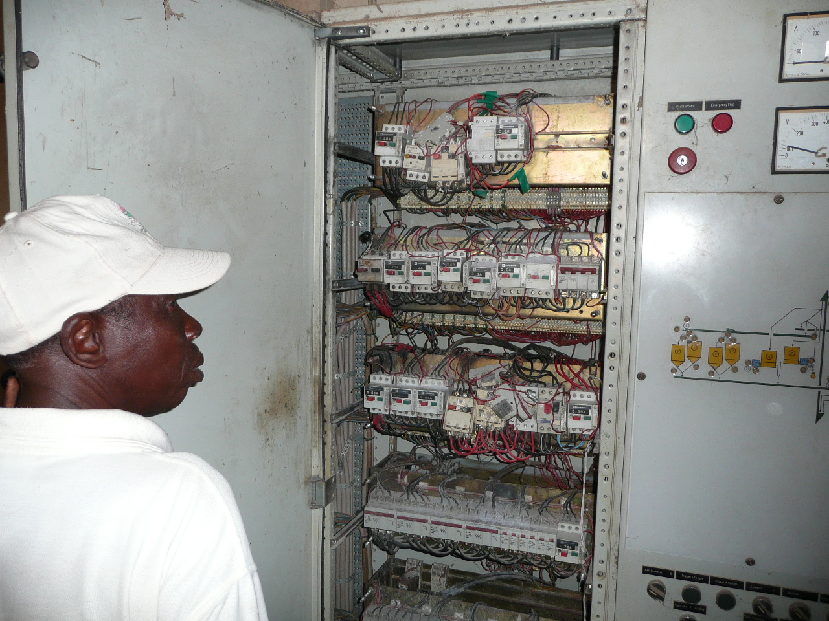

Slide 7
2. Objective

Slide 8
Objective
To provide FAO, member countries and development partners with information on what could be the foundation for building successful seed enterprises dealing with local food security crops

Slide 9
3. Definition

Slide 10
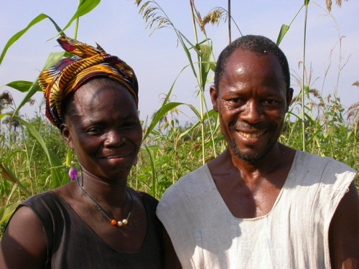
Definition
A successful seed enterprise is any farmer, association, small or medium-sized company or public agency that is able to stay in business for several years, producing or selling seed, overcoming the cash flow challenges of seed.

Slide 11
4. Methodology

Slide 12
Methodology
coordinated and funded by FAO and AfricaRice
social and agricultural scientists
innovation systems and entrepreneurial theory
inspired by FAO case studies in Brazil, India, Côte d’Ivoire
covering nine other African countries

Slide 13
Methodology
case study identification strategy: Dec 2009
field research: Feb 2010
internal review, regional workshop, peer review
submission manuscript to CABI: Nov 2010
book published: June 2011

Slide 14
Country context
History
Evolution of strategies, technologies, seed sales
Structure
Management
Cash Flow
Marketing
Communication
Infrastructure
Land
Linkages
Quality
Packaging
Clients
Strategies
Sources

Slide 15
5. Country overview

Slide 16
Cameroon
“Farmer seed enterprises have been tried and are not the solution”
Notes:
Country
“Stereotype”

Slide 18
Cameroon
FAO set up farmer seed-producing groups to provide rice, maize, sorghum and millet seed locally
in a remote, food insecure area, without private seed companies
groups were organised into a federation and had few competitors
acquired source seed from a national research agency
high demand from farmers for seed of new, short duration varieties

Slide 19
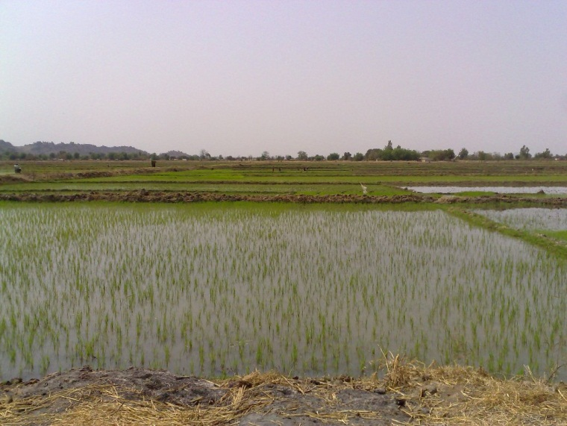
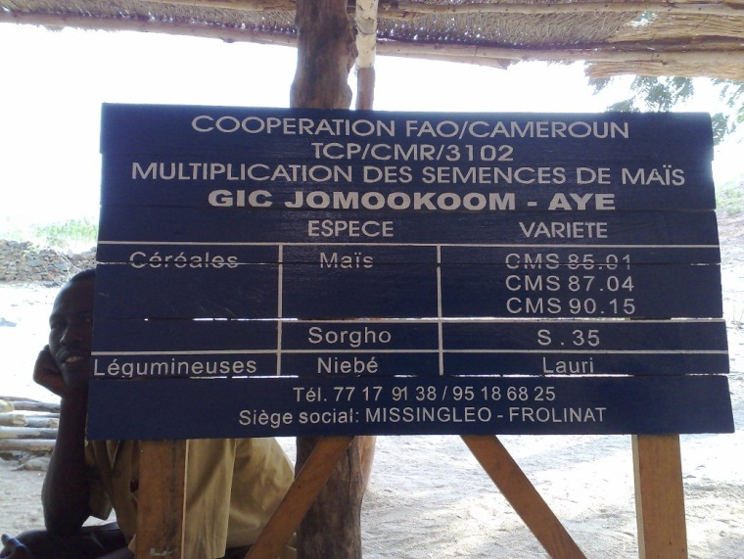
Cameroon
60% of all seed groups survived
especially those able to manage revolving funds
Some producers opened their own shop
Linkage facilitation is crucial
technical, financial and marketing training is needed

Slide 20
Nigeria
“Private sector cannot compete with public sector”
Notes:
Country
“Stereotype”

Slide 22
Certified seed production (tons) in Nigeria

Slide 23
Nigeria
unfair competition with state agencies (ADPs) for past 30 years
ADPs tend to produce the crops that are least profitable for the companies
companies rely more on hybrid maize and vegetables
although all produce various kinds of crop seed
seed companies survive under competition with ADP-subsidised seed, and a debt load created by government seed procurement programmes

Slide 24
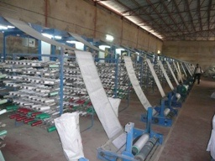
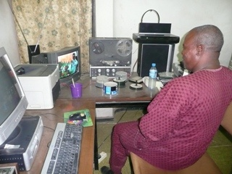
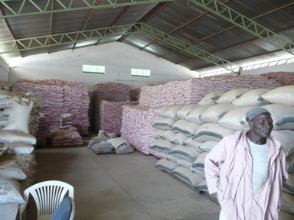
Nigeria
private companies are clustered around cities (like Zaria, link with universities, and FS suppliers)
companies try harder to make direct sales to farmers, with less interest in selling through agrodealers
keep overheads low; have a good product; be honest with outgrowers; and advertise their product

Slide 25
Mali
“Cooperatives should fullfill most functions within seed value chain”
Notes:
Country
“Stereotype”

Slide 27
Mali
strong donor and government support to agriculture
direct and indirect subsidies (fertiliser, seed, guarantee fund to BNDA and BMS)
Office du Niger vs remote production areas
many cooperatives vs few specialised traders

Slide 28
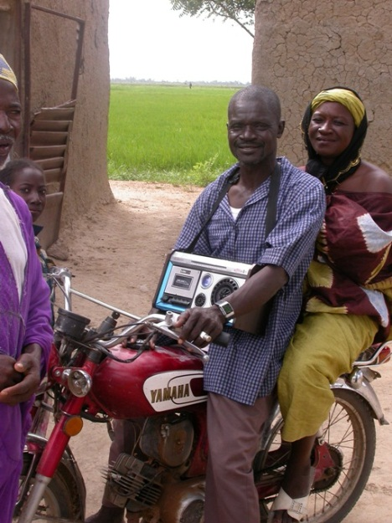
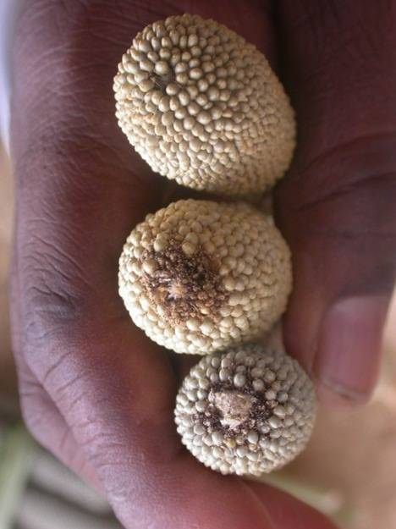
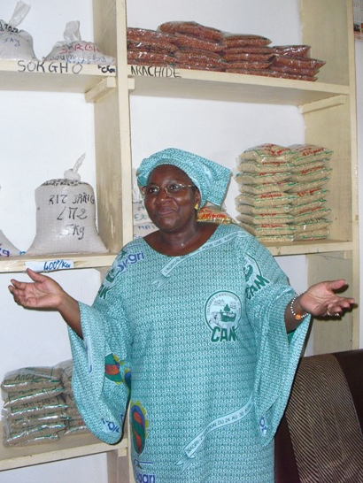
Mali
Faso Kaba started by the wife of a plant breeder, first buying and selling seed; began to produce seed after it acquired land and recruited an agronomist and an experienced seed technician. Buys from cooperatives

Slide 29
Mali
COPROSEM started with PVS; now produces sorghum and maize seed; announces its local seed fairs over the radio; prepares 100 g packages of new sorghum varieties to sell on the market
Nipagnon cooperative also grows seed of rice, cowpea and other crops; uses radio advertisements to promote its seed
both cooperatives supply local seed traders, but Nipagnon also sells to customers from neighbouring countries at the national seed fairs organised by the Ministry of Agriculture

Slide 30
Table 5.7: Clients of COPROSEM, Mali
 | 2006 | 2009 | 2015
Seed companies | 2 | 1 | 1
Projects and NGOs | - | 2 | 2
Sunday farmers | - | 3 | -
Individual farmers | 1 | 4 | 3
Members | - | 5 | 4
*Ranking assessment by senior management of seed enterprise, 1 being the most important

Slide 31
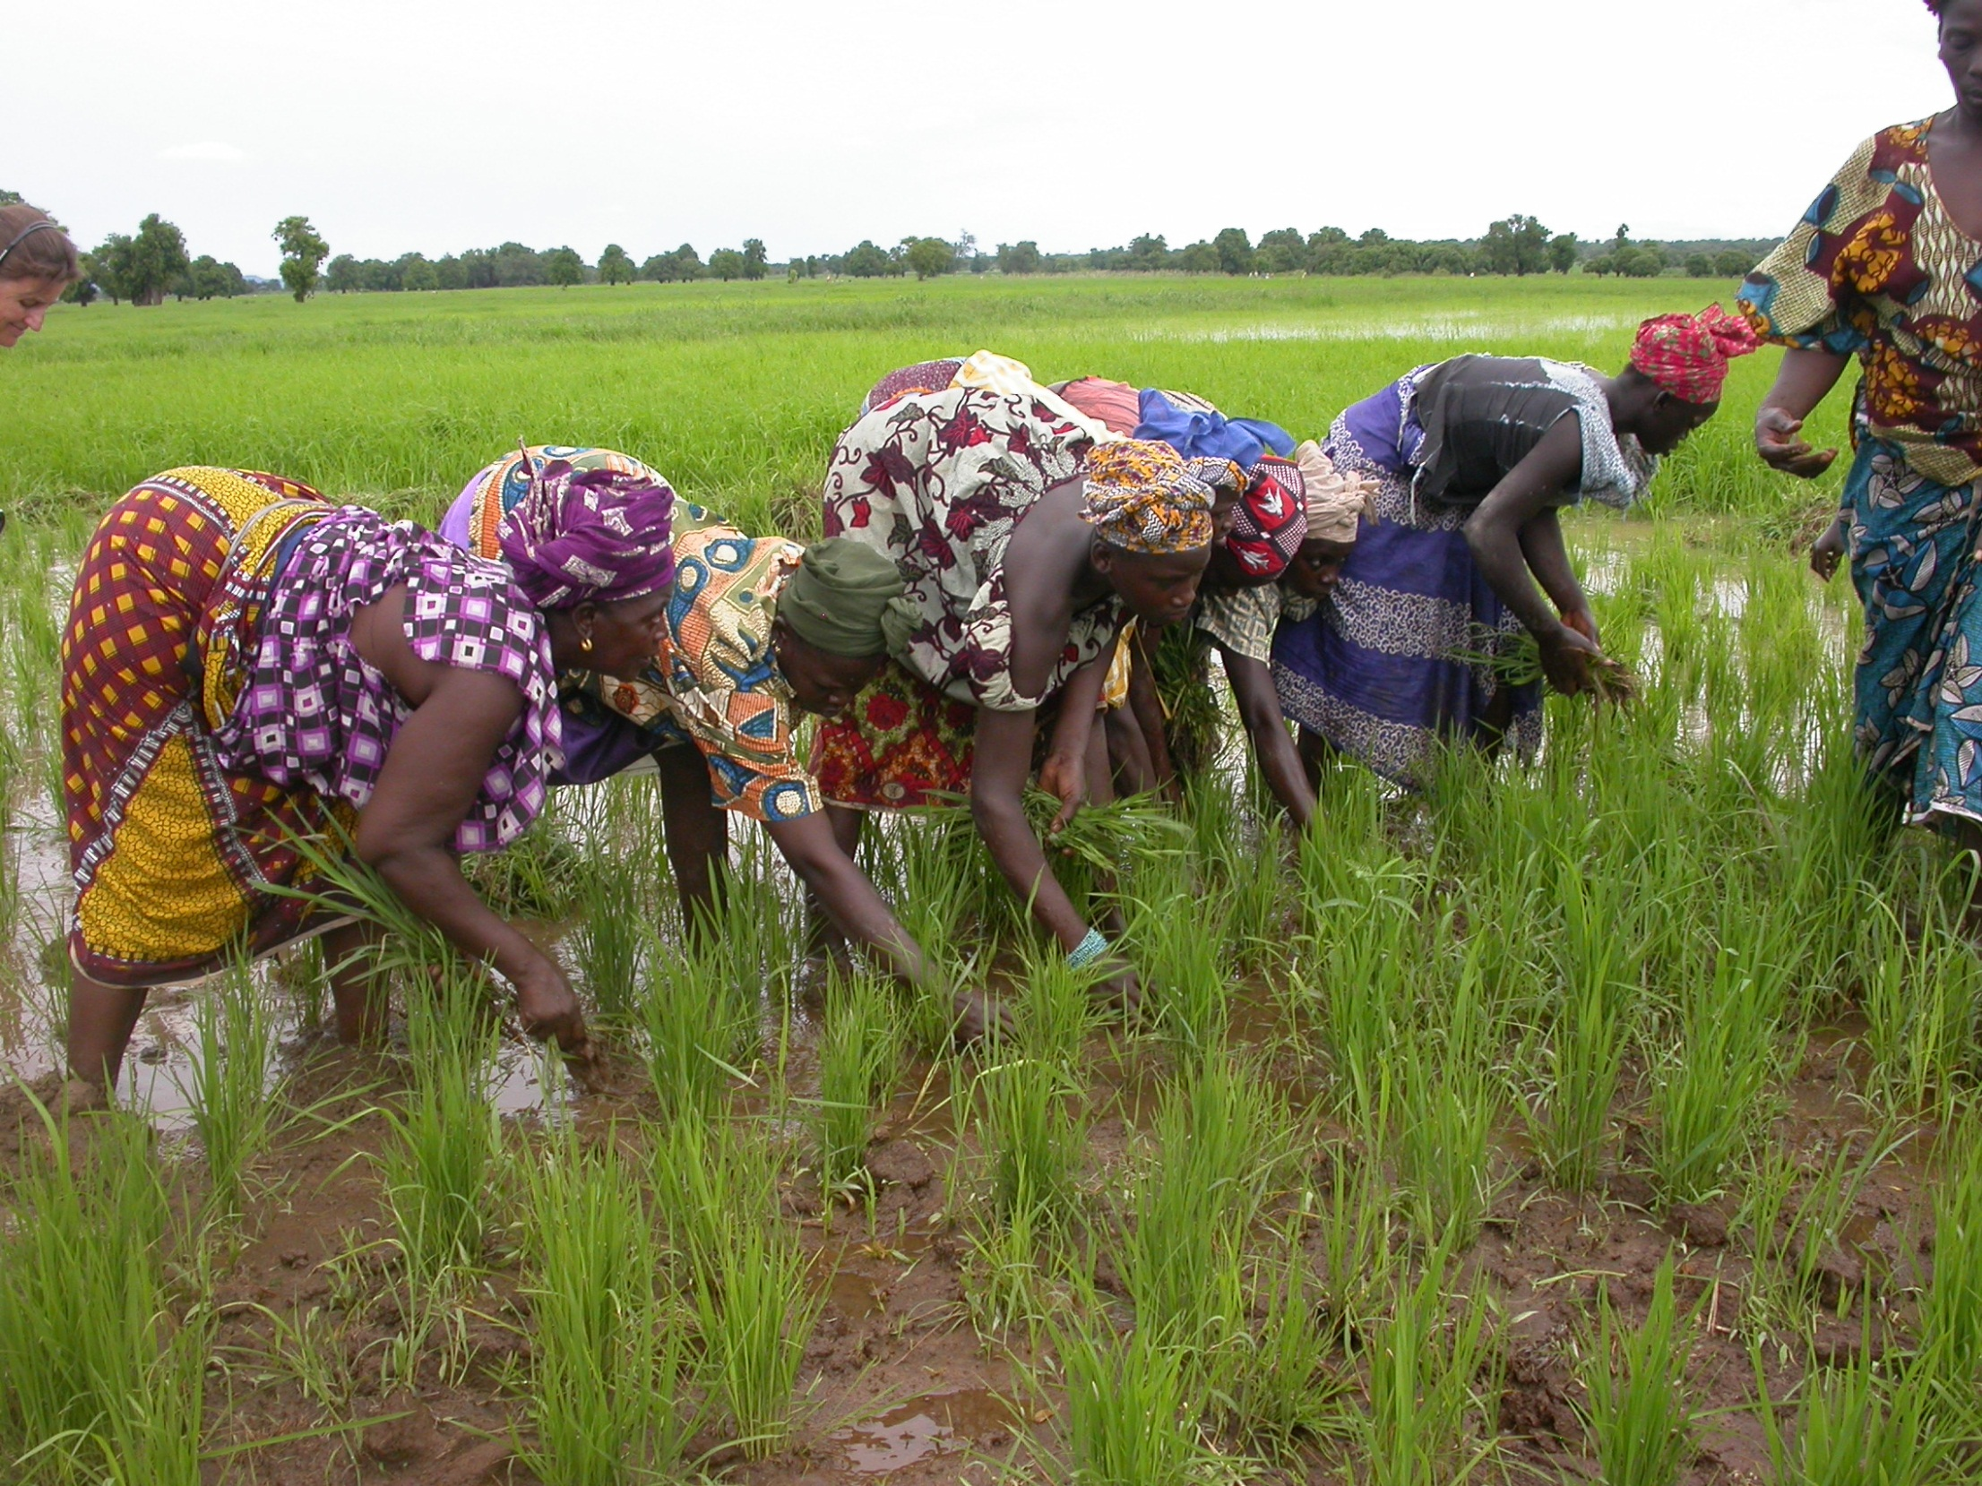

Slide 32
Guinea
“Seed projects should focus on improved varieties only”
Notes:
Country
“Stereotype”

Slide 34
Guinea
weak government support for agriculture
political instability (internal, SL and Liberia)
lack of formal financial institutions
lots of local entrepreneurial initiatives, some started with outside support/exposure

Slide 35
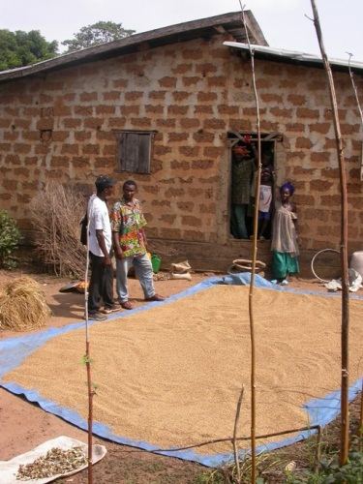
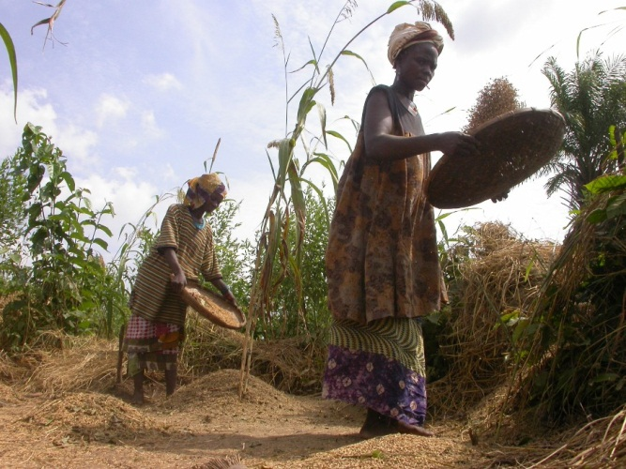
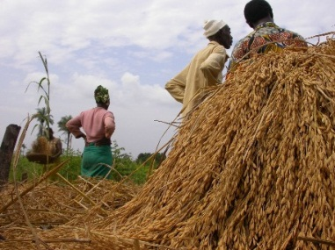
Guinea
Mama Adama produces and sells seed of one local variety entirely on her own; trades cross-country via family ties

Slide 36
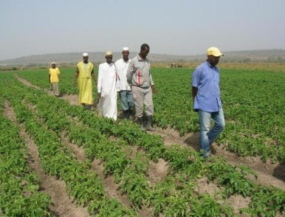
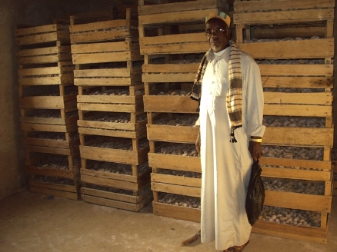
Guinea
Sharif began producing and selling seed of improved varieties under various projects, but shifted to local ones when he had to pay the full cost of fertilisers
El-Hadj Sow is a trader, inspired by his visit to France, who started growing potato, rice, maize and cowpea seed largely on his own, and he made it work

Slide 37
Guinea
certification services are nascent, creating an opportunity for small, private enterprises to produce and sell quality seed of local varieties, but also blocking entrepreneurs from exporting seed to neighbouring countries
professional seed traders exist, but have always been ignored by formal seed projects
traders equally sell improved and local varieties, offering what farmers want

Slide 38
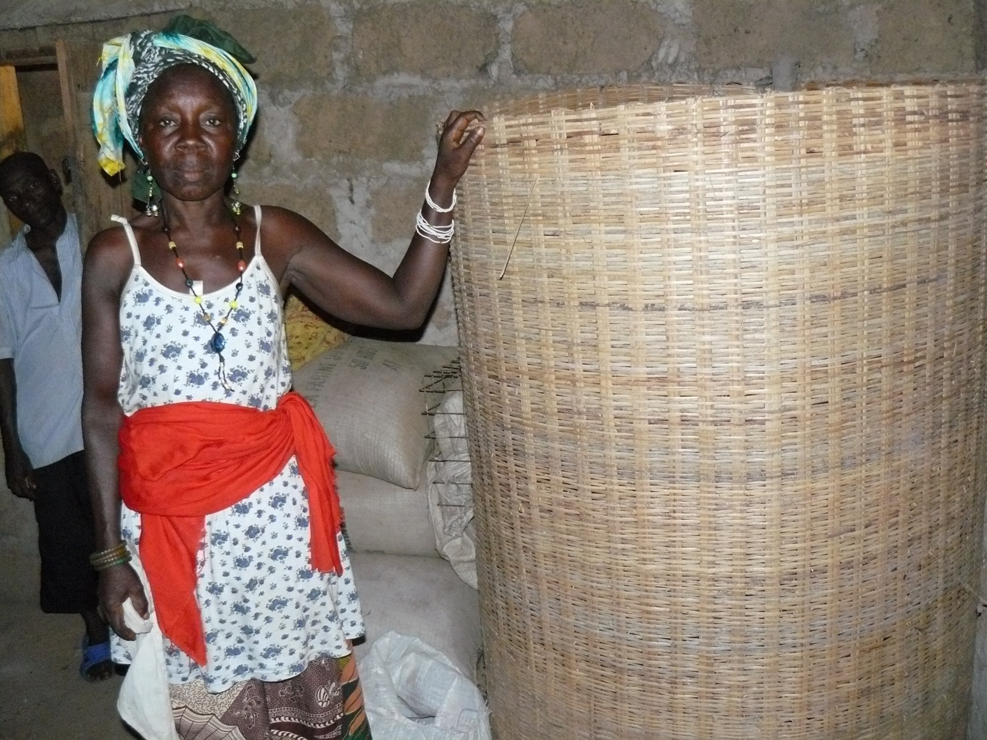

Slide 39
The Gambia
“Seed enterprises continuously need new varieties to stay in business”
Notes:
Country
“Stereotype”

Slide 41
The Gambia
produces enough coarse grains to be self-sufficient, but much is exported
Gambians prefer eating rice, which is easier to prepare
80% of the rice eaten in The Gambia is imported
no seed laws and no system of seed certification

Slide 42
The Gambia
Gambia Horticultural Enterprises has continued investing in marketing; runs the largest farm supply company, selling seed, agrochemicals and machinery, even exporting some products to Europe

Slide 43
Table 7.2: Seed sales, Gambia Horticultural Enterprises
 | 1990 | 1993 | 1997 | 2000 | 2005 | 2009
 | Importance (%) of seed sales in total company’s turnover
Seed sales | 100 | 80 | 70 | 50 | 40 | 30
 | Seed quantities sold (tonnes)
Vegetables | 0.5 | 1.0 | 2.0 | 2.0 | 3.0 | 5.0
Field crops | - | 1.0 | 2.0 | 3.0 | 20.0 | 50.0
 | Share (%) of individual field crops in the total sales of field crops
Rice | NA | NA | NA | NA | 50 | 50
Groundnut | NA | NA | NA | NA | 20 | 10
Maize | NA | NA | NA | NA | 20 | 30
Sorghum & millet | NA | NA | NA | NA | 10 | 10

Slide 44
The Gambia
Jambur Kafo, women’s cooperative, already a self-organised group doing PVS with NARI, who gives them seed and advice; sells only NERICA rice seed since 2002; makes deft use of radio and TV to advertise nationally

Slide 45
The Gambia
all enterprises have close ties with research, extension and media
demand for rice seed is tied to demand for grain, which is high, since rice is the staple food
enterprises have been selling same upland NERICA rice varieties for a decade, but renewal of FS is overdue!

Slide 46
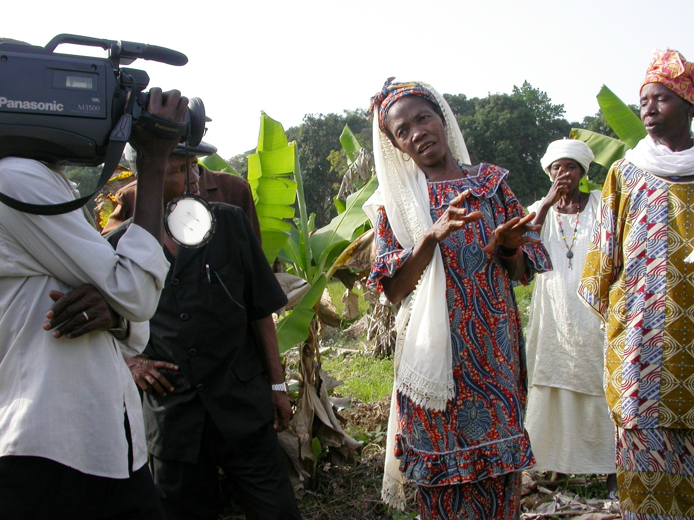

Slide 47
Morocco
“When governments produce seed, farmers are more seed secure”
Notes:
Country
“Stereotype”

Slide 49
Morocco
cereals grown on 58% of the cultivated land
government fixes prices for agricultural commodities, inputs and services
government provides infrastructure, research, training and extension, marketing and credit
national and foreign seed producers, and two national seed traders associations

Slide 50
Morocco
SONACOS defied structural adjustment and produced seed of wheat and other crops
renders the services it is assigned, and remains free of corruption and mismanagement
for many years it put quality seed into the hands of smallholders

Slide 51
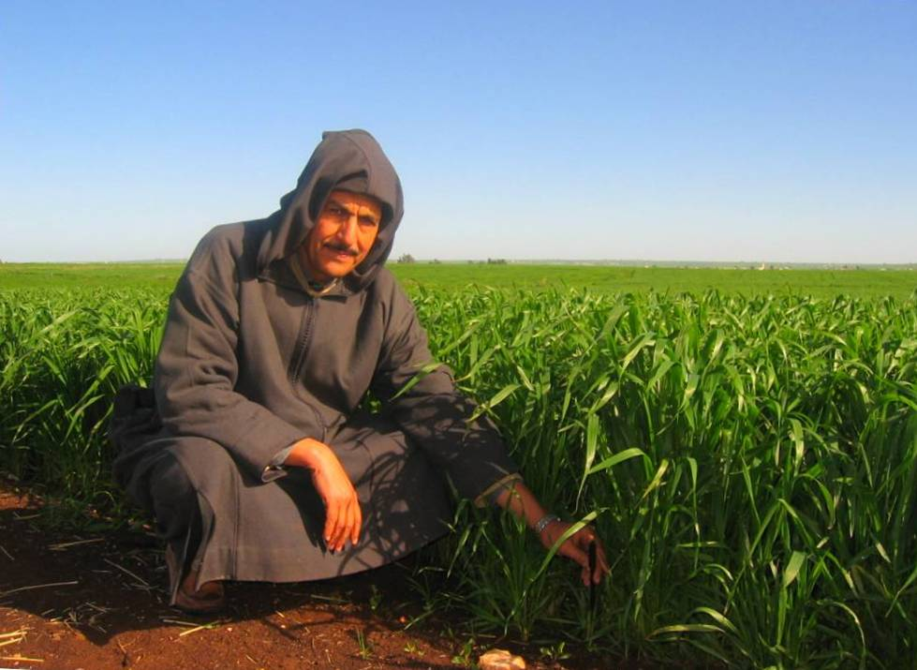
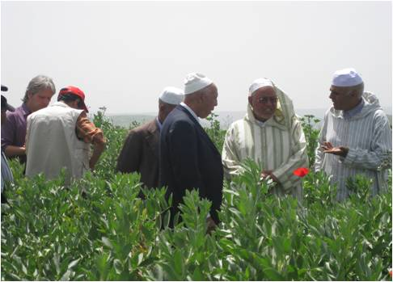
Morocco
however, agricultural output in Morocco has declined
declining demand for seed
government started to privatise agriculture and seed

Slide 52
Table 8.4. Distribution of private seed companies in Morocco
Location headquarters | Number of seed companies | Crops for which certified seed is produced | Number of seed companies
Casablanca | 54 | Food legumes | 68
Rabat | 11 | Maize | 60
Fès | 8 | Oilseed crops | 50
Kenitra | 7 | Forage legumes | 44
Agadir | 3 | Vegetables | 35
El Jadida | 3 | Wheat and barley | 9
Sidi Bennour | 2 | Potato | 4
Berkane | 1 | Rice | 3
Meknes | 1 | Sugar beet | 1
Nador | 1 | Forage beet | 1
Beni Mellal | 1 | Cotton | 1
Total | 92
Notes:
Early 1980s to late 1990s. Seed laws were enacted and breeding programmes started. Private seed companies began importing horticultural seeds.
Early 2000s to the present. SONACOS created regional centres with modern seed processing and storage facilities. New private seed companies including international ones showed interest in Morocco and some started private breeding and seed production for cereals, maize, tomato, potato and other crops.

Slide 53
Kenya
“Strict government regulations are needed for seed enterprises to thrive”
Notes:
Country
“Stereotype”

Slide 55
Kenya
maize and beans have historically been popularised unlike other crops
very rigid seed regulation
85% of total 34,000 tons of certified seed is for hybrid maize
large companies producing OPVs have either opted out, or scaled back due to low profits
seed companies grew from 18 (1996) to 73 (2010)

Slide 56
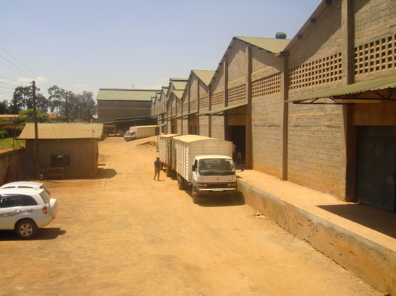
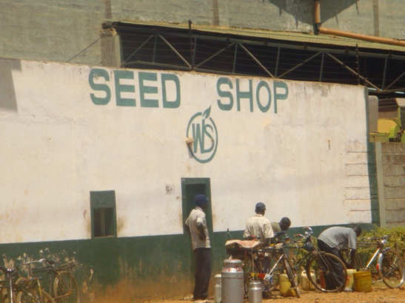
Kenya
Western Seed Company > OPV and hybrid maize seed
reaches 200,000 farmers through its network of distributors
no credit to agrodealers who are all trained by the company
prints recommended prices on its packages
OPVs have a unique niche when adapted to drought, infertile soils and Striga enjoying brisker sales

Slide 57
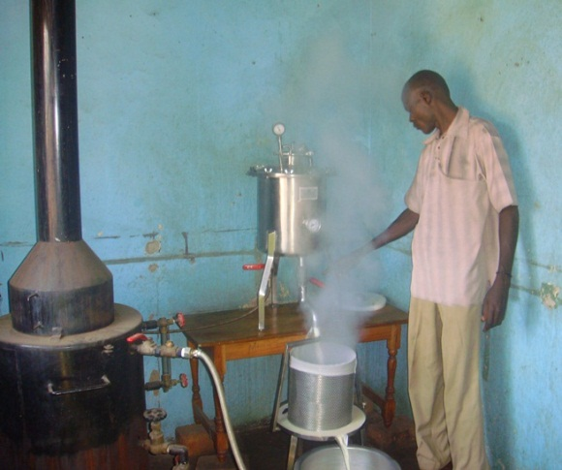
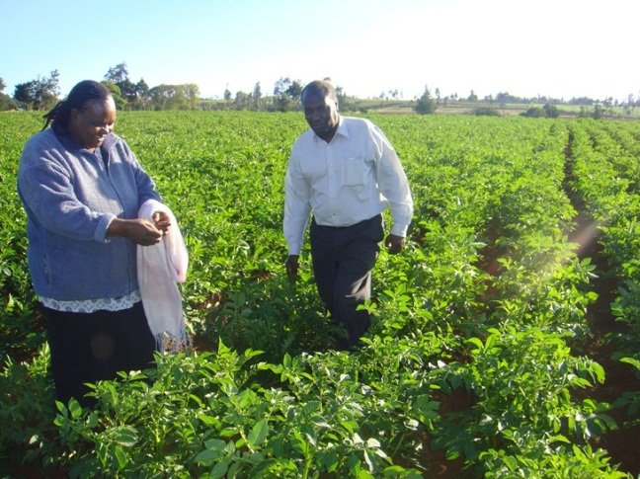
Kenya
Sungus is a family farm that used a bit of land, some creativity and hard work to spring-board off a German seed course to become a professional producer of seed potatoes; uses staggered planting to spread cash flow; near its customers to sell seed rapidly after harvest

Slide 58
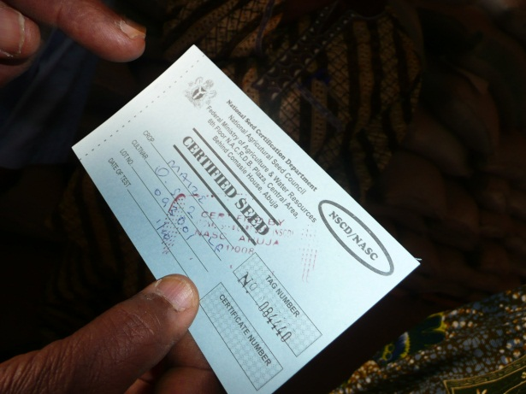
Kenya
CBOs and family seed enterprises can provide clean seed and serve smallholders, especially through partnerships with research institutes and seed companies, and should not be forced into certification
fragmented legislation (for fertiliser, seed certification, export, taxes, monitoring pesticide use,…) increases transaction costs for companies

Slide 59
Uganda
“Anyone can start a seed business”
Notes:
Country
“Stereotype”

Slide 61
Uganda
two rainy seasons = faster cash flow, but drying challenges
grain markets are protected and rapidly expanding
demand for maize, beans and upland rice seed increased because of:
opening up land in the North (since 2008)
substitution to disease-striken bananas/cassava
17 local seed companies > 50 distributors > 2000 stockists
supportive financial market and services

Slide 62
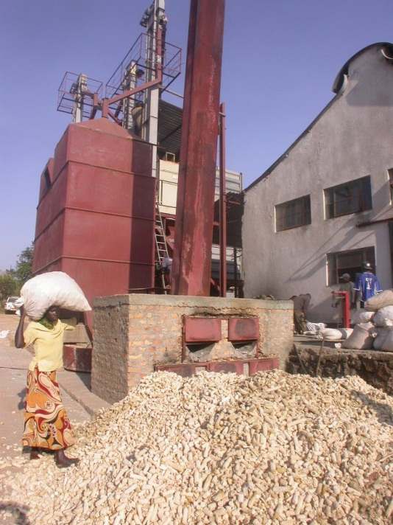
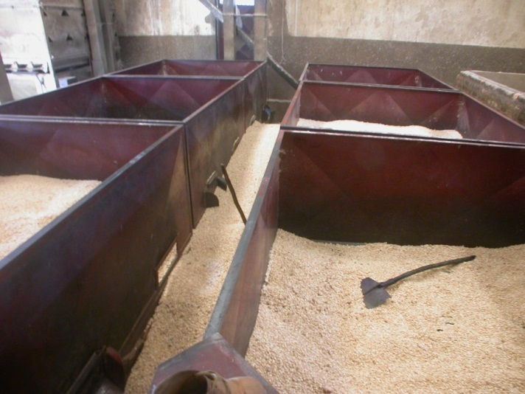
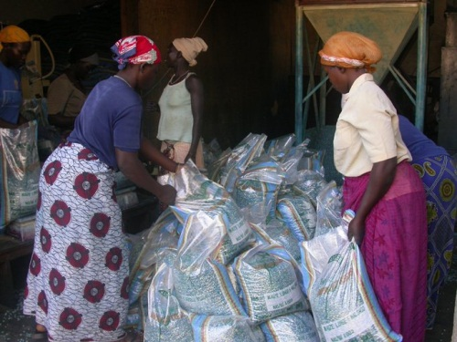
Uganda
NASECO started as an NGO initiative, eventually producing 2,600 tons of seed of 24 varieties of food crops (half of which OPV maize); invests in packaging to reduce counterfeiters

Slide 63
Table 10.2: Seed produced (tonnes), NASECO
 | 2005 | 2007 | 2009
Maize OPV | 864 | 682 | 1,360
Maize hybrid | 2 | 259 | 208
Bean | 69 | 490 | 196
Rice | 458 | 297 | 417
Sorghum | 84 | 22 | 129
Finger millet | 2 | 52 | 86
Groundnut | 141 | 434 | 129
Cowpea | 75 | 63 | 74
Soya bean | 16 | 28 | 4
Green gram | - | 66 | 23
Others | - | 14 | 2
Total | 1,710 | 2,405 | 2,628

Slide 64
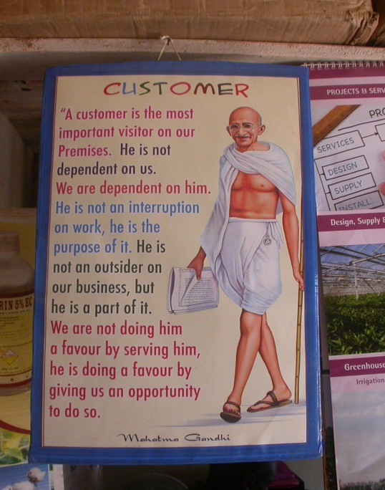
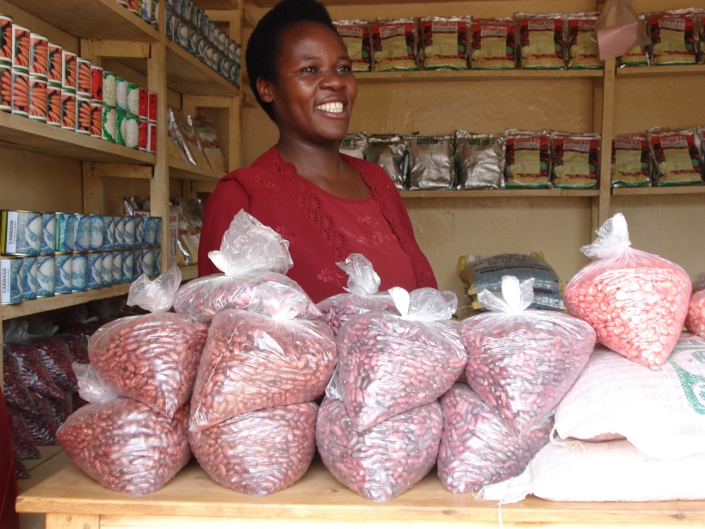
Uganda
a community-based enterprise started as a farmer field school (FFS) in 1999, which selected disease-resistant bean varieties and ended up training and supervising various bean producers’ groups, selling small packs of seed through a network of stockists

Slide 65
Uganda
Uganda National Agro-input Dealers Association (UNADA):
hosts half of the seed companies, distributors and about 2000 agrodealers
provides training, market promotion and linkages
since 2009 credit guarantee funds have allowed agrodealers to buy enough seed
seed companies prefer such sector-wide efforts

Slide 66
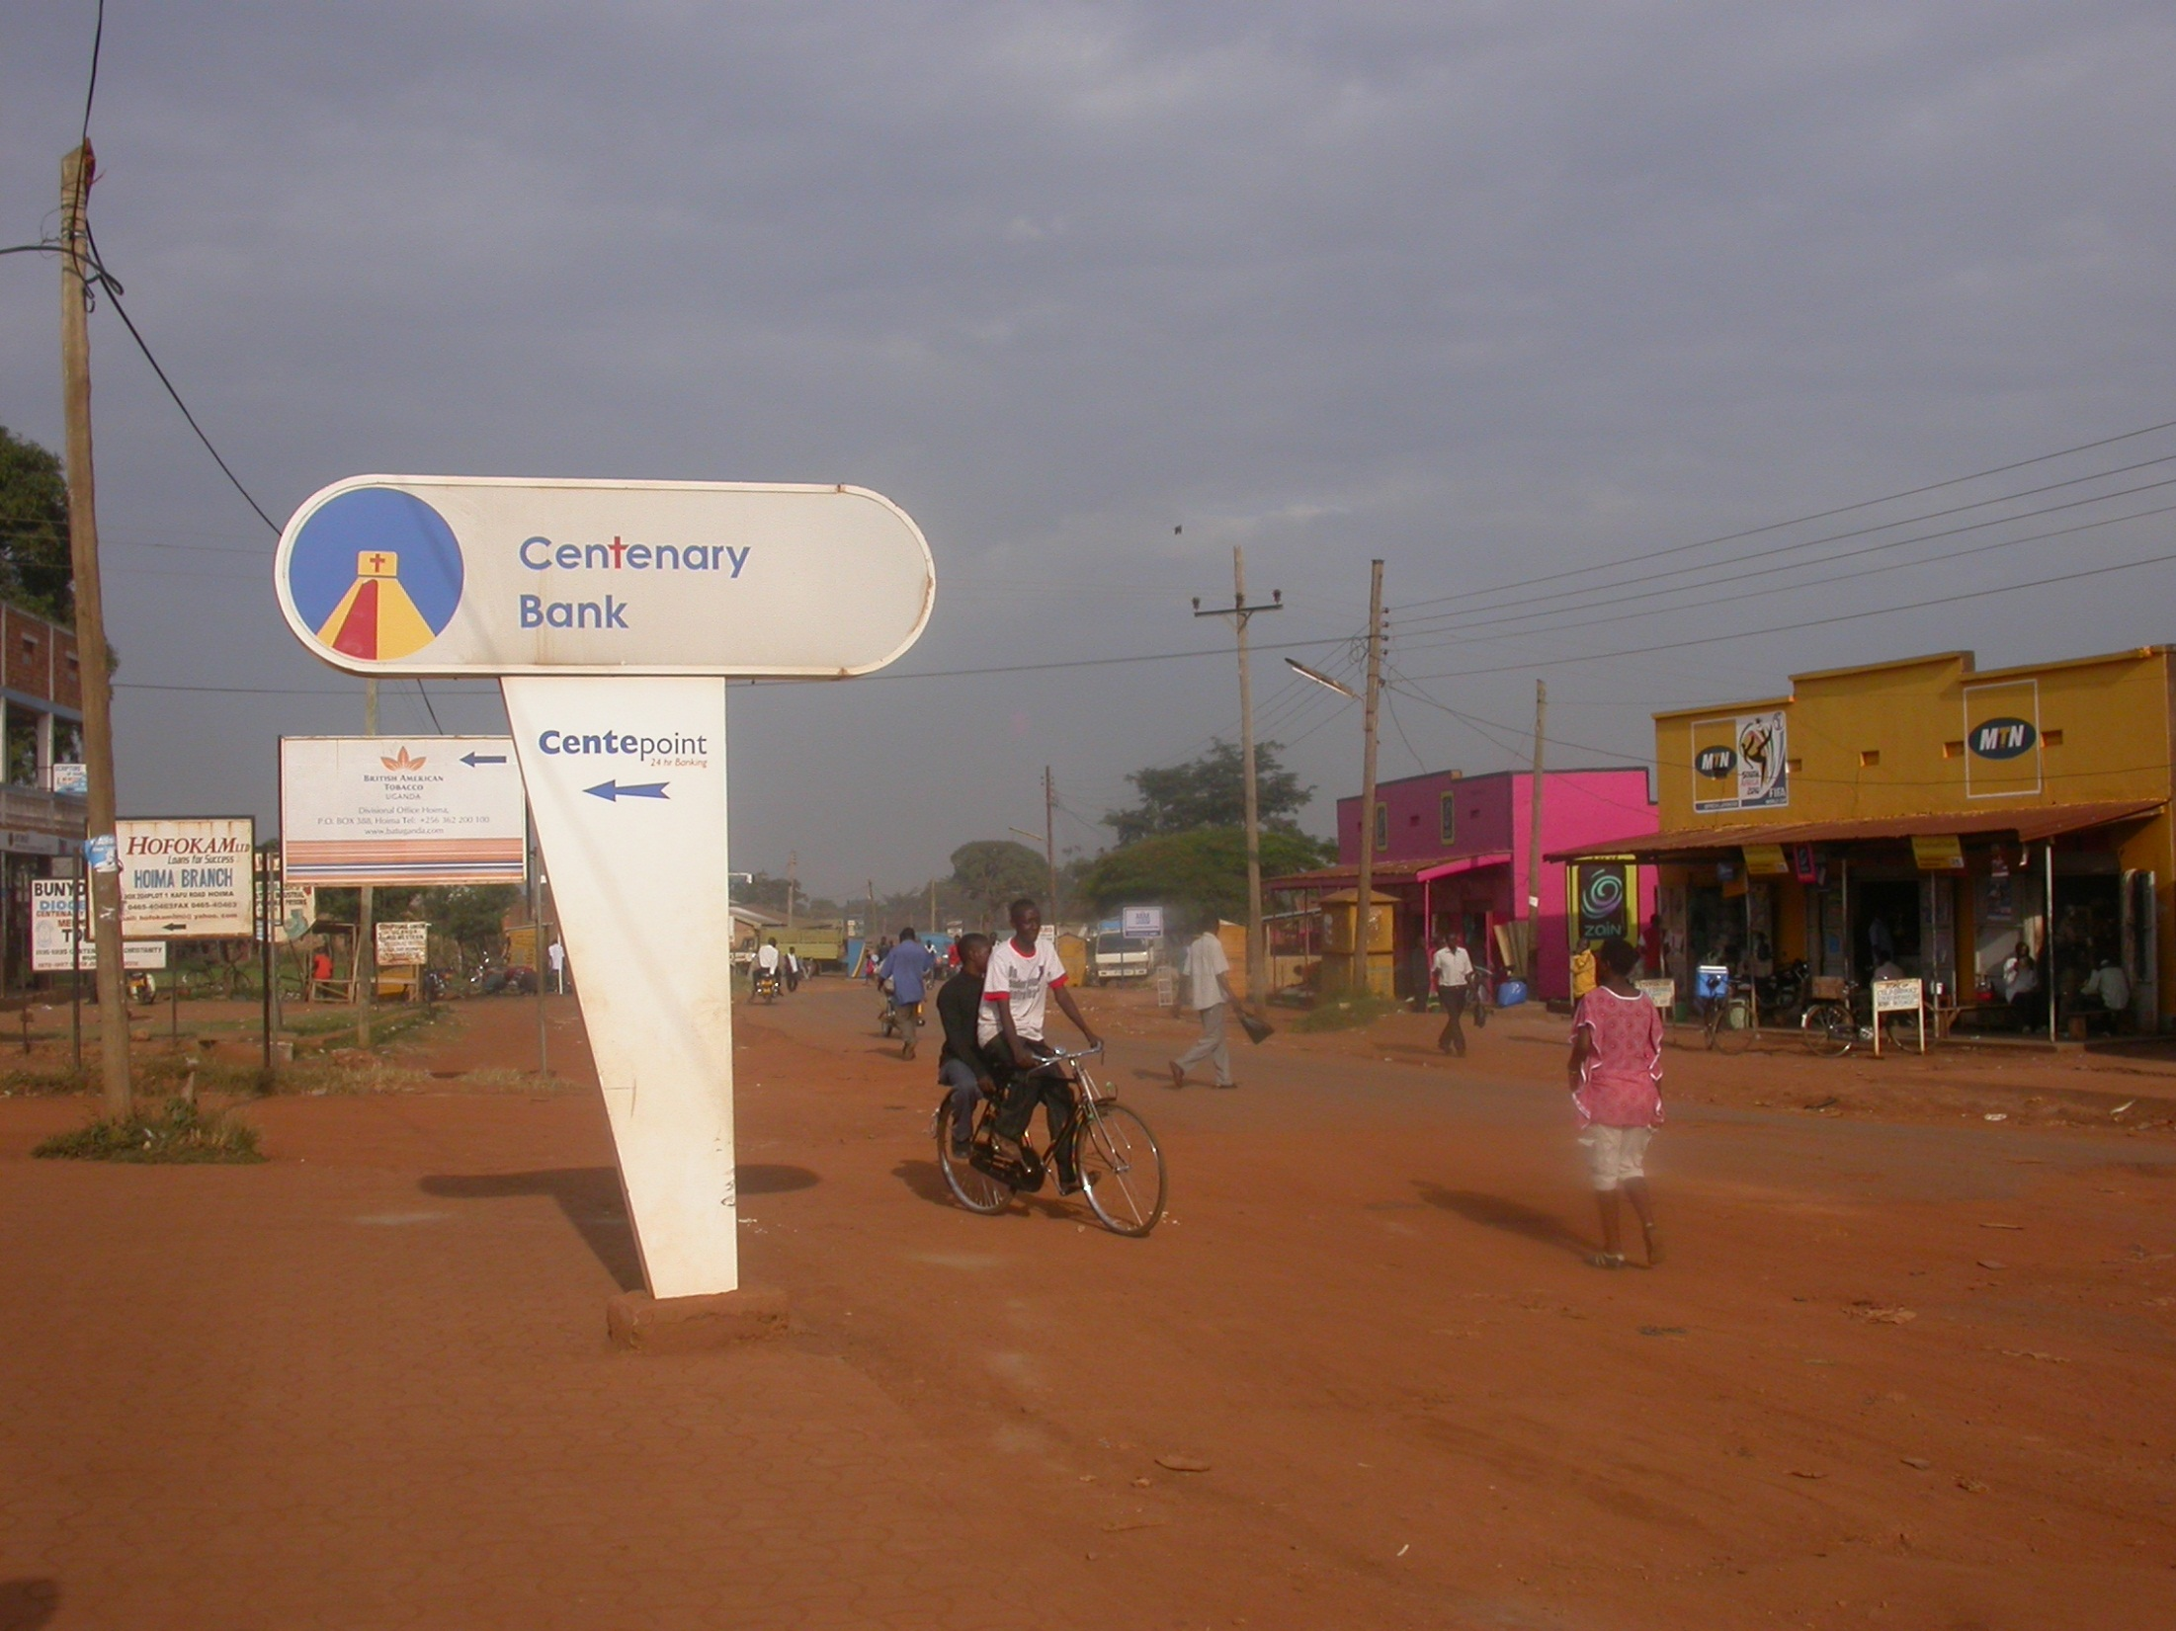

Slide 67
Madagascar
“Family relations hinder enterprise development in Africa”
Notes:
Country
“Stereotype”

Slide 69
Madagascar
island liable to cyclones, flooding and drought
privatisation of twenty seed multiplication centres began in 1995
Green Revolution plan in 2006 and boost of upland rice cultivation > no food crisis
political crisis since 2009

Slide 70
Madagascar
Valy Prod Sem is a family-based bean seed company that grew out of an experience with a privatised government seed centre, and is linked to communication and entertainment businesses
Andri-Ko produces rice and OPV maize seed on family land; recruits labour; has own warehouses and buys from trusted growers if demand exceeds supply

Slide 71
Madagascar
relief agencies buy the cheapest seed on the market, in large amounts with little emphasis on quality
with projects and NGOs as principle clients, some enterprises could not sell seed after the political crisis
family enterprises are diverse with built-in buffers to cope with system stresses

Slide 72
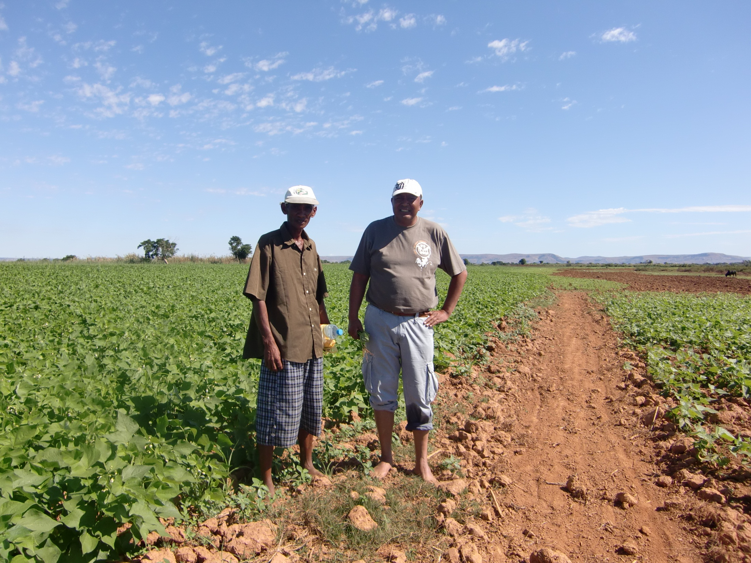

Slide 73
6. What makes African seed entrepreneurs?

Slide 74
What makes African seed entrepreneurs?
All enterprises showed adaptive management by:
diversifying their activities
often combining seed with crop production to speed up cash flow
selling small seed packs to increase their outreach to farmers

Slide 75
What makes African seed entrepreneurs?
have a good sense for opportunities and followed them with a stepwise, thoughtful approach, avoiding risky loans, trying it out at small scale
are frugal
are almost always from the area where they work
are all hands-on people, the kind who are in the seed factory or with the outgrowers every day
Need to be involved in any seed intervention

Slide 76
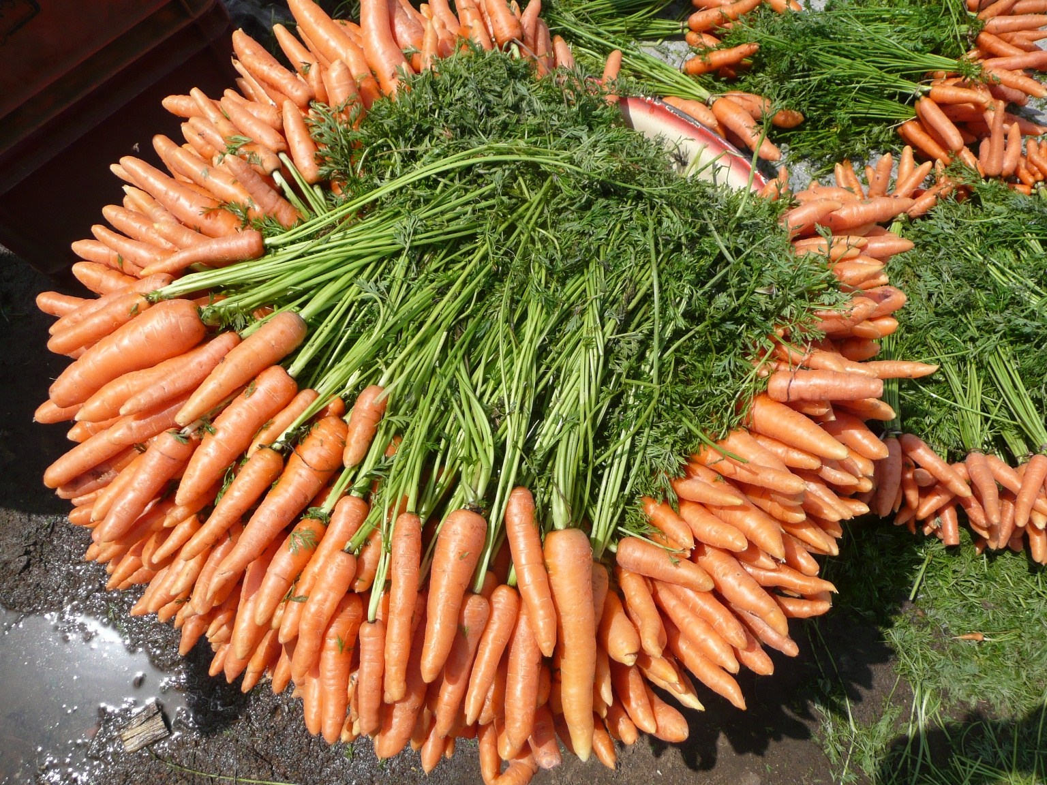

Slide 77
PART 2: CASE STUDIES
Brazil & India

Slide 78
Brazil
Strong Government support to the seed industry
Seed legislation in place since 1965 that defines production, processing, storing, quality standards and marketing regulations
Government and bank loans to seed and crop producers
Small-scale seed enterprises and cooperatives

Slide 79
Brazil
Seed production started with contract farmers
Premium price based on seed quality standards
Training and capacity building by NGO’s, Universities and Research institutes (Embrapa)
Access to improved varieties from Research

Slide 80
India
Seed industry evolved from a single parastatal company, to decentralized state or provincial parastatals, to a mixed private-public system
The public sector supplies predominantly self-pollinated varieties and the private sector supplies hybrids
Small seed enterprises link to multinational companies

Slide 81
Mulukanoor Cooperative Society
The cooperative provides:
inputs to the growers (seed, fertilizer, credit, implements
technical advise in seed production and quality control
The cooperative buys back all seed produced, after deducting the cost of inputs and credit advanced.
Seed is processed in the cooperative’s own seed processing facilities and is then marketed

Slide 82
University of Agricultural Science, Dharwad
Provides all infrastructure facilities and training to seed farmers through post-graduate students;
Buys back all seed that meets quality standards and sells it on to public and private seed enterprises

Slide 83
National seed policy in India promotes seed trade, provides incentives for private sector plant breeding and strong support to public sector institutes;
IPR provide a balance between protecting the interests of plant breeders and the rights of farmers;
Many subsidies are provided for seed sector development;
Capacity building, seed market and loans are guaranteed.

Slide 84
Key factors influencing the development of small-scale seed enterprises
Part 3

Slide 85
1. Conducive policy environment
Policies should promote the development of diverse sources of seed supply;
Must be supportive of the nature and scale of seed enterprise planned;
Need for continued state involvement in ensuring access to credit for farmers and entrepreneurs, providing extension services, and in setting and monitoring seed quality standards;
Few countries have policies supporting farmer seed systems.

Slide 86
2. Demand for seed
Sustained seed demand is important as was evident in the case studies of Brazil and India
Commercial seed production is viable only if purchased seed offers real benefits to farmer over own-saved seed
Development of improved cultivars/hybrids has stimulated development of seed enterprise in many countries
Major efforts will be needed to raise the awareness of farmers of the benefits of using high-quality seed

Slide 87
Seed quality is key to sustained demand
Seed price is a major determinant of demand; smaller quantities can make seed more affordable
Markets and market information are crucial for the development of seed enterprises;
Communication strategies contribute to creating demand

Slide 88
3. Availability of improved varieties and source seed
Availability of improved varieties and source seed from public sector breeding programmes is essential

Slide 89
4. Entrepreneurship, technical skills and capacity building
Skills in planning, management and marketing
Community-based seed enterprises to be based on marketing and profitability to ensure sustainability

Slide 90
5. Access to credit
Availability of credit at government-subsidized rates of interest has been a key to development of seed enterprises (Brazil, India)
6. Enterprise ownership and profitability
Seed enterprises based on local ownership and profitability for sustainable development and growth

Slide 91
7. Equipment & Infrastructure
processing and storage facilities
8. Public-private partnerships
Linkages with expertise and resources available in public sector benefits the seed enterprises

Slide 92
Part 4: Conclusion
Multinationals cannot handle seed of all crops
Public sector still has an important role to play in the development of the seed sectors of non-hybrids crops
Strong public-private partnerships are key to success

Slide 93
4. Local seed production and distribution problems can be solved with the right policy support, and when sufficient attention is given to establishing linkages and building capacities in technical, financial, marketing and communication aspects.

Slide 94
Thank you

