Slide 1
Status of the peach fruit fly,
Bactrocera zonata (Saunders)
and its control measures in Egypt
Ahmed H. El-Heneidy
Dept. of Biological Control,
Agricultural Research Center,
Giza, Egypt
Regional Symposium on the Management of Fruit Flies in Near East Countries,
Hammamet, Tunisia, 6-8 November 2012

Slide 2
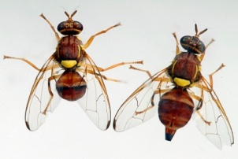
Introduction
Horticulture crops are subject to attack by polyphagous (attack wide ranges of crops) and/or monophagous (specific to certain horticultures' families) pest species.
Fruit flies are among the agricultural pests that have great economic importance. They include about 4000 species. Out of which 1200 species belong to family Tephritidae. Most of these species are polyphagous and about 40% of them attack several fruits while the rest attacks the flowers, stems, leaves and roots. Most of the fruit flies belong to 5 genera. Genus Bactrocera is the greatest one which contains about 500 described species.
African fauna comprises almost 1000 described species. More than 50 of them are of economic significance. Although most of these are species native to the African mainland or to any of the Indian Ocean islands, some were accidentally introduced from other regions, in particular from Asia.

Slide 3



Bactrocera cucurbitae
It is principally an Asian species
and its main hosts are species of
Cucurbitaceae. Although it was
Restricted to eastern Africa for several
decades, it has recently been reported
from Western Africa and the Seychelles
(White, 2006).
Geographical distribution
in Africa

Slide 4
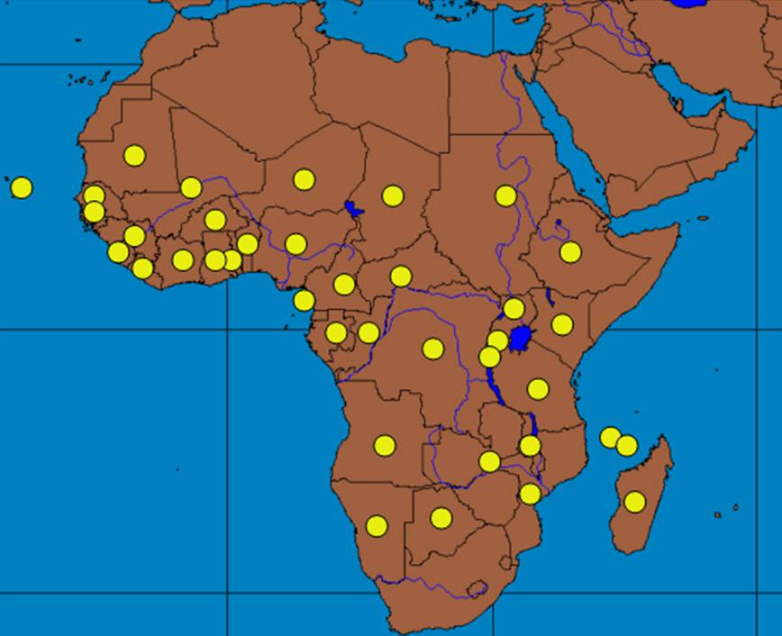

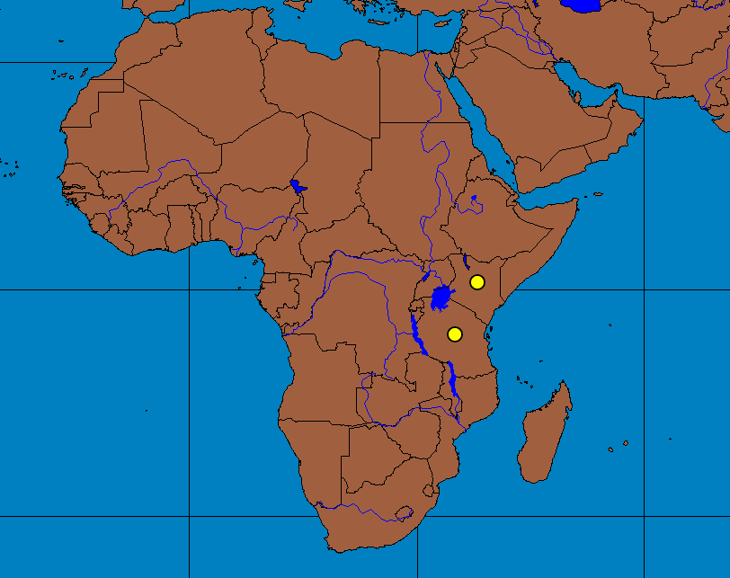
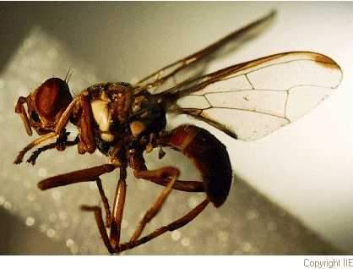
Bactrocera invadens: was first found in Kenya in 2003 (Lux et al., 2003) and somewhat later reported from Tanzania (Mwatawala et al., 2004).
Bactrocera latifrons: in 2007, it was also found in Kenya near the border with Tanzania (Mwatawala et al., 2010).
Geographical distribution
in Africa

Slide 5
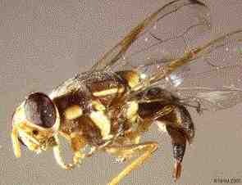
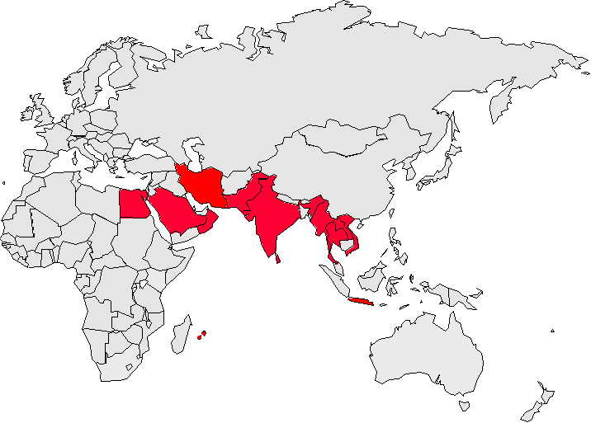
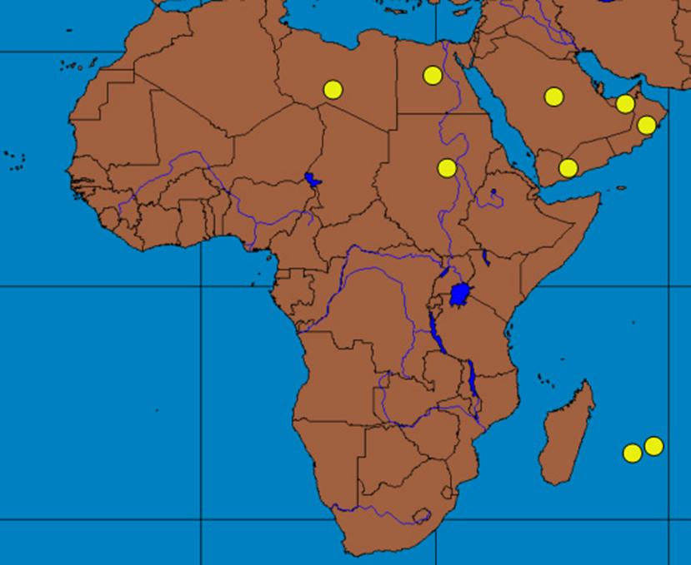
Bactrocera zonata: originates in South and South-East Asia, where it attacks many fruit species (more than 50 host plants).
B. zonata was detected in Egypt in 1914 and again in 1997 and now has distributed almost allover Egypt.
,
B. zonata in
the world
Egypt
B. zonata in
Africa

Slide 6

Countries where B. zonata is categorized
APPPC A2 list
CAN A1 list
CPPC A1 list
EPPO A1 list
EU A1 list
OIRSA A1 list
Africa
East Africa (wide spread in Egypt) A1 list
Southern Africa A1 list
Oceania
New Zealand Quarantine pest
Therefore, an urgent need for considerable strengthening of the human and physical quarantine and monitoring infrastructures in Africa, in order to avoid any further unwanted introductions.

Slide 7
Pest Status in Egypt
Historical Review
  In 1912, B. zonata was recorded for the first time in Egypt as a quarantine insect pest in Port–Said, Suez Canal region (Efflatoun, 1924).
In 1995, it was recorded again attacking a wide range of fruits but it was misidentified as Bacterocera pallidus (Aboul-Ela et al., 1998).
In 1998, its identification was corrected and it was reported as a serious pest on many fruit crops, particularly Guava at Alexandria region. Afterwards, the pest distribution was very fast in many regions and with high populations. More than 45000 traps and killing bags were used at that time to prevent its dispersal. But, the pest has been found attacking aggressively several fruit crops in the country (El-Minshawy et al., (1999).
In 2004, it was recorded B. zonata as a secondary pest species on some vegetable crops; cucurbits, tomatoes, paprika and eggplant in Egypt. Such transaction of the pest from fruit crops to some vegetable crops threats the production and export of those crops in the future in Egypt (Hasham et al. 2004).

Slide 8

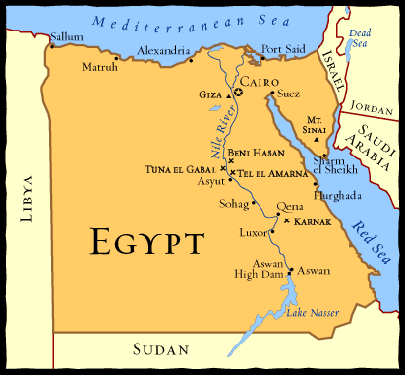
Pest Status in Egypt (continued)
Estimated levels of infestation reached up
to 30-40% (approx. 177 million US$ loss yearly).
B. zonata infestation is present year round,
reaching its highest levels in July-September.
The presence of susceptible host fruits in
combination with local climatic conditions
influences seasonal population fluctuations.
Preferable crops are Guava, Mango, Peach.
Permanent planting of mixed fruit fly hosts in
Egypt allow for rapid development and expansion of the pest.
The pest competes aggressively with the Medfly C. capitata and in many cases; it has displaced the Medfly when both species were found in the same orchards.

Slide 9

Control Measures in Egypt
Detection: Fruit flies detection in Egypt depends on scattered traps using non-toxic methyl eugenol plugs.
Control Methods
Current Practiced Measures
The major action in the control program depends upon use of pesticides.
Partial spray and/or bait spray of tree trunks.
Use of killing bags In semi-isolated orchards or in regions where moderate populations occur.
International cooperation has been initiated by the International Atomic Energy Agency (IAEA) and FAO to eradicate B. zonata and prevent any further spread (A current project ongoing in Egypt).
Mass trapping, using sex pheromone traps (Not common).
Relative consideration of some agricultural practices (pruning and weeding) and mechanical control (collecting fallen fruits) that helps in suppressing pest’s population.

Slide 10

Control Measures in Egypt (continued)
Non-Practiced Measures
Contribution of indigenous natural enemies (ABSENT). Through a wide survey for 3 years, no native specific parasitoid species have been found.
Biological control programs (NOT PRACTICED).
Legislative control measures, particularly the internal procedures
(UN-CONTROLLED)
Male Annihilation Technique (MAT) (NOT PRACTICED).
Sterile Insect Technique (SIT) (NOT PRACTICED).

Slide 11

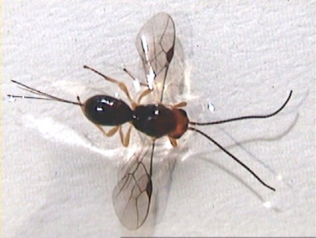
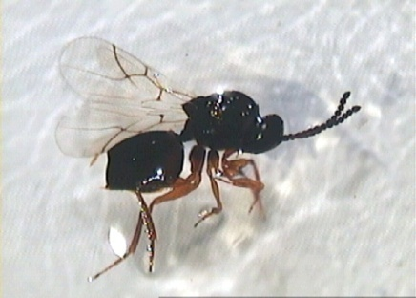
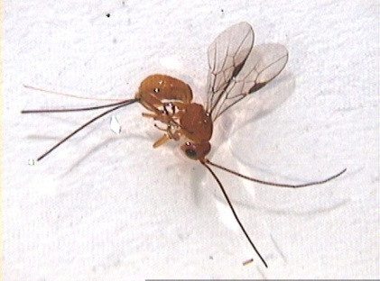
Control Measures in Egypt (continued)
B. zonata problem in Egypt is a classical example of an invasive species that is accidentally moved from Asia to the African continent without its specific natural enemies. Therefore, the fly increased without check and became a pest.
Parasitoids are one of the most potential and effective biocontrol agents of controlling the fruit flies everywhere. Thus, introduction of Asian parasitoids from the native region of the pest to be evaluated in Egypt was considered through a collaborative project with USDA, Hawaii (2008 – 2011).
Three braconid parasitoid species were introduced.
Fopius arisanus
(Egg- larval)
Aganaspis daci
(Larval)
Diachasmimorpha longicaudata
(Larval)

Slide 12
Recommendations
Effective communications
Strengthening cooperation among the MENA region through effective network and creation of fruit flies working group;
Strengthening phytosanitary measures
Preventing the introduction and spread of the pests to the non-infested countries in the Middle East and in North Africa;
Reviewing and updating phytosanitary legislation of the participating countries in order to ensure that adequate legal frameworks are in place; and
Establishing of a national and regional vigilance (surveillance) system.

Slide 13
Recommendations (continued)
Capacity building
Training government and industry personnel in surveillance and management techniques for Fruit Flies;
Training phytosanitary officers in Pest Risk Analysis with special emphasis on the identification of pathways for entry of the Fruit Flies; and
Training technicians and farmers for survey, monitoring and control of fruit flies.

Slide 14


Thanks for your attention
Ahmed H. El-Heneidy

