Slide 1
Evaluation of Ceranock “attract and kill” and Femilure mass-trapping strategies to combat Mediterranean fruit fly Ceratitis capitata on peach in Tunisia
Sarra Bouagga
Regional symposium on the management of fruit flies in Near East Countries
Hammamet, Tunisia 6-8 November 2012

Slide 2
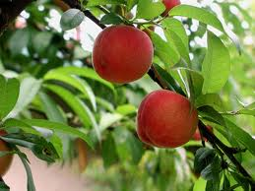
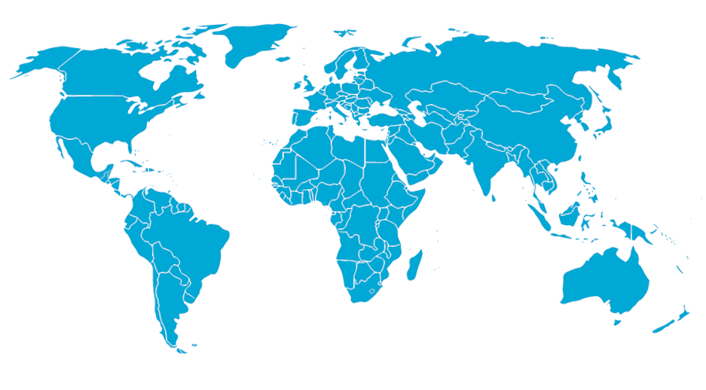
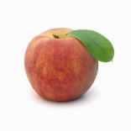
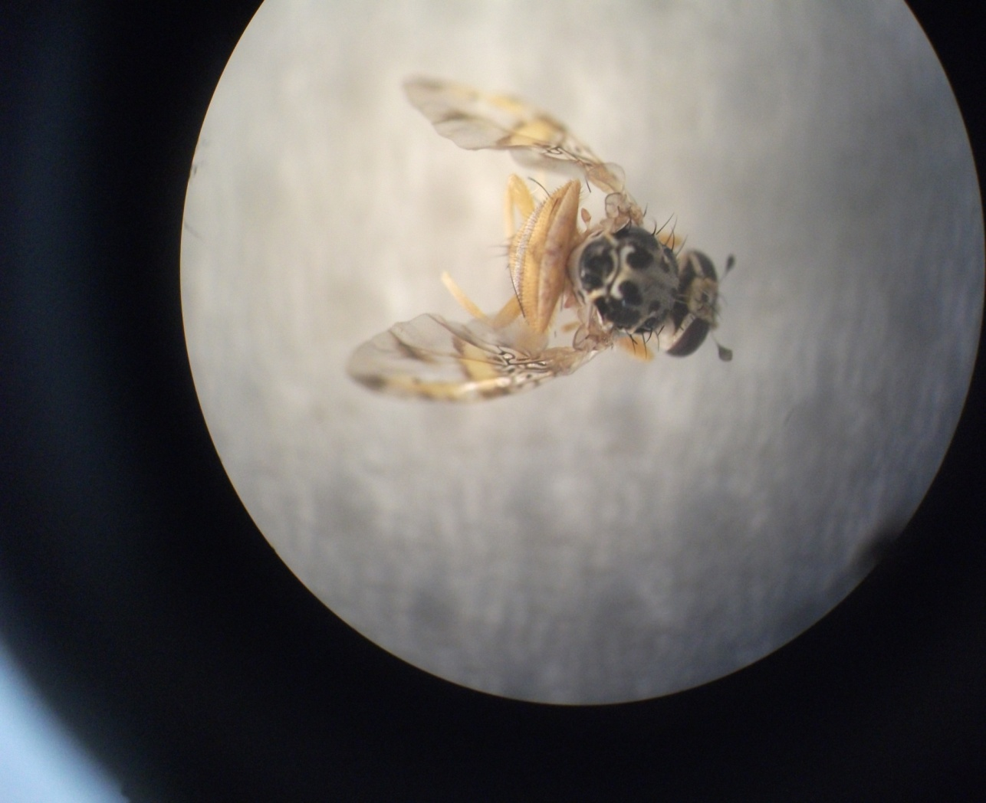
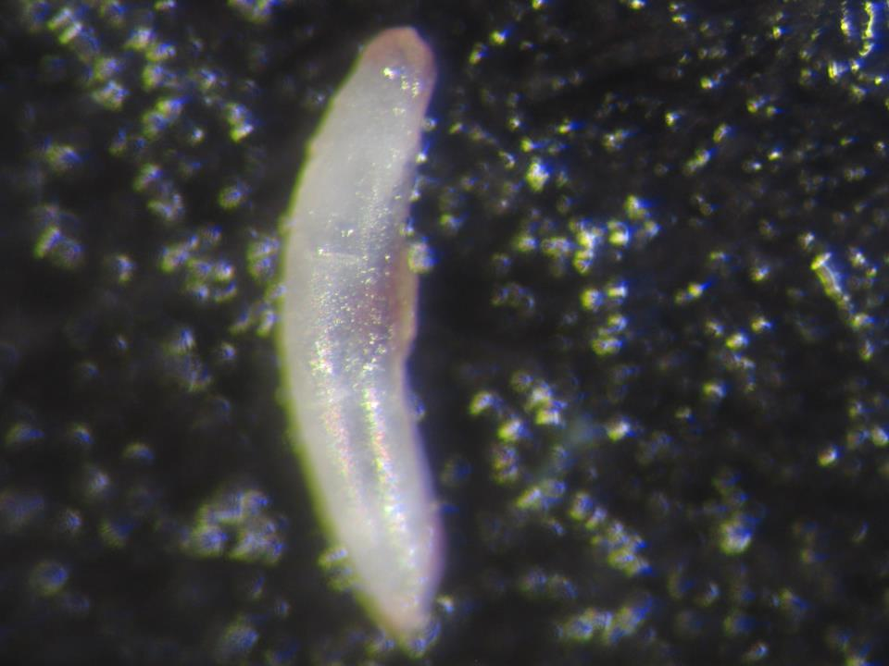
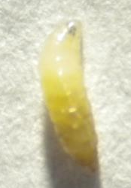
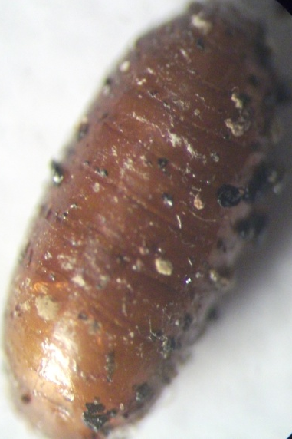
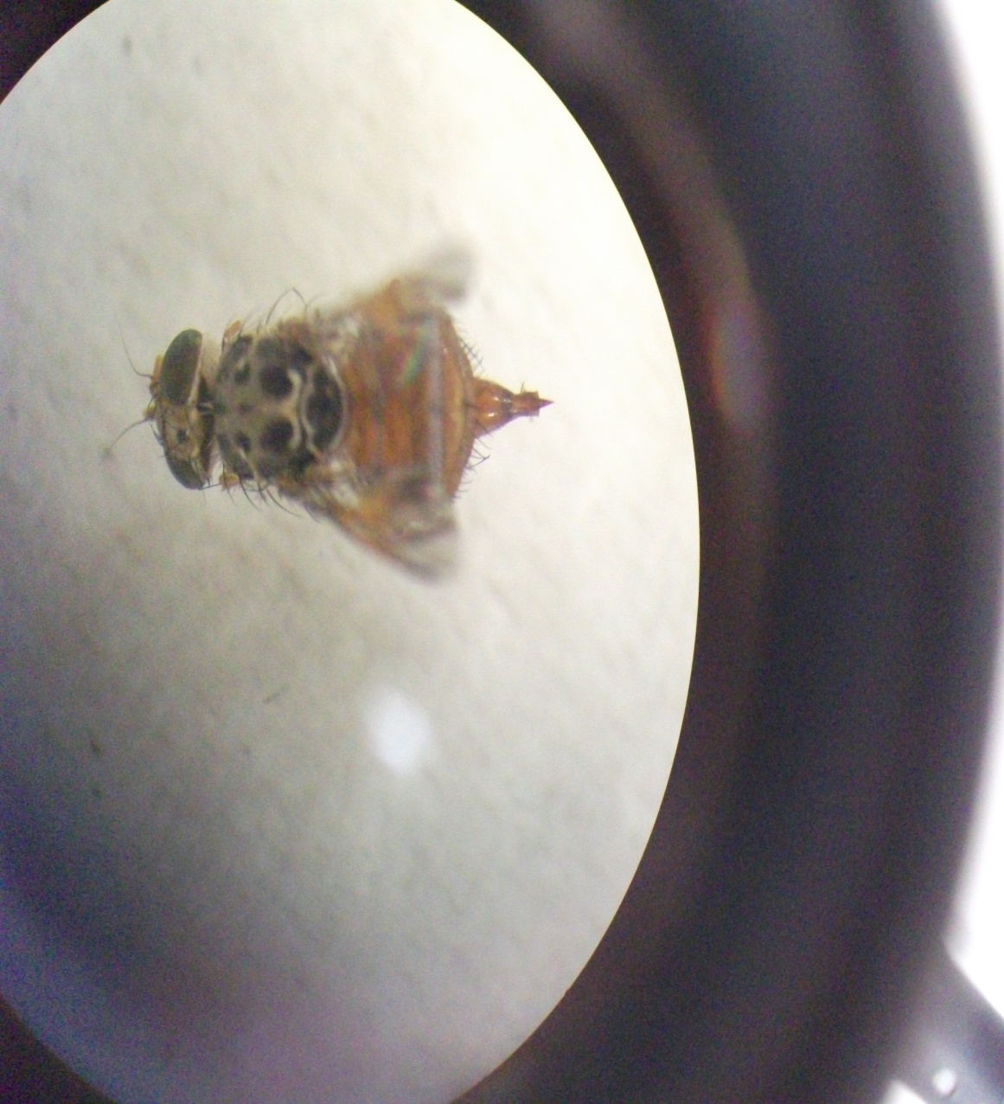
Introduction
Tunisia first detection in 1885
Peach is an important stone fruit grown in Tunisia
26 000 ha (GIF, 2010)
121 100 tons (GIF, 2010)
Mediterranean fruit fly Ceratitis capitata (Weidmann, 1824)
Serious pest in Tunisia
Highly polyphagous (350 botanical species)
Great power of reproduction + high number of generations
Peach yield losses: 33.7 % + quality losses: 888 thousand Tunisian dinars
Male
Female
Egg
Larvae
Pupae

Slide 3
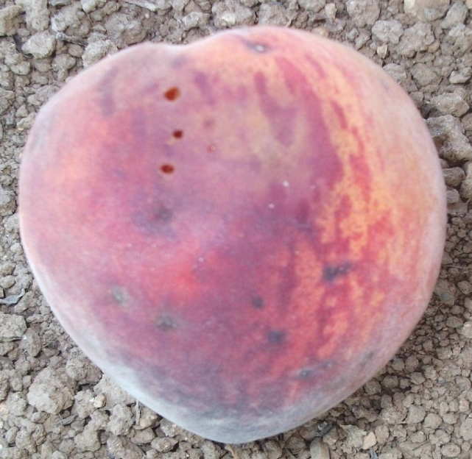
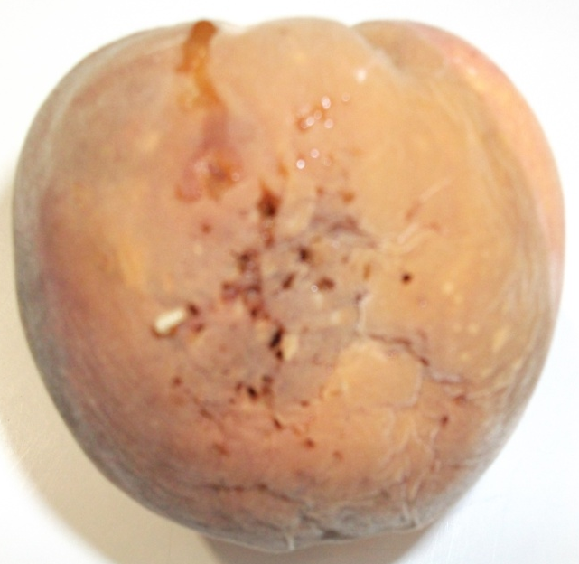
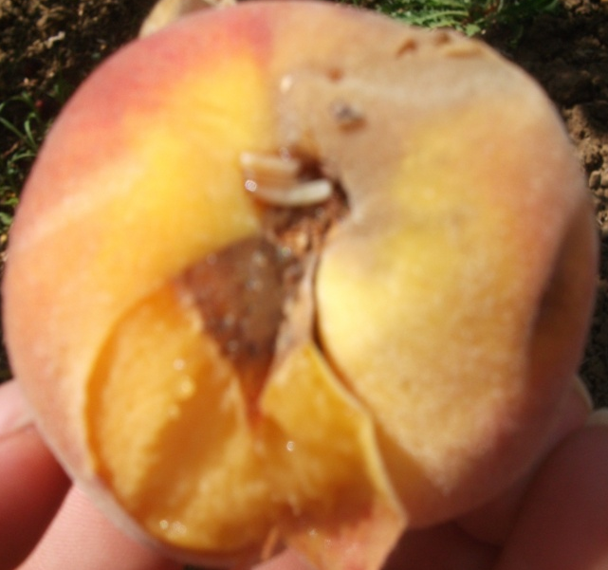
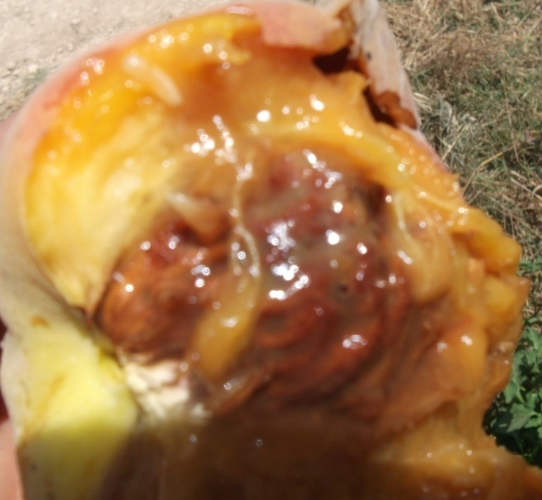
1. Peach fruit damages

Slide 4
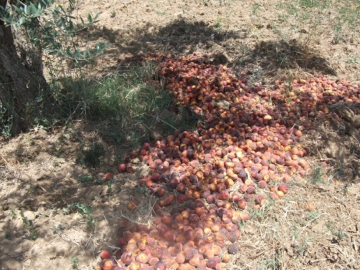
2. Integrated management of C. capitata
Chemical control
Sterile insect technique
Foliar treatment
(Malathion, Deltamethrin)
Soil treatment
(Chlorpyrifos, diazinon, fenthion)
SIT-IAEA program
MAGHREBMED program
MOSCAMED program (USA)
Biological control
Crop sanitation
Parasitoids, Predators, Entomopathogenic Nematods, Fungi and Bacteria (Bacillus thuringiensis) (Spinosad)
Mass-Trapping
Attract and Kill
Use of Semiochemicals

Slide 5
2.1. C. capitata mass-trapping technique
High density of traps in the field Attractants + Killing agent
?
Female attractants
Ammonium Acetate
Trimethylamine
Putrescine (Heath et al., 1997)
Synthetic food
based on mixed amine
Femilure !

Slide 6
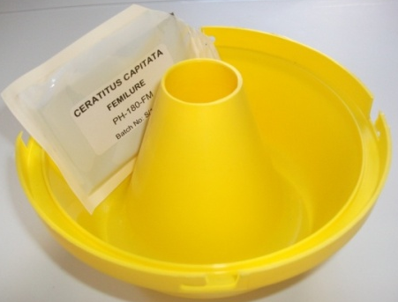
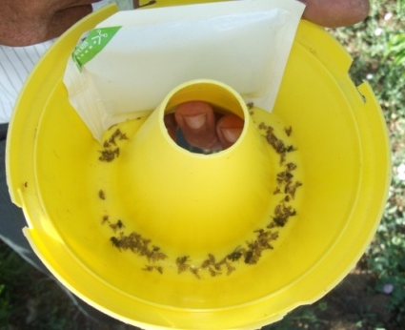
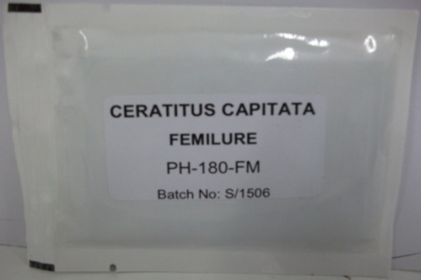
Femilure female attractant
Female synthetic food based on mixed amine
Ammonium acetate
Tri-methylamine chloride
Inert material
Long duration of Action covers the entire ripening period
Specific for female Med-fly detect females at low level
Compatible with IPM strategies
McPhail or Delta traps are the most suitable traps for Femilure and the toxicants used are DDVP or the yellow sticky card

Slide 7
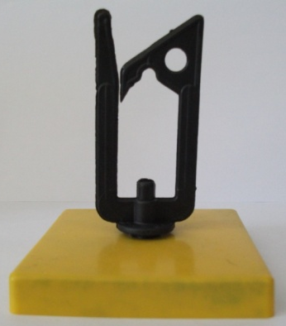
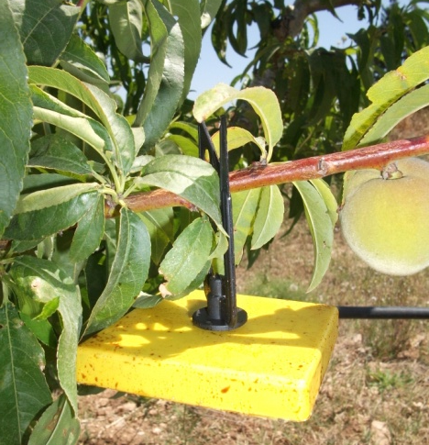
2.2. C. capitata “attract and kill” technique
Combination of Attractant and Insecticide
Ceranock : An innovative “attract and kill” system for Med-fly
Protein hydrlysate
Plant extract
Alpha Cypermethrin
Attractants
Killing agent
Ready and easy to use No risk to the consumer
No toxicity (No direct contact with crop)
Long season protection (life in the field: 4 months)
Cheap and competitive
Compatible with IPM strategies

Slide 8
Objectives
1- Evaluate the level of fruit protection, the efficiency and the selectivity of Femilure mass-trapping in Tunisian peach orchards.
2- Evaluate the control of C. capitata in Tunisian peach orchards by using innovative Ceranock “attract and kill” system.
3- Study the Med-fly population dynamics at Ceranock treatment, center and border area.
4- Relative comparison of both control systems in respect
Monitoring traps catches data
Reduction rate of Med-fly population
Fruit damages
Yield
Cost and labor

Slide 9
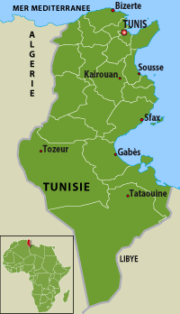
Localization of the selected country

Slide 10
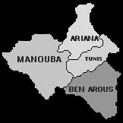
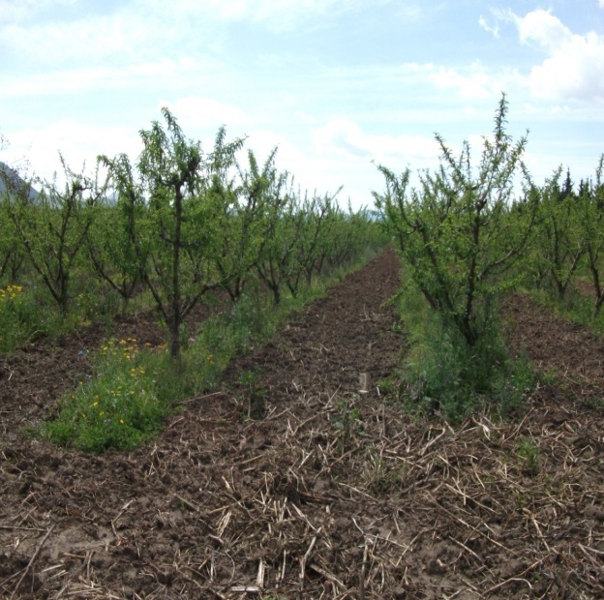
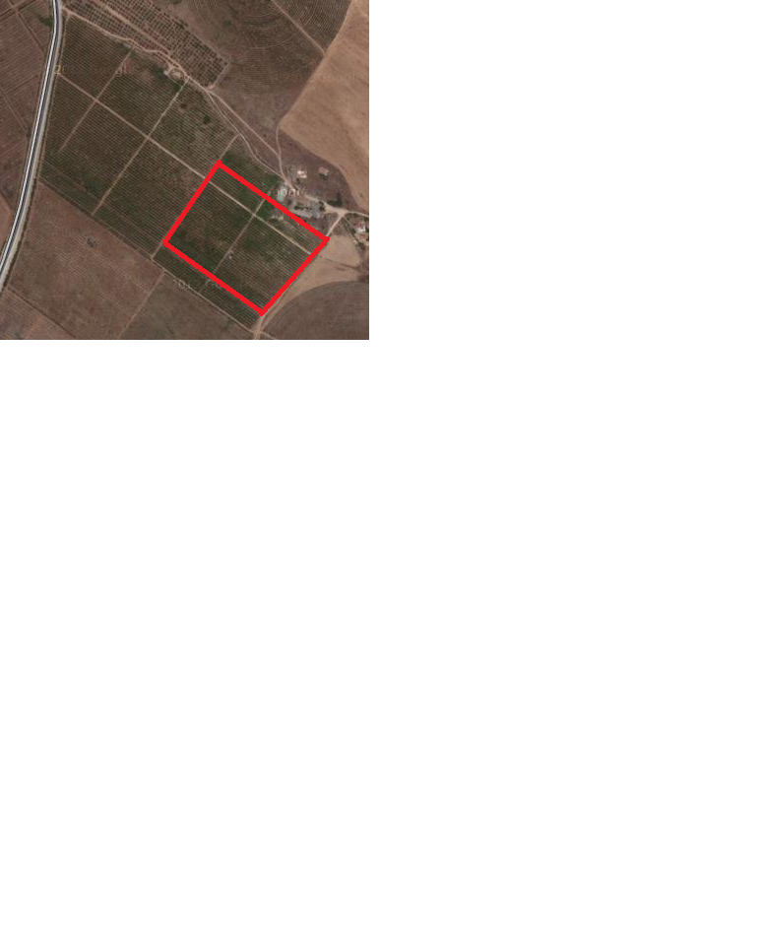
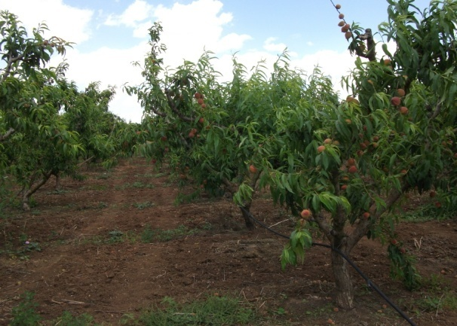
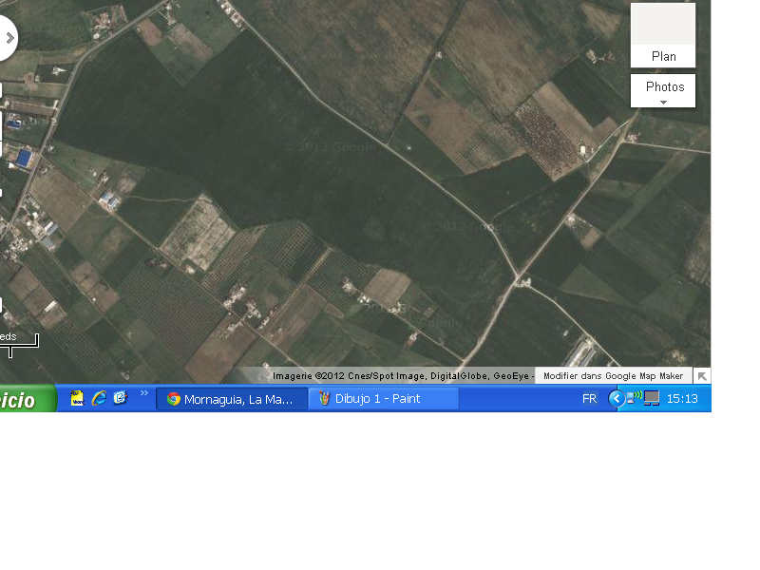
Experimental orchards
Borj-touil experimental site (A)
El-Kssibi Mornag experimental site (B)
3 ha of peach (10 year old)
conducted in organic mode
Rome star (Mid-August)
Density of plantation: 3/4 (800 trees/ha)
Rootstock: GF-305
3 ha of peach (7 years old)
conducted in conventional mode
May-Gold (End-July)
Density of plantation: 4/5
(500 trees/ha)
Rootstock: GF-305
Last year Med-fly: 10 sprays using Spinosad: fruit damages 18%
Last year Med-fly: 10 sprays using Lebaycid: fruit damages 12%

Slide 11
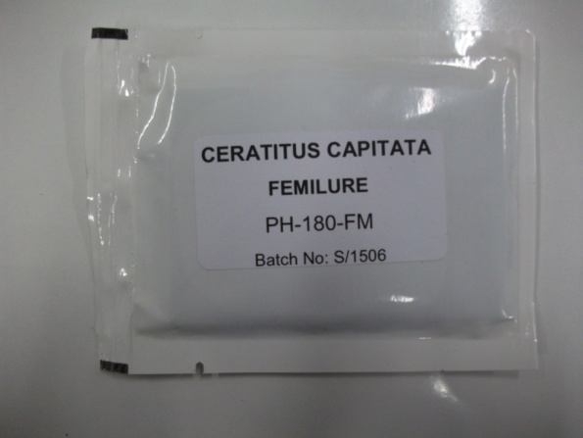
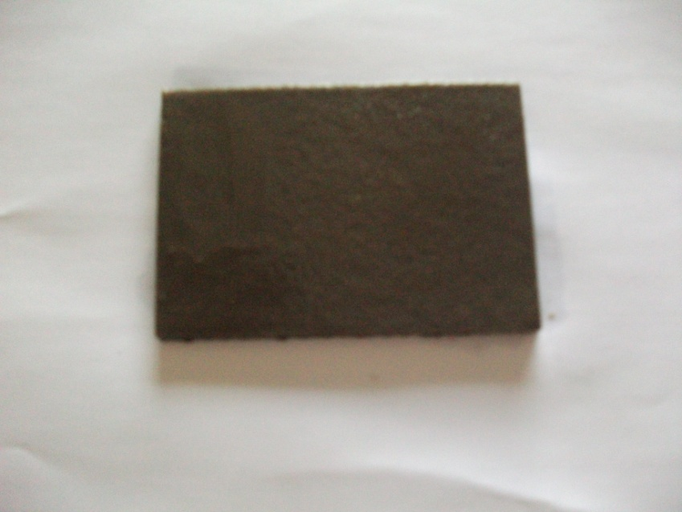
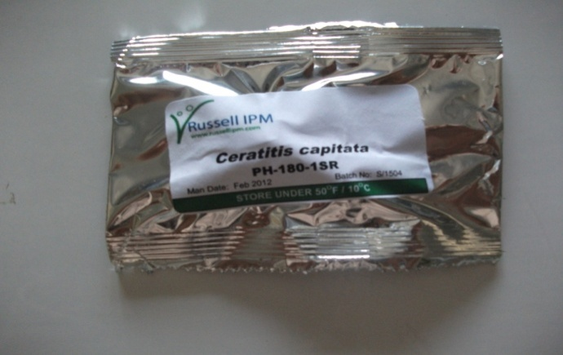
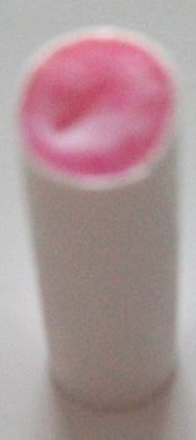
Trial 1: Mass-trapping using Femilure
Experimental site:
1 ha (A1) from plot A + 1 ha (B1) from plot B
Attractants
1) Femilure (Female)
2) Trimedlure (Male)
20% Ammonium acetate
40% Trimethylamine chloride
40% Inert material
Med-fly monitoring in treated and control site
Changed every (4 weeks)

Slide 12
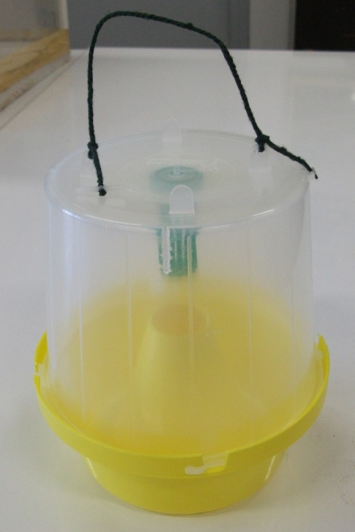
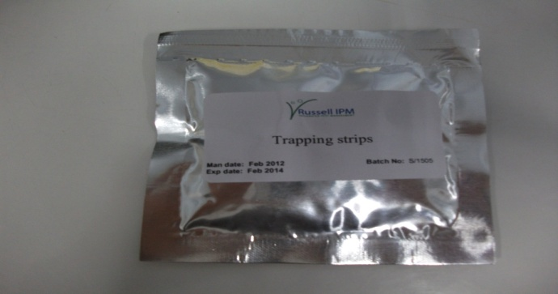
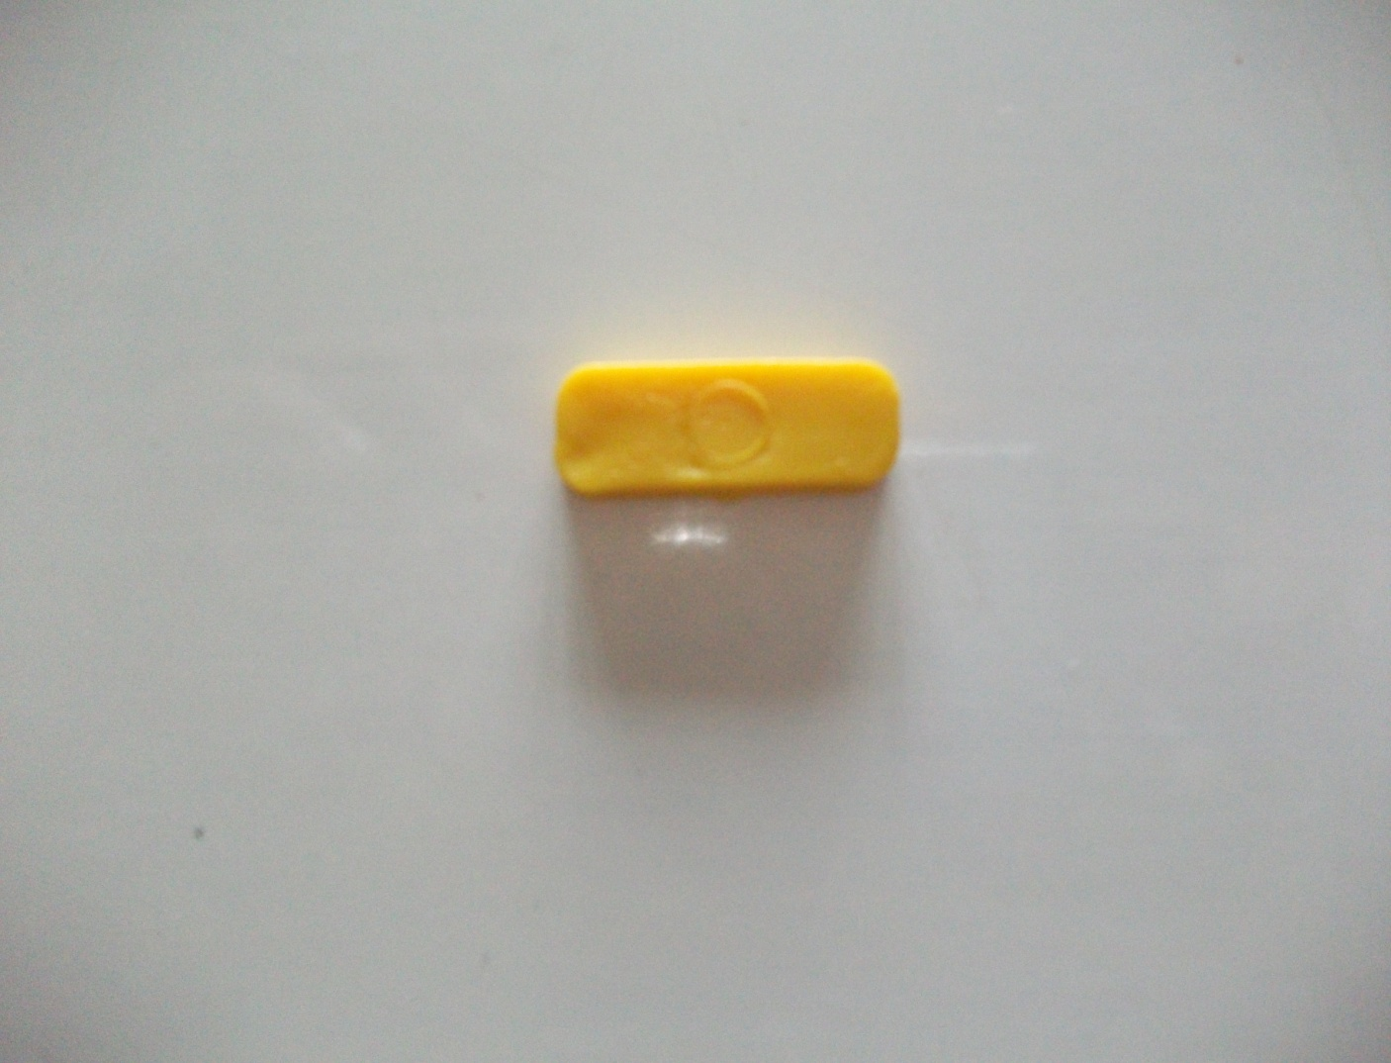
Killing agent
Traps
3) DDVP (dichlorovos or 2.2-dichlorovinyl dimethyl phosphate)
Changed every (6-8 weeks)
4) McPhail trap
Hanging string
Green dispenser cage
Transparent
top
Yellow base
Dose
60 Femilure baited traps/ ha in Plot A1 and 60 traps/ha in Plot B1
3 Trimedlure baited traps/ha for Monitoring
3 Trimedlure baited traps/ha for control plot
Experimental period
Start 4 weeks before peach fruit change color (May) till harvesting (End-July- Mid-August)

Slide 13
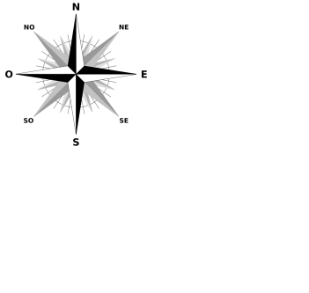




Mass-trapping experimental design
20 m
15 m
1 ha
M
M
M

Slide 14

Trial 2: Ceranock “attract and kill” system
Experimental site:
1 ha (A2) from plot A + 1 ha (B2) from plot B
Ceranock system
Plastic hook
Plastic case
Protein hydrolysate (5 g/station)
Plant extract (Citrus) (5 g/station)
Alpha cypermethrin (0.01 g/station)
Felt
Dose: 400 Ceranock bait station/ ha
Monitoring: 9 females Femilure + 9 males Trimedlure baited traps/ha
Experimental period: Start 6 weeks before peach fruit change color (May) till harvesting (End July - Mid August)

Slide 15




Ceranock experimental design
F
M
M
F
M
F
M
F
9 Trimedlure male traps placed 6 weeks before fruit change color
F
M
1 ha
9 Femilure female traps placed 4 weeks before fruit change color
F
M
F
M
F
M
M
F

Slide 16
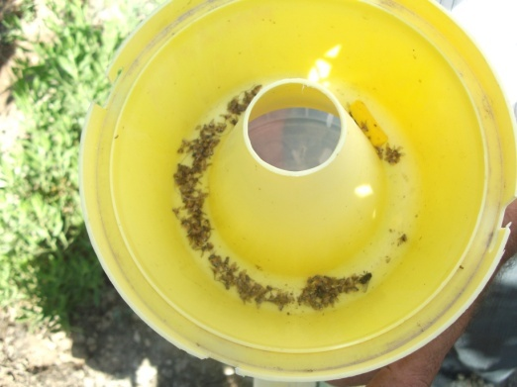

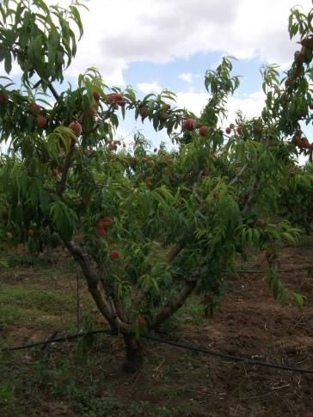
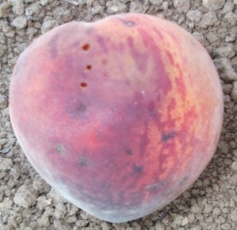
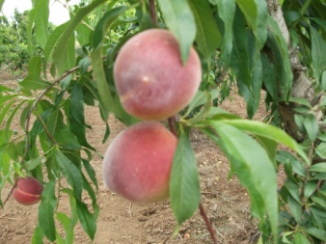
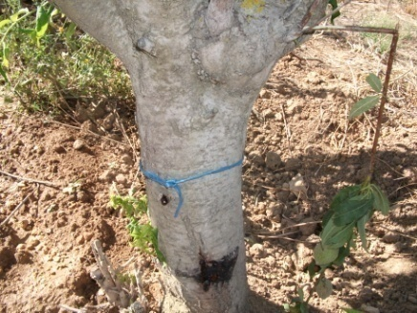

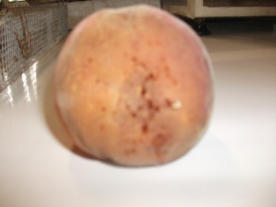
Methodology: Femilure mass-trapping
and Ceranock data assessment
♂
♀
Femilure traps catches data were collected weekly from plot A1,B1, A2, B2.
Trimedlure traps catches data were collected weekly from plots A1, B1, A2, B2 and from control: insects were identified, counted and sexed
1)Dropped fruits
2)Soften/dropped 3)Soften fruits on the tree
In the field
Selected trees
20 trees/ha
4) Number of larvae/ fruit
Selected fruits 40 fruits/trees
In the laboratory

Slide 17
Relative comparison of both control systems femilure mass-trapping and ceranock attract and kill in respect:
Total number of Med-fly captures (Monitoring traps)
Fruit damages
Total Yield (fruits/tree)
Cost and labor
Rate of population reduction following Abbott method (1925)
TR (%)= (C-T/ C)x100 where C = rate of Med-fly captures in the control field and T = rate of Med-fly captures in the treated field
Experimental data was analyzed by standard statistical procedure (ANOVA) and the experimental design used was the randomized complete block (LSD test at P < 0.05)

Slide 18
Trial 1: Mass-trapping using Femilure
1. Evaluation of Male and Female C. capitata weekly captures from Femilure traps
Plot A1
Plot B1
Male and Female %
of captures
95.32%
94.36%
Dates
Dates

Slide 19
2. Sex ratio of C. capitata captures using Femilure
Sex ratio of captures: 1/5 (Male) and 4/5 (Female)
High significant difference among male and female % of captures for both plots.
0% of captures for non target species.
No significant difference within plots.
Femilure is powerful Med-fly food bait attractant, Specific and Selective for female, independently to the rate of infestation.

Slide 20
Trial 2: Ceranock « attract and kill »
1. C. capitata population dynamic in Ceranock treated area
Plot A2
Plot B2
a
-----------------------
82%
-
18%
87%
a
13%
b
c
b
c
Ceranock system remain effective in the control of C. capitata reducing the insect pressure from the border to the center, independently to the rate of infestation

Slide 21
Femilure mass-trapping and Ceranock
“attract and kill” efficacy and comparaison
Treatments efficiency was evaluated on 5 different levels:
1.Monitoring traps catches data
Plot A
Flies/trap/week
Plot B
2. Rate of Med-fly population reduction
FTD= 20.05 a
3. Fruit damages assessment
FTD= 11.72 b
FTD= 9.88 b
FTD= 10.55 a
4. Yield
FTD= 4.44 b
FTD= 3.38 b
5. Cost

Slide 22
2. Rate of Med-fly population reduction: TR (%)
70%
63%
60%
52%
Femilure Mass-trapping reduced Med-fly population to more than the half
Ceranock system reduced Med-fly population 10% more than Mass-trapping
No significant difference between treatments and plots

Slide 23
3. Fruit damages assessment
Plot A
Plot B
a
a
a
a
a
a
b
b
b
b
b
c
b
c
c
b
c
b
% of total fruit damages
a
35%
a
31%
b
c
b
c
9%
8%
5%
4%

Slide 24
4. Yield (Number of healthy fruits/tree)
Plot A
Plot B
240
202
195
166
143
128
Femilure mass-trapping reduced fruit damages 4 times more than the untreated orchards and 10% more than the last year
Ceranock reduced fruit damages 7 times more than the untreated orchards and 15% more than the last year
Ceranock more effective than mass-trapping using Femilure in the control of C. capitata.

Slide 25
5. Cost : Economic evaluation
The cost of Femilure mass-trapping will be reduced to 160€ for the second season because traps are reused. The technique need a chemical spray to reduce damages which will increase again the cost.
Ceranock technique cost less than mass-trapping, where only farming practices integrated with this technique can ensure a good level of protection.

Slide 26
Conclusions
Mass-trapping using Femilure and “attract and kill” using Ceranock bait station could be involved as an appropriate and effective strategy for the control of Med-fly in Tunisia, offering a viable and an efficient alternative to chemical control.
Femilure attractant based on ammonium acetate and trimethylamine, was found as specific and selective female Med-fly attractant.
It can work alongside with natural bio-control agent.
Mass-trapping using Femilure application have to be integrated in an integrated pest management (IPM) program in order to ensure a better level of protection.

Slide 27
Ceranock “attract and kill” system ensure a better level of protection, reducing Med-fly population from the border to the center, selectively remove female in the treated area and it reduces fruit damages 3 times more than mass-trapping.
It created and environment in the field which help in the reduction of female laying eggs and this is could be a useful finding.
Ceranock system is considered for farmers as the best safe way to control Med-fly for its strategic advantages: efficiency, cost, labor and field longevity .
Further area wide trials on Citrus have to be conducted in Tunisia in order to evaluate the efficacy of both techniques and to improve their suppressive potential, which will open an opportunity for growers to ensure pesticides residues free fruit production and to cope with export legislation set out by GLOBALGAP.

Slide 28
Acknowledgment
L’instito Agronomico Mediterraneo di Bari/ Italy (IAM Bari)
Russell IPM
General direction of plant protection and quality control of agronomic product in Tunisia (DGPCQPA)
High agronomic institute ISA Chott Mariem/ Sousse-Tunisia

Slide 29
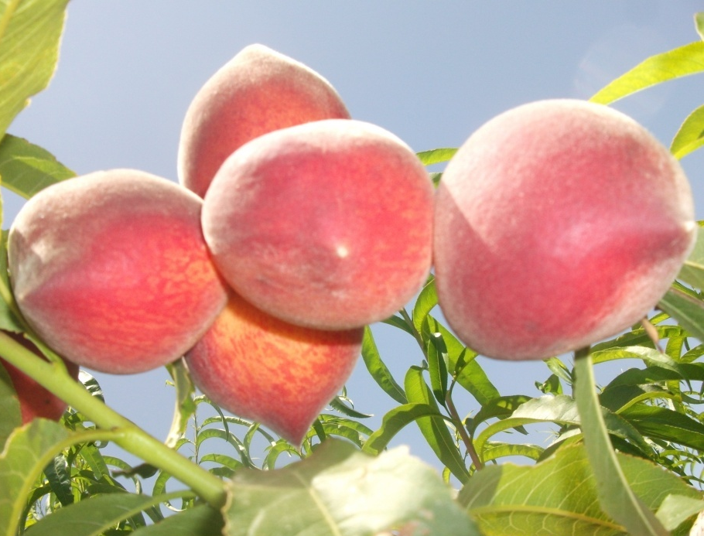
Thank you for your
attention

