Slide 1
Outline for working group sessions

Slide 2
Objectives of the workshop (page 4 in programme):
create awareness about the FAO-WHO joint initiative on fruits and vegetables for health;
document the production and consumption of fruit and vegetables and their current position in the market in the South Pacific;
map existing policies, programmes and activities for the promotion of fruit and vegetables in the South Pacific;
follow up on the relevant national level actions set within the Pacific Food Summit Framework of Action for the countries that have laid this out, identifying current challenges next steps, and assist developing specific action plans to implement the “Kobe” framework for promoting fruits and vegetables at national level;
strengthen inter-sector collaboration on promoting fruit and vegetable production and consumption in the South Pacific; and
highlight critical food safety issues associated with production and consumption of fresh fruits and vegetables

Slide 3
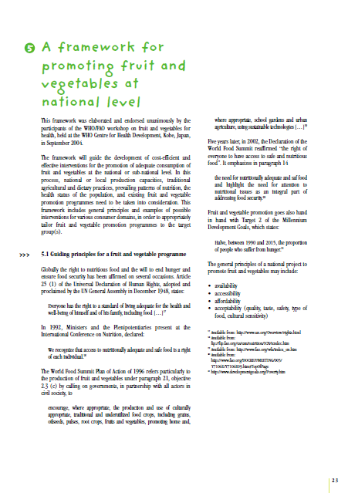

Overall, the working groups will devote as much time as possible to brainstorm about the way and means to activate (or enhance) a F&V initiative that capitalizes on ongoing relevant programmes, where they exist, and tries to strengthen them.
Refer to PROFAV 2011 Concept Note and the “Kobe Framework” for background
In each session strengthen coverage by integrating the topic of using the health/nutrition messages to leverage local demand for F&V

Slide 4
WORKING GROUPS
2 working groups, country groups together
Each group will have both health and agriculture sector together, with education sector participants distributed as evenly as possible
Each group will be provided with 2 facilitators
1 rapporteur to be nominated from within each group

Slide 5
Working Groups
Group ONE |  | Facilitators
Talei Room | Samoa (2) Tonga (1) Niue (2) Cook Islands (2) Tuvalu (3) | Alison Hodder Siosiua Halavatau Graham Lyons
Group TWO |  | Facilitators
?? Room | Marshall Islands (3) Kiribati (1?) Vanuatu (3) Fiji (2) | Makiko Taguchi Peter Hoejskov Alistair Gracie Minwook Kim

Slide 6
GUIDANCE FOR WORKING GROUP DISCUSSIONS
Tuesday, 21 October
Session (1) policy and strategy environment – 09.30 - 13.00
What are the main health problems/challenges/characteristics/ & positive aspects (strengths) at the national level?
What are the priority topics for the health agenda in each country?
What are the priority topics for the horticulture agenda in each country?
What are the main horticulture problems/challenges/ characteristics faced at the national level?
Discuss the relevance of linking promotion of F&V for development, agriculture improvement and NCDs prevention and HIV/AIDS care in your country

Slide 7
Session (2)– charting the challenge of increased F&V supply and consumption - 14:00 – 15:30
What are the main constraints for increasing the production AND /OR LOCAL AVAILABILITY of F&V?
Propose ways to overcome each of these constraints

Slide 8
Tuesday Session (2)–continued
Reflect on different roles for:
(a) urban/peri-urban horticulture
(b) intensive specialised F&V production in high potential rural areas, and
(c) analyze their relevance in the light of your country characteristics
Suggest ways of:
(a) targeting the different sectors in your country to improve their contribution to fruit and vegetable availability and
(b) List possible entry points for new/strengthened interventions and the main expected barriers to be overcome

Slide 9
Session (3) – Elements of a framework for action
-16:00 – 17:30
Identify ongoing programmes/projects that fit the F&V initiative at national level
What would be realistic goals and objectives for a national initiative on F&V promotion, considering aspects such as:
  Advocacy and awareness raising;
  Policy planning and reform;
  Strengthening scientific knowledge base
  Building technical capacity
Discuss the main outcomes/benefits/ leverage of increasing F&V production and consumption at the national level for: consumers, producers, traders and other supply chain actors, children, women, etc...(different target groups/beneficiaries)
Suggest ways of monitoring outcomes and impact and list key indicators

Slide 10
Wednesday, 22 October
Same working groups continue
Session (4) – promoting coordinated action
- 09:00 – 13:00
Consider the stakeholders suggested in the Kobe framework, and other relevant stakeholders that could be involded in a national policy for FV promotion.
Describe National Institutional context and Linkages to National food security programmes , poverty reduction strategy and MDGs
How would the stakeholder interaction be conducted?
Identify possible barriers for the stakeholder interaction and ways to overcome these barriers.
What kind of multi stakeholder mechanism would be appropriate to use in your country?
Who would take the lead? who would be responsible for what?
Discuss requirements and opportunities for regional cooperation and information sharing

Slide 11
Session (5) – Outcomes of the workshop
– 14.00-16.00
Describe specific actions that can be done in the 12 months following the workshop and who/ which institution would be responsible by acting
List a few key conclusions from each working session that you'd like to report back to the plenary at 16.30
Session (6) – Plenary
Working group report and discussions

