Slide 1
UN Nutrition’s Engagement in Nutrition for Growth
CFS Advisory Group Meeting
Meeting
14 January 2022

Slide 2
N4G in short
Five themes: Health; Diets and Food Systems; Resilience; Finance and Accountability
Mobilisation within and beyond the nutrition community →Pledges from multiple actors
Side events
Positioning among other global events (UNFSS, COP26 & N4G)

Slide 3





UN Nutrition members encouraged governments to formulate N4G commitments
[Examples]:
Cambodia
Madagascar
El Salvador
Supported ONN to catalyse N4G commitments & help register them, using national Nutrition Week as a springboard
Worked closely with SUN Gov’t Focal Point to help formulate a wide range of commitments from crop diversity to food safety to school meals, among other commitments
Underscoring importance & supporting strengthening of food security & nutrition governance via legal & policy frameworks
OVERVIEW OF UN PLEDGES
Honduras
Advocated for legislation & regulations on processed foods in line with UN Decade of Action on Nutrition (2016‒2025) & SDG2
Burkina Faso
Through strong partnerships, UN supported formulation of commitments on wasting, dietary diversity & governance → BF a nutrition champion (e.g. GAP frontrunner)
Notes:
Tokyo N4G Summit was a golden opportunity to elevate nutrition on the political agenda & encourage governments to increase domestic investment in nutrition (e.g. Rwanda).
Linking global to country level through the Outreach Group (virtual Secretariat) or the Chair in support of GoJ
Addressing country requests about N4G formulation of commitments & submission in the platform
Mobilizing the UN country offices for their nutrition leadership
Leveraging UN Nutrition country colleagues to disseminate information & provide support to country teams

Slide 4
UN pledges covered multiple areas to sustainably address all forms of malnutrition
Healthy diets
UNICEF & WHO to launch the Global Alliance for Children’s Diets → advance UNFSS follow-up (e.g. healthy diets coalition)
WFP to increase access to/consumption of healthy diets from 40% of its total beneficiaries reached in 2020 → 80% in 2025
Value Chains
IFAD to integrate nutrition in its investment portfolio, targeting all stages of food value chain, with focus on rural poor
OVERVIEW OF UN PLEDGES
Data
WFP to support 35 additional gov’ts by 2025 with analytical tools (e.g. FNG), to identify barriers of most vulnerable to healthy diets
WHO to expand & strengthen its efforts in nutrition data ‒ systems/use/capacity ‒ among other key areas
GAP
UNICEF to reach at least 100 million children/year with services to address wasting in >30 countries by 2025
Notes:
N4G commitments take the form of financial, policy, programmatic and/or impact pledges and were clustered around the 5 thematic areas of the 2021 summit (health, food, resilience, data & financing).
These examples are illustrative (not exhaustive).
GAP = Global Action Plan on Child Wasting
UNICEF’s wasting services straddle prevention, early detection + treatment.

Slide 5


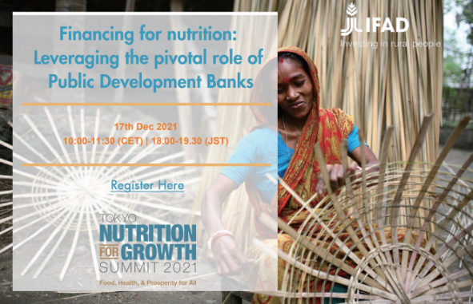
UN Nutrition’s engagement in side events spanned diverse topics
A glance at our members:
UNICEF/WHO series on how food & health systems can deliver sustainable healthy diets
FAO side events on:
Nutrition & forestry
Preventing malnutrition ‒ climate change & biodiversity loss
A PLETHORA OF N4G SIDE EVENTS
Joint FAO/WFP/WHO side event on:
Schools, child nutrition & food system transformation
IFAD side event on financing, particularly the role of Public Development Banks in nutrition-smart food systems transformation
+ many others!!
Notes:
Other WHO side events on:
Childhood obesity in the Pacific
Transforming food environment to achieve sodium reduction
A different WFP side event highlighted steps that can be taken – even in fragile contexts – to improve access to healthy diets so people better cope with shocks.
FAO side event:
Preventing malnutrition among the most vulnerable communities in the context of climate change and biodiversity loss

Slide 6

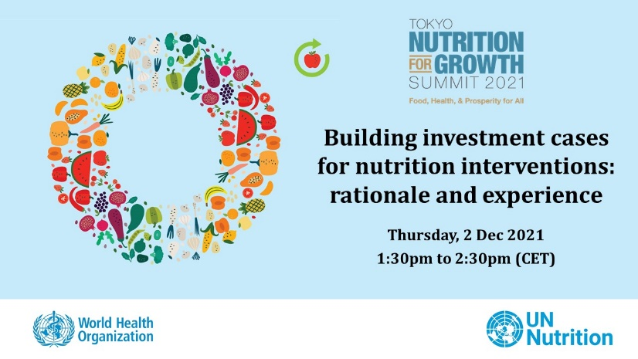
The UN Nutrition Secretariat primarily engaged in N4G side events on 2 themes
Accountability
Making the Investment Case
1
2
A PLETHORA OF N4G SIDE EVENTS
2 side events
co-organized with SUN Civil Society Network, ACF, etc. leveraging experiences from W. Africa
organized by the GNR & others: Data for monitoring. Accountability as part of good governance
Methodologies developed by UNDP, WHO & the United Nations Interagency Task Force on NCDs
Country examples of NCD investment cases (Thailand & Uganda) & how they triggered policy/legislative measures
Some included nutrition components, but also scope to harness learning for nutrition ICs
Notes:
Emphasize that UN Nutrition did this in support of its members

Slide 7

Global momentum for system change for better nutrition (and vv)
Early 2021: VGFSYN
N4G/FSS joint narrative
Common messaging (healthy diets: win-win)
UNFSS follow-up within COP/N4G foras
→ to continue in 2022 (FSS coalitions, COPs, Stockholm + 50, HLPF)
CONNECTION BETWEEN GLOBAL SUMMITS

Slide 8
Thank you
UN Nutrition Secretariat
info@unnutrition.org • www.unnutrition.org
Follow us: @UN_Nutrition @unnutrition

