Slide 1
CountrySTAT / FENIX
Overview of the
Coding System
in the new CountrySTAT platform
TRAINING OF FOCAL POINTS
ON THE CountrySTAT/FENIX SYSTEM

Slide 2
Overview
Work flow
Coding System: Central Product Classification
Coding System: Harmonized Commodity Description and Coding System
Coding System: Global Administrative Unit Layers
Coding System: CountrySTAT indicators
Coding System: Fishery products
Coding System: Scientific Fishery products
Coding System: Forestry products
Coding System: Forestry trees
Coding System: DAC
Coding System: Attributes
Coding System: Unit of measurement
Coding System: Flags
Coding System: Country specific

Slide 3
Work flow
Have the data ready
Create your table following the rules
Use the right Coding System
CVS format
No columns with labels
CPC 2.1
HS
GAUL
CountrySTAT indicators
Unit of Measurement
DAC
Attributes
Flag
Forestry production
Fishery production
Scientific Fishery production
Codifications: Forestry trees
Title
Subject
Data type
Domain
Have the metadata ready
Your table is published
Go to the metadata editor
Upload the values
Create the DSD structure
Fill all metadata

Slide 4
Coding Systems
CPC 2.1
For goods and services
HS
For trade data
UM
Unit of measurement
Flags
To indicate missing and estimated values
DAC
For sectors
GAUL
GAUL
For geo data
CountrySTAT indicators
For all indicators
Attributes
Characteristics of the indicators
Forestry products
Fishery products
Scientific Fishery products
Forestry trees

Slide 5
Coding System: CPC
The Central Product Classification (CPC) constitutes a complete product classification covering all goods and services based on a set of internationally agreed concepts, definitions, principles and classification rules
It provides a comprehensive framework within which data on products can be collected and presented in a format that allows for economic analysis supporting decision-taking and policy-making

Slide 6
http://unstats.un.org/unsd/cr/registry/regcst.asp?Cl=31
Coding System: CPC
The current version, CPC version 2.1, is the result of a scheduled review of the CPC structure and detail, in order to ensure the classification’s relevance for describing current products in the economy.
For CountrySTAT should be utilized an expanded version (provided in the Excel file)
All detailed structure and explanatory notes can be found at the following link (CPC 2.1 not expanded version):
Here all the available correspondences:
http://unstats.un.org/unsd/cr/registry/regot.asp?Lg=1

Slide 7
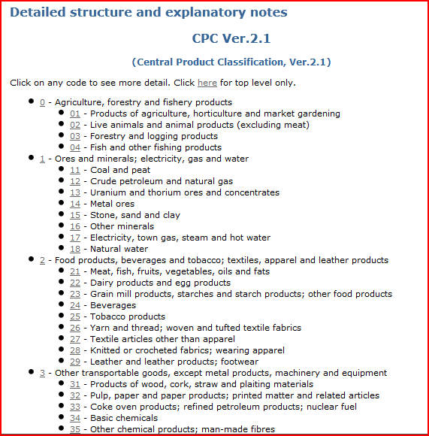
CPC 2.1 : Broad structure

Slide 8
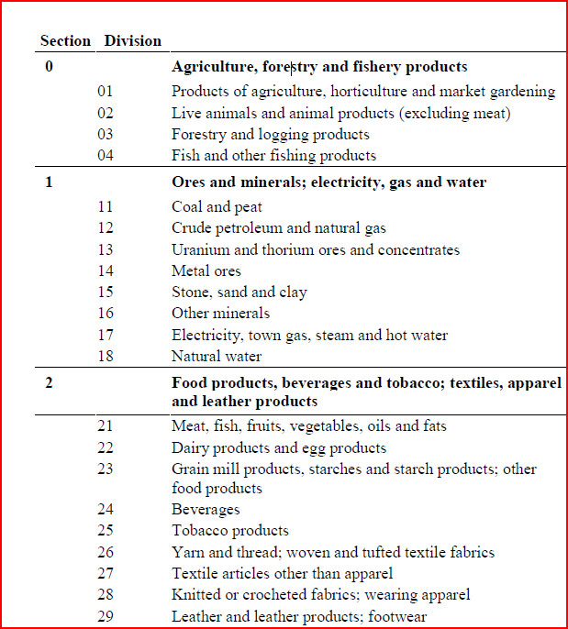

Slide 9
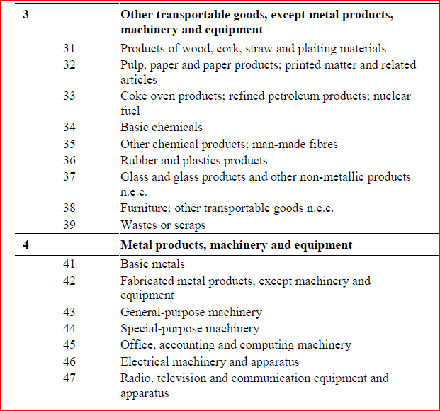
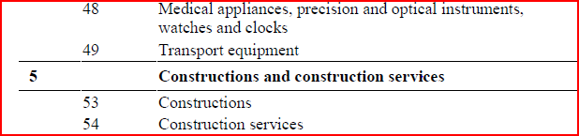

Slide 10
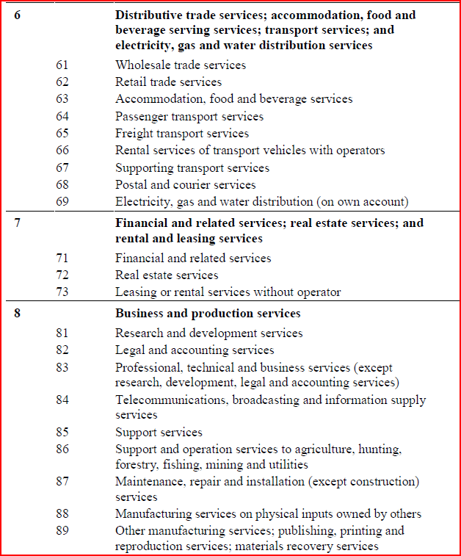

Slide 11
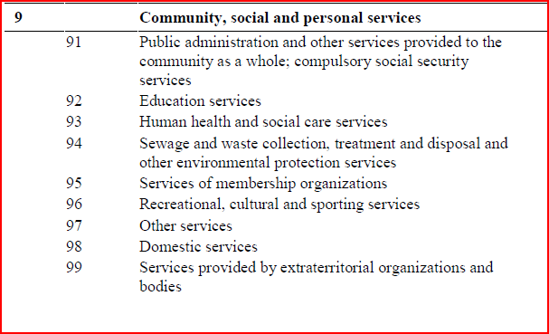

Slide 12
Coding Systems: HS
The Harmonized Commodity Description and Coding System generally referred to as "Harmonized System" or simply "HS" is a multipurpose international product nomenclature developed by the World Customs Organization (WCO).
The Harmonized Commodity Description and Coding System (HS) is an exhaustive nomenclature of internationally traded commodities (goods) classified according to the following criteria:
  raw or basic material
  degree of processing
  use or function
  economic activities
In CountrySTAT we use the 6 digits HS codification

Slide 13
Coding Systems: GAUL
The Global Administrative Unit Layers (GAUL) is an initiative implemented by FAO within the Bill & Melinda Gates Foundation, Agricultural Market Information System (AMIS) and AfricaFertilizer.org projects.
The GAUL compiles and disseminates the best available information on administrative units for all the countries in the world, providing a contribution to the standardization of the spatial dataset representing administrative units. The GAUL always maintains global layers with a unified coding system at country, first (e.g. departments) and second administrative levels (e.g. districts). Where data is available, it provides layers on a country by country basis down to third, fourth and lowers levels

Slide 14
Coding Systems: GAUL
The overall methodology consists in
collecting the best available data from most reliable sources
establishing validation periods of the geographic features (when possible)
adding selected data to the global layer based on the last country boundaries map provided by the UN Cartographic Unit (UNCS)
generating codes using GAUL Coding System
distribute data to the users

Slide 15
Coding Systems: GAUL
Because GAUL works at global level, unsettled territories are reported. The approach of GAUL is to deal with these areas in such a way to preserve national integrity for all disputing countries .
GAUL is released once a year and the target beneficiary of GAUL data is the UN community and other authorized international and national partners. Data might not be officially validated by authoritative national sources and cannot be distributed to the general public. A disclaimer should always accompany any use of GAUL data.
GAUL keeps track of administrative units that has been changed, added or dismissed in the past for political causes. Changes implemented in different years are recorded in GAUL on different layers. For this reason the GAUL product is not a single layer but a group of layers, named "GAUL Set" .

Slide 16
Coding Systems: GAUL
ADM0_NAME | ADM1_CODE | ADM1_NAME | STR1_YEAR | EXP1_YEAR
Afghanistan | 99877 | Paktika | 1000 | 1994
Afghanistan | 297 | Parwan | 1000 | 2003
Afghanistan | 301 | Uruzgan | 1000 | 2003
Afghanistan | 272 | Badakhshan | 1000 | 3000
Afghanistan | 273 | Badghis | 1000 | 3000
Afghanistan | 274 | Baghlan | 1000 | 3000
Afghanistan | 275 | Balkh | 1000 | 3000
Afghanistan | 276 | Bamyan | 1000 | 3000
Afghanistan | 99878 | Daykundi | 2004 | 3000
Afghanistan | 277 | Farah | 1000 | 3000
Afghanistan | 278 | Faryab | 1000 | 3000
Afghanistan | 279 | Ghazni | 1000 | 3000
Afghanistan | 280 | Ghor | 1000 | 3000
These are just the first few lines to give an idea of the codification. Entire codification is provided through the Excel file “GAUL”

Slide 17
Coding Systems: CountrySTAT Indicators
Domain | code | indicator
Production | 0101 | Production quantity
 | 0102 | Production value
 | 0103 | Yield
 | 0104 | Area Harvested
 | 0105 | Area sown
 | 0106 | Seeds quantity
Food availability | 0201 | Protein quantity
 | 0202 | Lipid quantity
 | 0203 | Food supply quantity
Trade | 0301 | Export quantity
 | 0302 | Export value
 | 0303 | Import quantity
 | 0304 | Import value
 | 0305 | Consumption quantity
 | 0306 | Re-export quantity
 | 0307 | Re-export value
 | 0308 | Re-import quantity
 | 0309 | Re-import value
Machinery | 0401 | Machines in service
Population | 0501 | Population
 | 0502 | Economically active population
 | 0503 | Population total density
 | 0504 | Population growth Rate
 | 0505 | Life expectancy
Prices | 0601 | Consumer price
 | 0602 | Producer price
 | 0603 | Commercial rate
 | 0604 | Official rate
 | 0605 | Wholesale price
 | 0606 | Annual average price
Value added | 0701 | Constant prices
 | 0702 | Current prices

Slide 18
Coding Systems: CountrySTAT Indicators
Land use | 0801 | Administrative Area
 | 0802 | Agricultural area
 | 0803 | Arable land
 | 0804 | Arable land and permanent crops area
 | 0805 | Area equipped for irrigation
 | 0806 | Fallow Land
 | 0807 | Forest area
 | 0808 | Inland water
 | 0809 | Land Area
 | 0810 | Other land
 | 0811 | Other wooded land
 | 0812 | Permanent crops area
 | 0813 | Permanent meadows and pastures
 | 0814 | Temporary crops area
 | 0815 | Temporary meadows and pastures
Employment | 0901 | Unemployment Rate
 | 0902 | Labour force Participation Rate
Water | 1001 | Average rainfall
 | 1002 | Max temperature
 | 1003 | Min temperature
Livestock | 1101 | Slaughtered animals
 | 1102 | Live animals
 | 110201 | Female Live Animals
 | 110202 | Lactating Animals
 | 110203 | Male Live Animals
 | 110204 | Born Animals
 | 110205 | Bought Animals
 | 110206 | Animals got as gift
 | 110207 | Animals got for caretaking
 | 110208 | Sold Animals
 | 110209 | Stolen Animals
 | 110210 | Animals given for caretaking
 | 110211 | Animals given as gift
 | 1103 | Laying hens
 | 1104 | Dead Animals
 | 1105 | Total Input
 | 1106 | Total Output

Slide 19
Coding Systems: CountrySTAT Indicators
National Account | 1201 | GPD
 | 1202 | GDP growth
 | 1203 | GDP per capita
Fishery | 1301 | Aquaculture production
 | 130101 | Inland Aquaculture production
 | 130102 | Marine Aquaculture production
 | 13010201 | Industrial Marine Aquaculture production
 | 13010202 | Artisanal Marine Aquaculture production
 | 130103 | Marine/Brackish Aquaculture production
 | 1302 | Capture production
 | 130201 | Inland Capture production
 | 130202 | Marine Capture production
 | 13020201 | Industrial Marine Capture production
 | 13020202 | Artisanal Marine Capture production
 | 130203 | Marine/Brackish Capture production

Slide 20
Coding Systems: Unit of Measurement
Choose only 1 of the 3 codes
These are just the first few lines to give an idea of the codification. Entire codification is provided through the Excel file “2016_Codelist_final”

Slide 21
Coding Systems: Fishery products
code | product
1 | Freshwater fishes
11 | Carps, barbels and other cyprinids
12 | Tilapias and other cichlids
13 | Miscellaneous freshwater fishes
2 | Diadromous fishes
21 | Sturgeons, paddlefishes
22 | River eels
23 | Salmons, trouts, smelts
24 | Shads
25 | Miscellaneous diadromous fishes
3 | Marine fishes
31 | Flounders, halibuts, soles
32 | Cods, hakes, haddocks
33 | Miscellaneous coastal fishes
34 | Miscellaneous demersal fishes
35 | Herrings, sardines, anchovies
36 | Tunas, bonitos, billfishes
37 | Miscellaneous pelagic fishes
38 | Sharks, rays, chimaeras
39 | Marine fishes not identified
4 | Crustaceans
41 | Freshwater crustaceans
42 | Crabs, sea-spiders
43 | Lobsters, spiny-rock lobsters
44 | King crabs, squat-lobsters
45 | Shrimps, prawns
46 | Krill, planktonic crustaceans
47 | Miscellaneous marine crustaceans
5 | Molluscs
51 | Freshwater molluscs
52 | Abalones, winkles, conchs
53 | Oysters
54 | Mussels
55 | Scallops, pectens
56 | Clams, cockles, arkshells
57 | Squids, cuttlefishes, octopuses
58 | Miscellaneous marine molluscs
6 | Whales, seals and other aquatic mammals
61 | Blue-whales, fin-whales
62 | Sperm-whales, pilot-whales
63 | Eared seals, hair seals, walruses
64 | Miscellaneous aquatic mammals
7 | Miscellaneous aquatic animals
71 | Frogs and other amphibians
72 | Turtles
73 | Crocodiles and alligators
74 | Sea-squirts and other tunicates
75 | Horseshoe crabs and other arachnoids
76 | Sea-urchins and other echinoderms
77 | Miscellaneous aquatic invertebrates
8 | Miscellaneous aquatic animal products
81 | Pearls, mother-of-pearl, shells
82 | Corals
83 | Sponges
9 | Aquatic plants
91 | Brown seaweeds
92 | Red seaweeds
93 | Green seaweeds
94 | Miscellaneous aquatic plants

Slide 22
Coding Systems: Scientific Fishery products
code | dimensions
1400100101 | Cycleptus elongatus
1400100201 | Deltistes luxatus
1400100401 | Catostomus catostomus
1400100402 | Catostomus commersoni
1400100403 | Catostomus latipinnis
1400100404 | Catostomus macrocheilus
1400100405 | Catostomus tahoensis
1400100601 | Moxostoma congestum
1400100602 | Moxostoma erythrurum
1400100603 | Moxostoma macrolepidotum
1400100901 | Lagochila lacera
1400101101 | Ictiobus cyprinellus
1400102001 | Myxocyprinus asiaticus
1400102901 | Carpiodes carpio
1400110601 | Xyrauchen texanus
1400112001 | Chasmistes cujus
1400112801 | Minytrema melanops
1400112901 | Erimyzon sucetta
1400113701 | Hypentelium nigricans
1400200102 | Abramis brama
1400200201 | Cyprinus carpio
1400200202 | Cyprinus pellegrini
1400200401 | Aaptosyax grypus
1400200501 | Abbottina rivularis
1400200601 | Acanthalburnus microlepis
1400200701 | Tinca tinca
1400200801 | Acapoeta tanganicae
1400201201 | Alburnus alburnus
1400201202 | Alburnus albidus
1400201301 | Barbus barbus
1400201302 | Barbus meridionalis
1400201303 | Barbus canis
1400201304 | Barbus aeneus
1400201305 | Barbus capensis
1400201307 | Barbus haasi
1400201308 | Barbus holotaenia
1400201309 | Barbus johnstonii
1400201310 | Barbus macrotaenia
1400201311 | Barbus neumayeri
These are just the first few lines to give an idea of the codification. Entire codification is provided through the Excel file “2016_Codelist_final”

Slide 23
Coding Systems: Forestry products
code | product
0101 | Recovered Fibre Pulp
0102 | Uncoated Mechanical
0103 | Uncoated Woodfree
0104 | Coated Papers
0105 | Case Materials
0106 | Folding Boxboard
0107 | Wrapping Papers
0108 | Other Papers Packaging
0109 | Wood Charcoal
0110 | Mechanical Wood Pulp
0111 | Semi-Chemical Wood Pulp
0112 | Chemical Wood Pulp
0113 | Unbleached Sulphite Pulp
0114 | Bleached Sulphite Pulp
0115 | Unbleached Sulphate Pulp
0116 | Bleached Sulphate Pulp
0117 | Dissolving Wood Pulp
0118 | Other Fibre Pulp
0119 | Recovered Paper
0120 | Newsprint
0121 | Printing+Writing Paper
0122 | Other Paper+Paperboard
0123 | Household+Sanitary Paper
0124 | Wrapg+Packg Paper+Board
0125 | Paper+Paperboard NES
0126 | Sawlogs+Veneer Logs (C)
0127 | Pulpwood,Round&Split(C)
0128 | Pulpwood,Round&Split(NC)
0129 | Sawlogs+Veneer Logs (NC)
0130 | Pulpwood+Particles(C)
0131 | Pulpwood+Particles(NC)
0132 | Pulpwood,Round&Split Trd
0133 | Chips and Particles
0134 | Wood Residues
0135 | Other Indust Roundwd(C)
0136 | Other Indust Roundwd Trd
0137 | Other Indust Roundwd(NC)
0138 | Wood Fuel(C)
0139 | Wood Fuel(NC)
0140 | Wood Fuel Trd
0141 | Sawnwood (C)
0142 | Sawnwood (NC)
0143 | Veneer Sheets
0144 | Plywood
0145 | Particle Board
0146 | Hardboard
0147 | MDF
0148 | Fibreboard, Compressed
0149 | Insulating Board
0150 | Ind Rwd Wir (C)
0151 | Ind Rwd Wir (NC) Tropica
0152 | Ind Rwd Wir (NC) Other

Slide 24
Coding Systems: Forestry trees
Code | Latin name | English name
001 | Achras sapota | Sapodilla
002 | Actinidia arguta | Hardy Kiwifruit
003 | Actinidia deliciosa | Kiwifruit
004 | Aframomum angustifolium | False Cardamom
005 | Aleurites moluccana | Candle nut
006 | Alpinia caerulea | Native Ginger
007 | Ananas comosus | Ananas
008 | Annona atemoya | Custard Apple
009 | Annona cherimoya | Cherimoya
010 | Annona muricata | Soursop
011 | Annona purpurea | Soncoya
012 | Annona scleroderma | Poshte
013 | Annona squamosa | Sugar Apple/Sweetsop
014 | Araucaria bidwillii | Bunya Nut
015 | Artocarpus integrifolia | Jakfruit
016 | Asparagus officinalis | Asparagus
These are just the first few lines to give an idea of the codification. Entire codification is provided through the Excel file “2016_Codelist_final”

Slide 25
Coding Systems: Attributes – DAC: Sector
DAC 5 CODE | DESCRIPTION
110 | EDUCATION
111 | Education, level unspecified
112 | Basic education
113 | Secondary education
114 | Post-secondary education
120 | HEALTH
121 | Health, general
122 | Basic health
130 | POPULATION POLICIES/PROGRAMMES AND REPRODUCTIVE HEALTH
140 | WATER SUPPLY AND SANITATION
150 | GOVERNMENT AND CIVIL SOCIETY
151 | Government and civil society, general
152 | Conflict prevention and resolution, peace and security
160 | OTHER SOCIAL INFRASTRUCTURE AND SERVICES
210 | TRANSPORT AND STORAGE
230 | ENERGY GENERATION AND SUPPLY
240 | BANKING AND FINANCIAL SERVICES
250 | BUSINESS AND OTHER SERVICES
310 | AGRICULTURE+FORESTRY+FISHERY
311 | AGRICULTURE
These are just the first few lines to give an idea of the codification. Entire codification is provided through the Excel file “2016_Codelist_final”

Slide 26
Coding Systems: Attributes
Gender
Agricultural population
code | dimensions
5001 | Female
5002 | Male
5003 | Unspecified
5004 | Total
code | dimensions
6001 | Agricultural
6002 | Non agricultural
6003 | Unspecified
6004 | Total
Residence
Food
code | dimensions
7001 | Rural
7002 | Urban
7003 | Unspecified
7004 | Total
code | dimensions
9001 | Food
9002 | Non Food
9003 | Unspecified
9004 | Total

Slide 27
Coding Systems: Attributes
Field management
code | dimensions
8001 | Rainfed
8002 | Irrigated
8003 | Cultivated
8004 | Cultivated and irrigated
8005 | Natural Growth
8006 | Organic
8007 | Certified organic
8008 | In conversion to organic
8009 | Unspecified
8010 | Total

Slide 28
Coding Systems: FLAGS
FLAGS
“e”= Estimated value
“c”= Calculated value (through a formula)
FLAG AUTOMATICALLY GENERETED BY THE SYSTEM
“m”= Missing data / Data not existing
Missing data (data exist but were not collected) / Data do not even hypothetically exist
“m” DATA SHOULD NOT BE ENTERED IN THE SYSTEM BECAUSE IT WILL BE AUTOMATICALLY GENERATED BY THE SYSTEM WHENEVER NEEDED

Slide 29
Country-specific Coding Systems
If a country has its own specific Coding System, it can be added to the CountrySTAT/FENIX list
The CountrySTAT/FENIX team is working on the conversion tool to allow automatic conversion between different Coding Systems
the country will be responsible for matching its coding systems with the existing ones

