Slide 1
Improving Livestock Statistics in Uganda: Core Indicators and Data Integration
Joseph Sserugga
Ministry of Agriculture, Animal Industry and Fisheries, Uganda
Ugo Pica-Ciamarra
Animal Production and Health Division, FAO
FAO-WB-ILRI-AU-IBAR Livestock Data Innovation in Africa Project
Ibrahim G. Ahmed
African Union – InterAfrican Bureau for Animal Resources
Africa Development Bank Meeting on ‘Improving Statistics for Food Security, Sustainable Agriculture, and Rural Development - Action Plan for Africa’ - Addis Ababa, 27-29 August 2012

Slide 2
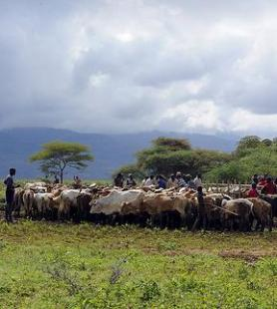
Outline
The issue
Uganda’s approach to improve livestock statistics
Core livestock indicators in Uganda
Lessons so far and next steps

Slide 3
The issue
Limited quantity / quality of agricultural statistics
Limited quality of public and private sector investments
Strengthening Statistics for Planning, MAAIF, 2007

Slide 4
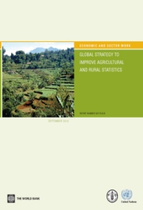
Improving agricultural statistics
START FROM CORE INDICATORS
The 2010 Global Strategy to Improve Agricultural and Rural Statistics, to be implemented in Africa in 2011-15 (1st phase) , recommends that any improvement in agricultural data / indicators starts from CORE INDICATORS and be based on COOPERATION / COLLABORATION between key stakeholders

Slide 5
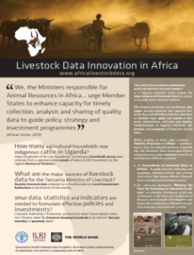
Improving livestock statistics
LIVESTOCK DATA INNOVATION IN AFRICA PROJECT
2010-2013 Initiative implemented by FAO, World Bank, ILRI in collaboration with AU-IBAR
Pilot project to improve quantity / quality of livestock data in Niger, Tanzania and Uganda
Support implementation of Global Strategy, including core indicators and data integration

Slide 6
Uganda’s approach to improve livestock statistics

Slide 7
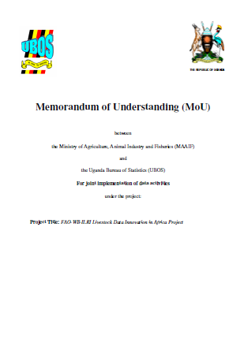
MAAIF-UBOS MoU on livestock data
MAAIF-UBOS agreed on a Memorandum of Understanding (MoU) for ‘joint implementation of livestock data activities’
Facilitated by the World Bank-FAO-ILRI-AU-IBAR Livestock Data Innovation in Africa Project (knoweldge broker)
consistent with Global Strategy: targets core indicators and data integration

Slide 8
MAAIF-UBOS MoU: content
Identification of core livestock indicators, essential for both MAAIF and UBOS (workshop held on 31 May 2012)
Joint analysis of MAAIF routine data and UBOS survey data to appreciate what core indicators could be built with available data, and their quality (June to Nov. 2012)
Joint review of MAAIF and UBOS systems of data collection to identify options for improvement for core livestock indicators to be regularly generated (June to Nov. 2012)
Recommendations presented to stakeholeders, including potential donors (workshop - 1° quarter 2013 at the latest)
<

Slide 9
Core livestock indicators in Uganda MAAIF-UBOS Workshop, 31 May 2012

Slide 10
Livestock data stakeholders in Uganda
Multiplicity of livestock data stakeholders with different ‘core indicators’:
- Ministry of Agriculture, Animal Industry and Fishery
- Uganda Bureau of Statistics
- Local Governments
- Other Ministries (e.g. Trade and Industry and Health)
- Semi-autonomous agencies (e.g. Dairy Development Authority/ National Agricultural Research Organization, etc.)
- Research institutes / universities
- Private sector
- NGOs
- Other

Slide 11
Livestock data stakeholders in Uganda
Multiplicity of livestock data stakeholders with different ‘core indicators’:
- Ministry of Agricultural, Animal Industry and Fishery
- Uganda Bureau of Statistics
- Local Governments
- Other Ministries (e.g. Trade and Industry)
- Semi-autonomous agencies (e.g. Dairy Development Authorities / National Agricultural Research Organization, etc.)
- Research institutes / universities
- Private sector
- NGOs
- Other
Core livestock indicators: For whom?
By whom?

Slide 12
Livestock data stakeholders in Uganda
Multiplicity of livestock data stakeholders with different ‘core indicators’:
- Ministry of Agricultural, Animal Industry and Fishery
- Uganda Bureau of Statistics
- Local Governments
- Other Ministries (e.g. Trade and Industry)
- Semi-autonomous agencies (e.g. Dairy Development Authorities / National Agricultural Research Organization, etc.)
- Research institutes / universities
- Private sector
- NGOs
- Other
Focus on indicators used by two major data collectors / users

Slide 13
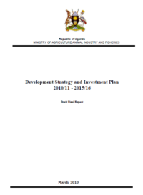
Uganda MAAIF
Ministry of Agriculture Animal Industry and Fisheries (MAAIF)
Directorate of Animal Resources responsible for livestock-related matters
Formulation and review of national agricultural (and livestock) sector policies and plans
Control and manage crop and animal diseases

Slide 14
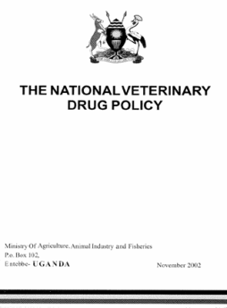
Data are critical for MAAIF
Livestock data needed for:
Formulation of policies
Annual budget and planning
Disease surveillance and monitoring
Monitoring & Evaluation
Monthly and quarterly data
District level data

Slide 15
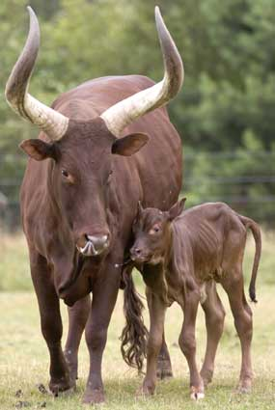
Data are critical for MAAIF
Livestock data target:
Livestock population
Animal health
Production
Trade
Marketing (some)
Vet staff and equipment availability (e.g. computers, cars)

Slide 16
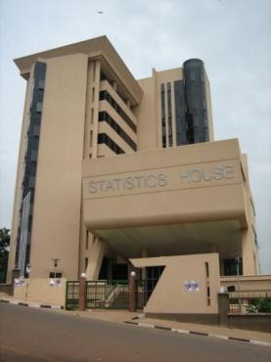
Uganda Bureau of Statistics
UBOS
a semi-autonomous body to promote the production of reliable official statistics and ensure the development and maintenance of the National Statistical System (NSS)

Slide 17
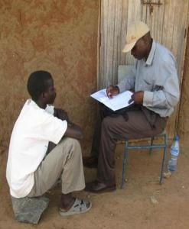
UBOS livestock data
UBOS - Directorate of Agriculture and Environment Statistics
Livestock data needed for:
Production of official statistics, including GDP
Disseminate agricultural statistical information
Quarterly and annual data

Slide 18
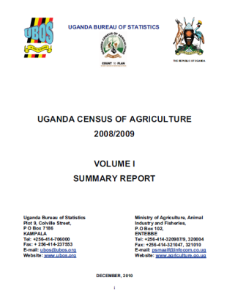
UBOS livestock data
UBOS - Directorate of Agriculture and Environment Statistics
Livestock data target:
Livestock population
Production (meat, milk, eggs, hides & skins), including slaughter and value (price)
Trade

Slide 19
Common core indicators
Core Indicators | UBOS | MAAIF
Livestock inventory | X | X
No. of animal slaughtered (off-take ) | X | X
Production-related indicators (meat, milk, eggs) | X | X
Trade related indicators | X | X
Price-related indicators | X
Disease related indicators |  | X
Staff and resources available in livestock |  | X

Slide 20
Common core indicators
Core Indicators | UBOS | MAAIF
Livestock inventory | X | X
No. of animal slaughtered (off-take) | X | X
Production-related indicators (meat, milk, eggs) | X | X
Trade related indicators | X | X
Price-related indicators | X
Disease related indicators |  | X
Staff and resources available in livestock |  | X
Endorsed / approved by the National Agriculture Statistical Technical Committe as Uganda Core Livestock Indicators in August 2012

Slide 21
Common core indicators
Core Indicators | UBOS | MAAIF
Livestock inventory | X | X
No. of animal slaughtered (off-take) | X | X
Production-related indicators (meat, milk, eggs) | X | X
Trade related indicators | X | X
Price-related indicators | X
Disease related indicators |  | X
Staff and resources available in livestock |  | X
No information system in place which, today, can accomodate all core livestock indicators. Opportunities from the roll-out of ARIS 2 by AU-IBAR

Slide 22
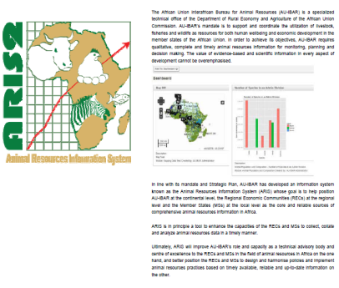
ARIS 2
Animal Resources Information System (ARIS) of the Interafrican Bureau for Animal Resources of AU (AU-IBAR) – currently being rolled out throughout Africa
‘a tool to enhance the capacities of the RECs and MSs to collect, collate and analyze animal resources data in a timely manner’
‘to design and harmonise policies and implement animal resources practices based on timely available, reliable and up-to-date information’

Slide 23
ARIS 2
Animal Resources Information System (ARIS) of the Interafrican Bureau for Animal Resources of AU (AU-IBAR) – currently being rolled out throughout Africa
open source database engine
web-base interface with off-line mode
international statistical standards
inter-operability with other data platforms (e.g. FAOSTAT, WAHIS)
multiple-contents (inventory / health / production / trade, etc.)
flexible / ad hoc ‘modules’

Slide 24
ARIS 2
Animal Resources Information System (ARIS) of the Interafrican Bureau for Animal Resources of AU (AU-IBAR) – currently being rolled out throughout Africa
open source database engine
web-base interface with off-line mode
international statistical standards
inter-operability with other data platforms (e.g. FAOSTAT, WAHIS)
multiple-contents (inventory / health / production / trade, etc.)
flexible / ad hoc ‘modules’
CORE LIVESTOCK INDICATORS

Slide 25
Lessons so far and next steps

Slide 26
Lessons
Core indicators are those used regularly by major data suppliers
MAAIF and UBOS in Uganda, i.e. those indicators that the two institutions use to fulfill their corperate mandate
Only when those indicators are regularly produced, and are of good quality, will MAAIF – UBOS have incentives to collect/ produce additional livestock data and indicators, as demanded by other stakeholders
Significant commonalities of indicators between Ministry responsible for animal resources and Statistical Authority in Uganda and other countries: incentives for collaboration
No information system in place which can accommodate core livestock indicators

Slide 27
MAAIF-UBOS next joint activities
Joint analysis of MAAIF data (routine data) and UBOS data (surveys) to appreciate what core indicators could be built with available data, and their quality (June to Nov. 2012)
Joint review of MAAIF and UBOS systems of data collection to identify options for core livestock indicators to be regulalry generated (June to Nov. 2012)
Recommendations presented to stakeholeders, including potential donors (workshop - 1° quarter 2013 at the latest), with the objective of piloting methods to improve quantity / quality of livestock data, before scaling out the most effective to cover the whole country
<

Slide 28
Next steps: Livestock Data Project
Identification of core livestock indicators in Tanzania, in collaboration with EAC.
Identification of core livestock indicators in Niger
Develop and apply methodologies to estimate livestock technical conversion factors in Tanzania, which are critical to produce livestock statistics
Partnership with AU-IBAR on improvement of data systems, including ARIS 2
Production of a Sourcebook on Livestock Data Collection and Analysis and of an Advocacy Document on Livestock for Development. Both build on project’s activities, including data collection, in Niger, Tanzania and Uganda

Slide 29
Thank you

