Slide 1
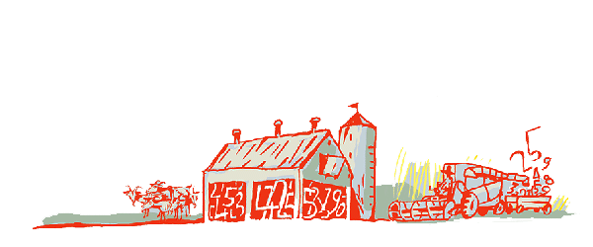
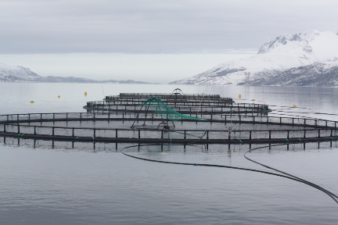
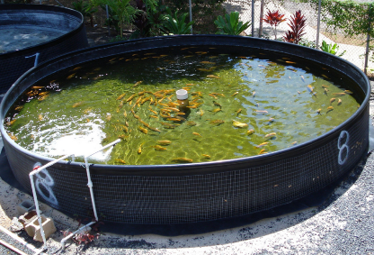
Regional Roundtable on
World Programme for the Census of Agriculture 2020
Port of Spain, Trinidad and Tobago
22-26 May 2017
Themes 12 and 14: Aquaculture and Fisheries
Technical Session 13
Adriana Neciu
Agricultural Census and Survey Team
FAO Statistics Division

Slide 2
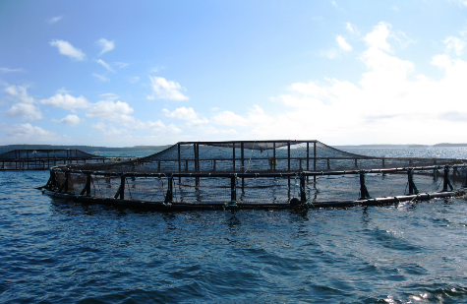
Aquaculture in the Agricultural Census
Outline
Concepts and Definitions
Importance of aquaculture statistics
Items
Country experiences

Slide 3
Concepts & Definitions
Aquaculture is the farming of aquatic organisms such as fish, crustaceans, molluscs, plants, crocodiles, alligators and amphibians.
Farming refers to some intervention in the rearing process to enhance production, such as regular stocking, feeding and protection.
A distinction must be made between aquaculture and other forms of aquatic exploitation, such as capture fisheries.
Aquaculture normally involves rearing of organisms from fry, spat or juveniles. Aquaculture may be carried out in ponds, paddy fields, lagoons, estuaries, irrigation canals or the sea, using structures such as cages and tanks.
According to the International Standard Industrial Classification Rev.4 (ISIC-Rev.4), agriculture (ISIC groups 011-015) and aquaculture (group 032) are separate economic activities.

Slide 4
Importance of Aquaculture Statistics
Aqua-cultural products supply much needed protein, contributing to improvement of nutritional status of under-nourished population.
Aquaculture is an important activity in many countries
Aquaculture is often integrated with agricultural production (e.g. rice-cum-fish culture).
Contributes cash income, employment and export earnings.

Slide 5
Aquaculture data collection in the context of the agricultural census
For the purpose of the agricultural census, presence of aquaculture refers to aquacultural production activities carried out in association with agricultural production. E.g. aquacultural activities are often integrated with agricultural production (rice-cum-fish culture), or aquaculture and agriculture sharing the same inputs, such as machinery and labour.
If aquaculture is important in a country, aquacultural census could be undertaken in conjunction with the agricultural census, to provide structural data on the type of production facility, type of water, sources of water, type of organism, and aquacultural machinery (see par. 5.24-5.33 of WCA 2020).
In such a case, for a complete picture of aquaculture activities in a country, the frame used for an aquacultural census must include all aquaculture holdings at both household and non-household levels, and not just those associated with an agriculture holding.

Slide 6
Items
Theme 12 comprises 6 items (for the holding):
1201 Presence of aquaculture on the holding
1202 Area of aquaculture according to type of site.
1203 Area of aquaculture according to type of production facility.
1204 Type of water.
1205 Sources of water for aquaculture.
1206 Type of aquacultural organism cultivated

Slide 7
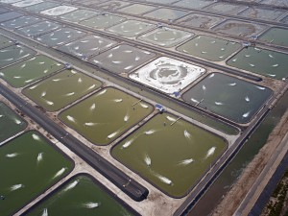
Item 1201: Presence of aquaculture on the holding
Type: Essential and Frame item.
Reference period: Census reference year
Notes:
  Capture fisheries (catching aquatic animals or gathering aquatic plants “in the wild”) are excluded. An important characteristic of capture fisheries is that the aquatic organisms being exploited are common property, as opposed to being owned by the holding as is the case for aquaculture.
  However, where fish are caught in the wild and fattened up for sale, the fattening process should be considered as aquaculture.

Slide 8
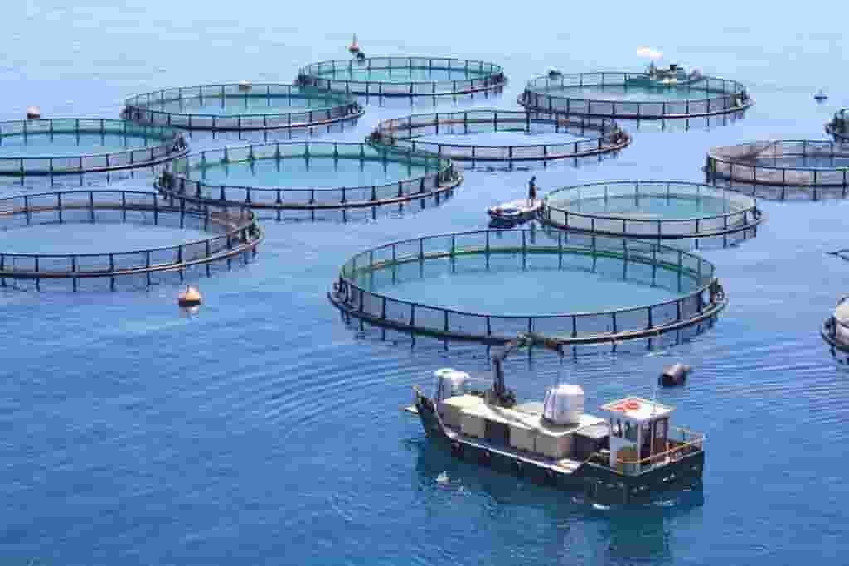
Item 1202: Area of aquaculture according to type of site (for the holding)
Type: Additional item.
Reference period: Census reference year
Concept: Area of aquaculture refers to the area under water used for aquaculture on the holding.
Notes:
  The area figure should include supporting structures such as pond banks and floating structures of cages.
  It should exclude area of land-based aquaculture-related facilities such as hatcheries, storage buildings, fish processing facilities, laboratories and offices.
  The area should include land owned by the holding as well as bodies of water rented from others for use for aquacultural purposes. Such bodies of water could include parts of rivers, lakes, reservoirs, dams, canals, lagoons/estuaries, bays/coves, or the open sea.

Slide 9
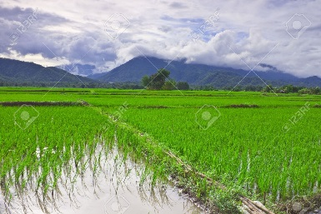
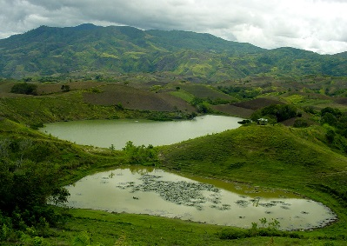
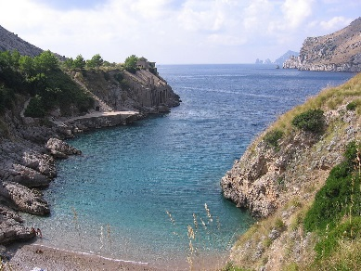
Item 1202: Area of aquaculture according to type of site (for the holding) cont’d.
Type of site:
  Land-based: aquaculture practised in rice fields, ponds, tanks, raceways and other land areas on the holding. In the case of ponds, countries may need to develop criteria to distinguish between land-based and inland water aquaculture. It can be split into:
    Arable land (for crop production);
    Non-arable land (saline-alkaline lands and wetlands).
  Inland waters includes dams, reservoirs, lakes and rivers.
  Coastal waters include lagoons, estuaries, shallow and open seas, bays and coves, including inter-tidal mudflats.
Notes:
In case of inland waters, the area of aquaculture should refer to the part of the body of water that is occupied by the aquacultural facilities – for example, the total area of the pen or cage network in the water.
From the land use point of view, all land-based areas of aquaculture, except the one classified as arable land, should be classified as LU8 “area used for aquaculture” or more specifically to “land used for aquaculture” if a country wishes to further subdivide the class LU8 in line with the SEEA land use classification see SEEA land use class 1.3 (Annex 8 of the Programme).
Area of aquaculture based on inland waters and coastal waters should be classified as LU8 “area used for aquaculture” or more specifically to “inland waters used for aquaculture or holding facilities” and “coastal waters used for aquaculture or holding facilities”, respectively, if a country wishes to further subdivide the class LU8 in line with the SEEA land use classification see SEEA land use classes 2.1 and 3.1 (Annex 8 of te Programme).

Slide 10
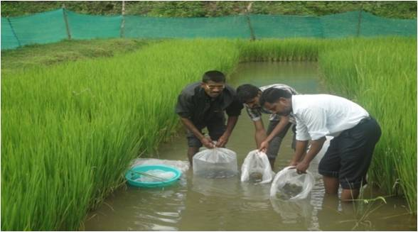
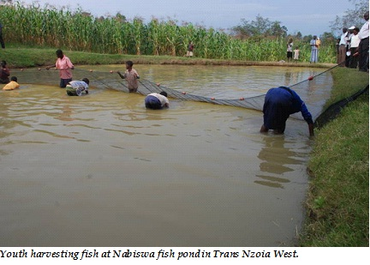
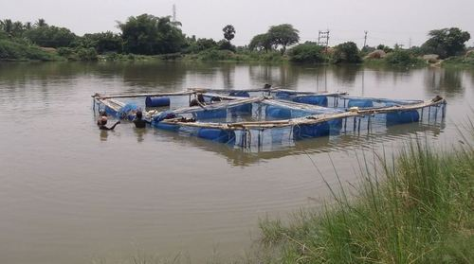
Item 1203: Area of aquaculture according to type of production facility (for the holding)
Type: Additional item.
Reference period: Census reference year
Type of production facility:
  Rice-cum-fish culture is the use of land for the culture of both rice and aquatic organisms in the form of:
    introduction of broodstock or seed into (often modified) flooded paddy fields;
    rice and fish raised on the same land in different seasons. Wild fish entering paddy fields during flooding is not included.
  Pond culture is the breeding or rearing of aquatic plants or animals in natural or artificial enclosures. Sometimes, large ponds are used in association with cages or hapas. Often there is some integration between crops, livestock and pond culture, as in fish-cum-vegetable culture or fish-cum-animal husbandry.
  Pens, cages and hapas are net enclosures used for rearing aquatic animals or plants in lakes, rivers, reservoirs or the open sea. Pens are fixed, cages are held by floating structures while hapas are simple net enclosures suspended by stakes.

Slide 11
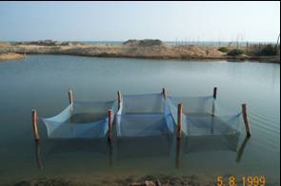
Item 1203: Area of aquaculture according to type of production facility (for the holding) cont’d
Pens are fixed
Cages are held by floating structures.
Hapas are simple net enclosures suspended by stakes.
Notes:
Pens are fixed by frameworks made of metal, plastic, bamboo or wood.
Cages are held in place by floating structures.
Hapas are simple net enclosures suspended by stakes in the four corners in open water bodies.

Slide 12
Item 1203: Area of aquaculture according to type of production facility (for the holding) cont’d
Type of production facility (cont’d):
  4. Tanks and raceways are fixed structures used for raising aquatic animals or plants. They are normally built above ground and can be made of bricks, concrete or plastic. Tanks are small round or rectangular structures, whereas raceways are long, narrow structures.
  5. Floating rafts, lines, ropes, bags and stakes refer to the aquacultural practice based on these facilities, commonly used for the cultivation of shellfish and seaweed.

Slide 13
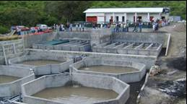
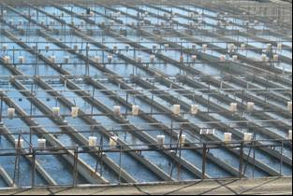
Item 1203: Area of aquaculture by type of production facility (cont’d)
Tanks
Raceways
Notes:
Tanks and raceways are fixed structures used for raising aquatic animals or plants. They are normally built above ground and can be made of bricks, concrete or plastic.
Tanks are small round or rectangular structures, whereas....
raceways are long, narrow structures.

Slide 14
Item 1203: Area of aquaculture by type of production facility (cont’d)
Floating rafts, lines, ropes, bags and stakes are common in shellfish/seaweed cultivation.
Seaweed structure showing line system
Stake system for cultivating seaweed on a beach
Notes:
Finally, Floating rafts, lines, ropes, bags and stakes refer to the aquacultural practice based on these facilities, commonly used for the cultivation of shellfish and seaweed.

Slide 15
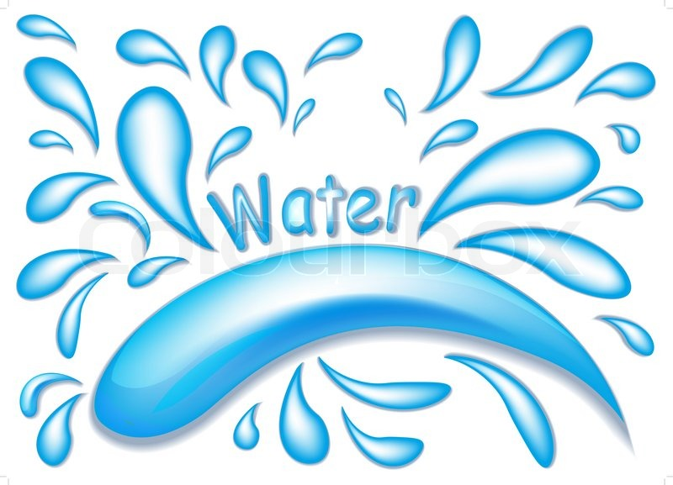
Item 1204: Type of water
Type: Additional item.
Reference period: Census reference year
Concept: This refers to whether aquaculture is carried out on Freshwater, Brackish water and/or Saltwater. There may be more than one type of water used on a holding.
Type of water:
Freshwater refers to reservoirs, rivers, lakes and canals, with consistently negligible salinity.
Brackish water has more salinity than fresh water, but not as much as seawater. It may result from mixing of seawater with fresh water, as in estuaries, coves, bays and fjords.
Saltwater (or marine water) refers to coastal and offshore waters where salinity is high and is not subject to significant daily or seasonal variation.

Slide 16
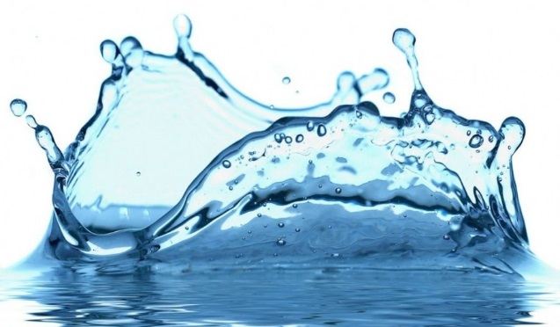
Item 1205: Sources of water for aquaculture
(for the holding)
Type: Additional item.
Reference period: Census reference year
Sources of water: This refers to whether water for aquacultural production on the holding was obtained from:
    – Rain-fed -Dams
    – Groundwater -Estuaries/lagoons
    – Rivers/canals -Coves/bays/sea
    – Lakes/reservoirs
Notes:
  There may be more than one source of water used for aquaculture on a holding. The source of water is usually closely related to the type of site.
  Countries may adapt these categories to suit local conditions.

Slide 17
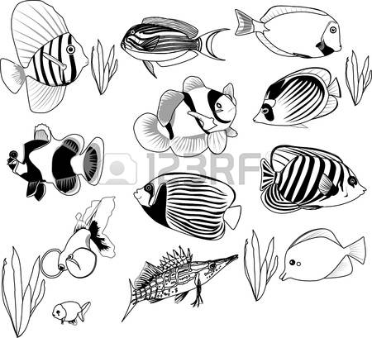
Item 1206: Type of aquacultural organism cultivated (for the holding)
Type: Additional item.
Reference period: Census reference year
Types of organisms: It refers to which of the following types of aquatic organisms were cultivated on the holding:
    Freshwater fish (such as carps and tilapias)
    Diadromous fish (can live in both fresh and seawater, such as trout, salmon, eels and sturgeon)
    Marine fish (flounder, cod and tuna)
    Crustaceans (crabs, lobsters and shrimps)
    Molluscs (belonging to the phylum Mollusca, including abalones, oysters, mussels, scallops, clams and squids)
    Other aquatic animals (frogs, crocodiles, alligators, turtles, sea-squirts and sea urchins)
    Aquatic plants (seaweed and lotus).
Notes:
  More than one type of organism may be cultivated on a holding.
  The classification refers to the type of aquatic organism cultivated, not the type of product generated (e.g. pearl production is under “molluscs”).
Notes:
This last item refers to which of the types of aquatic organisms shown on the screen were cultivated on the holding during the census reference year. As it can be seen it includes fish, crustaceans, molluscs and plants. The main types of freshwater fish are carps and tilapias. Diadromous fish are fish that can live in both fresh and seawater, such as trout, salmon, eels and sturgeon. Marine fish include flounder, cod and tuna. Crustaceans are aquatic animals with hard shells, such as crabs, lobsters and shrimps. Molluscs are animals belonging to the phylum Mollusca, including abalones, oysters, mussels, scallops, clams and squids. Other aquatic animals include frogs, crocodiles, alligators, turtles, sea-squirts and sea urchins. Aquatic plants include seaweed and lotus.
More than one type of organism may be cultivated on a holding.
The classification refers to the type of aquatic animal or plant cultivated, not the type of aquacultural product generated. Thus, pearl production is shown under “Molluscs”.

Slide 18
Country experience
Venezuela - VII Censo Agrícola 2008
Section VI of the questionnaire (CA 01) is dedicated to aquaculture. The following information were included.
Is there aquaculture activity in the UPA* (agriculture production unit) on the day of enumeration?
Is it registered in INAPESCA*?
    Type of production: for fattening, for seed, marine, ornamental, full cycle, other
    Area of cultivation: coastal boundary (lagoons, coastal, bays, estuaries, salt flats), lagoon, gulf, delta, continental (rivers, lagoons, reservoirs or dams), others.
    Organisms cultivated: fish, crustaceans, molluscs, algae, others
    Type of fertilizer: organic, inorganic
    Feeding type: natura (plankton), artificial (pellet, flakes and extrudates)
3. Did you produced aquaculture species between May 1st, 2007 and 30th of April 2008?
  Species cultivated: bagre, bocachico, cachama, camaron, coporo, morocoto, pavon, tilapia, trucha, ornamentales, marino.
  Area
  Density
  Cicle per year
  Production
  Destination of production (self-consumption, national, internacional)
  *UPA – unidad de producción agrícola
  * INAPESCA - organismo adscrito al MPPAT cuyas siglas significan Instituto Nacional de Pesca y Acuicultura

Slide 19
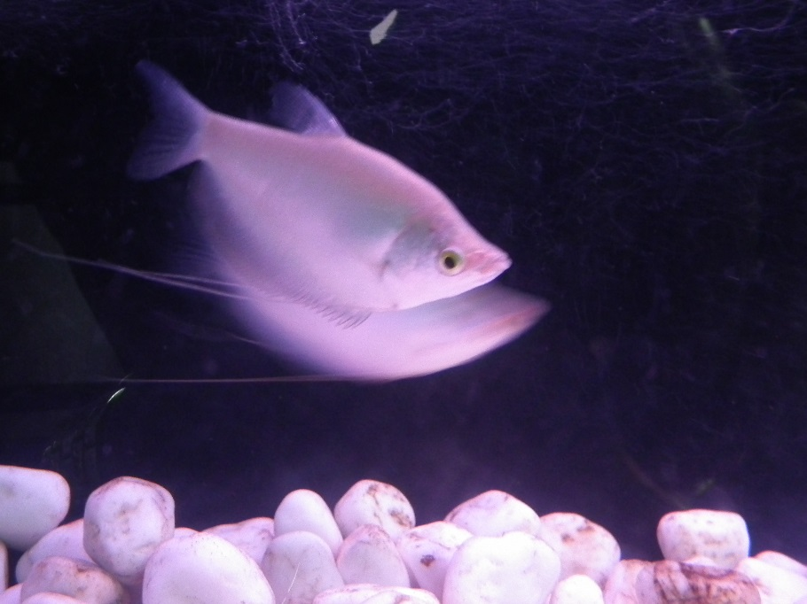
Regional Roundtable on
World Programme for the Census of Agriculture 2020
Budapest, Hungary
3-7 April 2017
Theme14: Fisheries
Adriana Neciu
Agricultural Census and Survey Team
FAO Statistics Division

Slide 20
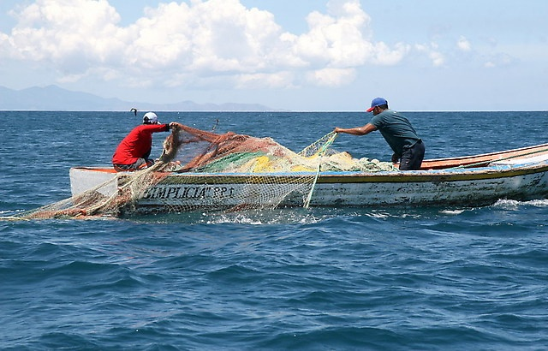
Contents
Background
Importance of the theme
Fisheries in the frame work of the census of agriculture
Items
Concepts and definitions

Slide 21

Background
Theme 14: “Fisheries” is a new theme in the WCA 2020 Programme. It comprises capture fisheries conducted at household level. It does not refer to large-scale commercial fisheries enterprises.
According to the International Standard Industrial Classification (ISIC) Rev.4 the agricultural (groups 011-015) and fisheries (group 031) activities are different economic activities. As a result, household capture fisheries activities remain outside the scope of the census of agriculture. However, the theme is of interest to many countries.
The collection of data about household fisheries activities can be faced from two different angles - fishers belonging to:
households that also have agricultural holdings;
other households as well, when conducting a wider agricultural census.

Slide 22
Importance of the theme
Fish and other aquatic organisms are an important source of proteins and other nutrients contributing to improvement of nutritional status of under-nourished population.
Fisheries contribute to cash income, employment and export earnings in many countries and, in many cases, is an important part of households’ activity.
In many cases, members of households in agricultural holdings are engaged in marine or freshwater capture fishing activities, both in :
the household’s own-account capture fisheries and/or
on an employment basis in other economic units.

Slide 23

Fisheries in the framework of the census of agriculture
Two main situations need to be analyzed:
1. Fishers belonging to households with agricultural holdings;
2. Fishers belonging also to other households, in the framework of a wider agricultural census.
In the first case, the census fisheries items are applied to holder’s household members engaged in either marine or freshwater capture fishing activities.
In the second case, in a wider agricultural census, the census fisheries items are applied to both agricultural and non-agricultural production households.

Slide 24
Items
Theme 14 comprises 7 items:
1401 Engagement of household members in fishing activity
1402 Number of household members engaged in fishing activity by sex
1403 Number of fishers by sex employed by the household
1404 Access arrangements for fishing
1405 Main purpose of household fishing activity
1406 Type of fishing vessel used by source
1407 Type of fishing gear used

Slide 25
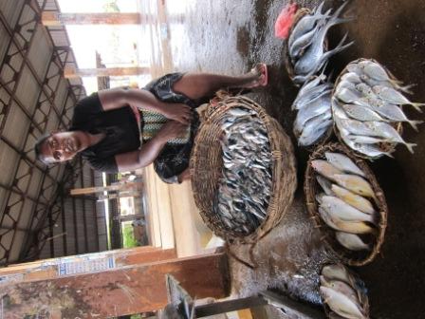
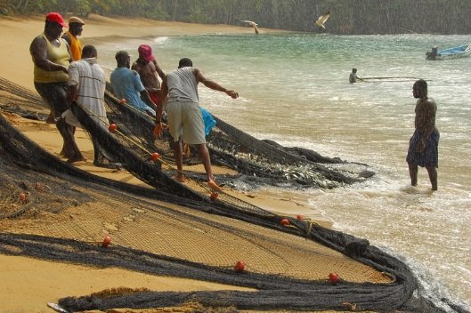
Item 1401: Engagement of household members in fishing activity
Type: Frame item
Reference period: Census reference year
Concept: The item refers to households in which any member is engaged in either marine or freshwater capture fishing activities, regardless of the amount of time engaged, in:
    the household and/or
    in other economic units.
Engagement in household fishing relates to own-account fishing activity of the holder’s household.
Engagement “in other economic units” refers to member(s) of the household engaged in capture fishing activity outside of the household.

Slide 26
Item 1401: Engagement of household members in fishing activity (cont’d.)
  Notes:
    The item does not cover households with members engaged only in the processing of products from fisheries or only in trading of products from fishing.
    Fishing activity includes “the hunting, collecting and gathering activities directed at removing or collecting live wild aquatic organisms (predominantly fish, molluscs and crustaceans) including plants from the oceanic, coastal or inland waters for human consumption and other purposes by hand or more usually by various types of fishing gear such as nets, lines and stationary traps”.
    Unlike in aquaculture (group 032 of ISIC Rev.4), the aquatic resource being captured is usually common property resource irrespective of whether the harvest from this resource is undertaken with or without exploitation rights.
Notes:
Such activities can be conducted on the intertidal shoreline (e.g. collection of molluscs such as mussels and oysters) or [using] shore-based netting, or from home-made dugouts or more commonly using commercially made boats in inshore, coastal waters or offshore waters. Such activities also include fishing restocked water bodies.” Fishing activity excludes raising fish, molluscs and crustaceans in captivity, which is covered under Theme 12: Aquaculture. Such activities also include fishing restocked water bodies.” Fishing activity excludes raising fish, molluscs and crustaceans in captivity, which is covered under Theme 12: Aquaculture.
Fishing includes any activity – other than scientific research conducted by a scientific research vessel – that involves the catching, taking or harvesting of fish or any attempt to do so, or any activity that can reasonably be expected to result in the catching, taking or harvesting of fish and any operations at sea in support of it.

Slide 27

Item 1402: Number of household members engaged in fishing activity by sex
Type: Additional item
Reference period: Census reference year
Concept: The purpose of this item is to obtain information regarding the number of household members engaged in:
  household fishing activity – i.e. for the household’s own-account capture fisheries; and/or
  capture fishing activity outside of the household – i.e. in other households, fishing enterprises or other economic units.
Notes:
  If a household member has been engaged in capture fishing activity both in the household and in another economic unit, he/she should be counted only once and assigned to the activity/unit in which he/ she has spent the most time during the reference year.
  Data regarding gender are important to capture accurate information on the activities of women in fishing.

Slide 28
Item 1402: Number of household members engaged in fishing activity by sex (cont’d.)
Ways to collect the information: Countries may wish to quantify the volume of work in the household’s fishing activity. The measurement of working time could be based on:
the assessment of hours or days engaged in the holding’s fishing activity, or
broad categories such as full-year/part-year or full-time/part-time.

Slide 29

Item 1403: Number of fishers by sex employed by the household
Type: additional item
Reference period: Census reference year
Concept: This item refers to paid workers engaged in fishing activities of the fishing households (not household members). This includes regular employees, as well as seasonal, short-term and casual workers.
Notes:
Employees may be paid in cash or in the form of food or other products, but there may also be other remuneration arrangements. Exchange of labour should be treated as a form of paid employment. Persons employed by the household but not working in fishing are excluded. Family members are covered in item
1402 and are excluded here. Countries may wish to quantify the volume of work contributed by employed fishers. Working time data for employees engaged in fishing activities of the household should be consistent
with the similar data for household members.

Slide 30
Item 1404: Access arrangements for fishing
Type: Additional item
Reference period: Census reference year
Concept: This item refers to access arrangements for individuals to utilize aquatic resources for the purpose of fishing. These include formal (such as licences) and informal tenure given to either individuals or communities. Tenure systems are used to regulate access to natural resources such as fish stocks and can be informal or established formally through legislation or through community customs.
Arrangements:
  Access arrangement for marine fishing
  Access arrangement for freshwater fishing
  No access arrangement required for marine fishing
  No access arrangement required for freshwater fishing
Notes:
Marine fishing refers to fishing in oceans and seas, including adjacent saltwater and shore areas; freshwater fishing refers to fishing in inland waters, including lakes, rivers, brooks, streams, ponds, inland canals, dams and other landlocked water areas, regardless of water salinity.

Slide 31
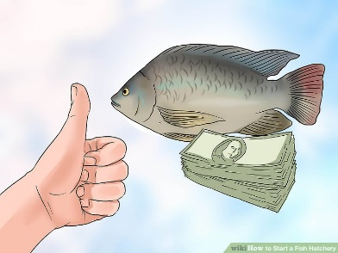
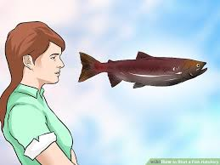
Item 1405: Main purpose of household fishing activity
Type: Additional item
Reference period: Census reference year
Aim of this item: to get a broader indicator of the extent of participation in the market economy. In cases where the household fishing is for more than one purpose, the main purpose should be the one which represents the larger value of products from fishing.
Main purposes:
  Producing mainly for own consumption
  Producing mainly for sale
Notes:
Sale includes selling produce for cash or in exchange for other produce (barter). Disposal of fishing products in other ways, such as payment for labour, sending to family members, gifts or payments of taxes, should not be considered in assessing main purpose.

Slide 32
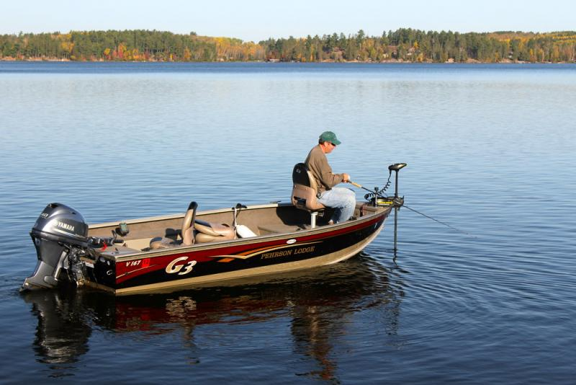
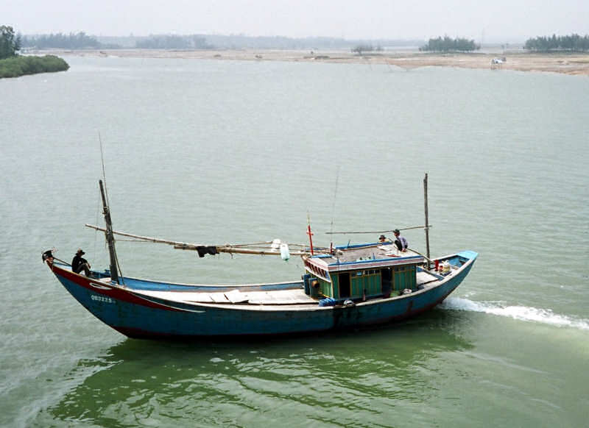
Item 1406: Type of fishing vessel used by source
Type: Additional item
Reference period: Census reference year
Types of vessels:
  a) Motorized vessels (vessels using motors, either inboard or outboard, for propulsion):
    owned solely by household members
    owned by the household jointly with other households
    lent from others (with or without payment)
  b) Non-motorized vessels:
    owned solely by household members
    owned by the household jointly with other households
    lent from others (with or without payment)
  c) No vessel used (e.g. fishing from the shore or on the shore)

Slide 33
Item 1407: Type of fishing gear used
Type: Additional item
Reference period: Census reference year
Types of fishing gear according to the International Standard Statistical Classification of Fishing Gears*:
Surrounding nets | Gillnets and entangling nets
Seine nets | Traps
Trawls | Hooks and lines
Dredges | Grappling and wounding
Lift nets | Harvesting machines
Falling gear | Miscellaneous gear (including gathering by hand with simple hand implements)

Slide 34
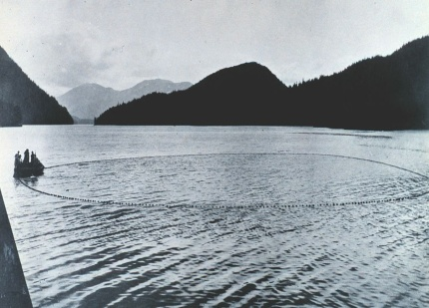
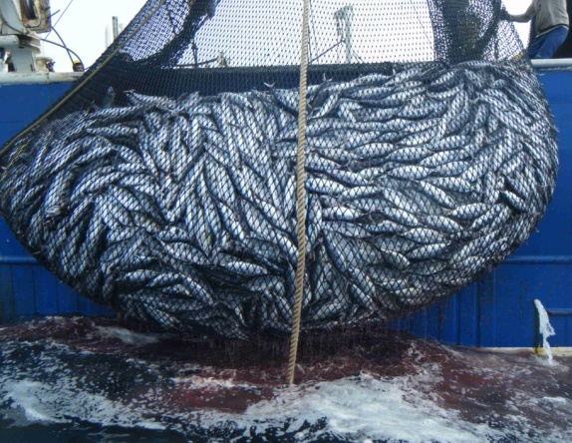
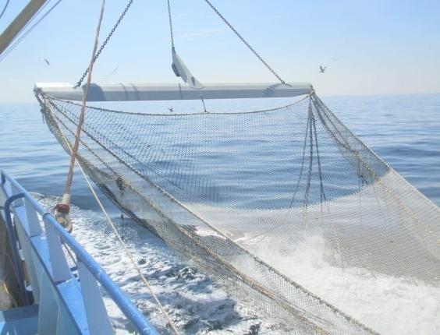
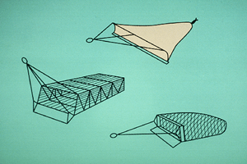
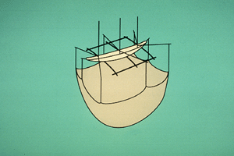
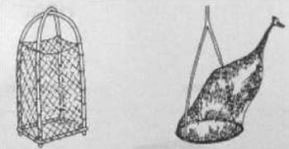
Item 1407: Type of fishing gear used (cont’d)
A surrounding net A seine net being lifted Trawls
Dredges Lift nets Falling gear

Slide 35
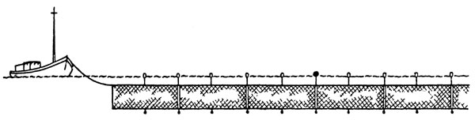
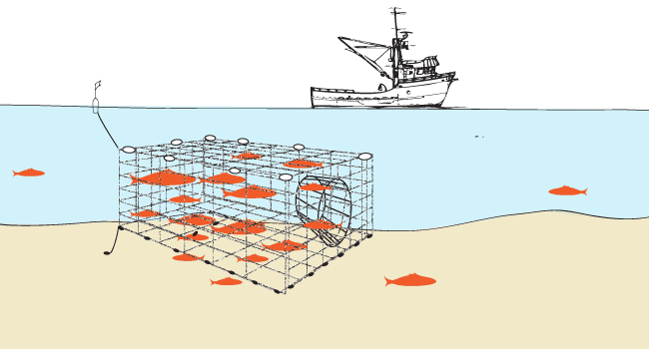
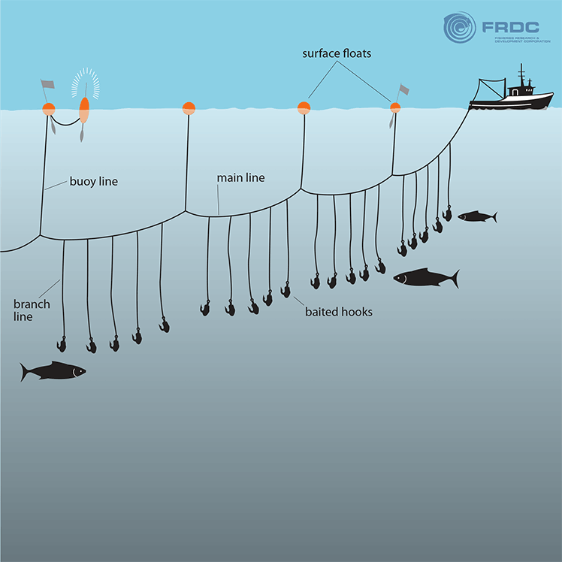
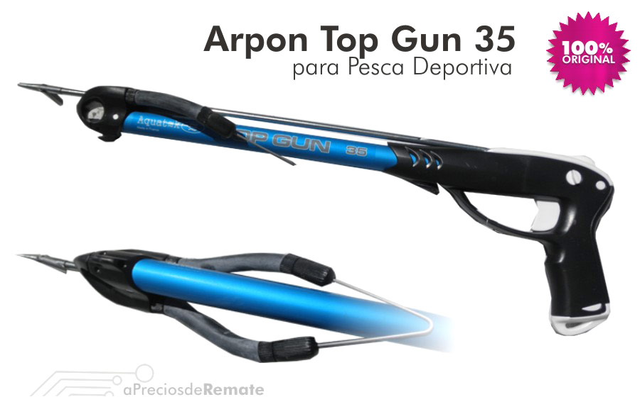
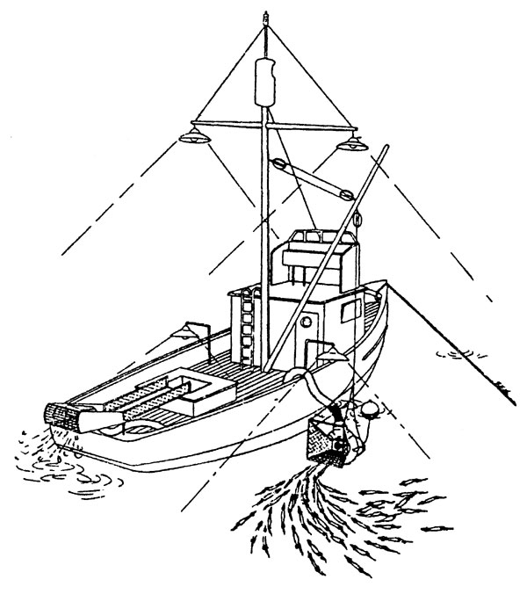
Item 1407: Type of fishing gear used (cont’d)
Gillnets & entangling nets Traps Hooks and lines
Grappling and wounding Harvesting machines

Slide 36
Country experiences
Saint Lucia – Census of Agriculture and Fisheries (CAF) 2007
CAF A–Agricultural census questionnaire
CAF B–Fishing census questionnaire – is dedicated to collection of information on every household with members involved in fishing. The following information were included:
Identification and location of household engaged in fishing activity.
Characteristics of the fishing household
    name of members of houshold engaged in comercial fishing, their sex and age;
    role of fishery: boat owner/owner/captain/crew/vendor, type of activity: full time/part time
    percentage of income coming from fishing
    ownership solely or jointly any comercial fishing boat: name, registration number, lenght, age, no.of engines, combined hourse power
Ownership of boat and equipment
    credit for purchasing the boat,
    other fishing equipment and/or fishing gear,
    assistance from government, cooperatives and/or friends,
    membership of a fisheries cooperative or association
    equipment available: float, GPS, scale, compass, radio, mobile pone, mirrors, day/night flares, flash light, life jackets
    fishing metods: trolling lines longlines, handlines, palangres, fillet nets, flying fish nets, beach seines, scuba tanks, spearguns, harpoons, fish pots
Operation of the boat (no of days unable to operate the boat due to: bad wheater, engine repairs, boat repairs, other)
Management of catch (type of storage used for the catch while at sea: ice box, open hull, other)
Income and cost
average cost per trip: fuell/stores/gears
average earning per trip: high season/low season
Notes:
For fishing activities the statistical units are the fishing household defined as a household in a single location primarily engaged in fishing and the fishing boat. For purposes of the 2007 St Lucia CAF, the fishing household will provide socio-economic information related to persons engaged in fishing. On the other hand, persons operating the boat will give information about fishing practices, equipment, operation, damages and main operative problems.
Identification and location of fishing household.
Characteristics of the fishing household
(name of members of houshold engaged in comercial fishing and their sex and age, role of fishery: boat owner/owner/captain/crew/vendor, type of activity: full time/part time, percentage of income coming from fishing, ownership solely or jointly any comercial fishing boat: name, registration number, lenght, age, no.of engines, combined hourse power)
Ownership of boat and equipment
(credit for purchasing the boat, other fishing equipment and/or fishing gear, assistance from government, cooperatives and/or Friends, membership of a fisheries cooperative or association)
Operation of the boat
Management of catch
Income and cost

Slide 37
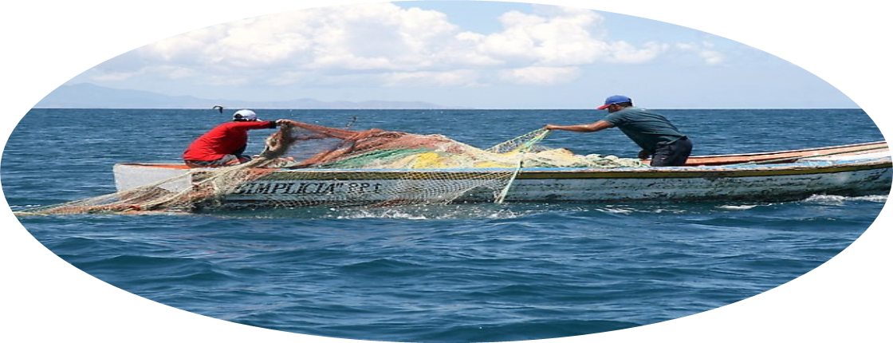
MANY THANKS

