Slide 1
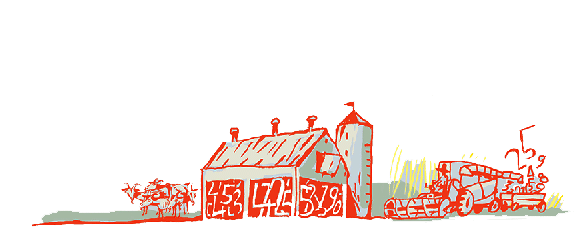
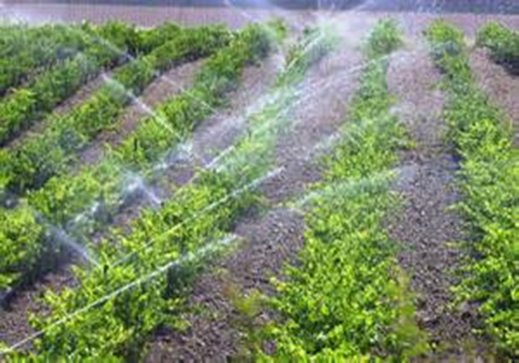
Regional Roundtable
World Programme for the Census of Agriculture 2020 Port of Spain, Trinidad and Tobago 22-26 May 2017
Theme 03 – Irrigation
Technical Session 7
Adriana Neciu
Agricultural Census and Survey Team
FAO Statistics Division

Slide 2
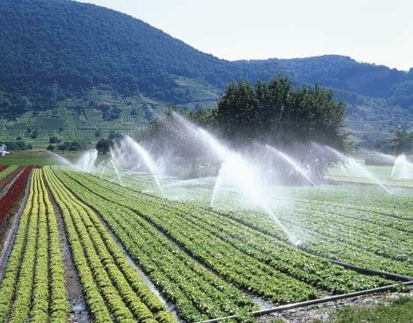
Contents
Background
Importance of the theme
Concept of irrigation
Items: type, reference periods, importance of the item, concepts and special characteristics
Country experiences

Slide 3
Background
In Theme 3, new items are included:
Item 0302: Area of land actually irrigated: fully controlled and partially controlled irrigation (it is also essential item)
Item 0309: Area equipped for irrigation in working order: fully and partially controlled irrigation
Theme 3 has only one frame item: use of irrigation on the holding: fully controlled and partially controlled irrigation.
The theme comprises 10 items all of them at holding level.

Slide 4
Importance of the Theme
Data about irrigation cross tabulated with land use are important for analysis of farm management and agricultural practices.
It is important to better understand cropping practices and the constraints in improving agricultural productivity;
Irrigation has important consequences in environmental aspects of the agricultural production referred to for example: source, type and quality of water; drainage and use of wastewater.
Irrigation has also important financial aspects: payment for irrigation, investments needs, etc.

Slide 5
Concept of irrigation
Irrigation refers to purposely providing land with water, other than rain, for improving pastures or crop production.
Irrigation usually implies the existence of infrastructure and equipment such as: irrigation canals, pumps, sprinklers or localized watering systems.
However, it also includes manual watering of plants.
Uncontrolled land flooding by overflowing of rivers or streams is NOT considered irrigation.

Slide 6
Items
Theme 3: Irrigation comprises the following items:
0301: Use of irrigation on the holding: fully and partially controlled irrigation; 0302: Area of land actually irrigated: fully and partially controlled irrigation; 0303: Area of land actually irrigated according to land use types: fully and partially controlled irrigation (for the holding); 0304: Area of land actually irrigated according to method of irrigation: fully controlled irrigation (for the holding); 0305: Area of crops actually irrigated for each crop type: fully controlled irrigation (for the holding); | 0306: Sources of irrigation water: fully controlled irrigation (for the holding); 0307: Payment terms for irrigation water: fully and partially controlled irrigation (for the holding); 0308: Use of other types of irrigation: partially controlled irrigation (for the holding); 0309: Area equipped for irrigation in working order: fully and partially controlled irrigation; 0310: Presence of drainage equipment (for the holding) 1506: Rice cultivation: irrigation and water regimes (explained in Theme 15)
Notes:
Items 0301, 0302, 0303, 0307 and 0309 are applicable to both fully and partially controlled irrigation; Items 0304, 0305, 0306 are relevant to fully controlled irrigation methods and Item 0308 to partially controlled irrigation methods.
8.3.4 Items 0301 to 0308 refer to the actual use of irrigation, not to whether the holding is equipped for irrigation.

Slide 7
Item 0301: Use of irrigation on the holding: fully and partially controlled irrigation
Type: frame item.
Reference period: census reference year.
Precision: this item is recommended for inclusion in the core module when a modular approach is used, to provide a sampling frame for related surveys.

Slide 8
Item 0302: Area of land actually irrigated: fully and partially controlled irrigation
Type: essential item.
Reference period: census reference year.
Concept: this item refers to the physical area of land irrigated, not the total area of crops irrigated. Therefore, if the same area is cropped, irrigated and harvested twice a year, it should be counted once.

Slide 9
Item 0303: Area of land actually irrigated according to land use type: fully and partially controlled irrigation (for the holding)
Type: additional item.
Reference period: census reference year.
Concept: as in the previous case, this item refers to the physical area of land irrigated, not the total area of crops irrigated. Thus, the land irrigated for successive crops in different seasons within the reference year is only counted once.
Land use categories:
Land under permanent crops
Land under temporary crops:
Single-irrigated crop;
Multiple-irrigated crops.
Land under temporary meadows and pastures
Land under permanent meadows and pastures

Slide 10
Item 0304: Area of land actually irrigated according to method of irrigation: fully controlled irrigation (for the holding)
Type: additional item.
Reference period: census reference year.
Concept: this item includes only areas of land irrigated by methods of fully controlled irrigation.
Methods:
Surface irrigation
Sprinklers
Localized irrigation
The definition and images of each method are given in the following slides.
Notes:
Manual irrigation using buckets or watering cans is also included.
The use of water from water harvesting facilities, such as roof water harvesting, is included if the water supply is reliable. Surface irrigation does NOT refer to the method of transporting the water from the source up to the field, which may be done by gravity or by pumping.

Slide 11
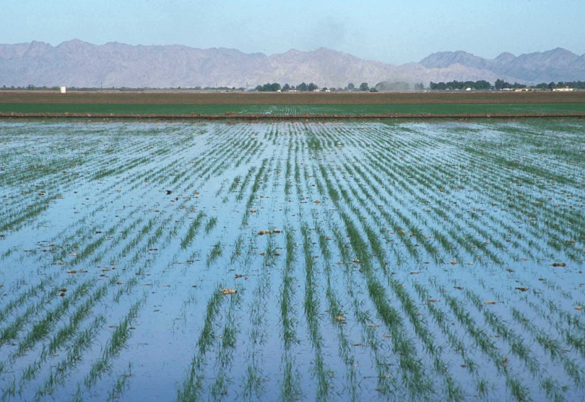
Methods of irrigation
Surface irrigation:
System for partially or completely covering land with water for the purpose of irrigation. They include several types including furrow, border strip and basin irrigation.
Basin irrigation
Furrow Irrigation

Slide 12
Methods of irrigation (contd.)
Sprinklers: Sprinkler irrigation refers to pipes networks through which water moves under pressure before being delivered to the crop via sprinkler nozzles.

Slide 13
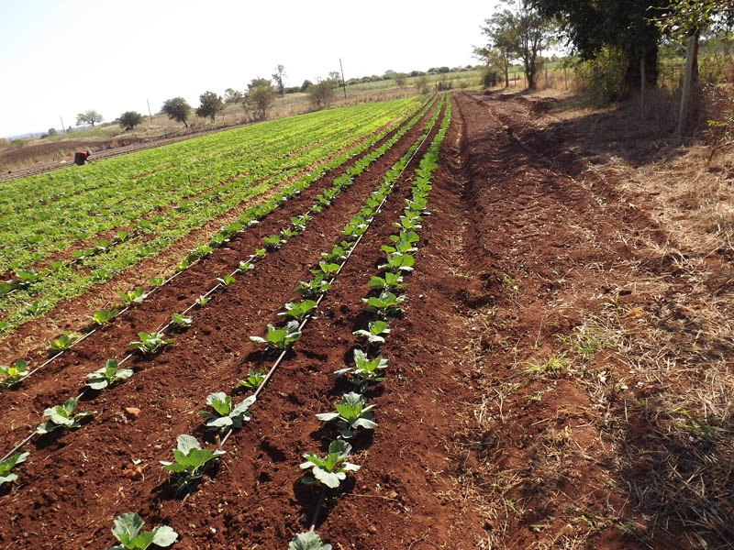
Methods of irrigation (contd.)
Localized irrigation: It is a system whereby water is distributed under low pressure through a piped network, in a pre-determined pattern and applied as a small discharge to each plant.

Slide 14
Item 0305: Area of crops actually irrigated for each crop type: fully controlled irrigation (for the holding)
Type: additional item.
Reference period: census reference year.
Concept: This item includes only areas of land irrigated by methods of fully controlled irrigation. It refers to the area of crops irrigated, as opposed to the area of land irrigated of previous items.
Precision: For temporary crops, this item refers to that portion of the harvested area irrigated at some time during the reference year. For permanent crops, it refers to that portion of the area with permanent crops present of the day of enumeration that was irrigated at some time during the reference year.
Notes:
This item refers to the area of crops irrigated, as opposed to the area of land irrigated given in Items 0302, 0303 and 0304 (see paragraph 8.3.9). For example, a plot of 0.4 ha with crops irrigated in two seasons within the reference year is recorded as 0.4 ha of land irrigated in Item 0302 and 0.8 ha of crops irrigated in this item. Analysis of the crop area irrigated in relation to the land irrigated provides information on cropping intensity under irrigation.

Slide 15
Item 0306: Sources of irrigation water: fully controlled irrigation (for the holding)
Type: additional item.
Reference period: census reference year.
Concept: This item includes only areas of land irrigated by methods of fully controlled irrigation. It refers to whether irrigation water used on the holding was obtained from one or several of the following sources:
Surface water (e.g. streams, rivers, ponds, lakes, etc.) Groundwater: water stored underground in aquifers, usually pumped from wells Mixed surface water and groundwater | Municipal water supply: source of water accessible to at least two holdings withdrawn from the public piped distribution network Treated wastewater: water without further immediate value for the purpose to which it was used or produced because of its quality Other

Slide 16
Item 0307: Payment terms of irrigation water: fully and partially controlled irrigation (for the holding)
Type: additional item.
Reference period: census reference year.
Concept: This item refers to whether payment was made for the irrigation water used in the holding. It encompasses the following categories:
Did not pay for water
Paid for water:
Fee based on area of land irrigated
Fee based on volume of water
Other (e.g. both, based on area an volume)

Slide 17
Item 0308: Use of other types of irrigation: partially controlled irrigation (for the holding)
Type: additional item.
Reference period: Data on partially controlled irrigation are normally collected for the census reference year, but data may be distorted by unusual weather conditions.
Concept: Partially controlled irrigation activity covers the following specific methods:
Equipped wetland and inland valley bottoms: lowland areas subject to seasonal flooding that are used when covered with water. When control structures such as canals are constructed it falls in the partially controlled category
Equipped flood recession: it refers to areas along the edges of rivers or other water bodies where cultivation occurs making use of water from receding floods. Structures may be built to retain receding water in which case it falls in the partially controlled category
Spate irrigation: it is a method of random irrigation using the floodwaters of a normally dry watercourse or riverbed (wadi). There are two types of spate irrigation: a) floodwater is harvested in streambeds and spread through the wadi in which the crops are planted; b) floodwater is diverted from seasonal rivers into adjacent embanked fields for direct application
Notes:
Floating rice is included as a flood recession crop.

Slide 18
Item 0309: Area equipped for irrigation in working order: fully and partially controlled irrigation
Type: additional item.
Reference period: census reference day.
Concept: This item refers to the existence of infrastructure and equipment for applying water to crops, which is in working order.
Precision 1: Manual watering of plants using buckets, watering cans, etc. is not covered by this item.
Precision 2: The equipment does not have to be used during the reference year. The item only refers to the existence in using conditions.
Notes:
Unlike Item 0302, which refers to the area actually irrigated, this item refers only to whether the holding is equipped for irrigation and the equipment is in good working order on the census reference day. The equipment does not have to be used during the reference year .

Slide 19
Item 0310: Presence of drainage equipment (for the holding)
Type: additional item.
Reference period: census reference day.
Concept: Drainage means the artificial removal of the excess of water (both surface or groundwater) from the land surface by means of surface or subsurface conduits, to enhance agricultural production. Presence of drainage equipment means that the equipment is present on holding on the census reference day.
Precision: Management of water for flood recession cropping (item 0308) is considered partially controlled irrigation, not drainage.
Notes:
Drainage does not include natural drainage of excess water into lakes, swamps and rivers.

Slide 20
Country experiences
Grenada – Agricultural census 2012
Section VIII of Grenada Agriculture Census questionnaire is related to irrigation
During the last twelve months did you use irrigation on this Parcel? Yes/no
Area of parcel irrigated
Type of irrigation: Drip, Micro sprinklers, Overhead, Other.
For each irrigation type:
Area irrigated
Type of crop (vegetables, root, fruit)
Main water source: river, Nat’l Water & Sewerage Authority , wells, Other

Slide 21
Many thanks

