Slide 1
Integrating Agriculture Questions into a P & H Census
Rhinehart Silas
Office of Planning and Statistics
Ministry of Finance
Republic of Palau
http://www.palaugov.net/stats

Slide 2
Outline
Census 2005 and Ahead
Farm Survey (2011)
Opportunities

Slide 3
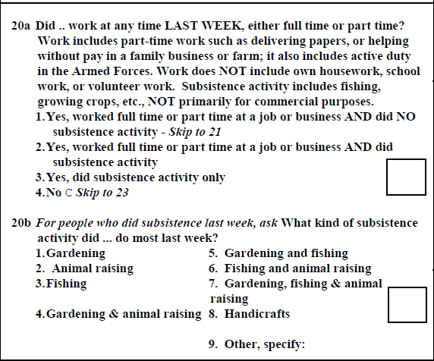
Census 2005 and Next
Census 2005

Slide 5
Then and Now…
Planned 2008 Agriculture Census
2010 Census
Next schedule: 2015 P & H Census (legal reinforcement through Statistics Act 2011)

Slide 6
Farm Survey 2011
Covered agriculture and aquaculture farms
Objective: To utilize GIS technology and analysis to
1. map all agriculture and aquaculture farm varieties across Palau 2. assess the different types of farms, their sizes and quantity in Palau
3. identify potential suitable agriculture and aquaculture areas in Palau
4. examine climate change impacts on agri/aquaculture farm varieties across Palau
5. develop the National Food Security Policy for the Republic of Palau

Slide 7
Farm Survey
Activity 1: survey & plot coordinates for all farms (agri/aquaculture) – Collection of the the following by BoA, PCC and BMR:
(a) Coordinates (PALARIS)
(b) Photo (PALARIS)
(c) Unique Farm ID (PALARIS & Resource Agencies)
(d) Owner’s name
(e) Type of farm
(f) Size of farm (actual or spot points?)
(g) Species diversity - what variety of crops/animals
(h) Worth of farm (investment - revenues & total cost to maintain)
(i) Climate change impacts experienced or observed
Activity2: processing of data by PALARIS and BoA ongoing
Activity 3: generation of map layers & additional data tables ongoing by PALARIS and BoA staff

Slide 8
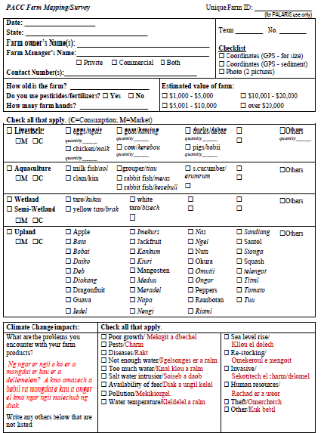

Slide 9
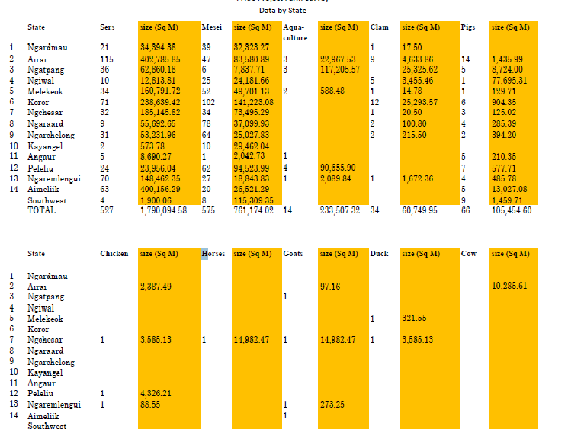

Slide 10
Opportunities
Maturing skill sets across Ministries/Bureaus
Gap-filling role by external partners, e.g. SPC, FAO and others
Streamlining of 2005 P&H Census Questionnaire to incorporate more agriculture questions

