Slide 1
Webinar on the Operational Guidelines of the WCA 2020. Virtual Meeting – Europe and Central Asia 25-29 October 2021
Legal and institutional frameworks
Technical Session 3.1: Planning the census of agriculture
Giorgi KVINIKADZE Statistician, FAO Regional Office for Europe and Central Asia (REU)
1

Slide 2
Contents
CENSUS LEGISLATION WITHIN THE NATIONAL LEGAL FRAMEWORK
MAIN FEATURES OF THE CENSUS LEGISLATION
POLITICAL SUPPORT FOR CONDUCTING A CENSUS
CENSUS EXECUTING AUTHORITY
CENSUS COORDINATING BOARDS
COUNTRY EXAMPLE
2

Slide 3
Contents
CENSUS LEGISLATION WITHIN THE NATIONAL LEGAL FRAMEWORK
MAIN FEATURES OF THE CENSUS LEGISLATION
POLITICAL SUPPORT FOR CONDUCTING A CENSUS
CENSUS EXECUTING AUTHORITY
CENSUS COORDINATING BOARDS
COUNTRY EXAMPLE
3

Slide 4
Census legislation within the national legal framework (1/2)
The agricultural census (AC) legislation exists within overall national legal and administrative frameworks. It commonly consists of:
Basic or primary legislation (such as “Act of Parliament”) enacted by a legislature or other governing body; and
Secondary legislation (delegated, subordinate / subsidiary legislation), made by an executive authority (such as the Cabinet of Ministers, the Ministry of Agriculture, etc) under powers delegated by primary legislation.
Census legal framework may be based on:
The primary legislation of general nature, such as “statistics law” or the law establishing the ministry of agriculture, for the ACs.
Specific agricultural census laws; such a “census law’’ may prescribe the conduct of the census on a regular basis or may be set up before each AC.
The Law (Act) on Agricultural Statistics (e.g. in Germany, United Kingdom) or by the Law on Agriculture (Switzerland).
3
Notes:
Census legislation comprises the collection of laws, regulations, resolutions, etc. governing agricultural census activities.
The census legal framework commonly consists of:
basic or primary legislation enacted by a legislature or other governing body; and
delegated legislation (also referred to as “subordinate legislation” or “subsidiary legislation”)
made by an executive authority (such as the Cabinet of Ministers, Executive Council/Government, the Ministry of Agriculture, etc.) under powers delegated by an enactment of primary legislation.
The existence of an appropriate legal framework is one of the key conditions for the successful implementation of the census of agriculture.
Agricultural censuses entail major commitments, especially of resources, and
it is essential that adequate and timely legislative provision be made for their preparation and conduct.
If a country lacks an appropriate legal framework for taking periodic censuses,
it is important to act early to establish it.
In the process of development or updating of the census legislation,
subject matter specialists from the census executing authority (from now on “census agency”)
should work closely with administrative officers and legal experts to ensure the coherence of census acts with other relevant legislation.

Slide 5
Census legislation within the national legal framework (1/2)
General law or detailed legislation:
Both general laws and detailed census laws offer benefits and drawbacks.
The general features of a Principal Act:
to authorise census taking,
to designate the census executing authority (or “census agency”),
to state general provisions about the census implementation and
to empower a governmental institution,
such as a ministry, to prescribe rules.
Compliance of census legislation with Fundamental Principles of Official Statistics (FPOS):
A census of agriculture as a statistical operation for collecting, processing and disseminating data on the structure of agriculture, is an integral part of the national system of official statistics in a country.
The census of agriculture should fully encompass the FPOS.

Slide 6
Contents
CENSUS LEGISLATION WITHIN THE NATIONAL LEGAL FRAMEWORK
MAIN FEATURES OF THE CENSUS LEGISLATION
POLITICAL SUPPORT FOR CONDUCTING A CENSUS
CENSUS EXECUTING AUTHORITY
CENSUS COORDINATING BOARDS
COUNTRY EXAMPLE
6

Slide 7
Main features of the census legislation
Scope and coverage of the census
Responsibility for the census
Frequency of the census and time reference
Administrative and financial provisions
Rights and obligations of the public with respect to the AC
Confidentiality of information
Identification, obligations and rights of enumerators and other census personnel
Access to administrative data sources (ADS)
Census data dissemination
Sanctions

Slide 8
Contents
CENSUS LEGISLATION WITHIN THE NATIONAL LEGAL FRAMEWORK
MAIN FEATURES OF THE CENSUS LEGISLATION
POLITICAL SUPPORT FOR CONDUCTING A CENSUS
CENSUS EXECUTING AUTHORITY
CENSUS COORDINATING BOARDS
COUNTRY EXAMPLE
8

Slide 9
Ensuring political support for conducting a census
Like in a population census (PC), in an AC the combination of
three factors makes managing a census challenging:
It is one of the largest statistical activities in a country
It is conducted only periodically, generally every 10 years
It involves the mobilization of important financial, human
and other resources during a short period.
Strong political support and efficient coordination between
the census agency and other agencies is essential.

Slide 10
Contents
CENSUS LEGISLATION WITHIN THE NATIONAL LEGAL FRAMEWORK
MAIN FEATURES OF THE CENSUS LEGISLATION
POLITICAL SUPPORT FOR CONDUCTING A CENSUS
CENSUS EXECUTING AUTHORITY
CENSUS COORDINATING BOARDS
COUNTRY EXAMPLE
10

Slide 11
Census executing authority (1/2)
The Census Agency (CA) should be specified in the primary census legislation.
The administrative authority and responsibility to conduct ACs may be:
Delegated to a specific government institution, such as:
❑
❑
National Statistics Office (NSO)
Ministry of Agriculture (MoA) or other executive branch of the government charged with agriculture
Under the joined responsibility of NSO and MoA and possibly may involve other ministries and agencies, and/or local governments.

Slide 12
Census executing authority (2/2)
The Census Office (CO):
Has the primary and chief responsibility for planning, organizing, conducting and supervising the AC.
Commonly is established within the CA on a permanent basis or just for period of preparation to the census.
The number of census personnel is adjusted to meet the needs at different stages of census operation.
The role of the Census Coordinator (usually the CO Head) is to ensure a successful census programme.
Often the CO consists of:
Central Office &
Provincial Offices / District Offices (COs at sub national level).

Slide 13
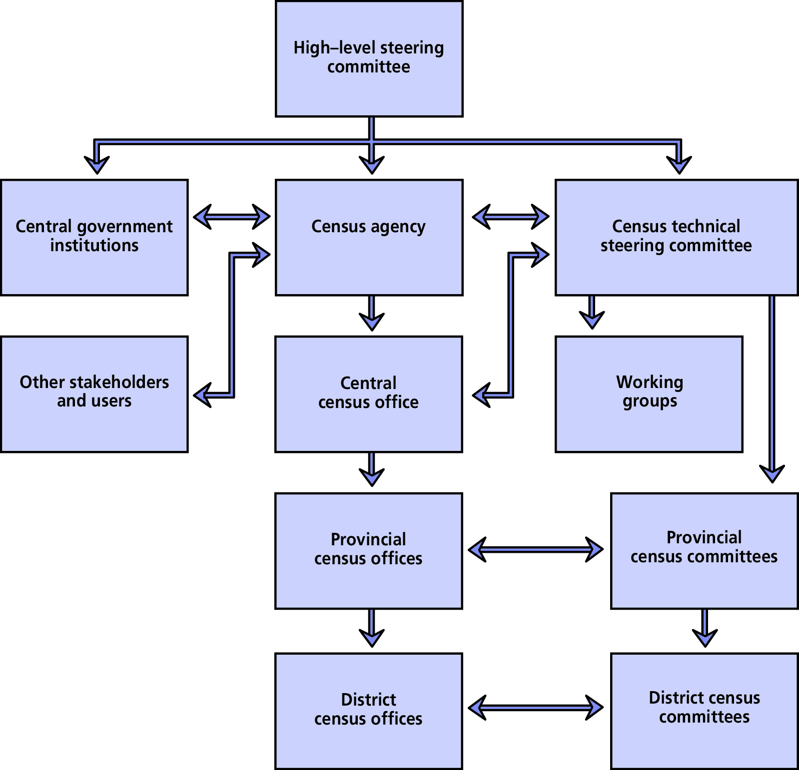
Example of structure of a census organization

Slide 14
Contents
CENSUS LEGISLATION WITHIN THE NATIONAL LEGAL FRAMEWORK
MAIN FEATURES OF THE CENSUS LEGISLATION
POLITICAL SUPPORT FOR CONDUCTING A CENSUS
CENSUS EXECUTING AUTHORITY
CENSUS COORDINATING BOARDS
COUNTRY EXAMPLE
14

Slide 15
Census Coordinating boards (1/4)
Technical Steering Committee (TSC):
Coordination of technical aspects of census preparation and implementation.
Generally, responsible for the overall planning and direction of the census, subject to review by the census coordinator.
Endorses the AC work plan, scope and coverage, main methodological principles, questionnaires, manuals, budgetary and personnel requirements, plans for the publicity campaign, logistical needs, pre-test and pilot censuses, post-enumeration survey plan.
Consists of representatives of major stakeholders, who are able to provide high-level specialist advice and are in a position to take decisions on behalf of the institutions they represent.
Usually created by the regulatory text establishing the census.
The committee’s chairperson could be the head of the CA or another person appointed by him/her.
Should start functioning at least two years ahead of the AC fieldwork and cease to function after the dissemination and archiving of census data.

Slide 16
Census Coordinating boards (2/4)
National High-level Steering Committee (NSC):
Main tasks:
Facilitates good collaboration with relevant ministries / public agencies at the national and sub national levels,
Ensures public support through a wide census publicity
campaign.
It is chaired by a high-ranking official in the government and its members are high level representatives from ministries and other public agencies, as well as from NGOs, businesses and academia.
Useful especially in countries with little experience in AC taking, a de-centralized agricultural statistics system or/and lacking a well-established coordination mechanism of agricultural statistics.

Slide 17
Census Coordinating boards (3/4)
Subcommittees, advisory and working groups:
May be created, under the area of coordination or supervision of a member of the TSC or NSC.
To advise on specific technical matters (concepts and definitions, methodological aspects, questionnaire design, data processing, etc.), or on more general aspects (communications, transportation, logistics, recruitment, training, publicity, data dissemination, etc.).
Would normally consist of a small group of subject matter specialists.
Advisory boards:
To advise the CO on strategic issues or particular technical aspects of census
operation.
Members could be experts on agriculture, agricultural statistics, sample design, IT, representatives of important users segments.
More relevant in the planning and preparation phases and not in the operational phases.

Slide 18
Census Coordinating boards (4/4)
Provincial committees:
Main functions: to coordinate the activities of different institutions contributing to census implementation at the provincial level.
May be established especially in large countries.
Could make recommendations to the CA for items specific to the province to be included in census questionnaires and to advise on provincial tabulations.
Coordinated by the steering committee (TSC or NSC) and should be carried out in close cooperation with the provincial census office.
Usually the head of provincial census office act as a secretary of a provincial committee.
In some countries, census committees are also set up at district level and at a lower administrative level.

Slide 19
Contents
CENSUS LEGISLATION WITHIN THE NATIONAL LEGAL FRAMEWORK
MAIN FEATURES OF THE CENSUS LEGISLATION
POLITICAL SUPPORT FOR CONDUCTING A CENSUS
CENSUS EXECUTING AUTHORITY
CENSUS COORDINATING BOARDS
COUNTRY EXAMPLE
19

Slide 20
Country example: Legal framework
Azerbaijan: 2015 Agricultural Census (1)
The legal basis for conducting the AC 2015 in Azerbaijan consisted of:
the Law on Official Statistics, of 18 February 1994, No. 789, with further amendments;
Presidential Decree No. 2621 of 21 December 2012 on the approval of the State Programme on Development of Official Statistics in the Republic of Azerbaijan in 2013–2017;
Resolution No. 357 of the Cabinet of Ministers dated 28 December 2013, specifying the conduct of the AC in 2015.

Slide 21
Country example: Legal framework
Azerbaijan: 2015 Agricultural Census (2)
The AC 2015 was conducted by the State Statistical Committee (SSC), which, together with its regional offices, was responsible for all activities related to preparation and implementation of the census, data processing and publication of census results.
The Ministry of Agriculture, the Ministry of Economy, the Ministry of Ecology and Natural Resources, the Ministry of Finance, the State Committee on Property Issues, the Azerbaijan State Agrarian University, the Institute of Economy of National Sciences Academy and the Scientific-Research Institute on Agriculture Economy were involved in the elaboration of the census program.

Slide 22
THANK YOU!

