Slide 1
Medium-term prospects in the
global oilmeal market
Peter Thoenes
Trade and Markets Division -
Food and Agriculture Organization of the U.N.
------------------------------------------------------------------------------------
Louis Dreyfus Commodities
OILSEEDS MEETING
3 - 5 December 2014, Barcelona

Slide 2
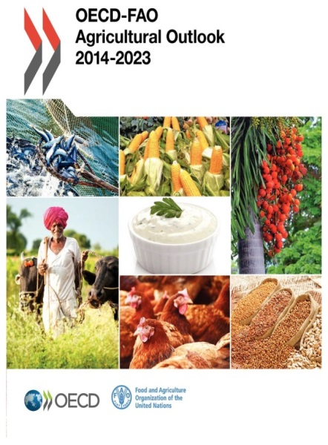
Outline
  Model features & assumptions
  Livestock and aquaculture sectors
  Oilseed complex
    oilseed: production, trade, crush
    oilmeals: production, utilization, trade
  Fishmeal: production, utilization, trade
  Price outlook
  Model limitations & uncertainties
2

Slide 3
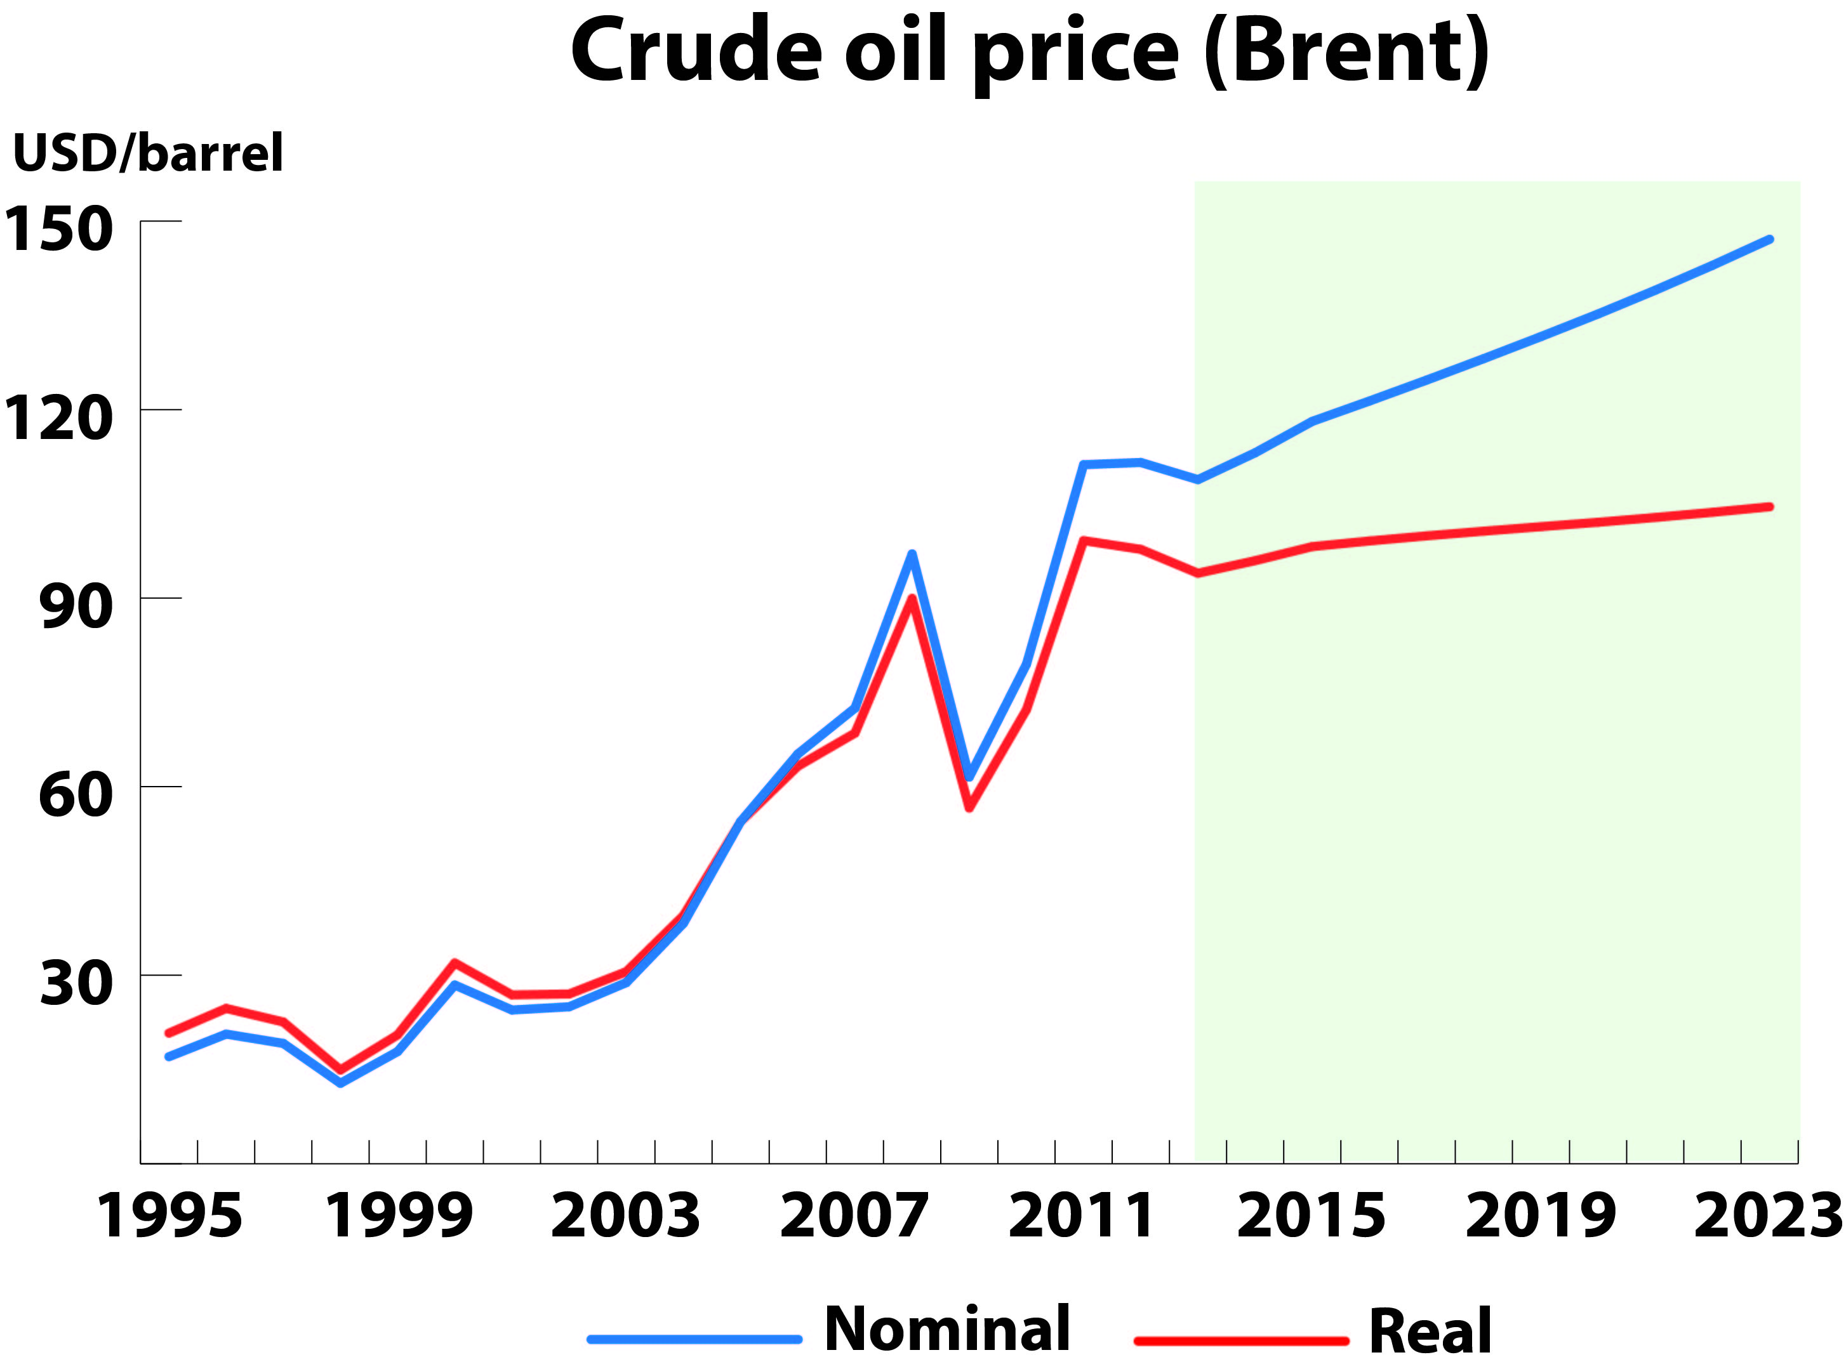
OECD-FAO projections – features & assumptions
main features:
- prepared jointly by OECD and FAO
- based on a comprehensive dynamic model & expert judgment
- global coverage & consistent scenario for entire agricultural sector
- endogenous / exogenous variables
- projections – not forecasts !
general conventions:
- normal production conditions (weather, diseases)
- trended yield development
- no change in policies
specific assumptions:
- technology parameters and elasticities
- population growth
- macroeconomic environment
- crude oil prices
PIC 1
3
Notes:
main features:
Prepared on an annual basis, jointly by OECD and FAO
horizon : 10 years to 2023
based on a comprehensive dynamic GE model, country input and expert judgment
global coverage & consistent scenario for entire agricultural sector
endogenous variables: production, consumption, trade, prices (domestic and international prices are determined simultaneously - as a reflection of expected market fundamentals)
exogenous variables: macroeconomic conditions (demographic projections; GDP, CPI, GDP deflators, exchange rates of national currencies vs. USD, crude oil price); product/country-specific crop yield levels
projections – not forecasts:
forecast: best-guess estimates of a situation in the near future, taking into account latest changes
projection: conditional long-run scenario about what would be expected to happen under a specific set of assumptions about (i) the policies in place, (ii) the responsiveness of market participants, (iii) the future values of exogenous market drivers
general conventions:
normal production conditions: no unforeseen market shocks coming from extreme weather events, animal disease outbreaks, etc.
national policies/laws in place in 2013 to remain in effect: (i) continued progress towards the elimination of direct national price supports; (ii) continuation of import protection measures, domestic support and price intervention policies; (iii) US: 2014 Farm bill not included; EPA 2014 proposals to reduce biofuel mandates not included.
specific assumptions:
technology parameters, e.g. yield: trended yield development by country/crop
elasticities: define the responsiveness of market participants by sector/country
population: slowdown in population growth (UN projections)
macroeconomic environment
global economic recovery to remain modest and uneven: weak recovery in dvlpd countries (US 2.4% p.a., Canada 2.3%, Japan 1,1%), vibrant growth in many dvlpg countries (though slowing down in China, India); source: OECD/IMF
inflation to remain moderate; consumer food price inflation to slow across the world
exchange rates characterized by a stronger USD compared to other currencies (in line with recovery of US economy); NB: Real exch. Rate differ from nominal rates due to inflation differentials vis-à-vis the US. Real rates to depreciate in Australia, Brazil, Japan, EU, India, China, Indonesia - possibly stimulating export growth in some countries; but appreciating in Argentina, Russian Fed., Egypt - possibly hampering exportation
crude oil price: rising energy prices (based on OECD/IEA projections): annual average growth rate 2.8% (crude oil price to climb from USD 109 per barrel in 2013 to 147 USD in 2023) … one of the most important and uncertain assumptions underlying the agric. price projections.

Slide 4
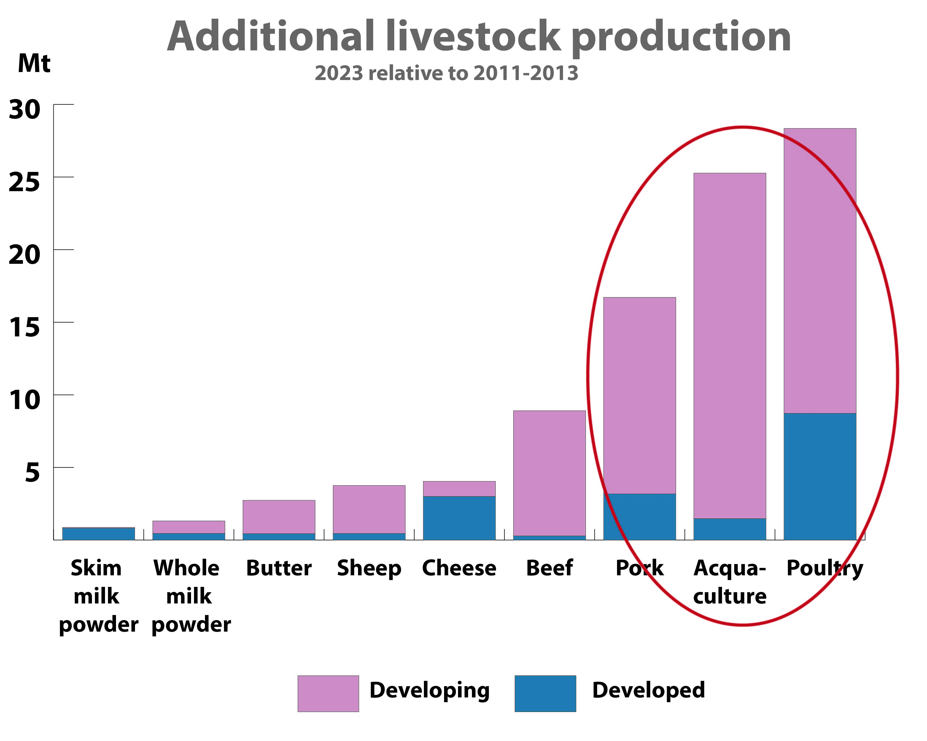
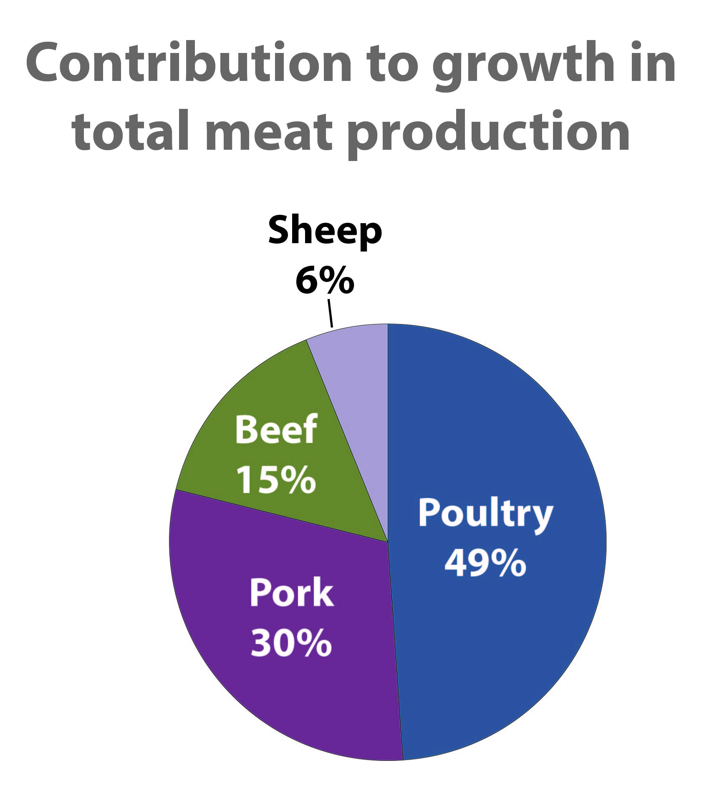
The livestock and aquaculture sectors
significant growth in non-ruminant sector and in aquaculture
Meat sector
Meat sector:
- production expansion to slow down
- growth leader: poultry
4
Notes:
Overview: significant further expansion in non-ruminant sector and in aquaculture
Meat sector
Global production growth up by 58 mmt or 19% (2023 over 2011/13 avg.), although growth will be restrained compared to past decade:
feed costs projected to remain relatively high
other input costs expected to rise (incl. costs associated with meeting more stringent regulations and requirements for environment/animal welfare and health/water/labour)
Share of individual meat types in total pdct growth:
growth led by poultry, followed by pork – two sectors where compound feed (and hence protein meal) play an important role
in absolute terms, global poultry pdct to overtake world pigmeat pdct
poultry: cheapest and most accessible source of meat for lower income consumers + viewed as healthy due to its low content of saturated fat + low cultural barriers related to cspt

Slide 5
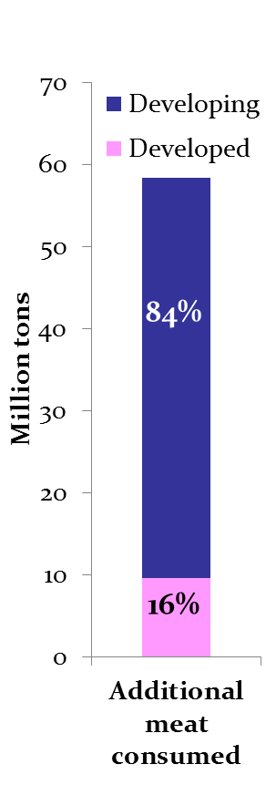
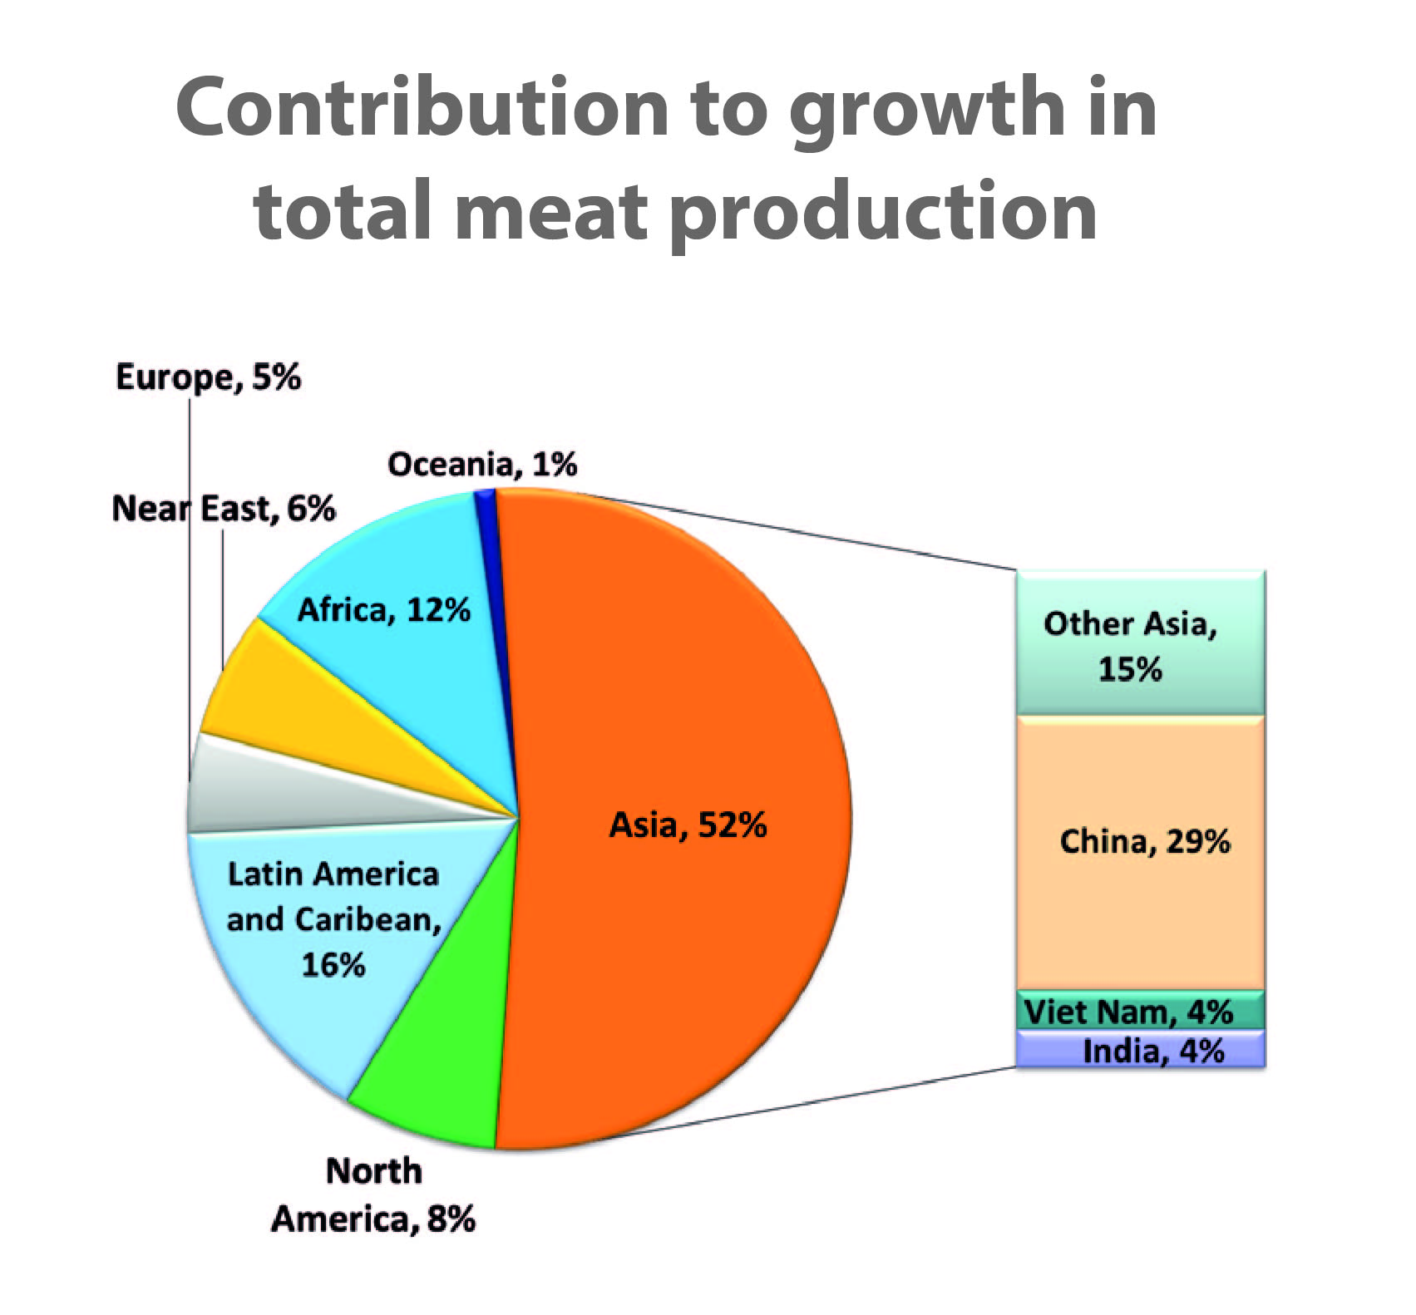
meat consumption growth concentrated in dvlpg world
- growth leader: Asia (notably China)
- sluggish growth in OECD countries
5
Notes:
Geographical distribution of growth:
share of dvlpd and dvlpg group in total pdct increase: 16% and 84% respectively
in dvlpg countries meat cspt keeps expanding due to pop./income growth , urbanization, and changing dietary habits
growth leaders (in absolute terms): regions in order of importance: Asia (led by China), LatAm, Africa, North America; individual countries: China, US, Brazil, Russian Federation
high expansion rates also in Argentina, Russian Federation, Indonesia, Vietnam
OECD group: generally weak growth ← stagnating domestic demand and escalating costs related to preservation of the environment

Slide 6
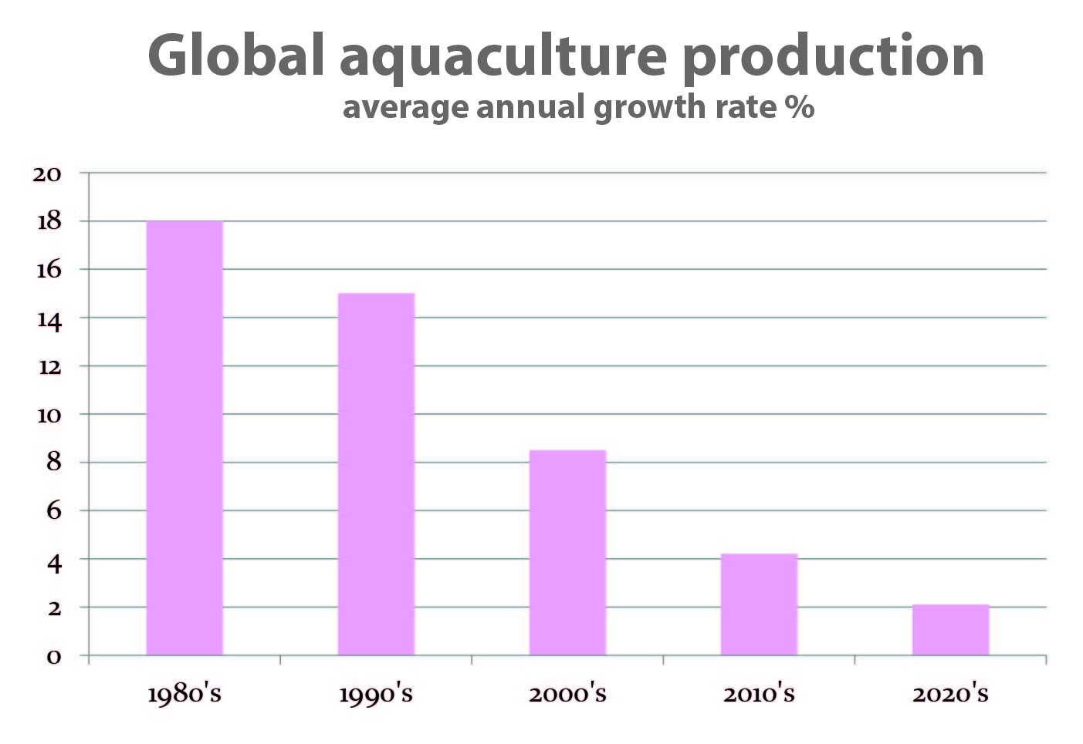
Dairy sector
- production slowdown
growth concentrates in developing countries
India to become the world’s largest milk producer
Aquaculture
one of the fastest growing
food sectors
but deceleration compared
to past decade
6
Notes:
Dairy sector
global pdct of milk and dairy products will continue to expand at a strong rate
annual expansion in total pdct to slow down from slightly
pdct growth to originate mostly from dvlpg countries (78%), thanks to both herd increases and yield improvements; however, herd growth is limited by constraints in water and land availability; meanwhile, yield growth is picking up as modern dairy production systems spread
India to become world’s largest milk producer, outpacing the EU; sluggish EU growth due to weak growth in domestic demand and relatively high pdct costs.
Aquaculture
expansion in global aquaculture pdct to continue: 36% increase over the outlook period
but slowdown compared to past decade (annual growth down to 2.5%, from 5.6% ; slowdown attributed to:
increasingly stringent environmental regulations
disease problems (related to high density issues)
competition from other users of water and coastal spaces
high costs of fishmeal, fishoil and other related feeds
but remember: aquaculture remains one of the fastest growing sectors when compared to other food-producing systems

Slide 7
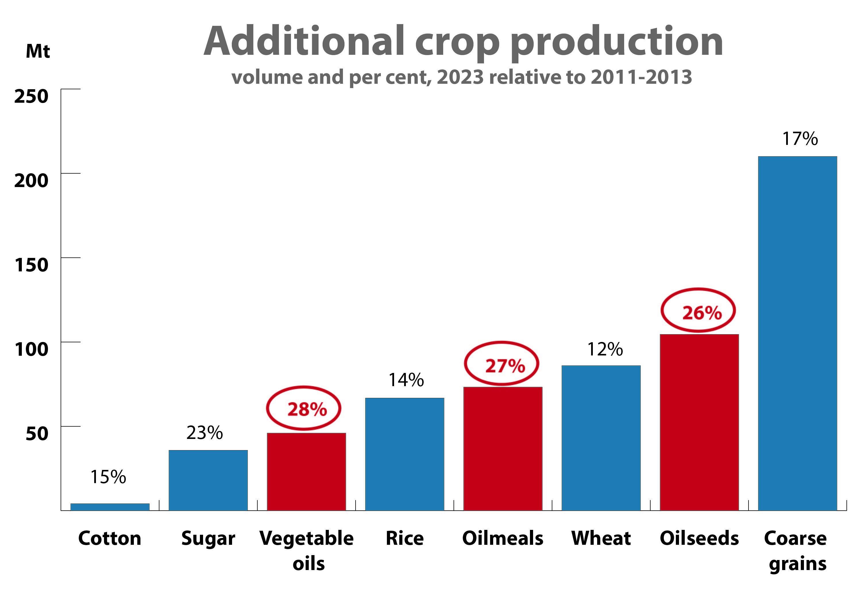
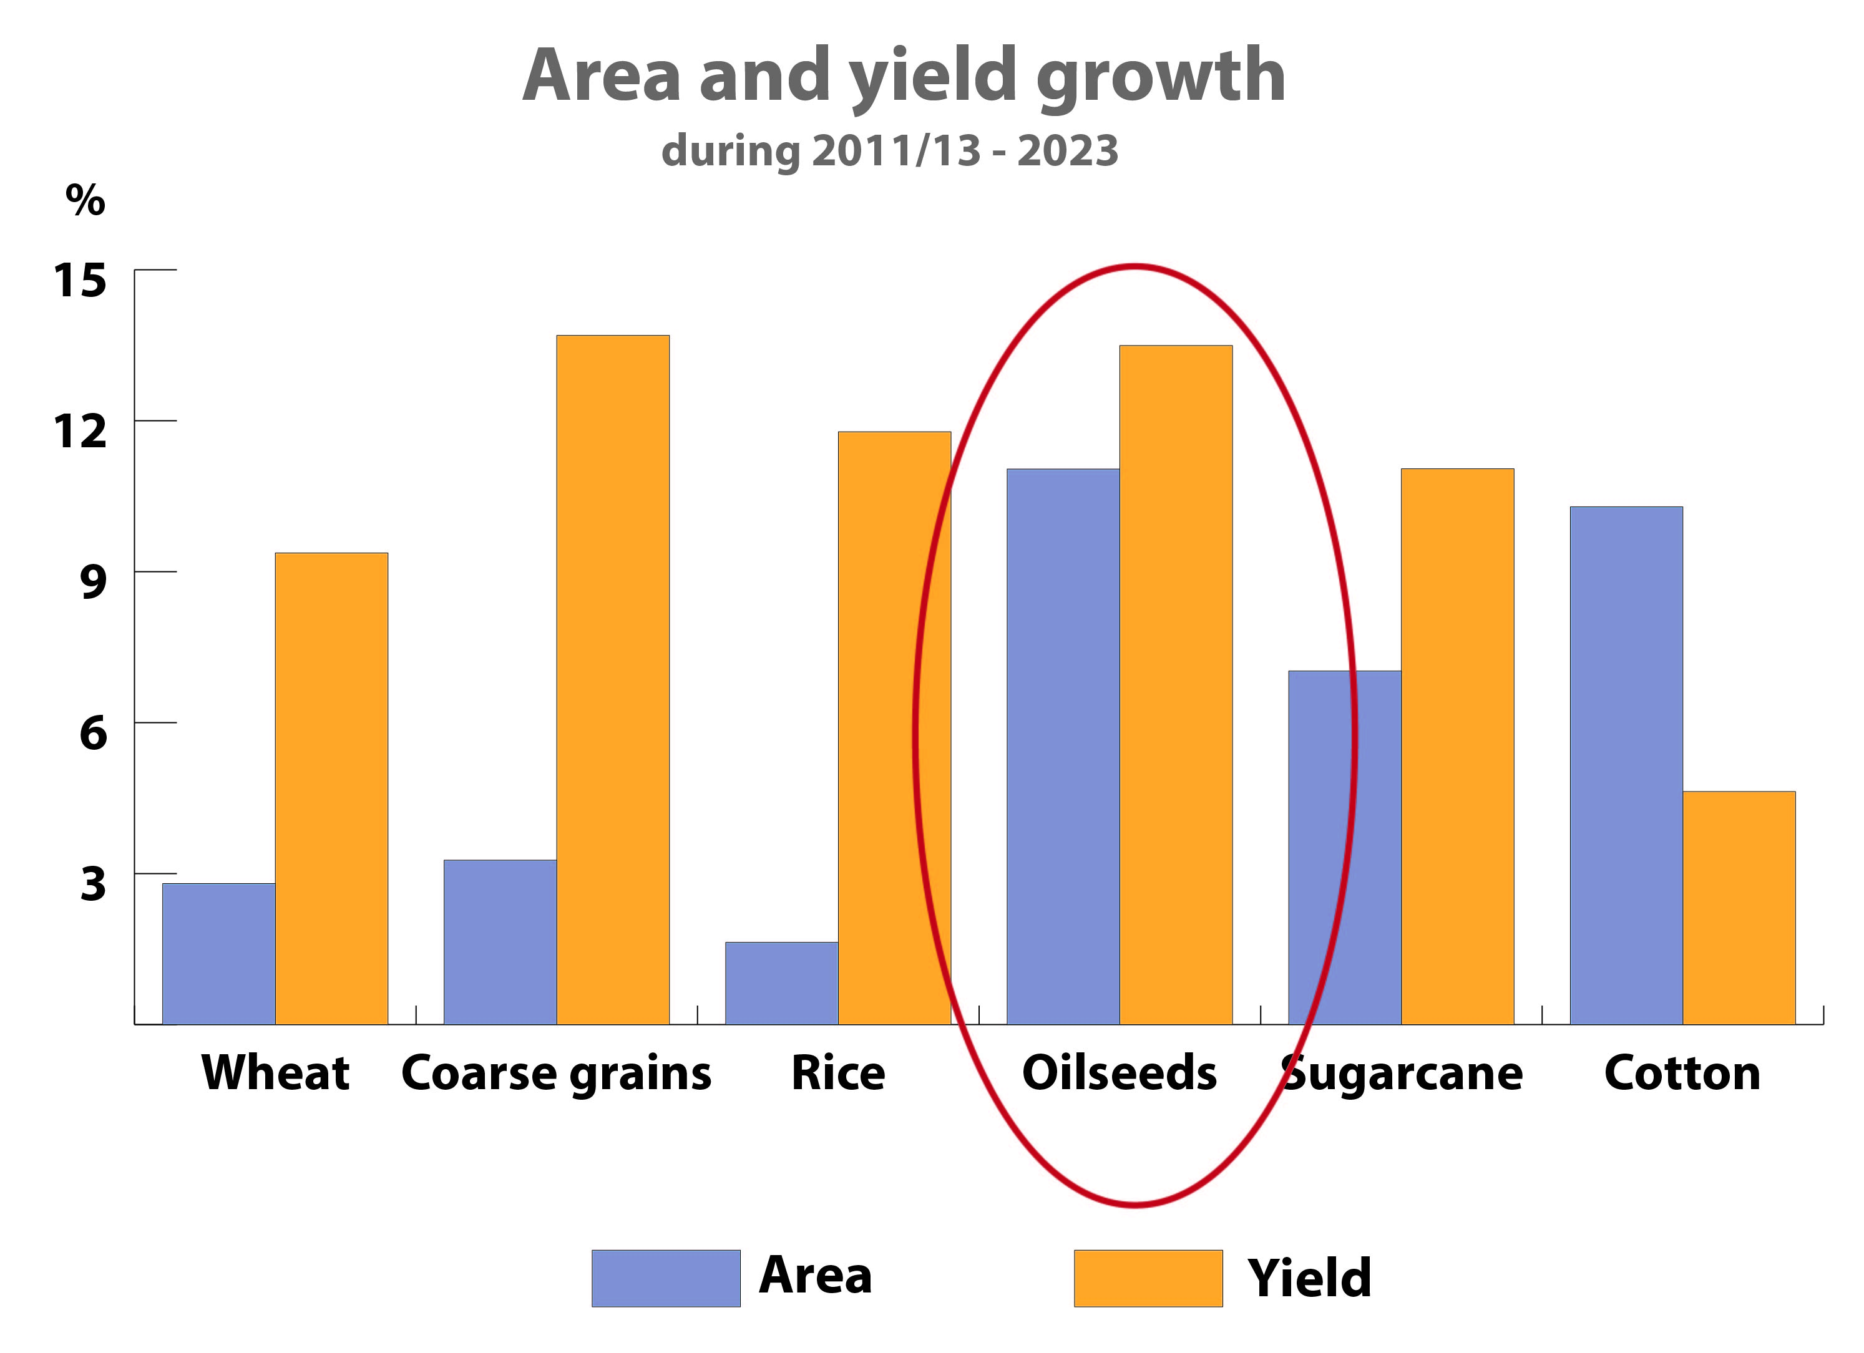
7
The oilseed complex
oilseed industry remains a
fast rising sector
Global oilseed production:
production growing as a result
of both larger area and yield improvements
Notes:
Oilseed industry remains a fast-rising sector – outpacing all other sectors in relative terms! (see percentage figures in red print)
Oilseeds production (soya+rape+sun+groundnut+cottonseed)
total production: up 26% (2023 over 2011-13) – on sustained demand for oilseed products
pdct expansion comes from a combination of higher area (11%) and improved yields (14%) (NB: for cereals – wheat, coarse grains, rice – pdct growth will be mostly yield-based)
area cutlivated:
global oilseed area up in part because in some oilseed-growing regions additional land is still available: see Latin America, Eastern Europe; in the remaining regions, allocation of limited land among different crops is driven by market conditions and the relative profitability of crops
model does not reveal how displacement of other crops and land conversion contribute to the overall increase in plantings
share of oilseeds in total area sown with main commodities expected to increase by 1 percent (from 19.6% to 20.6%) – marking a slowdown compared to last decade
especially in the past two seasons, oilseeds took away land from maize → maize requires larger amounts of increasingly costly fertilizer and energy than oilseeds, which has led to cost advantages for soybeans
the ease of substitution of land between maize and soybeans concerns in particular the US, but also Brazil and South America
additional land shifts in favour of soybeans are confirmed for the current season (2014/15) → as prices for maize have dropped relatively more than those for soybeans

Slide 8
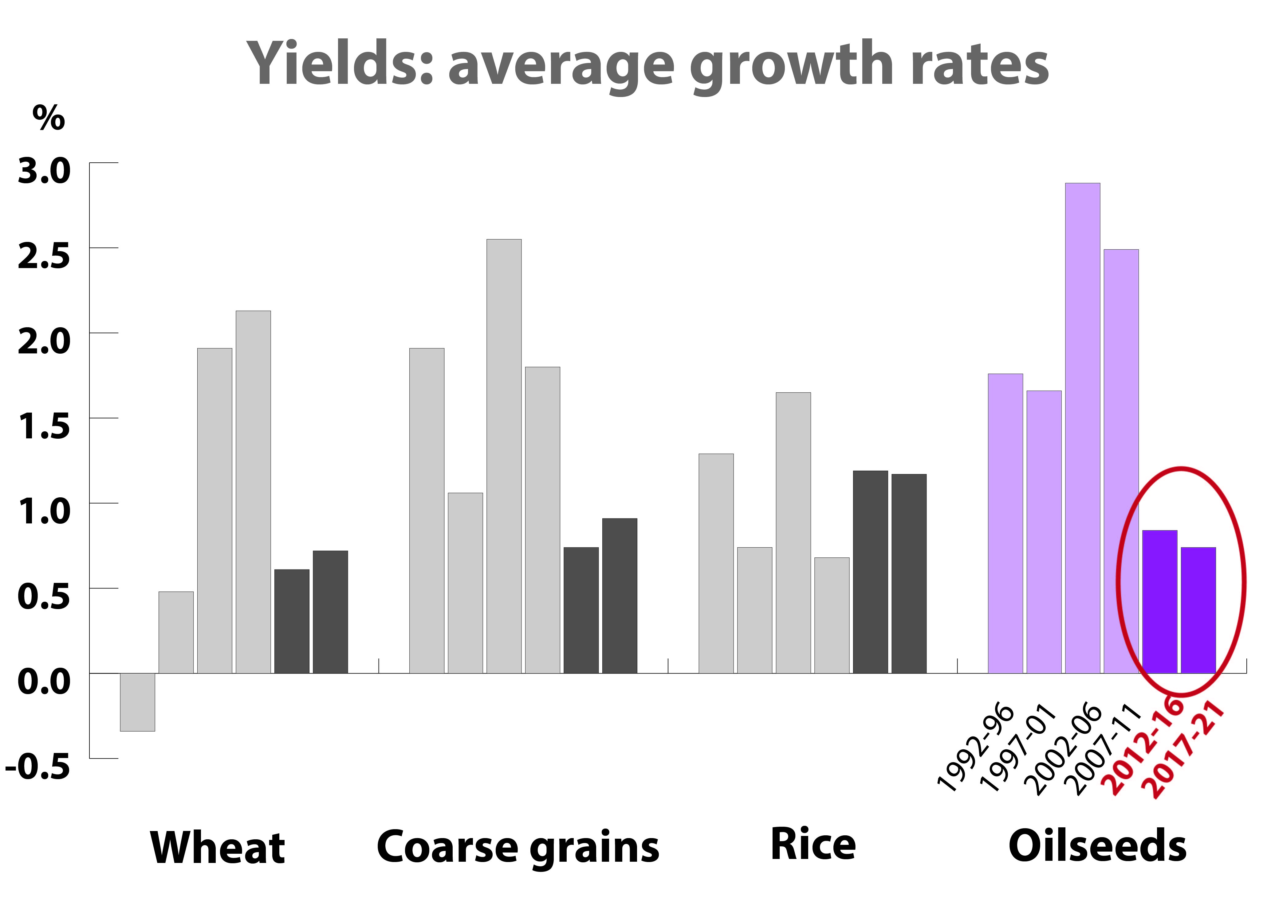
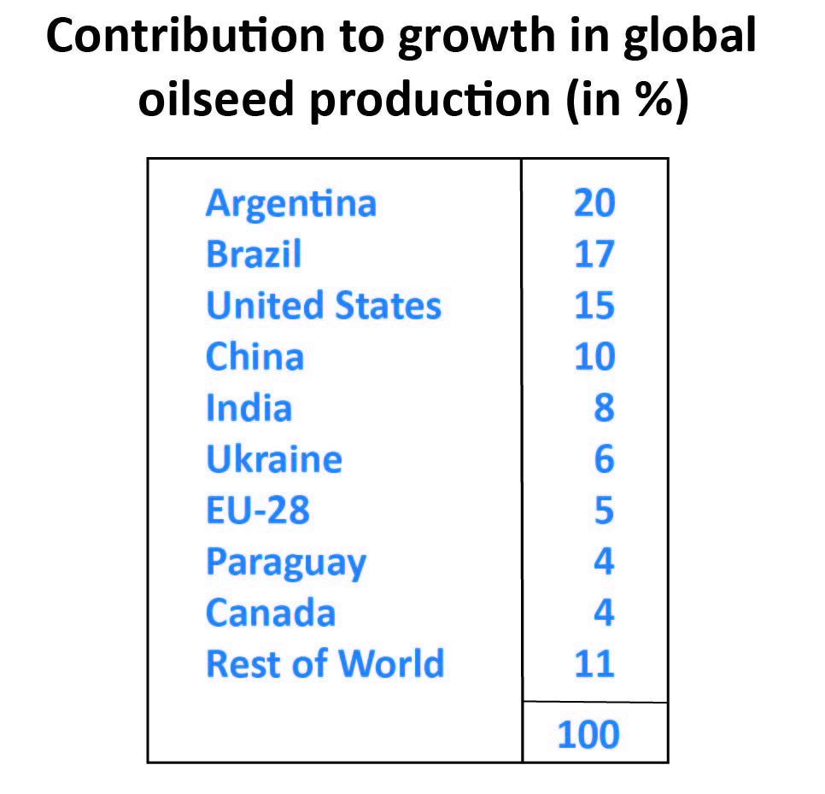
yield improvements are
expected to flatten
countries leading the expansion in global
production: Argentina, Brazil, US and
China … concerning primarily soybeans
8
Notes:
yield levels:
in general, there has been a distinct slowdown (flattening) in yield growth rates in recent decades – in both developed and developing countries
projection results suggest that the decrease in yield growth will continue in the coming decade, most noticeably for oilseeds and wheat
drivers behind the deceleration: (i) rising costs of pdct (esp. higher prices for energy inputs, labour); and (ii) resource constraints (land degradation, water scarcity, increasing environmental pressure)
production:
centers of expansion: Argentina, Brazil and US
main crop concerned: soybeans

Slide 9
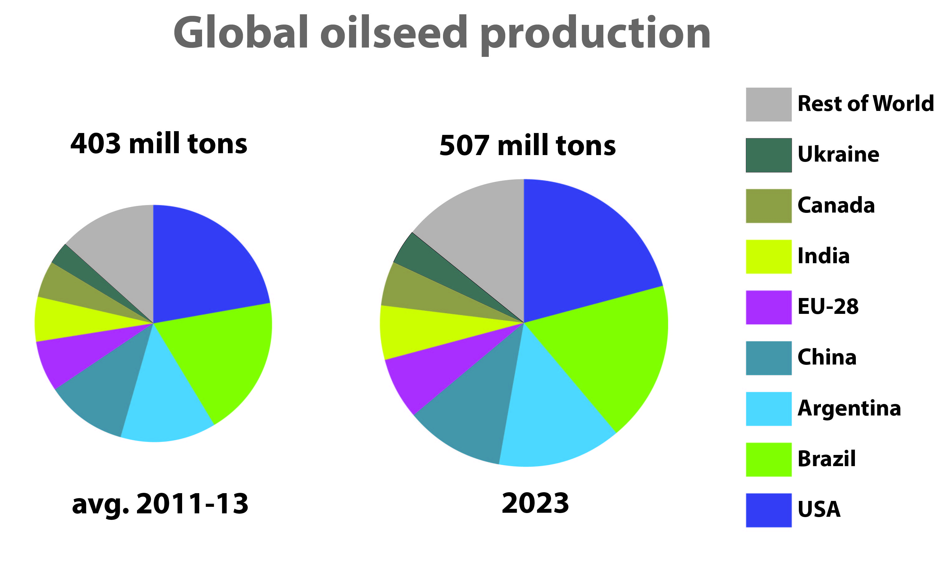
- no major changes in global pattern of production
- dominant position of US, Brazil, Arg. And China to continue
- share of Latin American producers to somewhat increase
9
Notes:
global production pattern
no major changes compared to base period
US, Brazil, Arg. and China will continue to dominate global production; together they will account for almost 2/3 of global output
the share of LatAm (Arg+Bra+Par+Uru) will increase further: from 34% to 36% … whereas the US-share could fall slightly to 21%, though the country is set to remain the world’s single largest producer
Ukr share set to rise (from 3% to 4%)

Slide 10
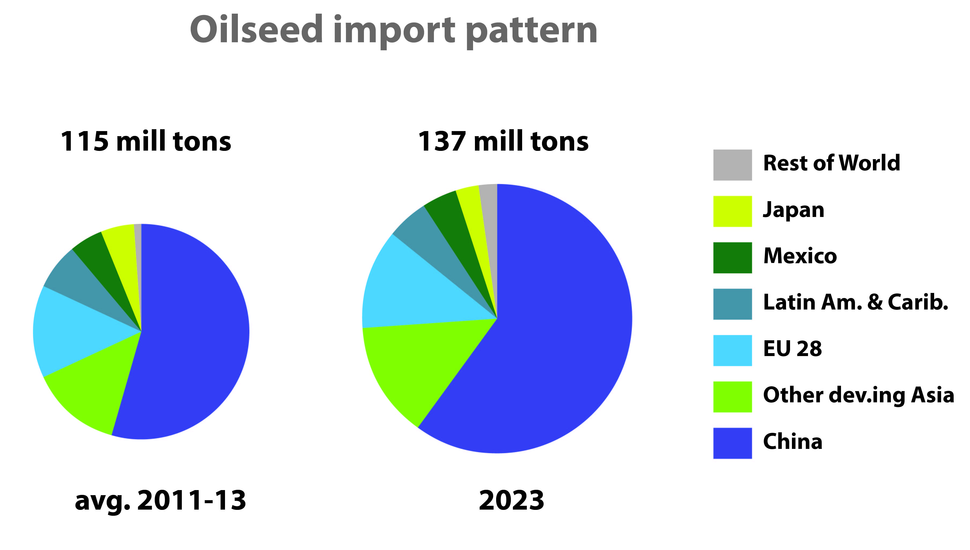
Trade in oilseeds
- overall trade expansion to slow down markedly, mainly reflecting reduced
growth in China’s imports
- still, China’s import market share is expected to climb to 60%
- market concentration to prevail
10
Notes:
Oilseeds trade
global trade up 19%; but avg. annual growth rate to slow down strongly (1% vs. formerly 6%); the slowdown in part reflects slower expansion in crush in some importing countries
imports:
slowdown stems mainly from China, the world’s leading importer: annual growth expected to drop below 2%
imports by EU (second largest buyer) projected to remain stable - as increased crush demand should be met primarily by rising domestic oilseed production
market shares: China’s share to climb to 60% (was 55%); other dvlpg Asia to remain unchanged at 14%; EU share falling to 12% (was 14%)

Slide 11
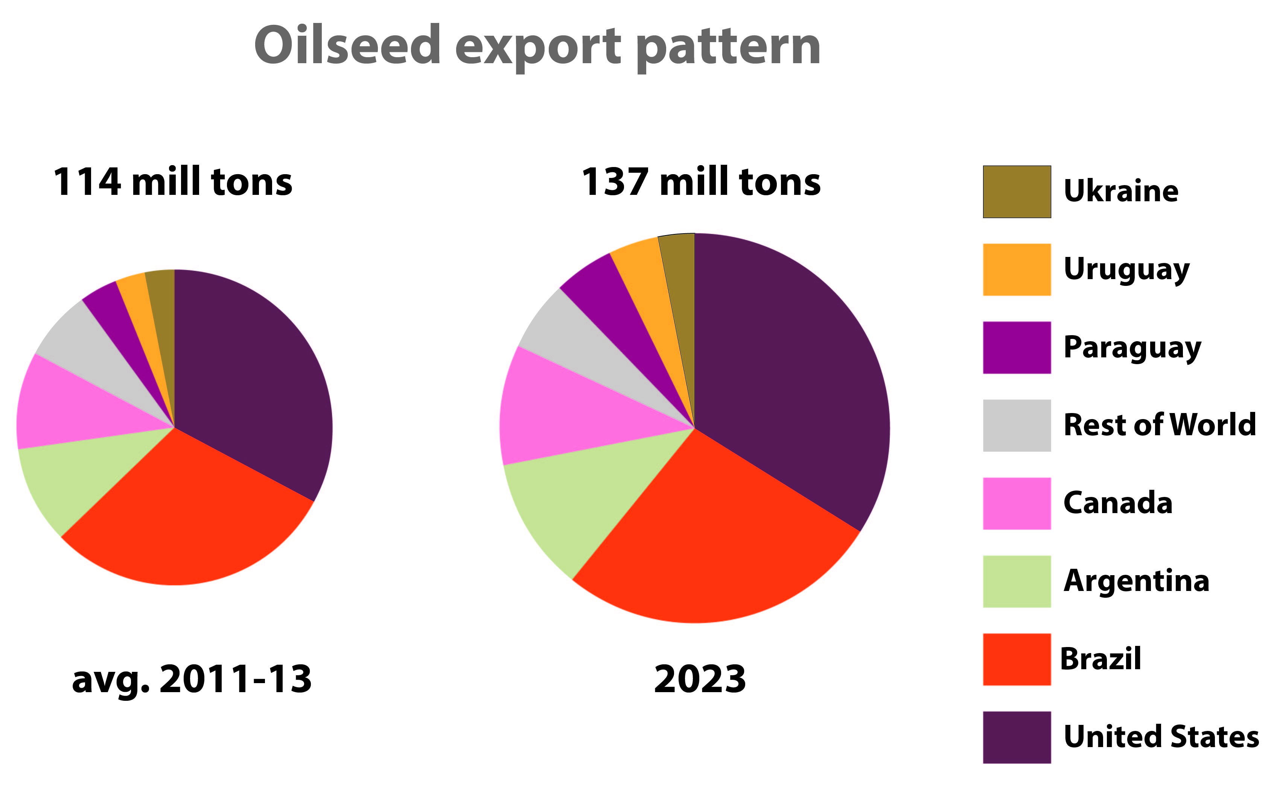
Export market:
- export expansion driven by US, Argentina and China
- Brazil: reduced growth as preference is given to oilmeal exports
- global export market remains highly concentrated
11
Notes:
exports:
sales by dvlpd country group to grow slightly more (in abs. terms) than in dvlpg group
outlook for the four main exporters: in US, Arg., Canada, export volumes to grow by about 21-22% in each case; Brazil, by contrast, only 8% up → due to rel. high level in the base year and to the anticipated further increase in domestic crush … i.e. preference is given to exports of meal
rapid growth expected in Paraguay, Uruguay and Ukraine: joint market share is seen rising to 12%
Overall, the global export market should remain highly concentrated: joint share of US+Canada+Brazil+Arg to reach 82% in 2023

Slide 12
Oilseed crush
- expansion in global crush to slow down
China: marked slowdown in domestic crush expansion
Argentina, Brazil and Ukraine to climb up in the ranking
12
Notes:
Oilseed crush
global crush will be driven by demand for oilseed products, especially veg. oils (although it needs to be kept in mind that meal and oil are produced in fixed proportions …); veg. oil demand for both food and fuel keeps rising, based on, respectively, population/income growth and biofuel consumption mandates
global crush expected to approach 450 mill t, up 27% from base; such increase translates into avg. annual growth of 2% – compared to 3.5% last decade
global pattern and key players:
distribution of crush around the world continues to be determined by, inter alia: transportation costs, trade policies, GMO acceptance, processing costs, and avaiable infrastructure
China (world’s largest crusher): marked slowdown in domestic crush expansion (from 7% to 2% per year)
significant slowdown also in most other countries; except for slight acceleration in US, Argentina, India
country ranking (crush volume): Argentina and Brazil are set to surpass the EU; Ukraine is expected to surpass the Russian Federation

Slide 13
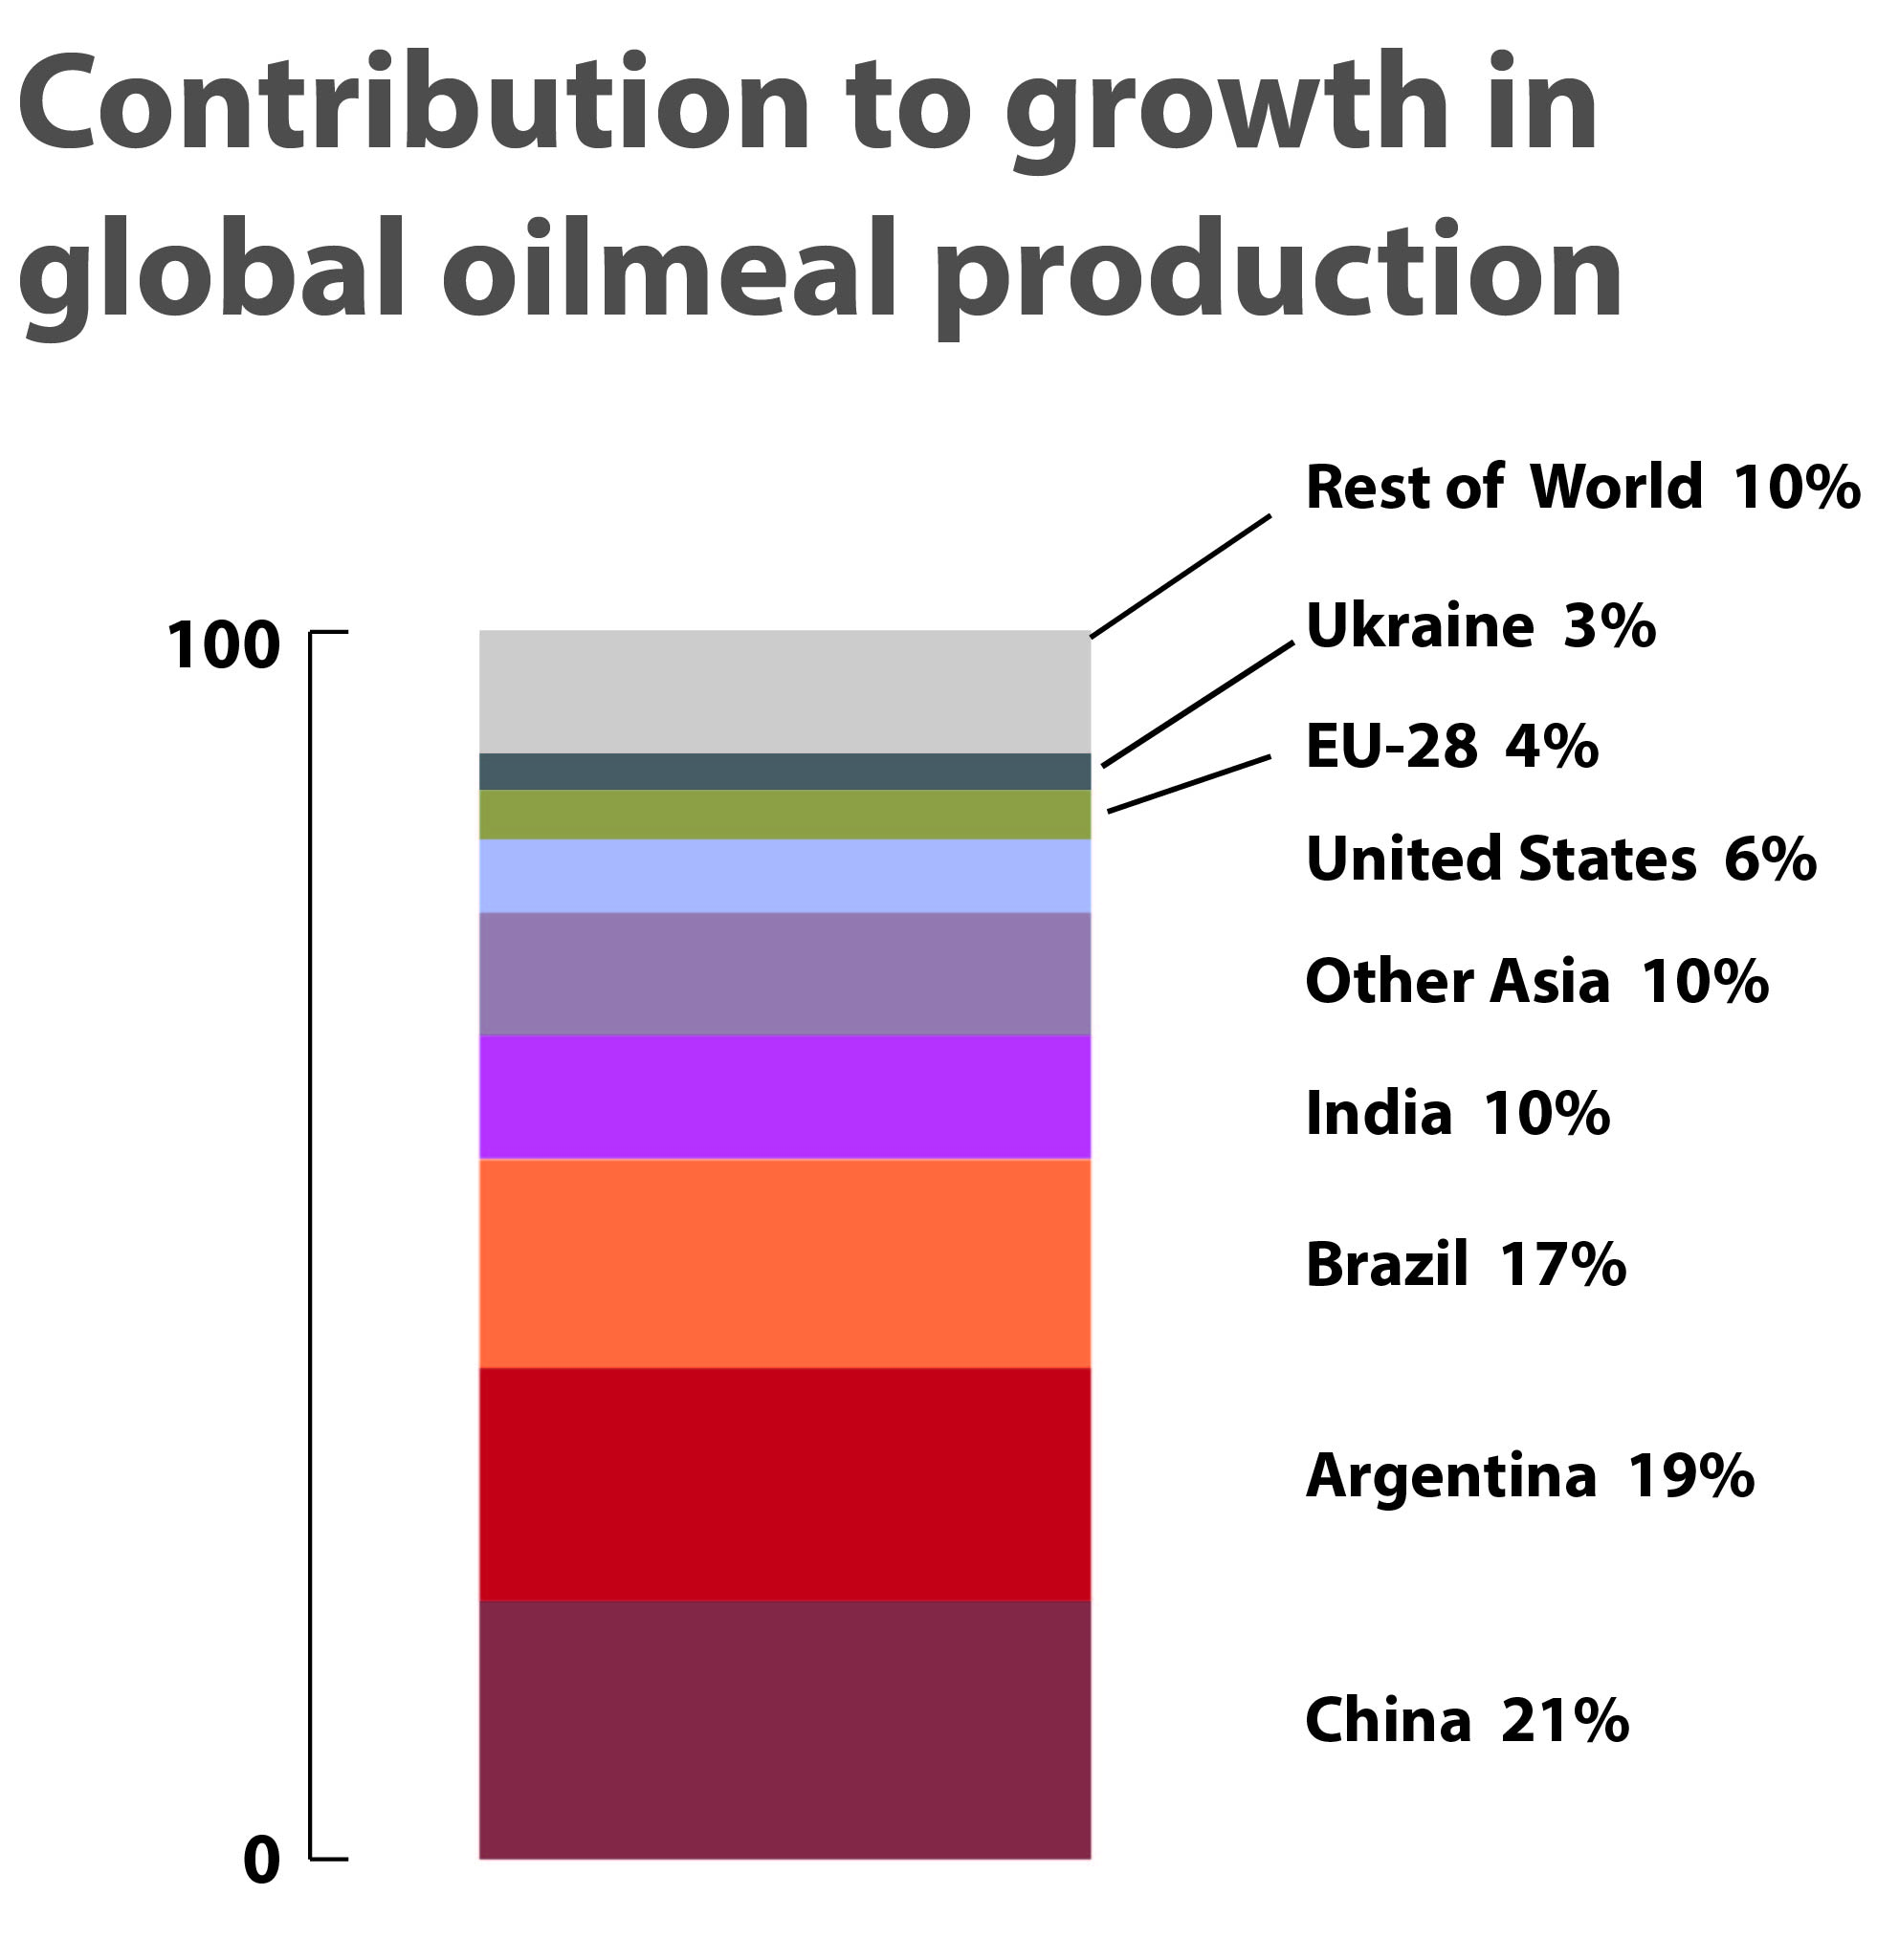
Oilmeal production
global oilmeal output to expand further, though at a lower pace
level of concentration remains high: six nations account for
3/4 of total production
growth driven by dvlpg countries,
notably: China, Argentina,
India and Brazil
13
Notes:
Oilmeal output (soy+rape+sun+copra+palmkernel)
global output to climb to almost 351 mmt, a 27% rise from base
but growth to slow down compared to previous decade: annual avg. growth rate of 2% – compared to 3.2% last decade
global meal pdct remains highly concentrated: just six producers – China, US, Arg, Bra, EU, India – are expected to account for 77% of global output
sources of growth (see diagramme):
growth largely driven by dvlpg countries and concentrated in only 4 nations: China, Argentina, Brazil, India – which, together, should account for two thirds of additional global output
dvlpd world – which includes some large producers – only accounts for 15% of global expansion
individual producers:
China (top producer): output to expand 22% – considerably less than during last decade; China share in global output should stabilize around 25%
in the rest of Asia, sizeable expansion appears likely also in India, Indonesia, Pakistan
US and EU will contribute only modestly to global production growth; but they will retain their position in the overall ranking of producers – as no. 2 and no. 5
in China and EU, oilmeal production will continue to rely on both domestically grown and imported oilseeds (in China 72% of pdct is expected to originate from imported material); other main producers rely almost entirely on domestically grown oilseeds

Slide 14
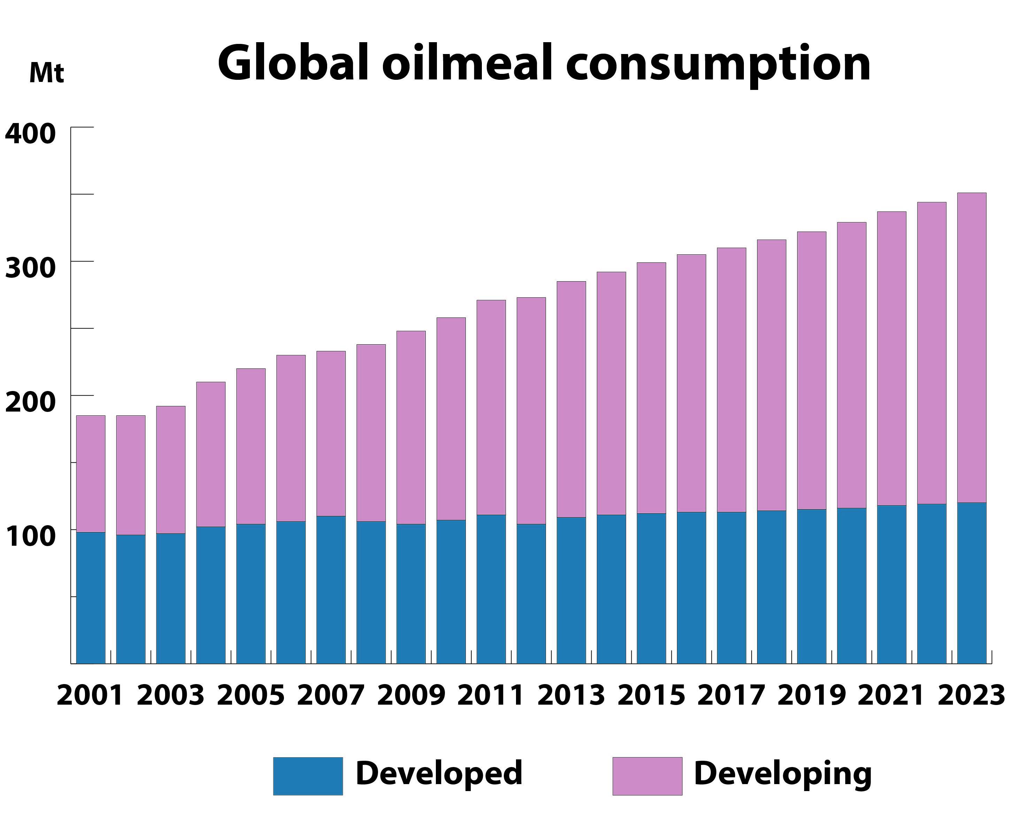
Oilmeal utilization
consumption growth dominated
by developing countries
• growth driver: rising demand from non-ruminant and
milk sectors ← structural change
• but annual growth in global consumption is expected to
slow down ← efficiency gains
14
Notes:
Oilmeal consumption
right hand diagramme: global cspt up by 27% over the outlook period
centers of growth:
dvplg. world – lead by China and other dvlpg countries in Asia – account for much of the increase in total use (84%) ← this is because, as shown before, in most dvlpg countries, meat consumption keeps expanding
dvlpd world only accounts for 15% of global consumption increase
in general, cspt growth is driven by further expansion in demand for non-ruminant meat and milk; in these sectors: greater incorporation rate of oilmeals in feed rations [i.e. more feed per animal – structural change]; this situation applies to most developing countries
however, global cspt growth should slow down compared to previous decade; explanations:
slower growth in global livestock production (incl. in the non-ruminant sector)
slowdown in the inclusion of oilmeals in feed rations - as optimum oilmeal incorporation levels will be approached in commercial farms [i.e. more meat per feed – efficiency gains]; this situation applies to many dvlpd countries, but possibly also to some dvlpg nations, e.g. Brazil, Mexico and some others

Slide 15
Global consumption pattern broadly unchanged
dvlpg countries: expansion
expected to slow down
dvlpd countries: continued
weak growth
15
Notes:
global cspt. pattern and individual countries:
no major changes in overall pattern: China and EU remain the leading oilmeal consumers, followed by US, Brazil and India; meanwhile, China, other countries in Asia and Brazil are expected to gain weight, while the EU and the US should lose some weight
key dvlpg countries (see table, central column): significant expansion – in volume terms – likely in several important consumers: China, Brazil, India, Indonesia; fast growth also in a number of LDC countries (though rel. small in abs. terms); however, in all cases, slowdowns compared to past decade
among dvlpd countries (see table, columns on the right): slow growth of the past to continue – as the penetration rate of oilmeals in feed rations remains stable due to mature livestock industries
EU: only minimal growth in domestic consumption
US: oilmeal cspt to resume growing after last decade’s contraction (caused by rising availability of DDGs, a by-product of ethanol pdct); as the ccountry is approaching the ethanol ‘blend wall’, domestic availability of DDG should eventually stabilize … thus allowing oilmeal demand to grow again
Russian Federation and Ukraine: further expansion in domestic consumption, though at considerably lower rates than last decade; in the region, the amount of oilmeals incorporated in feed rations remains well below that of other developed countries
Japan: negative growth, i.e. domestic consumption could fall in absolute terms

Slide 16
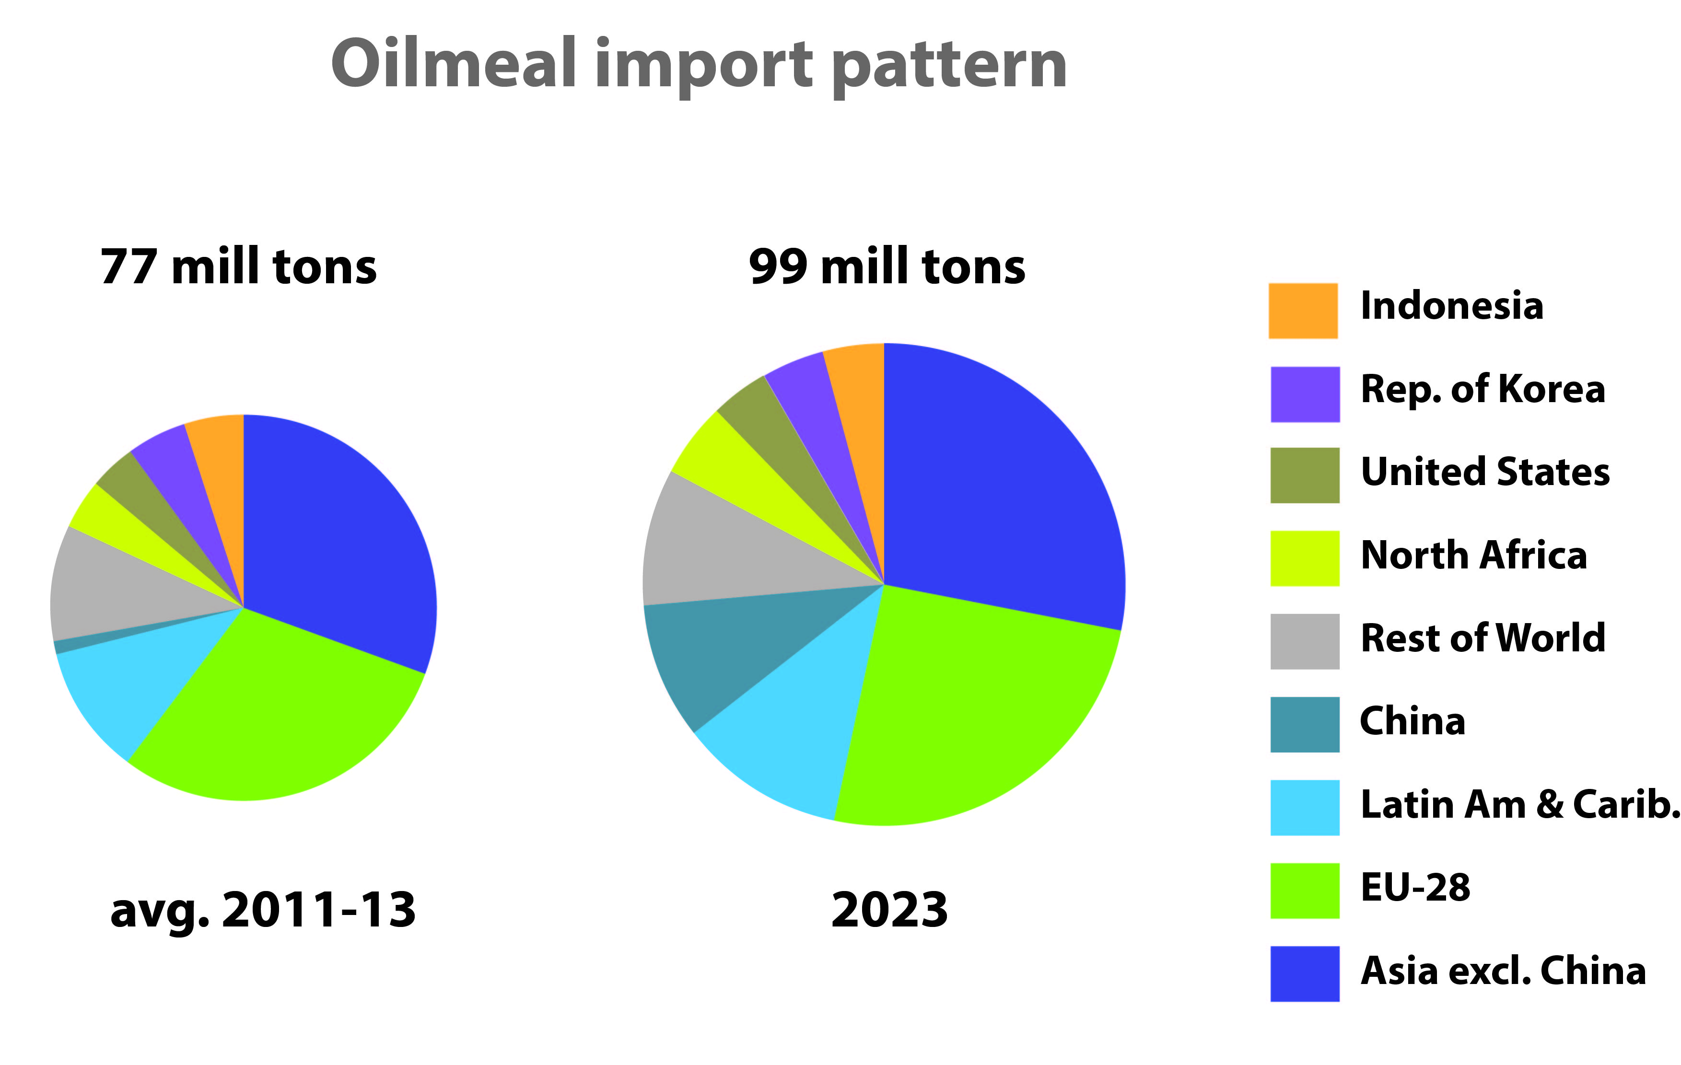
Trade in oilmeals
Global trade expansion to slow down
Imports: - growth dominated by developing world
- China to become a major player
- EU import requirements about unchanged
16
Notes:
global trade up by 22 mill t, or 28%; annual growth somewhat lower than last decade: 2% vs. 3%
Imports:
Asia and the EU set to remain the main importing regions
90% of global import growth to occur in dvlpg countries; dvlpd world only minimal import growth expected
China: domestically produced oilmeal could be increasingly insufficient to meet demand; annual import requirement could swell to as much as 9.3 mmt (from 1.1 mmt in base); this, if confirmed, would push up China’s market share from currently 1% to 9%
other importers in Asia: aggregate purchases up by 7.5 mmt or approx. 3% per year; also in North Africa and LatAm countries, annual growth rates around 3%
EU: trade deficit should remain about the same as in base; this is because growing domestic oilseed production [ … to produce the oil that is required for mandatory biodiesel production!] would also increase the domestic supply of oilmeals; the EU’s market share will fall to 28% (was 31%)
Japan: import requirement should not change significantly

Slide 17
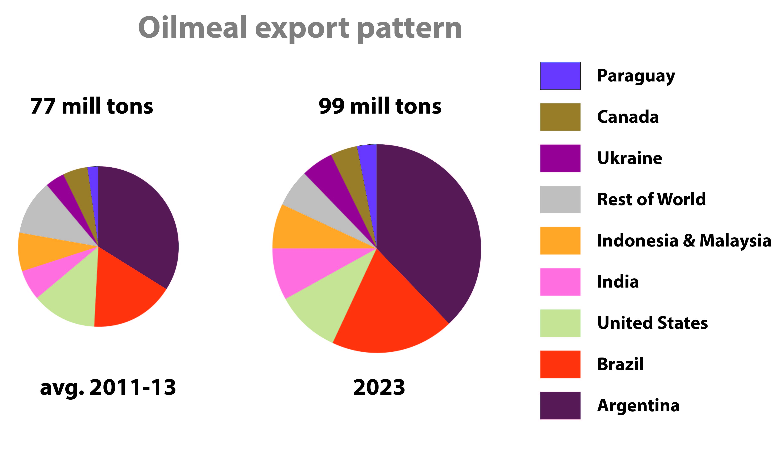
Exports:
- Argentina, Brazil and India to increase their sales
- US and Canada: only modest expansion
- dominance of South + North America to continue
17
Notes:
Exports:
Argentina to remain by far the largest oilmeal exporter; market share should rise from 34% to 38%; (it is the only country among the large oilmeal producers with a very small domestic consumption base)
Brazil: could achieve a marked rise in annual exports - up 38% ← steady expansion in domestic crushing will generate a greater surplus of oilmeals; the country’s market share should rise accordingly
US & Canada: only modest expansion in shipments; and falling market shares
together, producers in LatAm and North America will account for 74% of global oilmeal exports
in Asia: India is likely to expand its sales further (close to 7.5 mmt per year), whereas, in Indonesia and Malaysia, sales should remain virtually unchanged

Slide 18
18
Fishmeal
Production
- global production up 6% compared to base
- expansion driven by developing countries
- meal composition and quality may change
Utilization
- demand tends to outpace supply
- developing countries dominate consumption
- less fishmeal in farmed fish diets (as well as livestock feed)
Trade
- global trade virtually unchanged
- developing countries dominate trade
- import/export patterns about unchanged
Notes:
Fishmeal production:
global pdct to increase modestly: up about 6% from base
dvlpg countries drive pdct growth (up 7-8%); pdct in dvlpd group increases by less than 2%
on-going structural changes in production might affect the use of fishmeal: fishmeal is produced from whole fish caught in the wild or fish cut-offs and other fish by-products; now, as the importance of whole fish is expected to weaken while that of fish cut-offs will increase, the composition and quality of the resulting fishmeal is likely to be affected (… less protein, more ash/minerals, increased levels of small amino-acids), which could affect the use of fishmeal in fish/livestock farming
Fishmeal utilization:
generally, demand tends to outpace supply; global utilization is projected to rise by 7%
dvlpd countries: consumption to drop by 22%, whereas dvlpg country cspt is set to increase by 23%
as a result, share of dvlpg countries in global use climbing to 75%
inclusion rate of fishmeal in compound feed could fall further in both aquaculture and in the livestock industry ← due to (i) high prices, and (ii) innovation efforts (especially in aquaculture) to replace fishmeal with more affordable, equally balanced non-fish ingredients
however, fishmeal remains preferred feed in farming of certain fish species as well as in specific stages of piglet production
Fishmeal trade:
fishmeal trade projected to remain about unchanged; only 2% up by 2023
dvlpg countries – led by Asia – remain both the main exporters and importers of fishmeal
importers: China’s share in global fishmeal imports could fall somewhat (35% vs. 38%) as high international prices are expected to stimulate local fishmeal pdct to satisfy needs of China’s aquaculture/livestock industry
exporters: Peru and Chile to remain the world’s leading suppliers of fishmeal; however, their combined share in total exports might decrease from 52% to 46%

Slide 19
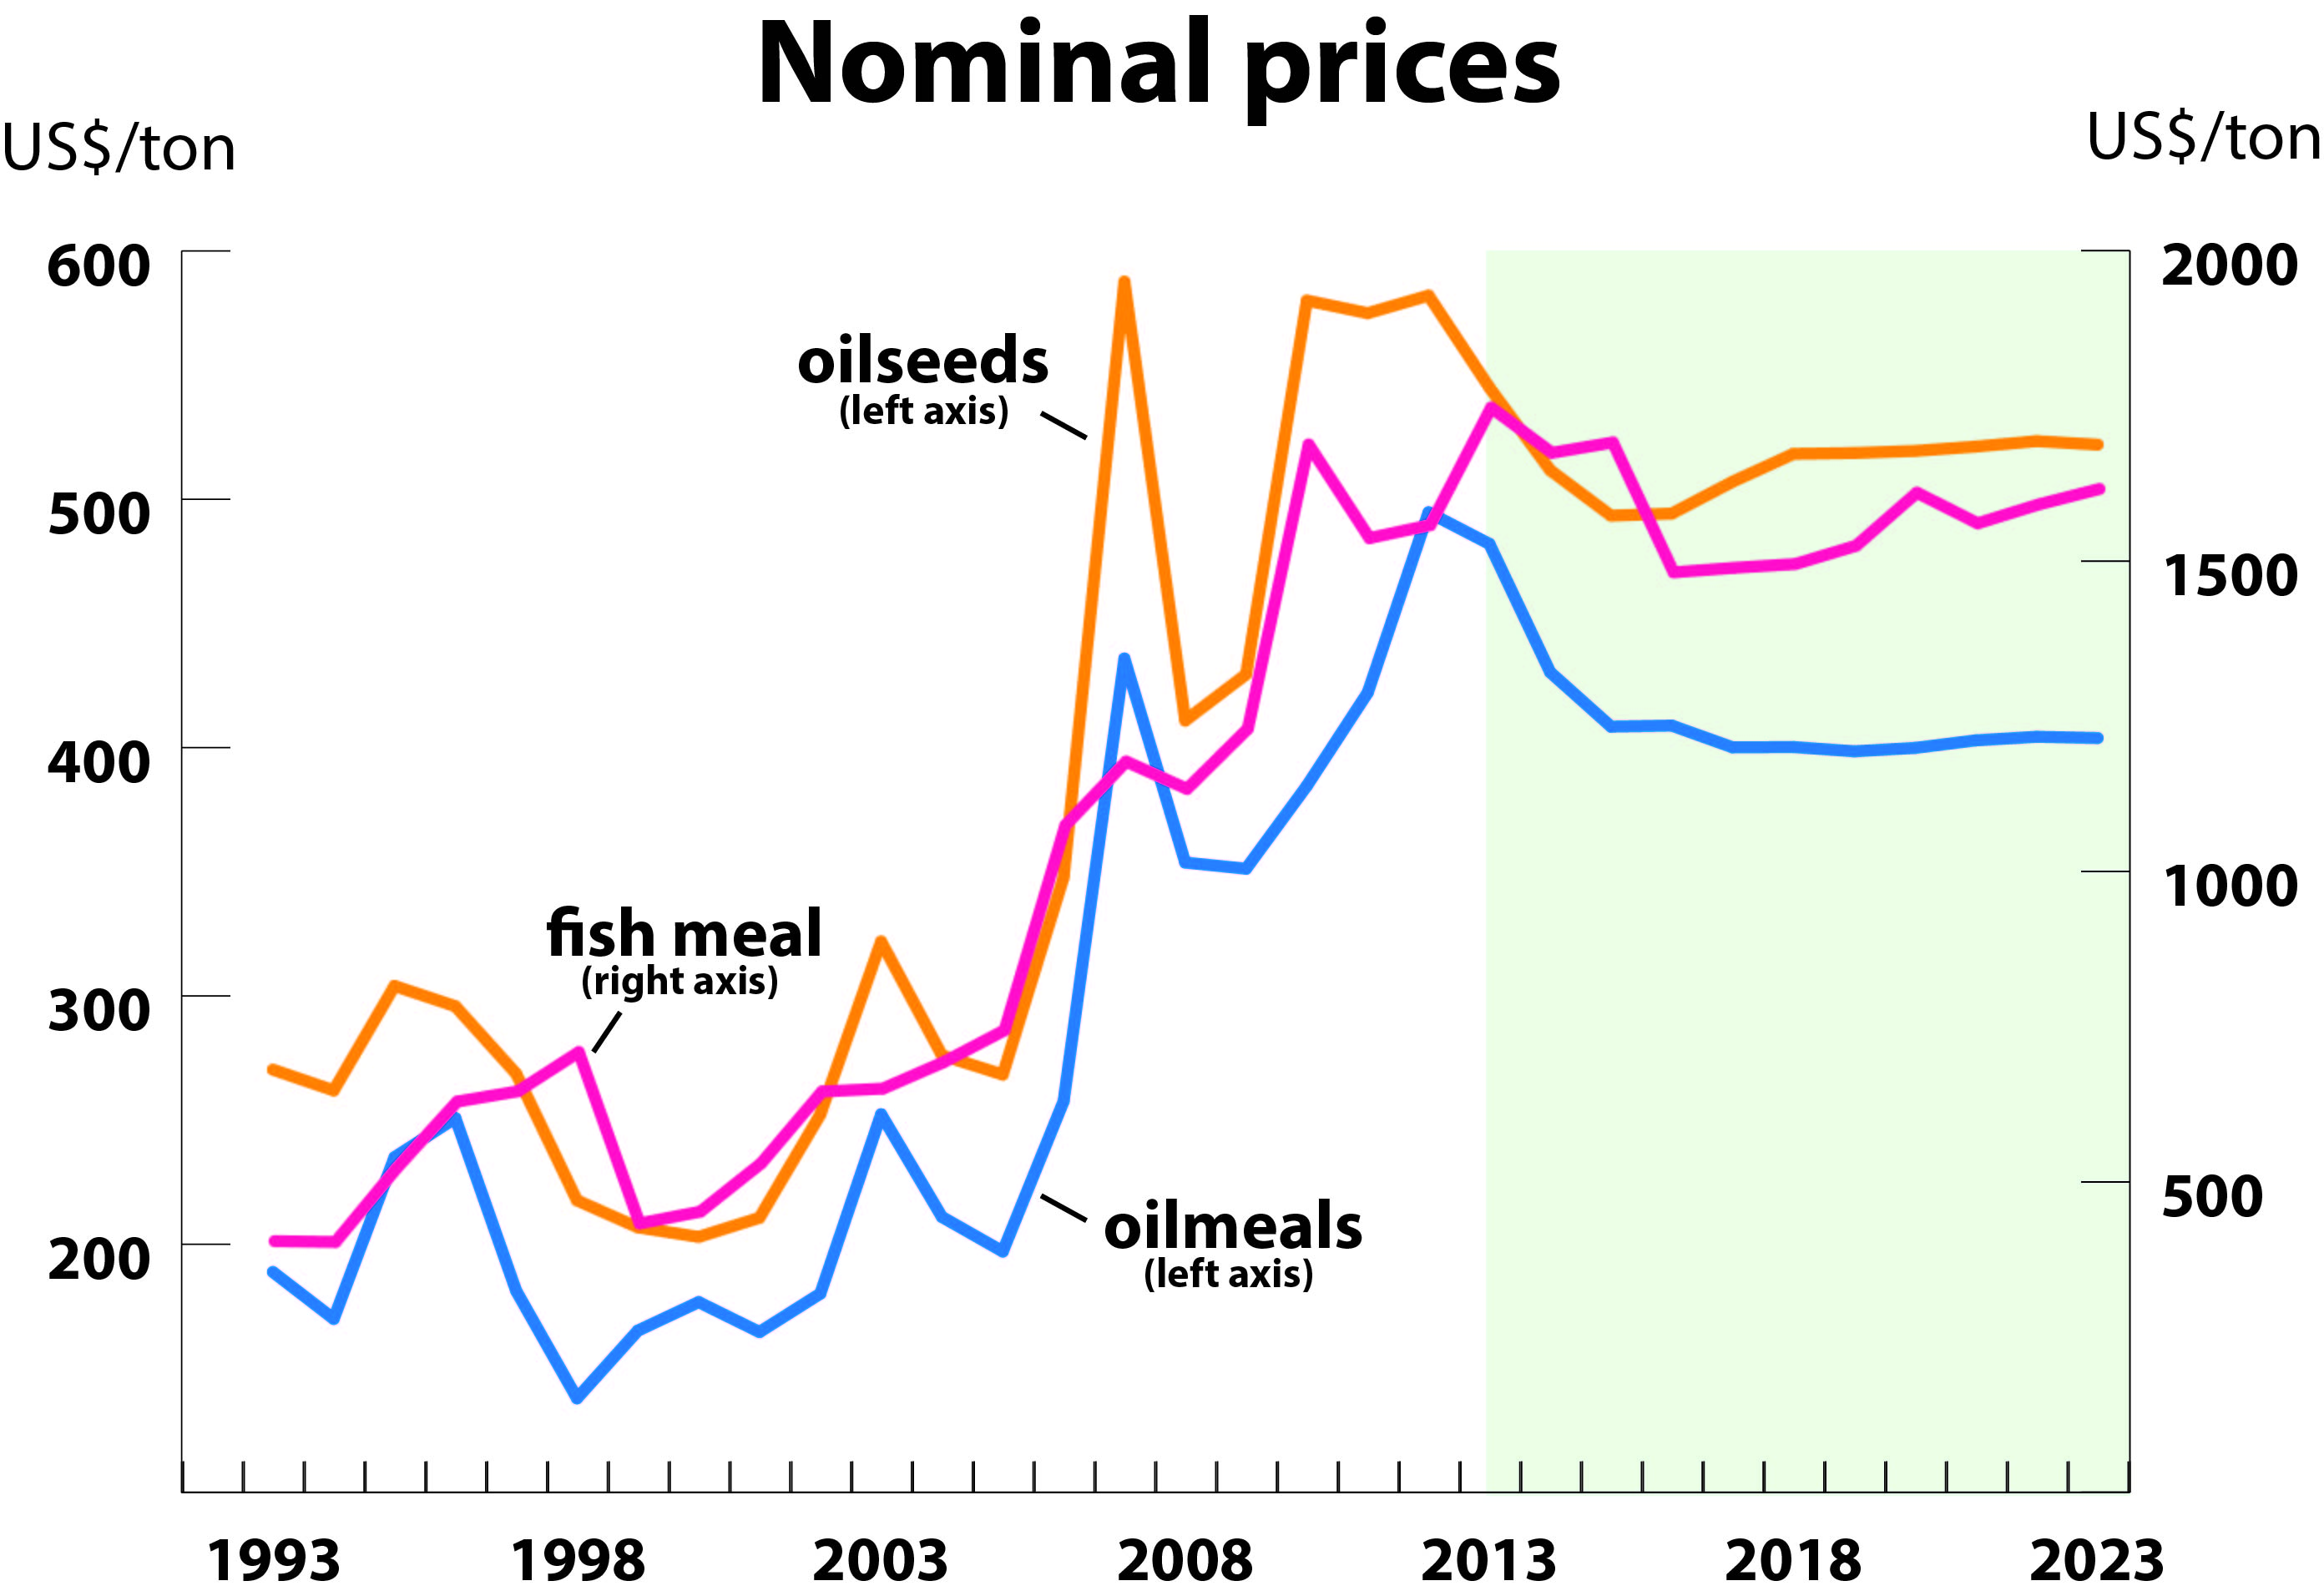
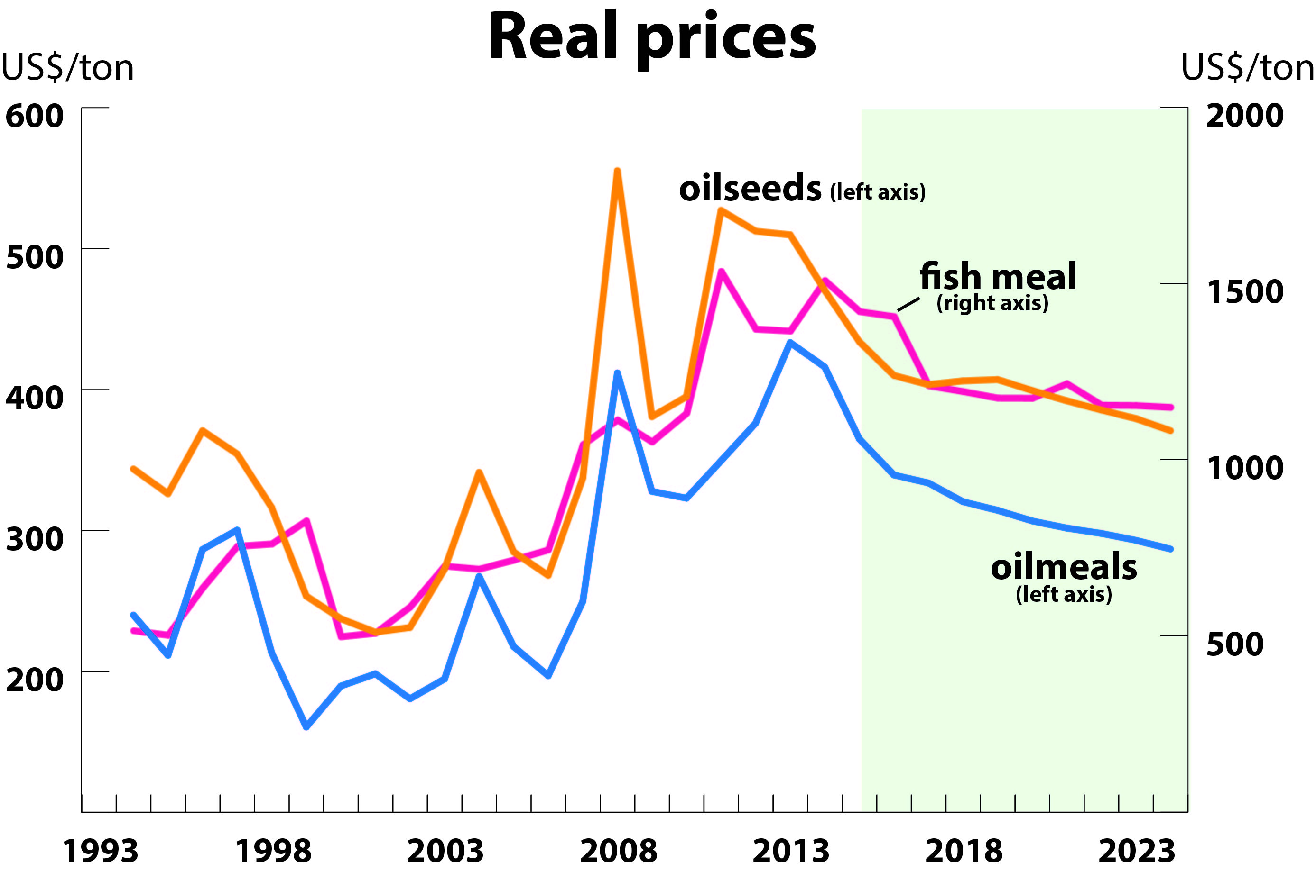
Price outlook
Oilseed complex:
after initial price corrections …
slow recovery in oilseed and
veg.oil values
oilmeal prices stabilizing –
on a higher plateau
Fishmeal:
following further downward
corrections, prices expected
to appreciate again
In real terms, all prices should ease
… compared to the recent historical record
19
Notes:
Oilseed complex:
recent development (2013): price relaxation in both oilseeds & products (as well as coarse grains) due to surplus market conditions
in 2013 (← production soared to record levels in response to preceding price peaks; absence of climate incidents)
outlook period:
2014-2016: further downward corrections in nominal prices
2017-2023:
slow recovery in oilseed prices ← supported by rising demand for veg. oils for both food and fuel
stabilization in oilmeal prices: meal prices to remain flat as supplies will likely be ample relative to demand ← meal supplies are poised to follow the expansion in global veg.oil production, given the joint product nature
meal prices to stabilize at historically high level: new price plateau would be some 50% above the level of 10 years ago ← (i) solid demand for protein meals as meat production keeps rising; (ii) support in part by firm fishmeal prices; and (iii) continued restrictions on the use of animal-derived meals (MBMs) in several countries
in real terms, prices for all products (seed, oil, meal) are expected to weaken – compared to the recent historical records
Fishmeal:
after initial downward corrections, nominal prices should appreciate again ← (i) rising production costs; (ii) strong demand, especially for aquaculture products; (iii) limited production growth in capture fisheries due to fishing quotas
prices to ease in real terms, but still ranging at a very high level compared to the mid 2000s

Slide 20
Limitations & uncertainties
general limitations
land projections
yield projections
oilmeal use in feed rations
general unknowns: weather, macro-economy
logistic issues
market concentration
supply response of emerging players
policy interventions:
  biofuel
  animal-based meals
  environmental regulations
  ad hoc / temporary measures
20
Notes:
General limitations: commodity coverage is not complete: projections refer to broad commodity aggregates; the model contains important simplifications and we face numerous constraints in disaggregating our results; there is only so much the projections can explain; where results are not convincing we can only: (i) increase the detail and accuracy of the underlying equations; (ii) carry out sensitivity or stochastic analyses; or (iii) modify the assumptions and run alternative scenarios and simulations
Land projections: multiple economic and agronomic factors are at play, and price relationship between competing commodities influence land allocation; furthermore, increasing marginal costs of converting pasture and forest land in to arable land influence the overall available land base; these complex processes are very difficult to capture in a model
Yield projections: the slowdown in yield growth rates is expected to continue in the majority of large producing countries and for several key crops; however, interpreting aggregate figures and averages remains problematic as land expansion to more marginal land and production shifts to areas of lower yields are not shown separately
Oilmeal use in feed rations: it remains difficult to adequately capture (i) the growth in compound feed use in dvlpg countries [i.e. structural change], and (ii) the optimization of feed rations in dvlpd countries [i.e. efficiency gains]; here constant adaptation of model specifications and diligent market monitoring are required
General unknowns: typical unknowns, common to most commodity sectors, include: (i) extreme weather events, and (ii) changes in the macro-economic environment … esp. crude oil prices are a good case in point (… see the recent, steep decline in crude oil quotations)
Logistical challenges: strong production and export growth in selected countries can lead to problems with infrastructure – see recent transportation bottlenecks in Brazil, Canada and US; such events can affect trade and can lead to shifts in comparative advantages
Market concentration: high levels of concentration in production and exports – like in the oilseed complex – raise the risk of market failures in case of external shocks (weather/disease problems, economic shocks)
Supply response of emerging players: the production and export potential of small, emerging players – e.g. in Eastern Europe, Central Asia, LatAm – is often difficult to assess with accuracy ← lack of reliable info on productivity levels, infrastructural constraints, national policy priorities
Policy measures:
biofuel: considerable uncertainty surrounds biofuel policies – esp. in the US, EU, but also in Indonesia, Malaysia, Brazil, Argentina (where BD sector accounts for a significant share of demand); mandatory blending could be reduced or limited (EU, US) or increased (Indonesia, Malaysia, Brazil, Argentina); uncertain future of BD tax credit in US
animal-based meals: future policies on use of processed animal-based protein feedstuffs (such as meat and bone meal) remain uncertain; bans on certain uses have been lifted in EU
environment regulations: introduction of increasingly stringent requirements can strongly affect land use, land allocation, production and trade (e.g. in the palm oil and soybean sector); effects along the commodity chain are complex and difficult to capture in a model
ad-hoc/temporary policy interventions: price volatility can be expected to remain high (with world prices projected to range above historic levels, falling stock-to-use ratios, and continued high levels of concentration in production and trade) and, as a result, ad-hoc/temporary policy interventions cannot be excluded (… notably measures to facilitate imports, creation of state reserves, pdct incentives, domestic marketing restrictions, control of export flows)

Slide 21
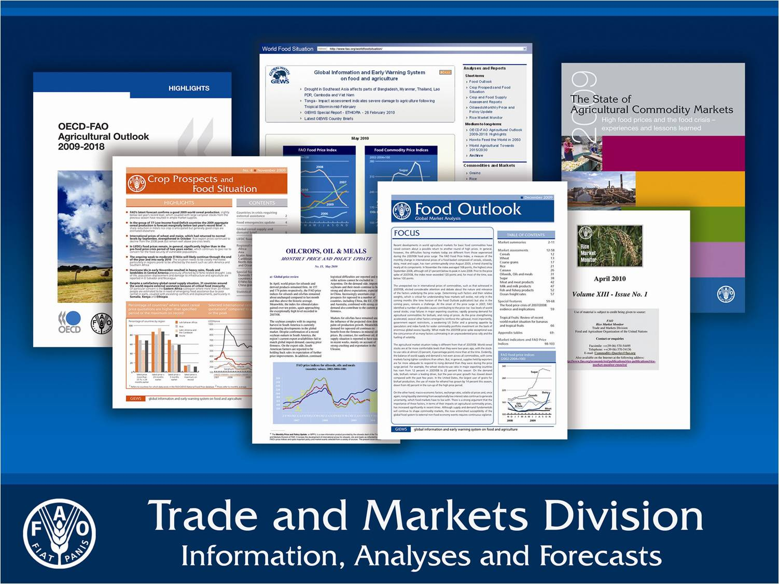
FAO Trade and Markets Division:
http://www.fao.org/economic/est/en/
Oilcrops desk:
http://www.fao.org/economic/est/est-commodities/oilcrops/en/
short-term market
assessments
monthly price and
policy updates
medium-term
projections
price statistics
field R&D projects
21

Slide 22
22
Thank you
Acknowledgements: - FAO/OECD Outlook team
- Mr. M. Milo (Research Ass.) and Ms. G. Karumathy (Economist)
OECD/FAO Outlook website: www.agri-outlook.org
@: Peter.Thoenes@fao.org
: +39 06 57053498
: Viale Terme di Caracalla, 00153 Roma, Italy

