Slide 1
Recent policy developments affecting global oilcrop markets
Peter Thoenes
Trade and Markets Division
Food and Agriculture Organization of the U.N.
---------------------------------------------------------------------------------------
XVII International Palm Oil Conference
25-28 September 2012, Cartagena, Colombia

Slide 2
Overview
  Overall setting
  Policy review
    food security measures
    sector development policies
    other policy domains
  Conclusions

Slide 3
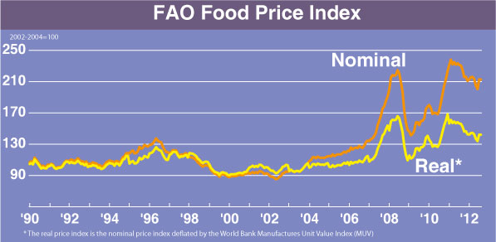
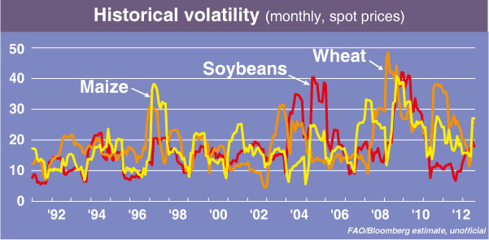
Overall market setting

Slide 4
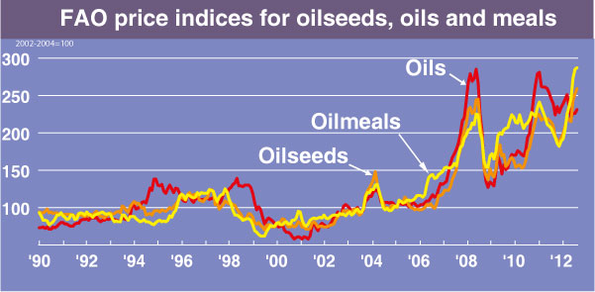
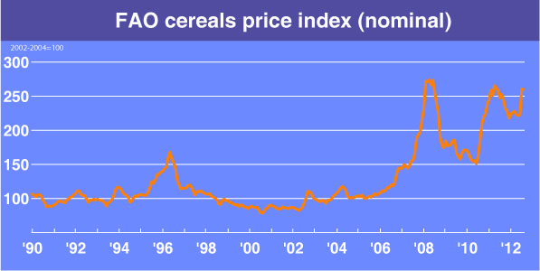
causes of the sudden, general 2007/08 price surge:
over the 1995-2005 decade,
global markets had become
increasingly vulnerable
concurrence of factors
in 2007/08

Slide 5
Policy review
  food security measures
  sector development policies
  other policy domains

Slide 6
Policy review
  food security measures
    domestic market measures
    border measures
  ad-hoc measures
  concentrated in poor, import dependant developing countries
  main intervention areas: local production, domestic markets, border measures
  objectives
    secure domestic supplies
    control food import bills
    maintain production incentives

Slide 7
domestic market measures
measures:
subsidized food distribution, tax rebates, other (mostly temp.)
social safety net schemes
food price controls, negotiated prices, price caps (mostly temp.)
other market controls, restrictions on private stocks
state reserves for public market intervention (China)
incidence:
  9 developing countries
  6 x food distribution, zero x social safety net schemes, 6 x price/market control
  public food reserves (… more lasting effect) only in one country
issues:
  reduced farmers incentives to raise output
  harmful to processors
  demanding to implement and costly
  wasteful if not well targeted
  perpetuation pressure

Slide 8
  border measures
IMPORT POLICIES
measures:
reduction/removal of tariffs
reduction in non-tariff measures
STE trade (temporary)
Gov-to-Gov trade (one-time)
incidence:
  26 countries, of which only 12 LIFDCs
  quickest and least costly means to address dom. food security problems
issues:
  governments taken unprepared
  increased international competition for limited global supplies … possibly fuelling further increases in international prices
  harming dom. producers - aggravating supply problems in the longer term
  negative economic welfare effect

Slide 9
EXPORT POLICIES
measures:
export taxation - variable/sliding schemes (specifically for domestic price stabilization)
export taxation - fix rates (but still temp)
quantitative exp restrictions, i.e. quota/bans (… most disruptive form!)
incidence:
  11 countries – incl. only 3 major exporters (Argentina, Indonesia. Malaysia)
  export taxation: 5 cases, export restrictions: 8 cases
issues:
  at domestic level
    modest impact on dom. supply situation
    dilution in objectives
    varying economic welfare effects

Slide 10
  at global level
    reduces global export supplies … possibly further pushing up world market prices!
    hurts importing trade partners -> inviting retaliation -> fueling protectionist policies
    unpredictability -> raises uncertainty, undermines trust in the trading system
    actual market impact: small if any repercussions in case of oilcrop market -- as opposed to cereal markets …!
food security measures – overall findings:
  wide range of measures used to calm domestic markets
  significant number of countries - but limited LIFDC participation
  most used: import measures (quickest , cheapest), followed by dom. market interventions; few export restrictions
  interventions almost exclusively of temporary nature (exemption: China’s strategic food reserves)

Slide 11
good news: correction of past neglect of food sector; attention to immediate consumer needs in developing countires
bad news:
  mostly ad-hoc/temp. interventions: not contributing to lasting protection of consumers and permanent improvement of dom. supply situation
  only addressing specific markets; no new broad-based, social safety net schemes
  measures used: not always effective; high economic costs; negative repercussions on other elements of the commodity chain, on trade partners & the global markets
  regulation of national markets: rising doubts reg. appropriate level and duration of government interventions
key questions:
  how to achieve and maintain reasonably stable prices for - remunerative for growers and equitable to consumers … conflicting objectives!
  what is needed to make international markets function better in crisis?

Slide 12
Policy review - cont’d
  sector development policies
    producer support
    general sector development support
    processing sector support

Slide 13
producer support
measures:
production support , income protection programmes and related measures:
  farmer price support (procurement), income support, production loan schemes:
  crop insurance, revenue insurance, risk management schemes
  other farmer oriented measures (investment, taxation,
  input supply schemes
  supporting trade measures (in exporting countries)
emergency assistance (temp.): natural calamities and other hardship situations
incidence:
production policies in place in 16 countries
11 countries afforded emergency measures
among developed countries and major producers: no major changes
small, developing nations: continued limited incidence of measures
crop/revenue insurance schemes & risk management tools: few countries
partly flanked by trade policies
overall, no significant improvement in the capacity of poor, vulnerable nations to react to domestic supply shortfalls … ill-equipped to respond to food crises

Slide 14
general sector support
main objectives
developing/improving the country’s export potential (building on comparative advantages)
allowing import substitution, reduce import dependence
measures:
support to producer or processors
crop improvement programmes
sector master plans
supply regulation
consolidation of farms
attracting investors
demand promotion
export promotion & export market studies
infrastructure development
support to market diversification (domestic value addition; specialty oils , other niche markets)
protection from competing imports; support to import substitution
Issues

Slide 15
incidence:
  wide range of commodity-specific measures, implemented in numerous countries, with different levels of public funding … and varying degrees of impact
  several new initiatives reflecting
    continued efforts to gain access to export markets
    market diversification efforts
    renewed concerns about national food security and self-sufficiency
    recourse to public market-regulation and border measures
  actual production impact: limited
  main hurdles
    weak price transmission from world to regional/local level
    lack of lasting, concerted policy efforts addressing the commodity chain as a whole
    no collaboration with the private sector
  other challenges:
    temporary welfare losses via inefficient resource allocation
    threat from competitively priced imports; temptation to resort to import restrictions

Slide 16
processing sector support
objective: enhancing domestic value addition
  of concern to governments in many producing/consuming countries
  importing and exporting countries pursuing diametrically opposed objectives
  instrument of choice: border measures
measures:
differential export taxes DET (or similar)
differential import duties DID (or similar)
incidence:
  big interests are at stake, notably in countries that invested heavily in their processing industries
  South Asia:
    India (specialized in refining imported oil) and Malaysia (specialized in exportation of refined oils) both struggling with low capacity utilization rates -- while Indonesia (traditionally exporting unprocessed oil) recently invested heavily in domestic refining
    Indonesia’s DET revision (2011): strong repercussions for producers, refiners and trade at regional & global level

Slide 17
Policy review (cont’d)
  other policy domains
    renewable energy policies
    financial market regulation
    environmental policies
    GMO regulations
    health related measures
    … …

Slide 18
other policy domains
  renewable energy policies
measures:
master plans and regulatory frameworks for BF production, distribution, sales
direct support measures to stimulate BF production/consumption (subsidies, tax breaks, etc.)
mandatory consumption targets or blending requirements (gradually replacing direct support measures)
government-set BF retail price
minimum GHG emission reduction requirements (feedstock-specific default values)
incentives for non-food feedstock and 2nd generation biofuels
supporting trade measures
    DET to stimulate BF exportation (at expense of dom. consumption?)
    import restrictions or import facilitation measures

Slide 19
incidence:
  started in early 2000s, initially mostly developed countries
  developing nations: slower and more prudent
  23 countries: direct production/consumption incentives
  24 countries: mandatory consumption or blending targets
emerging concerns:
  over-ambitious targets (regulatory challenges; insufficient production)
  doubts reg. environmental credentials of BFs: GHG reduction rates questioned; and criticism that rules were not leading to tangible improvements at source
  virtually no advance in 2nd gen. BFs (limited incentives; regulatory uncertainty)
  rising frictions between countries:
    different levels of support tend to affect trade
    different dom. regulations tend to affect trade
    possible trade discrimination
  rising use of veg.oils as BD feedstock -> reduces supplies for human consumption -> contributing to higher internat. prices -> food crisis

Slide 20
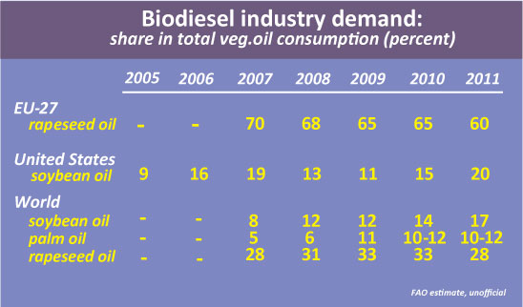

Slide 21
policy responses:
phasing-out of direct subsidies
revisiting mandatory consumption targets: lowered or delayed introduction
mandatory certification of sustainable production, sourcing and use of feedstock (EU)
2nd generation BFs: new promotion efforts
remaining challenges:
  frequent adjustments/corrections -> creating uncertainty
  idle BF production capacity
  EU’s sustainable certification requirements affecting trade
  trade disputes: 3 anti-dumping actions
further policy adjustments:
increased attention to negatively affected BF industries
considering temporary suspension of mandatory consumption/blending requirements
possible inclusion of ILUC-factors in GHG emission requirements (EU)

Slide 22
private sector/civil society initiatives:
investment in non-food agric. feedstock, waste veg.oil, etc.
independent research on environmental credentials of BF feedstock (GHG emission values, ILUC impact)
formulation of voluntary standards and certification schemes
  sustainable BF
  aviation-fuel BD blends
RSPO/RTRS: possible incorporation of GHG emission values into standards
automotive, aviation, other industries: BD blending tests, new BD uses
feedstock suppliers: adjusting to certification requirements
BF producers:
  sustainability certification: mixed reaction
  calls for protection from foreign competition

Slide 23
  other policy domains - cont’d
  financial market regulation
excessive speculation in agricultural futures and options market identified as one of the factors contributing to the 2007/08 food crisis
-> rules governing commodity derivatives revisited to
    prevent excessive speculation
    reduce volatility in food prices
      USA (2011, 2012 Dodd-Frank Act)
      EU (2012 EMIR-European Markets Infrastructure Regulation)
      China (2010), India (2012, temp.)

Slide 24
  other policy domains - cont’d
  environmental policies
environmental policies generally gaining weight
increased geographical concentration in production -> concerns regarding environmental sustainability – notably with regard to soybean and oil palm
policy measures:
production expansion controls/restrictions (Indonesia, 2011)
support and incentives for sustainable production expansion (Brazil, Indonesia, Malaysia)
formulation of national certification schemes (Indonesia, Thailand, Malaysia)
support to smallholder certification (oil palm)
EU: mandatory certification of biofuel feedstock

Slide 25
incidence:
  few countries – but includes heavyweights with environmentally fragile zones
  proceeding slowly, stepwise … so as not to harm sector development
  limited immediate effects (e.g. Indonesia moratorium)
  government-sponsored certification systems possibly competing with private sector schemes
  uncertainty about future policy action increasingly affecting investments and trade

Slide 26
Private sector/industry-led initiatives:
palm/soy sectors under tight scrutiny reg. sustainability of production
rising pressure for certification and traceability throughout the supply chain
voluntary actions are geared towards
  preventing demand slowdown/securing continued demand expansion
  improving companies’ “green” image
  securing future market share
voluntary initiatives:
global multi-stakeholder initiatives:
  RSPO c-o-p, standards, certification, controls & sanctions system; alternative trade options: full segregation method , mass balance calculation, book & claim mechanism
  RTRS c-o-p, standards, certification , trading tools
producer initiatives (national associations, individual companies):
  tropical forest moratorium, Brazil (6th year)
  sustainable soy production and certification, Brazil
  support to national certification schemes, Indonesia/Malaysia
  national adaptation of RTRS, China

Slide 27
traders:
  commitment to offer certified products
  setting up fully separated supply chains for certified products
  assisting producers to comply with certification requirements
processors:
  commitment to use certified products
  search for new non-food applications for veg. oils
  green processing technologies (recycling etc.)
Incidence:
at producer level:
increased production costs -> price premium required
smallholders disadvantaged
at market level:
mostly use of trade certificates as opposed to full segregation &traceability
uncertainty about future requirements (private vs. public)
actual market penetration is taking time

Slide 28
challenges:
availability of alternative standards raises questions
  compatibility of private sector initiatives with government measures
  recognition issues
  competition issues & possible market distortion
  long-term market effects? … gradual shifts in resource allocation & trade patterns? e.g. the case of S.E.Asian palm oil :
      stringent environmental regulations lead to rising land prices … triggering
      company consolidations to increase land base
      investments outside the region
      increased efforts to increase productivity
  need of a common internat. framework and harmonization – based on full private-public cooperation

Slide 29
Overall market setting
Policy review
  food security measures
  sector development policies
  other policy domains
Conclusions

Slide 30
recap of main policy trends:
2007/08 food crisis has given food security policies a prominent position in many countries – but includes only few LIFDCs !
governments taken by surprise: few long-term programmes in place; recourse to ad-hoc measures, especially easy-to-implement import measures and one-time domestic market interventions
conflicting domestic policy objectives
weak production response in many countries (poor price transmission; lack of lasting, effective policy measures)
oilseed markets strongly affected by other policy domains: bio-energy, environmental policies
private sector adjusting to new opportunities - in part filling regulatory void; but lack of harmonization is posing threats
winners and losers:
winners: farmers in leading producing countries (covered by crop insurance and revenue stabilization schemes; likely to benefit from higher world prices)
losers: poor, net-importing nations (surging import bills; costly market interventions; weak consumer protection; farmers not benefitting from high prices)

Slide 31
opportunities:
production response is coming forth in some countries
conditions for attracting investors back into agriculture expected to improving
new momentum: debate on how to manage markets better is on again (how to make markets more reliable and resilient to shocks)
increased room for international consultation
learning from past mistakes: so far, 2012 price spike has not escalated into a food crisis
emerging policy recommendations:
  a) national level:
  increase policy coherence (balancing consumer and producer interests)
  social safety-nets and national strategic food reserves
  complementing ad-hoc initiatives with longer-term measures
  improve price transmission
  make policy interventions more predictable
  engage private sector more

Slide 32
  b) international level:
  improve global market monitoring and market information systems (G-20 Group: AMIS)
  coordinate policy responses in cases of ‘abnormal’ market conditions to (G-20 Group: AMIS-Rapid Response Forum)
  closely watch price movements in global futures markets and take measures to prevent excessive speculation
  support the establishment of regional/national emergency food reserves
  strengthening WTO rules further (disciplining export restrictions)
  promote transparency and harmonization of regulatory frameworks …
    … in close collaboration with the private sector (concerns certification of sust. production, GHG requirements for green biofuels, trade in GMOs, health policies & related labeling rules , etc.)
  c) bio-energy policies
  refrain from direct support payments
  use consumption mandates flexibly
  avoid trade distortion or protectionist practices

Slide 33
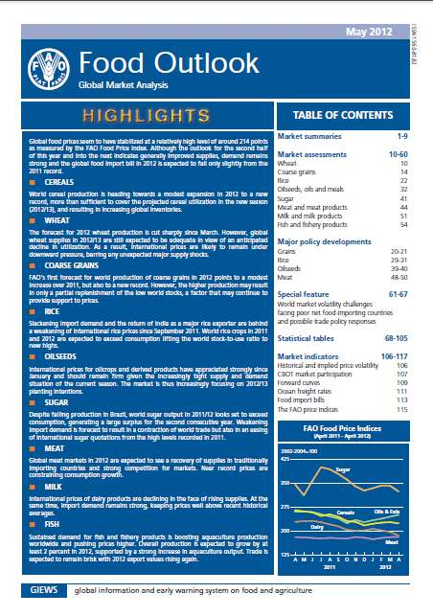
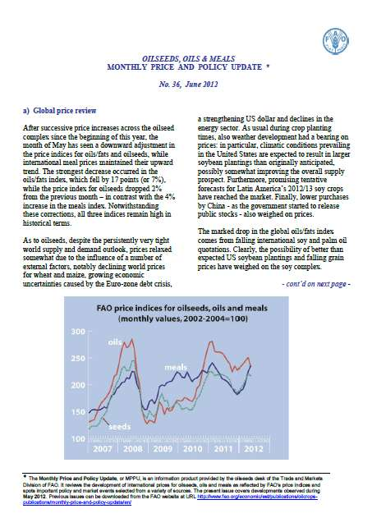
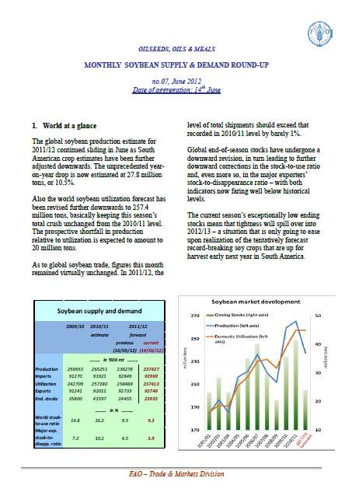
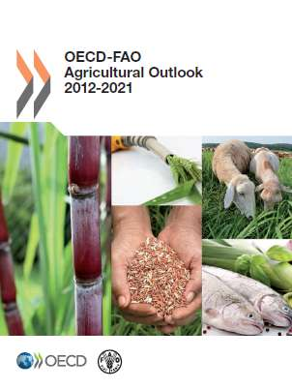
FAO Trade and Markets Division:
http://www.fao.org/economic/est/en/
Oilcrops desk:
http:/ www.fao.org/economic/est/est-commodities/oilcrops/en/
short-term market
assessments
monthly price and
policy updates
medium-term
projections
price information

Slide 34
THANK YOU FOR YOUR ATTENTION !
Acknowledgements:
  Ms. G. Karumathy, Mr. M. Milo (research assistants)
@: Peter.Thoenes@fao.org
: +39 06 57053498
: Viale Terme di Caracalla, 00153 Roma, Italy

