Slide 1
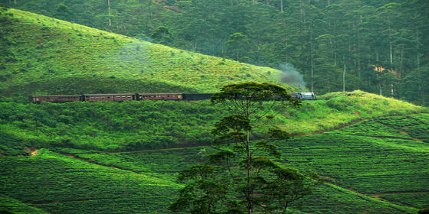
20th SESSION OF FAO /IGG ON TEA IN COLOMBO, SRI LANKA

Slide 2
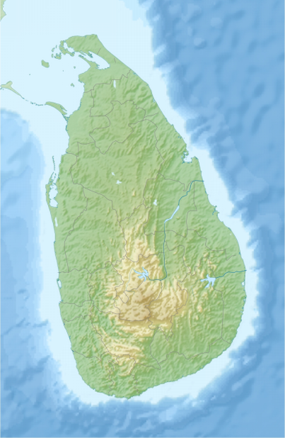
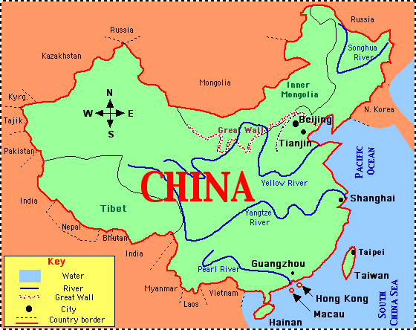
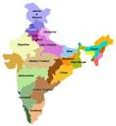
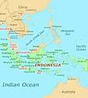
WORKING GROUP
ON
TEA TRADE & QUALITY
CHAIR – SRI LANKA
CO – CHAIRS – KENYA , CHINA, INDIA & INDONESIA

Slide 3
Back Ground
Initial proposal mooted at the 15th session in Colombo, Sri Lanka - 2003
Proposal ratified at the 16th session in Bali, Indonesia
Agenda paper submitted at the 17th session in Nairobi , Kenya - 2006
Formation of Working Group proposed at the 18th session in Hangzhou, China - 2008

Slide 4
Sri Lanka appointed as chairperson & India , Kenya, China as well as Indonesia selected as co- chairs in Rome , Italy - 2009
Progress reported by Sri Lanka at the 19th session in New Delhi , India - 2010
Road Map proposed by Sri Lanka at the Working Group Sessions in Mombasa , Kenya -2011

Slide 5
ACTION PLANS & RESOLUTIONS
Unanimity among most producer nations to ensure compliance of ISO 3720 Minimum Quality Standard for Black Tea
(a) National Legislation
(b) Statutory Provision
(c) Voluntary Standards
(d) Code of ethics

Slide 6
ACTION PLANS & RESOLUTIONS Cont.,
Invite prominent tea producing nations not regularly participating at FAO /IGG on Tea sessions to come on - board. Ex-: Turkey , Vietnam, & Iran etc.
Canvass important participating nations at FAO/IGG on Tea Sessions not committed as yet to agree to work towards ISO 3720 Minimum standard for Black Tea .
Ex: China, Argentina & Nepal etc.
Request smaller Asian & African tea producing countries to follow suit. Ex: Taiwan, Myanmar, Uganda, Zimbabwe, Burundi, Cameroon etc.

Slide 7
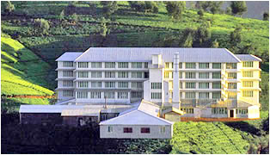
Harmonization on Points of Application to Comply with ISO 3720 Standard
Farm Gate (Tea Field) - GAP & Two Leaves & Bud Concept
Factory Level – GMP
Pre –Auction - sampling
Post Auction / Pre shipment – Sampling
Pre import / Post import – Sampling / Analysis
Post shipment / Retail - Analysis

Slide 8
Chemical Parameters for Black Tea
ISO 3720
Characteristics | Requirement | Testing Method
Water extract % (m/m) | 32 min. | ISO 9768
Total ash ,%(m/m) | 8 max. 4 min. | ISO 1575
Water – soluble ash, % (m/m of total ash) | 45 min. | ISO 1576
Alkalinity of water – soluble ash, % (m/m) | 1.0 min. 3.0 max. | ISO 1578
Acid - insoluble ash %(m/m) | 1.0 max. | ISO 1577
Crude fiber ,%(m/m) | 16.5 max. | ISO 5498 or ISO 15598
Total Polyphenols , %(m/m) | 9 min. | ISO 14502 - 1

Slide 9
Methodology for Monitoring of Quality Standards
Factory level/Pre Auction /Post Auction / Pre Imports / Post imports / Pre Shipment/Post Shipment/ Retail
Regular Sampling by Tea Inspectors / Instructors
Ensuring compliance of ISO 3720 minimum quality standard at the point of export
TESTING METHODS ADOPTED FOR ANALYSIS
Country : Sri Lanka

Slide 10
Status of Compliance With ISO 3720
Country | Status
Sri Lanka | Fully Compliant
India | Fully Compliant
Bangladesh | Fully Compliant
Malawi | Compliant
Tanzania | Compliant
Kenya | Awaiting Response
Vietnam | Awaiting Response
Indonesia | Awaiting Response
China | Awaiting Response
Rwanda | Awaiting Response
Uganda | Awaiting Response
Burundi | Awaiting Response
Nigeria | Awaiting Response
Nepal | Awaiting Response
Zimbabwe | Awaiting Response

Slide 11
Recognition of
ISO 3720 by Consumer Nations
Vital importance of tea consuming countries recognizing ISO 3720 Standard as a Minimum Quality parameter at the point of import
Endorsement of an internationally accepted food standard for tea
Ascertain views & observations from consumer member countries such as U.K, USA, Germany , Canada , Japan and Russia etc. on the possibilities of recognizing ISO 3720 Standard for Black Tea at point of entry.

Slide 12
Difficulties Encountered in Adopting
ISO 3720 Standard
Recognition that certain producer countries encounter difficulties in implementing ISO3720 standard
Identifying the specific difficulties of individual member nations
Lack of technicians &Laboratories highlighted by Rwanda , Uganda & Tanzania to be addressed
Formulation of a Road Map to assist tea producing countries with difficulties to work towards compliance of ISO 3720

Slide 13
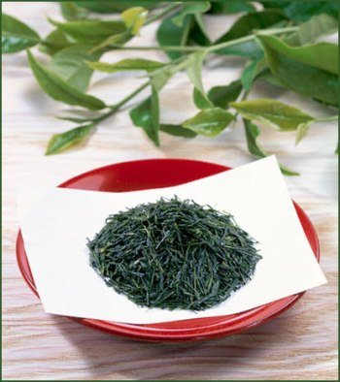
Chemical Parameters for Green Tea
ISO 11287
Characteristic | Requirement | Testing Method
Water extract % (m/m) | 32 min. | ISO 9768
Total ash ,%(m/m) | 8 max. 4 min. | ISO 1575
Water – soluble ash, % (m/m of total ash) | 45 min. | ISO 1576
Alkalinity of water – soluble ash, % (m/m) | 1.0 min. 3.0 max. | ISO 1578
Acid - insoluble ash %(m/m) | 1.0 max. | ISO 1577
Crude fiber ,%(m/m) | 16.5 max. | ISO 5498 or ISO 15598
Total Catechins, % (m/m) | 7 min. | ISO 14502 - 2
Total polyphenols,(%(m/m) | 11 min. | ISO 14502 - 1
Ratio total catechins to total polyphenols,(m/m) | 0.5min.

Slide 14
Status of Adaptation or Implementation of ISO 11287 Minimum Quality Standard for Green Tea
Country | Status
Sri Lanka | Fully Implemented
India | Fully Implemented
Bangladesh | Implementing ISO 3720 Standard
China | To be verified
Japan | To be verified
Taiwan | To be verified
Vietnam | To be verified
Indonesia | To be verified

Slide 15
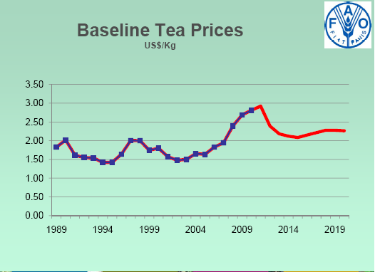
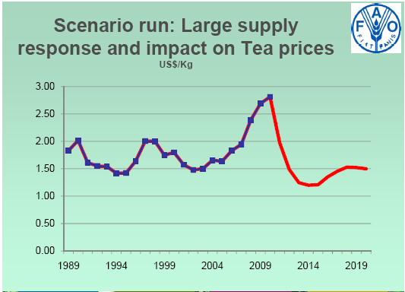
Forecast on Global T ea Prices by FAO

Slide 16
Thank You !
Hasitha De Alwis
Director – Promotion
Sri Lanka Tea Board

