Slide 1
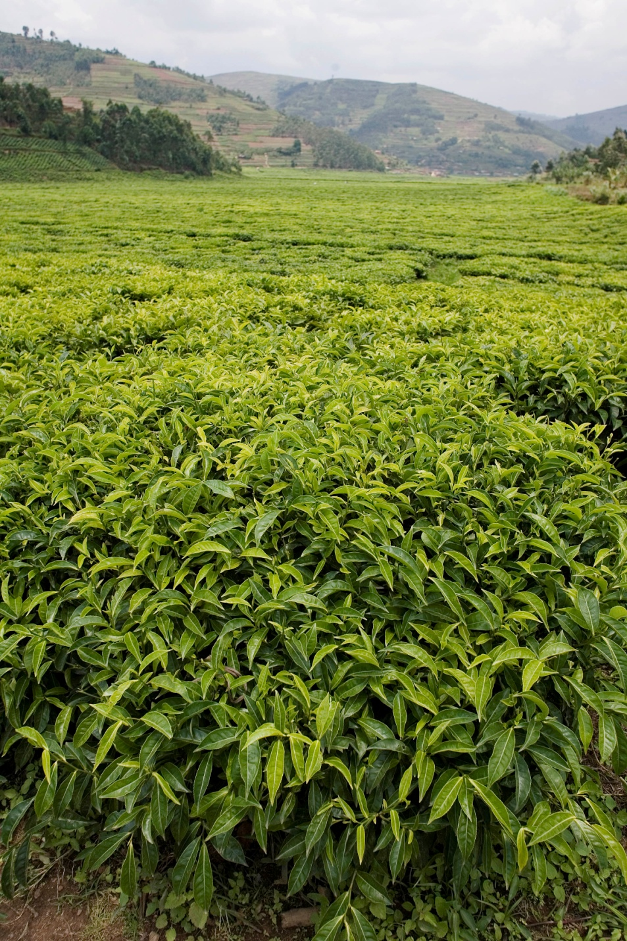

Socio-economic implications of climate change for tea producing countries

Slide 2
Outline
Introduction
Implication of climate change for tea
Socio-economic implications
  The estate sector
  The smallholder sector
Impact of climate change on the world tea market
Adaptation measures for tea cultivation
Conclusions

Slide 3
Introduction
Document CCP:TE 14/4 uses information to assess some socio-economic implications for tea producing countries
Mitigation = attempts to reduce greenhouse gas emissions at their source
Adaptation = attempts to reduce vulnerability to climate change

Slide 4
Implication of climate change for tea
Tea is:
  Important cash crop
  Plays a significant role in
    Rural development
    Poverty alleviation
    Food security
  Planted in 58 countries
3.36 million hectares under tea cultivation (2012)
4.78 million tonnes produced (2012)

Slide 5
Implication of climate change for tea (cont’d)

Slide 6
Implication of climate change for tea (cont’d)

Slide 7
Implication of climate change for tea (cont’d)

Slide 8
Implication of climate change for tea (cont’d)
Implications of climate change:
  Dry soil top if mulching is not applied
  Increased incidence of new pests and diseases
  More carbon dioxide being released into the atmosphere through deforestation
  Reduced or uncertain rainfall patterns and limited ground and river water
Main issues include of tea’s environmental footprint:
  Reduced biodiversity and ecosystem function
  High energy consumption
  High application of pesticides in some countries.

Slide 9
Implication of climate change for tea (cont’d)

Slide 10
Socio-economic implications: the estate sector
Issues estates are facing:
  Erosion of top soil
  Increased use of fertilizers
  Increased usage of pesticides
  Addressing longer dry seasons and heavier rains

Slide 11
Socio-economic implications: the estate sector
Increasing costs of mitigating climate change raise serious socio-economic issues:
  Low wages and low-quality housing
  Health and safety
  Declining workforce
  Casual or short-term employment
  Gender discrimination
  Diminishing workers’ representation

Slide 12
Socio-economic implications: the smallholder sector
Change in supply structure from large plantations to smallholders
Smallholders in Sri Lanka responsible for 76% of total production
Smallholders in Kenya responsible for 62% of total production
Issues constraining smallholders:
  Low farm gate prices
  Poor extension services
  Limited market channels
  Little or no access to credit
  Low level of farmer organization.
Changes in weather patterns:
  Possible income loss due to decrease in plucking days (G. Boriah, Tea Board of India).

Slide 13
Impact of climate change on the world tea market
Blending, packing and marketing of tea are the most profitable and controlled by a handful of multinational tea packers and brokers
Real prices for tea on the shop shelves have not increased over time but have in nominal terms.
Average real auction prices between 2000-2008 roughly half of those in the 1980s
Auction prices have increased somewhat since 2008.
Challenges for most producing countries:
  Capturing value addition in tea supply chain
  Increasing quality
  Rising costs to meet food safety standards
Sri Lanka, India and Kenya successful in capturing value addition

Slide 14
Impact of climate change on the world tea market (cont’d)
Table 1. Climate change scenario Impact at the world level
Average percentage change between baseline and simulation
Price | 26.3
Consumption | -3.3
Production | -3.4
Export | 2.3

Slide 15
Impact of climate change on the world tea market (cont’d)
Impact of climate change on the world
tea prices (USD/kg)

Slide 16
Adaptation measures for tea cultivation
Adaptation measures recommended by the Working Group on Climate Change:
  Planting drought and stress tolerant tea cultivars
  Diversifying production
  Intercropping tea with other tree crops
  Organic cultivation
  Water conservation

Slide 17
Conclusions
Evidence that GHGs are causing global warming and climate change
Climate change will have a significant impact on future tea production
Several uncertainties are not yet fully understood:
  Frequency of natural disasters
  The proliferation of certain pests and diseases
  Higher infrastructure cost.
Recommendations:
  Agricultural and socio-economic adaptation strategies are required in the short term
  Tea producing areas should be evaluated against climate projections
  Comparative studies are necessary
  Possibility of breeding special tea hybrids that cope better with climate change should be considered
A competitive environment for tea production and processing safeguarded by governments could create long-term socio-economic and environmental sustainability that will help mitigate the impact of climate change

Slide 18
Thank you!

