Slide 1

World Tea Production and Trade : Current and Future Development
By Kaison Chang – Secretary FAO Intergovernmental Group on Tea

Slide 2
Introduction
Current market situation and outlook to 2023;
Response to questionnaires by member countries, supplemented by other sources;
Macro-economic data from the IMF, World Bank and OECD.

Slide 3
INTRODUCTION
Grateful to Argentina, India, Indonesia, Kenya, Malawi, Sri Lanka, United Republic of Tanzania, and Vietnam;
Cooperation promotes:
Improving market transparency;
Fostering market expansion; and
Value chain enhancement.
Delegates to review the information presented in document CCP: TE 14/Inf. 3 with its annexed tables 1 to 9, and amend and supplement these where necessary, with updates pertaining to their countries.

Slide 7
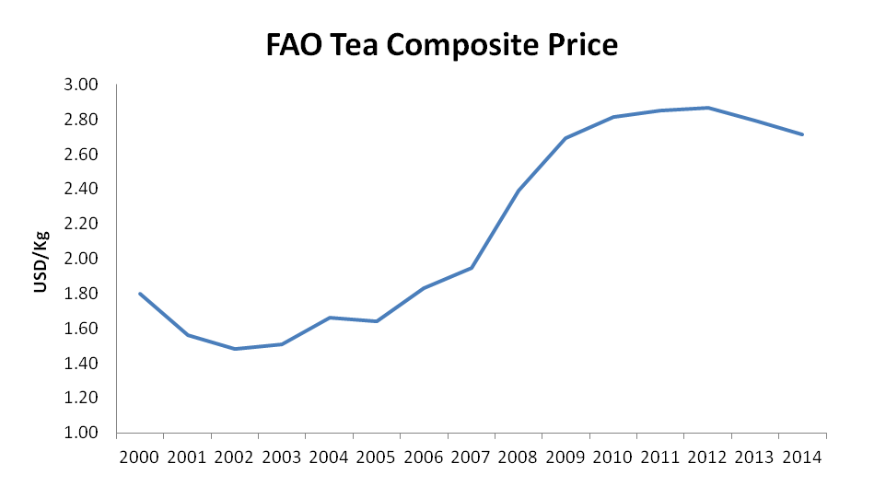

Slide 13
Concluding Remarks – Production and Exports
Tea trade increased 5%: earnings by 10% to USD 5.7 billion;
Contribution to food import bill:
Kenya at USD 1.3 billion > 50%
Sri Lanka at USD 1.55 billion = 71%.
Others :
Indonesia = USD 155 million; Tanzania =USD 61.4 million.
Trickle down effects to rural incomes and household food security were invaluable.

Slide 14
Concluding Remarks – cont’d
Weaker Composite Price, mostly due to CTC auction prices, and if there is no correction, this downward trend will continue;
Growth in demand is in green and specialist tea segments;
In the medium term, the projections suggest that supply and demand of black tea will be in equilibrium in 2023 at a nominal price of USD 2.81 per Kg. Real price will be lower.

Slide 16
Concluding Remarks – cont’d
However, if there is no correction in supplies and assume that output increases a further 5 percent, the impact on prices would be quite dramatic;
A 40 percent decline over the next 10 years reaching USD 1.82 per Kg in 2023 or an average of USD 1.60 for the decade.

Slide 18
Concluding Remarks – cont’d
However, if the reaction to the declining prices were to cut back on production, say by 5 percent less than the baseline, then prices could be 27 percent higher for the decade reaching USD 3.4 per Kg in 2023 .

Slide 20
Conclusions
Caution needs to be exercised;
Greater efforts should be directed at expanding demand, particularly in producing countries with relatively low per capita tea consumption and relatively strong economic growth, as consumption is already high in traditional markets;
Diversification into other segments of the market such as organic tea should also be encouraged and the health benefits of tea consumption should be used more extensively in promoting consumption in both producing and importing countries. However, in targeting potential growth markets, recognition of and compliance with food safety and quality standards is essential.

Slide 21
Thank You!

