Slide 1
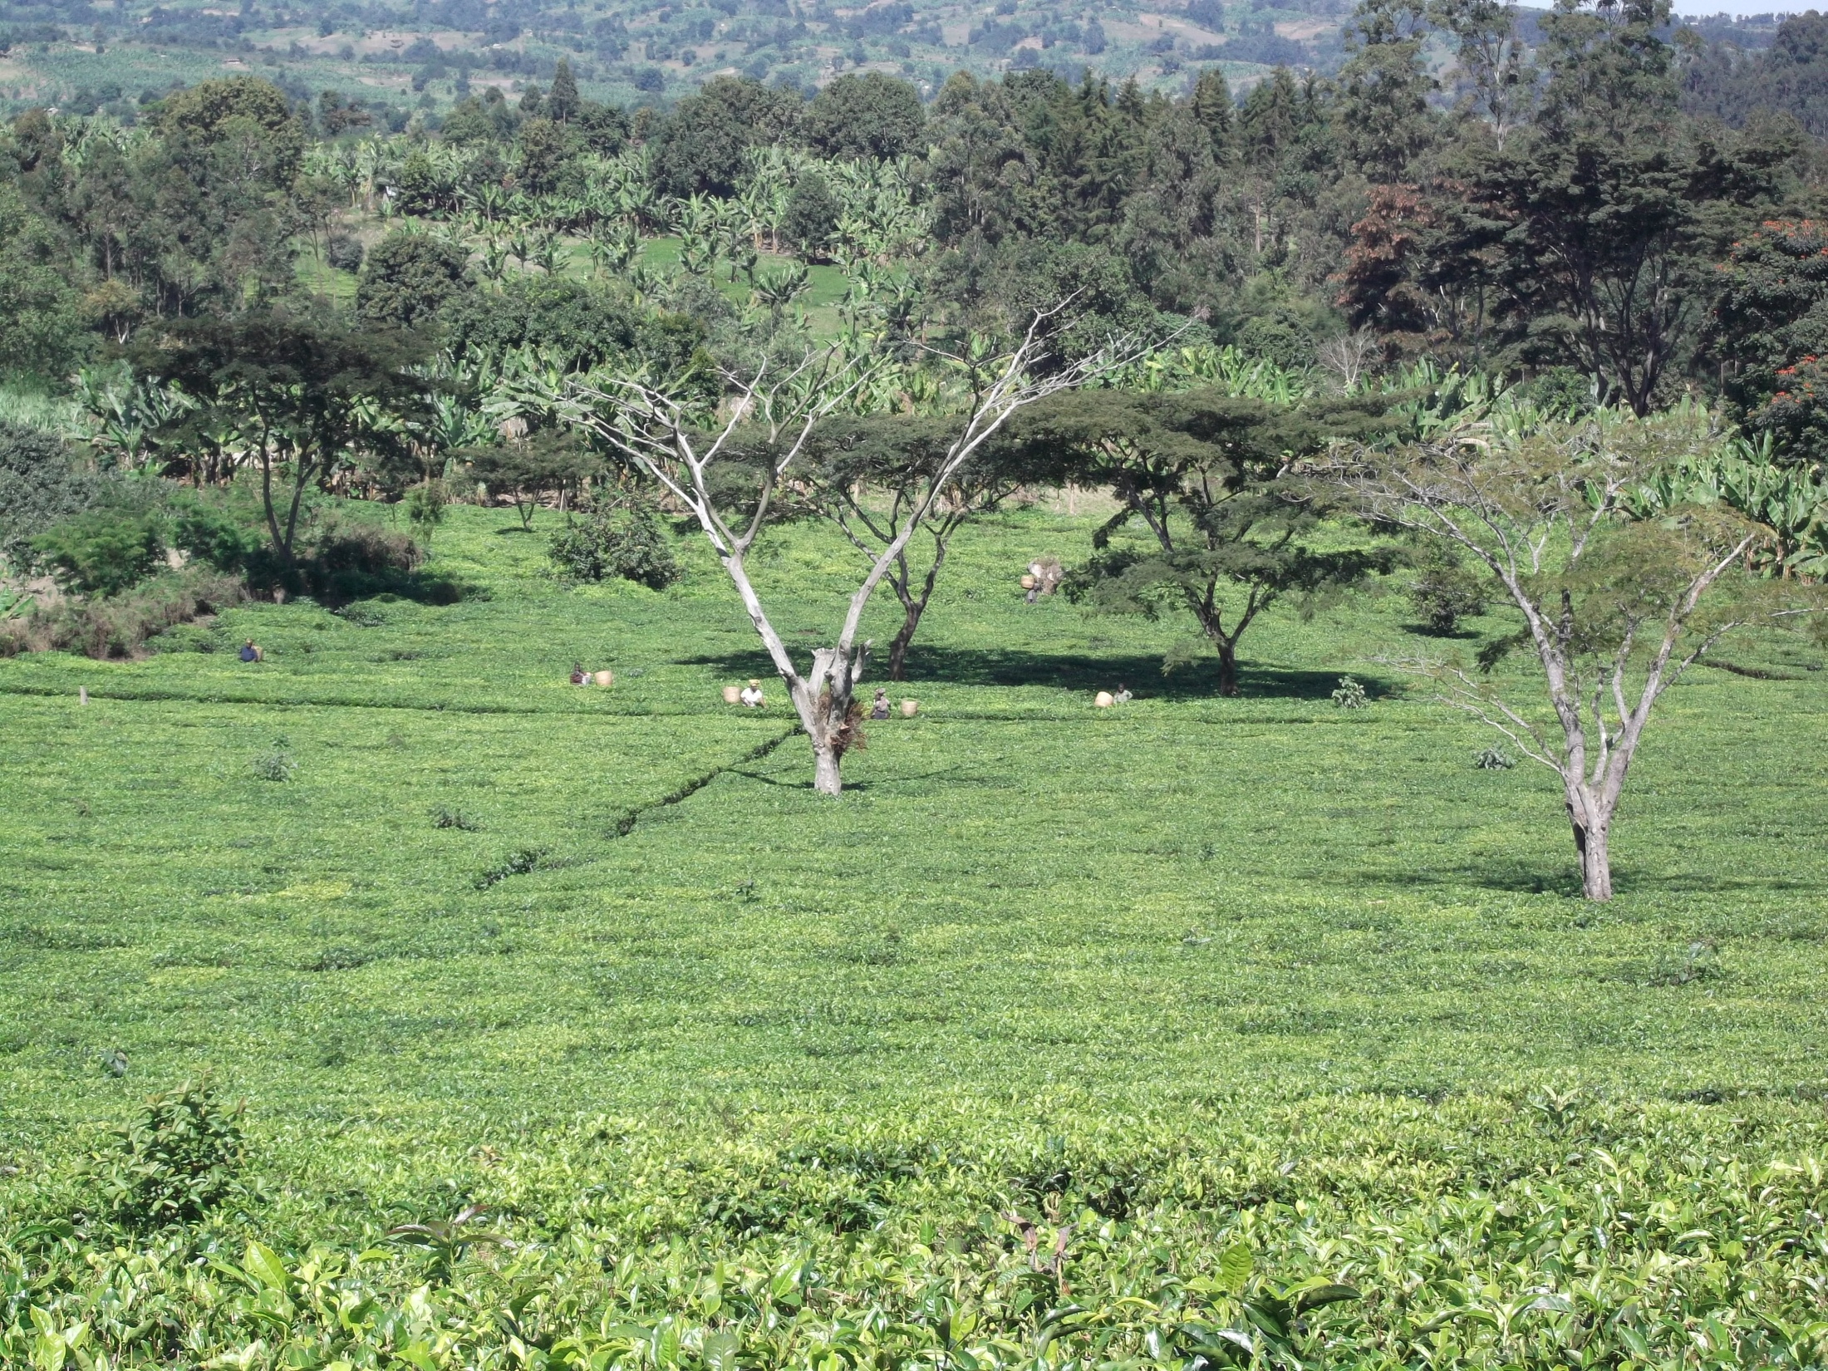
TANZANIA TEA INDUSTRY
CURRENT STATUS & FUTURE PROSPECTS

Slide 2
Overview of Tea Industry in Tanzania
Planted area – 22,721.55ha
  Estates Subsector - 11,272.10 ha
  Smallholders subsector - 11,449.45 ha
Tea processing
- 19 factories owned by large scale farmers
- 4 factories jointly owned with S.H/farmers
- Av. MT production 33,000 tons/annum
Tea Blending and packing
- 9 factories owned by private companies - Av. Local sales 5,000 tons/annum
Av. Foreign Exchange Earnings –over USD 50m annually

Slide 3
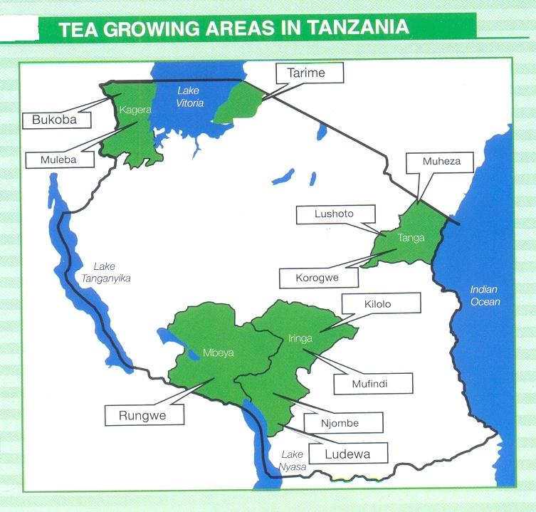

Slide 9
INITIATIVES UNDERTAKEN
Launching of Tea industry strategy (2012/13-2022/23), envisage; Double tea productivity & Focus on quality
Government subsidies on improved clonal planting materials; TSHTDA- 45m & TRIT-70m
Partnership between private Estates & The Government of Tanzania; aims at;
  Double tea production to some estates in Southern Highlands
  Improve productivity for the participating smallholder in an area of 6,000ha
Introduction of Green Leaf Pricing Mechanism
  Based on Cost sharing & final market price
  Introduce first and Second payment system
  Improve quality

Slide 10
CONCLUSION
Planted area to increase to 25,000ha by 2022/23
Made tea volume to increase to over 50,000 tons by 2022/23
Local sale volume to increase to over 20% by 2022/23
Export sales to constitute less than the current 85%
Quality of tea to increase from “low to medium” to high
Average Annual Income to increase to over USD 100m
FUTURE PROSPECTS

Slide 11
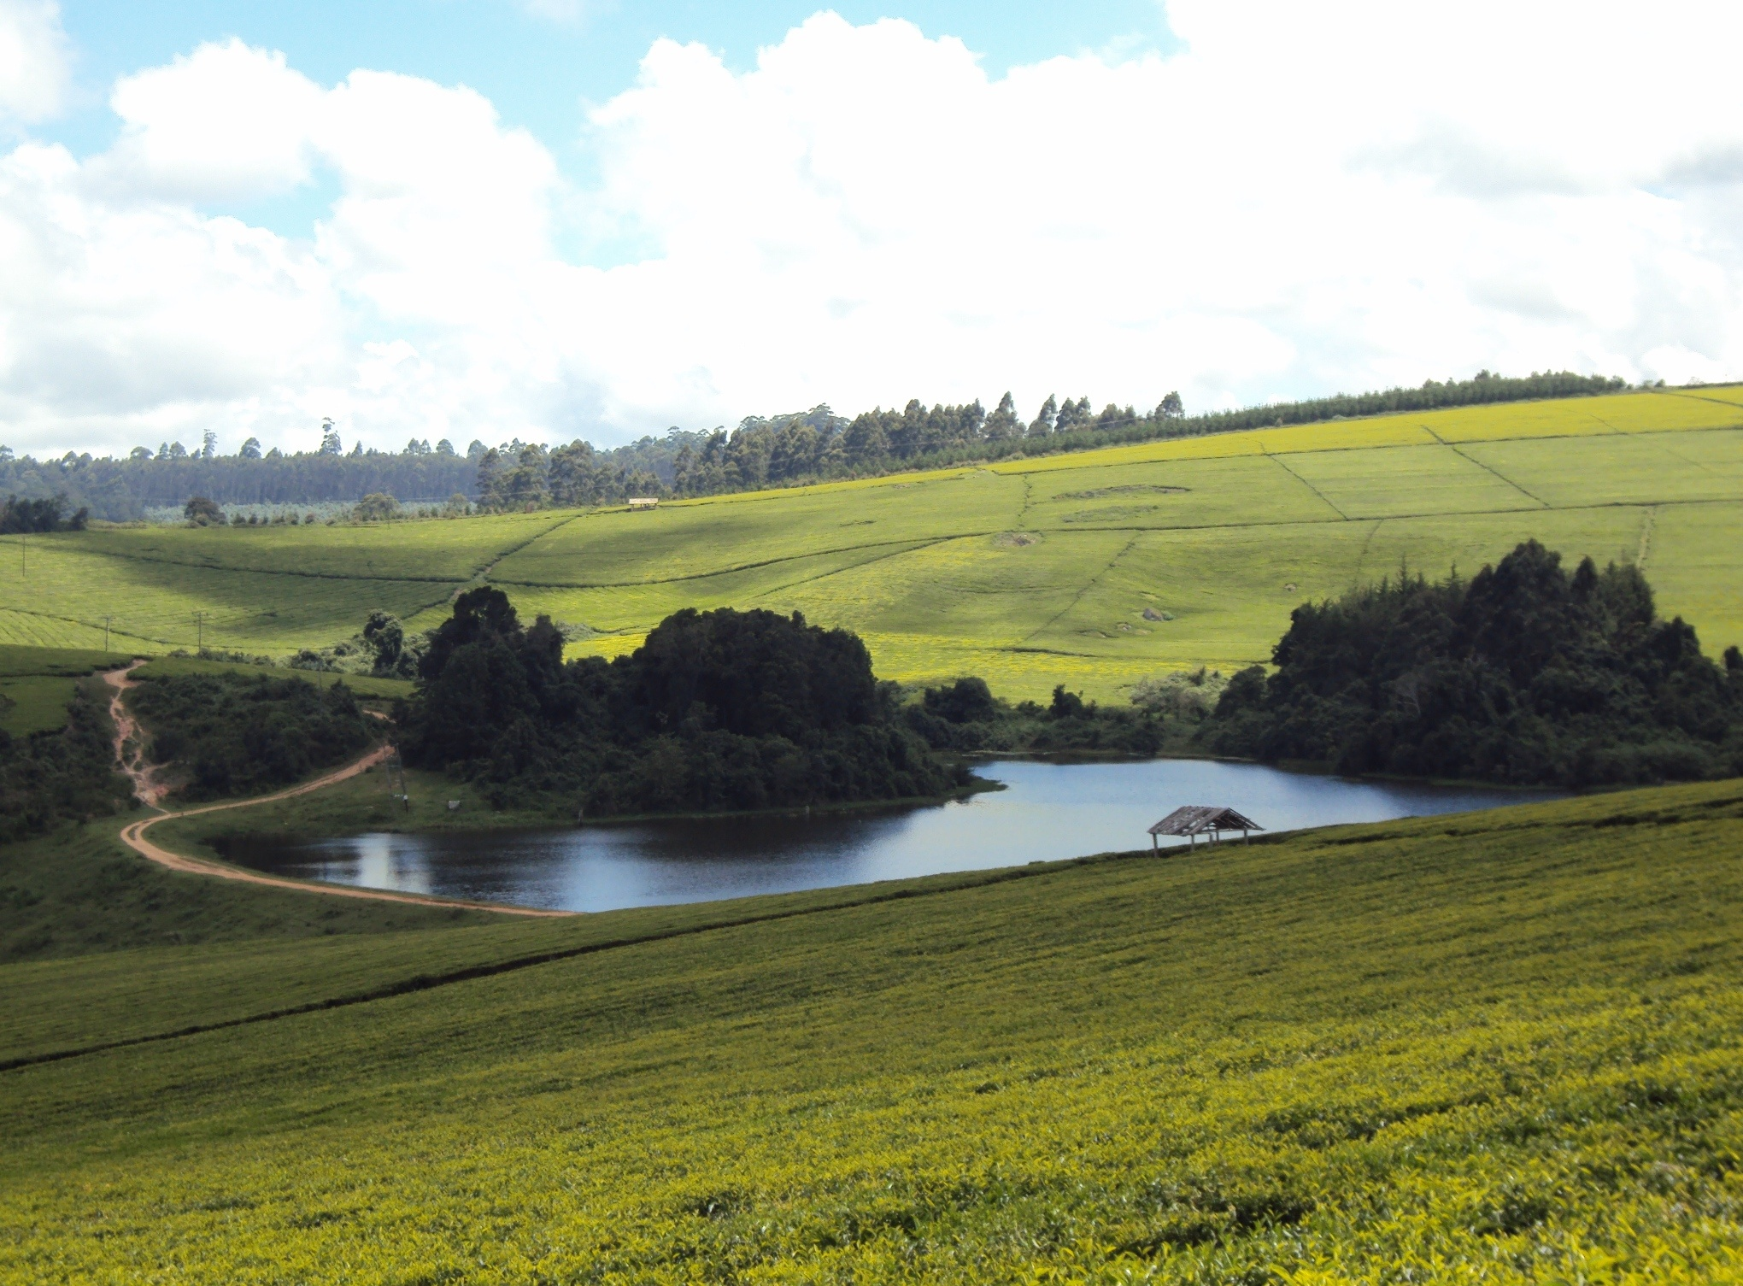
THANK YOU

