Slide 1
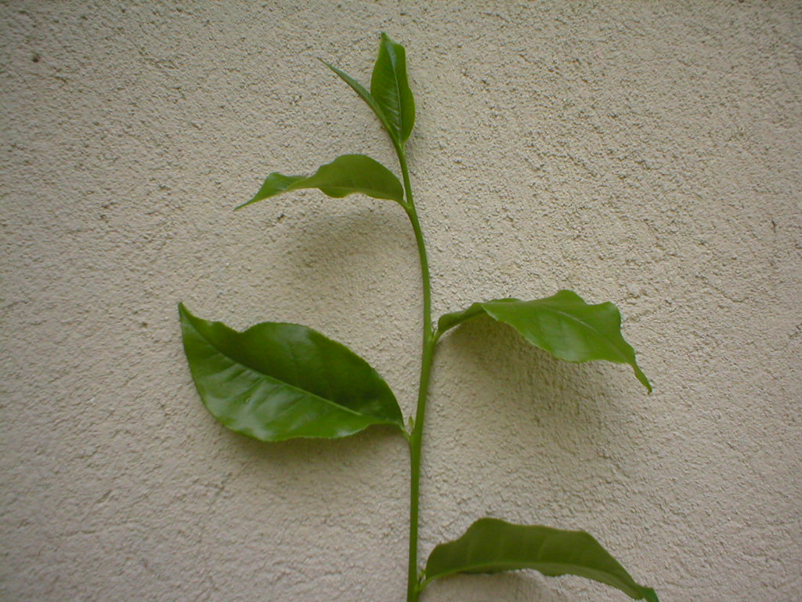
Tea Smallholdings Sector in
Sri Lanka
MB Cyril
General Manager
Tea Small holdings Development Authority

Slide 2
Outline
Current status of the sector
Smallholder profile
Community initiatives
Issues

Slide 3
Tea Smallholding
Holding less than 10 Acres (4 Ha) where tea is grown for the purpose of converting to made tea

Slide 4
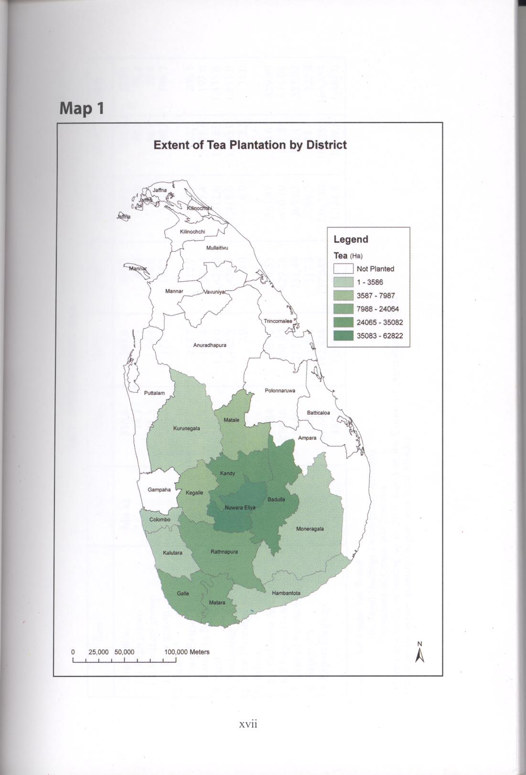
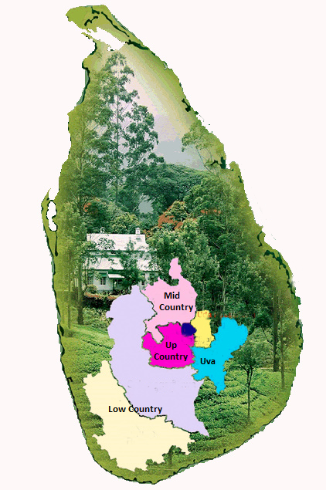
Distribution in the Island

Slide 5
Significance in the Economy
Share a three quarter production in the country that still the major FE earning agricultural activity in terms of green leaf
Supports livelihood of 400,000 families of a total population of approx 2 Mn, nearly 10% of the total population.
Employs half a Mn people in rural Ag sector

Slide 6
Extent and Production
Extent
Production

Slide 7
Extent of Tea by Size of holding
More than half of the total extent is in holdings less than 0.5 ha

Slide 8
Percentage of Holdings by Size
Larger majority of the small holdings are of the size less than 0.5 ha

Slide 9
Expansion of the Smallholdings

Slide 10
Production Trend in the Smallholdings

Slide 11
Share Trend of Smallholder Production

Slide 12
Expansion of Small Holdings
Census 1994
Holdings 206,652
Extent Ha 82,918
Census 2005
Holdings 350,982
% Increase
120 %
54.5%
Extent Ha 116,492
Census 1980
Holdings 159,865
Extent Ha 75,769

Slide 13
No of Small holders by status of ownership
Single ownership
64.9%
Joint ownership
7.1%
Govt Rented
12.4%
Private Rented
8.2%
Encroachment/Illicit
2.5%
Majority of smallholders enjoy single ownership over heir land

Slide 14
Disposal of Green Leaf
Direct to Factory
33.7%
Green leaf dealer/ Collector
51.8%
Tea Society
Any other/ Unspecified
6.9%
7.6%
Larger share of green leaf is handled by the collectors/ Dealers

Slide 15
Results of Sample Survey,2008
Characteristics of tea smallholders
Tea is main source of income of 50% of smallholders
56% reside in the tea holding and 35% are not in the holding but else where in the same village, another 6% resides out side
86% possess permanent dwellings and 7% semi permanent,3% reported to be temporary dwellings
Only 5% have obtained bank loan facilities during preceeding 5 Years,

Slide 16
Results of sample survey, 2008, Cont’d
Characteristics of smallholdings,
78% is under VP and 12% under seedling tea
92% of holdings are planted with cultivars of 1980s, TRI 2000 series
Estimated average productivity was 1788Kgs made tea/ ha/yr
32% of the holdings are in mixed crops, 15% with other minor export crops and 14% with coconut.
56% maintain rounds of a week or seven days and 26%, 8-10 intervals. another 16% maintain rounds more than 10 days owing to low yields

Slide 17
Social Organisation of small holders
Voluntary organisation in 1969 as leaf collecting societies
Forming in to societies in 1989 and institutionalising under the provisions of the Tea Smallholdings Development Act, amendment in 1991
Confer legality to these societies in 1997 under an amendment of the above act
Recognition by constitution, representation in decision making in all tea related institutions.

Slide 18
Society hierarchy
Federation of tea small holder societies
Regional Organization
Village Society
Village Society
Regional Organization
Village Society
National level
District/ Regional level (8)
Local level (1350)
Village Society

Slide 19
Institutional/ Organizational Relationship
Federation of Tea Smallholder Societies.
Board of Management of Tea Smallholdings Development Authority
District/ Regional Organization
Regional Office of the TSHDA
Village Tea Smallholdings Development Society
Tea Inspector/Extension officer

Slide 20
Role/ Responsibilities of Smallholder Societies
Provision of Services to membership
Operating leaf collection,
Supplying Fertilizer, other welfare services
Organizing Extension work in the field, directly linked to Extension Delivery

Slide 21
Government Assistance
Tea Planting Subsidies in Cash and Kind to cover 25% of the cost
Fertilizer Subsidy to cover 75% of cost
Technology transfer through Extension
  Research and extension dialogue ( with the research organization)
  Mechanization Initiatives
Livelihood support for lowest category of income.

Slide 22
Research Extension Linkages
Regional Technical Extension Forum (RTE)
TRI , TSHDA Linkage Meeting (National level)
Experiment and Extension Forum(National level)
TOT for Extension Staff by TRI Scientists
Joint Field Extension Services

Slide 23
Small holder position in the value chain
Small holder producer
Processing Unit manufacturer
Broker/
Auction sales
Buyer/ Trader/ Shipper
Importer/
Buyer/Trader
Retailer/ supermarket store
$20-30 /Kg
$ 2 -3/ Kg
$ 3- 4/ Kg
Tea Board Regulation

Slide 24
Issues
Unsecured price structure
Narrowing margin of the production
Facing adverse weather conditions
Dearth of labour

Slide 25
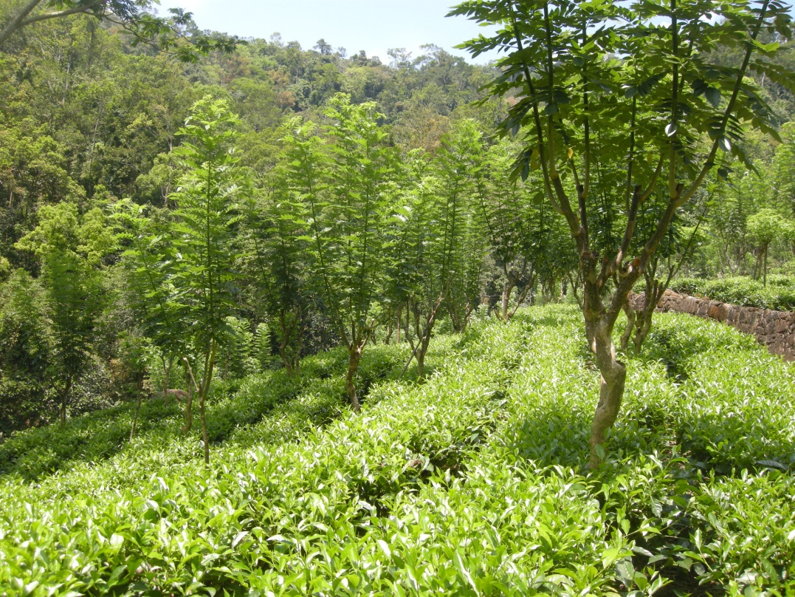
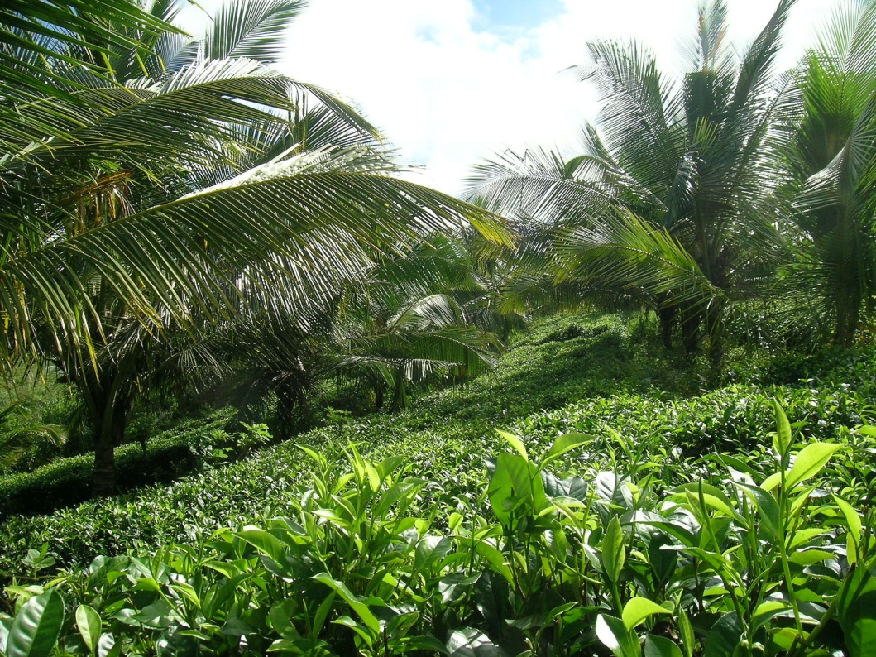
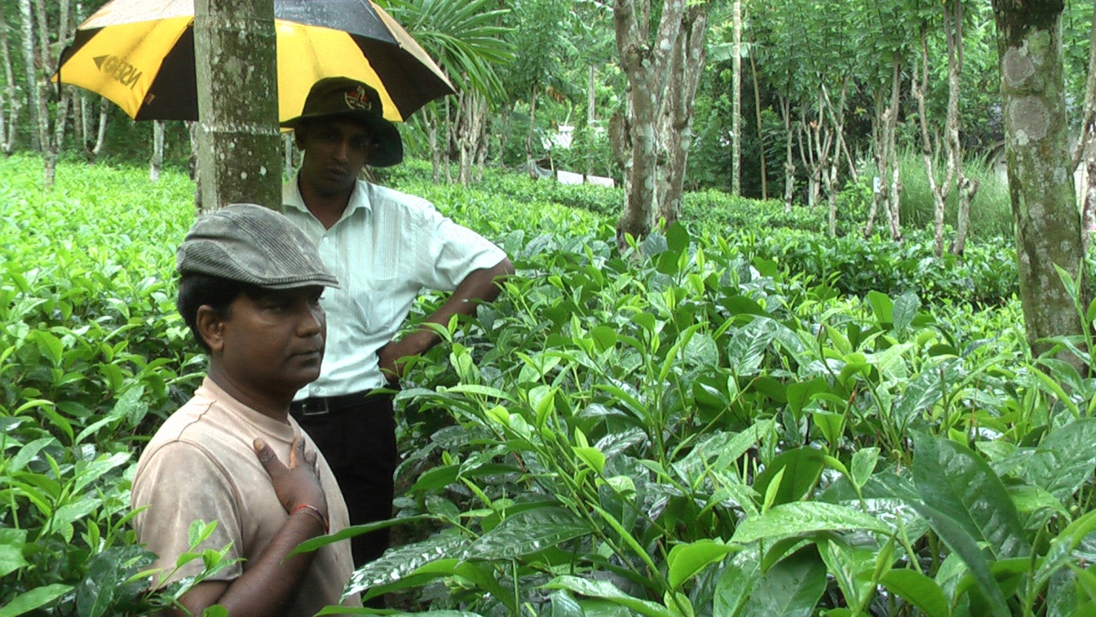
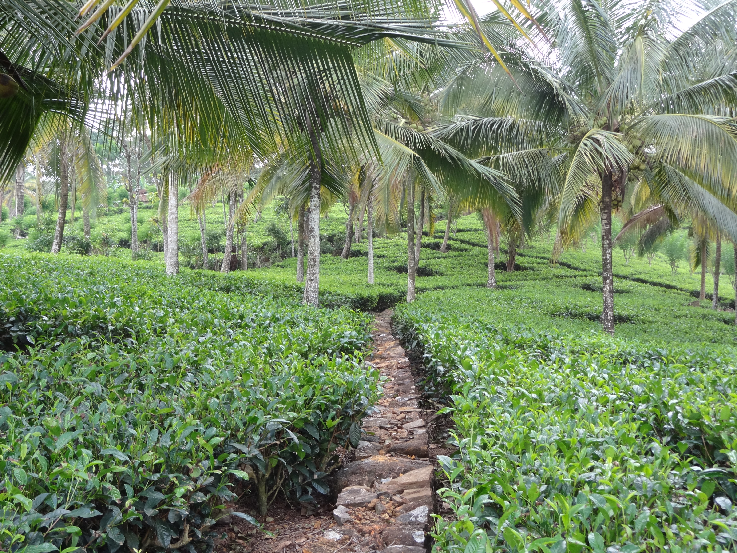

Slide 26
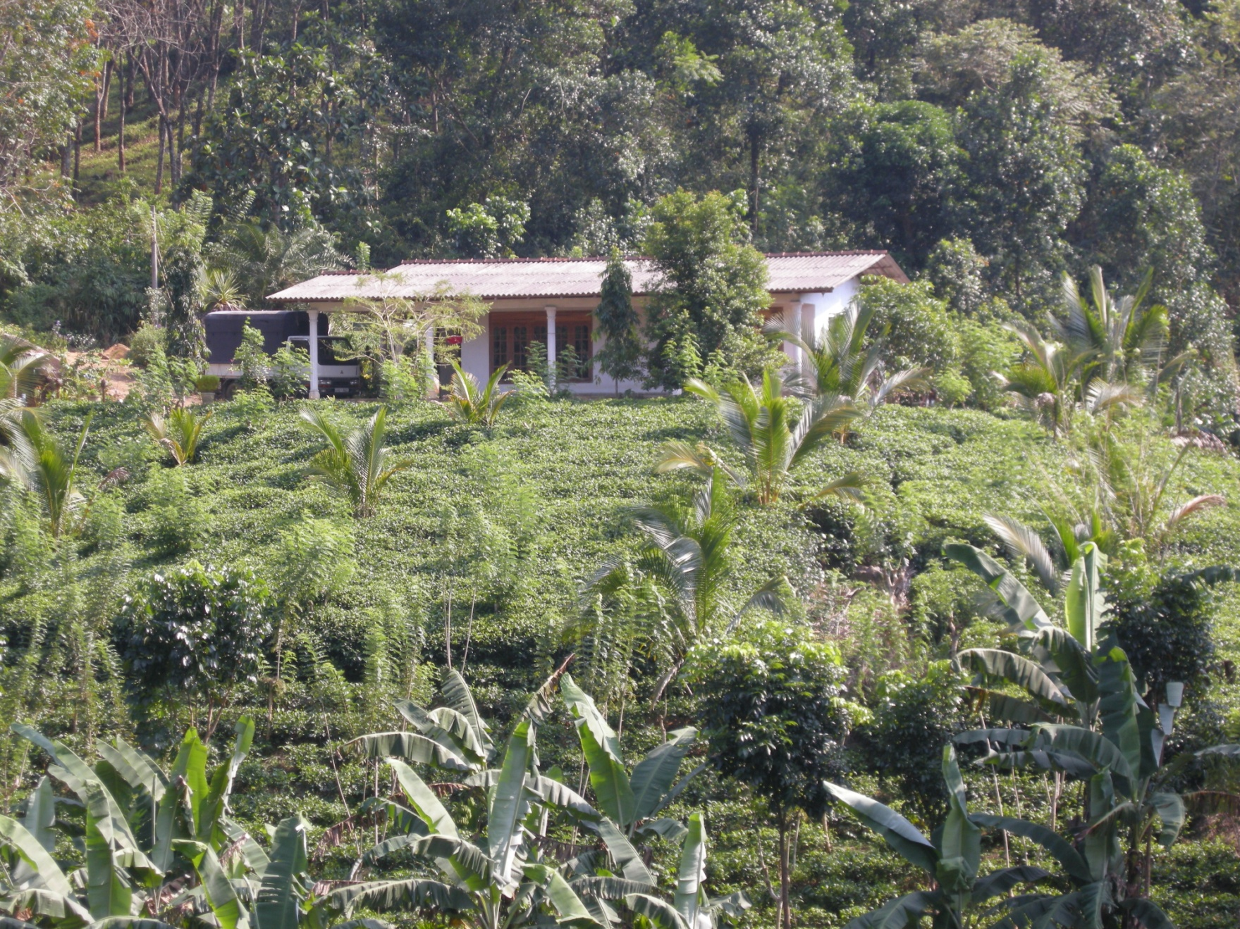
Smallholder Model

Slide 27
Thank you

