Slide 1

MAFAP in Tanzania
MAFAP TEAM TANZANIA
(MAFC – ESRF – FAO – OECD)
Agricultural Sector Consultative Working Group
28th November 2012 - Dar es Salaam (Tanzania)
With the financial support of

Slide 2
Presentation Outline
MAFAP in a nutshell
Institutional arrangements for MAFAP implementation in Tanzania
Work carried out so far

Slide 3
Presentation Outline
MAFAP in a nutshell
Institutional arrangements for MAFAP implementation in Tanzania
Work carried out so far

Slide 4
Bill and Melinda Gates Foundation funded project implemented by FAO and OECD
Ultimate objective: informed decision making to ensure that policies and investments are supportive of agricultural development, the sustainable use of natural resources and enhanced food security
Through:
Improved capacity to monitor policies affecting agriculture and food systems
Better informed policy dialogue at national, regional and international levels

Slide 5
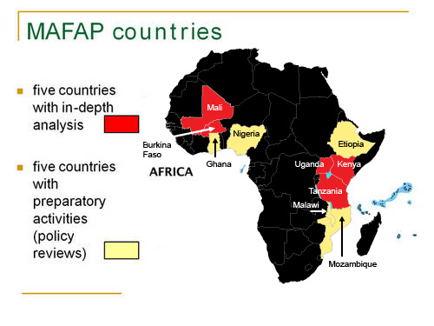
MAFAP basics: where..........

Slide 6
MAFAP Scope
Agricultural Policy Review: how has agricultural, food and rural development policy developed in the country?
Three pillars of indicators:
(dis)Incentives via prices
(dis)Incentives via public expenditure
Development and performance indicators

Slide 7
Presentation Outline
MAFAP in a nutshell
Institutional arrangements for MAFAP implementation in Tanzania
Work carried out so far

Slide 8
MAFAP timeline in Tanzania
First scoping mission in 2010 [inclusion of Tanzania as MAFAP intensive country]
Second scoping mission in 2011 [identification of partners]
Signature of agreements with partners October 2011
Capacity building workshop November 2011
Data gathering and analysis November 2011 – November 2012
Presentation of MAFAP to ASCG [April 2012]
Presentation of initial results [today]
Final report launched [First quarter 2013]

Slide 9




MAFAP implementation in Tanzania
Institutional partner
Department of Policy and Planning
Ministry of Agriculture, Food Security and Cooperatives
Technical partner
Economic and Social Research Foundation (ESRF)
Agricultural sector consultative Group
Agricultural Development Economics Division (ESA)
MAFAP secretariat
Trade and Agriculture Directorate (TAD)

Slide 10
Presentation Outline
MAFAP in a nutshell
Institutional arrangements for MAFAP implementation in Tanzania
Work carried out so far

Slide 11
Capacity building on price analysis and public expenditure for staff at ESRF and MAFC
Technical notes for price analysis on six commodities, and preliminary analysis on two additional ones
Analysis of public expenditures for the agricultural sector [2006-2011]
Selection of specific topic to be addressed in the country report

Slide 12
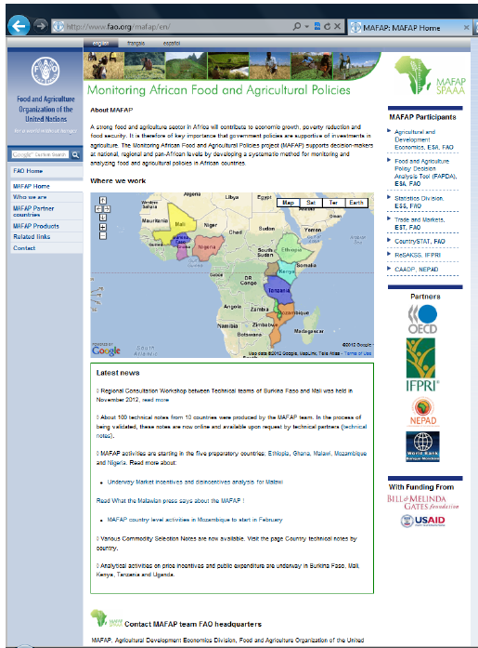
For additional information please visit: www.fao.org/mafap

