Slide 1

Results of price incentives and disincentives analysis in Tanzania
MAFAP TEAM TANZANIA
(MAFC – ESRF – FAO – OECD)
Agricultural Sector Consultative Working Group
28th November 2012 - Dar es Salaam (Tanzania)
With the financial support of
Notes:
thanks for the invitation to present

Slide 2
Presentation Outline
Products analyzed
Results for specific commodities
Overall results for the agricultural sector
Analysis by commodity groups

Slide 3
Presentation Outline
Products analyzed
Results for specific commodities
Overall results for the agricultural sector

Slide 4
Products analyzed
Products under analysis
Planned for future years
8 commodities [Rice, Maize, Coffee, Cotton, Sugar, Wheat, Cow Milk and pulses]
4 commodities [Cassava, Nuts, Livestock and Sorghum/millet]
3 commodities [Tobacco, Tea, Palm oil]
Notes:
% of marketed production probably much higher, would cover 74% of production if we add bananas

Slide 5
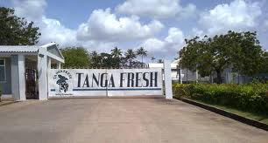

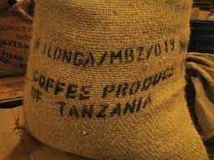
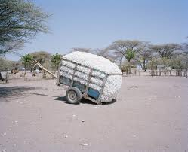
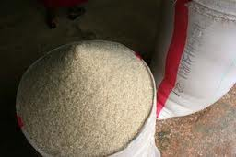


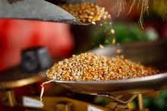
IMPORTS
EXPORTS
THINLY TRADED
Notes:
THREE MAIN GROUPS OF COMMODITIES
Imports will add: MEAT
Exports will add: NUTS, LIVESTOCK
Thinly traded will add: CASSAVA; SORGHUM MILLET

Slide 6
Presentation Outline
Products analyzed
Results for specific commodities
Overall results for the agricultural sector

Slide 7
Methodological approach
Compare domestic prices (real prices in the Tanzanian market) with their equivalents from international trade.
  International trade prices are adjusted to take into account:
    Cost of import or export procedures
    Cost of processing
    Cost of transport and handling, storage, etc.
    Margins of agents along the value chain
  This is done at two stages of the value chain: wholesale and farm gate

Slide 8
Methodological approach
HYPOTHESIS:
  Domestic prices embed the impact of domestic market and trade policies and actual functioning of markets
  International prices do not have the impact of domestic market and trade policies and reflect the functioning of integrated markets.
CONCLUSION:
  Differences can be used as measurement of impact of domestic market and trade policies and the actual functioning of markets
  Incentives and disincentive depending on relationship

Slide 9
Output per commodity [technical notes]
Revision of production, consumption, trade and marketing for the commodity.
Revision of the policy decisions and programs affecting the commodity
Description of assumptions and data used.
Indicators for the commodity and interpretation
Conclusions and recommendations

Slide 10
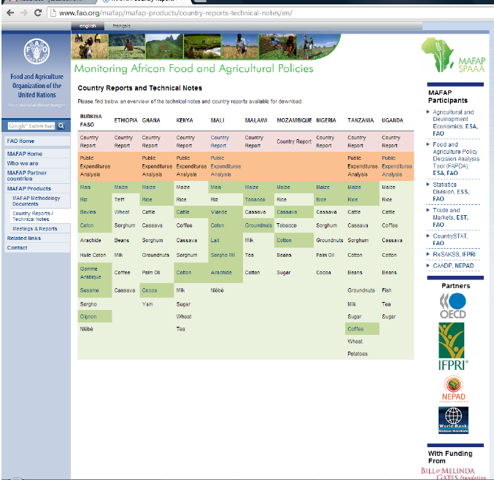
For now documents are only available for registered users
You can request a username and password by e-mailing
mafap@fao.org
Notes:
Available at MAFAP website
Currently

Slide 11
Sugar
IMPORTS
Import tariff of 100% with ad-hoc exemptions during the period 2008-2010
Even when prices are higher at the wholesale level (i.e. the tariff works at wholesale level) farmers do not benefit from them due to very high processing costs in Tanzania.
Protection to farmers in 2007 coincided with low production and increased exports which led to competition by mills for sugar cane
Notes:
Tariff of 100% except for unrefined which is 35%. Many exceptions (reductions and exemptions) for individual companies and/or quantities
For calculation of reference prices data of processing from South Africa was used, with the data provided by Mtibwa Sugar show that processing costs are at least 50% times higher in TZA.

Slide 12
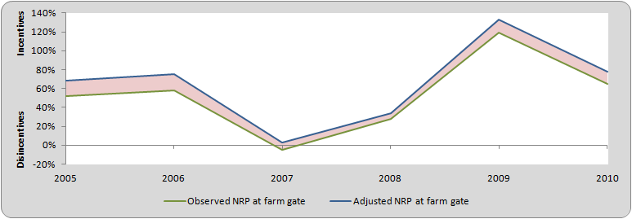
Wheat
IMPORTS
Import tariff of 35% which is reduced to 10% as of 2007. The level of protection follows this trend however as of 2008 the reduction in the protection does not lead to lower prices.
Incentives for production also include high costs for handling at the port of Dar es Salaam and lack of competition in the import market.
During 2009 and 2010 imports at lower tariff do not reflect lower protection which coincides with increased exports of wheat flour.
Notes:
Even with that level of protection wheat is not increasing in TZA, imports are 6X local production. Probably not good idea to retain protection

Slide 13
Cow Milk
IMPORTS
Import tariff of 60% with reduced tariff for Kenya and Uganda (effective tariff always above 50%)
Domestic prices are isolated from internationsl prices and variations in protection relate to variation on international markets
No data on farm gate prices but only a very limited % of farmers get this protection
Notes:
Important part of domestic production but only 3.5% marketed
Comapred to imports of powder milks taking into account conversion factors and processing costs

Slide 14
Rice
IMPORTS
Net exporter
Import tariff of 75% lead to higher domestic prices and avoiding ¨cheap imports¨ as declared by President Kikwete BUT other factors also affect higher prices including excessive marketing costs along the value chain
When international prices started raising the level of incentive was reduced, probably due to decreasing margins along the value chain and/or impact of releases of maize from NFRA.
As of 2007 the liberalization of the rice market results in incentives to farmers reduced and mantained for traders.
Notes:
Protection to farmers due to external tariff + inefficiencies in the value chain
We see a reduction of the protection as of 2007: this can be due to inefficiencies in the value chain are reduced when international prices increased (2008 & 2009) limiting the impact of international price increases on TZ; effect of Maize food releases by NFRA and/or tariff free imports.
As of 2010 TZA becomes a net exporter (continues in 2011)
Following liberalization (2007)we see that traders are now benefiting from more protection than farmers
Still to be proven that Tanzania can export without protection at the border.

Slide 15


Imported goods [Sugar, Wheat, Rice, Milk]
Rice 80% of indicator
Inclusion of Milk
Notes:
Imported good are protected with the exception of sugar
Protection is reduced over time
Results of 2005 and 2006 reflect importance of rice in the aggregate as of 2007 Milk is include with lower effective protection.
This is mainly due to the effect of reduction of the effective application of the tariff (Sugar, Wheat), but also due to shift to exports of rice

Slide 16
Pulses
EXPORTS
PEAS
BEANS
The situation shows incentives for farmers irrespective of the option considered in the analysis
This means that domestic prices are higher than that of exported commodities:
  Tanzania is suffering higher food prices than could be expected
Need for better integration of the beans market to assure:
  Lower prices for consumers
  Higher prices for producers
Notes:
Exception 2008 when trade for beans was really small and export price surged, for peas incentives were reduced but remain positive
Distribution of the price gaps between lower prices for consumers and higher prices for producers will depend on elasticities.

Slide 17
Coffee
EXPORTS
Disincentives mainly related to maket power of buyers at the auction
Impact of district cess is less important than overall disincentives (5% versus 20% disincentives on average)
Not clear explanation for reduction of disincentives during 2007-2009
Notes:
Farmers are more or less isolated from export prices while auction prices follow them quite smoothly
Lack of price transmission to farmgate despite efforts by GoT to split production and trading roles in the auction
Disceprancy between TCB and NBS data

Slide 18
Cotton
EXPORTS
Very low level of processing in Tanzania, most exports are raw cotton not combed or carded.
Disincentives linked to two aspects:
  High level of levies and taxes on cotton (estimated at 40.000 TzSh per ton)
  Very low ginning out turn of cotton factories in Tanzania compared to international standards
Need to assess the potential of increasing processing in Tanzania as a way to improve the incentives for farmers.

Slide 19
Exported goods [cotton, coffee, pulses]
Inclusion of pulses
Notes:
Classic exports are still penalized but beans distorts the results reducing the overall penalization
When considering potential improvements to the value chain most of the years even with the inclusion of beans domestic producers of export oriented goods are penalized.

Slide 20
Maize
Thinly traded
Net importer
Export ban
Volatile impact on farmers of policies and lack of market integration however overall not too important (max 20%)
IMPORTS - Interventions by NFRA more than compensate the incentives provided by the tariff when TZA is a net importer (2006 and 2008) while excessive marketing costs provide disincentives when NFRA is not active (2010).
EXPORTS – The export ban prevent farmers from obtaining higher prices (2009); when there is no export ban the lack of storage forces domestic prices to be higher than value obtained from exports.
Notes:
Key commodity in Tanzania 10% of production
Exported or imported depending on the year, however international trade is a small share of total production
Export Bans impact in 2009
Food releases by NFRA impact in 2006 and 2008

Slide 21
Presentation Outline
Products analyzed
Results for specific commodities
Overall results for the agricultural sector

Slide 22
Overall Agricultural sector [8 commodities]
Notes:
Prices in Tanzania are in general higher than their international equivalents.
This is due to the fact that most of our commodities are imports and beans (a significant share of production which is exported) are incentivized
This discrepancy is reduced with time (distortions in Tanzania are being reduced)
Specific inefficiencies at harbor, transport and excessive margins play a minor role compared to overall lack of market integration, taxation and trade policy
Results are more or less coherent with previous analysis by Anderson up to 2004 BUT higher as we don’t input 0 NRP for non analyzed products

Slide 23
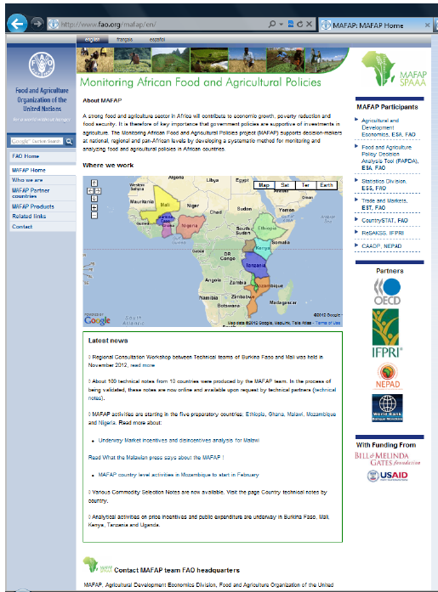
For additional information please visit: www.fao.org/mafap
Notes:
Analysis does not reach the farmer in most cases (we use wholesale prices in surplus areas)
Analysis does not seem to work with farm gate prices as reported by NBS (i.e. farm gate prices higher than wholesale prices)
We need to know more about policies and, MOST IMPORTANT, how they are implemented
We need to include the impacts of PE (in particular for specific commodities)
These indicators can be used, together with public expenditure, to assess coherence of objectives and actual implementation.

