Slide 1

Results of public expenditure analysis in Tanzania
MAFAP TEAM TANZANIA
(MAFC – ESRF – FAO – OECD)
Agricultural Sector Consultative Working Group
28th November 2012 - Dar es Salaam (Tanzania)
With the financial support of
Notes:
thanks for the invitation to present

Slide 2
Presentation Outline
Why we need to measure support to the agriculture sector in Africa
The level – how much is being spent
The composition – where the money is going
MAFAP methodology for measuring public expenditures in support of the food and agriculture sector
Application in the case of Tanzania

Slide 3
Importance of measuring support to agriculture
Agriculture’s key role in raising incomes, reducing poverty and improving food security
Reflected in 2003 Maputo declaration
Important to be able to analyse the incentives expenditures provide in order to make evidence-based policy choices
Having an economically meaningful classification system is a pre-requisite for policy analysis and efficient allocation of scarce resources

Slide 4
Principles behind measuring support to agriculture
The composition of public expenditures in support of agriculture is just as, if not more, important than the total level
Complementarities and trade-offs between spending in different categories
Proposed indicators seek to keep track of both the level and composition of expenditures (national and aid)
Economic incentives to ag. sector development
How much of budgetary allocations are disbursed
Correspondence of spending with stated objectives
Effectiveness – economic impact: out of scope

Slide 5
Principles behind measuring support to agriculture
Seek to measure all expenditures that are supportive of sectoral development
Seek to reconcile aid flows and national expenditures
Following OECD’s principles, propose an economically meaningful classification:
Payments to farmers vs payments to the sector
Public vs private goods
Ag-specific vs ag-supportive vs non-ag expenditures

Slide 6
MAFAP classification
I. Agriculture-specific policies
1.1. Payments to the agents in the agro-food sector: producers (e.g. input subsidies), consumers, input suppliers, processors, traders, transporters
1.2. General sector support: ag. research, tech. assistance, training, extension, inspection, infrastructure, storage, marketing and other
II. Agriculture supportive policies: rural education, health, infrastructure

Slide 7
Agriculture support may be higher than we think
Notes:
Mention what is captured in this expenditures: what ministries and expenditures

Slide 8
Composition of spending

Slide 9
I. Agriculture-specific payments → directed to the sector as a whole
2006/07-2007/08
average
2008/09-2010/11
average

Slide 10
II. Agriculture supportive expenditures → mostly in rural infrastructure
2006/07-2007/08
average
2008/09-2010/11
average

Slide 11
Composition of spending

Slide 12
II. Agriculture supportive expenditures → mostly in rural infrastructure
2006/07-2007/08
average
2008/09-2010/11
average

Slide 13
Aid is consistent with national priorities
bln TSh

Slide 14
Share of administrative costs remains high, though significant improvements made
 | 2006/07 | 2007/08 | 2008/09 | 2009/10 | 2010/11^{p}
Administration costs | 16 | 17 | 26 | 33 | 25
Policy transfers | 84 | 83 | 74 | 67 | 75
Total agricultural budget | 100 | 100 | 100 | 100 | 100
based on data for MAFC and MLFD

Slide 15
Disbursement rates could be improved
billion TSh | 2006/07 | 2007/08 | 2008/09 | 2009/10 | 2010/11^{p}
Total expenditures in support of food and agriculture
budgeted amount | 616.0 | 891.7 | 1143.3 | 1198.9 | 944.5
actual spending | 584.5 | 878.4 | 825.1 | 759.3 | 728.0
actual as a share of budget (%) | 95 | 99 | 72 | 63 | 77

Slide 16
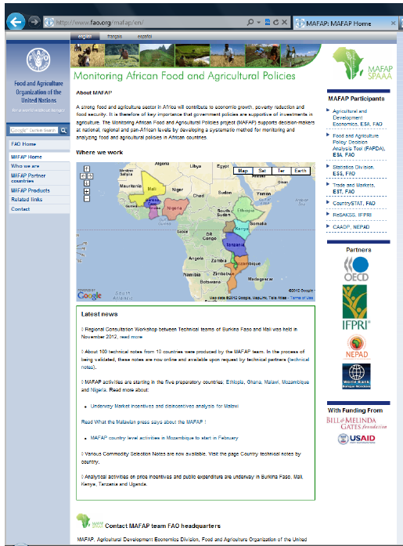
For additional information please visit: www.fao.org/mafap

