Slide 1

Future steps
MAFAP TEAM TANZANIA
( MAFC – ESRF– FAO – OECD)
Agricultural Sector Consultative Working Group
28th November 2012 - Dar es Salaam (Tanzania)
With the financial support of

Slide 2
TECHNICAL WORK
Price Incentives and Disincentives Analysis:
Draft technical notes for Milk and Pulses [Dec. 2012]
Finalize analysis and draft technical notes for Sorghum/Millet, Cassava, Nuts and Livestock [Dec. 2012]
Public Expenditure Analysis:
Include some additional expenditure that might have been missed (i.e. School Feeding Program) [Dec. 2012]
Country Report:
Finalize Policy Review Section [Dec. 2012]
Finalize Topic of Specific Interest (Export bans and Maize markets) [Dec. 2012]
Integrate all parts into the final document & policy coherence analysis [Dec. 2012]
Development of Policy Briefs:
For main commodities, Public Expenditure and Overall Findings [Jan. 2013]
Notes:
Huge time pressure for finalizing the report
Who does what – discussion on MONDAY
What commodities would be of most interest to do the Policy Briefs?

Slide 4
POLICY DIALOGUE, OUTREACH AND COMMUNICATION
Launch of Country Report
Present the Country Report and Policy Briefs at ASCG [Feb. 2013]
Public presentation of Country Report in a suitable policy forum and discussion of specific findings with relevant stakeholders [tbc]
Technical workshop for Eastern African MAFAP countries (Tanzania, Kenya and Uganda) involving EAC [Dates tbc]
Policy Dialogue at EAC level based on MAFAP findings [Dates tbc]
2nd Phase of MAFAP in Tanzania:
Updating analysis in technical notes and biennial country reports
Consolidation of in-country institutionalization of policy monitoring and analysis functions
Options to expand to other topics (consumers, input markets, etc.)
Improvement of price data collection in Tanzania and cooperation with specific commodity boards
Notes:
Discuss on potential date for ASCG meeting to present country report and policy briefs
Discuss the suitable bigger venue for presentation of results and discussion with stakeholders – maybe bilaterals on specific commodities.
KEY MESSAGE ON ITEM 8: ownership and engagement are required for sustainability and support - what MAFAP becomes in Tanzania is also about what they want to do about it.

Slide 5
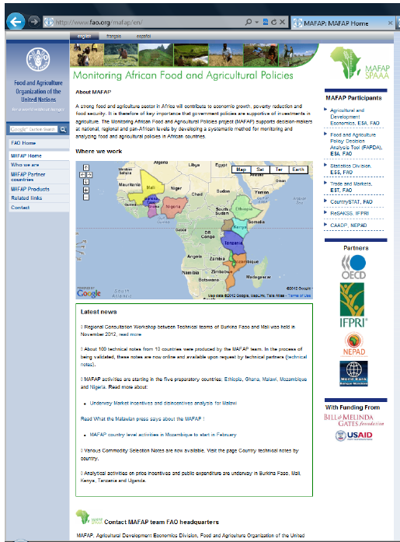
For additional information please visit: www.fao.org/mafap

