Slide 1
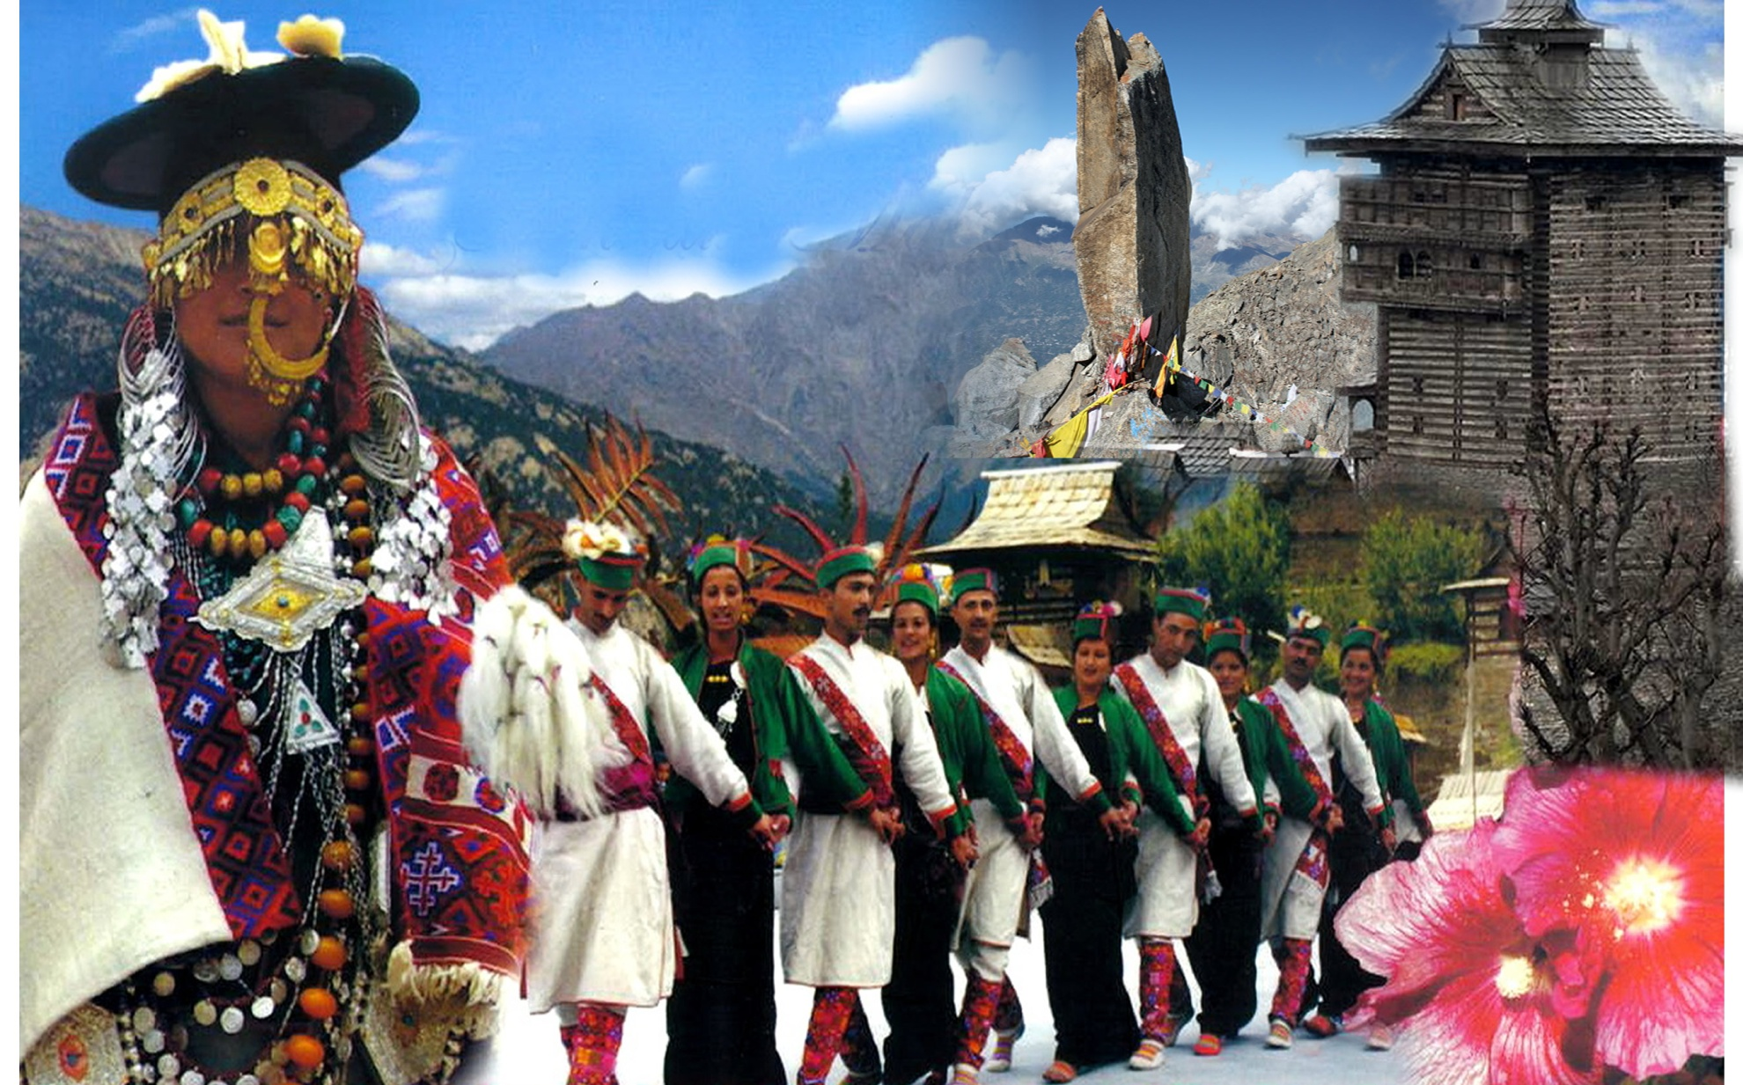
Challenges and opportunities in Food Security in District Kinnaur - Himachal Pradesh

Slide 2
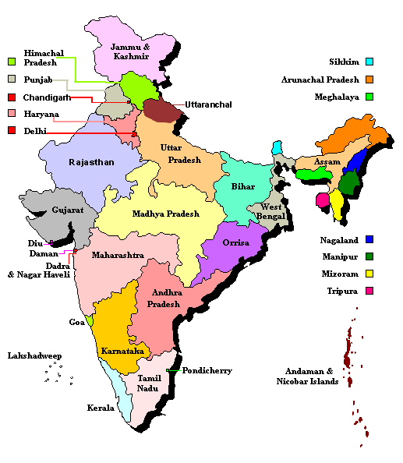

Slide 3
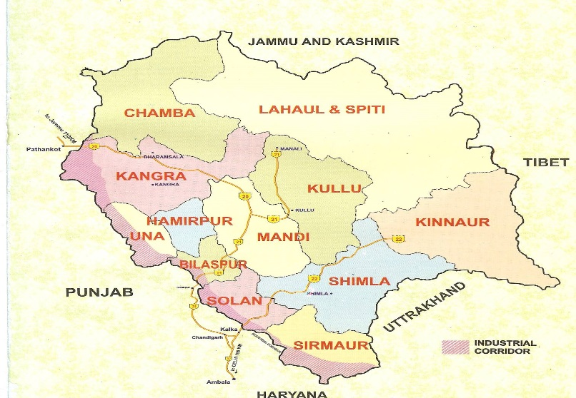
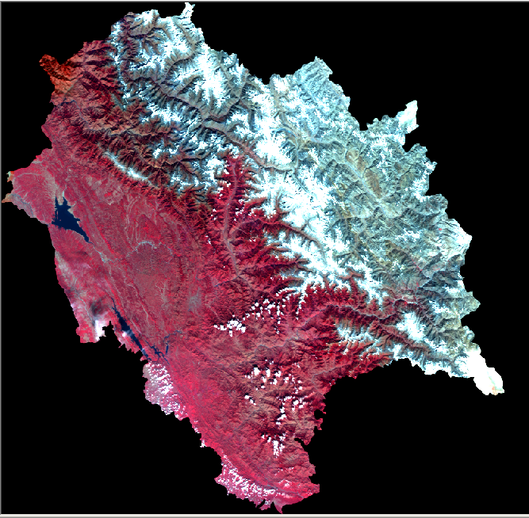
55673 Sq Km [2 D Area]
86384 Sq Km [3 D Area]
Percentage increase as per 3D area = 56%

Slide 4
District wise 3D and 2D geographical area
 | District | 2D area (sq. kms.) | 3D area (sq. kms.)
1. | Bilaspur | 1167.00 | 1327.0252
2. | Chamba | 6528.00 | 11674.5283
3. | Hamirpur | 1118.00 | 1146.642
4. | Kangra | 5739.00 | 7088.4325
5. | Kinnaur | 6401.00 | 11762.311
6. | Kullu | 5503.00 | 9693.987
7. | Lahaul & Spiti | 13835.00 | 22892.628
8. | Mandi | 3950.00 | 5402.766
9. | Shimla | 5131.00 | 7888.039
10. | Sirmour | 2825.00 | 3654.497
11. | Solan | 1936.00 | 2284.508
12. | Una | 1540.00 | 1569.406
 | Himachal Pradesh | 55673.00 | 86384.769
The 3 D Geographical Area is 56% higher than the 2 D area. Hilly States need to be suitably compensated for this area handicap in THFC devolution formula

Slide 5
Introduction to Himachal Pradesh
 | Unit | 2011 Census
Area | Sq. Kms. | 55673(2D Area) 86384(3DArea)
Districts | No. | 12
Tehsils | No. | 123
Development Blocks | No. | 78
Census Village s | No. | 20690
Gram Panchayats | No. | 3243
Towns | No. | 57

Slide 6
Demographic Profile of the State
 | HP | All India
Population (million) (Census 2011) | 6.8 | 1121
Decennial Growth Rate(%) | 12.94 | 17.64
Population Density per sq. km. | 123 | 382
Sex Ratio (Females per 1000 males) | 972 | 943
Rural Population | 89.96 | 68.84
Literacy Rates | 82.80 | 73.0
Life Expectancy (2006-10) | 70.0 | 66.1
Male | 67.7 | 64.6
Female | 72.4 | 67.7
Forest Area as a %age of total Area | 66.5% | 21.0%

Slide 7
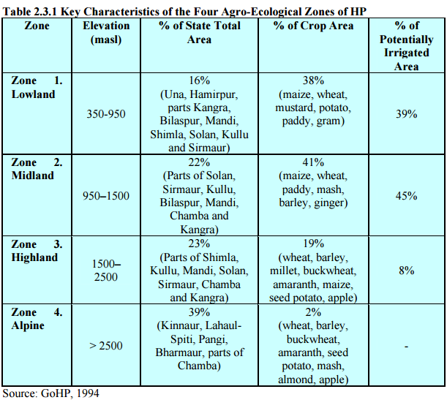

Slide 8
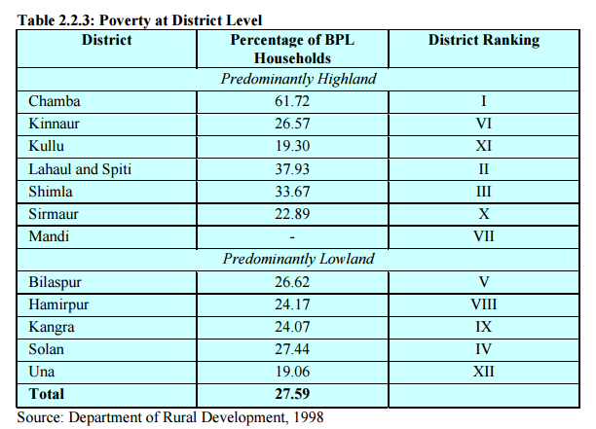

Slide 9
Food insecure livelihood groups
Subsistence farming households
Marginal ,commercial farming households
Agricultural labouring households
Migratory labouring households(non-farm)
Pastoralist tribal households

Slide 10
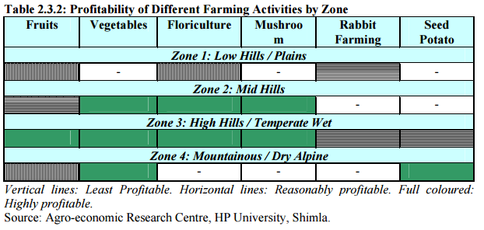

Slide 11
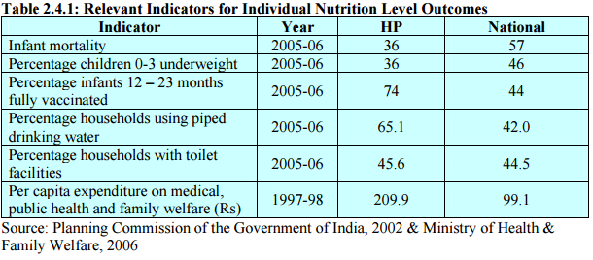

Slide 12
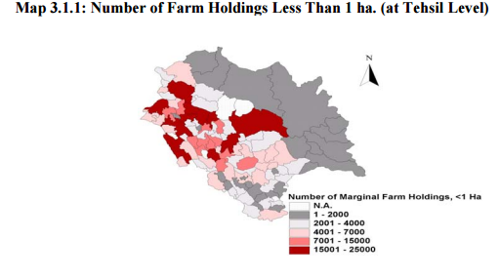

Slide 13
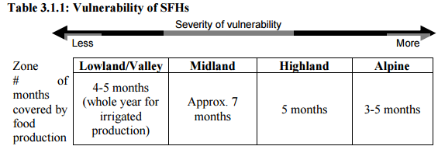

Slide 14
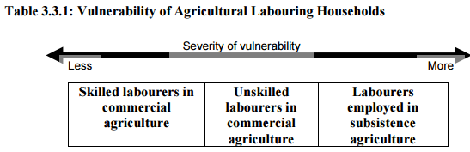
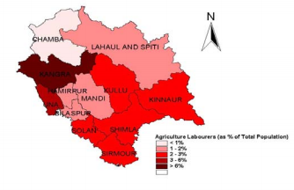

Slide 15
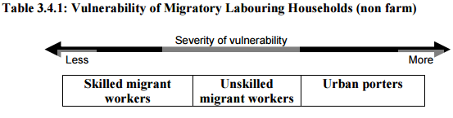

Slide 16
Challenges in High altitude areas
Loss of agro-biodiversity
Loss of cultural values and traditional wisdom
Changing climate pattern and resultant Disasters
Negative impact of development

Slide 17
Loss of Agro-biodiversity
Loss of Millets-(traditional crops)
Dryland farming
Sustainability
Kuth, koda, sattu, chulli, chilgoza
Nutritional value

Slide 18
Loss of cultural values and traditional wisdom
Intrusion of outside people
Lack of livelihood opportunities
Polyandry system.

Slide 19
Climate induced Hazards
Landslides
Erosion
Avalanches
Glaciers lake outburst floods
Cloudburst
Flashfloods

Slide 20
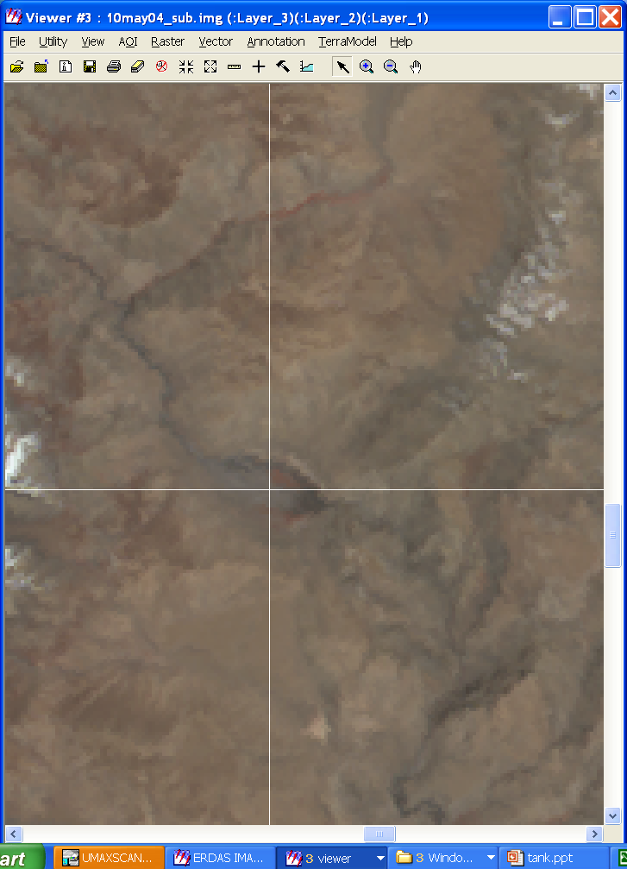
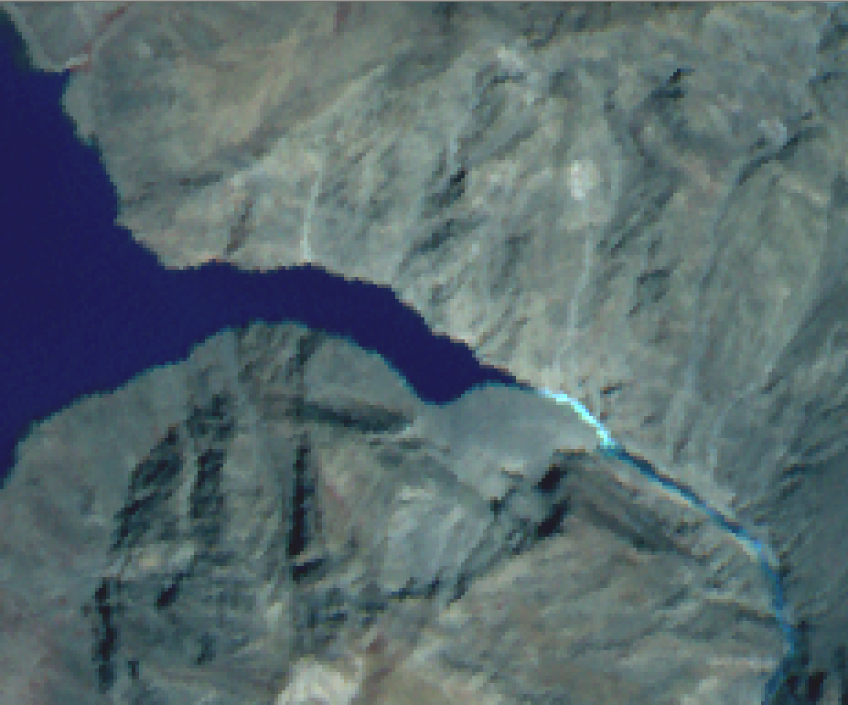
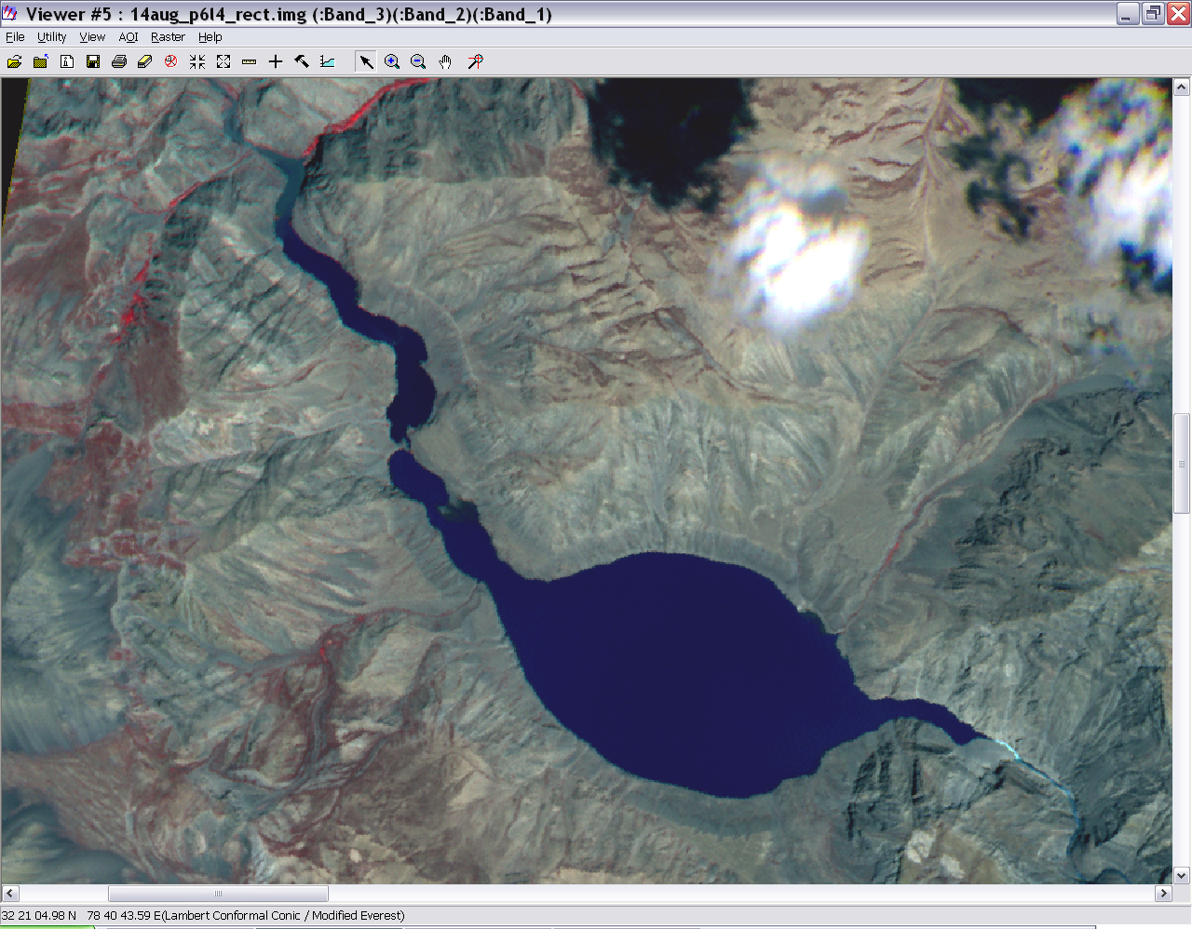
Glacier Land Slide : Pareechu Lake in Tibet
Rising Risk of Massive Flash Floods Downstream in India
Lake formed
Due to Landslide
(August 2004)
Overflow
Part of Sutlej Basin
Using IRS-P6 LISS-4 MSS Image
Blockade
Lake
Area prior to
the lake formation
(May 2004)
Water spread
~ 193 ha
Threat of massive flash floods

Slide 21
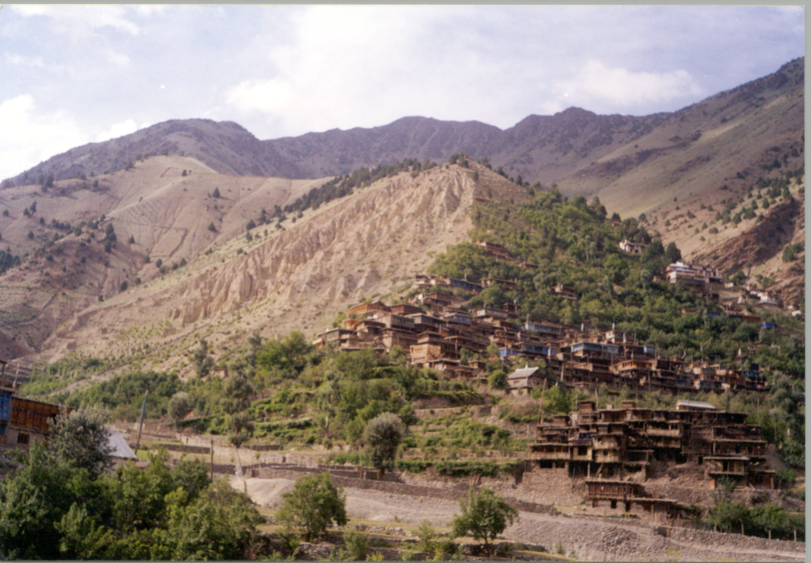
LANDSLIDE NEAR VILLAGE LIPPA IN KINNAUR CAUSING DANGER TO INHABITED AREAS

Slide 22
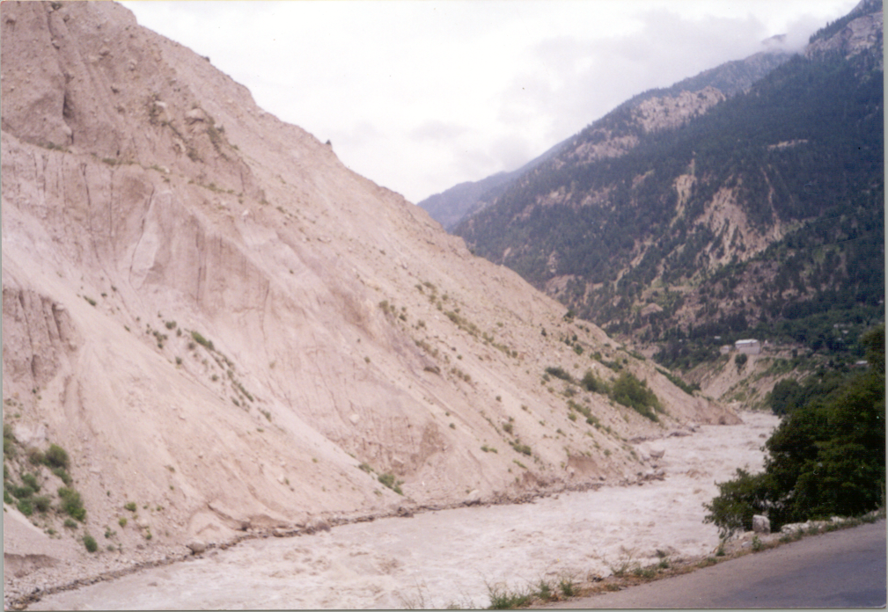
KHADRALA LANDSLIDE ALONG NH-22 CAUSED THE BURIAL OF MILITARY CONVOY

Slide 23
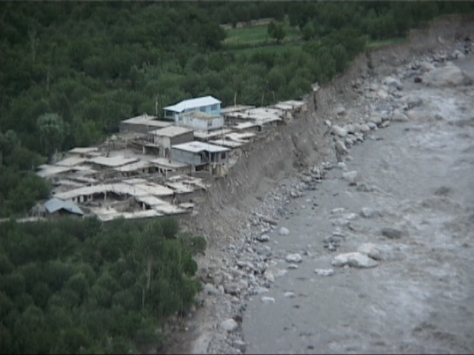
Damages in Leo Village

Slide 24
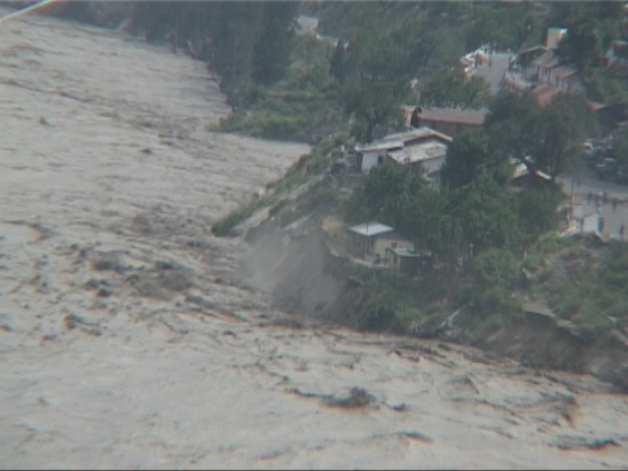
Onset of floods-26th June 2005

Slide 25
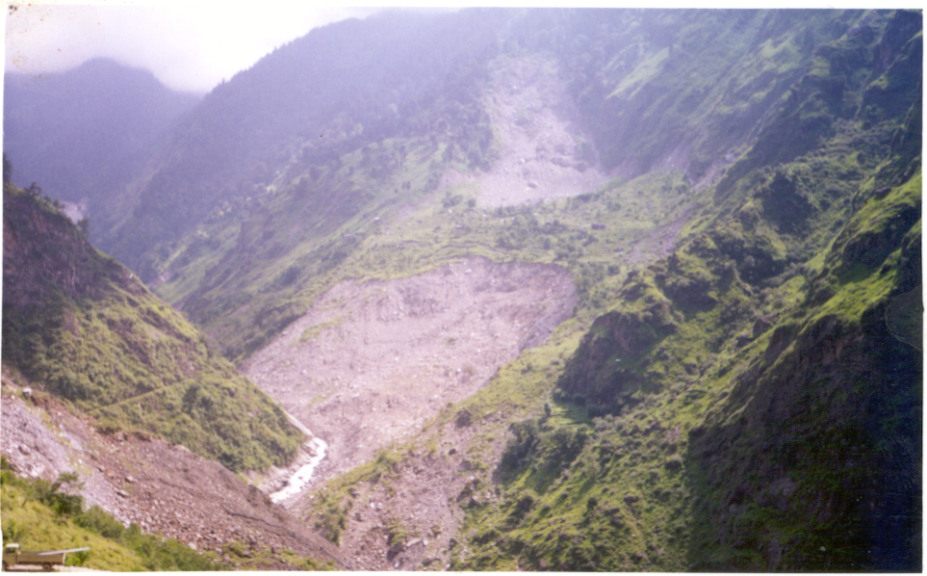
LANDSLIDE ACTIVATION IN THE SHOLDING NALA IN KINNAUR

Slide 26
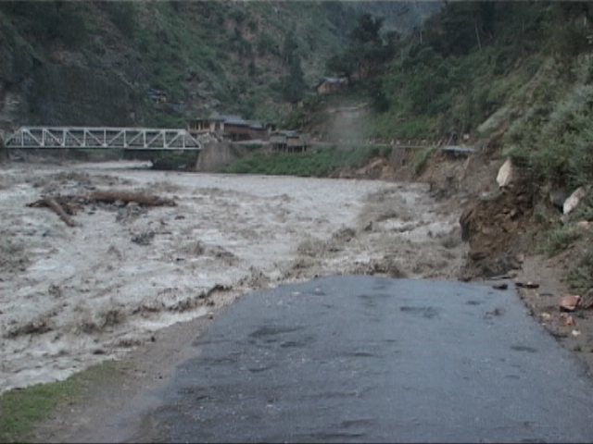
Onset of floods-26th June 2005

Slide 27
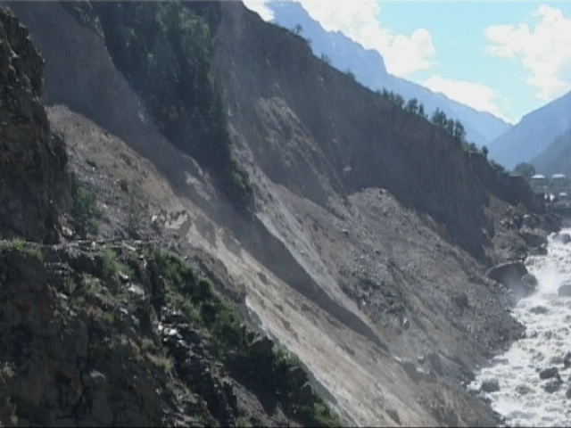
Damages caused due to flood

Slide 28
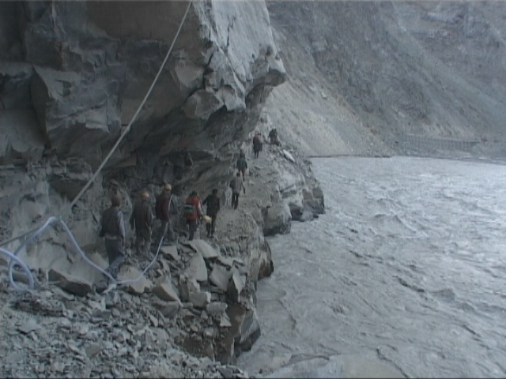
Making a foot track in the beginning

Slide 29
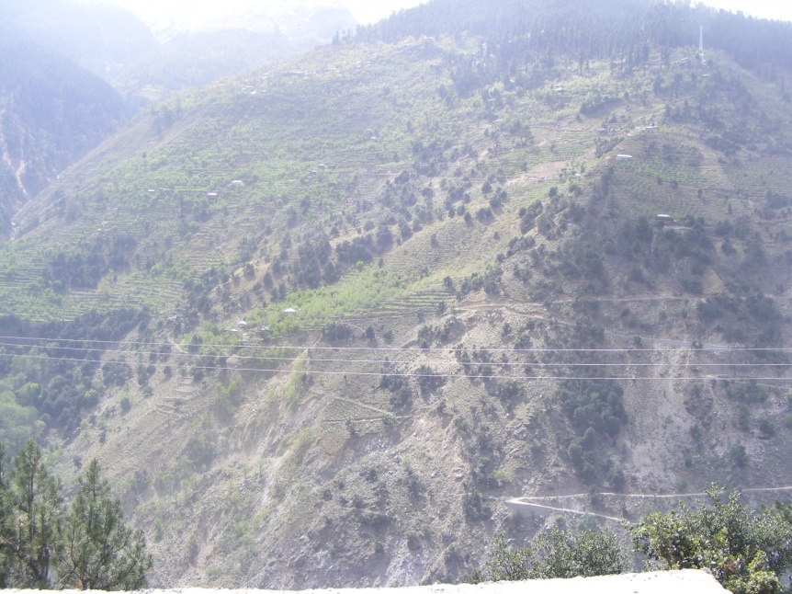
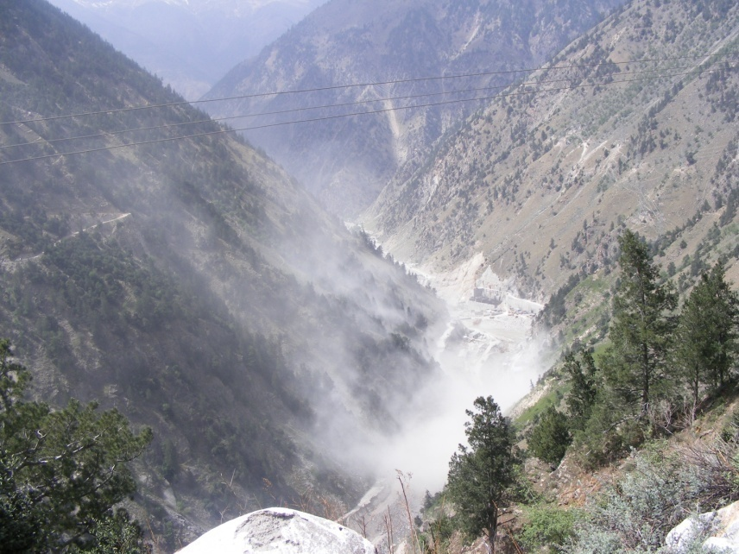
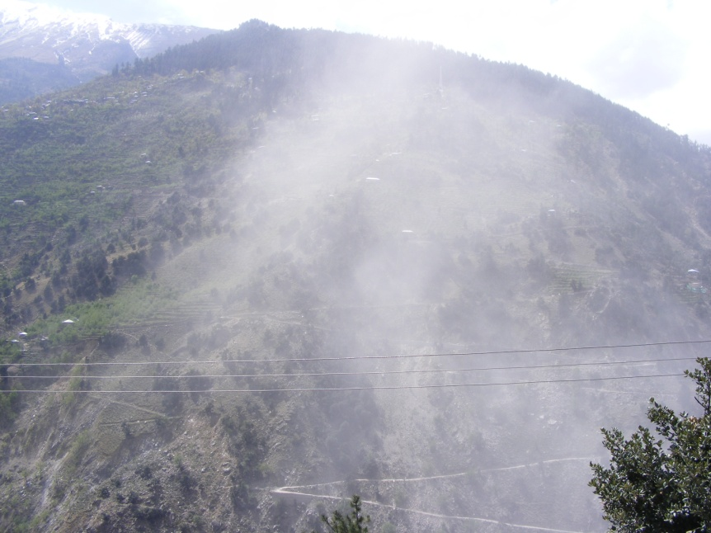

DUST POLUTION DUE TO UNSCIENTIFIC & ILLEGAL CONSTRUCTION ACTIVITIES OF J.K.H.C.L.

Slide 30
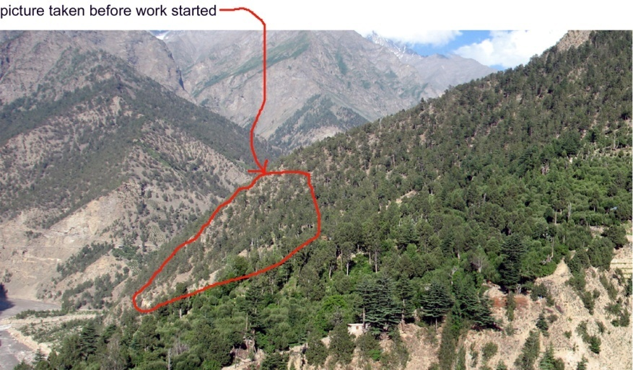
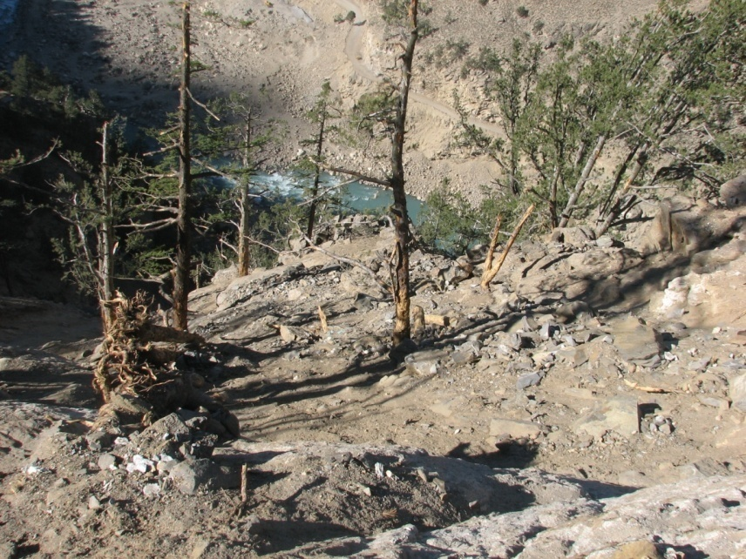
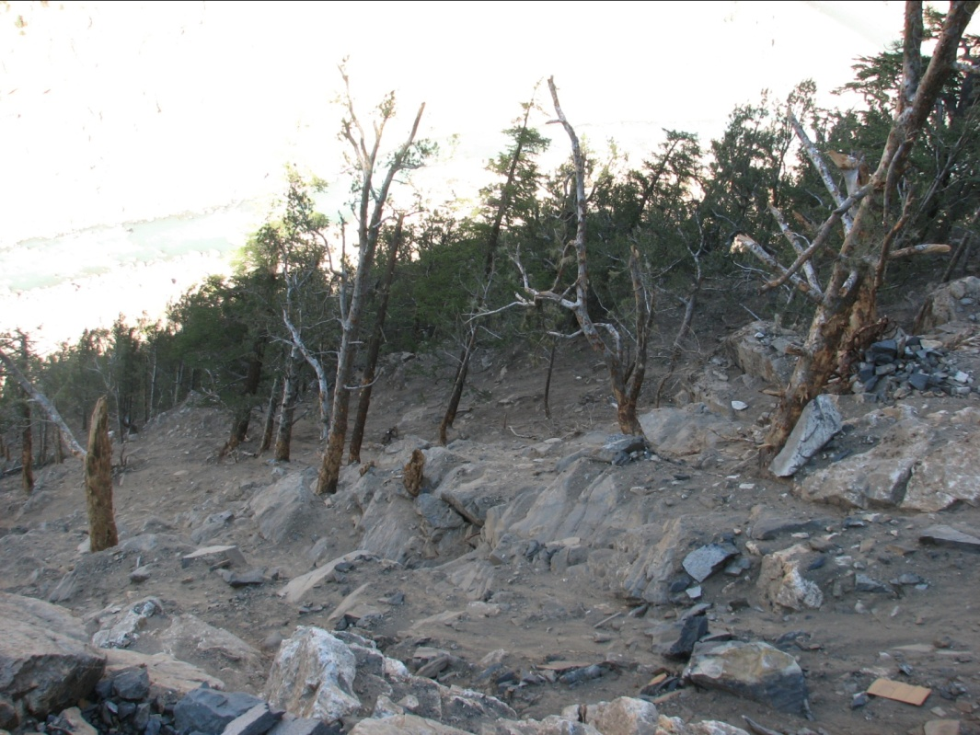
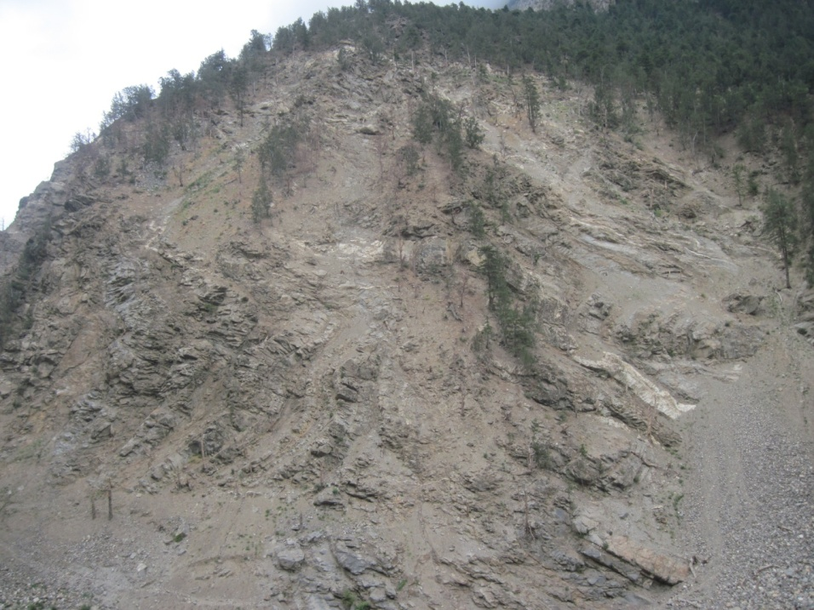
DENSITY OF FOREST PRIOR TO CONSTRUCTION
DAMAGED DONE TO ADJOINING FOREST AFTER CONSTRUCTION WORK STARTED

Slide 31
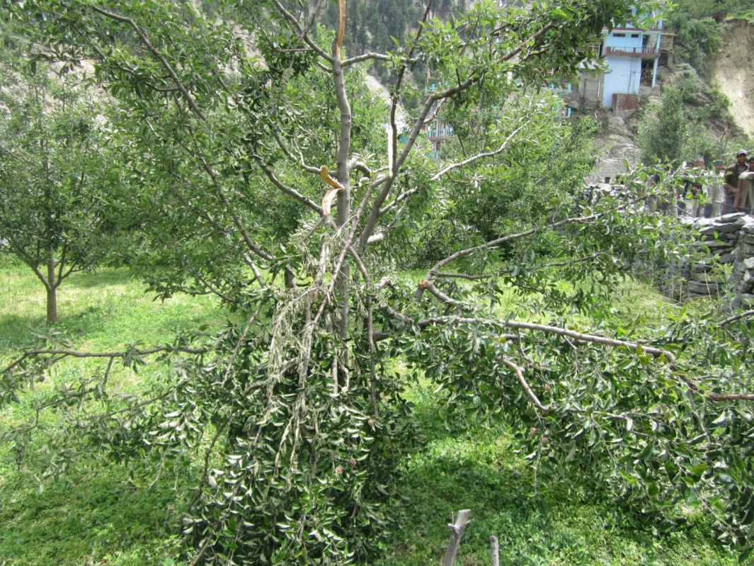
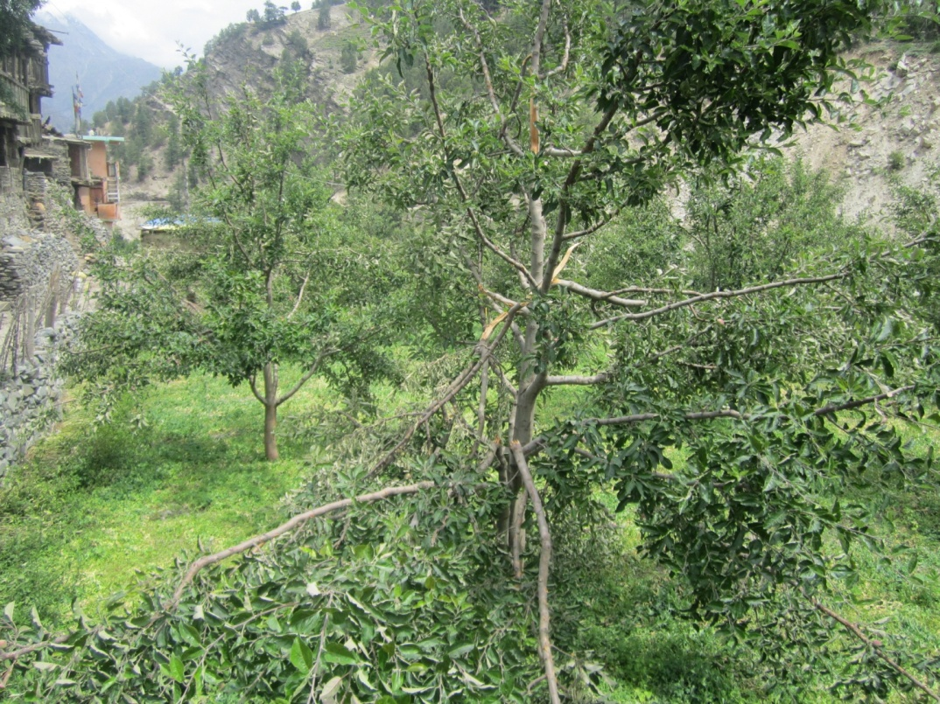
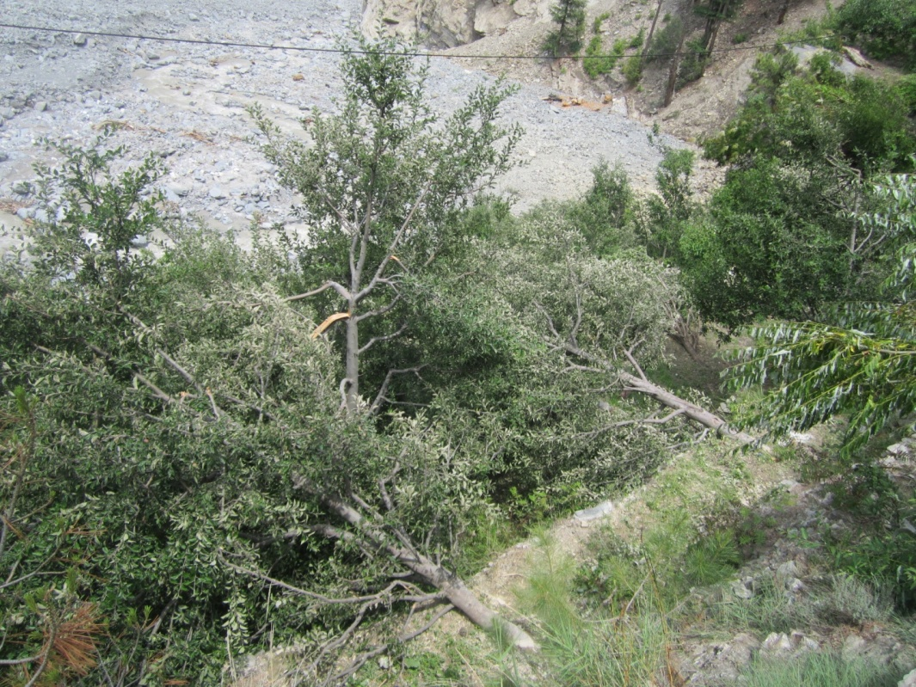
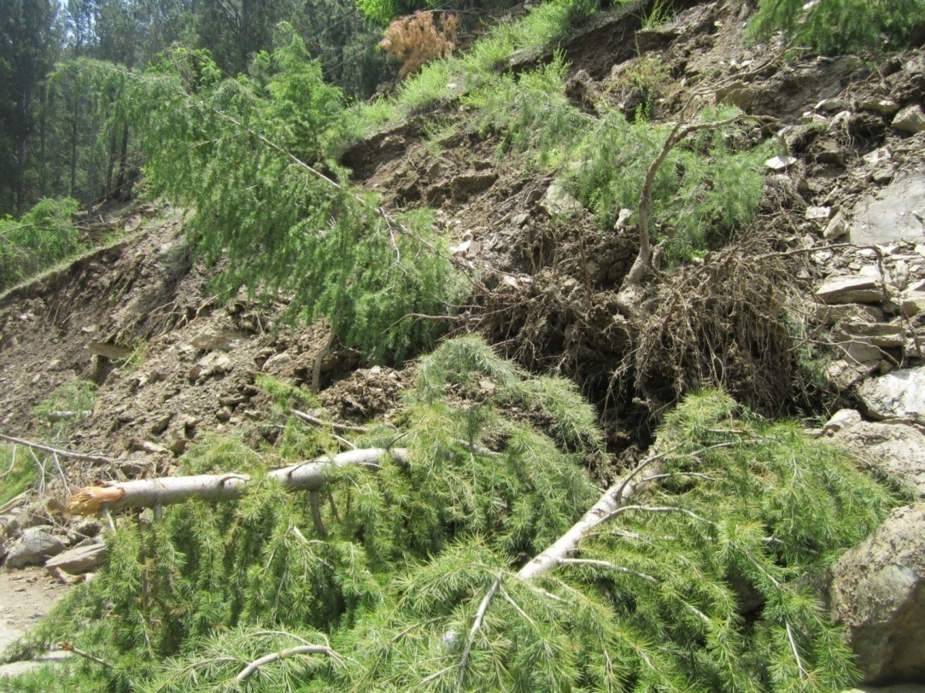

Slide 32
Developmental hazards
Environment degradation due to HE Projects
Degradation due to Roads constructions
Air pollution
Landslides
Drying of water resources
Dumping of Muck
Heavy and uncontrolled blasting
Degradation of agricultural land
Degradation of soil
Loss of productivity of agricultural and Horticultural crops

Slide 33
Micro-climate change
Erratic behavior of climate
Excessive rains/no rains

Slide 34
Opportunities
Improved accessibility
Niche habitat
Access to Hydro economy
Tourism and eco-tourism opportunities.
Climate change - a boon in some areas.
Check on migration.

Slide 35
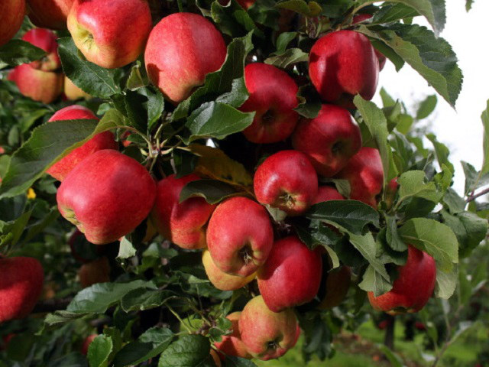
THANKS

