Slide 1
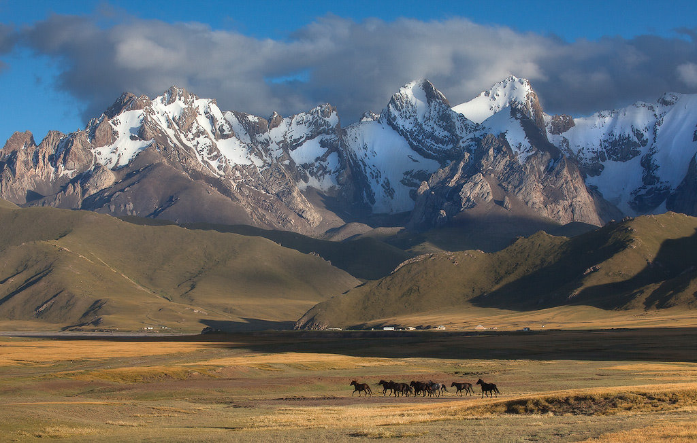
Food security and climate change in Central Asia
Osmanova Inna,
June 24,2015, Ormea

Slide 2
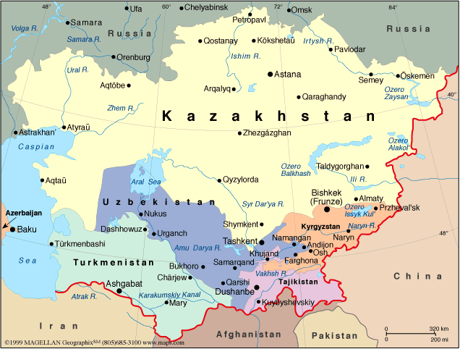

Slide 3
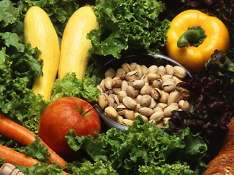
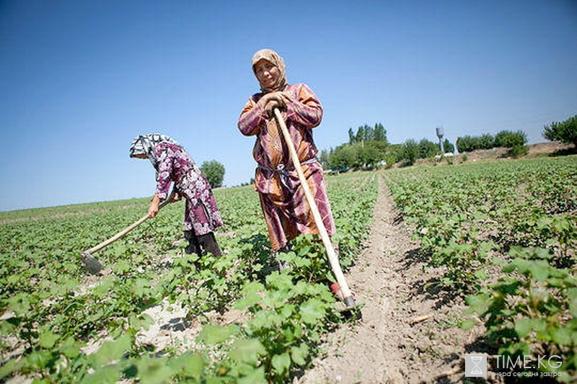
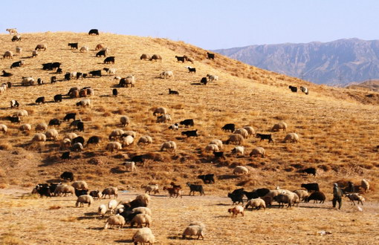
Agriculture in Central Asia
Tajikistan - 21% of GDP and 64% of total employment
Kyrgyz Republic-17% of GDP and 30,7 % of total employment
Uzbekistan – 17,2% of GDP and 42% of total employment
Turkmenistan - 8% of GDP and 48% of total employment
Kazakhstan – 4,6% of GDP and 24% of total employment

Slide 4
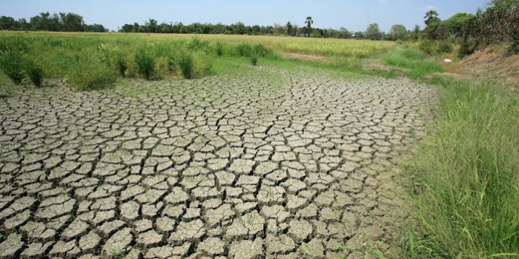
Threats to food security in Central Asia:
Rapid economic development and resource-intensive economies
Population growth
Climate change, etc. Crop yields decries to 30% by 2050:
- Kazakhstan: losses of wheat reached 50-70%
- Tajikistan decreased the crop yields by 30-40%

Slide 5
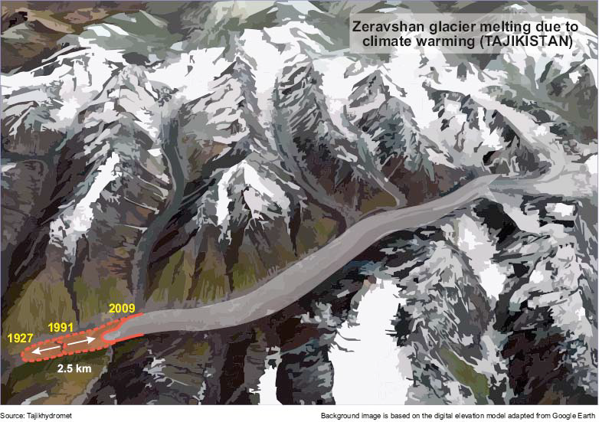

Slide 6
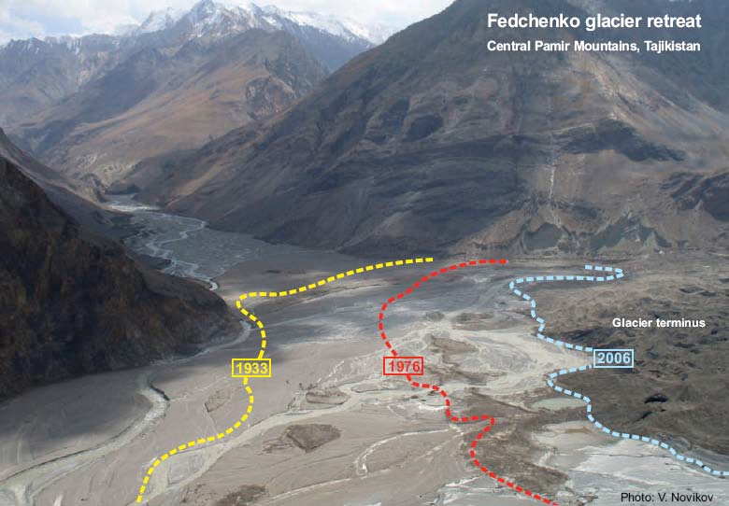

Slide 7
Policies and regulations
Insufficient legal basis on climate adaptation and resilience, including the issues of agriculture and food security
NAPAs are still on preparation stage
Planning of sector-based programs (including agriculture) does not envisage a close linkage between climate change and thematic activities

Slide 8
Our Approaches:
Support national policies of Central Asian countries on climate change issues
Capacity building on climate change issues
Assessments and Research climate change and adaptation
Promoting regional and international cooperation

Slide 9
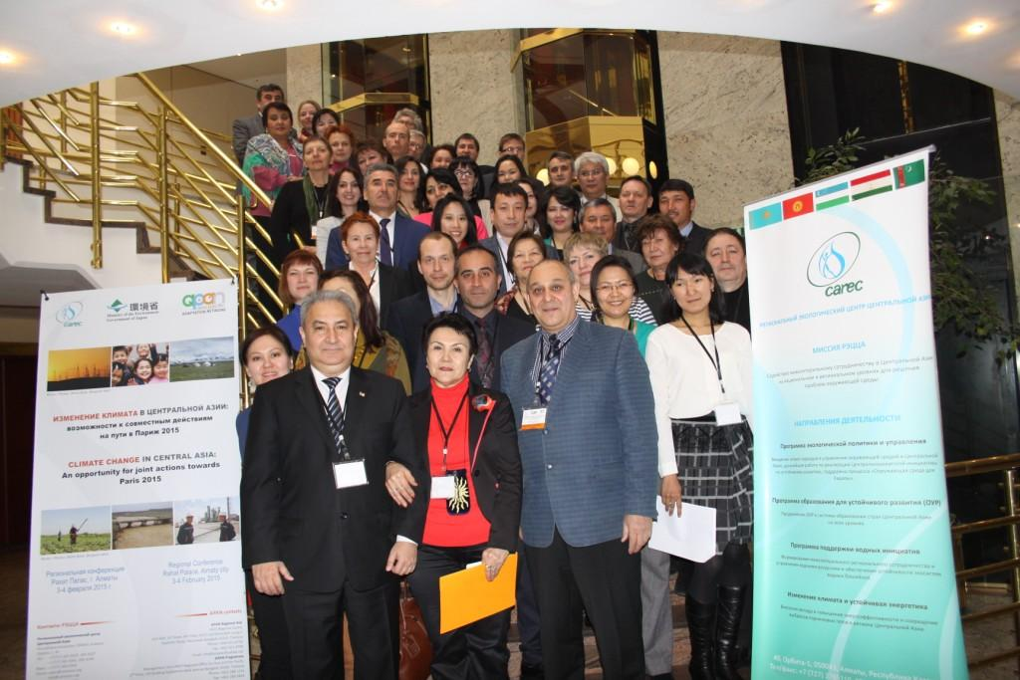
Projects:
  In order to manage and apply knowledge on climate change adaptation in the region and to support government agencies and other organizations working in the field of adaptation, with a focus on capacity building, within the framework of various projects on a regular basis we conduct regional trainings and conferences

Slide 10
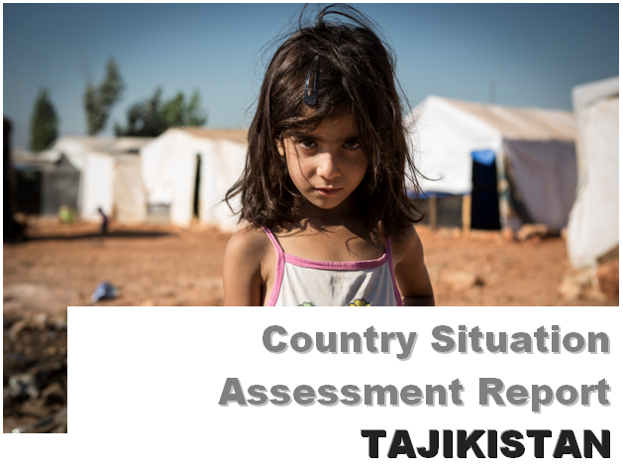
Projects:
Research and studies, such as "Ways to improve the sustainability of arid economies" - prepared assessment report on Tajikistan based on the latest national data on climate change, development and sustainability

Slide 11
Promoting regional and international cooperation
  Cooperation within the NEXUS platform (Water - Energy-Food)
  Promotion of cooperation and South-South network (e.g. APAN and Drynet)
  UNFCCC COP 15 (Copenhagen: 2009)
  International High-Level Summit on Sustainable Development (Rio + 20: 2012)
  New Global Climate Treaty => Towards Paris 2015

Slide 12
Thank you for attention!
Inna Osmanova
iosmanova@carececo.org

