Slide 1
IPROMO 2015
Food security in mountain areas
“Extraordinary Potential”
Personal presentation:
Petra Wolter
Ormea, Italy, 24 June 2015

Slide 2
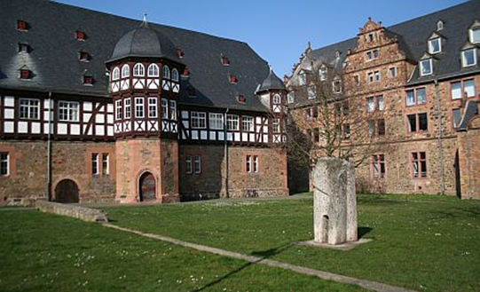
My Background
German national
Living in Italy since 1999
MSc in Geography
Professional experience:
Watershed management
Land use planning
Participatory approaches
Project management
Notes:
Physical and Human Geography , break the traditional divide between disciplines

Slide 3
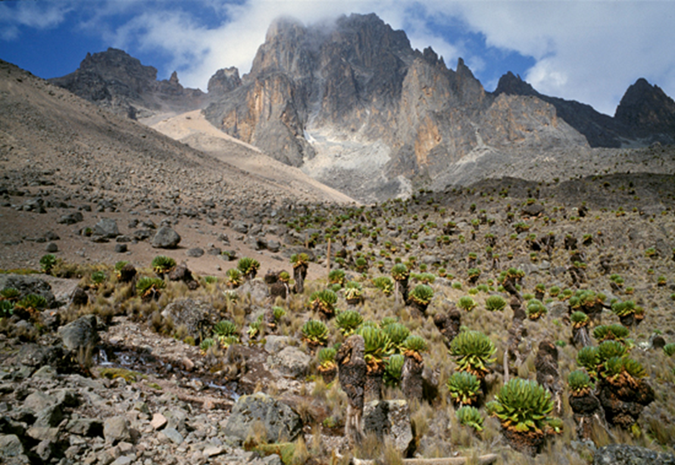
My Field Experience (I)
Photo © Mikkel Alexander Grabowski
Notes:
http://www.africa-expert.com/about-kenya/national-parks/mount-kenya/
That included climbing Mount Kenya (although I did not make it to the top) and exposure to different field projects (range and pasture management in the dry north, re-settlement in coastal areas near Lamu)
Visit to rural development projects of the German Development Cooperation and study tour to the German Assisted Settlement Programme, Lamu District, to assess the ecological features of the Lake Kenyatta and Lake Amu depressions as basis for a concept of environmentally oriented land use of the area.

Slide 4
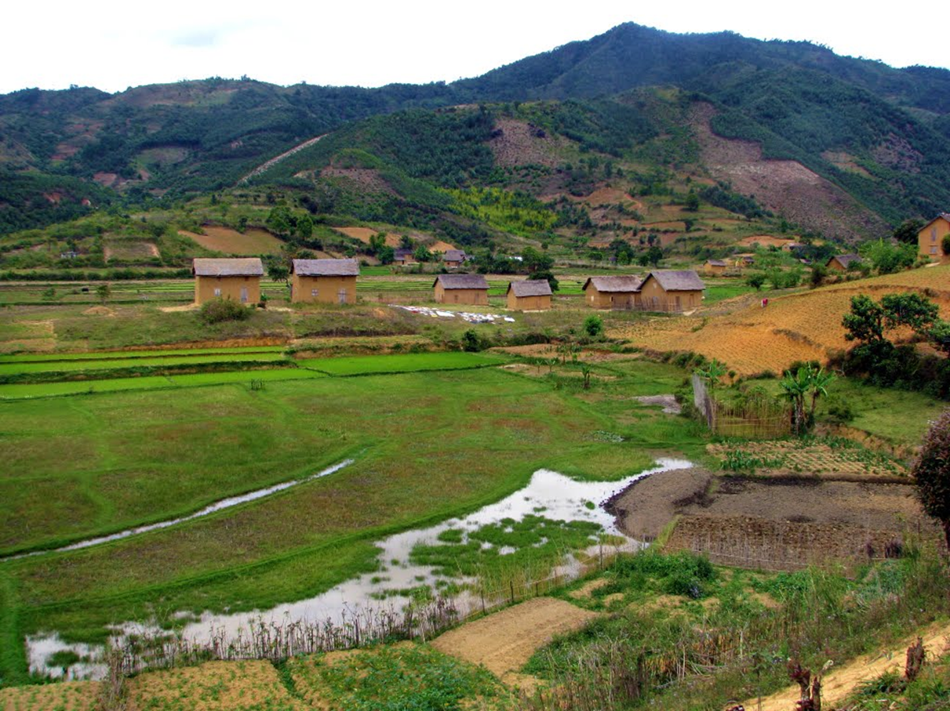
My Field Experience (II)
Photo © Linda de Volder
Notes:
http://www.panoramio.com/photo/54423219
These are the highlands in Madagascar where I spent 9 months to prepare my thesis on land use planning and PRA, again in the framework of a GIZ project to promote sustainable forestry management and rural development in the central highlands.
Title of thesis: Land use planning and participatory rural appraisal in the highlands of Madagascar
Integrated Forestry Development Project of the Vakinankaratra Region, Ambatolampy, Madagascar
Socio-economic field studies on land use planning at the village level and test of various participatory assessment and mapping tools; in close collaboration with project staff in charge of agroforestry, community development and natural resource management to emphasize the holistic approach of land use planning;

Slide 5
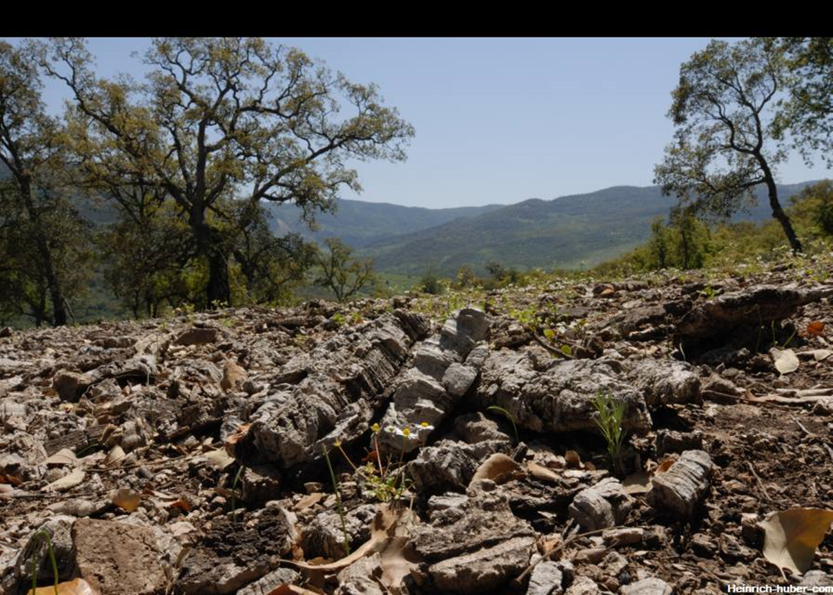
My Field Experience (III)
Notes:
http://foto.heinrich-huber.com/html/foto-tunesien-2007-60.php5
After termination of my studies for two years I was a junior expert in Tunisia, in the north-western parts of the country, based in Beja, where GIZ supported institution-building and capacity development of ODESYPANO a regional development body dealing with the silvo-pastoral resources for which GIZ had developed and implemented a more participatory approach to manage the natural resources jointly with the population, gradually ceding the predominant top-down approach. The area is rich in natural resources including cork oak trees but the people were among the poorest in the country.
• Improvement of the existing approach on participatory land use planning and community development;
• Capacity building and training on planning, monitoring and evaluation for administrators, field staff and farmers;
• Management of information systems with special emphasis on geographical information systems and the monitoring system;
• Project implementation, plan of operations, budget planning and monitoring;
• Collaboration with several donor organisations in the context of multi-donor projects
Regional Rural Development Project in North-Western Tunisia – advice to the “Office de Développement Sylvo-Pastoral dans le Nord-Ouest de la Tunisie”, Beja, Tunisia

Slide 6

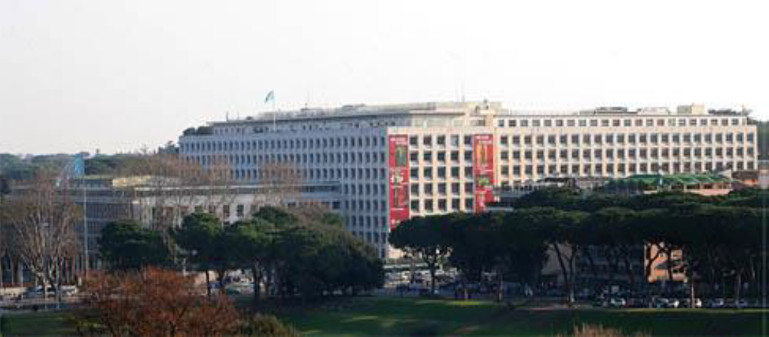
The UN Food and Agriculture Organization (FAO)
FAO's mandate is to raise levels of nutrition, improve agricultural productivity, better the lives of rural populations and contribute to the growth of the world economy.
Notes:
FAO HQ
From Tunisia I came to Rome joining my husband who had become an APO in the meantime in the area of non-wood forest products. I made it into FAO too and worked for several years in Technical Cooperation Department dealing with TCP and emergency projects, in different phases of the project cycle, from formulation to appraisal, approval and operations.
Following the programme‘s decentralization in 2010 I moved to the Forestry Department, more precisely to the Mountain and Watershed Team where I am still working today. I was involved in the management of two large interregional field projects.

Slide 7
Watershed Management and Mountain Team at FAO
Topics:
Watershed management
Mountain development
Forests and water
Types of work:
Normative activities
Field projects
International processes
Inter-departmental collaboration
Mountain Partnership
Notes:
Distinction between forests and water and watershed management not always clear.
I work mainly on what is highlighted in red

Slide 8
Watershed management
Watershed management is any human action aimed at ensuring a sustainable use of all watershed resources and:
promotes a more efficient and rationale use of natural resources;
addresses different land use systems in an integrated way;
applies by definition a landscape approach;
diversifies livelihood options;
builds on traditional local experiences in mountain areas;
applies participatory approaches and establishes enabling institutional mechanisms to empower local communities;
builds climate change resilience; and
improves food security.

Slide 9
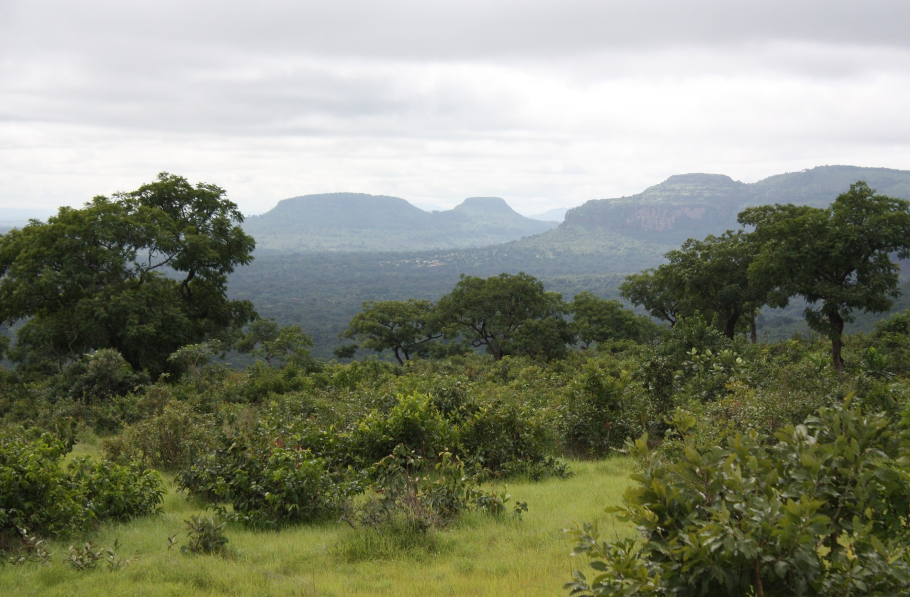
Fouta Djallon Highlands
Photo © Thomas Hofer
Notes:
The Fouta Djallon Highlands project in Guinea and other 7 countries in West Africa
WM for integrated natural resource management to bring order in the landscape, to prevent animal divagation in crop fields, to stop unsustainable practices on slopes that have led to degradation, erosion and bush fires, to intensify production in valley bottoms through irrigation channels, introduction of animal traction and soil fertility improvement
To promote small enterprise development for livelihood improvement
To promote regional collaboration with the FDH being the water towers for many West African rivers
To strengthen capacities of all stakeholders in NRM, participatory planning
The Guinean highlands are densely populated,
with up to 120 inhabitants per square kilometre
compared with the national average of 24
persons per square kilometre. The greatest share
of local livelihoods is derived from agroforestry,
forestry activities and animal husbandry. Natural
resource and watershed degradation are caused
principally by shifting cultivation, excessive
logging, uncontrolled bush fires and overgrazing.
Low farm productivity
Inadequate diversification of farming systems,
poor access to markets,
unsustainable land-use practices
Weak capacity among local institutions to innovate.

Slide 10
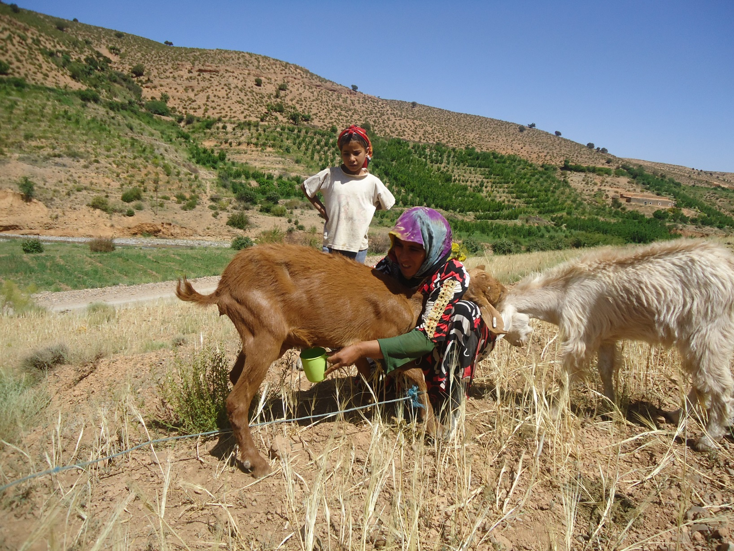
Morocco
Photo © Mustapha Azdad
Notes:
And the Oubame project that worked in Morocco, Mauritania and Ecuador and where I had the chance to visit Morocco
Mustapha Azdad
Collaborative WM to combat poverty and desertification in arid and semi-arid areas
Improved pasture management, controlled grazing schemes and reforestation
Fruit tree production (apples) and value chains (milk)

Slide 11
Knowledge Management
Methodological and conceptual approaches in watershed management;
Capitalization of experiences and lessons learned;
Preparation of case studies and good practices;
Knowledge exchange between projects and broader dissemination.

Slide 12
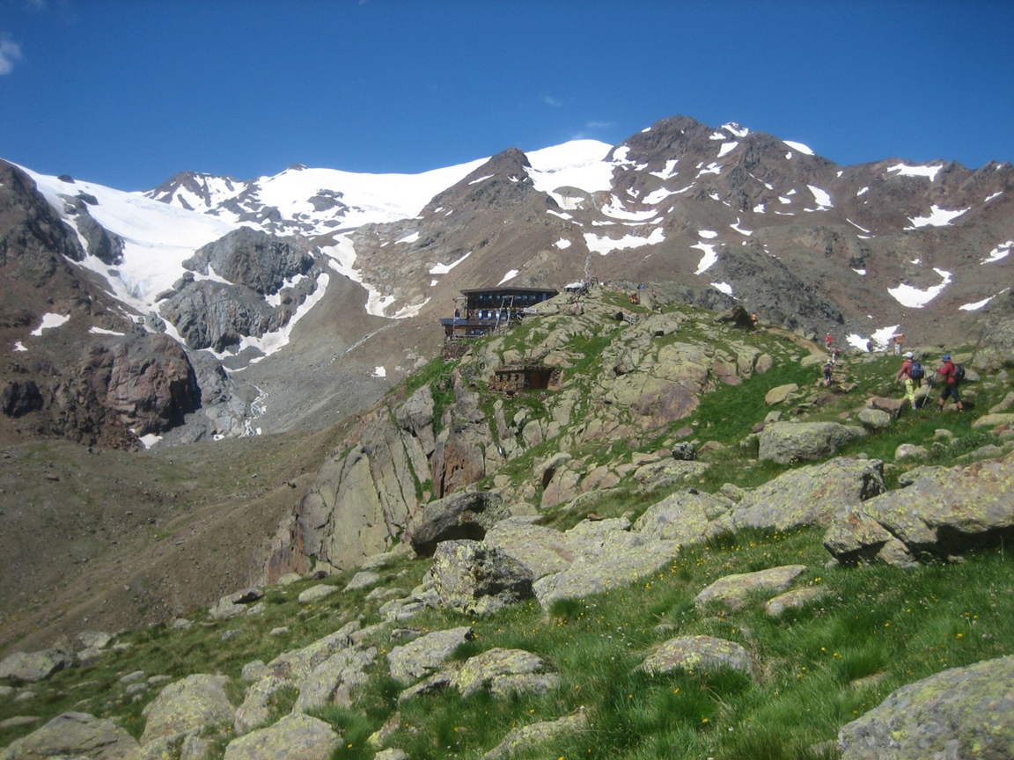
Thank you!
Contact:
Phone: +39 340 2838455
Email: pewolter@gmx.de
Notes:
Rifugio Larcher, 2608m
Parco Nazionale dello Stelvio
Hiking with my family during the holidays 2013

